Slide 1
Intro to Scheduling (+ OS sync wrap)
David E. Culler
CS162 – Operating Systems and Systems Programming
Lecture 10
Sept 17, 2014
Reading: A&D 7-7.1
HW 2 due wed
Proj 1 design review
https://computing.llnl.gov/tutorials/pthreads/

Slide 2
Objectives
Introduce the concept of scheduling
General topic that applies in many context
rich theory and practice
Fundamental trade-offs
not a simple find the “best”
resolution depends on context
Ground it in OS context
Ground implementation in Pintos
… after synch implementation wrap-up

Slide 3
Recall: A Lock
Value: FREE (0) or BUSY (1)
A queue of waiters (threads*)
attempting to acquire
An owner (thread)
Acquire: wait till Free, take ownership, make busy
Release: relinquish ownership, make Free, if waiter allow it to complete acquire
Both are atomic relative to other threads
semaphore has these
- value is int

Slide 4
Recall: the “else” question ???
Don’t we need to do this regardless?

Slide 5
Locks
READY
FREE
waiters
owner
Running
Thread B
INIT
int value = 0;
Acquire() { disable interrupts; if (value == 1) {
put thread on wait-queue;
go to sleep() //?? } else { value = 1; enable interrupts; } }
Thread A
lock.Acquire();
…
critical section;
…
lock.Release();
lock.Acquire();
…
critical section;
…
lock.Release();
Release() { disable interrupts; if anyone on wait queue { take thread off wait-queue Place on ready queue; } else { value = 0; } enable interrupts; }

Slide 6
Locks
READY
BUSY
waiters
owner
Running
Thread B
INIT
int value = 0;
Acquire() { disable interrupts; if (value == 1) {
put thread on wait-queue;
go to sleep() //?? } else { value = 1; enable interrupts; } }
Thread A
lock.Acquire();
…
critical section;
…
lock.Release();
lock.Acquire();
…
critical section;
…
lock.Release();
Release() { disable interrupts; if anyone on wait queue { take thread off wait-queue Place on ready queue; } else { value = 0; } enable interrupts; }

Slide 7
Locks
READY
BUSY
waiters
owner
Running
Thread B
INIT
int value = 0;
Acquire() { disable interrupts; if (value == 1) {
put thread on wait-queue;
go to sleep() //?? } else { value = 1; enable interrupts; } }
Thread A
lock.Acquire();
…
critical section;
…
lock.Release();
lock.Acquire();
…
critical section;
…
lock.Release();
Release() { disable interrupts; if anyone on wait queue { take thread off wait-queue Place on ready queue; } else { value = 0; } enable interrupts; }

Slide 8
Locks
READY
BUSY
waiters
owner
Running
Thread B
INIT
int value = 0;
Acquire() { disable interrupts; if (value == 1) {
put thread on wait-queue;
go to sleep() //?? } else { value = 1; enable interrupts; } }
Thread A
lock.Acquire();
…
critical section;
…
lock.Release();
lock.Acquire();
…
critical section;
…
lock.Release();
Release() { disable interrupts; if anyone on wait queue { take thread off wait-queue Place on ready queue; } else { value = 0; } enable interrupts; }

Slide 9
Locks
READY
BUSY
waiters
owner
Running
Thread B
INIT
int value = 0;
Acquire() { disable interrupts; if (value == 1) {
put thread on wait-queue;
go to sleep() //?? } else { value = 1; enable interrupts; } }
Thread A
lock.Acquire();
…
critical section;
…
lock.Release();
lock.Acquire();
…
critical section;
…
lock.Release();
Release() { disable interrupts; if anyone on wait queue { take thread off wait-queue Place on ready queue; } else { value = 0; } enable interrupts; }

Slide 10
Locks
READY
BUSY
waiters
owner
Running
Thread B
INIT
int value = 0;
Acquire() { disable interrupts; if (value == 1) {
put thread on wait-queue;
go to sleep() //?? } else { value = 1; enable interrupts; } }
Thread A
lock.Acquire();
…
critical section;
…
lock.Release();
lock.Acquire();
…
critical section;
…
lock.Release();
Release() { disable interrupts; if anyone on wait queue { take thread off wait-queue Place on ready queue; } else { value = 0; } enable interrupts; }

Slide 11
Locks
READY
BUSY
waiters
owner
Running
Thread A
INIT
int value = 0;
Acquire() { disable interrupts; if (value == 1) {
put thread on wait-queue;
go to sleep() //?? } else { value = 1; enable interrupts; } }
Thread A
lock.Acquire();
…
critical section;
…
lock.Release();
lock.Acquire();
…
critical section;
…
lock.Release();
Release() { disable interrupts; if anyone on wait queue { take thread off wait-queue Place on ready queue; } else { value = 0; } enable interrupts; }

Slide 12
Locks
READY
BUSY
waiters
owner
Running
Thread B
INIT
int value = 0;
Acquire() { disable interrupts; if (value == 1) {
put thread on wait-queue;
go to sleep() //?? } else { value = 1; enable interrupts; } }
Thread A
lock.Acquire();
…
critical section;
…
lock.Release();
lock.Acquire();
…
critical section;
…
lock.Release();
Release() { disable interrupts; if anyone on wait queue { take thread off wait-queue Place on ready queue; } else { value = 0; } enable interrupts; }

Slide 13
Locks
READY
BUSY
waiters
owner
Running
Thread B
INIT
int value = 0;
Acquire() { disable interrupts; if (value == 1) {
put thread on wait-queue;
go to sleep() //?? } else { value = 1; enable interrupts; } }
Thread A
lock.Acquire();
…
critical section;
…
lock.Release();
lock.Acquire();
…
critical section;
…
lock.Release();
Release() { disable interrupts; if anyone on wait queue { take thread off wait-queue Place on ready queue; } else { value = 0; } enable interrupts; }

Slide 14
Locks
READY
BUSY
waiters
owner
Running
Thread A
INIT
int value = 0;
Acquire() { disable interrupts; if (value == 1) {
put thread on wait-queue;
go to sleep() //?? } else { value = 1; enable interrupts; } }
Thread A
lock.Acquire();
…
critical section;
…
lock.Release();
lock.Acquire();
…
critical section;
…
lock.Release();
Release() { disable interrupts; if anyone on wait queue { take thread off wait-queue Place on ready queue; } else { value = 0; } enable interrupts; }

Slide 15
Locks
READY
BUSY
waiters
owner
Running
Thread A
INIT
int value = 0;
Acquire() { disable interrupts; if (value == 1) {
put thread on wait-queue;
go to sleep() //?? } else { value = 1; enable interrupts; } }
Thread A
lock.Acquire();
…
critical section;
…
lock.Release();
lock.Acquire();
…
critical section;
…
lock.Release();
Release() { disable interrupts; if anyone on wait queue { take thread off wait-queue Place on ready queue; } else { value = 0; } enable interrupts; }

Slide 16
Locks
READY
BUSY
waiters
owner
Running
Thread B
INIT
int value = 0;
Acquire() { disable interrupts; if (value == 1) {
put thread on wait-queue;
go to sleep() //?? } else { value = 1; enable interrupts; } }
Thread A
lock.Acquire();
…
critical section;
…
lock.Release();
lock.Acquire();
…
critical section;
…
lock.Release();
Release() { disable interrupts; if anyone on wait queue { take thread off wait-queue Place on ready queue; } else { value = 0; } enable interrupts; }

Slide 17
Locks
READY
BUSY
waiters
owner
Running
Thread B
INIT
int value = 0;
Acquire() { disable interrupts; if (value == 1) {
put thread on wait-queue;
go to sleep() //?? } else { value = 1; enable interrupts; } }
Thread A
lock.Acquire();
…
critical section;
…
lock.Release();
lock.Acquire();
…
critical section;
…
lock.Release();
Release() { disable interrupts; if anyone on wait queue { take thread off wait-queue Place on ready queue; } else { value = 0; } enable interrupts; }

Slide 18

recall: Multiple Consumers, etc.
Consumer
Line of text
Producer
Consumer
Input file
Line of text
Consumer
More general relationships require mutual exclusion
Each line is consumed exactly once!

Slide 19
Incorporate Mutex into shared object
Methods on the object provide the synchronization
Exactly one consumer will process the line
typedef struct sharedobject {
FILE *rfile;
pthread_mutex_t solock;
int flag;
int linenum;
char *line;
} so_t;
int waittill(so_t *so, int val) {
while (1) {
pthread_mutex_lock(&so->solock);
if (so->flag == val)
return 1; /* rtn with object locked */
pthread_mutex_unlock(&so->solock);
}
}
int release(so_t *so) {
return pthread_mutex_unlock(&so->solock);
}

Slide 20
Recall: Multi Consumer
void *producer(void *arg) {
so_t *so = arg;
int *ret = malloc(sizeof(int));
FILE *rfile = so->rfile;
int i;
int w = 0;
char *line;
for (i = 0; (line = readline(rfile)); i++) {
waittill(so, 0); /* grab lock when empty */
so->linenum = i; /* update the shared state */
so->line = line; /* share the line */
so->flag = 1; /* mark full */
release(so); /* release the loc */
fprintf(stdout, "Prod: [%d] %s", i, line);
}
waittill(so, 0); /* grab lock when empty */
so->line = NULL;
so->flag = 1;
printf("Prod: %d lines\n", i);
release(so); /* release the loc */
*ret = i;
pthread_exit(ret);
}

Slide 21
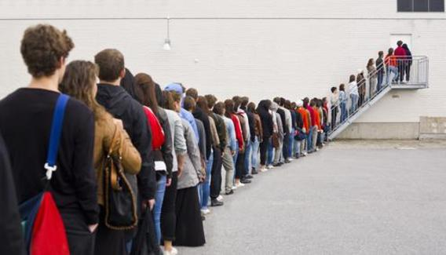



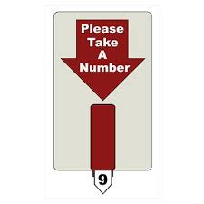
Scheduling
the art, theory, and practice of deciding what to do next
Ex: FIFO non-premptive scheduling
Ex: Round-Robin
Ex: Priority-based
Ex: Coordinated

Slide 22
Definition
Scheduling policy: algorithm for determining what to do next, when there are
multiple threads to run, or
multiple packets to send, or web requests to serve, or …
Job or Task: unit of scheduling
quanta of a thread
program to completion
…
Workload
Set of tasks for system to perform
Typically formed over time as scheduled tasks produce other tasks
Metrics: properties that scheduling may seek to optimize

Slide 23
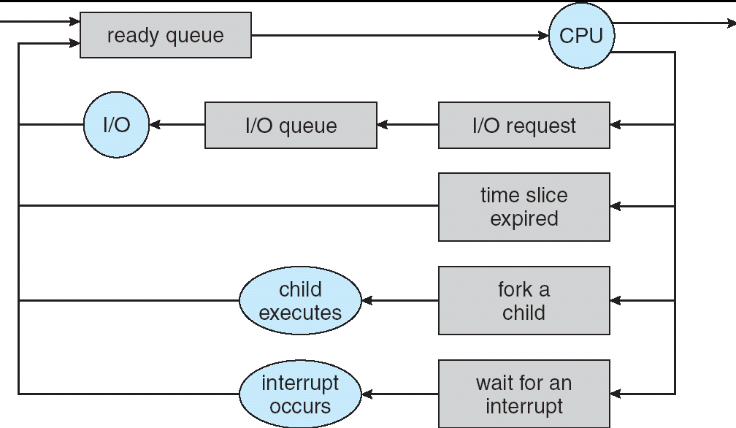
Processor Scheduling
life-cycle of a thread
Active threads work their way from Ready queue to Running to various waiting queues.
Scheduling: deciding which threads are given access to resources
How to decide which of several threads to dequeue and run?
So far we have a single ready queue
Reason for wait->ready may make a big difference!

Slide 24
Concretely: Pintos Scheduler
static void schedule (void) {
struct thread *cur = running_thread ();
struct thread *next = next_thread_to_run ();
struct thread *prev = NULL;
ASSERT (intr_get_level () == INTR_OFF);
ASSERT (cur->status != THREAD_RUNNING);
ASSERT (is_thread (next));
if (cur != next)
prev = switch_threads (cur, next);
thread_schedule_tail (prev);
}
Initially a round-robin scheduler of thread quanta
Algorithm: next_thread_to_run

Slide 25
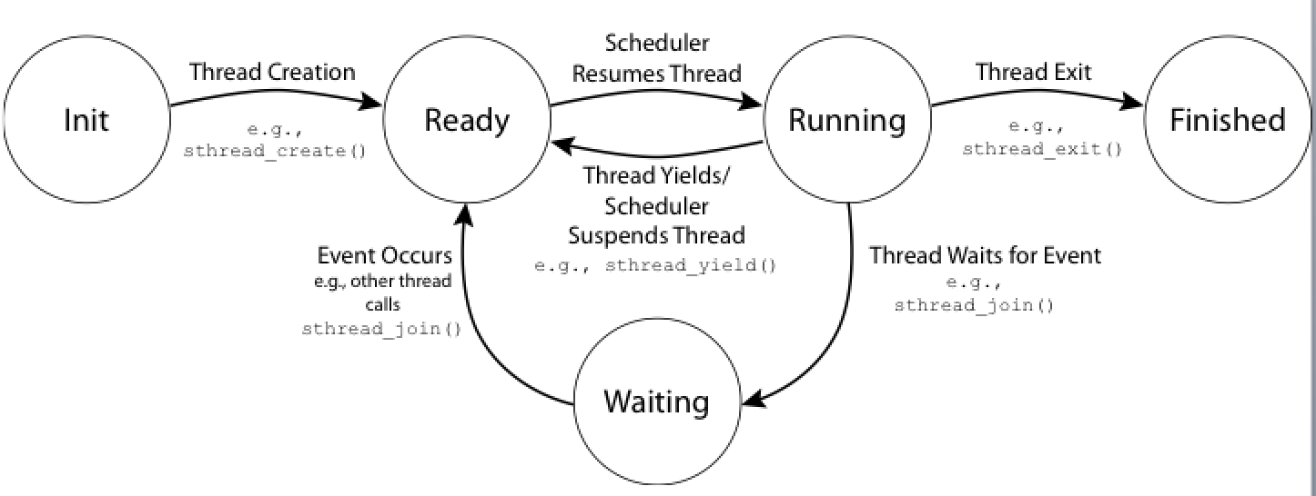
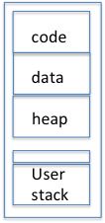
Kernel threads call into scheduler
At various points (eg. sema_down) kernel thread must block itself
it calls schedule to allow next task to be selected
void thread_block (void) {
ASSERT (!intr_context ());
ASSERT (intr_get_level () == INTR_OFF);
thread_current()->status = THREAD_BLOCKED;
schedule ();
}
schedule( .. ) {
}
code
Ready Threads
data
Kernel
User
***

Slide 26
First In First Out - FCFS
Schedule tasks in the order they arrive
Run until they complete or give up the processor
Arrive
Wait
start
Run
end
scheduling overhead
response time
Notes:
Always happens to me -- you go to the store to buy a carton of milk, you get stuck behind someone with a huge basket? And insists on paying in pennies. Feature -- gives you time to read the National Enquirer. Computer science professor has space alien's baby.

Slide 27
Round-Robin
Each task gets a fixed amount of the resource (time quantum)
if does not complete, goes back into queue
How large a time quantum?
Too short? Too long? Trade-offs?
response time
Notes:
Always happens to me -- you go to the store to buy a carton of milk, you get stuck behind someone with a huge basket? And insists on paying in pennies. Feature -- gives you time to read the National Enquirer. Computer science professor has space alien's baby.

Slide 28
Scheduling Metrics
Waiting Time: time the job is waiting in the ready queue
Time between job’s arrival in the ready queue and launching the job
Service (Execution) Time: time the job is running
Response (Completion) Time:
Time between job’s arrival in the ready queue and job’s completion
Response time is what the user sees:
Time to echo a keystroke in editor
Time to compile a program
Response Time = Waiting Time + Service Time
Throughput: number of jobs completed per unit of time
Throughput related to response time, but not same thing:
Minimizing response time will lead to more context switching than if you only maximized throughput
Notes:
What does CPU scheduling have to do with efficient use of the disk?
A lot! Have to have the CPU to make a disk request
Fairness: Minimize # of angry phone calls? Minimize my response time?

Slide 29
Scheduling Policy Goals/Criteria
Minimize Response Time
Minimize elapsed time to do an operation (or job)
Maximize Throughput
Two parts to maximizing throughput
Minimize overhead (for example, context-switching)
Efficient use of resources (CPU, disk, memory, etc)
Fairness
Share CPU among users in some equitable way
Fairness is not minimizing average response time:
Better average response time by making system less fair
Notes:
What does CPU scheduling have to do with efficient use of the disk?
A lot! Have to have the CPU to make a disk request
Fairness: Minimize # of angry phone calls? Minimize my response time?

Slide 30
Priority Scheduling
Priorities can be a way to express desired outcome to the scheduler
important (high priority) tasks first, quicker, …
while low priority ones when resources available, …
Peer discussion: in groups of 2-4 come up with two ways to introduce priorities into FIFO and RR.
How might priorities interact positively / negatively with synchronization? With I/O ?

Slide 31
Round Robin vs FIFO
FIFO
Round Robin

Slide 32
Round Robin vs. FIFO
Notes:
Everything is fair, but average response time in this case is awful – everyone finishes very late! In fact, this case is exactly when FIFO is optimal, RR is poor.
On the other hand, if we’re running streaming video, RR is great – everything happens in turn. SJF maximizes variance. But RR minimizes it.

Slide 33
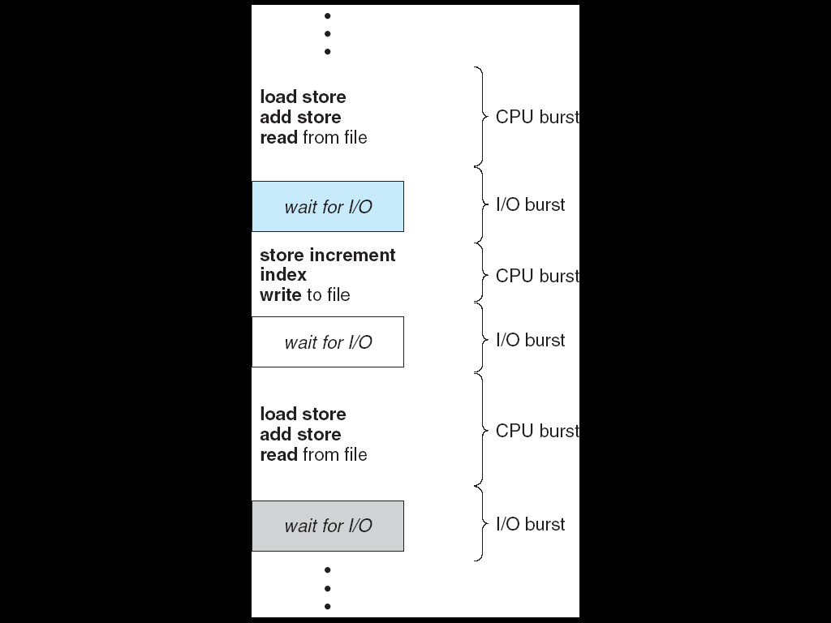
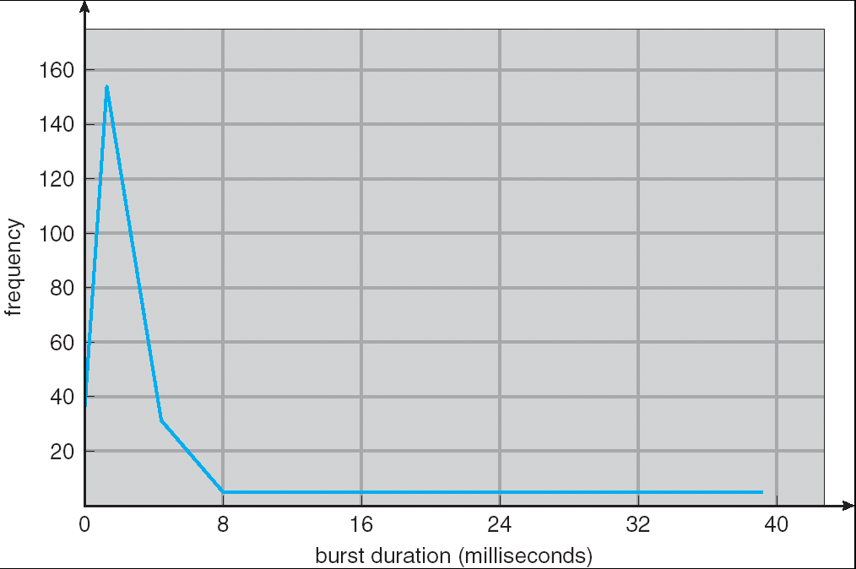
CPU Bursts
Weighted toward small bursts
Programs alternate between bursts of CPU and I/O
Program typically uses the CPU for some period of time, then does I/O, then uses CPU again
Each scheduling decision is about which job to give to the CPU for use by its next CPU burst
With timeslicing, thread may be forced to give up CPU before finishing current CPU burst

Slide 34
Round Robin Slice

Slide 35
Round-Robin Discussion
How do you choose time slice?
What if too big?
Response time suffers
What if infinite (∞)?
Get back FCFS/FIFO
What if time slice too small?
Throughput suffers!
Actual choices of timeslice:
Initially, UNIX timeslice one second:
Worked ok when UNIX was used by one or two people.
What if three compilations going on? 3 seconds to echo each keystroke!
In practice, need to balance short-job performance and long-job throughput:
Typical time slice today is between 10ms – 100ms
Typical context-switching overhead is 0.1ms – 1ms
Roughly 1% overhead due to context-switching

Slide 36
What if we Knew the Future?
Shortest Job First (SJF):
Run whatever job has the least amount of computation to do
Shortest Remaining Time First (SRTF):
Preemptive version of SJF: if job arrives and has a shorter time to completion than the remaining time on the current job, immediately preempt CPU
but how do you now???
Idea is to get short jobs out of the system
Big effect on short jobs, only small effect on long ones
Result is better average response time
Want a simple approximation to SRTF …
Notes:
Rich get richer, and poor get poorer = short jobs get through the system faster, long jobs take even longer

Slide 37


FIFO vs. SJF
But what if more and more short jobs keep arriving, e.g., lots of little I/Os ???

Slide 38
Discussion
SJF/SRTF are best at minimizing average response time
Provably optimal (SJF among non-preemptive, SRTF among preemptive)
Since SRTF is always at least as good as SJF, focus on SRTF
Comparison of SRTF with FCFS and RR
What if all jobs the same length?
SJF becomes the same as FCFS (i.e., FCFS is best can do if all jobs the same length)
What if jobs have varying length?
SRTF (and RR): short jobs not stuck behind long ones

Slide 39
Example to illustrate benefits of SRTF
A or B
C
C’s
I/O
C’s
I/O
C’s
I/O
Three jobs:
A,B: CPU bound, each run for a week C: I/O bound, loop 1ms CPU, 9ms disk I/O
If only one at a time, C uses 90% of the disk, A or B use 100% of the CPU
With FIFO:
Once A or B get in, keep CPU for one week each
What about RR or SRTF?
Easier to see with a timeline

Slide 40
RR vs. SRTF
Disk Utilization:
9/201 ~ 4.5%
C
A
B
C
RR 100ms time slice
Disk Utilization:
~90% but lots of wakeups!
C’s
I/O
C’s
I/O
CABAB…
C
RR 1ms time slice
C’s
I/O
C’s
I/O
Disk Utilization:
90%
C
A
A
A
SRTF
C’s
I/O
C’s
I/O

Slide 41
SRTF Further discussion
Starvation
SRTF can lead to starvation if many small jobs!
Large jobs never get to run
Somehow need to predict future
How can we do this?
Some systems ask the user
When you submit a job, have to say how long it will take
To stop cheating, system kills job if takes too long
But: even non-malicious users have trouble predicting runtime of their jobs
Bottom line, can’t really know how long job will take
However, can use SRTF as a yardstick for measuring other policies
Optimal => Practical approximations?
SRTF Pros & Cons
Optimal (average response time) (+)
Hard to predict future (-)
Unfair (-)

Slide 42
Summary
Scheduling: selecting a process from the ready queue and allocating the CPU to it
FCFS Scheduling:
Run threads to completion in order of submission
Pros: Simple (+)
Cons: Short jobs get stuck behind long ones (-)
Round-Robin Scheduling:
Give each thread a small amount of CPU time when it executes; cycle between all ready threads
Pros: Better for short jobs (+)
Cons: Poor when jobs are same length (-)
Shortest Remaining Time First (SRTF):
Run whatever job has the least remaining amount of computation to do
Pros: Optimal (average response time)
Cons: Hard to predict future, Unfair

Slide 43
Backup Detail on Scheduling Trade-Offs

Slide 44
First-Come, First-Served (FCFS) Scheduling
First-Come, First-Served (FCFS)
Also “First In, First Out” (FIFO) or “Run until done”
In early systems, FCFS meant one program scheduled until done (including I/O)
Now, means keep CPU until thread blocks
Example: Process Burst Time P₁ 24 P₂ 3 P₃ 3
Suppose processes arrive in the order: P₁ , P₂ , P₃ The Gantt Chart for the schedule is:
Waiting time for P₁ = 0; P₂ = 24; P₃ = 27
Average waiting time: (0 + 24 + 27)/3 = 17
Average completion time: (24 + 27 + 30)/3 = 27
Convoy effect: short process behind long process
P₁
P₂
P₃
0
24
27
30

Slide 45
FCFS Scheduling (Cont.)
Example continued:
Suppose that processes arrive in order: P₂ , P₃ , P₁ Now, the Gantt chart for the schedule is:
Waiting time for P₁ = 6; P₂ = 0; P₃ = 3
Average waiting time: (6 + 0 + 3)/3 = 3
Average Completion time: (3 + 6 + 30)/3 = 13
In second case:
Average waiting time is much better (before it was 17)
Average completion time is better (before it was 27)
FCFS Pros and Cons:
Simple (+)
Short jobs get stuck behind long ones (-)
Safeway: Getting milk, always stuck behind cart full of small items
P₂
P₃
P₁
0
3
6
30

Slide 46
Round Robin (RR)
FCFS Scheme: Potentially bad for short jobs!
Depends on submit order
If you are first in line at supermarket with milk, you don’t care who is behind you, on the other hand…
Round Robin Scheme
Each process gets a small unit of CPU time (time quantum), usually 10-100 milliseconds
After quantum expires, the process is preempted and added to the end of the ready queue
n processes in ready queue and time quantum is q ⇒
Each process gets 1/n of the CPU time
In chunks of at most q time units
No process waits more than (n-1)q time units
Performance
q large ⇒ FCFS
q small ⇒ Interleaved
q must be large with respect to context switch, otherwise overhead is too high (all overhead)

Slide 47
Example of RR with Time Quantum = 20
Example: Process Burst Time Remaining Time P₁ 53 53 P₂ 8 8 P₃ 68 68 P₄ 24 24
The Gantt chart is:

Slide 48
Example of RR with Time Quantum = 20
Example: Process Burst Time Remaining Time P₁ 53 33 P₂ 8 8 P₃ 68 68 P₄ 24 24
The Gantt chart is:
P₁
0
20

Slide 49
Example of RR with Time Quantum = 20
Example: Process Burst Time Remaining Time P₁ 53 33 P₂ 8 0 P₃ 68 68 P₄ 24 24
The Gantt chart is:
P₁
P₂
0
20
28

Slide 50
Example of RR with Time Quantum = 20
Example: Process Burst Time Remaining Time P₁ 53 33 P₂ 8 0 P₃ 68 48 P₄ 24 24
The Gantt chart is:
P₁
P₂
P₃
0
20
28
48

Slide 51
Example of RR with Time Quantum = 20
Example: Process Burst Time Remaining Time P₁ 53 33 P₂ 8 0 P₃ 68 48 P₄ 24 4
The Gantt chart is:
P₁
P₂
P₃
P₄
0
20
28
48
68

Slide 52
Example of RR with Time Quantum = 20
Example: Process Burst Time Remaining Time P₁ 53 13 P₂ 8 0 P₃ 68 48 P₄ 24 4
The Gantt chart is:
P₁
P₂
P₃
P₄
P₁
0
20
28
48
68
88

Slide 53
Example of RR with Time Quantum = 20
Example: Process Burst Time Remaining Time P₁ 53 13 P₂ 8 0 P₃ 68 28 P₄ 24 4
The Gantt chart is:
P₁
P₂
P₃
P₄
P₁
P₃
0
20
28
48
68
88
108

Slide 54
Example of RR with Time Quantum = 20
Example: Process Burst Time Remaining Time P₁ 53 0 P₂ 8 0 P₃ 68 0 P₄ 24 0
The Gantt chart is:
Waiting time for P₁=(68-20)+(112-88)=72 P₂=(20-0)=20 P₃=(28-0)+(88-48)+(125-108)=85 P₄=(48-0)+(108-68)=88
Average waiting time = (72+20+85+88)/4=66¼
Average completion time = (125+28+153+112)/4 = 104½
Thus, Round-Robin Pros and Cons:
Better for short jobs, Fair (+)
Context-switching time adds up for long jobs (-)
P₁
P₂
P₃
P₄
P₁
P₃
P₄
P₁
P₃
P₃
0
20
28
48
68
88
108
112
125
145
153

Slide 55
Round-Robin Discussion
How do you choose time slice?
What if too big?
Response time suffers
What if infinite (∞)?
Get back FCFS/FIFO
What if time slice too small?
Throughput suffers!
Actual choices of timeslice:
Initially, UNIX timeslice one second:
Worked ok when UNIX was used by one or two people.
What if three compilations going on? 3 seconds to echo each keystroke!
In practice, need to balance short-job performance and long-job throughput:
Typical time slice today is between 10ms – 100ms
Typical context-switching overhead is 0.1ms – 1ms
Roughly 1% overhead due to context-switching

Slide 56
Comparisons between FCFS and Round Robin
Assuming zero-cost context-switching time, is RR always better than FCFS?
Simple example: 10 jobs, each takes 100s of CPU time RR scheduler quantum of 1s All jobs start at the same time
Completion Times:
FIFO average 550
RR average 995.5!
FCFS
P1
P2
…
P9
P10
0
100
200
800
900
1000
RR
…
…
…
…
…
0
10
20
980
990
1000
991
999
Job # | FIFO | RR
1 | 100 | 991
2 | 200 | 992
… | … | …
9 | 900 | 999
10 | 1000 | 1000

Slide 57
Comparisons between FCFS and Round Robin
Assuming zero-cost context-switching time, is RR always better than FCFS?
Simple example: 10 jobs, each takes 100s of CPU time RR scheduler quantum of 1s All jobs start at the same time
Both RR and FCFS finish at the same time
Average response time is much worse under RR!
Bad when all jobs same length
Also: Cache state must be shared between all jobs with RR but can be devoted to each job with FCFS
Total time for RR longer even for zero-cost switch!
FCFS
P1
P2
…
P9
P10
0
100
200
800
900
1000
RR
…
…
…
…
…
0
10
20
980
990
1000
991
999

Slide 58
Earlier Example with Different Time Quantum
P₂
[8]
P₄
[24]
P₁
[53]
P₃
[68]
Best FCFS:
0
8
32
85
153
Quantum
P₁
P₂
P₃
P₄
Average
Wait
Time
Best FCFS
32
0
85
8
31¼
Completion
Time
Best FCFS
85
8
153
32
69½

Slide 59
Earlier Example with Different Time Quantum
P₃
[68]
P₁
[53]
P₄
[24]
P₂
[8]
Worst FCFS:
0
68
121
145
153
Quantum
P₁
P₂
P₃
P₄
Average
Wait
Time
Best FCFS
32
0
85
8
31¼
Worst FCFS
68
145
0
121
83½
Completion
Time
Best FCFS
85
8
153
32
69½
Worst FCFS
121
153
68
145
121¾

Slide 60
Earlier Example with Different Time Quantum
P₃
[68]
P₁
[53]
P₄
[24]
P₂
[8]
Worst FCFS:
0
68
121
145
153
Quantum
P₁
P₂
P₃
P₄
Average
P₁
P₂
P₃
P₄
P₁
P₃
P₄
P₁
P₃
P₄
P₁
P₃
P₁
P₃
P₁
P₃
P₁
P₃
P₃
P₃
Wait
Time
Best FCFS
32
0
85
8
31¼
Q = 1
84
22
85
57
62
0
8
16
24
32
40
48
56
64
72
80
88
96
104
112
120
128
133
141
149
153
Q = 5
82
20
85
58
61¼
Q = 8
80
8
85
56
57¼
Q = 10
82
10
85
68
61¼
Q = 20
72
20
85
88
66¼
Worst FCFS
68
145
0
121
83½
Completion
Time
Best FCFS
85
8
153
32
69½
Q = 1
137
30
153
81
100½
Q = 5
135
28
153
82
99½
Q = 8
133
16
153
80
95½
Q = 10
135
18
153
92
99½
Q = 20
125
28
153
112
104½
Worst FCFS
121
153
68
145
121¾

