Slide 1
Scheduling
David E. Culler
CS162 – Operating Systems and Systems Programming
Lecture 11
Sept 24, 2014
Reading: A&D 7-7.1
HW 2 due 9/26
Proj 1 design review
MT1: 9/29 6:00-7:00

Slide 2
Recall: Objectives
Introduce the concept of scheduling
General topic that applies in many context
rich theory and practice
Fundamental trade-offs
not a simple find the “best”
resolution depends on context
Ground it in OS context
Ground implementation in Pintos
… after synch implementation wrap-up

Slide 3
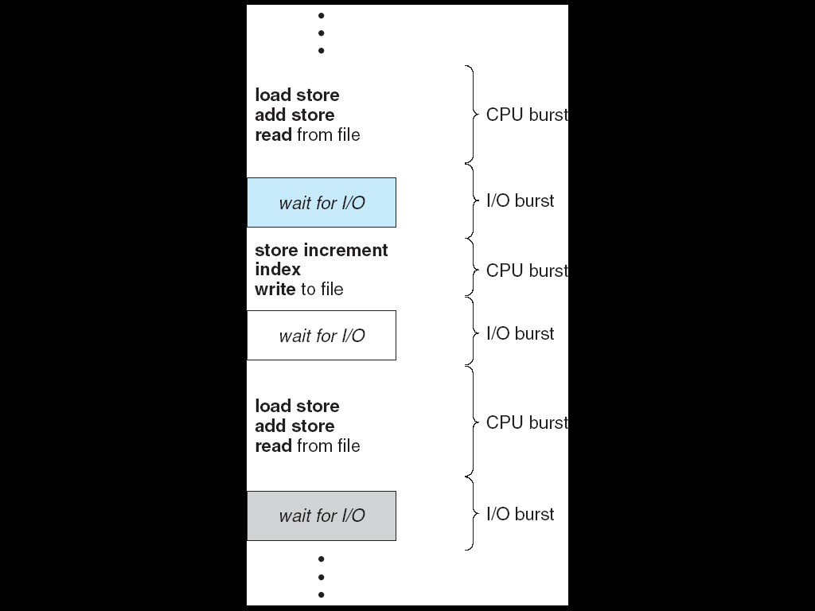
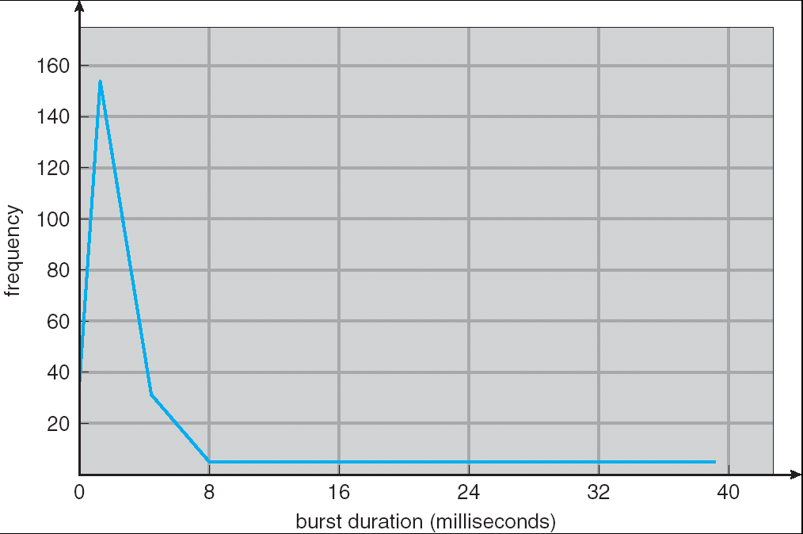
Recall: CPU Bursts
Weighted toward small bursts
Programs alternate between bursts of CPU and I/O
Program typically uses the CPU for some period of time, then does I/O, then uses CPU again
Each scheduling decision is about which job to give to the CPU for use by its next CPU burst
With timeslicing, thread may be forced to give up CPU before finishing current CPU burst

Slide 4
Recall: First-Come, First-Served (FCFS) Scheduling
First-Come, First-Served (FCFS)
Also “First In, First Out” (FIFO) or “Run until done”
In early systems, FCFS meant one program scheduled until done (including I/O)
Now, means keep CPU until thread blocks
Example: Process Burst Time P₁ 24 P₂ 3 P₃ 3
Suppose processes arrive in the order: P₁ , P₂ , P₃ The Gantt Chart for the schedule is:
Waiting time for P₁ = 0; P₂ = 24; P₃ = 27
Average waiting time: (0 + 24 + 27)/3 = 17
Average completion time: (24 + 27 + 30)/3 = 27
Convoy effect: short process behind long process
P₁
P₂
P₃
0
24
27
30

Slide 5
FCFS Scheduling (Cont.)
Example continued:
Suppose that processes arrive in order: P₂ , P₃ , P₁ Now, the Gantt chart for the schedule is:
Waiting time for P₁ = 6; P₂ = 0; P₃ = 3
Average waiting time: (6 + 0 + 3)/3 = 3
Average Completion time: (3 + 6 + 30)/3 = 13
In second case:
Average waiting time is much better (before it was 17)
Average completion time is better (before it was 27)
FCFS Pros and Cons:
Simple (+)
Short jobs get stuck behind long ones (-)
Safeway: Getting milk, always stuck behind cart full of small items
P₂
P₃
P₁
0
3
6
30

Slide 6
Recall: Round Robin (RR)
FCFS Scheme: Potentially bad for short jobs!
Depends on submit order
If you are first in line at supermarket with milk, you don’t care who is behind you, on the other hand…
Round Robin Scheme
Each process gets a small unit of CPU time (time quantum), usually 10-100 milliseconds
After quantum expires, the process is preempted and added to the end of the ready queue
n processes in ready queue and time quantum is q ⇒
Each process gets 1/n of the CPU time
In chunks of at most q time units
No process waits more than (n-1)q time units
Performance
q large ⇒ FCFS
q small ⇒ Interleaved
q must be large with respect to context switch, otherwise overhead is too high (all overhead)

Slide 7
Example of RR with Time Quantum = 20
Example: Process Burst Time Remaining Time P₁ 53 53 P₂ 8 8 P₃ 68 68 P₄ 24 24
The Gantt chart is:

Slide 8
Example of RR with Time Quantum = 20
Example: Process Burst Time Remaining Time P₁ 53 33 P₂ 8 8 P₃ 68 68 P₄ 24 24
The Gantt chart is:
P₁
0
20

Slide 9
Example of RR with Time Quantum = 20
Example: Process Burst Time Remaining Time P₁ 53 33 P₂ 8 0 P₃ 68 68 P₄ 24 24
The Gantt chart is:
P₁
P₂
0
20
28

Slide 10
Example of RR with Time Quantum = 20
Example: Process Burst Time Remaining Time P₁ 53 33 P₂ 8 0 P₃ 68 48 P₄ 24 24
The Gantt chart is:
P₁
P₂
P₃
0
20
28
48

Slide 11
Example of RR with Time Quantum = 20
Example: Process Burst Time Remaining Time P₁ 53 33 P₂ 8 0 P₃ 68 48 P₄ 24 4
The Gantt chart is:
P₁
P₂
P₃
P₄
0
20
28
48
68

Slide 12
Example of RR with Time Quantum = 20
Example: Process Burst Time Remaining Time P₁ 53 13 P₂ 8 0 P₃ 68 48 P₄ 24 4
The Gantt chart is:
P₁
P₂
P₃
P₄
P₁
0
20
28
48
68
88

Slide 13
Example of RR with Time Quantum = 20
Example: Process Burst Time Remaining Time P₁ 53 13 P₂ 8 0 P₃ 68 28 P₄ 24 4
The Gantt chart is:
P₁
P₂
P₃
P₄
P₁
P₃
0
20
28
48
68
88
108

Slide 14
Example of RR with Time Quantum = 20
Example: Process Burst Time Remaining Time P₁ 53 0 P₂ 8 0 P₃ 68 0 P₄ 24 0
The Gantt chart is:
Waiting time for P₁=(68-20)+(112-88)=72 P₂=(20-0)=20 P₃=(28-0)+(88-48)+(125-108)=85 P₄=(48-0)+(108-68)=88
Average waiting time = (72+20+85+88)/4=66¼
Average completion time = (125+28+153+112)/4 = 104½
Thus, Round-Robin Pros and Cons:
Better for short jobs, Fair (+)
Context-switching time adds up for long jobs (-)
P₁
P₂
P₃
P₄
P₁
P₃
P₄
P₁
P₃
P₃
0
20
28
48
68
88
108
112
125
145
153

Slide 15
Round-Robin Discussion
How do you choose time slice?
What if too big?
Response time suffers
What if infinite (∞)?
Get back FCFS/FIFO
What if time slice too small?
Throughput suffers!
Actual choices of timeslice:
Initially, UNIX timeslice one second:
Worked ok when UNIX was used by one or two people.
What if three compilations going on? 3 seconds to echo each keystroke!
In practice, need to balance short-job performance and long-job throughput:
Typical time slice today is between 10ms – 100ms
Typical context-switching overhead is 0.1ms – 1ms
Roughly 1% overhead due to context-switching

Slide 16
Round Robin Slice

Slide 17
Comparisons between FCFS and Round Robin
Assuming zero-cost context-switching time, is RR always better than FCFS?
Simple example: 10 jobs, each takes 100s of CPU time RR scheduler quantum of 1s All jobs start at the same time
Completion Times:
FIFO average 550
RR average 995.5!
FCFS
P1
P2
…
P9
P10
0
100
200
800
900
1000
RR
…
…
…
…
…
0
10
20
980
990
1000
991
999
Job # | FIFO | RR
1 | 100 | 991
2 | 200 | 992
… | … | …
9 | 900 | 999
10 | 1000 | 1000

Slide 18
Comparisons between FCFS and Round Robin
Assuming zero-cost context-switching time, is RR always better than FCFS?
Simple example: 10 jobs, each takes 100s of CPU time RR scheduler quantum of 1s All jobs start at the same time
Both RR and FCFS finish at the same time
Average response time is much worse under RR!
Bad when all jobs same length
Also: Cache state must be shared between all jobs with RR but can be devoted to each job with FCFS
Total time for RR longer even for zero-cost switch!
FCFS
P1
P2
…
P9
P10
0
100
200
800
900
1000
RR
…
…
…
…
…
0
10
20
980
990
1000
991
999

Slide 19
Earlier Example with Different Time Quantum
P₂
[8]
P₄
[24]
P₁
[53]
P₃
[68]
Best FCFS:
0
8
32
85
153
Quantum
P₁
P₂
P₃
P₄
Average
Wait
Time
Best FCFS
32
0
85
8
31¼
Completion
Time
Best FCFS
85
8
153
32
69½

Slide 20
Earlier Example with Different Time Quantum
P₃
[68]
P₁
[53]
P₄
[24]
P₂
[8]
Worst FCFS:
0
68
121
145
153
Quantum
P₁
P₂
P₃
P₄
Average
Wait
Time
Best FCFS
32
0
85
8
31¼
Worst FCFS
68
145
0
121
83½
Completion
Time
Best FCFS
85
8
153
32
69½
Worst FCFS
121
153
68
145
121¾

Slide 21
Earlier Example with Different Time Quantum
P₃
[68]
P₁
[53]
P₄
[24]
P₂
[8]
Worst FCFS:
0
68
121
145
153
Quantum
P₁
P₂
P₃
P₄
Average
P₁
P₂
P₃
P₄
P₁
P₃
P₄
P₁
P₃
P₄
P₁
P₃
P₁
P₃
P₁
P₃
P₁
P₃
P₃
P₃
Wait
Time
Best FCFS
32
0
85
8
31¼
Q = 1
84
22
85
57
62
0
8
16
24
32
40
48
56
64
72
80
88
96
104
112
120
128
133
141
149
153
Q = 5
82
20
85
58
61¼
Q = 8
80
8
85
56
57¼
Q = 10
82
10
85
68
61¼
Q = 20
72
20
85
88
66¼
Worst FCFS
68
145
0
121
83½
Completion
Time
Best FCFS
85
8
153
32
69½
Q = 1
137
30
153
81
100½
Q = 5
135
28
153
82
99½
Q = 8
133
16
153
80
95½
Q = 10
135
18
153
92
99½
Q = 20
125
28
153
112
104½
Worst FCFS
121
153
68
145
121¾

Slide 22
Round-Robin Discussion
How do you choose time slice?
What if too big?
Response time suffers
What if infinite (∞)?
Get back FCFS/FIFO
What if time slice too small?
Throughput suffers!
Actual choices of timeslice:
Initially, UNIX timeslice one second:
Worked ok when UNIX was used by one or two people.
What if three compilations going on? 3 seconds to echo each keystroke!
In practice, need to balance short-job performance and long-job throughput:
Typical time slice today is between 10ms – 100ms
Typical context-switching overhead is 0.1ms – 1ms
Roughly 1% overhead due to context-switching

Slide 23
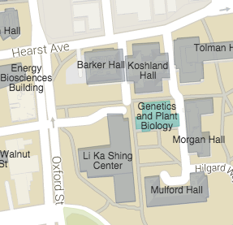
Administrative Break
Survey thanks
Midterm Monday 6pm
145 DWINELLE (aa – ft)
2040 VALLEY LSB (fu – jl)
2060 VALLEY LSB (jm – ni)
review session 1-3:00 pm on Sat 9/26 @100 GPB
Vote: Q&A Monday ???
Design review is to help you get a clear path to completion – not a big grading hurdle
HWs are to help you internalize the concepts
project test jigs …

Slide 24
What if we Knew the Future?
Shortest Job First (SJF):
Run whatever job has the least amount of computation to do
Shortest Remaining Time First (SRTF):
Preemptive version of SJF: if job arrives and has a shorter time to completion than the remaining time on the current job, immediately preempt CPU
but how do you now???
Idea is to get short jobs out of the system
Big effect on short jobs, only small effect on long ones
Result is better average response time
Want a simple approximation to SRTF …
Notes:
Rich get richer, and poor get poorer = short jobs get through the system faster, long jobs take even longer

Slide 25


FIFO vs. SJF
But what if more and more short jobs keep arriving, e.g., lots of little I/Os ???

Slide 26
Discussion
SJF/SRTF are best at minimizing average response time
Provably optimal (SJF among non-preemptive, SRTF among preemptive)
Since SRTF is always at least as good as SJF, focus on SRTF
Comparison of SRTF with FCFS and RR
What if all jobs the same length?
SJF becomes the same as FCFS (i.e., FCFS is best can do if all jobs the same length)
What if jobs have varying length?
SRTF (and RR): short jobs not stuck behind long ones

Slide 27
Example to illustrate benefits of SRTF
A or B
C
C’s
I/O
C’s
I/O
C’s
I/O
Three jobs:
A,B: CPU bound, each run for a week C: I/O bound, loop 1ms CPU, 9ms disk I/O
If only one at a time, C uses 90% of the disk, A or B use 100% of the CPU
With FIFO:
Once A or B get in, keep CPU for one week each
What about RR or SRTF?
Easier to see with a timeline

Slide 28
RR vs. SRTF
Disk Utilization:
9/201 ~ 4.5%
C
A
B
C
RR 100ms time slice
Disk Utilization:
~90% but lots of wakeups!
C’s
I/O
C’s
I/O
CABAB…
C
RR 1ms time slice
C’s
I/O
C’s
I/O
Disk Utilization:
90%
C
A
A
A
SRTF
C’s
I/O
C’s
I/O

Slide 29
SRTF Further discussion
Starvation
SRTF can lead to starvation if many small jobs!
Large jobs never get to run
Somehow need to predict future
How can we do this?
Some systems ask the user
When you submit a job, have to say how long it will take
To stop cheating, system kills job if takes too long
But: even non-malicious users have trouble predicting runtime of their jobs
Bottom line, can’t really know how long job will take
However, can use SRTF as a yardstick for measuring other policies
Optimal => Practical approximations?
SRTF Pros & Cons
Optimal (average response time) (+)
Hard to predict future (-)
Unfair (-)

Slide 30
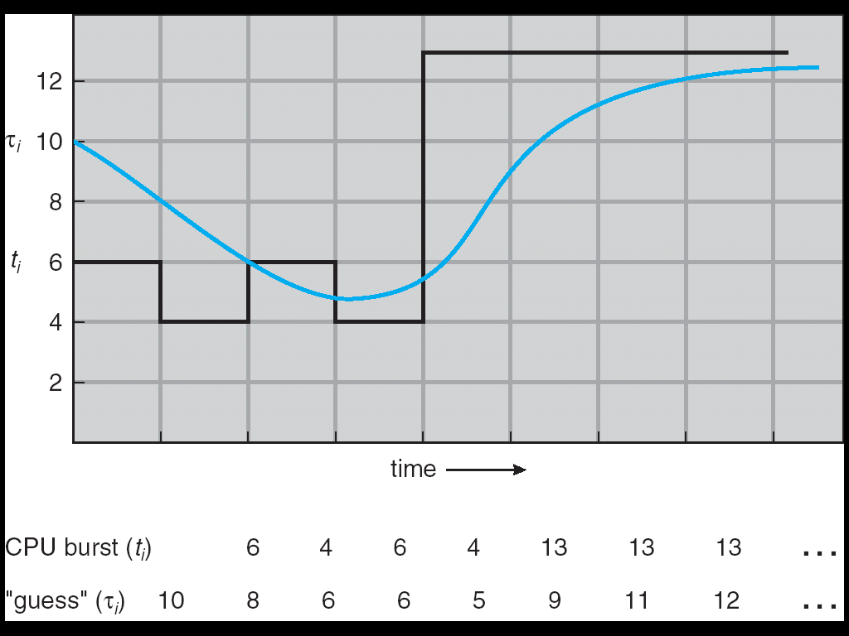
Predicting the Length of the Next CPU Burst
Adaptive: Changing policy based on past behavior
CPU scheduling, in virtual memory, in file systems, etc.
Works because programs have predictable behavior
If program was I/O bound in past, likely in future
If computer behavior were random, wouldn’t help
Example: SRTF with estimated burst length
Use an estimator function on previous bursts: Let t_{n-1}, t_{n-2}, t_{n-3}, etc. be previous CPU burst lengths. Estimate next burst τ_{n} = f(t_{n-1}, t_{n-2}, t_{n-3}, …)
Function f could be one of many different time series estimation schemes (Kalman filters, etc.)
Example: Exponential averaging τ_{n} = αt_{n-1}+(1-α)τ_{n-1} with (0<α≤1)

Slide 31
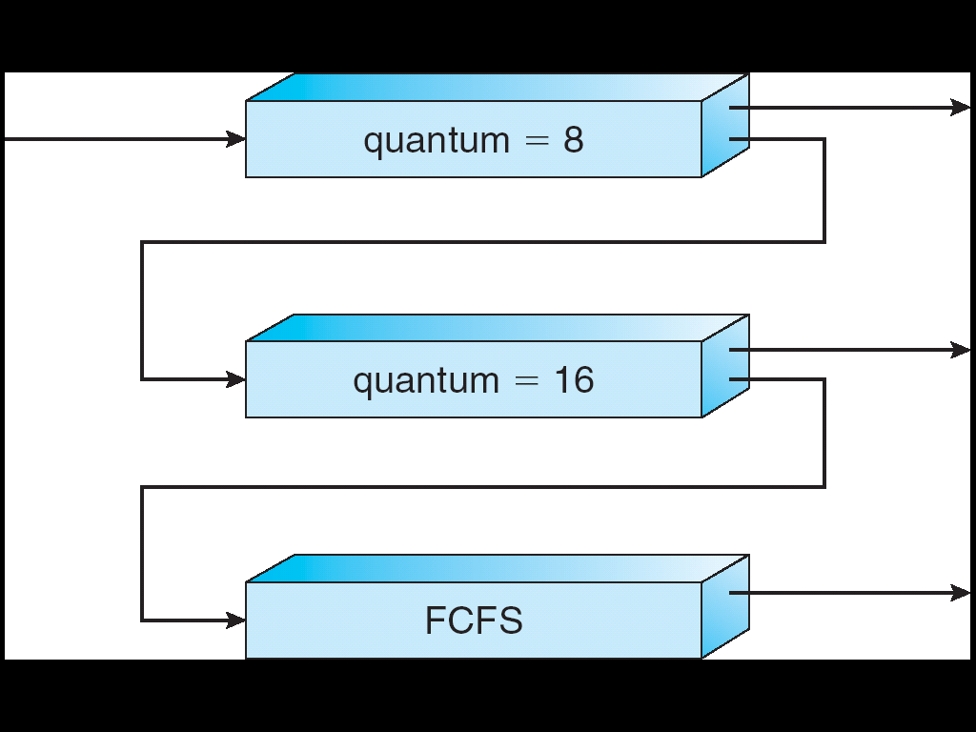
Multi-Level Feedback Scheduling
Long-Running
Compute tasks
demoted to low priority
Another method for exploiting past behavior
First used in Cambridge Time Sharing System (CTSS)
Multiple queues, each with different priority
Higher priority queues often considered “foreground” tasks
Each queue has its own scheduling algorithm
e.g., foreground – RR, background – FCFS
Sometimes multiple RR priorities with quantum increasing exponentially (highest:1ms, next:2ms, next: 4ms, etc.)
Adjust each job’s priority as follows (details vary)
Job starts in highest priority queue
If timeout expires, drop one level
If timeout doesn’t expire, push up one level (or to top)

Slide 32
Scheduling Details
Result approximates SRTF:
CPU bound jobs drop like a rock
Short-running I/O bound jobs stay near top
Scheduling must be done between the queues
Fixed priority scheduling:
Serve all from highest priority, then next priority, etc.
Time slice:
Each queue gets a certain amount of CPU time
e.g., 70% to highest, 20% next, 10% lowest

Slide 33
Scheduling Fairness
What about fairness?
Strict fixed-priority scheduling between queues is unfair (run highest, then next, etc):
Long running jobs may never get CPU
In Multics, shut down machine, found 10-year-old job
Must give long-running jobs a fraction of the CPU even when there are shorter jobs to run
Tradeoff: fairness gained by hurting average response time!
How to implement fairness?
Could give each queue some fraction of the CPU
What if one long-running job and 100 short-running ones?
Like express lanes in a supermarket—sometimes express lanes get so long, get better service by going into one of the other lines
Could increase priority of jobs that don’t get service
What is done in UNIX
This is ad hoc—what rate should you increase priorities?

Slide 34
Lottery Scheduling
Yet another alternative: Lottery Scheduling
Give each job some number of lottery tickets
On each time slice, randomly pick a winning ticket
On average, CPU time is proportional to number of tickets given to each job
How to assign tickets?
To approximate SRTF, short running jobs get more, long running jobs get fewer
To avoid starvation, every job gets at least one ticket (everyone makes progress)
Advantage over strict priority scheduling: behaves gracefully as load changes
Adding or deleting a job affects all jobs proportionally, independent of how many tickets each job possesses

Slide 35
Lottery Scheduling Example
Lottery Scheduling Example
Assume short jobs get 10 tickets, long jobs get 1 ticket
What if too many short jobs to give reasonable response time?
In UNIX, if load average is 100, hard to make progress
One approach: log some user out
# short jobs/ # long jobs | % of CPU each short jobs gets | % of CPU each long jobs gets
1/1 | 91% | 9%
0/2 | N/A | 50%
2/0 | 50% | N/A
10/1 | 9.9% | 0.99%
1/10 | 50% | 5%

Slide 36
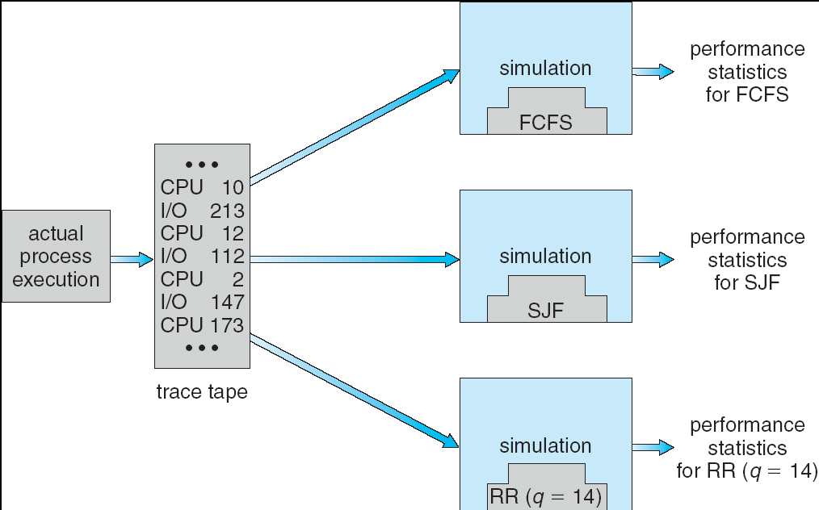
How to Evaluate a Scheduling algorithm?
Deterministic modeling
Takes a predetermined workload and compute the performance of each algorithm for that workload
Queuing models
Mathematical approach for handling stochastic workloads
Implementation/Simulation:
Build system which allows actual algorithms to be run against actual data. Most flexible/general.

Slide 37
A Final Word On Scheduling
When do the details of the scheduling policy and fairness really matter?
When there aren’t enough resources to go around
When should you simply buy a faster computer?
(Or network link, or expanded highway, or …)
One approach: Buy it when it will pay for itself in improved response time
Assuming you’re paying for worse response time in reduced productivity, customer angst, etc…
Might think that you should buy a faster X when X is utilized 100%, but usually, response time goes to infinity as utilization⇒100%
An interesting implication of this curve:
Most scheduling algorithms work fine in the “linear” portion of the load curve, fail otherwise
Argues for buying a faster X when hit “knee” of curve
Response time
100%
Utilization

Slide 38
Scheduling Summary
Scheduling: selecting a process from the ready queue and allocating the CPU to it
FCFS Scheduling:
Run threads to completion in order of submission
Pros: Simple (+)
Cons: Short jobs get stuck behind long ones (-)
Round-Robin Scheduling:
Give each thread a small amount of CPU time when it executes; cycle between all ready threads
Pros: Better for short jobs (+)
Cons: Poor when jobs are same length (-)
Shortest Remaining Time First (SRTF)
Run whatever job has the least remaining amount of computation to do !!!
Pros: Optimal (average response time)
Cons: Hard to predict future, Unfair

Slide 39
Summary (cont’d)
Multi-Level Feedback Scheduling:
Multiple queues of different priorities
Automatic promotion/demotion of process priority in order to approximate SJF/SRTF
Lottery Scheduling:
Give each thread a number of tokens (short tasks ⇒ more tokens)
Reserve a minimum number of tokens for every thread to ensure forward progress/fairness

