Slide 1
On to I/O via Virtual Memory
David E. Culler
CS162 – Operating Systems and Systems Programming
Lecture 20
October 15, 2014
Reading: A&D 11.2 (OSC 13)
HW 4 out
Proj 2 out

Slide 2
… bottom lines of the long road here
Virtual-to-physical address translation provides the illusion of a large, sparsely occupied virtual address space for every process
Used to solve many OS requirements
Protection, memory allocation, multi-programming, sharing, fast IO (!!!)
Implemented through mapping structures
Exponents matter (2^20 millions, 2^30, 2^60 gazillions)
Has to be VERY FAST in the common (success) case
Caches provide the illusion of a very large, fast physical memory
Essential to performance (100x) on modern machines
Similar techniques and trade-offs in cache of translations and memory blocks
All aspects of modern OS design must be cache friendly
Slow OS perceived as Slow Computer

Slide 3
Objectives
Recall and solidify understanding the concept and mechanics of caching.
Understand how caching and caching effects pervade OS design.
Put together all the mechanics around TLBs, Paging, and Memory caches
Solidify understanding of Virtual Memory

Slide 4
Recall: the most basic OS function

Slide 5
Loading an executable into memory
disk (huge)
memory
info
data
code
exe
.exe
lives on disk in the file system
contains contents of code & data segments, relocation entries and symbols
OS loads it into memory, initializes registers (and initial stack pointer)
program sets up stack and heap upon initialization: CRT0

Slide 6
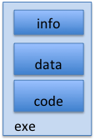
Create Virtual Address Space of the Process
disk (huge)
process VAS
memory
kernel
user page
frames
stack
sbrk
user pagetable
heap
data
kernel code & data
code
Utilized pages in the VAS are backed by page blocks on disk
called the backing store
typically in an optimized block store, but can think of it like a file

Slide 7
Create Virtual Address Space of the Process
disk (huge, TB)
process VAS (GBs)
memory
kernel
stack
user page
frames
stack
heap
heap
user pagetable
data
data
code
kernel code & data
code
User Page table maps entire VAS
All the utilized regions are backed on disk
swapped into and out of memory as needed
For every process

Slide 8
Create Virtual Address Space of the Process
disk (huge, TB)
VAS – per process
PT
memory
kernel
stack
user page
frames
stack
heap
heap
user pagetable
data
data
code
kernel code & data
code
User Page table maps entire VAS
resident pages to the frame in memory they occupy
the portion of it that the HW needs to access must be resident in memory

Slide 9
Provide Backing Store for VAS
disk (huge, TB)
VAS – per process
memory
kernel
stack
user page
frames
stack
heap
heap
user pagetable
data
data
code
kernel code & data
code
User Page table maps entire VAS
Resident pages mapped to memory frames
For all other pages, OS must record where to find them on disk

Slide 10
What data structure is required to map non-resident pages to disk?
FindBlock(PID, page#) => disk_block
Like the PT, but purely software
Where to store it?
Usually want backing store for resident pages too.
Could use hash table (like Inverted PT)

Slide 11
Provide Backing Store for VAS
disk (huge, TB)
VAS 1
PT 1
memory
kernel
stack
stack
stack
heap
user page
frames
heap
heap
data
VAS 2
PT 2
data
code
user pagetable
data
kernel
code
stack
kernel code & data
heap
data
code

Slide 12
On page Fault …
disk (huge, TB)
VAS 1
PT 1
memory
kernel
stack
stack
stack
heap
user page
frames
heap
heap
data
VAS 2
PT 2
data
code
user pagetable
data
kernel
code
stack
kernel code & data
heap
active process & PT
data
code

Slide 13
On page Fault … find & start load
disk (huge, TB)
VAS 1
PT 1
memory
kernel
stack
stack
stack
heap
user page
frames
heap
heap
data
VAS 2
PT 2
data
code
user pagetable
data
kernel
code
stack
kernel code & data
heap
active process & PT
data
code

Slide 14
On page Fault … schedule other P or T
disk (huge, TB)
VAS 1
PT 1
memory
kernel
stack
stack
stack
heap
user page
frames
heap
heap
data
VAS 2
PT 2
data
code
user pagetable
data
kernel
code
stack
kernel code & data
heap
active process & PT
data
code

Slide 15
On page Fault … update PTE
disk (huge, TB)
VAS 1
PT 1
memory
kernel
stack
stack
stack
heap
user page
frames
heap
heap
data
VAS 2
PT 2
data
code
user pagetable
data
kernel
code
stack
kernel code & data
heap
active process & PT
data
code

Slide 16
Eventually reschedule faulting thread
disk (huge, TB)
VAS 1
PT 1
memory
kernel
stack
stack
stack
heap
user page
frames
heap
heap
data
VAS 2
PT 2
data
code
user pagetable
data
kernel
code
stack
kernel code & data
heap
active process & PT
data
code

Slide 17
Where does the OS get the frame?
Keeps a free list
Unix runs a “reaper” if memory gets too full
As a last resort, evict a dirty page first

Slide 18
How many frames per process?
Like thread scheduling, need to “schedule” memory resources
allocation of frames per process
utilization? fairness? priority?
allocation of disk paging bandwith

Slide 19
Management & Access to the Memory Hierarchy
Managed in Hardware
Managed in Software - OS
Processor
Secondary Storage (Disk)
TLB
Core
L2 Cache
PT
Registers
L1 Cache
Secondary Storage (SSD)
PT
PT
Main
Memory
(DRAM)
PT
L3 Cache (shared)
Core
TLB
L2 Cache
Registers
L1 Cache
Accessed in Hardware
Speed (ns):
0.3
1
3
10-30
100
100,000 (0.1 ms)
10,000,000
(10 ms)
Size (bytes):
100Bs
10kBs
100kBs
MBs
GBs
100GBs
TBs
Notes:
The design goal is to present the user with as much memory as is available in the cheapest technology (points to the disk).
While by taking advantage of the principle of locality, we like to provide the user an average access speed that is very close to the speed that is offered by the fastest technology.
(We will go over this slide in details in the next lecture on caches).
+1 = 16 min. (X:56)

Slide 20
Summary
Virtual address space for protection, efficient use of memory, AND multi-programming.
hardware checks & translates when present
OS handles EVERYTHING ELSE
Conceptually memory is just a cache for blocks of VAS that live on disk
but can never access the disk directly
Address translation provides the basis for sharing
shared blocks of disk AND shared pages in memory
How else can we use this mechanism?
sharing ???
disks transfers on demand ???
accessing objects in blocks using load/store instructions

Slide 21
Historical Perspective
Mainframes and minicomputers (servers) were “always paging”
memory was limited
processor rates <> disk xfer rates were much closer
When overloaded would THRASH
with good OS design still made progress
Modern systems hardly every page
primarily a safety net + lots of untouched “stuff”
plus all the other advantages of managing a VAS
Effective use of the entire storage hierarchy is absolutely essential

Slide 22
Admin: Projects
Project 1
deep understanding of OS structure, interrupt, threads, thread implementation, synchronization, scheduling, and interactions of scheduling and synchronization
work effectively in a team
effective teams work together with a plan
=> schedule three 1-hour joint work times per week
Project 2
exe load and VAS creation provided for you
syscall processing, FORK+EXEC, file descriptors backing user file handles, ARGV
registers & stack frames
two development threads for team
but still need to work together

Slide 23
You are here …

Slide 24
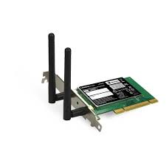
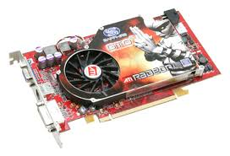
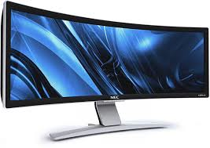

OS Basics: I/O
Threads
Address Spaces
Windows
Processes
Files
Sockets
Software
OS Hardware Virtualization
Hardware
ISA
Memory
Processor
Protection Boundary
OS
Ctrlr
storage
Networks
Displays
Inputs

Slide 25
The Question of the Day
The OS provides convenient, protected, high-level abstractions of shared physical resources
Processors => Threads
Memory => Address Space
Disk Blocks => Files
Network Packets => Messages
Keyboard, Mouse, Display => Windows
So, how does it access the hardware to build these?

Slide 26
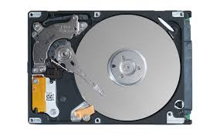
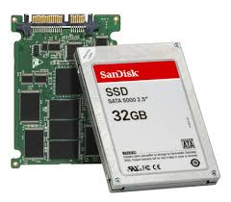
In a picture
Read / Write
wires
Processor
I/O
Controllers
Secondary Storage (Disk)
Core
L2 Cache
Registers
L1 Cache
interrupts
Secondary Storage (SSD)
Read / Write
Main
Memory
(DRAM)
DMA transfer
L3 Cache (shared)
Core
L2 Cache
Registers
L1 Cache
I/O devices you recognize are supported by I/O Controllers
Processors accesses them by reading and writing IO registers as if they were memory
Write commands and arguments, read status and results

Slide 27
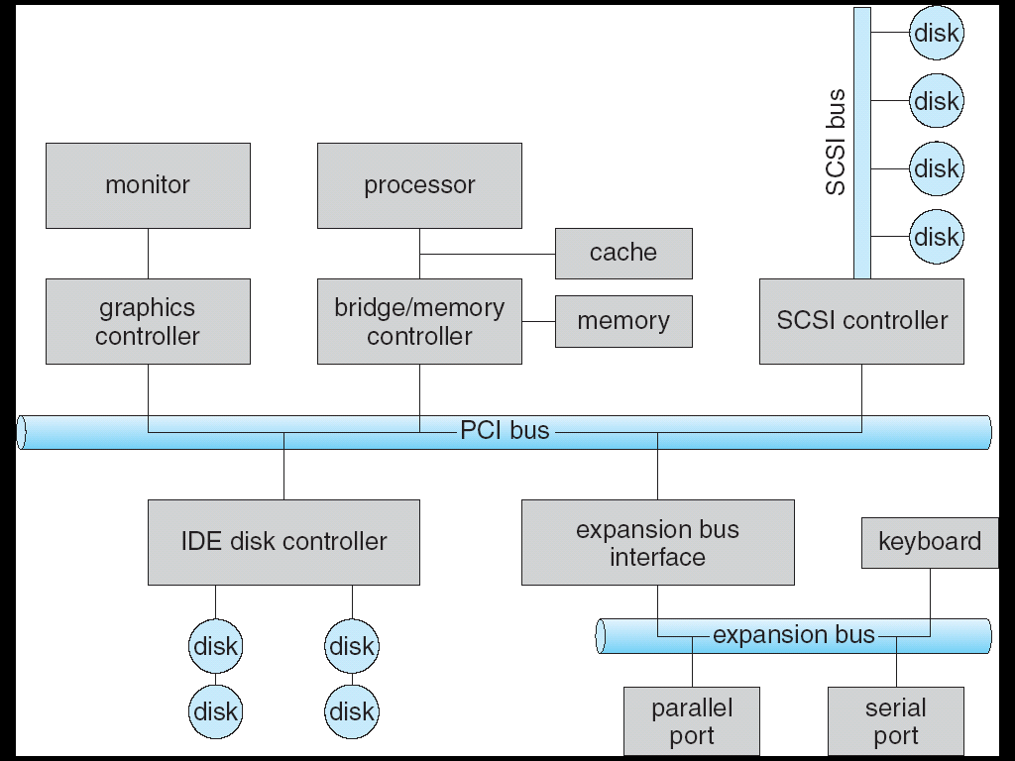

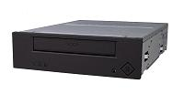
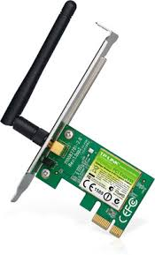
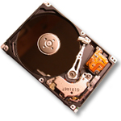

Modern I/O Systems
network

Slide 28
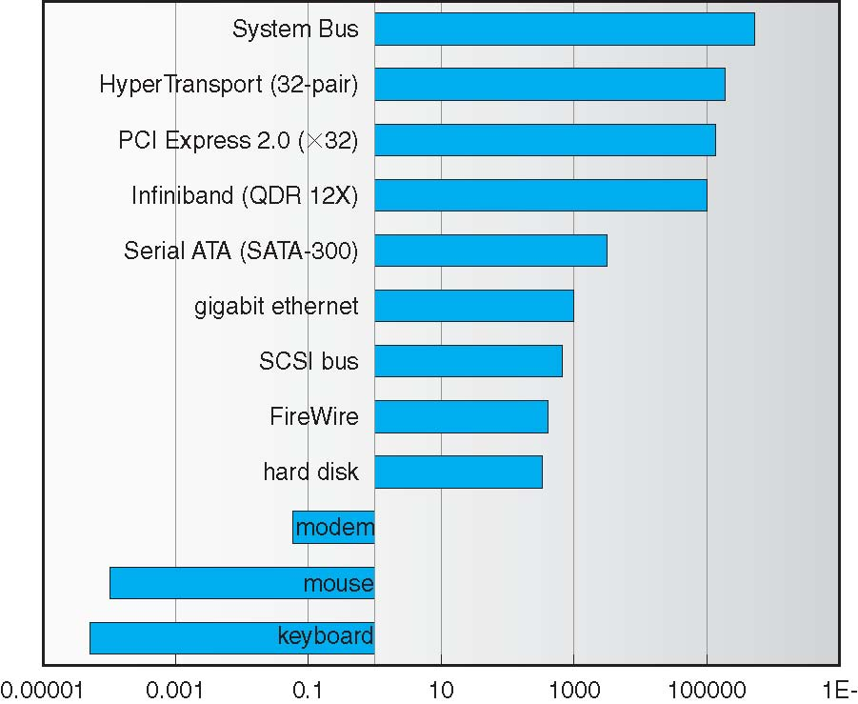
Example Device-Transfer Rates in Mb/s (Sun Enterprise 6000)
10m
Device Rates vary over 12 orders of magnitude !!!
System better be able to handle this wide range
Better not have high overhead/byte for fast devices!
Better not waste time waiting for slow devices

Slide 29
What does it mean for OS?
Physical Devices
Memory mapped I/O
Direct Memory Access
Interrupts

Slide 30
How Does the Processor Talk to Devices?
Processor Memory Bus
Regular
Memory
CPU
Bus
Adaptor
Bus
Adaptor
Device
Controller
Address+
Data
Other Devices
or Buses
Bus
Interface
Hardware
Controller
Interrupt
Controller
Interrupt Request
read
Addressable
Memory
and/or
Queues
write
control
CPU interacts with a Controller
Contains a set of registers that can be read and written
May contain memory for request queues or bit-mapped images
Regardless of the complexity of the connections and buses, processor accesses registers in two ways:
I/O instructions: in/out instructions (e.g., Intel’s 0x21,AL)
Memory mapped I/O: load/store instructions
Registers/memory appear in physical address space
I/O accomplished with load and store instructions
status
Registers
(port 0x20)
Memory Mapped
Region: 0x8f008020

Slide 31
Example: Memory-Mapped Display Controller
Memory-Mapped:
Hardware maps control registers and display memory into physical address space
Addresses set by hardware jumpers or programming at boot time
Simply writing to display memory (also called the “frame buffer”) changes image on screen
Addr: 0x8000F000—0x8000FFFF
Writing graphics description to command-queue area
Say enter a set of triangles that describe some scene
Addr: 0x80010000—0x8001FFFF
Writing to the command register may cause on-board graphics hardware to do something
Say render the above scene
Addr: 0x0007F004
Can protect with address translation
0x80020000
Graphics
Command
Queue
0x80010000
Display
Memory
0x8000F000
0x0007F004
Command
0x0007F000
Status
Physical Address
Space

Slide 32
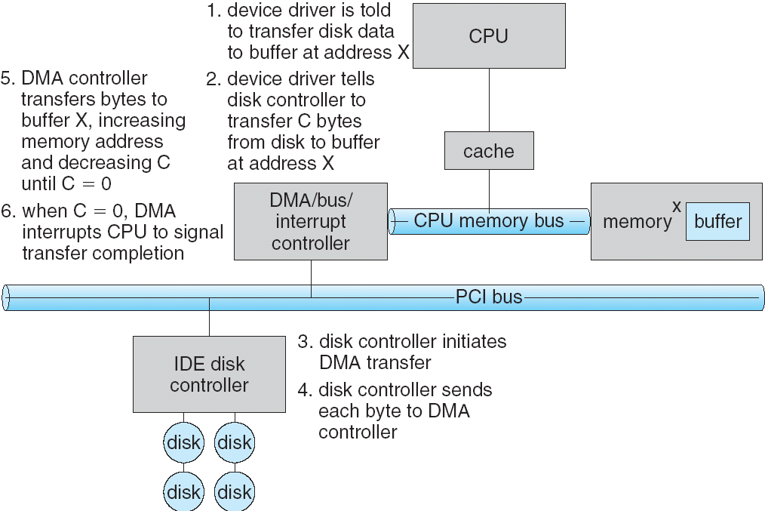
Transferring Data To/From Controller
Programmed I/O:
Each byte transferred via processor in/out or load/store
Pro: Simple hardware, easy to program
Con: Consumes processor cycles proportional to data size
Direct Memory Access:
Give controller access to memory bus
Ask it to transfer data blocks to/from memory directly
Sample interaction with DMA controller (from OSC):
addr
len

Slide 33
I/O Device Notifying the OS
The OS needs to know when:
The I/O device has completed an operation
The I/O operation has encountered an error
I/O Interrupt:
Device generates an interrupt whenever it needs service
Pro: handles unpredictable events well
Con: interrupts relatively high overhead
Polling:
OS periodically checks a device-specific status register
I/O device puts completion information in status register
Pro: low overhead
Con: may waste many cycles on polling if infrequent or unpredictable I/O operations
Actual devices combine both polling and interrupts
For instance – High-bandwidth network adapter:
Interrupt for first incoming packet
Poll for following packets until hardware queues are empty
Notes:
After the OS has issued a command to the I/O device either via a special I/O instruction or by writing to a location in the I/O address space, the OS needs to be notified when:
(a) The I/O device has completed the operation.
(b) Or when the I/O device has encountered an error.
This can be accomplished in two different ways: Polling and I/O interrupt.
+1 = 58 min. (Y:38)

Slide 34
What is the Role of I/O?
Without I/O, computers are useless (disembodied brains?)
But… thousands of devices, each slightly different
How can we standardize the interfaces to these devices?
Devices unreliable: media failures and transmission errors
How can we make them reliable???
Devices unpredictable and/or slow
How can we manage them if we don’t know what they will do or how they will perform?

Slide 35
If time – take apart a new machine

Slide 36
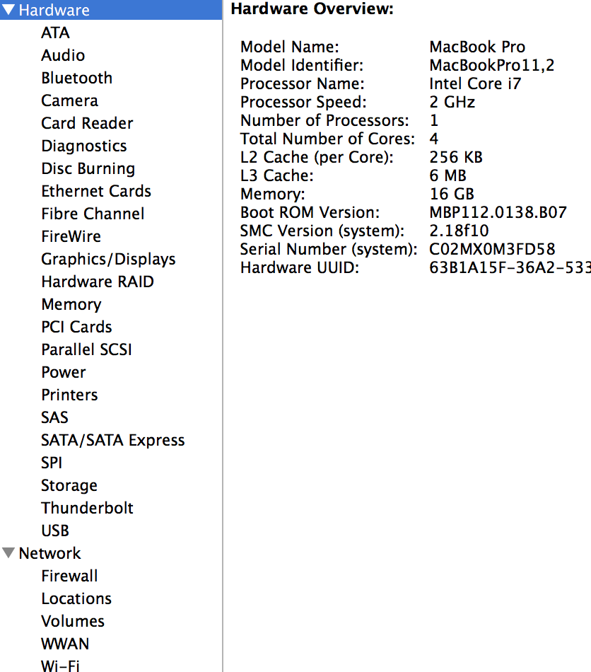
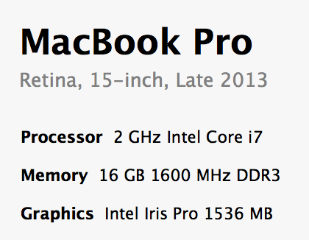
My New MacPro

Slide 37
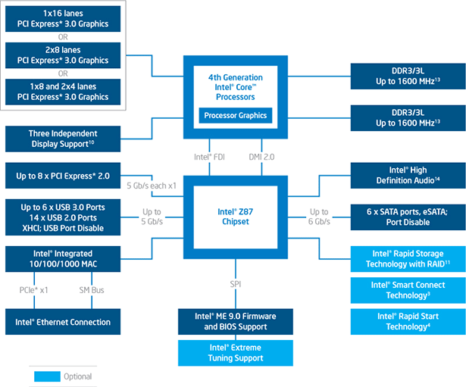
Intel i7 Core …

Slide 38
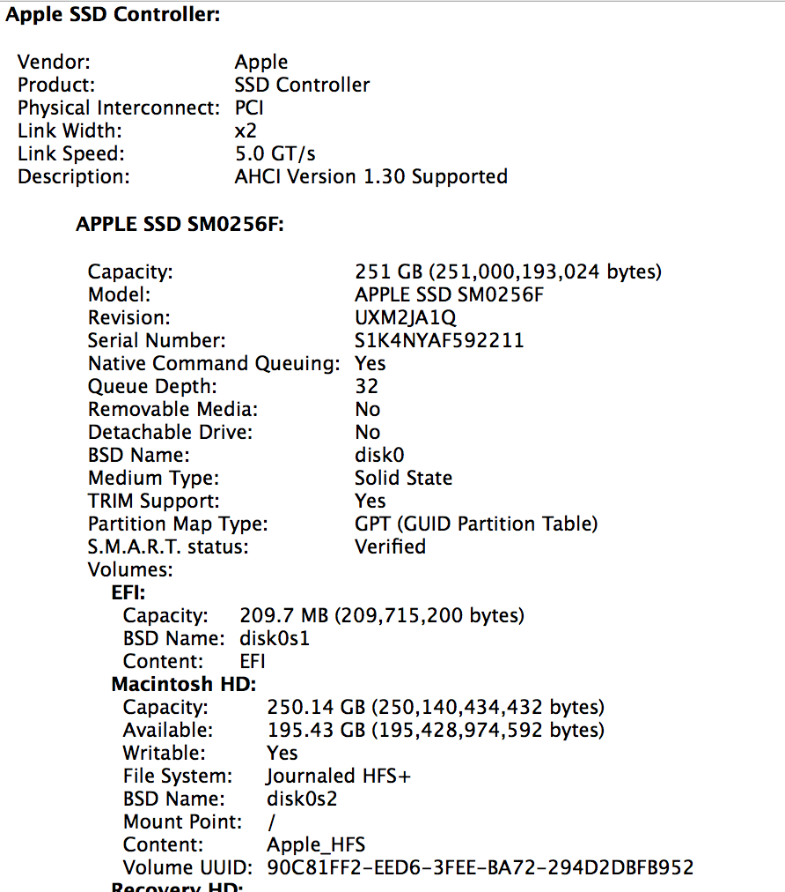
My Disk

Slide 39
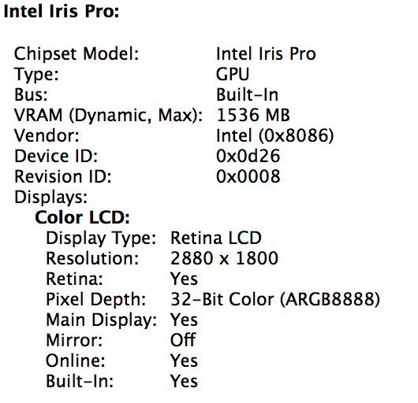
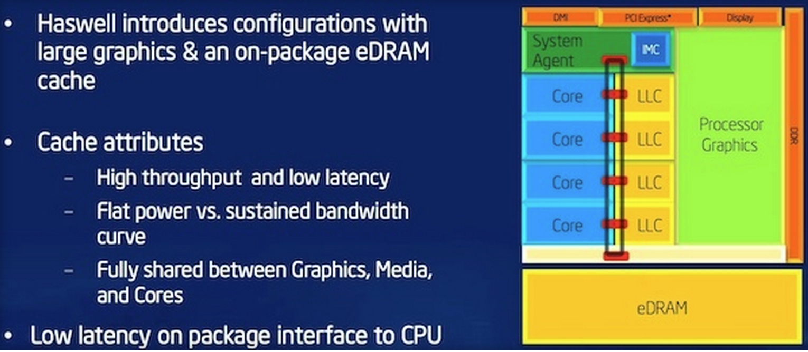
My Graphics

