Slide 1
I/O – where OS meet the real world
David E. Culler
CS162 – Operating Systems and Systems Programming
Lecture 21
October 17, 2014
Reading: A&D 11.3, 12
HW 4 out
Proj 2 out

Slide 2
What is the Role of I/O?
Without I/O, computers are useless (disembodied brains?)
But… thousands of devices, each slightly different
How can we standardize the interfaces to these devices?
Devices unpredictable and/or slow
How can we manage them if we don’t know what they will do or how they will perform?
Devices unreliable: media failures and transmission errors
How can we make them reliable???

Slide 3
Objectives
Understand concept of I/O driver
OS module that interfaces to particular device and provides a consistent I/O interface
Still quite low level compared to user API
Understand Basic Classes of Devices / Drivers
Build a simple performance model to guide thinking
Understand storage devices below the file system

Slide 4
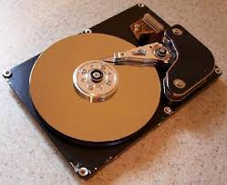
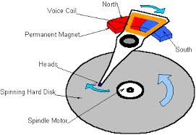
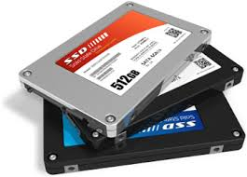


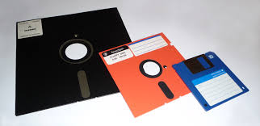
Recall: I/O & Storage Layers
Operations, Entities and Interface
Application / Service
streams
fopen, fread, fgets, …, fprintf, … on FILE *
High Level I/O
format, buffer streams, call low I/O
Low Level I/O
handles
open, read, write, close on ints & void *
Syscall
registers
File System
descriptors
I/O Driver
Commands and Data Transfers
Disks, Flash, Controllers, DMA

Slide 5

I/O & Storage Layers
Operations, Entities and Interface
Application / Service
streams
High Level I/O
open, read, write, close on ints & void *
Low Level I/O
handles
Move args to regs, issue syscalls
registers
EAX, EBX, … ESP
Syscall
File System
descriptors
pintos/src/lib/user/syscall.c
I/O Driver
Commands and Data Transfers
Disks, Flash, Controllers, DMA

Slide 6
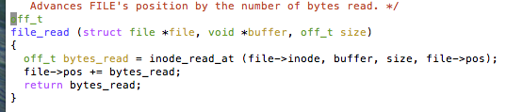
I/O & Storage Layers
Operations, Entities and Interface
Application / Service
streams
High Level I/O
Low Level I/O
handles
EAX, EBX, … ESP
Proj 2
Syscall
registers
Regs => Args, Dispatch call to Handler
file_open, file_read, … on struct file * & void *
File System
descriptors
pintos/src/filesys/file.c
I/O Driver
Commands and Data Transfers
Disks, Flash, Controllers, DMA

Slide 7
I/O & Storage Layers
Operations, Entities and Interface
Application / Service
streams
High Level I/O
Low Level I/O
handles
Syscall
registers
file_open, file_read, … on struct file * & void *
File System
descriptors
Next Week
I/O Driver
Commands and Data Transfers
Disks, Flash, Controllers, DMA

Slide 8
I/O & Storage Layers – Today
Application / Service
Operations and Interface
streams
High Level I/O
fopen, fread, fgets, …, fwrite, fclose on FILE *
Low Level I/O
handles
open, read, write, close on int & char *
Syscall
registers
EAX, EBX, … ESP
File System
descriptors
I/O Driver
Commands and Data Transfers
ld, st PIO ctrl regs, dma
Disks, Flash, Controllers, DMA

Slide 9
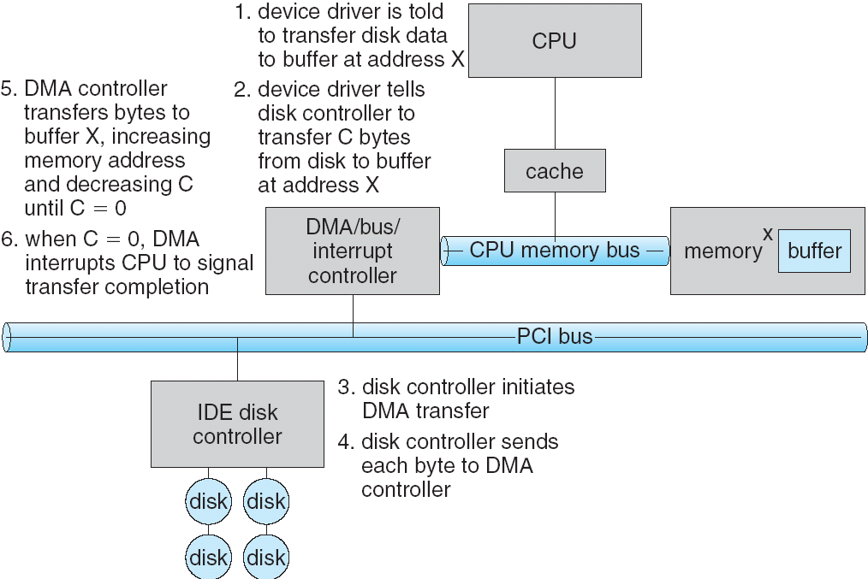
Transferring Data To/From Controller
Programmed I/O:
Each byte transferred via processor in/out or load/store
Pro: Simple hardware, easy to program
Con: Consumes processor cycles proportional to data size
Direct Memory Access:
Give controller access to memory bus
Ask it to transfer data blocks to/from memory directly
Sample interaction with DMA controller (from OSC):
addr
len

Slide 10
I/O Device Notifying the OS
The OS needs to know when:
The I/O device has completed an operation
The I/O operation has encountered an error
I/O Interrupt:
Device generates an interrupt whenever it needs service
Pro: handles unpredictable events well
Con: interrupts relatively high overhead
Polling:
OS periodically checks a device-specific status register
I/O device puts completion information in status register
Pro: low overhead
Con: may waste many cycles on polling if infrequent or unpredictable I/O operations
Actual devices combine both polling and interrupts
For instance – High-bandwidth network adapter:
Interrupt for first incoming packet
Poll for following packets until hardware queues are empty
Notes:
After the OS has issued a command to the I/O device either via a special I/O instruction or by writing to a location in the I/O address space, the OS needs to be notified when:
(a) The I/O device has completed the operation.
(b) Or when the I/O device has encountered an error.
This can be accomplished in two different ways: Polling and I/O interrupt.
+1 = 58 min. (Y:38)

Slide 11
Operational Parameters for I/O
Data granularity: Byte vs. Block
Some devices provide single byte at a time (e.g., keyboard)
Others provide whole blocks (e.g., disks, networks, etc.)
Access pattern: Sequential vs. Random
Some devices must be accessed sequentially (e.g., tape)
Others can be accessed “randomly” (e.g., disk, cd, etc.)
Fixed overhead to start sequential transfer (more later)
Transfer Notification: Polling vs. Interrupts
Some devices require continual monitoring
Others generate interrupts when they need service
Transfer Mechanism: Programmed IO and DMA

Slide 12
The Goal of the I/O Subsystem
Provide uniform interfaces, despite wide range of different devices
This code works on many different devices:
FILE *fd = fopen(“/dev/something”,“rw”); for (int i = 0; i < 10; i++) { fprintf(fd, “Count %d\n”,i); } close(fd);
Why?
Because code that controls devices (“device driver”) implements standard interface
Standard user library raise the standard driver / subsystem interface
We will try to get a flavor for what is involved in actually controlling devices
Can only scratch surface!

Slide 13
Want Standard Interfaces to Devices
Block Devices: e.g., disk drives, tape drives, DVD-ROM
Access blocks of data
Driver Commands include open(), read(), write(), seek()
Raw I/O or file-system access
Memory-mapped file access possible (discussed later … VAS!)
Character/Byte Devices: e.g., keyboards, mice, serial ports, some USB devices
Single characters at a time
Commands include get(), put()
Libraries layered on top allow line editing
Network Devices: e.g., Ethernet, Wireless, Bluetooth
Different enough from block/character to have own interface
Unix and Windows include socket interface
Separates network protocol from network operation
Includes select() functionality

Slide 14
I/O & Storage Layers
Operations, Entities and Interface
Application / Service
streams
High Level I/O
Low Level I/O
handles
Syscall
registers
file_open, file_read, … on struct file * & void *
File System
descriptors
open, read, … on ??? (blocks, chars, nets)
I/O Driver
Commands and Data Transfers
Disks, Flash, Controllers, DMA

Slide 15
Basic Performance Concepts
Response Time or Latency: Time to perform an operation (s)
Bandwidth or Throughput: Rate at which operations are performed (op/s)
Files: mB/s, Networks: mb/s, Arithmetic: GFLOP/s
Start up or “Overhead”: time to initiate an operation
Most I/O operations are roughly linear
Latency (n) = Ovhd + n/Bandwdth

Slide 16
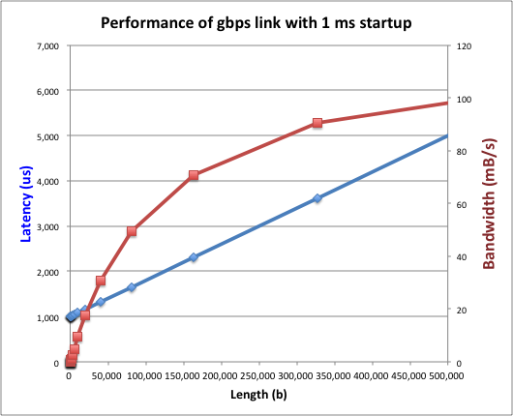
Example (fast network)
Consider a gpbs link (125 mB/s)
With a startup cost S = 1 ms
Theorem: half-power point occurs at n=S*B
- When transfer time = startup
T(S*B) = S + S*B/B

Slide 17
Example: at 10 ms startup (disk)

Slide 18
What determines peak BW for I/O ?
Bus Speed
PCI-X: 1064 MB/s = 133 MHz x 64 bit (per lane)
ULTRA WIDE SCSI: 40 MB/s
Serial Attached SCSI & Serial ATA & IEEE 1394 (firewire) : 1.6 Gbps full duplex (200 MB/s)
USB 1.5 – 12 mb/s
Device Transfer Bandwidth
Rotational speed of disk
Write / Read rate of nand flash
Signaling rate of network link
Whatever is the bottleneck in the path

Slide 19
Storage Devices
Magnetic disks
Storage that rarely becomes corrupted
Large capacity at low cost
Block level random access
Slow performance for random access
Better performance for streaming access
Flash memory
Storage that rarely becomes corrupted
Capacity at intermediate cost (50x disk ???)
Block level random access
Good performance for reads; worse for random writes
Erasure requirement in large blocks
Wear patterns

Slide 20
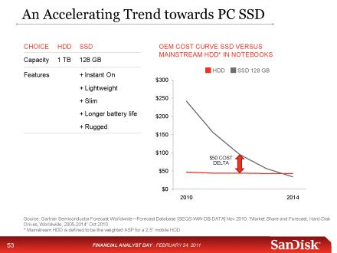
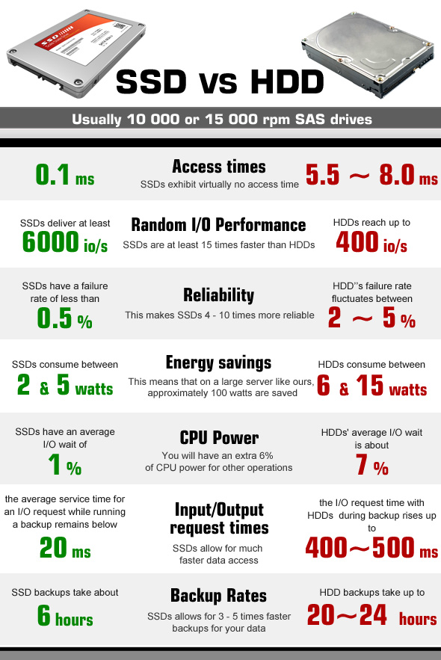
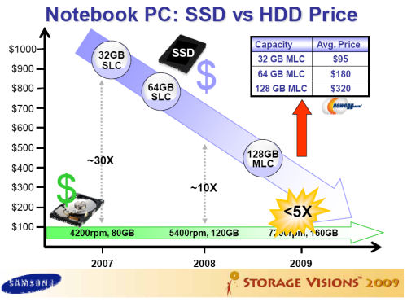
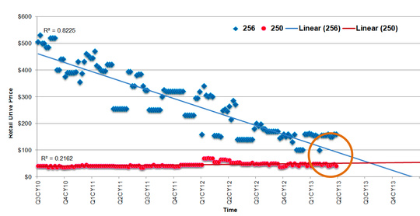
Are we in an inflection point?

Slide 21
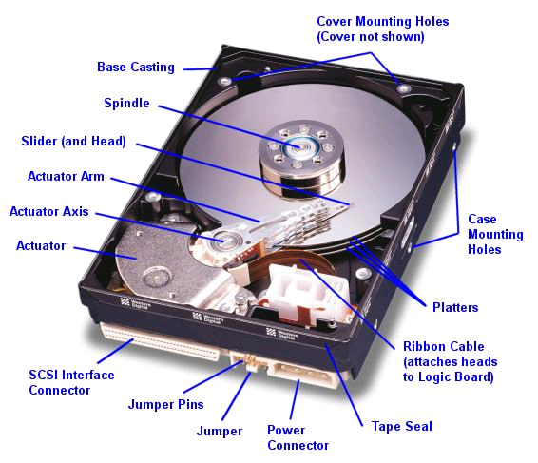
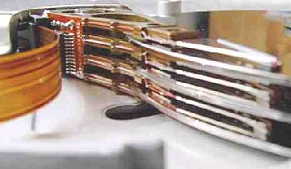
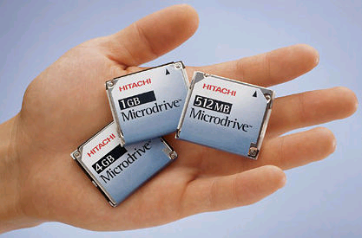
Hard Disk Drives (HDDs)
Read/Write Head
Side View
Western Digital Drive
http://www.storagereview.com/guide/
IBM Personal Computer/AT (1986)
30 MB hard disk - $500
30-40ms seek time
0.7-1 MB/s (est.)
IBM/Hitachi Microdrive
Notes:
Winchester disk drives developed by IBM: 1973 first drive
Uses “sealed” assembly with heads floating on air bearings – Bernoulli effect

Slide 22
The Amazing Magnetic Disk
Unit of Transfer: Sector
Ring of sectors form a track
Stack of tracks form a cylinder
Heads position on cylinders
Disk Tracks ~ 1 micron wide
Wavelength of light is ~ 0.5 micron
Resolution of human eye: 50 microns
100K on a typical 2.5” disk
Separated by unused guard regions
Reduces likelihood neighboring tracks are corrupted during writes (still a small non-zero chance)
Track length varies across disk
Outside: More sectors per track, higher bandwidth
Disk is organized into regions of tracks with same # of sectors/track
Only outer half of radius is used
Most of the disk area in the outer regions of the disk

Slide 23
Magnetic Disk Characteristic
Sector
Track
Cylinder: all the tracks under the head at a given point on all surfaces
Read/write: three-stage process:
Seek time: position the head/arm over the proper track (into proper cylinder)
Rotational latency: wait for the desired sector to rotate under the read/write head
Transfer time: transfer a block of bits (sector) under the read-write head
Disk Latency = Queuing Time + Controller time + Seek Time + Rotation Time + Xfer Time
Highest Bandwidth:
Transfer large group of blocks sequentially from one track
Head
Cylinder
Platter
Software
Queue
(Device Driver)
Hardware
Controller
Media Time
(Seek+Rot+Xfer)
Request
Result
Notes:
To read write information into a sector, a movable arm containing a read/write head is located over each surface.
The term cylinder is used to refer to all the tracks under the read/write head at a given point on all surfaces.
To access data, the operating system must direct the disk through a 3-stage process.
(a) The first step is to position the arm over the proper track. This is the seek operation and the time to complete this operation is called the seek time.
(b) Once the head has reached the correct track, we must wait for the desired sector to rotate under the read/write head. This is referred to as the rotational latency.
(c) Finally, once the desired sector is under the read/write head, the data transfer can begin.
The average seek time as reported by the manufacturer is in the range of 12 ms to 20ms and is calculated as the sum of the time for all possible seeks divided by the number of possible seeks.
This number is usually on the pessimistic side because due to locality of disk reference, the actual average seek time may only be 25 to 33% of the number published.
+2 = 34 min. (Y:14)

Slide 24
Typical Numbers for Magnetic Disk
Parameter | Info / Range
Average seek time | Typically 5-10 milliseconds. Depending on reference locality, actual cost may be 25-33% of this number.
Average rotational latency | Most laptop/desktop disks rotate at 3600-7200 RPM (16-8 ms/rotation). Server disks up to 15,000 RPM. Average latency is halfway around disk yielding corresponding times of 8-4 milliseconds
Controller time | Depends on controller hardware
Transfer time | Typically 50 to 100 MB/s. Depends on: Transfer size (usually a sector): 512B – 1KB per sector Rotation speed: 3600 RPM to 15000 RPM Recording density: bits per inch on a track Diameter: ranges from 1 in to 5.25 in
Cost | Drops by a factor of two every 1.5 years (or even faster). $0.03-0.07/GB in 2013
Notes:
As far as rotational latency is concerned, most disks rotate at 3,600 RPM or approximately 16 ms per revolution.
Since on average, the information you desired is half way around the disk, the average rotational latency will be 8ms.
The transfer time is a function of transfer size, rotation speed, and recording density.
The typical transfer speed is 2 to 4 MB per second.
Notice that the transfer time is much faster than the rotational latency and seek time.
This is similar to the DRAM situation where the DRAM access time is much shorter than the DRAM cycle time.
***** Do anybody remember what we did to take advantage of the short access time versus cycle time? Well, we interleave!
New International Disk Drive, Equipment, and Materials Association standard is 4KB sectors instead of 512 byte sectors
+2 = 36 min. (Y:16)

Slide 25
Intelligence in the controller
Sectors contain sophisticated error correcting codes
Disk head magnet has a field wider than track
Hide corruptions due to neighboring track writes
Sector sparing
Remap bad sectors transparently to spare sectors on the same surface
Slip sparing
Remap all sectors (when there is a bad sector) to preserve sequential behavior
Track skewing
Sector numbers offset from one track to the next, to allow for disk head movement for sequential ops
…

Slide 26
Question
How long to complete 500 random disk reads, in FIFO order?

Slide 27
Question
How long to complete 500 random disk reads, in FIFO order?
Seek: average 10.5 msec
Rotation: average 4.15 msec
Transfer: 5-10 usec
500 * (10.5 + 4.15 + 0.01)/1000 = 7.3 seconds

Slide 28
Question
How long to complete 500 sequential disk reads?

Slide 29
Question
How long to complete 500 sequential disk reads?
Seek Time: 10.5 ms (to reach first sector)
Rotation Time: 4.15 ms (to reach first sector)
Transfer Time: (outer track)
500 sectors * 512 bytes / 128MB/sec = 2ms
Total: 10.5 + 4.15 + 2 = 16.7 ms
Might need an extra head or track switch (+1ms)
Track buffer may allow some sectors to be read off disk out of order (-2ms)

Slide 30
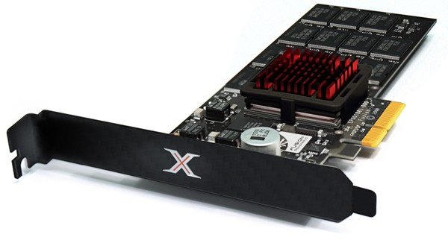
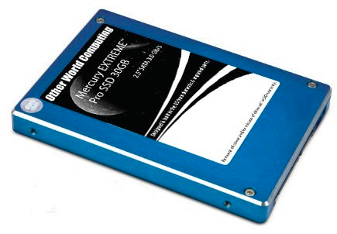
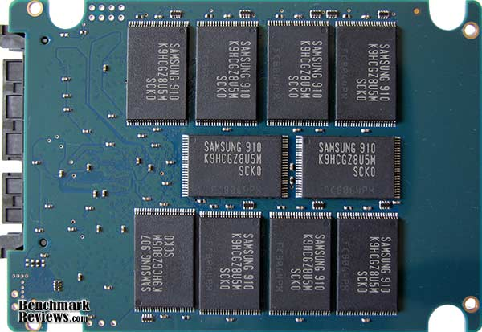
Solid State Disks (SSDs)
1995 – Replace rotating magnetic media with non-volatile memory (battery backed DRAM)
2009 – Use NAND Multi-Level Cell (2-bit/cell) flash memory
Sector (4 KB page) addressable, but stores 4-64 “pages” per memory block
No moving parts (no rotate/seek motors)
Eliminates seek and rotational delay (0.1-0.2ms access time)
Very low power and lightweight
Limited “write cycles”
Rapid advance in capacity and cost since

Slide 31
SSD Architecture – Reads
NAND
NAND
NAND
NAND
NAND
NAND
NAND
NAND
Host
Buffer
Manager
(software
Queue)
Flash
Memory
Controller
NAND
NAND
NAND
NAND
SATA
NAND
NAND
NAND
NAND
NAND
NAND
NAND
NAND
DRAM
NAND
NAND
NAND
NAND
NAND
NAND
Read 4 KB Page: ~25 usec
No seek or rotational latency
Transfer time: transfer a 4KB page
SATA: 300-600MB/s => ~4 x10³ b / 400 x 10⁶ bps => 10 us
Latency = Queuing Time + Controller time + Xfer Time
Highest Bandwidth: Sequential OR Random reads
NAND
NAND
NAND
NAND
NAND
NAND

Slide 32
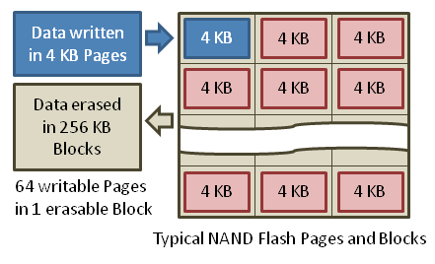
SSD Architecture – Writes (I)
Writing data is complex! (~200μs – 1.7ms )
Can only write empty pages in a block
Erasing a block takes ~1.5ms
Controller maintains pool of empty blocks by coalescing used pages (read, erase, write), also reserves some % of capacity
Rule of thumb: writes 10x reads, erasure 10x writes
https://en.wikipedia.org/wiki/Solid-state_drive

Slide 33
Storage Performance & Price (jan 13)
 | Bandwidth (Sequential R/W) | Cost/GB | Size
HDD² | 50-100 MB/s | $0.03-0.07/GB | 2-4 TB
SSD^{1,2} | 200-550 MB/s (SATA) 6 GB/s (read PCI) 4.4 GB/s (write PCI) | $0.87-1.13/GB | 200GB-1TB
DRAM² | 10-16 GB/s | $4-14*/GB *SK Hynix 9/4/13 fire | 64GB-256GB
¹http://www.fastestssd.com/featured/ssd-rankings-the-fastest-solid-state-drives/
²http://www.extremetech.com/computing/164677-storage-pricewatch-hard-drive-and-ssd-prices-drop-making-for-a-good-time-to-buy
BW: SSD up to x10 than HDD, DRAM > x10 than SSD
Price: HDD x20 less than SSD, SSD x5 less than DRAM

Slide 34
SSD Summary
Pros (vs. hard disk drives):
Low latency, high throughput (eliminate seek/rotational delay)
No moving parts:
Very light weight, low power, silent, very shock insensitive
Read at memory speeds (limited by controller and I/O bus)
Cons
Small storage (0.1-0.5x disk), expensive (20x disk ???)
Hybrid alternative: combine small SSD with large HDD
Asymmetric block write performance: read pg/erase/write pg
Controller garbage collection (GC) algorithms have major effect on performance
Limited drive lifetime
1-10K writes/page for MLC NAND
Avg failure rate is 6 years, life expectancy is 9–11 years
These are changing rapidly

Slide 35
What goes into startup cost for I/O?
Syscall overhead
Operating system processing
Controller Overhead
Device Startup
Mechanical latency for a disk
Media Access + Speed of light + Routing for network
Queuing (next week)

Slide 36
Summary
Drivers interface to I/O devices
Provide clean Read/Write interface to OS above
Manipulate devices through PIO, DMA & interrupt handling
2 types: block, character, and network
Devices have complex protocols for interaction and performance characteristics
Response time (Latency) = Queue + Overhead + Transfer
Effective BW = BW * T/(S+T)
HDD: controller + seek + rotation + transfer
SDD: controller + transfer (erasure & wear)
Bursts & High Utilization introduce queuing delays
Systems (e.g., file system) designed to optimize performance and reliability
Relative to performance characteristics of underlying device

