Slide 1
IO Performance Oriented Drivers
David E. Culler
CS162 – Operating Systems and Systems Programming
Lecture 22
October 20, 2014
Reading: A&D 7.5, 12.1c
HW 4 out
Proj 2 out

Slide 2
I/O Performance
300
Response
Time (ms)
Controller
User
Thread
I/O
device
200
Queue
[OS Paths]
100
Response Time = Queue + I/O device service time
0
0%
100%
Performance of I/O subsystem
Metrics: Response Time, Throughput
Effective BW per op = transfer size / response time
EffBW(n) = n / (S + n/B) = B / (1 + SB/n )
Contributing factors to latency:
Software paths (can be loosely modeled by a queue)
Hardware controller
I/O device service time
Queuing behavior:
Can lead to big increases of latency as utilization increases
Solutions?
Throughput (Utilization)
(% total BW)

Slide 3
A Simple Deterministic World
arrivals
Queue
Server
departures
T _{Q}
T _{S}
T _{A}
T _{A}
T _{A}
Assume requests arrive at regular intervals, take a fixed time to process, with plenty of time between …
Service rate (μ = 1/T _{S}) - operations per sec
Arrival rate: (λ = 1/T _{A}) - requests per second
Utilization: U = λ/μ , where λ < μ
Average rate is the complete story

Slide 4
A Ideal Linear World
Saturation
1
1
Delivered Throughput
Delivered Throughput
Empty Queue
Unbounded
0
1
0
1
Offered Load (T_{A}/T_{S})
Offered Load (T_{A}/T_{S})
Queue delay
Queue delay
time
time
What does the queue wait time look like?
Grows unbounded at a rate ~ (T_{s}/T_{A}) till request rate subsides

Slide 5
A Bursty World
arrivals
Queue
Server
departures
T _{Q}
T _{S}
Arrivals
Q depth
Server
Requests arrive in a burst, must queue up till served
Same average arrival time, but almost all of the requests experience large queue delays
Even though average utilization is low

Slide 6
So how do we model the burstiness?
Elegant mathematical framework if you start with exponential distribution
Probability density function of a continuous random variable with a mean of 1/λ
f(x) = λe^{-λx}
“Memoryless”
Likelihood of an event occuring is independent of how long we’ve been waiting
mean arrival interval (1/λ)
Lots of short arrival intervals (i.e., high instantaneous rate)
Few long gaps (i.e., low instantaneous rate)
x (λ)

Slide 7



How Long should we expect to wait?
RespTime = ServTime * 1/(1-U)
Better if gaussian (spread around the mean)
Variance in R = S/(1-U)²
Response Time vs. Utilization

Slide 8
Little’s Law
N
arrivals
departures
B
L
In any stable system
Average arrival rate = Average departure rate
the average number of tasks in the system (N) is equal to the throughput (B) times the response time (L)
N (ops) = B (ops/s) x L (s)
Regardless of structure, bursts of requests, variation in service
instantaneous variations, but it washes out in the average
Overall requests match departures

Slide 9
I/O Performance
Controller
300
Response
Time (ms)
User
Thread
I/O
device
200
Queue
[OS Paths]
100
Response Time = Queue + I/O device service time
Solutions?
Make everything faster ☺
More Decoupled (Parallelism) systems
multiple independent buses or controllers
Optimize the bottleneck to increase service rate
Use the queue to optimize the service
Do other useful work while waiting
Queues absorb bursts and smooth the flow
Admissions control (finite queues)
Limits delays, but may introduce unfairness and livelock
0
0%
100%
Throughput (Utilization)
(% total BW)

Slide 10
Ex: Disk Scheduling to Minimize Seek

Slide 11
Disk Performance Examples
Assumptions:
Ignoring queuing and controller times for now
Avg seek time of 5ms,
7200RPM ⇒ Time for one rotation: 60000ms/7200 ~= 8ms
Transfer rate of 4MByte/s, sector size of 1 KByte
Read sector from random place on disk:
Seek (5ms) + Rot. Delay (4ms) + Transfer (0.25ms)
Approx 10ms to fetch/put data: 100 KByte/sec
Read sector from random place in same cylinder:
Rot. Delay (4ms) + Transfer (0.25ms)
Approx 5ms to fetch/put data: 200 KByte/sec
Read next sector on same track:
Transfer (0.25ms): 4 MByte/sec
Key to using disk effectively (especially for file systems) is to minimize seek and rotational delays

Slide 12
Disk Scheduling
Disk can do only one request at a time; What order do you choose to do queued requests?
Request denoted by (track, sector)
Scheduling algorithms:
First In First Out (FIFO)
Shortest Seek Time First
SCAN
C-SCAN
In our examples we ignore the sector
Consider only track #
User
Requests
2,2
5,2
7,2
3,10
2,1
2,3
Head
3
Disk Head
2
1
4

Slide 13
FIFO: First In First Out
Schedule requests in the order they arrive in the queue
Example:
Request queue: 2, 1, 3, 6, 2, 5
Scheduling order: 2, 1, 3, 6, 2, 5
16 tracks, 6 seeks
Pros: Fair among requesters
Cons: Order of arrival may be to random spots on the disk ⇒ Very long seeks
6
Disk Head
5
4
3
2
1

Slide 14
SSTF: Shortest Seek Time First
Pick the request that’s closest to the head on the disk
Although called SSTF, include rotational delay in calculation, as rotation can be as long as seek
Example:
Request queue: 2, 1, 3, 6, 2, 5
Scheduling order: 5, 6, 3, 2, 2, 1
6 tracks, 4 seeks
Pros: reduce seeks
Cons: may lead to starvation
Greedy. Not optimal
6
Disk Head
5
4
3
2
1

Slide 15
SCAN
6
Implements an Elevator Algorithm: take the closest request in the direction of travel
Example:
Request queue: 2, 1, 3, 6, 2, 5
Head is moving towards center
Scheduling order: 5, 3, 2, 2, 1, 6
8 tracks, 4 seeks
Pros:
No starvation
Low seek
Cons: favors middle tracks
May spend time on sparse tracks while dense requests elsewhere
Disk Head
5
4
3
2
1

Slide 16
C-SCAN
Like SCAN but only serves request in only one direction
Example:
Request queue: 2, 1, 3, 6, 2, 5
Head only serves request on its way from center towards edge
Scheduling order: 5, 6, 1, 2, 2, 3
8 tracks, 5 seeks
Pros:
Fairer than SCAN
Accumulate work in remote region then go get it
Cons: longer seeks on the way back
Optimization: dither to pickup nearby requests as you go
6
Disk Head
5
4
3
2
1

Slide 17
When is the disk performance highest
When there are big sequential reads, or
When there is so much work to do that they can be piggy backed (c-scan)
OK, to be inefficient when things are mostly idle
Bursts are both a threat and an opportunity
<your idea for optimization goes here>
Waste space for speed?

Slide 18

Ex: Concurrency to break the bottleneck
Busses provide a way of connecting many (N) different things with a single set of wires and standard connections and protocols
N² relationships with 1 set of wires (!!!)
But only one transaction can go on at a time
The rest have to wait
Queue up at “bus arbitration”

Slide 19
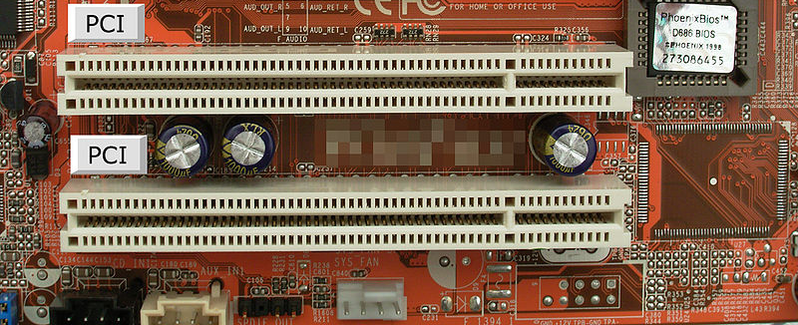
PCI Bus evolution
PCI started life out as a bus
32 physical bits double for address/data
But a parallel bus has many limitations
Multiplexing address/data for many requests
Slowest device must be able to tell what’s happening
➔ Bus speed is set to that of the slowest device

Slide 20
PCI Express “Bus”
No longer a parallel bus
Really a collection of fast serial channels or “lanes”
Devices can use as many as they need to achieve a desired bandwidth
Slow devices don’t have to share with fast ones
Both motherboard slots and daughter cards are sized for the number of lanes, x4, x8, or x16
Speeds (in an x16 configuration):
v1.x: 4 GB/s (40 GT/s)
v2.x: 8 GB/s (80 GT/s)
v3.0: 15.75 GB/s (128 GT/s)
v4.0: 31.51 GB/s (256 GT/s)
3.0+ Speeds are competitive with block memory-to-memory operations on the CPU

Slide 21
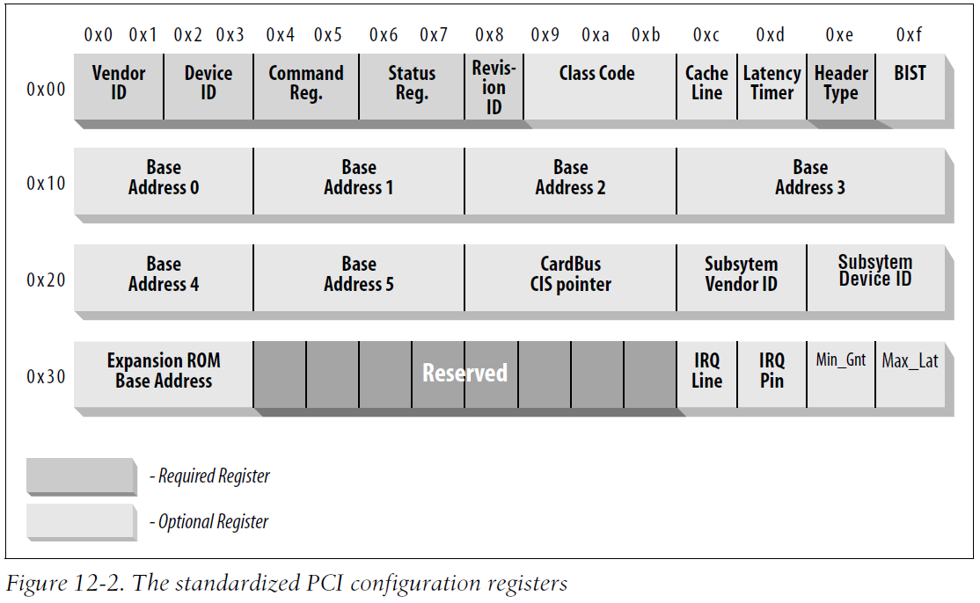
PCI Express Interface (Linux)
One of the successes of device abstraction in Linux was the ability to migrate from PCI to PCI-Express
Although the physical interconnect changed completely, the old API still worked
Drivers written for older PCI devices still worked, because of the standardized API for both models of the interface
PCI register map:
Figure from “Linux Device Drivers,” 3rd Ed, Jonathan Corbet, Alessandro Rubini, Greg Kroah-Hartman
Notes:
Up to size address regions, 4 GB addressable I/O memory

Slide 22
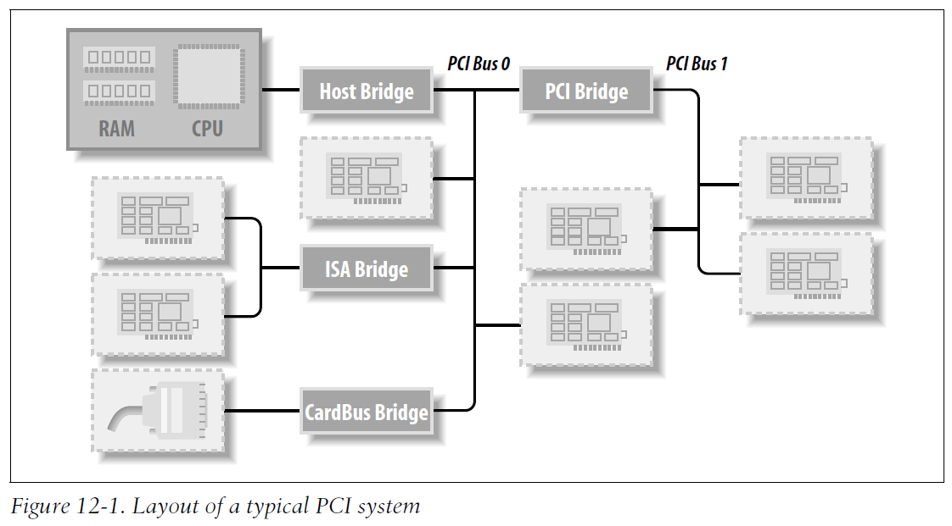
PCI Express Bus
In practice PCI is used as the interface to many other interconnects on a PC:
Figure from “Linux Device Drivers,” 3rd Ed, Jonathan Corbet, Alessandro Rubini, Greg Kroah-Hartman

Slide 23
OS Solutions
Reduce the impact of I/O delays by doing other useful work in the meantime.
Reduce overhead through user level drivers

Slide 24
How do we hide I/O latency?
Blocking Interface: “Wait”
When request data (e.g., read() system call), put process to sleep until data is ready
When write data (e.g., write() system call), put process to sleep until device is ready for data
Non-blocking Interface: “Don’t Wait”
Returns quickly from read or write request with count of bytes successfully transferred to kernel
Read may return nothing, write may write nothing
Asynchronous Interface: “Tell Me Later”
When requesting data, take pointer to user’s buffer, return immediately; later kernel fills buffer and notifies user
When sending data, take pointer to user’s buffer, return immediately; later kernel takes data and notifies user

Slide 25
Kernel vs User-level I/O
Both are popular/practical for different reasons:
Kernel-level drivers for critical devices that must keep running, e.g. display drivers.
Programming is a major effort, correct operation of the rest of the kernel depends on correct driver operation.
User-level drivers for devices that are non-threatening, e.g USB devices in Linux (libusb).
Provide higher-level primitives to the programmer, avoid every driver doing low-level I/O register tweaking.
The multitude of USB devices can be supported by Less-Than-Wizard programmers.
New drivers don’t have to be compiled for each version of the OS, and loaded into the kernel.

Slide 26
Kernel vs User-level Programming Styles
Kernel-level drivers
Have a much more limited set of resources available:
Only a fraction of libc routines typically available.
Memory allocation (e.g. Linux kmalloc) much more limited in capacity and required to be physically contiguous.
Should avoid blocking calls.
Can use asynchrony with other kernel functions but tricky with user code.
User-level drivers
Similar to other application programs but:
Will be called often – should do its work fast, or postpone it – or do it in the background.
Can use threads, blocking operations (usually much simpler) or non-blocking or asynchronous.

Slide 27
Summary
IO and data transfers often described by linear performance model and utilization model
T(n) = S + n/B
U = Service Rate / Request Rate
But for shared resources burstiness in request rate can introduce substantial delays
Subsystem design focuses on eliminating bottlenecks, e.g.,
disk scheduling to minimize seek and latency overhead
Multiple lanes to allow simultaneous transfers
Non-blocking requests (or threads) to overlap IO and compute
User level access to devices

