Slide 1
File System Design
David E. Culler
CS162 – Operating Systems and Systems Programming
Lecture 23
October 22, 2014
Reading: A&D 13.1-3a
HW 4 out
Proj 2 out

Slide 2

Big hairy thought-provoking question to help review recent topics
The One vs The All
Is improving response time (the One) in alignment or in opposition to improving throughput (the All) ?
E.g., C-SCAN ?
Delay servicing queue?

Slide 3
Performance: multiple outstanding requests
Queue
Server
Suppose each read takes 10 ms to service.
If a process works for 100 ms after each read, what is the utilization of the disk?
U = 10 ms / 110ms = 9%
What it there are two such processes?
U = (10 ms + 10 ms) / 110ms = 18%
What if each of those processes have two such threads?

Slide 4
How else do we hide I/O latency?
Blocking Interface: “Wait”
When request data (e.g., read() system call), put process to sleep until data is ready
When write data (e.g., write() system call), put process to sleep until device is ready for data
Non-blocking Interface: “Don’t Wait”
Returns quickly from read or write request with count of bytes successfully transferred to kernel
Read may return nothing, write may write nothing
Asynchronous Interface: “Tell Me Later”
When requesting data, take pointer to user’s buffer, return immediately; later kernel fills buffer and notifies user
When sending data, take pointer to user’s buffer, return immediately; later kernel takes data and notifies user

Slide 5
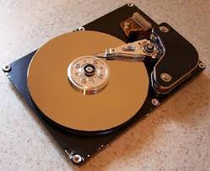
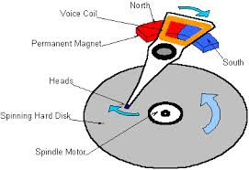
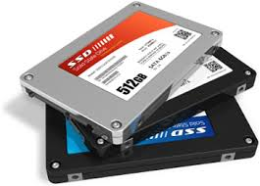

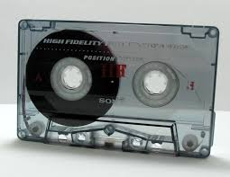
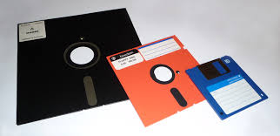
I/O & Storage Layers
Operations, Entities and Interface
Application / Service
streams
High Level I/O
Low Level I/O
handles
Syscall
registers
file_open, file_read, … on struct file * & void *
File System
descriptors
we are here …
I/O Driver
Commands and Data Transfers
Disks, Flash, Controllers, DMA

Slide 6
So you are going to design a file system …
What factors are critical to the design choices?

Slide 7
Recall: C Low level I/O
Operations on File Descriptors – as OS object representing the state of a file
User has a “handle” on the descriptor
#include <fcntl.h>
#include <unistd.h>
#include <sys/types.h>
int open (const char *filename, int flags [, mode_t mode])
int creat (const char *filename, mode_t mode)
int close (int filedes)
Bit vector of:
Access modes (Rd, Wr, …)
Open Flags (Create, …)
Operating modes (Appends, …)
Bit vector of Permission Bits:
User|Group|Other X R|W|X
http://www.gnu.org/software/libc/manual/html_node/Opening-and-Closing-Files.html

Slide 8
Recall: C Low Level Operations
ssize_t read (int filedes, void *buffer, size_t maxsize)
- returns bytes read, 0 => EOF, -1 => error
ssize_t write (int filedes, const void *buffer, size_t size)
- returns bytes written
off_t lseek (int filedes, off_t offset, int whence)
int fsync (int fildes) – wait for i/o to finish
void sync (void) – wait for ALL to finish
When write returns, data is on its way to disk and can be read, but it may not actually be permanent!

Slide 9
So you are going to design a file system …
What factors are critical to the design choices?
Durable data store => it’s all on disk
Disks Performance !!!
Maximize sequential access, minimize seeks
Open before Read/Write
Can perform protection checks and look up where the actual file resource are, in advance
Size is determined as they are used !!!
Can write (or read zeros) to expand the file
Start small and grow, need to make room
Organized into directories
What data structure (on disk) for that?
Need to allocate / free blocks
Such that access remains efficient

Slide 10
Components of a File System
File path
Directory
Structure
File Index
Structure
File number
Data blocks
…

Slide 11
Components of a file system
file name
offset
file number
offset
Storage block
directory
index structure
Open performs name resolution
Translates pathname into a “file number”
Used as an “index” to locate the blocks
Creates a file descriptor in PCB within kernel
Returns a “handle” (another int) to user process
Read, Write, Seek, and Sync operate on handle
Mapped to descriptor and to blocks

Slide 12
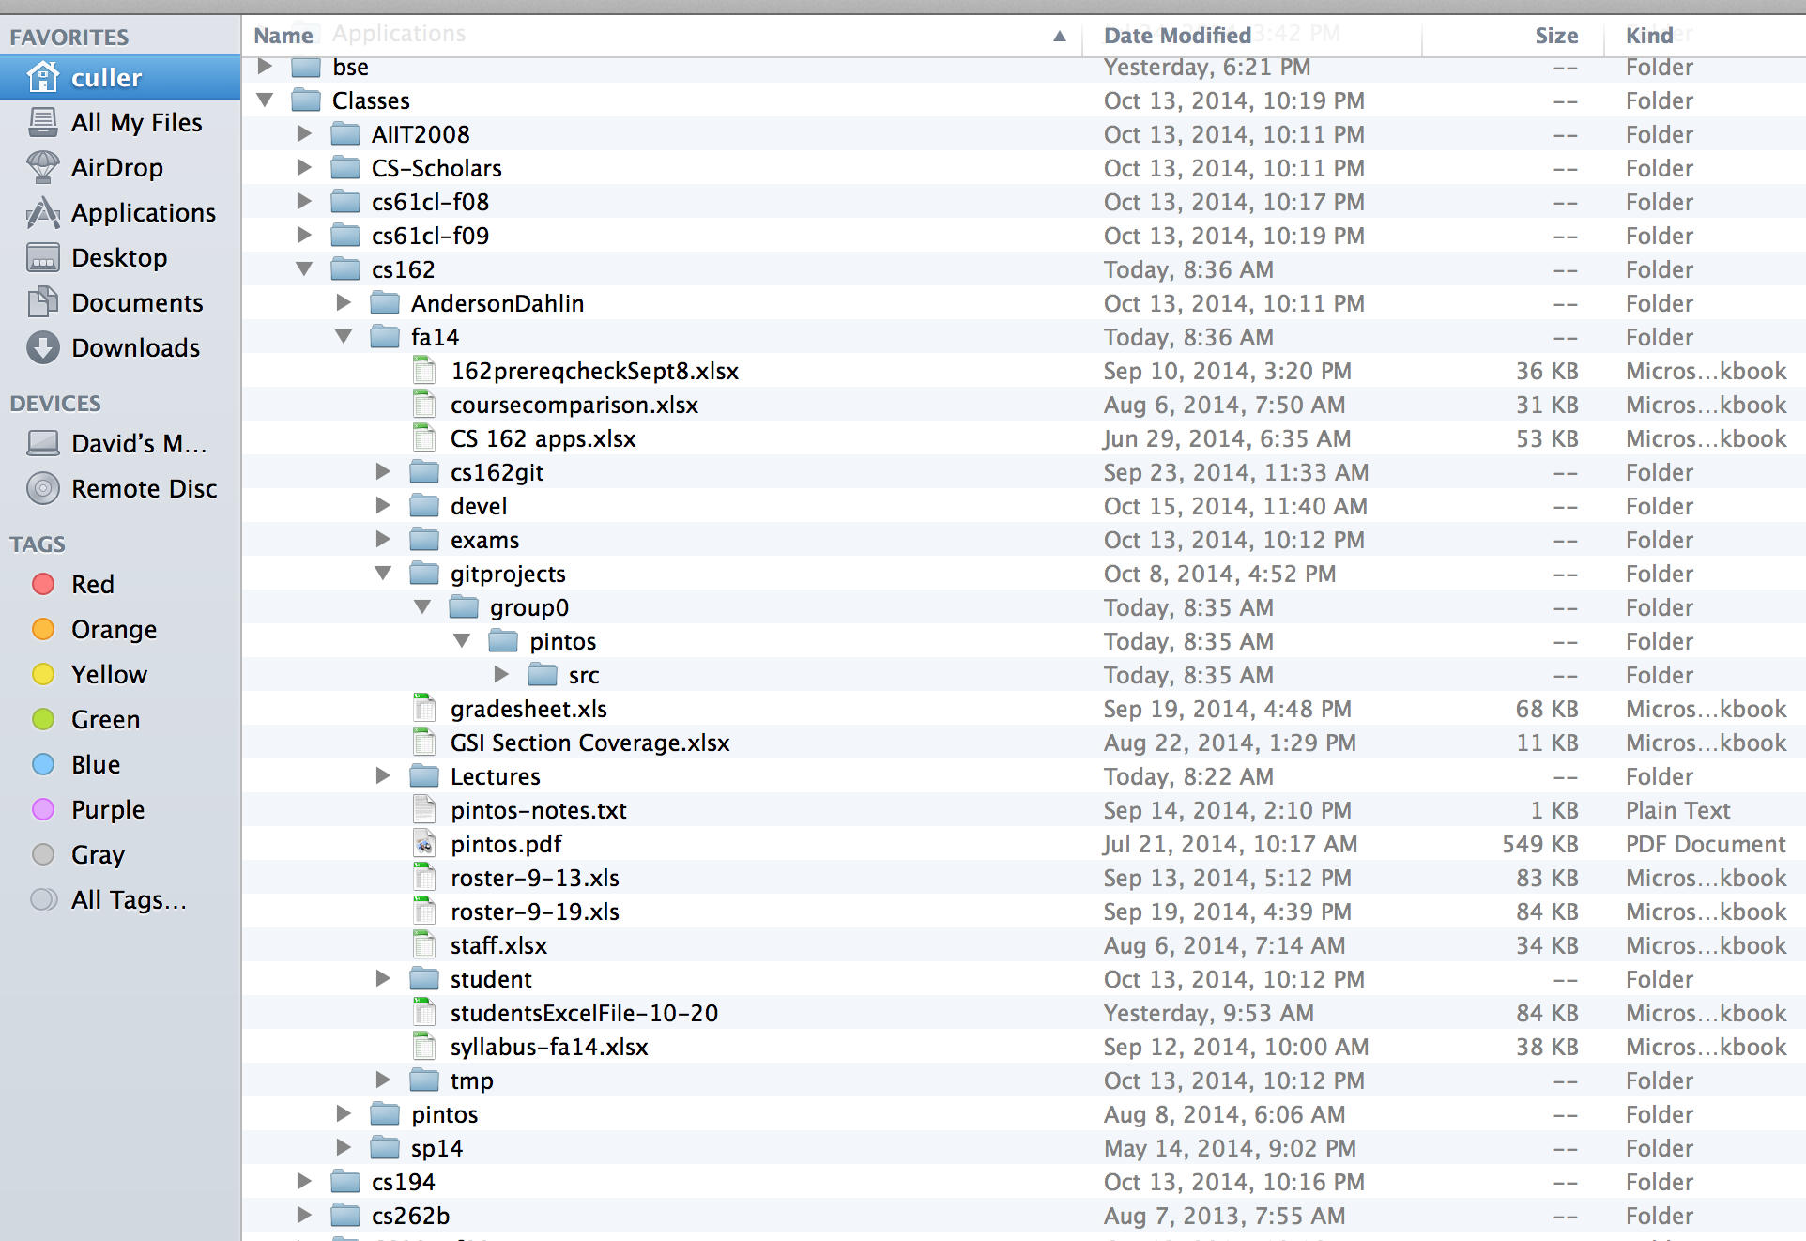
Directories

Slide 13
Directory
Basically a hierarchical structure
Each directory entry is a collection of
Files
Directories
A link to another entries
Each has a name and attributes
Files have data
Links (hard links) make it a DAG, not just a tree
Softlinks (aliases) are another name for an entry

Slide 14
I/O & Storage Layers
Application / Service
streams
High Level I/O
Low Level I/O
handles
#4 - handle
Syscall
registers
File System
descriptors
I/O Driver
Commands and Data Transfers
Data blocks
Disks, Flash, Controllers, DMA
…
Directory Structure

Slide 15
File
Named permanent storage
Contains
Data
Blocks on disk somewhere
Metadata (Attributes)
Owner, size, last opened, …
Access rights
R, W, X
Owner, Group, Other (in Unix systems)
Access control list in Windows system
Data blocks
File handle
…
File descriptor
Fileobject (inode)
Position

Slide 16
FAT (File Allocation Table)
Assume (for now) we have a way to translate a path to a “file number”
i.e., a directory structure
Disk Storage is a collection of Blocks
Just hold file data
Example: file_read 31, < 2, x >
Index into FAT with file number
Follow linked list to block
Read the block from disk into mem
FAT
Disk Blocks
file number
0:
0:
31:
File 31 , Block 0
File 31 , Block 1
File 31 , Block 2
N-1:
N-1:
mem

Slide 17
FAT (File Allocation Table)
File is collection of disk blocks
FAT is linked list 1-1 with blocks
File Number is index of root of block list for the file
File offset (o = B:x )
Follow list to get block #
Unused blocks ⬄ FAT free list
FAT
Disk Blocks
0:
0:
file number
31:
File 31 , Block 0
File 31 , Block 1
File 31 , Block 3
free
File 31 , Block 2
N-1:
N-1:
mem

Slide 18
FAT (File Allocation Table)
File is collection of disk blocks
FAT is linked list 1-1 with blocks
File Number is index of root of block list for the file
File offset (o = B:x )
Follow list to get block #
Unused blocks ⬄ FAT free list
Example: file_write(51, <3, y> )
FAT
Disk Blocks
0:
0:
file number
31:
File 31 , Block 0
File 31 , Block 1
File 31 , Block 3
free
File 31 , Block 2
N-1:
N-1:
mem

Slide 19
FAT (File Allocation Table)
File is collection of disk blocks
FAT is linked list 1-1 with blocks
File Number is index of root of block list for the file
File offset (o = B:x )
Follow list to get block #
Unused blocks ⬄ FAT free list
Grow file by allocating free blocks and linking them in
FAT
Disk Blocks
0:
0:
file number
31:
File 31 , Block 0
File 31 , Block 1
File 31 , Block 3
free
File 31 , Block 2
N-1:
N-1:
mem

Slide 20
FAT (File Allocation Table)
File is collection of disk blocks
FAT is linked list 1-1 with blocks
File Number is index of root of block list for the file
Grow file by allocating free blocks and linking them in
Example Create file, write, write
FAT
Disk Blocks
0:
0:
file number
31:
File 31 , Block 0
File 31 , Block 1
File 17 , Block 1
File 2 number
File 31 , Block 3
free
File 17 , Block 0
File 31 , Block 2
N-1:
N-1:
mem

Slide 21
FAT Assessment
Used in DOS, Windows, thumb drives, …
Where is FAT stored ?
On Disk, restore on boot, copy in memory
What happens when you format a disk?
Zero the blocks, link up the FAT free
Simple
FAT
Disk Blocks
0:
0:
free
31:
File 31 , Block 0
file number
File 31 , Block 1
File 17 , Block 1
File 31 , Block 3
file 2 number
File 17 , Block 0
File 31 , Block 2
N-1:
N-1:

Slide 22
FAT Assessment
Time to find block (large files) ??
Free list usually just a bit vector
Next fit algorithm
Block layout for file ???
Sequential Access ???
Random Access ???
Fragmentation ???
Small files ???
Big files ???
FAT
Disk Blocks
0:
0:
free
31:
File 31 , Block 0
file number
File 31 , Block 1
File 17 , Block 1
File 31 , Block 3
file 2 number
File 17 , Block 0
File 31 , Block 2
N-1:
N-1:

Slide 23
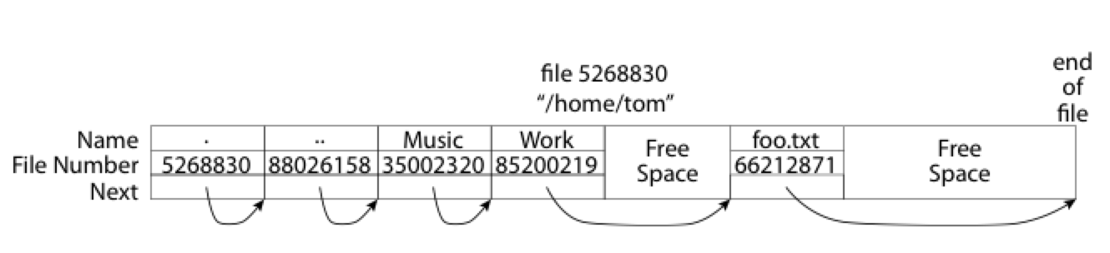
What about the Directory?
Essentially a file containing <file_name: file_number> mappings
Free space for new entries
In FAT: attributes kept in directory (!!!)
Each directory a linked list of entries
Where do you find root directory ( “/” )

Slide 24
Bit more on directories
Stored in files, can be read, but don’t
System calls to access directories
Open / Creat traverse the structure
mkdir /rmdir add/remove entries
Link / Unlink
Link existing file to a directory
Not in FAT !
Forms a DAG
libc support
DIR * opendir (const char *dirname)
struct dirent * readdir (DIR *dirstream)
int readdir_r (DIR *dirstream, struct dirent *entry, struct dirent **result)
/usr
/usr/lib
/usr/lib4.3
/usr/lib/foo
/usr/lib4.3/foo

Slide 25
When can a file be deleted ?
Maintain reference count of links to the file.
Delete after the last reference is gone.
/usr
/usr/lib
/usr/lib4.3
/usr/lib/foo
/usr/lib4.3/foo

Slide 26
Big FAT security holes
FAT has no access rights
FAT has no header in the file blocks
Just gives and index into the FAT
(file number = block number)

Slide 27
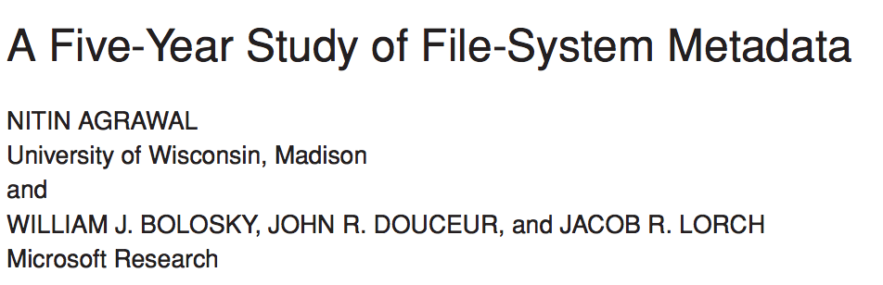
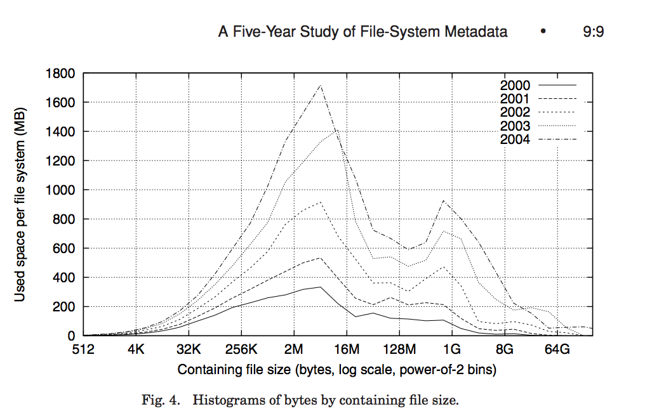
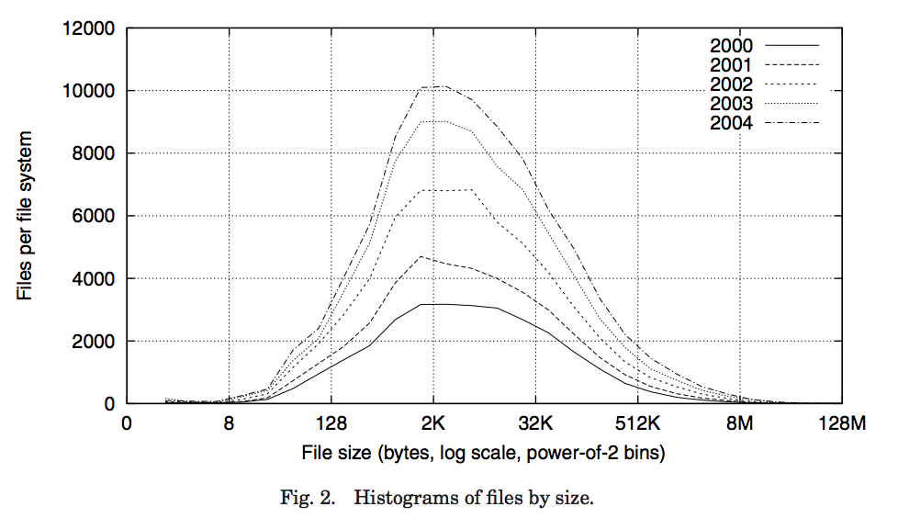
Characteristics of Files
Most files are small
Most of the space is occupied by the rare big ones

Slide 28
So what about a “real” file system
Meet the inode

