Slide 1
File System Design
David E. Culler
CS162 – Operating Systems and Systems Programming
Lecture 24
October 24, 2014
Reading: A&D 13.3
HW 4 due 10/27
Proj 2 final 11/07

Slide 2
Recall: Components of a File System
File path
Directory
Structure
File Index
Structure
File number
Data blocks
…

Slide 3
Recall: FAT (File Allocation Table)
File is collection of disk blocks
FAT is linked list 1-1 with blocks
File Number is index of root of block list for the file
Grow file by allocating free blocks and linking them in
Example Create file, write, write
FAT
Disk Blocks
0:
0:
file number
31:
File 31 , Block 0
File 31 , Block 1
File 17 , Block 1
File 2 number
File 31 , Block 3
free
File 57 , Block 0
File 31 , Block 2
N-1:
N-1:
mem

Slide 4
FAT Assessment
Time to find block ??
Free list usually just a bit vector
Next fit algorithm
Block layout for file ???
Sequential Access ???
Random Access ???
Fragmentation ???
Small files ???
Big files ???
FAT
Disk Blocks
0:
0:
free
31:
File 31 , Block 0
file number
File 31 , Block 1
File 17 , Block 1
File 31 , Block 3
file 2 number
File 17 , Block 0
File 31 , Block 2
N-1:
N-1:

Slide 5
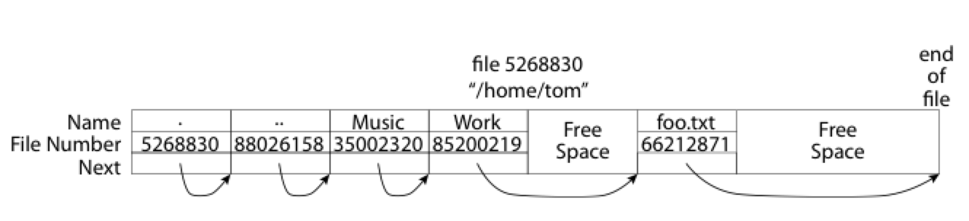
What about the Directory?
Essentially a file containing <file_name: file_number> mappings
Free space for new entries
In FAT: attributes kept in directory (!!!)
Each directory a linked list of entries
Where do you find root directory ( “/” )

Slide 6
Directory Structure (Con’t)
How many disk accesses to resolve “/my/book/count”?
Read in file header for root (fixed spot on disk)
Read in first data block for root
Table of file name/index pairs. Search linearly – ok since directories typically very small
Read in file header for “my”
Read in first data block for “my”; search for “book”
Read in file header for “book”
Read in first data block for “book”; search for “count”
Read in file header for “count”
Current working directory: Per-address-space pointer to a directory (inode) used for resolving file names
Allows user to specify relative filename instead of absolute path (say CWD=“/my/book” can resolve “count”)

Slide 7
Big FAT security holes
FAT has no access rights
FAT has no header in the file blocks
Just gives and index into the FAT
(file number = block number)

Slide 8
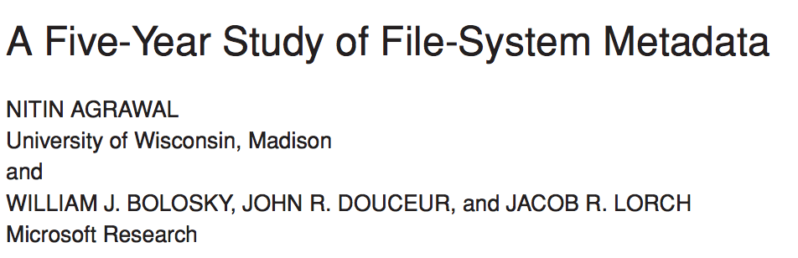
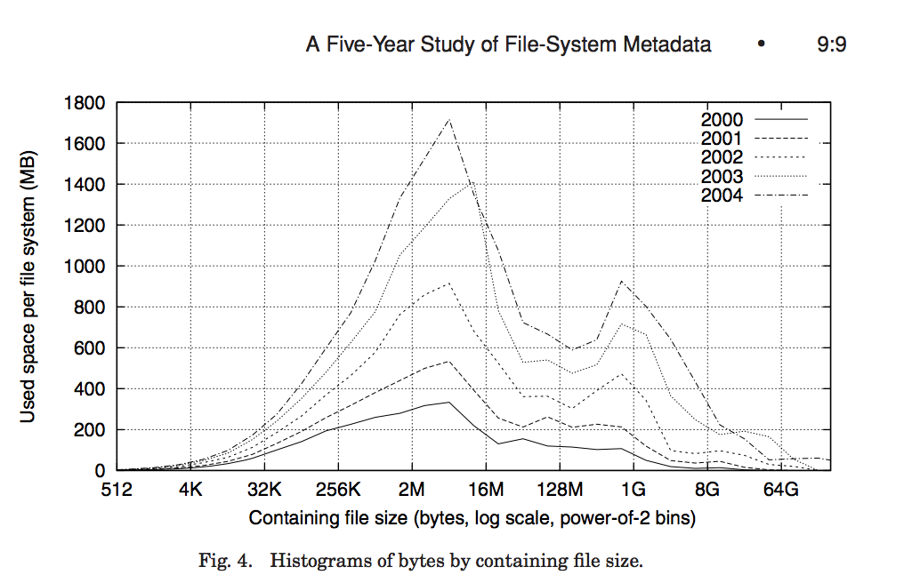
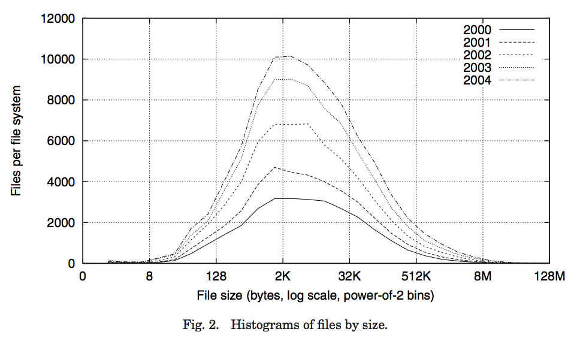
Characteristics of Files
Most files are small
Most of the space is occupied by the rare big ones

Slide 9
So what about a “real” file system
Meet the inode
file_number

Slide 10
Unix Fast File System
File Number is index into inode arrays
Multi-level index structure
Great for little to large
Asymmetric tree with fixed sized blocks
Metadata associated with the file
Rather than in the directory that points to it
Locality Heuristics
Block group placement
Reserve space
Scalable directory structure

Slide 11
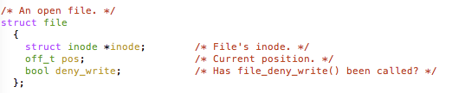
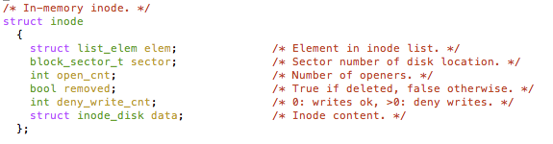
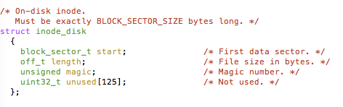
An “almost real” file system
Pintos: src/filesys/file.c, inode.c
file_number

Slide 12
FFS: File Attributes
Inode metadata
User
Group
9 basic access control bits
- UGO x RWX
Setuid bit
- execute at owner permissions
- rather than user
Getgid bit
- execute at group’s permissions

Slide 13
FFS: Data Storage
Small files: 12 pointers direct to data blocks
Direct pointers
With 4kB blocks, sufficient
For files up to 48KB

Slide 14
FFS: Data Storage
Large files: 1,2,3 level indirect pointers
Indirect pointers
- point to a disk block
containing only pointers
- eg. 4 kB blocks => 1024 pointers
=> 4 MB @ level 2
=> 4 GB @ level 3
=> 4 TB @ level 4
48 KB
+4 MB
+4 GB
+4 TB

Slide 15
Freespace Management
Bit vector with a bit per storage block
Stored at a fixed location within the file system

Slide 16
Where are inodes stored?
In early UNIX and DOS/Windows’ FAT file system, headers stored in special array in outermost cylinders
Header not stored anywhere near the data blocks. To read a small file, seek to get header, seek back to data.
Fixed size, set when disk is formatted. At formatting time, a fixed number of inodes were created (They were each given a unique number, called an “inumber”)

Slide 17
Where are inodes stored?
Later versions of UNIX moved the header information to be closer to the data blocks
Often, inode for file stored in same “cylinder group” as parent directory of the file (makes an ls of that directory run fast).
Pros:
UNIX BSD 4.2 puts a portion of the file header array on each of many cylinders. For small directories, can fit all data, file headers, etc. in same cylinder ⇒ no seeks!
File headers much smaller than whole block (a few hundred bytes), so multiple headers fetched from disk at same time
Reliability: whatever happens to the disk, you can find many of the files (even if directories disconnected)
Part of the Fast File System (FFS)
General optimization to avoid seeks

Slide 18
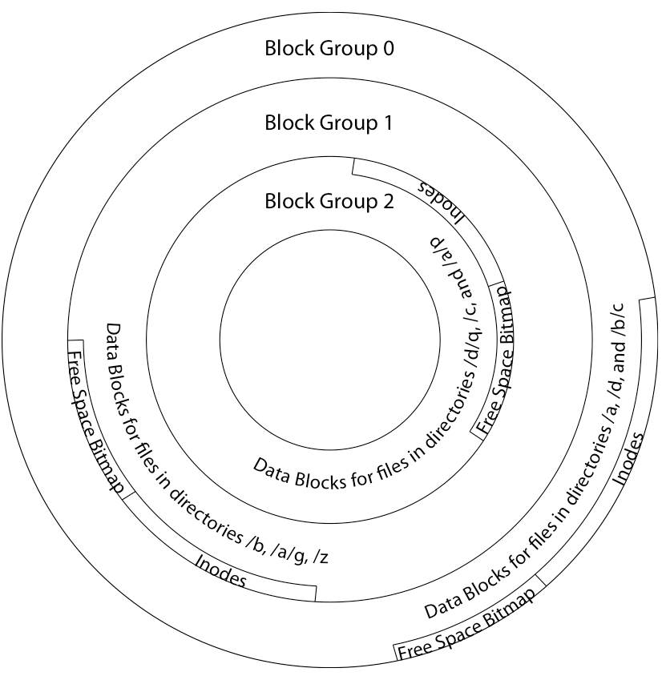
Locality: Block Groups
File system volume is divided into a set of block groups
Close set of tracks
File data blocks, metadata, and free space are interleaved within block group
Avoid huge seeks between user data and system structure
Put directory and its files in common block group
First-Free allocation of new file block
Few little holes at start, big sequential runs at end of group
Avoids fragmentation
Sequential layout for big
Reserve space in the BG

Slide 19
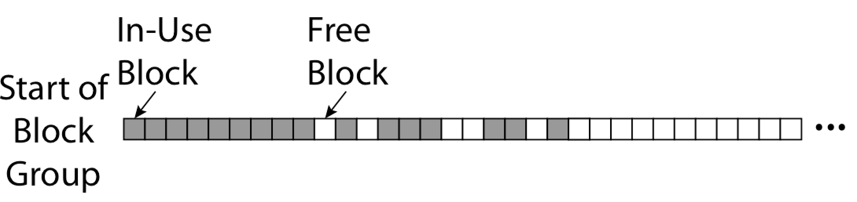
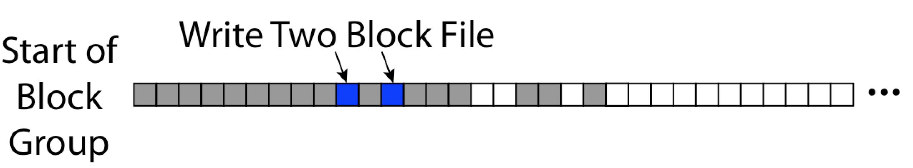
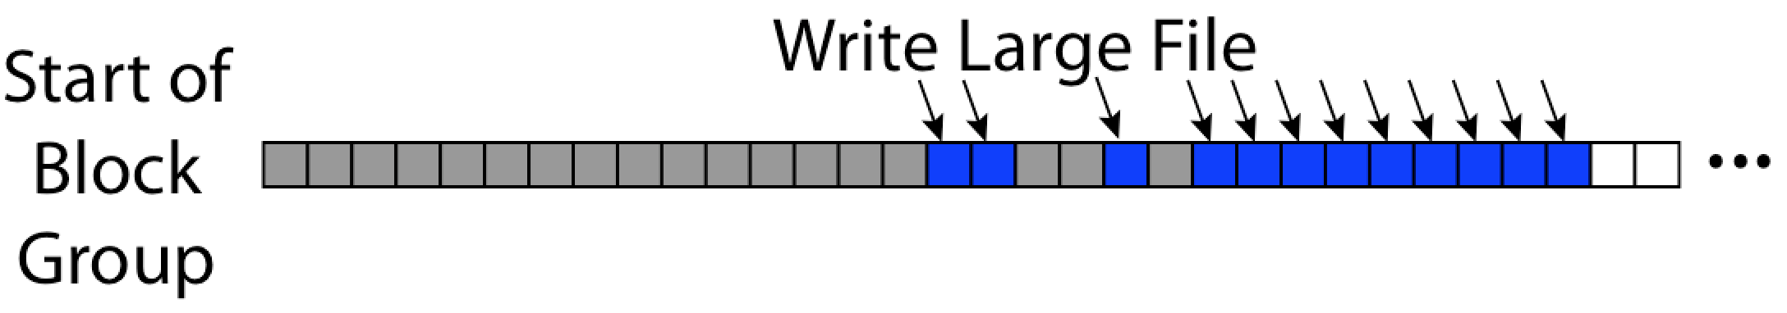
FFS First Fit Block Allocation
Fills in the small holes at the start of block group
Avoids fragmentation, leaves contiguous free space at end

Slide 20
FFS
Pros
Efficient storage for both small and large files
Locality for both small and large files
Locality for metadata and data
Cons
Inefficient for tiny files (a 1 byte file requires both an inode and a data block)
Inefficient encoding when file is mostly contiguous on disk (no equivalent to superpages)
Need to reserve 10-20% of free space to prevent fragmentation

Slide 21
Bit more on directories
Stored in files, can be read, but don’t
System calls to access directories
Open / Creat traverse the structure
mkdir /rmdir add/remove entries
Link / Unlink
Link existing file to a directory
Not in FAT !
Forms a DAG
libc support
DIR * opendir (const char *dirname)
struct dirent * readdir (DIR *dirstream)
int readdir_r (DIR *dirstream, struct dirent *entry, struct dirent **result)
/usr
/usr/lib
/usr/lib4.3
/usr/lib/foo
/usr/lib4.3/foo

Slide 23
When can a file be deleted ?
Maintain reference count of links to the file.
Delete after the last reference is gone.
/usr
/usr/lib
/usr/lib4.3
/usr/lib/foo
/usr/lib4.3/foo

Slide 24
Links
Hard link
Sets another directory entry to contain the file number for the file
Creates another name (path) for the file
Each is “first class”
Soft link or Symbolic Link
Directory entry contains the name of the file
Map one name to another name

Slide 25
Large Directories: B-Trees

Slide 26
NTFS
Master File Table
Flexible 1KB storage for metadata and data
Variable-sized attribute records (data or metadata)
Extend with variable depth tree (non-resident)
Extents – variable length contiguous regions
Block pointers cover runs of blocks
Similar approach in linux (ext4)
File create can provide hint as to size of file
Journalling for reliability
Discussed next week

Slide 27
NTFS Small File
Create time, modify time, access time,
Owner id, security specifier, flags (ro, hid, sys)
data attribute
Attribute list

Slide 28
NTFS Medium File

Slide 29
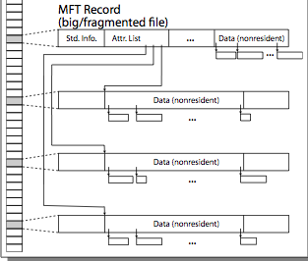
NTFS Multiple Indirect Blocks

Slide 31
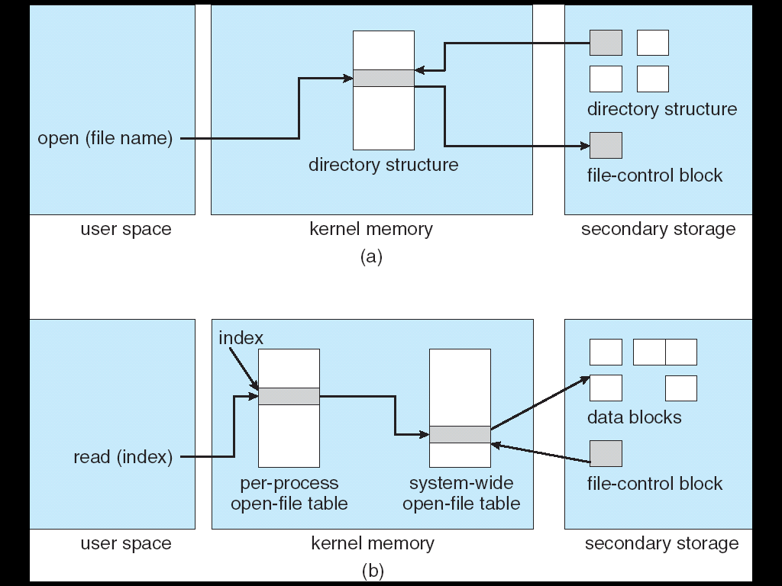
In-Memory File System Structures
Open system call:
Resolves file name, finds file control block (inode)
Makes entries in per-process and system-wide tables
Returns index (called “file handle”) in open-file table

Slide 32
In-Memory File System Structures
Read/write system calls:
Use file handle to locate inode
Perform appropriate reads or writes

Slide 33
Quizzie: File Systems
Q1: True _ False _ A hard-link is a pointer to other file
Q2: True _ False _ inumber is the id of a block
Q3: True _ False _ Typically, directories are stored as files
Q4: True _ False _ Storing file headers on the outermost cylinders minimizes the seek time

Slide 34
Quizzie: File Systems
Q1: True _ False _ A hard-link is a pointer to other file
Q2: True _ False _ inumber is the id of a block
Q3: True _ False _ Typically, directories are stored as files
Q4: True _ False _ Storing file headers on the outermost cylinders minimizes the seek time
X
X
X
X

Slide 35
File System Summary (1/2)
File System:
Transforms blocks into Files and Directories
Optimize for access and usage patterns
Maximize sequential access, allow efficient random access
File (and directory) defined by header, called “inode”
Multilevel Indexed Scheme
Inode contains file info, direct pointers to blocks,
indirect blocks, doubly indirect, etc..

Slide 36
File System Summary (2/2)
4.2 BSD Multilevel index files
Inode contains pointers to actual blocks, indirect blocks, double indirect blocks, etc.
Optimizations for sequential access: start new files in open ranges of free blocks, rotational Optimization
Naming: act of translating from user-visible names to actual system resources
Directories used for naming for local file systems

