Slide 1
File System Design: advanced topics
David E. Culler
CS162 – Operating Systems and Systems Programming
Lecture 25
October 27, 2014
Reading: A&D 13.3, 9.6
HW 4 due 10/27
Proj 2 final 11/07

Slide 2

Big Thought-provoking Questions
The One vs The All
The Many vs The Few
Guided by workload measurements
Simplicity vs Versatility
Fixed blocks vs Variable extents
Reliability vs Performance
Collective
Throughput
Individual
Response Time
Lots of Little Objects
Few Huge
Objects

Slide 3
Recall: Components of a File System
File path
Directory
Structure
File Index
Structure
File number
Data blocks
…

Slide 4
Recall: directories
Stored in files, can be read, but don’t
System calls to access directories
Open / Creat traverse the structure
mkdir /rmdir add/remove entries
Link / Unlink
Link existing file to a directory
Not in FAT !
Forms a DAG
libc support
DIR * opendir (const char *dirname)
struct dirent * readdir (DIR *dirstream)
int readdir_r (DIR *dirstream, struct dirent *entry, struct dirent **result)
/usr
/usr/lib
/usr/lib4.3
/usr/lib/foo
/usr/lib4.3/foo

Slide 5
When can a file be deleted ?
Maintain reference count of links to the file.
Delete after the last reference is gone.
/usr
/usr/lib
/usr/lib4.3
/usr/lib/foo
/usr/lib4.3/foo

Slide 6
Links
Hard link
Sets another directory entry to contain the file number for the file
Creates another name (path) for the file
Each is “first class”
Soft link or Symbolic Link
Directory entry contains the name of the file
Map one name to another name

Slide 7
Large Directories: B-Trees

Slide 8
Data Structure Trade-offs
Contiguous arrays
FAT, inode tables, disk blocks, … , page tables, …
Direct index (constant time access), linear search
Compact, easy to grow – up to a limit
Linked lists
Simple, Relatively compact
Linear time index or search => good for few
Tree-like structures (tree, b-tree, …, inode, …)
Directories, … , Multi-level page tables
Complex, Multiple Pointers (but mix in direct)
Log time index or search

Slide 9
NTFS
Variable length extents
Rather than fixed blocks
Everything (almost) is a sequence of <attribute:value> pairs
Meta-data and data
Mix direct and indirect freely

Slide 10
NTFS
Master File Table
Flexible 1KB storage for metadata and data
Variable-sized attribute records (data or metadata)
Extend with variable depth tree (non-resident)
Extents – variable length contiguous regions
Block pointers cover runs of blocks
Similar approach in linux (ext4)
File create can provide hint as to size of file
Journaling for reliability
Discussed next lecture

Slide 11
NTFS Small File
Create time, modify time, access time,
Owner id, security specifier, flags (ro, hid, sys)
data attribute
Attribute list

Slide 12
NTFS Medium File

Slide 13
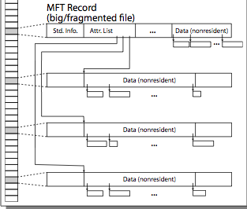
NTFS Multiple Indirect Blocks

Slide 15
Quizzie: File Systems
Q1: True _ False _ A hard-link is a pointer to other file
Q2: True _ False _ inumber is the id of a block
Q3: True _ False _ Typically, directories are stored as files
Q4: True _ False _ Storing file headers on the outermost cylinders minimizes the seek time

Slide 16
Quizzie: File Systems
Q1: True _ False _ A hard-link is a pointer to other file
Q2: True _ False _ inumber is the id of a block
Q3: True _ False _ Typically, directories are stored as files
Q4: True _ False _ Storing file headers on the outermost cylinders minimizes the seek time
X
X
X
X

Slide 17
Towards Copy-on-Write
Files are for durable storage AND flexible process-independent, protected namespace
Files grow incrementally as written
Update-in-place file systems start with a basic chunk and append (possibly larger) chunks as file grows
Transition from random access to large sequential
Disks trends: huge and cheap, high startup
Design / Memory trends: cache everything
Reads satisfied from cache, buffer multiple writes and do them all together
Application trends: make multiple related changes to a file and commit all or nothing

Slide 18
Emulating COW @ user level
Transform file foo to a new version
Open/Create a new file foo.v
where v is the version #
Do all the updates based on the old foo
Reading from foo and writing to foo.v
Including copying over any unchanged parts
Update the link
ln –f foo foo.v
Does it work?

Slide 19
Creating a New Version
old version
new version
Write
If file represented as a tree of blocks, just need to update the leading fringe

Slide 20
Creating a New Version
old version
new version
Write
If file represented as a tree of blocks, just need to update the leading fringe

Slide 21
ZFS
Variable sized blocks: 512 B – 128 KB
Symmetric tree
Know if it is large or small when we make the copy
Store version number with pointers
Can create new version by adding blocks and new pointers
Buffers a collection of writes before creating a new version with them
Free space represented as tree of extents in each block group
Delay updates to freespace (in log) and do them all when block group is activated

Slide 23
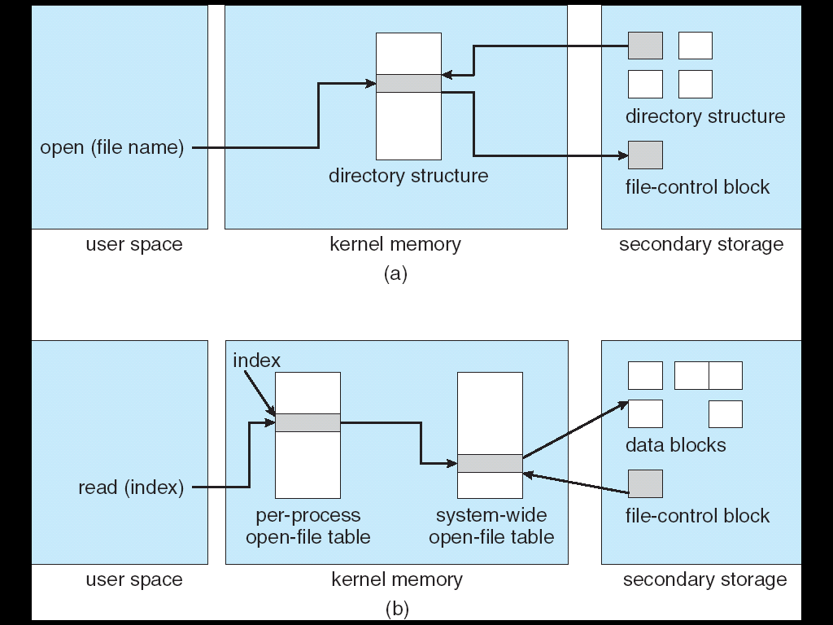
In-Memory File System Structures
Open system call:
Resolves file name, finds file control block (inode)
Makes entries in per-process and system-wide tables
Returns index (called “file handle”) in open-file table

Slide 24
In-Memory File System Structures
Read/write system calls:
Use file handle to locate inode
Perform appropriate reads or writes

Slide 25
Memory Mapped Files
Traditional I/O involves explicit transfers between buffers in process address space to regions of a file
This involves multiple copies into caches in memory, plus system calls
What if we could “map” the file directly into an empty region of our address space
Implicitly “page it in” when we read it
Write it and “eventually” page it out
Executable file is treated this way when we exec the process !!

Slide 26
Recall: Who does what when ?
Process
virtual address
physical address
MMU
page#
PT
instruction
frame#
retry
exception
page fault
offset
Operating System
update PT entry
Page Fault Handler
load page from disk
scheduler

Slide 27
Using Paging to mmap files
Process
virtual address
physical address
MMU
page#
PT
instruction
frame#
offset
page fault
Operating System
Create PT entries
for mapped region
as “backed” by file
Page Fault Handler
File
scheduler
mmap file to region of VAS

Slide 28
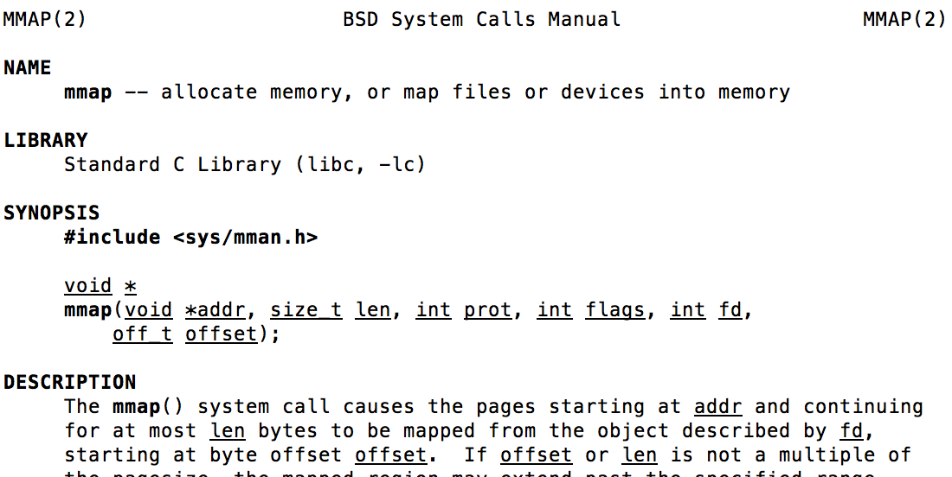
mmap system call
May map a specific region or let the system find one for you
Tricky to know where the holes are
Used both for manipulating files and for sharing between processes

Slide 29
An example
#include <sys/mman.h>
int something = 162;
int main (int argc, char *argv[]) {
int infile;
char *mfile;
void *sadddr = 0;
something++;
printf("Data at: %16lx\n", (long unsigned int) &something);
printf("Heap at : %16lx\n", (long unsigned int) malloc(1));
printf("Stack at: %16lx\n", (long unsigned int) &mfile);
mfile = mmap(0, 10000, PROT_READ|PROT_WRITE, MAP_FILE|MAP_SHARED, infile, 0);
if (mfile == MAP_FAILED) {perror("mmap failed"); exit(1);}
printf("mmap at : %16lx\n", (long unsigned int) mfile);
puts(mfile);
strcpy(mfile+20,"Let's write over it");
close(infile);
return 0;
}

Slide 30
Sharing through Mapped Files
VAS 1
VAS 2
0x000…
0x000…
instructions
instructions
data
data
File
heap
heap
Memory
stack
stack
OS
OS
0xFFF…
0xFFF…

Slide 31
File System Summary (1/2)
File System:
Transforms blocks into Files and Directories
Optimize for size, access and usage patterns
Maximize sequential access, allow efficient random access
Projects the OS protection and security regime (UGO vs ACL)
File defined by header, called “inode”
Multilevel Indexed Scheme
inode contains file info, direct pointers to blocks, indirect blocks, doubly indirect, etc..
NTFS uses variable extents, rather than fixed blocks, and tiny files data is in the header
4.2 BSD Multilevel index files
Inode contains pointers to actual blocks, indirect blocks, double indirect blocks, etc.
Optimizations for sequential access: start new files in open ranges of free blocks, rotational Optimization

Slide 32
File System Summary (2/2)
Naming: act of translating from user-visible names to actual system resources
Directories used for naming for local file systems
Linked or tree structure stored in files
File layout driven by freespace management
Integrate freespace, inode table, file blocks and directories into block group
Copy-on-write creates new (better positioned) version of file upon burst of writes
Deep interactions between memory management, file system, and sharing

