Slide 1
Memory Mapped Files & Transactions
David E. Culler
CS162 – Operating Systems and Systems Programming
Lecture 26
October 27, 2014
Reading: A&D 14.1
HW 5 out
Proj 2 final 11/07

Slide 2
File System Summary (1/2)
File System:
Transforms blocks into Files and Directories
Optimize for size, access and usage patterns
Maximize sequential access, allow efficient random access
Projects the OS protection and security regime (UGO vs ACL)
File defined by header, called “inode”
Multilevel Indexed Scheme
inode contains file info, direct pointers to blocks, indirect blocks, doubly indirect, etc..
NTFS uses variable extents, rather than fixed blocks, and tiny files data is in the header
4.2 BSD Multilevel index files
Inode contains pointers to actual blocks, indirect blocks, double indirect blocks, etc.
Optimizations for sequential access: start new files in open ranges of free blocks, rotational Optimization

Slide 3
File System Summary (2/2)
Naming: act of translating from user-visible names to actual system resources
Directories used for naming for local file systems
Linked or tree structure stored in files
File layout driven by freespace management
Integrate freespace, inode table, file blocks and directories into block group
Copy-on-write creates new (better positioned) version of file upon burst of writes
Deep interactions between memory management, file system, and sharing

Slide 4
Bring Distant Concepts together
Can we use files for interprocess communication?
Yes, but want flock, in addition to fflush!
Can we use the file namespace, operations, etc. at the performance of memory?
Without the durability
Can we use the virtual memory machinery to access files with load/store instructions?
Map files into the virtual address space
Controlled sharing between processes by using file for rendezvous

Slide 5
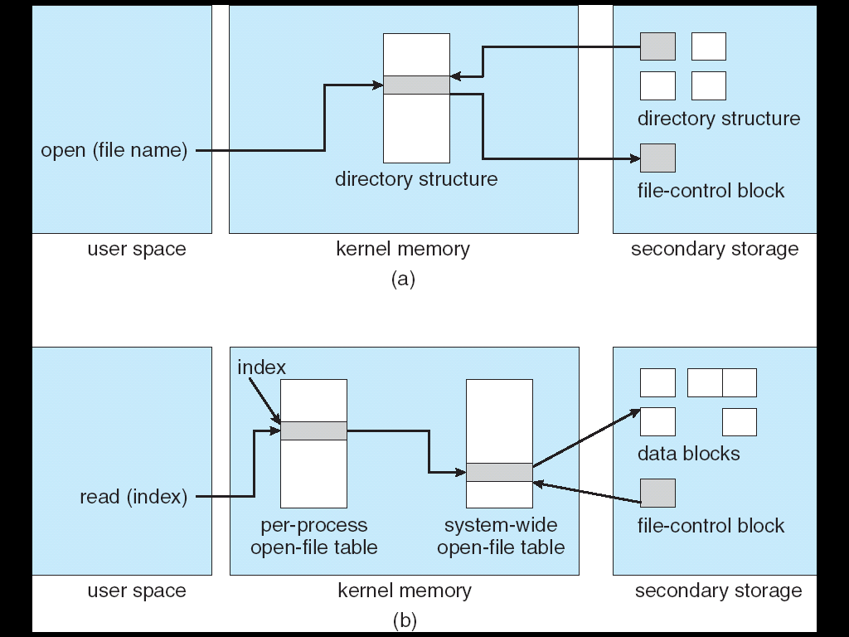
In-Memory File System Structures
Open system call:
Resolves file name, finds file control block (inode)
Makes entries in per-process and system-wide tables
Returns index (called “file handle”) in open-file table

Slide 6
In-Memory File System Structures
Read/write system calls:
Use file handle to locate inode
Perform appropriate reads or writes

Slide 7
Memory Mapped Files
Traditional I/O involves explicit transfers between buffers in process address space to regions of a file
This involves multiple copies into caches in memory, plus system calls
What if we could “map” the file directly into an empty region of our address space
Implicitly “page it in” when we read it
Write it and “eventually” page it out
Executable file is treated this way when we exec the process !!

Slide 8
Recall: Who does what when ?
Process
virtual address
physical address
MMU
page#
PT
instruction
frame#
retry
exception
page fault
offset
Operating System
update PT entry
Page Fault Handler
load page from disk
scheduler

Slide 9
Using Paging to mmap files
Process
virtual address
physical address
MMU
page#
PT
instruction
frame#
offset
page fault
Operating System
Create PT entries
for mapped region
as “backed” by file
Page Fault Handler
File
scheduler
mmap file to region of VAS

Slide 10
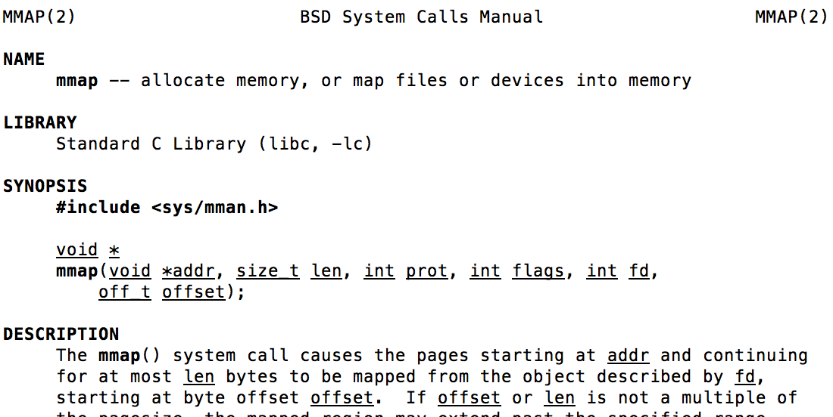
mmap system call
May map a specific region or let the system find one for you
Tricky to know where the holes are
Used both for manipulating files and for sharing between processes

Slide 11
An example
#include <sys/mman.h>
int something = 162;
int main (int argc, char *argv[]) {
int infile;
char *mfile;
void *sadddr = 0;
something++;
printf("Data at: %16lx\n", (long unsigned int) &something);
printf("Heap at : %16lx\n", (long unsigned int) malloc(1));
printf("Stack at: %16lx\n", (long unsigned int) &mfile);
mfile = mmap(0, 10000, PROT_READ|PROT_WRITE, MAP_FILE|MAP_SHARED, infile, 0);
if (mfile == MAP_FAILED) {perror("mmap failed"); exit(1);}
printf("mmap at : %16lx\n", (long unsigned int) mfile);
puts(mfile);
strcpy(mfile+20,"Let's write over it");
close(infile);
return 0;
}

Slide 12
Sharing through Mapped Files
VAS 1
VAS 2
0x000…
0x000…
instructions
instructions
data
data
File
heap
heap
Memory
stack
stack
OS
OS
0xFFF…
0xFFF…

Slide 13
Admin Breaks
Next week: guest lectures
Prof. Stoica – kev/val store
Kaifei – RPC, Vaishaal – NFS
Prof. Culler will not be available for office hours
This W/Th and Next Week
Midterm II on 11/14 6-7:30 Pimintel

Slide 14
Reliable Storage
How can we make a storage system more reliable than the physical devices that it is built out of?
Disks fail
SSDs wear out
Redundancy

Slide 15
Example: Replicated Storage
Suppose we write each data block to disks on 100 machines spread around the planet.
Are we likely to be able to read the data even if disk(s) crash?

Slide 16
Definitions
A system is reliable if it performs its intended function.
A system is available if it currently can respond to a request.
A storage system’s reliability is the probability that it will continue to be reliable for some specified period of time.
Its availability is the probability that it will be available at any given time.

Slide 17
Replicated Storage Example
Highly reliable
Highly available for reads
Low availability for writes
Can’t write if any one is not up

Slide 18
Threats to Reliability
Interrupted Operation
Crash or power failure in the middle of a series of related updates may leave stored data in an inconsistent state.
e.g.: transfer funds from BofA to Schwab. What if transfer is interrupted after withdrawal and before deposit
Loss of stored data
Failure of non-volatile storage media may cause previously stored data to disappear or be corrupted

Slide 19
Solutions
Transactions for Atomic Updates
Ensure that multiple related updates are performed atomically
i.e., if a crash occurs in the middle, the state of the systems reflects either all or none of the updates
Most modern file systems use transactions internally to update the many pieces
Many applications implement their own transactions
Redundancy for media failures
Redundant representation (error correcting codes)
Replication
E.g., RAID disks

Slide 20
Transactions
Closely related to critical sections in manipulating shared data structures
Extend concept of atomic update from memory to stable storage
Atomically update multiple persistent data structures
Like flags for threads, many ad hoc approaches
FFS carefully ordered the sequence of updates so that if a crash occurred while manipulating directory or inodes the disk scan on reboot would detect and recover the error, -- fsck
Applications use temporary files and rename

Slide 21
Key concept: Transaction
An atomic sequence of actions (reads/writes) on a storage system (or database)
That takes it from one consistent state to another
transaction
consistent state 1
consistent state 2

Slide 22
Typical Structure
Begin a transaction – get transaction id
Do a bunch of updates
If any fail along the way, roll-back
Commit the transaction

Slide 23
“Classic” Example: Transaction
BEGIN; --BEGIN TRANSACTION
UPDATE accounts SET balance = balance - 100.00 WHERE name = 'Alice';
UPDATE branches SET balance = balance - 100.00 WHERE name = (SELECT branch_name FROM accounts WHERE name = 'Alice');
UPDATE accounts SET balance = balance + 100.00 WHERE name = 'Bob';
UPDATE branches SET balance = balance + 100.00 WHERE name = (SELECT branch_name FROM accounts WHERE name = 'Bob');
COMMIT; --COMMIT WORK
Transfer $100 from Alice’s account to Bob’s account

Slide 24
The ACID properties of Transactions
Atomicity: all actions in the transaction happen, or none happen
Consistency: transactions maintain data integrity, e.g.,
Balance cannot be negative
Cannot reschedule meeting on February 30
Isolation: execution of one transaction is isolated from that of all others; no problems from concurrency
Durability: if a transaction commits, its effects persist despite crashes

