Slide 1


Implementing Transactions for File System Reliability
David E. Culler
CS162 – Operating Systems and Systems Programming
Lecture 27
October 31, 2014
Reading: A&D 14.1
HW 5 out
Proj 2 final 11/07

Slide 2
File System Reliability
What can happen if disk loses power or machine software crashes?
Some operations in progress may complete
Some operations in progress may be lost
Overwrite of a block may only partially complete
File system wants durability (as a minimum!)
Data previously stored can be retrieved (maybe after some recovery step), regardless of failure

Slide 3
Achieving File System Reliability
Problem posed by machine/disk failures
Transaction concept
Approaches to reliability
Careful sequencing of file system operations
Copy-on-write (WAFL, ZFS)
Journalling (NTFS, linux ext4)
Log structure (flash storage)
Approaches to availability
RAID

Slide 4
Storage Reliability Problem
Single logical file operation can involve updates to multiple physical disk blocks
inode, indirect block, data block, bitmap, …
With remapping, single update to physical disk block can require multiple (even lower level) updates
At a physical level, operations complete one at a time
Want concurrent operations for performance
How do we guarantee consistency regardless of when crash occurs?

Slide 5
The ACID properties of Transactions
Transaction is a group of operations:
Atomicity: all actions in the transaction happen, or none happen
Consistency: transactions maintain data integrity, e.g.,
Balance cannot be negative
Cannot reschedule meeting on February 30
Isolation: execution of one transaction is isolated from that of all others; no problems from concurrency
Durability: if a transaction commits, its effects persist despite crashes

Slide 6

Fast AND Right ???
The concepts related to transactions appear in many aspects of systems
File Systems
Data Base systems
Concurrent Programming
Example of a powerful, elegant concept simplifying implementation AND achieving better performance.
The key is to recognize that the system behavior is viewed from a particular perspective.
Properties are met from that perspective
Reliability
Performance

Slide 7
Reliability Approach #1: Careful Ordering
Sequence operations in a specific order
Careful design to allow sequence to be interrupted safely
Post-crash recovery
Read data structures to see if there were any operations in progress
Clean up/finish as needed
Approach taken in FAT, FFS (fsck), and many app-level recovery schemes (e.g., Word)

Slide 8
FFS: Create a File
Normal operation:
Allocate data block
Write data block
Allocate inode
Write inode block
Update bitmap of free blocks
Update directory with file name -> file number
Update modify time for directory
Recovery:
Scan inode table
If any unlinked files (not in any directory), delete
Compare free block bitmap against inode trees
Scan directories for missing update/access times
Time proportional to size of disk

Slide 9
Application Level
Normal operation:
Write name of each open file to app folder
Write changes to backup file
Rename backup file to be file (atomic operation provided by file system)
Delete list in app folder on clean shutdown
Recovery:
On startup, see if any files were left open
If so, look for backup file
If so, ask user to compare versions

Slide 10
Reliability Approach #2: Copy on Write File Layout
To update file system, write a new version of the file system containing the update
Never update in place
Reuse existing unchanged disk blocks
Seems expensive! But
Updates can be batched
Almost all disk writes can occur in parallel
Approach taken in network file server appliances (WAFL, ZFS)

Slide 11
Transactional File Systems
Journaling File System
Applies updates to system metadata using transactions (using logs, etc.)
Updates to non-directory files (i.e., user stuff) is done in place (without logs)
Ex: NTFS, Apple HFS+, Linux XFS, JFS, ext3, ext4
Logging File System
All updates to disk are done in transactions

Slide 12
Logging File Systems
Instead of modifying data structures on disk directly, write changes to a journal/log
Intention list: set of changes we intend to make
Log/Journal is append-only
Once changes are in the log, it is safe to apply changes to data structures on disk
Recovery can read log to see what changes were intended
Can take our time making the changes
As long as new requests consult the log first
Once changes are copied, safe to remove log
But, …
If the last atomic action is not done … poof … all gone

Slide 13
THE atomic action
Write a sector on disk

Slide 14
Redo Logging
Prepare
Write all changes (in transaction) to log
Commit
Single disk write to make transaction durable
Redo
Copy changes to disk
Garbage collection
Reclaim space in log
Recovery
Read log
Redo any operations for committed transactions
Garbage collect log

Slide 15
Example: Creating a file
Find free data block(s)
Find free inode entry
Find dirent insertion point
-------------------------------
Write map (i.e., mark used)
Write inode entry to point to block(s)
Write dirent to point to inode
Free Space map
Data blocks
…
Inode table
Directory
entries

Slide 16
Ex: Creating a file (as a transaction)
Find free data block(s)
Find free inode entry
Find dirent insertion point
-------------------------------
Write map (used)
Write inode entry to point to block(s)
Write dirent to point to inode
Free Space map
Data blocks
…
Inode table
Directory
entries
tail
head
done
pending
start
commit
Log in non-volatile storage (Flash or on Disk)

Slide 17
ReDo log
After Commit
All access to file system first looks in log
Eventually copy changes to disk
Free Space map
Data blocks
…
Inode table
Directory
entries
tail
tail
tail
tail
tail
head
done
start
commit
Log in non-volatile storage (Flash)
pending

Slide 18
Crash during logging - Recover
Upon recovery scan the long
Detect transaction start with no commit
Discard log entries
Disk remains unchanged
Free Space map
Data blocks
…
Inode table
Directory
entries
tail
head
done
pending
start
Log in non-volatile storage (Flash or on Disk)

Slide 19
Recovery After Commit
Scan log, find start
Find matching commit
Redo it as usual
Or just let it happen later
Free Space map
Data blocks
…
Inode table
Directory
entries
tail
head
done
pending
start
commit
Log in non-volatile storage (Flash or on Disk)

Slide 20
What if had already started writing back the transaction ?
Idempotent – the result does not change if the operation is repeat several times.
Just write them again during recovery

Slide 21
What if the uncommitted transaction was discarded on recovery?
Do it again from scratch
Nothing on disk was changed

Slide 22
What if we crash again during recovery?
Idempotent
Just redo whatever part of the log hasn’t been garbage collected

Slide 23
Redo Logging
Prepare
Write all changes (in transaction) to log
Commit
Single disk write to make transaction durable
Redo
Copy changes to disk
Garbage collection
Reclaim space in log
Recovery
Read log
Redo any operations for committed transactions
Ignore uncommitted ones
Garbage collect log

Slide 24
Can we interleave transactions in the log?
tail
head
start
start
pending
commit
commit
This is a very subtle question
The answer is “if they are serializable”
i.e., would be possible to reorder them in series without violating any dependences
Deep theory around consistency, serializability, and memory models in the OS, Database, and Architecture fields, respectively
A bit more later --- and in the graduate course…

Slide 25
Back of the Envelope …
Assume 5 ms average seek+rotation
And 100 MB/s transfer
4 KB block => .04 ms
100 random small create & write
4 blocks each (free, inode, dirent + data)
NO DISK HEAD OPTIMIZATION! = FIFO
Must do them in order
100 x 4 x 5 ms = 2 sec
Log writes: 5 ms + 400 x 0.04 ms = 6.6 ms
Get to respond to the user almost immediately
Get to optimize write-backs in the background
Group them for sequential, seek optimization
What if the data blocks were huge?
Reliability
Performance

Slide 26
Performance
Log written sequentially
Often kept in flash storage
Asynchronous write back
Any order as long as all changes are logged before commit, and all write backs occur after commit
Can process multiple transactions
Transaction ID in each log entry
Transaction completed iff its commit record is in log

Slide 27
Redo Log Implementation

Slide 28
Isolation
Process A:
move foo from dir x to dir y
mv x/foo y/
Process B:
grep across a and b
grep 162 x/* y/* > log
Assuming 162 appears only in foo,
what are the possible outcomes of B without transactions?
If x, y and a,b are disjoint
If x == a and y == b

Slide 29
Isolation
Process A:
move foo from dir x to dir y
mv x/foo y/
Process B:
grep across x and y
grep 162 x/* y/* > log
Assuming 162 appears only in foo,
And A is done as a transaction
What if grep starts after the changes are loggend but before they are committed?
Must prevent the interleaving
Also what we do to isolate transactions

Slide 30
What do we use to prevent interleaving?
Locks!
But here we need to acquire multiple locks
We didn’t cover it specifically, but wherever we are acquiring multiple locks there is the possibility of deadlock!
More on how to avoid that later

Slide 31
Two-Phase Commit (2PC)
Acquire all the locks & log the transaction
Then commit
And release the locks

Slide 32
Two Phase Locking
Two phase locking: release locks only AFTER transaction commit
Prevents a process from seeing results of another transaction that might not commit

Slide 33
Locks – in a new form
“Locks” to control access to data
Two types of locks:
shared (S) lock – multiple concurrent transactions allowed to operate on data
exclusive (X) lock – only one transaction can operate on data at a time
Lock
Compatibility
Matrix
 | S | X
S | √ | –
X | – | –

Slide 34
Two-Phase Locking (2PL)
1) Each transaction must obtain:
S (shared) or X (exclusive) lock on data before reading,
X (exclusive) lock on data before writing
2) A transaction can not request additional locks once it releases any locks
Thus, each transaction has a “growing phase” followed by a “shrinking phase”
Lock Point!
Growing
Phase
Shrinking
Phase
Avoid deadlock by acquiring locks in some lexicographic order

Slide 35
Two-Phase Locking (2PL)
2PL guarantees that the dependency graph of a schedule is acyclic.
For every pair of transactions with a conflicting lock, one acquires is first → ordering of those two → total ordering.
Therefore 2PL-compatible schedules are conflict serializable.
Note: 2PL can still lead to deadlocks since locks are acquired incrementally.
An important variant of 2PL is strict 2PL, where all locks are released at the end of the transaction.

Slide 36
Transaction Isolation
Process A:
LOCK x, y
move foo from dir x to dir y
mv x/foo y/
Commit and Release x, y
Process B:
LOCK x, y and log
grep across x and y
grep 162 x/* y/* > log
Commit and Release x, y, log
grep appears either before or after move
Need log/recover AND 2PL to get ACID

Slide 37
Serializability
With two phase locking and redo logging, transactions appear to occur in a sequential order (serializability)
Either: grep then move or move then grep
If the operations from different transactions get interleaved in the log, it is because it is OK
2PL prevents it if serializability would be violated
Typically, because they were independent
Other implementations can also provide serializability
Optimistic concurrency control: abort any transaction that would conflict with serializability

Slide 38
Caveat
Most file systems implement a transactional model internally
Copy on write
Redo logging
Most file systems provide a transactional model for individual system calls
File rename, move, …
Most file systems do NOT provide a transactional model for user data
Historical artifact ? - quite likely
Unfamiliar model (other than within OS’s and DB’s)?
perhaps

Slide 39
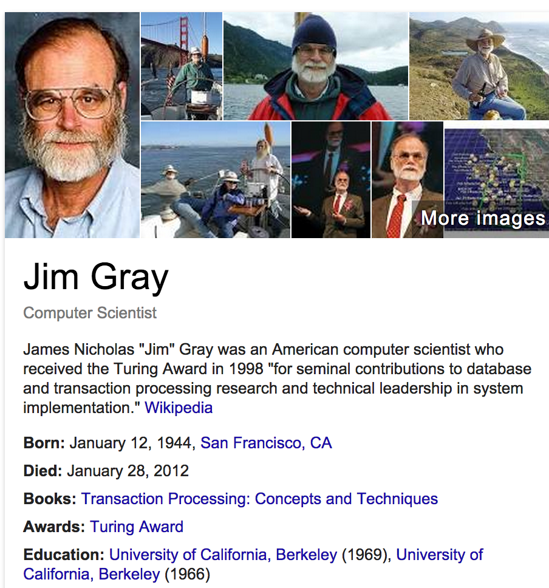

Slide 40
Atomicity
A transaction
might commit after completing all its operations, or
it could abort (or be aborted) after executing some operations
Atomic Transactions: a user can think of a transaction as always either executing all its operations, or not executing any operations at all
Database/storage system logs all actions so that it can undo the actions of aborted transactions

Slide 41
Consistency
Data follows integrity constraints (ICs)
If database/storage system is consistent before transaction, it will be after
System checks ICs and if they fail, the transaction rolls back (i.e., is aborted)
A database enforces some ICs, depending on the ICs declared when the data has been created
Beyond this, database does not understand the semantics of the data (e.g., it does not understand how the interest on a bank account is computed)

Slide 42
Isolation
Each transaction executes as if it was running by itself
It cannot see the partial results of another transaction
Techniques:
Pessimistic – don’t let problems arise in the first place
Optimistic – assume conflicts are rare, deal with them after they happen

Slide 43
Durability
Data should survive in the presence of
System crash
Disk crash → need backups
All committed updates and only those updates are reflected in the file system or database
Some care must be taken to handle the case of a crash occurring during the recovery process!

