Slide 1
Finish – Introduction to Process Introduction to File Systems
David E. Culler
CS162 – Operating Systems and Systems Programming
Lecture 2’ & 3
Sept 5, 2014
Reading: A&D 3.1-3, 11.1-2
HW: 0 out, due 9/8

Slide 2
Recall:User/Kernal(Priviledged) Mode
User Mode
interrrupt
exception
syscall
rtn
rfi
Kernel Mode
exit
exec
Limited HW access
Full HW access

Slide 3
Recall: Interrupt Vector
Address and properties of each interrupt handler
interrupt number
(i)
intrpHandler_i () {
….
}
Where else do you see this dispatch pattern?

Slide 4
Simple B&B: User => Kernel
0000…
Proc 1
Proc 2
Proc n
code
…
Static Data
OS
heap
stack
sysmode
0
1000…
code
Base
1000 …
0000…
Static Data
Bound
1100…
FFFF…
heap
uPC
xxxx…
stack
1100…
PC
0000 1234
code
3000…
regs
00FF…
Static Data
How to return to system?
…
heap
stack
3080…
FFFF…

Slide 5
Simple B&B: Interrupt
0000…
Proc 1
Proc 2
Proc n
code
…
Static Data
OS
heap
stack
sysmode
1
1000…
code
Base
1000 …
0000…
Static Data
Bound
1100 …
FFFF…
heap
uPC
0000 1234
stack
1100…
PC
IntrpVector[i]
code
3000…
regs
00FF…
Static Data
How to save registers and set up system stack?
…
heap
stack
3080…
FFFF…

Slide 6
Simple B&B: Switch User Process
0000…
Proc 1
Proc 2
Proc n
code
RTU
…
Static Data
OS
heap
stack
sysmode
1
1000…
1000 …
code
Base
3000 …
0000…
Static Data
1100 …
Bound
0080 …
FFFF…
heap
0000 1234
uPC
0000 0248
regs
stack
1100…
PC
0001 0124
00FF…
code
3000…
regs
00D0…
Static Data
How to save registers and set up system stack?
…
heap
stack
3080…
FFFF…

Slide 7
Simple B&B: “resume”
0000…
Proc 1
Proc 2
Proc n
code
RTU
…
Static Data
OS
heap
stack
sysmode
0
1000…
1000 …
code
Base
3000 …
0000…
Static Data
1100 …
Bound
0080 …
FFFF…
heap
0000 1234
uPC
xxxx xxxx
regs
stack
1100…
PC
000 0248
00FF…
code
3000…
regs
00D0…
Static Data
How to save registers and set up system stack?
…
heap
stack
3080…
FFFF…

Slide 8
What’s wrong with this simplistic address translation mechanism?

Slide 9
x86 – segments and stacks
code
Static Data
Processor Registers
heap
CS
EIP
stack
SS
ESP
CS:
EIP:
code
EAX
DS
EBX
ES
ECX
Static Data
EDX
ESI
EDI
heap
Start address, length and access rights associated with each segment
SS:
ESP:
stack

Slide 10
Virtual Address Translation
Simpler, more useful schemes too!
Give every process the illusion of its own BIG FLAT ADDRESS SPACE
Break it into pages
More on this later

Slide 11
Running Many Programs ???
We have the basic mechanism to
switch between user processes and the kernel,
the kernel can switch among user processes,
Protect OS from user processes and processes from each other
Questions ???
How do we decide which user process to run?
How do we represent user processes in the OS?
How do we pack up the process and set it aside?
How do we get a stack and heap for the kernel?
Aren’t we wasting are lot of memory?
…

Slide 12
Process Control Block
Kernel represents each process as a process control block (PCB)
Status (running, ready, blocked, …)
Register state (when not ready)
Process ID (PID), User, Executable, Priority, …
Execution time, …
Memory space, translation, …
Kernel Scheduler maintains a data structure containing the PCBs
Scheduling algorithm selects the next one to run

Slide 13
Scheduler
if ( readyProcesses(PCBs) ) {
nextPCB = selectProcess(PCBs);
run( nextPCB );
} else {
run_idle_process();
}

Slide 14
Putting it together: web server
syscall
syscall
RTU
RTU
wait
wait
interrupt
interrupt

Slide 15
4 OS concepts working together
Privilege/User Mode
The hardware can operate in two modes, with only the “system” mode having the ability to access certain resources.
Address Space
Programs execute in an address space that is distinct from the memory space of the physical machine
Process
An instance of an executing program is a process consisting of an address space and one or more threads of control
Protection
The OS and the hardware are protected from user programs and user programs are isolated from one another by controlling the translation from program virtual addresses to machine physical addresses

Slide 17
Introduction to File Systems
David E. Culler
CS162 – Operating Systems and Systems Programming
Lecture 3
Sept 5, 2014
Reading: A&D 3.1-3, 11.1-2
HW: 0 out, due 9/8

Slide 18
Objective of this lecture
Show how Operating System functionality distributes across layers in the system.
Introduce I/O & storage services – i.e., file systems

Slide 19
Reflecting on the process intro
You said that applications request services from the operating system via syscall, but …
I’ve been writing all sort of useful applications and I never ever saw a “syscall” !!!
That’s right.
It was buried in the programming language runtime library (e.g., libc.a)
… Layering

Slide 20
OS run-time library
Proc 1
Proc 2
Proc n
…
OS
Appln
login
Window Manager
…
OS library
OS library
OS library
OS

Slide 21
A Kind of Narrow Waist
Word Processing
Compilers
Web Browsers
Email
Databases
Web Servers
Application / Service
Portable OS Library
OS
User
System Call
Interface
System
Portable OS Kernel
Software
Platform support, Device Drivers
Hardware
x86
PowerPC
ARM
PCI
Ethernet (10/100/1000)
802.11 a/b/g/n
SCSI
IDE
Graphics

Slide 22
Key Unix I/O Design Concepts
Uniformity
file operations, device I/O, and interprocess communication through open, read/write, close
Allows simple composition of programs
find | grep | wc …
Open before use
Provides opportunity for access control and arbitration
Sets up the underlying machinery, i.e., data structures
Byte-oriented
Even if blocks are transferred, addressing is in bytes
Kernel buffered reads
Streaming and block devices looks the same, read blocks yielding processor to other task
Kernel buffered writes
Completion of out-going transfer decoupled from the application, allowing it to continue
Explicit close

Slide 23
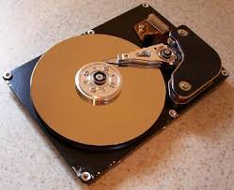
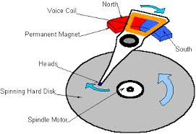
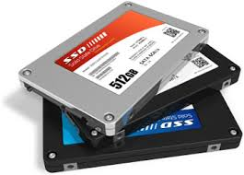

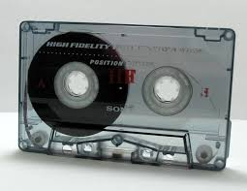
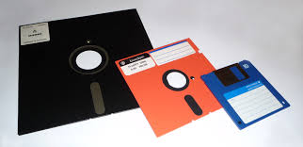
I/O & Storage Layers
Application / Service
streams
High Level I/O
Low Level I/O
handles
Syscall
registers
File System
descriptors
I/O Driver
Commands and Data Transfers
Disks, Flash, Controllers, DMA

Slide 24
The file system abstraction
File
Named collection of data in a file system
File data
Text, binary, linearized objects
File Metadata: information about the file
Size, Modification Time, Owner, Security info
Basis for access control
Directory
“Folder” containing files & Directories
Hierachical (graphical) naming
Path through the directory graph
Uniquely identifies a file or directory
/home/ff/cs162/public_html/fa14/index.html
Links and Volumes (later)

Slide 25
C high level File API – streams (review)
Operate on “streams” - sequence of bytes, whether text or data, with a position
#include <stdio.h>
FILE *fopen( const char *filename, const char *mode );
int fclose( FILE *fp );
Mode Text | Binary | Descriptions
r | rb | Open existing file for reading
w | wb | Open for writing; created if does not exist
a | ab | Open for appending; created if does not exist
r+ | rb+ | Open existing file for reading & writing.
w+ | wb+ | Open for reading & writing; truncated to zero if exists, create otherwise
a+ | ab+ | Open for reading & writing. Created if does not exist. Read from beginning, write as append
Don’t forget to flush

Slide 26
Connecting Processes, Filesystem, and Users
Process has a ‘current working directory’
Absolute Paths
/home/ff/cs152
Relative paths
index.html, ./index.html - current WD
../index.html - parent of current WD
~, ~cs152 - home directory

Slide 27
C API Standard Streams
Three predefined streams are opened implicitly when the program is executed.
FILE *stdin – normal source of input, can be redirected
FILE *stdout – normal source of output, can too
FILE *stderr – diagnostics and errors
STDIN / STDOUT enable composition in Unix

Slide 28
C high level File API – stream ops
#include <stdio.h>
// character oriented
int fputc( int c, FILE *fp ); // rtn c or EOF on err
int fputs( const char *s, FILE *fp ); // rtn >0 or EOF
int fgetc( FILE * fp );
char *fgets( char *buf, int n, FILE *fp );
// block oriented
size_t fread(void *ptr, size_t size_of_elements,
size_t number_of_elements, FILE *a_file);
size_t fwrite(const void *ptr, size_t size_of_elements,
size_t number_of_elements, FILE *a_file);
// formatted
int fprintf(FILE *restrict stream, const char *restrict format, ...);
int fscanf(FILE *restrict stream, const char *restrict format, ... );

Slide 29
C Stream API positioning
int fseek(FILE *stream, long int offset, int whence); long int ftell (FILE *stream)
void rewind (FILE *stream)
Preserves high level abstraction of a uniform stream of objects

Slide 30
What’s below the surface ??
Application / Service
streams
High Level I/O
Low Level I/O
handles
Syscall
registers
File System
descriptors
I/O Driver
Commands and Data Transfers
Disks, Flash, Controllers, DMA

Slide 31
C Low level I/O
Operations on File Descriptors – as OS object representing the state of a file
User has a “handle” on the descriptor
#include <fcntl.h>
#include <unistd.h>
#include <sys/types.h>
int open (const char *filename, int flags [, mode_t mode])
int creat (const char *filename, mode_t mode)
int close (int filedes)
Bit vector of:
Access modes (Rd, Wr, …)
Open Flags (Create, …)
Operating modes (Appends, …)
Bit vector of Permission Bits:
User|Group|Other X R|W|X
http://www.gnu.org/software/libc/manual/html_node/Opening-and-Closing-Files.html

Slide 32
C Low Level: standard descriptors
#include <unistd.h>
STDIN_FILENO - macro has value 0
STDOUT_FILENO - macro has value 1
STDERR_FILENO - macro has value 2
int fileno (FILE *stream)
FILE * fdopen (int filedes, const char *opentype)
Crossing levels: File descriptors vs. streams
Don’t mix them!

Slide 33
C Low Level Operations
ssize_t read (int filedes, void *buffer, size_t maxsize)
- returns bytes read, 0 => EOF, -1 => error
ssize_t write (int filedes, const void *buffer, size_t size)
- returns bytes written
off_t lseek (int filedes, off_t offset, int whence)
int fsync (int fildes) – wait for i/o to finish
void sync (void) – wait for ALL to finish
When write returns, data is on its way to disk and can be read, but it may not actually be permanent!

Slide 34
And lots more !
TTYs versus files
Memory mapped files
File Locking
Asynchronous I/O
Generic I/O Control Operations
Duplicating descriptors
int dup2 (int old, int new)
int dup (int old)

Slide 35
What’s below the surface ??
Application / Service
streams
High Level I/O
Low Level I/O
handles
Syscall
registers
File System
descriptors
I/O Driver
Commands and Data Transfers
Disks, Flash, Controllers, DMA

Slide 36
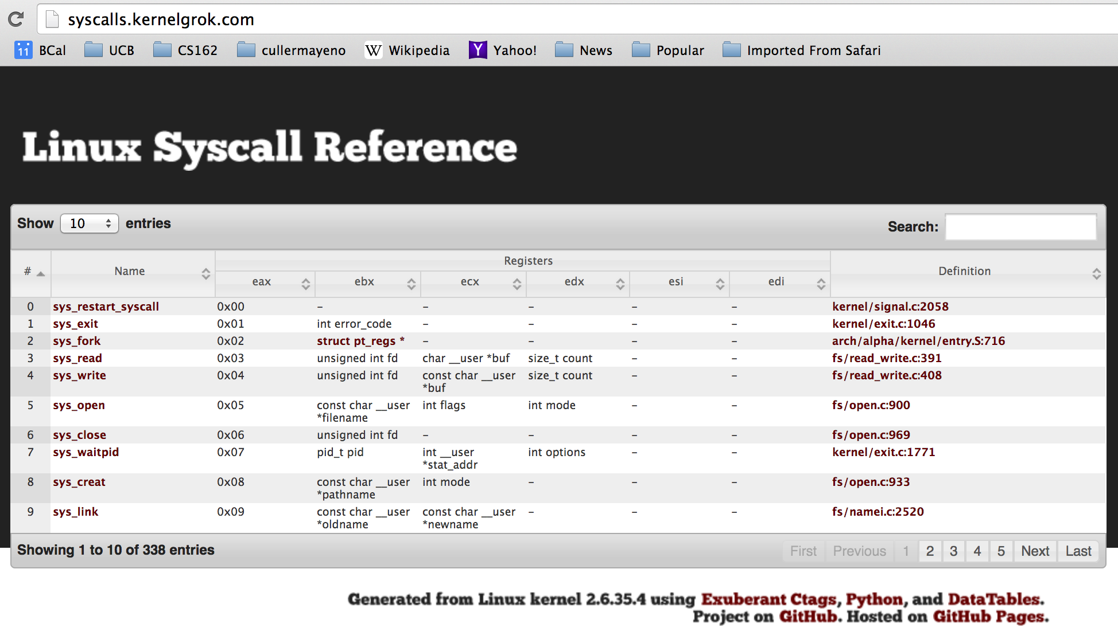
SYSCALL
Low level lib parameters are set up in registers and syscall instruction is issued

Slide 37
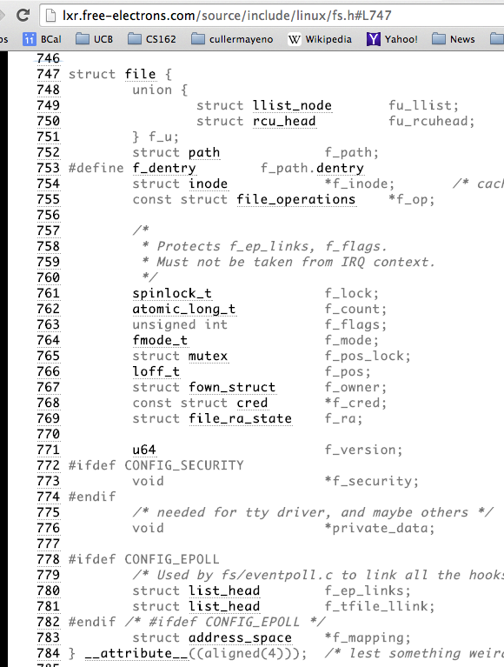
Internal OS File Descriptor
Internal Data Structure describing everything about the file
Where it resides
Its status
How to access it

Slide 38
File System: from syscall to driver
In fs/read_write.c
ssize_t vfs_read(struct file *file, char __user *buf, size_t count, loff_t *pos)
{
ssize_t ret;
if (!(file->f_mode & FMODE_READ)) return -EBADF;
if (!file->f_op || (!file->f_op->read && !file->f_op->aio_read))
return -EINVAL;
if (unlikely(!access_ok(VERIFY_WRITE, buf, count))) return -EFAULT;
ret = rw_verify_area(READ, file, pos, count);
if (ret >= 0) {
count = ret;
if (file->f_op->read)
ret = file->f_op->read(file, buf, count, pos);
else
ret = do_sync_read(file, buf, count, pos);
if (ret > 0) {
fsnotify_access(file->f_path.dentry);
add_rchar(current, ret);
}
inc_syscr(current);
}
return ret;
}

Slide 39
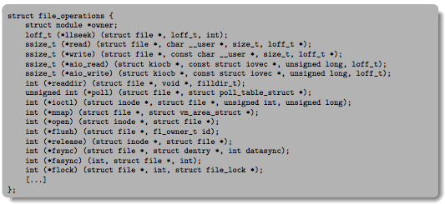
Low Level Driver
Associated with particular hardware device
Registers / Unregisters itself with the kernel
Handler functions for each of the file operations

Slide 40
So what happens when you fgetc?
Application / Service
streams
High Level I/O
handles
Low Level I/O
registers
Syscall
File System
descriptors
I/O Driver
Commands and Data Transfers
Disks, Flash, Controllers, DMA

