Slide 1
Distributed System Design
David E. Culler
CS162 – Operating Systems and Systems Programming
http://cs162.eecs.berkeley.edu/
Lecture 31
Nov 10, 2014
Read: end-2-end
HW 5: Due 11/12
Mid 2: 11/14
Proj 3: due 12/8

Slide 2
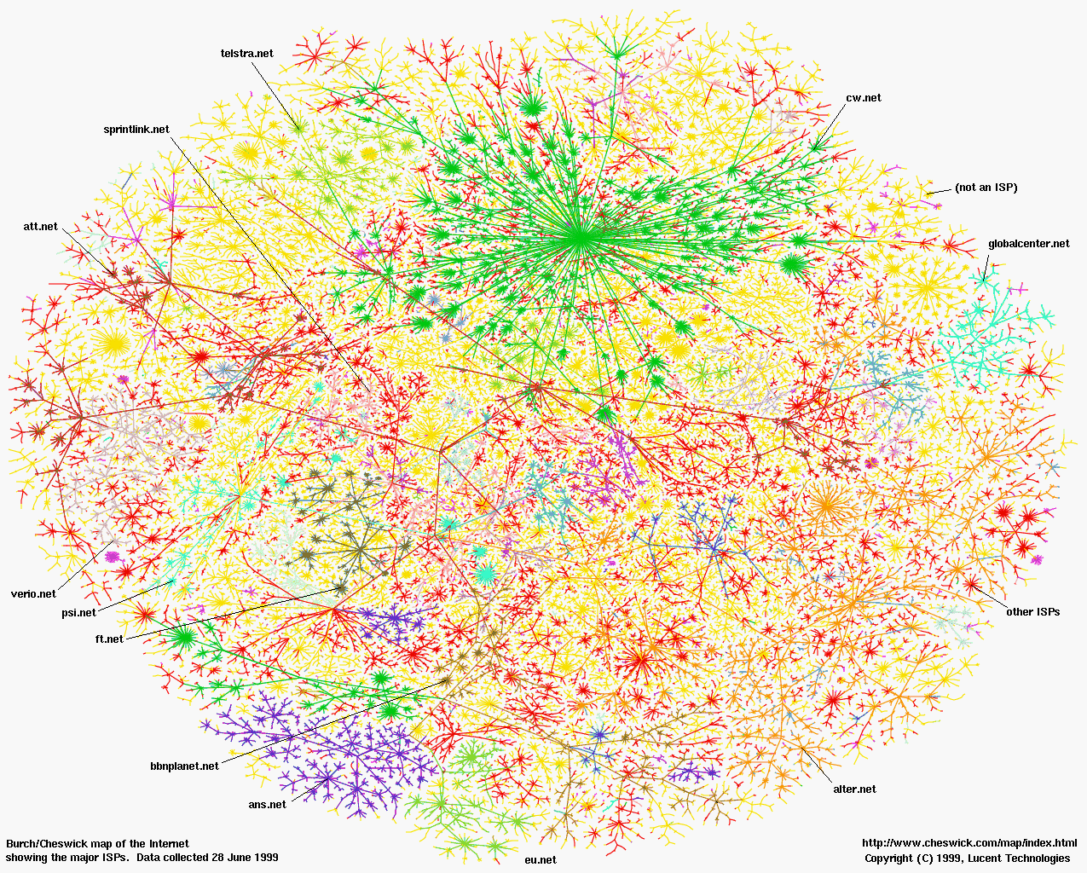
Greatest Artifact of Human Civilization …

Slide 3
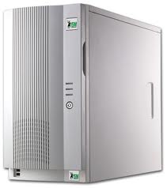
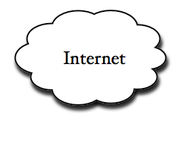
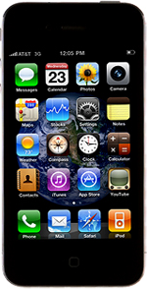
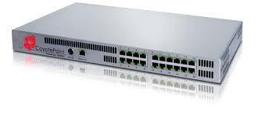
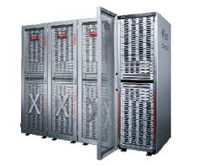
Example: What’s in a Search Query?
DNS
Servers
Datacenter
DNS
request
create
result
page
Search
Index
Page store
Load
balancer
Ad Server
Complex interaction of multiple components in multiple administrative domains
Systems, services, protocols, …
Notes:
In this course we are not focusing on a single node system but on the end-to-end system. The reason is very simple: today the majority of applications we use does not run on our system. Social networks, e-mail, google docs, online gamming, etc.

Slide 4
Course Structure: Spiral
File Systems (8)
Address Space (4)
Concurrency (6)
Reliability, Security, Cloud (8)
Distributed Systems (8)
OS Concepts (3)
intro

Slide 5
Review: Remote Procedure Call
marshal args
Client
(caller)
call
Client
Stub
send
Packet
Handler
return
receive
unmarshal
ret vals
Machine A
Network
Network
Machine B
marshal args
Server
(callee)
return
Server
Stub
send
Packet
Handler
call
receive
unmarshal
ret vals

Slide 6
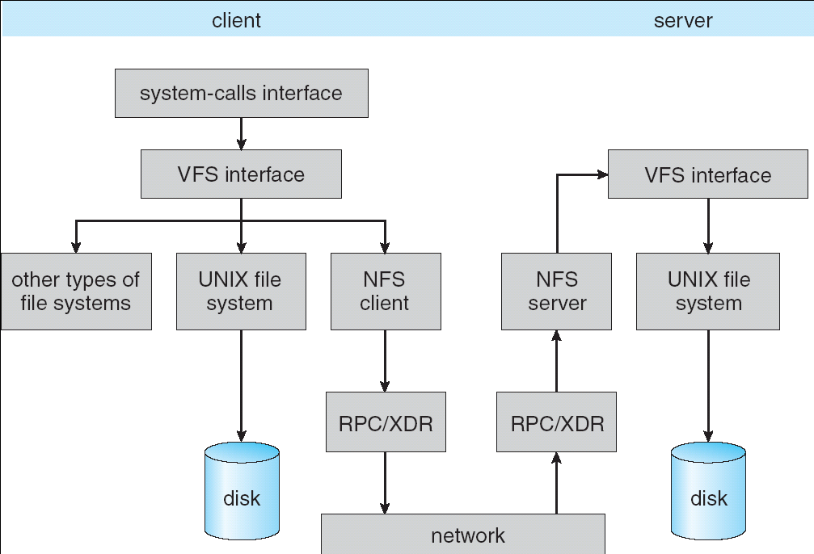
Review: Schematic View of NFS Architecture
Layering
RPC stubs
Marshaling
Notes:
This is the big picture of NFS
You already know system-call (open, read, write, delete, close), UFS + others, disk, RPC/XDR, Network
NFS runs on RPC
Let’s for now only look at …
External data representation
pause

Slide 7
Protocol Trade-offs

Slide 8
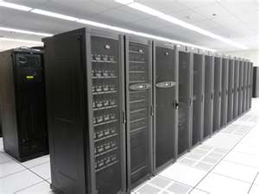
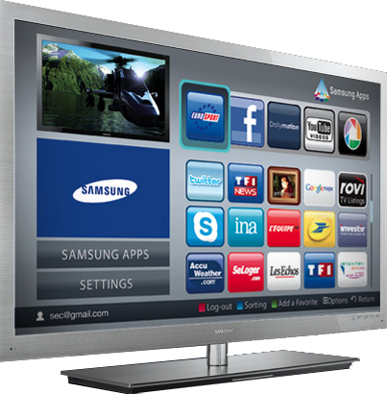
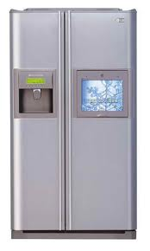
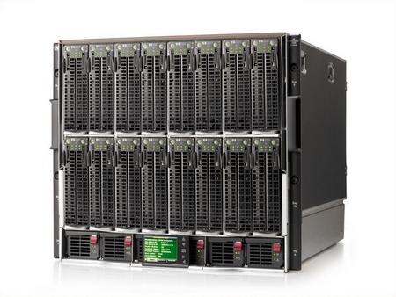


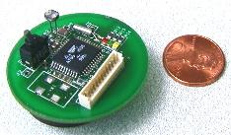

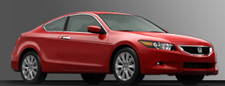

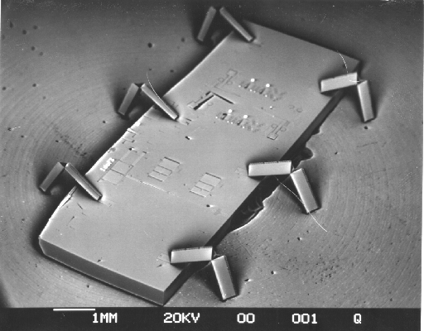

Societal Scale Information Systems
Massive Cluster
The world is a large distributed system
Microprocessors in everything
Vast infrastructure behind them
Gigabit Ethernet
Clusters
Massive Cluster
Clusters
Gigabit Ethernet
Internet Connectivity
Scalable, Reliable,
Secure Services
Databases
Information Collection
Remote Storage
Online Games
Commerce
…
MEMS for
Sensor Nets

Slide 9
What Is A Protocol?
A protocol is an agreement on how to communicate
Includes
Syntax: how a communication is specified & structured
Format, order messages are sent and received
Semantics: what a communication means
Actions taken when transmitting, receiving, or when a timer expires
Described formally by a state machine
Often represented as a message transaction diagram

Slide 10
Examples of Protocols in Human Interactions
Telephone
(Pick up / open up the phone)
Listen for a dial tone / see that you have service
Dial
Should hear ringing …
Callee: “Hello?”
Caller: “Hi, it’s John….” Or: “Hi, it’s me” (← what’s that about?)
Caller: “Hey, do you think … blah blah blah …” pause
Callee: “Yeah, blah blah blah …” pause
Caller: Bye
Callee: Bye
Hang up

Slide 11
Protocols in Human Interactions
Asking a question
Raise your hand
Wait to be called on
Or: wait for speaker to pause and vocalize

Slide 12

End System: Computer on the ‘Net
Internet
Also known as a “host”…

Slide 13
What’s in a name?

Slide 14
Recall:

Slide 15
Clients and Servers
Client program
Running on end host
Requests service
E.g., Web browser
GET /index.html

Slide 16
Clients and Servers
Client program
Running on end host
Requests service
E.g., Web browser
Server program
Running on end host
Provides service
E.g., Web server
GET /index.html
“Site under construction”

Slide 17
Client-Server Communication
Client “sometimes on”
Initiates a request to the server when interested
E.g., Web browser on your laptop or cell phone
Doesn’t communicate directly with other clients
Needs to know the server’s address
Server is “always on”
Services requests from many client hosts
E.g., Web server for the www.cnn.com Web site
Doesn’t initiate contact with the clients
Needs a fixed, well-known address

Slide 18
Peer-to-Peer Communication
No always-on server at the center of it all
Hosts can come and go, and change addresses
Hosts may have a different address each time
Example: peer-to-peer file sharing (e.g., BitTorrent)
Any host can request files, send files, query to find where a file is located, respond to queries, and forward queries
Scalability by harnessing millions of peers
Each peer acting as both a client and server

Slide 19
The Problem
Many different applications
email, web, P2P, etc.
Many different network styles and technologies
Wireless vs. wired vs. optical, etc.
How do we organize this mess?

Slide 20
The Problem (cont’d)
Application
Skype
SSH
NFS
HTTP
Transmission
Media
Coaxial
cable
Fiber
optic
Packet
Radio
Re-implement every application for every technology?
No! But how does the Internet design avoid this?

Slide 21
Solution: Intermediate Layers
Introduce intermediate layers that provide set of abstractions for various network functionality & technologies
A new app/media implemented only once
Variation on “add another level of indirection”
Application
Skype
SSH
NFS
HTTP
Intermediate
layers
Transmission
Media
Coaxial
cable
Fiber
optic
Packet
radio

Slide 22
Software System Modularity
Partition system into modules & abstractions:
Well-defined interfaces give flexibility
Hides implementation - thus, it can be freely changed
Extend functionality of system by adding new modules
E.g., libraries encapsulating set of functionality
E.g., programming language + compiler abstracts away not only how the particular CPU works …
… but also the basic computational model
Well-defined interfaces hide information
Present high-level abstractions
But can impair performance

Slide 23
Network System Modularity
Like software modularity, but:
Implementation distributed across many machines (routers and hosts)
Must decide:
How to break system into modules:
Layering
What functionality does each module implement:
End-to-End Principle: don’t put it in the network if you can do it in the endpoints.
We will address these choices more in next lecture

Slide 24
Layering: A Modular Approach
Partition the system
Each layer solely relies on services from layer below
Each layer solely exports services to layer above
Interface between layers defines interaction
Hides implementation details
Layers can change without disturbing other layers

Slide 25
Protocol Standardization
Ensure communicating hosts speak the same protocol
Standardization to enable multiple implementations
Or, the same folks have to write all the software
Standardization: Internet Engineering Task Force
Based on working groups that focus on specific issues
Produces “Request For Comments” (RFCs)
Promoted to standards via rough consensus and running code
IETF Web site is http://www.ietf.org/
RFCs archived at http://www.rfc-editor.org/
De facto standards: same folks writing the code
P2P file sharing, Skype, <your protocol here>…

Slide 26
Administration Break
Midterm 2: Friday 11/14 6-7:30 @ 1 Pimentel
Bring one 2-sides 8.5 x 11
Email cs162@eecs for conflicts
Study guide answers releases
Review session in Section this week
Focused on Lectures 12-27
But assumes earlier material
Project 3: Key-Value Store in Java !!!
Less readings ahead – lecture even more important

Slide 27

Example: The Internet Protocol (IP): “Best-Effort” Packet Delivery
Datagram packet switching
Send data in packets
Header with source & destination address
Service it provides:
Packet arrives quickly (if it does)
Packets may be lost
Packets may be corrupted
Packets may be delivered out of order
source
destination
IP network

Slide 28
Example: Transmission Control Protocol (TCP)
Communication service
Ordered, reliable byte stream
Simultaneous transmission in both directions
Key mechanisms at end hosts
Retransmit lost and corrupted packets
Discard duplicate packets and put packets in order
Flow control to avoid overloading the receiver buffer
Congestion control to adapt sending rate to network load
TCP connection
source
network
destination

Slide 29
Recall: Socket Protocol

Slide 30
Recall: Sockets

Slide 31
Recall: Socket creation and connection
File systems provide a collection of permanent objects in structured name space
Processes open, read/write/close them
Files exist independent of the processes
Sockets provide a means for processes to communicate (transfer data) to other processes.
Creation and connection is more complex
Form 2-way pipes between processes
Possibly worlds away

Slide 32
Recall: Sockets in concept
Client
Server
Create Server Socket
Create Client Socket
Bind it to an Address (host:port)
Connect it to server (host:port)
Listen for Connection
Accept connection
Connection Socket
write request
read request
read response
write response
Close Client Socket
Close Connection Socket
Close Server Socket

Slide 33
Client Protocol
char *hostname;
int sockfd, portno;
struct sockaddr_in serv_addr;
struct hostent *server;
server = buildServerAddr(&serv_addr, hostname, portno);
/* Create a TCP socket */
sockfd = socket(AF_INET, SOCK_STREAM, 0)
/* Connect to server on port */
connect(sockfd, (struct sockaddr *) &serv_addr, sizeof(serv_addr)
printf("Connected to %s:%d\n",server->h_name, portno);
/* Carry out Client-Server protocol */
client(sockfd);
/* Clean up on termination */
close(sockfd);

Slide 34
Server Protocol (v1)
/* Create Socket to receive requests*/
lstnsockfd = socket(AF_INET, SOCK_STREAM, 0);
/* Bind socket to port */
bind(lstnsockfd, (struct sockaddr *)&serv_addr,sizeof(serv_addr));
while (1) {
/* Listen for incoming connections */
listen(lstnsockfd, MAXQUEUE);
/* Accept incoming connection, obtaining a new socket for it */
consockfd = accept(lstnsockfd, (struct sockaddr *) &cli_addr,
&clilen);
server(consockfd);
close(consockfd);
}
close(lstnsockfd);

Slide 35
Sockets in concept: fork
Client
Server
Create Server Socket
Create Client Socket
Bind it to an Address (host:port)
Connect it to server (host:port)
Listen for Connection
Accept connection
child
Connection Socket
Parent
Close Listen Socket
Close Connection Socket
write request
read request
read response
write response
Close Connection Socket
Wait for child
Close Client Socket
Close Server Socket

Slide 36
Server Protocol (v2)
while (1) {
listen(lstnsockfd, MAXQUEUE);
consockfd = accept(lstnsockfd, (struct sockaddr *) &cli_addr,
&clilen);
cpid = fork(); /* new process for connection */
if (cpid > 0) { /* parent process */
close(consockfd);
tcpid = wait(&cstatus);
} else if (cpid == 0) { /* child process */
close(lstnsockfd); /* let go of listen socket */
server(consockfd);
close(consockfd);
exit(EXIT_SUCCESS); /* exit child normally */
}
}
close(lstnsockfd);

Slide 37



Socket API
Base level Network programming interface
Application
Socket
API
Transport
TCP
UDP
Network
IP

Slide 38
BSD Socket API
Created at UC Berkeley (1980s)
Most popular network API
Ported to various OSes, various languages
Windows Winsock, BSD, OS X, Linux, Solaris, …
Socket modules in Java, Python, Perl, …
Similar to Unix file I/O API
In the form of file descriptor (sort of handle).
Can share same read()/write()/close() system calls

Slide 39
TCP: Transport Control Protocol
Reliable, in-order, and at most once delivery
Stream oriented: messages can be of arbitrary length
Provides multiplexing/demultiplexing to IP
Provides congestion and flow control
Application examples: file transfer, chat

Slide 40
TCP Service
Open connection: 3-way handshaking
Reliable byte stream transfer from (IPa, TCP_Port1) to (IPb, TCP_Port2)
Indication if connection fails: Reset
Close (tear-down) connection

Slide 41
Open Connection: 3-Way Handshaking
Goal: agree on a set of parameters, i.e., the start sequence number for each side
Starting sequence number: sequence of first byte in stream
Starting sequence numbers are random

Slide 42
Open Connection: 3-Way Handshaking
Server waits for new connection calling listen()
Sender call connect() passing socket which contains server’s IP address and port number
OS sends a special packet (SYN) containing a proposal for first sequence number, x
Client (initiator)
Server
Active Open
connect()
listen()
SYN, SeqNum = x
Passive Open
time

Slide 43
Open Connection: 3-Way Handshaking
If it has enough resources, server calls accept() to accept connection, and sends back a SYN ACK packet containing
Client’s sequence number incremented by one, (x + 1)
Why is this needed?
A sequence number proposal, y, for first byte server will send
Client (initiator)
Server
Active Open
connect()
listen()
SYN, SeqNum = x
Passive Open
accept()
SYN and ACK, SeqNum = y and Ack = x + 1
time
ACK, Ack = y + 1
allocate buffer space

Slide 44
3-Way Handshaking (cont’d)
Three-way handshake adds 1 RTT delay
Why?
Congestion control: SYN (40 byte) acts as cheap probe
Protects against delayed packets from other connection (would confuse receiver)

Slide 45
Close Connection
Goal: both sides agree to close the connection
4-way connection tear down
Host 1
Host 2
close
FIN
FIN ACK
data
FIN
close
FIN ACK
closed
Can retransmit FIN ACK if it is lost
timeout
closed

Slide 46
Quiz 15.2: Protocols
Q1: True _ False _ Protocols specify the syntax and semantics of communication
Q2: True _ False _ Protocols specify the implementation
Q3: True _ False _ Layering helps to improve application performance
Q4: True _ False _ “Best Effort” packet delivery ensures that packets are delivered in order
Q5: True _ False _ In p2p systems a node is both a client and a server
Q6: True _ False _ TCP ensures that each packet is delivered within a predefined amount of time

Slide 47
Quiz 15.2: Protocols
Q1: True _ False _ Protocols specify the syntax and semantics of communication
Q2: True _ False _ Protocols specify the implementation
Q3: True _ False _ Layering helps to improve application performance
Q4: True _ False _ “Best Effort” packet delivery ensures that packets are delivered in order
Q5: True _ False _ In p2p systems a node is both a client and a server
Q6: True _ False _ TCP ensures that each packet is delivered within a predefined amount of time
X
X
X
X
X
X

Slide 48
Summary
Important roles of
Protocols, standardization
Clients, servers, peer-to-peer
A layered architecture is a powerful means for organizing complex networks
But, layering has its drawbacks too
Next lecture
Layering
End-to-End arguments (please read the paper before lecture!)

