Slide 1
TCP Flow Control – an illustration of distributed system thinking
David E. Culler
CS162 – Operating Systems and Systems Programming
http://cs162.eecs.berkeley.edu/
Lecture 33
Nov 17, 2014
Read: TCP ’88

Slide 2
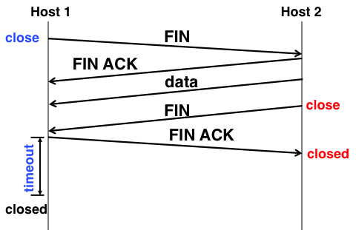
Recall: Connecting API to Protocol
Client
Server
Create Server Socket
Create Client Socket
Bind it to an Address (host:port)
Connect it to server (host:port)
SYN, SeqNum = x
Listen for Connection
time
SYN and ACK, SeqNum = y and Ack = x + 1
Accept connection
ACK, Ack = y + 1
Connection Socket
write request
read request
read response
write response
Close Client Socket
Close Connection Socket
Close Server Socket

Slide 3
Recall: Stop & Wait with Errors
If a loss wait for a retransmission timeout and retransmit
How do you pick the timeout?
Sender
Receiver
1
RTT
ACK 1
timeout
1
Time

Slide 4
Where we are
TCP: Reliable Byte Stream
Open connection (3-way handshaking)
Close connection: no perfect solution; no way for two parties to agree absolutely in the presence of arbitrary message losses (Byzantine General’s Problem)
Reliable transmission
Stop&Wait not efficient for links with large capacity, i.e., bandwidth-delay product
Sliding window more efficient but more complex
Flow Control
OS on sender and receiver manage buffers
Sending rate adjusted according to acks and losses
Receiver drops to slow sender on over-run

Slide 5
Recap: Sliding Window
window = set of adjacent sequence numbers
The size of the set is the window size
Assume window size is n
Let A be the last ACK’d packet of sender without gap; then window of sender = {A+1, A+2, …, A+n}
Sender can send packets in its window
Let B be the last received packet without gap by receiver, then window of receiver = {B+1,…, B+n}
Receiver can accept out of sequence, if in window

Slide 6
Sliding Window w/o Errors
Throughput = W*packet_size/RTT
Unacked packets
in sender’s window
Out-o-seq packets
in receiver’s window
Window size (W) = 3 packets
{1}
1
{1, 2}
2
{}
{1, 2, 3}
3
{}
{2, 3, 4}
4
{}
{3, 4, 5}
5
.
.
.
{4, 5, 6}
6
.
.
.
Time
Sender
Receiver

Slide 7
Example: Sliding Window w/o Errors
Assume
Link capacity, C = 1Gbps
Latency between end-hosts, RTT = 80ms
packet_length = 1000 bytes
What is the window size W to match link’s capacity, C?
Solution
We want Throughput = C
Throughput = W*packet_size/RTT
C = W*packet_size/RTT
W = C*RTT/packet_size = 10⁹bps*80*10⁻³s/(8000b) = 10⁴ packets
Bandwidth-Delay Product
Window size ~ Bandwidth (Capacity) x delay (RTT/2)
Remember Little’s Law !

Slide 8
Sliding Window with Errors
Two approaches
Go-Back-n (GBN)
Selective Repeat (SR)
In the absence of errors they behave identically
Go-Back-n (GBN)
Transmit up to n unacknowledged packets
If timeout for ACK(k), retransmit k, k+1, …
Typically uses NACKs instead of ACKs
Recall, NACK specifies first in-sequence packet missed by receiver

Slide 9
GBN Example with Errors
Out-o-seq packets
in receiver’s window
Window size (W) = 3 packets
1
2
{}
{}
{}
3
4
5
4 is
missing
Timeout
Packet 4
6
{5}
{5,6}
NACK 4
NACK 4
4
Why doesn’t sender retransmit packet 4 here?
5
Assume packet 4 lost!
6
{}
Sender
Receiver

Slide 10
Selective Repeat (SR)
Sender: transmit up to n unacknowledged packets
Assume packet k is lost
Receiver: indicate packet k is missing (use ACKs)
Sender: retransmit packet k

Slide 11
SR Example with Errors
Unacked packets
in sender’s window
Window size (W) = 3 packets
{1}
1
{1, 2}
2
{1, 2, 3}
3
{2, 3, 4}
4
{3, 4, 5}
5
{4, 5, 6}
6
ACK 5
{4,5,6}
4
ACK 6
Time
{7}
7
Sender
Receiver

Slide 12
Flow Control
Recall: Flow control ensures a fast sender does not overwhelm a slow receiver
Example: Producer-consumer with bounded buffer
A buffer between producer and consumer
Producer puts items into buffer as long as buffer not full
Consumer consumes items from buffer
Recall: solutions on one machine using locks, etc.
buffer
Produ-cer
Con-sumer

Slide 13
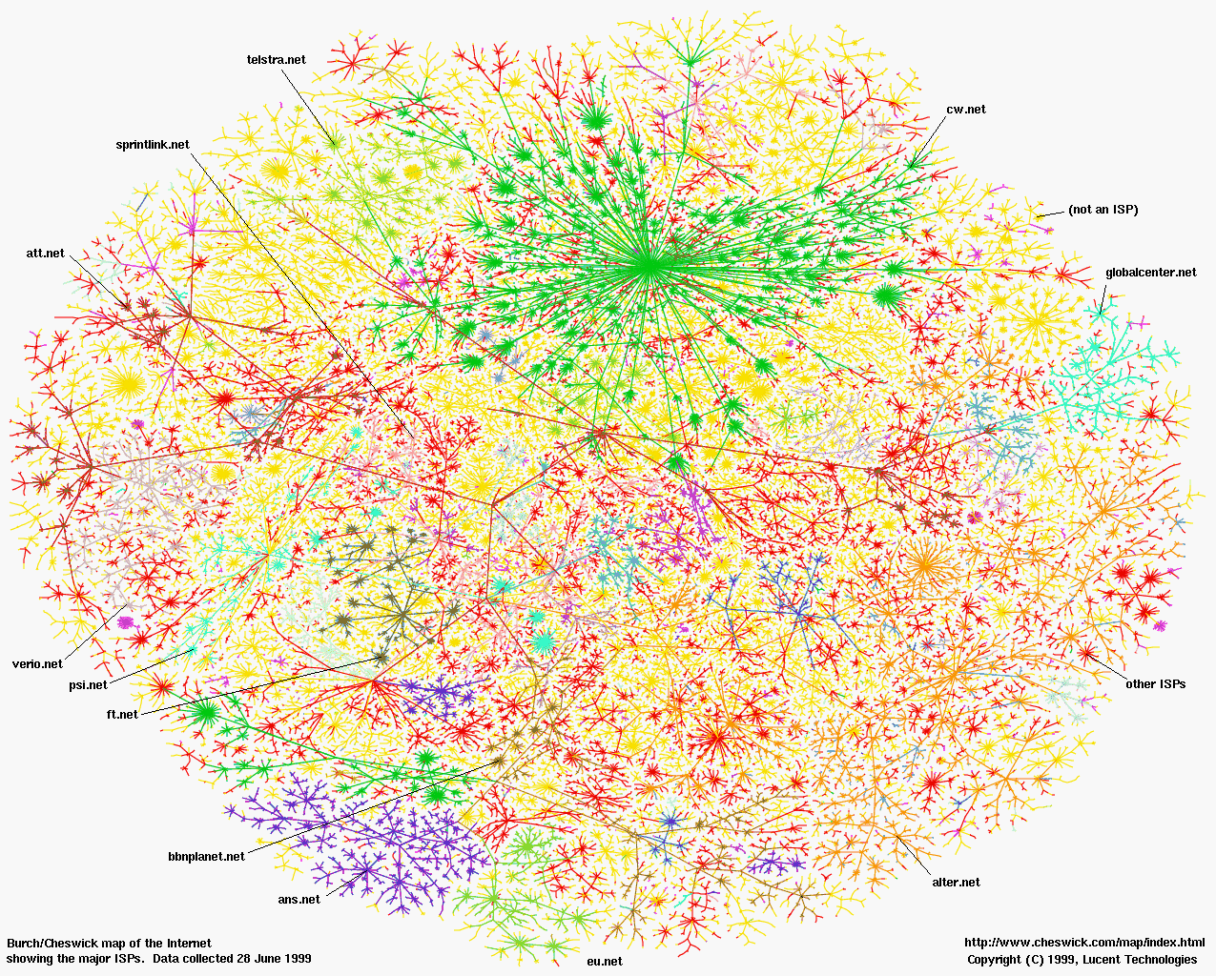
The Distributed Case
buffer
Produ-cer
Con-sumer
Think Globally – Act Locally

Slide 14
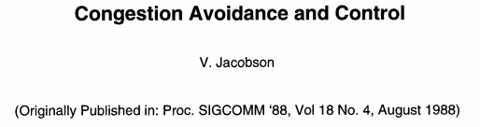
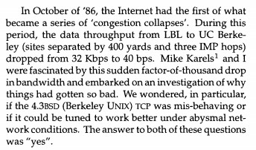
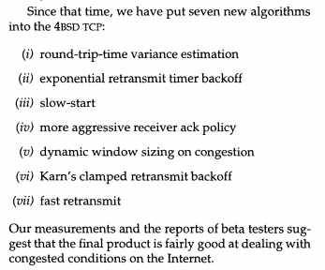
When the Internet was young …

Slide 15
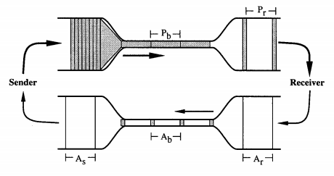
Van Jacobson’s Concept
Packets get “space out” going through bottleneck
Sender learns this spacing (rate) from ack timing
Loss is due primarily to congestion, including receiver over-run
Start slow and continually increase rate, but …
Slow-down in response to loss

Slide 16
TCP Flow Control
TCP: sliding window protocol at byte (not packet) level
Go-back-N: TCP Tahoe, Reno, New Reno
Selective Repeat (SR): TCP Sack
Receiver tells sender how many more bytes it can receive without overflowing its buffer
the AdvertisedWindow
The ACK contains sequence number N of next byte the receiver expects,
receiver has received all bytes in sequence up to and including N-1

Slide 17
TCP Flow Control
Sending Process
Receiving Process
OS
(TCP/IP)
OS
(TCP/IP)
TCP/IP implemented by OS (Kernel)
Cannot do context switching on sending/receiving every packet
At 1Gbps, it takes 12 usec to send an 1500 bytes, and 0.8usec to send an 100 byte packet
Need buffers to match …
sending app with sending TCP
receiving TCP with receiving app

Slide 18
TCP Flow Control
Sending Process
Receiving Process
TCP layer
1
3
TCP layer
OS
IP layer
IP layer
2
Three pairs of producer-consumer’s
sending process → sending TCP
Sending TCP → receiving TCP
receiving TCP → receiving process

Slide 19
TCP Flow Control
Sending Process
Receiving Process
TCP layer
TCP layer
300 bytes
OS
IP layer
IP layer
Example assumptions:
Maximum IP packet size = 100 bytes
Size of the receiving buffer (MaxRcvBuf) = 300 bytes
Recall, ack indicates the next expected byte in-sequence, not the last received byte
Use circular buffers

Slide 20
Circular Buffer
Assume
A buffer of size N
A stream of bytes, where bytes have increasing sequence numbers
Think of stream as an unbounded array of bytes and of sequence number as indexes in this array
Buffer stores at most N consecutive bytes from the stream
Byte k stored at position (k mod N) + 1 in the buffer
buffered data
sequence #
27
28
29
30
31
32
33
34
35
36
H
E
L
L
O
W
O
R
L
(28 mod 10) + 1 = 9
(35 mod 10) + 1 = 6
Circular buffer
(N = 10)
L
O
W
O
R
E
E
L
1
2
3
4
5
6
7
8
9
10
end
start

Slide 21
TCP Flow Control
Sending Process
Receiving Process
LastByteWritten(0)
LastByteRead(0)
LastByteAcked(0)
LastByteSent(0)
LastByteRcvd(0)
NextByteExpected(1)
LastByteWritten: last byte written by sending process
LastByteSent: last byte sent by sender to receiver
LastByteAcked: last ack received by sender from receiver
LastByteRcvd: last byte received by receiver from sender
NextByteExpected: last in-sequence byte expected by receiver
LastByteRead: last byte read by the receiving process

Slide 22
TCP Flow Control
Sending Process
Receiving Process
LastByteWritten
LastByteRead
MaxSendBuffer
MaxRcvBuffer
LastByteAcked
LastByteSent
NextByteExpected
LastByteRcvd
AdvertisedWindow: number of bytes TCP receiver can receive
SenderWindow: number of bytes TCP sender can send
AdvertisedWindow = MaxRcvBuffer – (LastByteRcvd – LastByteRead)
SenderWindow = AdvertisedWindow – (LastByteSent – LastByteAcked)

Slide 23
TCP Flow Control
Sending Process
Receiving Process
LastByteWritten
LastByteRead
MaxSendBuffer
MaxRcvBuffer
LastByteAcked
LastByteSent
NextByteExpected
LastByteRcvd
Still true if receiver missed data….
WriteWindow: number of bytes sending process can write
AdvertisedWindow = MaxRcvBuffer – (LastByteRcvd – LastByteRead)
WriteWindow = MaxSendBuffer – (LastByteWritten – LastByteAcked)

Slide 24
TCP Flow Control
Sending Process
Receiving Process
LastByteWritten(350)
LastByteRead(0)
1, 350
LastByteAcked(0)
LastByteSent(0)
LastByteRcvd(0)
NextByteExpected(1)
Sending app sends 350 bytes
Recall:
We assume IP only accepts packets no larger than 100 bytes
MaxRcvBuf = 300 bytes, so initial Advertised Window = 300 byets

Slide 25
TCP Flow Control
Sending Process
Receiving Process
LastByteWritten(350)
LastByteRead(0)
1, 350
1,
100
101, 350
1, 100
LastByteAcked(0)
LastByteSent(100)
LastByteRcvd(100)
NextByteExpected(101)
{[1,100]}
Data[1,100]
{[1,100]}
Sender sends first packet (i.e., first 100 bytes) and receiver gets the packet
time

Slide 26
TCP Flow Control
Sending Process
Receiving Process
LastByteWritten(350)
LastByteRead(0)
1, 350
1,
100
101, 350
1, 100
LastByteAcked(0)
LastByteSent(100)
LastByteRcvd(100)
NextByteExpected(101)
{[1,100]}
Data[1,100]
{[1,100]}
Ack=101, AdvWin = 200
Receiver sends ack for 1st packet
AdvWin = MaxRcvBuffer – (LastByteRcvd – LastByteRead)
= 300 – (100 – 0) = 200

Slide 27
TCP Flow Control
Sending Process
Receiving Process
LastByteWritten(350)
LastByteRead(0)
1,
100
101, 350
101,
200
201, 350
1, 100
101, 200
LastByteAcked(0)
LastByteSent(200)
LastByteRcvd(200)
NextByteExpected(201)
{[1,100]}
Data[1,100]
{[1,100]}
{[1,200]}
Data[101,200]
{[1,200]}
Ack=101, AdvWin = 200
Sender sends 2nd packet (i.e., next 100 bytes) and receiver gets the packet

Slide 28
TCP Flow Control
Sending Process
Receiving Process
LastByteWritten(350)
LastByteRead(0)
1, 200
101, 350
201, 350
1, 200
LastByteAcked(0)
LastByteSent(200)
LastByteRcvd(200)
NextByteExpected(201)
{[1,100]}
Data[1,100]
{[1,100]}
{[1,200]}
Data[101,200]
{[1,200]}
Ack=101, AdvWin = 200
Sender sends 2nd packet (i.e., next 100 bytes) and receiver gets the packet

Slide 29
TCP Flow Control
Sending Process
Receiving Process
1,
100
LastByteWritten(350)
LastByteRead(100)
1, 200
101, 350
201, 350
101, 200
LastByteAcked(0)
LastByteSent(200)
LastByteRcvd(200)
NextByteExpected(201)
{[1,100]}
Data[1,100]
{[1,100]}
{[1,200]}
Data[101,200]
{[1,200]}
Ack=101, AdvWin = 200
Receiving TCP delivers first 100 bytes to receiving process

Slide 30
TCP Flow Control
Sending Process
Receiving Process
LastByteWritten(350)
LastByteRead(100)
1, 200
101, 350
201, 350
101, 200
LastByteAcked(0)
LastByteSent(200)
LastByteRcvd(200)
NextByteExpected(201)
{[1,100]}
Data[1,100]
{[1,100]}
{[1,200]}
Data[101,200]
{[1,200]}
Ack=101, AdvWin = 200
Ack=201, AdvWin = 200
Receiver sends ack for 2nd packet
AdvWin = MaxRcvBuffer – (LastByteRcvd – LastByteRead)
= 300 – (200 – 100) = 200

Slide 31
TCP Flow Control
Sending Process
Receiving Process
LastByteWritten(350)
LastByteRead(100)
1, 200
101, 350
201, 350
201,
300
301, 350
101, 200
LastByteAcked(0)
LastByteSent(300)
LastByteRcvd(200)
NextByteExpected(201)
{[1,100]}
Data[1,100]
{[1,100]}
{[1,200]}
Data[101,200]
{[1,200]}
{[1,300]}
Data[201,300]
Sender sends 3rd packet (i.e., next 100 bytes) and the packet is lost

Slide 32
TCP Flow Control
Sending Process
Receiving Process
LastByteWritten(350)
LastByteRead(100)
1,300
101, 350
201, 350
301, 350
101, 200
LastByteAcked(0)
LastByteSent(300)
LastByteRcvd(200)
NextByteExpected(201)
{[1,100]}
Data[1,100]
{[1,100]}
{[1,200]}
Data[101,200]
{[1,200]}
{[1,300]}
Data[201,300]
Sender stops sending as window full
SndWin = AdvWin – (LastByteSent – LastByteAcked)
= 300 – (300 – 0) = 0

Slide 33
TCP Flow Control
Sending Process
Receiving Process
LastByteWritten(350)
LastByteRead(100)
1,300
101, 350
201, 350
301, 350
101, 200
LastByteAcked(0)
LastByteSent(300)
LastByteRcvd(200)
NextByteExpected(201)
{[1,100]}
Data[1,100]
{[1,100]}
{[1,200]}
Data[101,200]
{[1,200]}
{[1,300]}
Data[201,300]
Ack=101, AdvWin = 200
Sender gets ack for 1st packet
AdWin = 200

Slide 34
TCP Flow Control
Sending Process
Receiving Process
LastByteWritten(350)
LastByteRead(100)
101, 350
101,300
201, 350
301, 350
101, 200
LastByteAcked(100)
LastByteSent(300)
LastByteRcvd(200)
NextByteExpected(201)
{[1,100]}
Data[1,100]
{[1,100]}
{[1,200]}
Data[101,200]
{[1,200]}
{[1,300]}
Data[201,300]
{101, 300}
Ack=101, AdvWin = 200
Ack for 1st packet (ack indicates next byte expected by receiver)
Receiver no longer needs first 100 bytes

Slide 35
TCP Flow Control
Sending Process
Receiving Process
LastByteWritten(350)
LastByteRead(100)
101, 350
101,300
201, 350
301, 350
101, 200
LastByteAcked(100)
LastByteSent(300)
LastByteRcvd(200)
NextByteExpected(201)
{[1,100]}
Data[1,100]
{[1,100]}
{[1,200]}
Data[101,200]
{[1,200]}
{[1,300]}
Data[201,300]
{101, 300}
Ack=101, AdvWin = 200
Sender still cannot send as window full
SndWin = AdvWin – (LastByteSent – LastByteAcked)
= 200 – (300 – 100) = 0

Slide 36
TCP Flow Control
Sending Process
Receiving Process
LastByteWritten(350)
LastByteRead(100)
101, 350
101,300
201, 350
301, 350
101, 200
LastByteAcked(100)
LastByteSent(300)
LastByteRcvd(200)
NextByteExpected(201)
{[1,100]}
Data[1,100]
{[1,100]}
{[1,200]}
Data[101,200]
{[101,200]}
{[1,300]}
Data[201,300]
{101, 300}
{201, 300}
Ack=201, AdvWin = 200
Sender gets ack for 2nd packet
AdvWin = 200 bytes

Slide 37
TCP Flow Control
Sending Process
Receiving Process
LastByteWritten(350)
LastByteRead(100)
101, 350
201,300
201, 350
301, 350
101, 200
LastByteAcked(200)
LastByteSent(300)
LastByteRcvd(200)
NextByteExpected(201)
{[1,100]}
Data[1,100]
{[1,100]}
{[1,200]}
Data[101,200]
{[101,200]}
{[1,300]}
Data[201,300]
{101, 300}
{201, 300}
Ack=201, AdvWin = 200
Sender can now send new data!
SndWin = AdvWin – (LastByteSent – LastByteAcked) = 100

Slide 38
TCP Flow Control
Sending Process
Receiving Process
LastByteWritten(350)
LastByteRead(100)
101, 350
201,300
201, 350
301,350
301, 350
101, 200
301, 350
LastByteAcked(200)
LastByteSent(350)
LastByteRcvd(350)
NextByteExpected(201)
{[1,100]}
Data[1,100]
{[1,100]}
{[1,200]}
Data[101,200]
{[101,200]}
{[1,300]}
Data[201,300]
{101, 300}
{[201,350]}
Data[301,350]
{[101,200],[301,350]}

Slide 39
TCP Flow Control
Sending Process
Receiving Process
LastByteWritten(350)
LastByteRead(100)
101, 350
201,300
201, 350
301,350
301, 350
101, 200
301, 350
LastByteAcked(200)
LastByteSent(350)
LastByteRcvd(350)
NextByteExpected(201)
{[1,100]}
Data[1,100]
{[1,100]}
{[1,200]}
Data[101,200]
{[101,200]}
{[1,300]}
Data[201,300]
{101, 300}
{[201,350]}
Data[301,350]
{[101,200],[301,350]}
{201, 350}
Ack=201, AdvWin = 50

Slide 40
TCP Flow Control
Sending Process
Receiving Process
LastByteWritten(350)
LastByteRead(100)
101, 350
201,300
201, 350
301,350
301, 350
101, 200
301, 350
LastByteAcked(200)
LastByteSent(350)
LastByteRcvd(350)
NextByteExpected(201)
{[201,350]}
Data[301,350]
{[101,200],[301,350]}
Ack still specifies 201 (first byte out of sequence)
AdvWin = 50, so can sender re-send 3rd packet?
{201, 350}
Ack=201, AdvWin = 50

Slide 41
TCP Flow Control
Sending Process
Receiving Process
LastByteWritten(350)
LastByteRead(100)
101, 350
201,300
201, 350
301,350
301, 350
101, 200
301, 350
LastByteAcked(200)
LastByteSent(350)
LastByteRcvd(350)
NextByteExpected(201)
{[201,350]}
Data[301,350]
{[101,200],[301,350]}
{201, 350}
Ack=201, AdvWin = 50
Ack still specifies 201 (first byte out of sequence)
AdvWin = 50, so can sender re-send 3rd packet?

Slide 42
TCP Flow Control
Sending Process
Receiving Process
LastByteWritten(350)
LastByteRead(100)
101, 350
201,300
201, 350
301,350
301, 350
101, 200
201, 300
301, 350
LastByteAcked(200)
LastByteSent(350)
LastByteRcvd(350)
NextByteExpected(351)
{[201,350]}
Data[301,350]
{[101,200],[301,350]}
{201, 350}
Ack=201, AdvWin = 50
{[201,350]}
Data[201,300]
{[101,350]}
Yes! Sender can re-send 3rd packet since it’s in existing window – won’t cause receiver window to grow

Slide 43
TCP Flow Control
Sending Process
Receiving Process
LastByteWritten(350)
LastByteRead(100)
101, 350
201,300
201, 350
301,350
301, 350
101, 350
LastByteAcked(200)
LastByteSent(350)
LastByteRcvd(350)
NextByteExpected(351)
{[201,350]}
Data[301,350]
{[101,200],[301,350]}
{201, 350}
Ack=201, AdvWin = 50
{[201,350]}
Data[201,300]
{[101,350]}
Yes! Sender can re-send 3rd packet since it’s in existing window – won’t cause receiver window to grow

Slide 44
TCP Flow Control
Sending Process
Receiving Process
LastByteWritten(350)
LastByteRead(100)
201,300
301,350
101, 350
LastByteAcked(200)
LastByteSent(350)
LastByteRcvd(350)
NextByteExpected(351)
{[201,350]}
Data[301,350]
{[101,200],[301,350]}
{201, 350}
Ack=201, AdvWin = 50
{[201,350]}
Data[201,300]
{[101,350]}
{}
Ack=351, AdvWin = 50
Sender gets 3rd packet and sends Ack for 351
AdvWin = 50

Slide 45
TCP Flow Control
Sending Process
Receiving Process
LastByteWritten(350)
LastByteRead(100)
101, 350
LastByteAcked(350)
LastByteSent(350)
LastByteRcvd(350)
NextByteExpected(351)
{[201,350]}
Data[301,350]
{[101,200],[301,350]}
{201, 350}
Ack=201, AdvWin = 50
{[201,350]}
Data[201,300]
{[101,350]}
{}
Ack=351, AdvWin = 50
Sender DONE with sending all bytes!

Slide 46
Discussion
Why not have a huge buffer at the receiver (memory is cheap!)?
Sending window (SndWnd) also depends on network congestion
Congestion control: ensure that a fast sender doesn’t overwhelm a router in the network
discussed in detail in CS168
In practice there is another set of buffers in the protocol stack, at the link layer (i.e., Network Interface Card)

Slide 47
Summary: Reliability & Flow Control
Flow control: three pairs of producer consumers
Sending process → sending TCP
Sending TCP → receiving TCP
Receiving TCP → receiving process
AdvertisedWindow: tells sender how much new data the receiver can buffer
SenderWindow: specifies how many more bytes the sending application can send to the sending OS
Depends on AdvertisedWindow and on data sent since sender received AdvertisedWindow

Slide 48
Internet Layering – engineering for intelligence and change
ApplicationLayer
Any distributed protocol
(e.g., HTTP, Skype, p2p,
KV protocol in your project)
Data
Send segments to another
process running on same or
different node
Transport Layer
Data
Trans.
Hdr.
Send packets to another node
possibly located in a different
network
Network Layer
Data
Net.
Hdr.
Trans.
Hdr.
Send frames to other node
directly connected to same
physical network
Datalink Layer
Data
Frame
Hdr.
Net.
Hdr.
Trans.
Hdr.
Send bits to other node directly
connected to same physical
network
Physical Layer
101010100110101110

