Slide 1

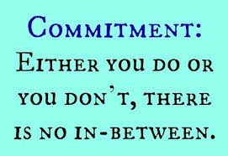


Distributed 2PC & Deadlock
David E. Culler
CS162 – Operating Systems and Systems Programming
Lecture 36
Nov 21, 2014
Reading: OSC Ch 7 (deadlock)

Slide 2
Consistency Review
Problem: shared state replicated across multiple clients, do they see a consistent view?
Propagation: Writes become visible to reads
Serializability: The order of writes seen by each client’s series of reads and writes is consistent with a total order
As if all writes and reads had been serviced at a single point
The total order is not actually generated, but it could be
Many distributed systems provide weaker semantics
Eventual consistency

Slide 3
In Everyday Life
Where do we meet?
Where do we meet?
Where do we meet?
Where do we meet?
At Nefeli’s
At Top Dog
Where do we meet?
Where do we meet?
Where do we meet?
At Nefeli’s
At Nefeli’s
At Nefeli’s
At Top Dog
At Top Dog
At Top Dog
Where do we meet?
Where do we meet?
Where do we meet?
At Nefeli’s
At Top Dog
At Nefeli’s
At Nefeli’s
At Top Dog
Alternative: timestamp every write, present entire log in timestamp order, with tie breaker

Slide 4
Unfinished Business: Multiple Servers
Storage
Server
Storage
Server
?
Client
Finish Previous Lecture
What happens if cannot update all the replicas?
Availability => Inconsistency

Slide 5
Durability and Atomicity
How do you make sure transaction results persist in the face of failures (e.g., server node failures)?
Replicate store / database
Commit transaction to each replica
What happens if you have failures during a transaction commit?
Need to ensure atomicity: either transaction is committed on all replicas or none at all

Slide 6
Two Phase (2PC) Commit
2PC is a distributed protocol
High-level problem statement
If no node fails and all nodes are ready to commit, then all nodes COMMIT
Otherwise ABORT at all nodes
Developed by Turing award winner Jim Gray (first Berkeley CS PhD, 1969)

Slide 7
2PC Algorithm
One coordinator
N workers (replicas)
High level algorithm description
Coordinator asks all workers if they can commit
If all workers reply “VOTE-COMMIT”, then coordinator broadcasts “GLOBAL-COMMIT”,
Otherwise coordinator broadcasts “GLOBAL-ABORT”
Workers obey the GLOBAL messages

Slide 8
Detailed Algorithm
Coordinator Algorithm
Worker Algorithm
Coordinator sends VOTE-REQ to all workers
Wait for VOTE-REQ from coordinator
If ready, send VOTE-COMMIT to coordinator
If not ready, send VOTE-ABORT to coordinator
And immediately abort
If receive VOTE-COMMIT from all N workers, send GLOBAL-COMMIT to all workers
If doesn’t receive VOTE-COMMIT from all N workers, send GLOBAL-ABORT to all workers
If receive GLOBAL-COMMIT then commit
If receive GLOBAL-ABORT then abort

Slide 9
Failure Free Example Execution
coordinator
VOTE-REQ
GLOBAL-COMMIT
worker 1
worker 2
VOTE-COMMIT
worker 3
time

Slide 10
State Machine of Coordinator
Coordinator implements simple state machine
INIT
Recv: START
Send: VOTE-REQ
WAIT
Recv: VOTE-ABORT
Send: GLOBAL-ABORT
Recv: all VOTE-COMMIT
Send: GLOBAL-COMMIT
ABORT
COMMIT

Slide 11
State Machine of Workers
INIT
Recv: VOTE-REQ
Send: VOTE-ABORT
Recv: VOTE-REQ
Send: VOTE-COMMIT
READY
Recv: GLOBAL-ABORT
Recv: GLOBAL-COMMIT
ABORT
COMMIT

Slide 12
Dealing with Worker Failures
How to deal with worker failures?
Failure only affects states in which the node is waiting for messages
Coordinator only waits for votes in “WAIT” state
In WAIT, if doesn’t receive
N votes, it times out and sends
GLOBAL-ABORT
INIT
Recv: START
Send: VOTE-REQ
WAIT
Recv: VOTE-ABORT
Send: GLOBAL-ABORT
Recv: VOTE-COMMIT
Send: GLOBAL-COMMIT
ABORT
COMMIT

Slide 13
Example of Worker Failure
INIT
WAIT
coordinator
ABORT
COMM
timeout
GLOBAL-ABORT
VOTE-REQ
worker 1
VOTE-COMMIT
worker 2
worker 3
time

Slide 14
Dealing with Coordinator Failure
How to deal with coordinator failures?
worker waits for VOTE-REQ in INIT
Worker can time out and abort (coordinator handles it)
worker waits for GLOBAL-* message in READY
If coordinator fails, workers must
BLOCK waiting for coordinator
to recover and send
GLOBAL_* message
INIT
Recv: VOTE-REQ
Send: VOTE-ABORT
Recv: VOTE-REQ
Send: VOTE-COMMIT
READY
Recv: GLOBAL-ABORT
Recv: GLOBAL-COMMIT
ABORT
COMMIT

Slide 15
Example of Coordinator Failure #1
INIT
READY
coordinator
ABORT
COMM
VOTE-REQ
timeout
worker 1
VOTE-ABORT
worker 2
timeout
timeout
worker 3

Slide 16
Example of Coordinator Failure #2
INIT
READY
ABORT
COMM
coordinator
restarted
VOTE-REQ
worker 1
VOTE-COMMIT
GLOBAL-ABORT
worker 2
block waiting for coordinator
worker 3

Slide 17
Durability
All nodes use stable storage* to store which state they are in
Upon recovery, it can restore state and resume:
Coordinator aborts in INIT, WAIT, or ABORT
Coordinator commits in COMMIT
Worker aborts in INIT, ABORT
Worker commits in COMMIT
Worker asks Coordinator in READY
* - stable storage is non-volatile storage (e.g. backed by disk) that guarantees atomic writes.

Slide 18
Blocking for Coordinator to Recover
A worker waiting for global decision can ask fellow workers about their state
If another worker is in ABORT or COMMIT state then coordinator must have sent GLOBAL-*
Thus, worker can safely abort or commit, respectively
If another worker is still in INIT state
then both workers can decide to abort
If all workers are in ready, need to BLOCK (don’t know if coordinator wanted to abort or commit)
INIT
Recv: VOTE-REQ
Send: VOTE-ABORT
Recv: VOTE-REQ
Send: VOTE-COMMIT
READY
Recv: GLOBAL-ABORT
Recv: GLOBAL-COMMIT
ABORT
COMMIT

Slide 19
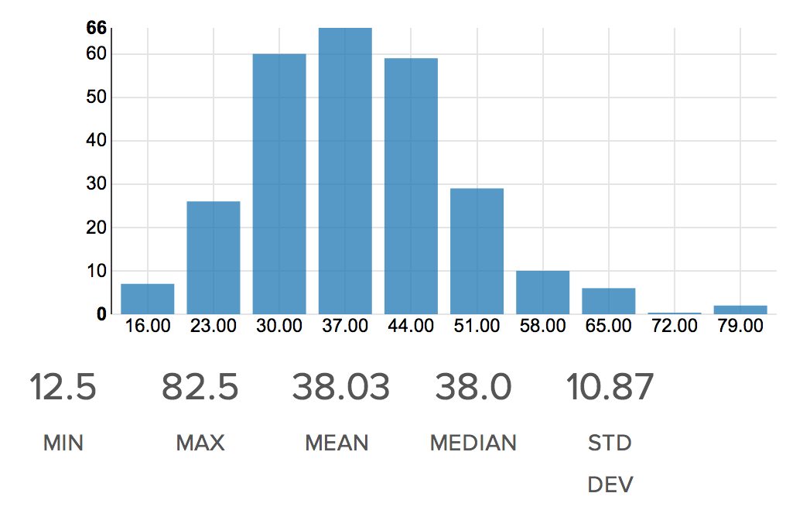
Admin Break
MidTerm (mult by 4/3)

Slide 20
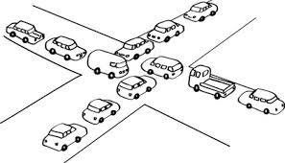
What’s a Deadlock?
Situation where all entities (e.g., threads, clients, …)
have acquired certain resources and
need to acquire additional resources,
but those additional resources are held some other entity that won’t release them

Slide 21
Bridge Crossing Example
Honk!
Each segment of road can be viewed as a resource
Car “owns” the segment under them
Must acquire segment that they are moving into
Must acquire both halves of bridge to cross
Traffic only in one direction at a time
Problem occurs when two cars in opposite directions on bridge: each acquires one segment and needs next
If a deadlock occurs, it can be resolved if one car backs up (preempt resources and rollback)
Several cars may have to be backed up
Starvation is possible
East-going traffic really fast ⇒ no one goes west

Slide 22
OS analog of the bridge
Exclusive Access to Multiple Resouces:
x=1, y=1
Thread A Thread B
x.Down(); y.Down();
y.Down(); x.Down();
… …
y.Up(); x.Up();
x.Up(); y.Up();
Say, x is free-list and y is directory
Deadlock
A: x.Down();
B: y.Down();
A: y.Down();
B: x.Down();
...

Slide 23
Deadlock vs. Starvation
Deadlock: circular waiting for resources
Thread A owns Res 1 and is waiting for Res 2 Thread B owns Res 2 and is waiting for Res 1
Starvation: thread waits indefinitely
Example, low-priority thread waiting for resources constantly in use by high-priority threads
Deadlock ⇒ Starvation, but not vice versa
Starvation can end (but doesn’t have to)
Deadlock can’t end without external intervention
Thread A
Wait
For
Owned
By
Res 1
Res 2
Wait
For
Thread B
Owned
By

Slide 24
OS analog of the bridge
Exclusive Access to Multiple Resouces:
x=1, y=1
Thread A Thread B
x.Down(); y.Down();
y.Down(); x.Down();
… …
y.Up(); x.Up();
x.Up(); y.Up();
Say, x is free-list and y is directory structure
Deadlock is typically not deterministic
Timing in this example has to be “just so”
Deadlocks occur with multiple resources
Can’t solve deadlock for each resource independently
Deadlock
A: x.Down();
B: y.Down();
A: y.Down();
B: x.Down();
...

Slide 25
Can this deadlock?
void transaction(account *from, account *to, double amount) {
acquire(from->lock);
acquire(to->lock);
withdraw(from, amount);
deposit(to, amount);
release(from->lock);
release(to->lock);
}
Under what conditions?

Slide 26
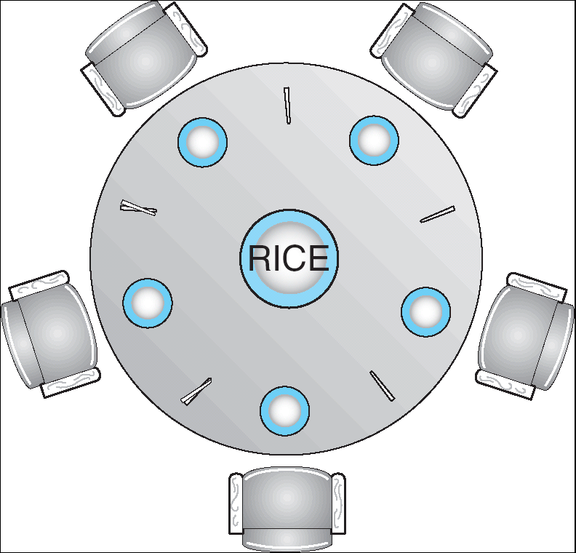
Dining Philosophers Problem
N chopsticks/ N philosophers
Need two chopsticks to eat
Free for all: Philosopher will grab any one they can
What if all grab at same time?
Deadlock!
How to fix deadlock?
Make one of them give up a chopstick (Hah!)
Eventually everyone will get chance to eat
How to prevent deadlock?

Slide 27
Four requirements for Deadlock
Mutual exclusion
Only one thread at a time can use a resource
Hold and wait (incremental allocation)
Thread holding at least one resource is waiting to acquire additional resources held by other threads
No preemption
Resources are released only voluntarily by the thread holding the resource, after thread is finished with it
Circular wait
e.g, There exists a set {T₁, …, T_{n}} of waiting threads,
T₁ is waiting for a resource that is held by T₂
T₂ is waiting for a resource that is held by T₃, …
T_{n} is waiting for a resource that is held by T₁

Slide 28
Methods for Handling Deadlocks
Deadlock prevention: design system to ensure that it will never enter a deadlock
E.g., monitor all lock acquisitions
Selectively deny those that might lead to deadlock
Allow system to enter deadlock and then recover
Requires deadlock detection algorithm
E.g., Java JMX findDeadlockedThreads()
Some technique for forcibly preempting resources and/or terminating tasks
Ignore the problem and hope that deadlocks never occur in the system
Used by most operating systems, including UNIX
Resort to manual version of recovery

Slide 29
Techniques for Deadlock Prevention
Eliminate the Shared Resources
E.g., give each Philosopher two chopsticks, open the other bridge lane, …
Or at least two virtual chopsticks
OK, if sharing was do to resource limitations
Not if sharing is due to true interactions
Must modify Directory Structure AND File Index AND the Block Free list
Must enter the intersection to turn left

Slide 30
Techniques for Deadlock Prevention
Eliminate the Shared Resources
Eliminate the Mutual Exclusion
E.g., many processes can have read-only access to file
But still need mutual-exclusion for writing

Slide 31
Techniques for Deadlock Prevention
Eliminate the Shared Resources
Eliminate the Mutual Exclusion
Eliminate Hold-and-Wait

Slide 32
Acquire all resources up front
Philosopher grabs for both chopsticks at once
If not both available, don’t pickup either, try again later
Phone call signaling attempts to acquire resources all along the path, “busy” if any point not available
File Systems: lock {dir. Structure, file index, free list}
Or the piece of each in a common block group
Databases: lock all tables touched by the query
Hard in general, but often natural in specific cases

Slide 33
Techniques for Deadlock Prevention
Eliminate the Shared Resources
Eliminate the Mutual Exclusion
Eliminate Hold-and-Wait
Permit pre-emption

Slide 34
Incremental Acquisition with Pre-emption
Philosopher grabs one, goes for other, if not available, releases the first
Analogous for sequence of system resources
Danger of turning deadlock into livelock
Everyone is grabbing and releasing, no one every gets two
Works great at low utilization
Potential for thrashing (or failure) as utilization increases
Similar to CSMA (carrier sense multiple access) in networks
Randomize the back-off

Slide 35
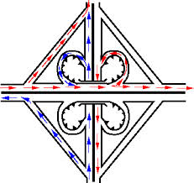
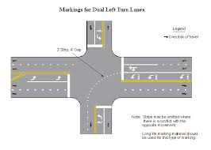
Techniques for Deadlock Prevention
Eliminate the Shared Resources
Eliminate the Mutual Exclusion
Eliminate Hold-and-Wait
Permit pre-emption
Eliminate the creation of circular wait
Dedicated resources to break cycles
Ordering on the acquisition of resources

Slide 36
Cyclic Dependence of resources
2
3
1
4
0
Suppose everyone grabs left first
Acquisition of the right chopstick depends on the acquisition of the left one
A cycle of dependences forms

Slide 37
Ordered Acquisition to prevent cycle from forming
2
3
1
4
0
Suppose everyone grabs lowest first
Dependence graph is acyclic
Someone will fail to grab chopstick 0 !
How do you modify the rule to retain fairness ?
OS: define ordered set of resource classes
Acquire locks on resources in order
Page Table => Memory Blocks => …

Slide 38
Deadlock Detection
There are threads that never become ready
Are they deadlocked or just … ?

Slide 39
A Simple Resource Graph
System Model
A set of Threads T₁, T₂, . . ., T_{n}
Resource types R₁, R₂, . . ., R_{m}
locks in this case
Each thread utilizes a resource as follows:
Request() / Use() / Release()
Resource-Allocation Graph:
V is partitioned into two types:
T = {T₁, T₂, …, T_{n}}, the set threads in the system.
R = {R₁, R₂, …, R_{m}}, the set of resource types in system
request edge – directed edge T_{i} → R_{j}
_{Wait-List}
assignment edge – directed edge R_{j} → T_{i}
_{Owns}
Symbols
T₁
T₂
R₁
R₂

Slide 40
Resource Allocation Graph Examples
R₁
R₂
R₁
R₂
T₁
T₂
T₃
T₁
T₂
T₃
R₃
R₃
R₄
R₄
Simple Resource
Allocation Graph
Deadlocked Resource
Allocation Graph

Slide 41
How would you look for cycles?

Slide 42
Resource Allocation Graph Examples
R₁
R₂
R₁
R₂
T₁
T₂
T₃
T₁
T₂
T₃
R₃
R₃
R₄
R₄
Simple Resource
Allocation Graph
Deadlocked Resource
Allocation Graph

Slide 43
How would avoid cycle creation ?
On attempt to acquire an owned lock
Check to see if adding the request edge would create a cycle
R₁
R₂
T₁
T₂
T₃
R₃
R₄

Slide 44
More General Case
Each resources has a capacity (# instances)
Each thread requests a portion of each resource

Slide 45
General Resource-Allocation Graph
System Model
A set of Threads T₁, T₂, . . ., T_{n}
Resource types R₁, R₂, . . ., R_{m}
CPU cycles, memory space, I/O devices
Each resource type R_{i} has W_{i} instances.
Each thread utilizes a resource as follows:
Request() / Use() / Release()
Resource-Allocation Graph:
V is partitioned into two types:
T = {T₁, T₂, …, T_{n}}, the set threads in the system.
R = {R₁, R₂, …, R_{m}}, the set of resource types in system
request edge – directed edge T_{i} → R_{j}
assignment edge – directed edge R_{j} → T_{i}
Symbols
T₁
T₂
R₁
R₂

Slide 46
Resource Allocation Graph Examples
Recall:
request edge – directed edge T_{i} → R_{j}
assignment edge – directed edge R_{j} → T_{i}
R₁
R₂
R₁
R₂
R₁
T₂
T₁
T₂
T₃
T₁
T₂
T₃
T₁
T₃
R₃
T₄
R₄
R₃
R₂
R₄
Simple Resource
Allocation Graph
Allocation Graph With Deadlock
Allocation Graph With Cycle, but
No Deadlock

Slide 47
Deadlock Detection Algorithm
Only one of each type of resource ⇒ look for loops
More General Deadlock Detection Algorithm
Let [X] represent an m-ary vector of non-negative integers (quantities of resources of each type):
[FreeResources]: Current free resources each type [Request_{X}]: Current requests from thread X [Alloc_{X}]: Current resources held by thread X
See if tasks can eventually terminate on their own
[Avail] = [FreeResources] Add all nodes to UNFINISHED do {
done = true Foreach node in UNFINISHED { if ([Request_{node}] <= [Avail]) { remove node from UNFINISHED [Avail] = [Avail] + [Alloc_{node}] done = false } } } until(done)
Nodes left in UNFINISHED ⇒ deadlocked
R₁
T₂
T₁
T₃
T₄
R₂

Slide 48
Deadlock Detection Algorithm Example
[Request_{T1}] = [1,0]; Alloc_{T1} = [0,1]
[Request_{T2}] = [0,0]; Alloc_{T2} = [1,0]
[Request_{T3}] = [0,1]; Alloc_{T3} = [1,0]
[Request_{T4}] = [0,0]; Alloc_{T4} = [0,1]
[Avail] = [0,0]
UNFINISHED = {T1,T2,T3,T4}
do {
done = true Foreach node in UNFINISHED { if ([Request_{node}] <= [Avail]) { remove node from UNFINSHED [Avail] = [Avail] + [Alloc_{node}] done = false }
} } until(done)
R₁
T₂
T₁
T₃
T₄
R₂

Slide 49
Deadlock Detection Algorithm Example
[Request_{T1}] = [1,0]; Alloc_{T1} = [0,1]
[Request_{T2}] = [0,0]; Alloc_{T2} = [1,0]
[Request_{T3}] = [0,1]; Alloc_{T3} = [1,0]
[Request_{T4}] = [0,0]; Alloc_{T4} = [0,1]
[Avail] = [0,0]
UNFINISHED = {T1,T2,T3,T4}
do {
done = true Foreach node in UNFINISHED { if ([Request_{T1}] <= [Avail]) { remove node from UNFINSHED [Avail] = [Avail] + [Alloc_{T1}] done = false }
} } until(done)
R₁
T₂
T₁
T₃
False
T₄
R₂

Slide 50
Deadlock Detection Algorithm Example
[Request_{T1}] = [1,0]; Alloc_{T1} = [0,1]
[Request_{T2}] = [0,0]; Alloc_{T2} = [1,0]
[Request_{T3}] = [0,1]; Alloc_{T3} = [1,0]
[Request_{T4}] = [0,0]; Alloc_{T4} = [0,1]
[Avail] = [0,0]
UNFINISHED = {T1,T2,T3,T4}
do {
done = true Foreach node in UNFINISHED { if ([Request_{node}] <= [Avail]) { remove node from UNFINSHED [Avail] = [Avail] + [Alloc_{node}] done = false }
} } until(done)
R₁
T₂
T₁
T₃
T₄
R₂

Slide 51
Deadlock Detection Algorithm Example
[Request_{T1}] = [1,0]; Alloc_{T1} = [0,1]
[Request_{T2}] = [0,0]; Alloc_{T2} = [1,0]
[Request_{T3}] = [0,1]; Alloc_{T3} = [1,0]
[Request_{T4}] = [0,0]; Alloc_{T4} = [0,1]
[Avail] = [0,0]
UNFINISHED = {T1,T2,T3,T4}
do {
done = true Foreach node in UNFINISHED { if ([Request_{T2}] <= [Avail]) { remove node from UNFINSHED [Avail] = [Avail] + [Alloc_{T2}] done = false }
} } until(done)
R₁
T₂
T₁
T₃
T₄
R₂

Slide 52
Deadlock Detection Algorithm Example
[Request_{T1}] = [1,0]; Alloc_{T1} = [0,1]
[Request_{T2}] = [0,0]; Alloc_{T2} = [1,0]
[Request_{T3}] = [0,1]; Alloc_{T3} = [1,0]
[Request_{T4}] = [0,0]; Alloc_{T4} = [0,1]
[Avail] = [0,0]
UNFINISHED = {T1,T3,T4}
do {
done = true Foreach node in UNFINISHED { if ([Request_{T2}] <= [Avail]) { remove node from UNFINSHED [Avail] = [Avail] + [Alloc_{T2}] done = false }
} } until(done)
R₁
T₂
T₁
T₃
T₄
R₂

Slide 53
Deadlock Detection Algorithm Example
[Request_{T1}] = [1,0]; Alloc_{T1} = [0,1]
[Request_{T2}] = [0,0]; Alloc_{T2} = [1,0]
[Request_{T3}] = [0,1]; Alloc_{T3} = [1,0]
[Request_{T4}] = [0,0]; Alloc_{T4} = [0,1]
[Avail] = [1,0]
UNFINISHED = {T1,T3,T4}
do {
done = true Foreach node in UNFINISHED { if ([Request_{T2}] <= [Avail]) { remove node from UNFINSHED [Avail] = [Avail] + [Alloc_{T2}] done = false }
} } until(done)
R₁
T₂
T₁
T₃
T₄
R₂

Slide 54
Deadlock Detection Algorithm Example
[Request_{T1}] = [1,0]; Alloc_{T1} = [0,1]
[Request_{T2}] = [0,0]; Alloc_{T2} = [1,0]
[Request_{T3}] = [0,1]; Alloc_{T3} = [1,0]
[Request_{T4}] = [0,0]; Alloc_{T4} = [0,1]
[Avail] = [1,0]
UNFINISHED = {T1,T3,T4}
do {
done = true Foreach node in UNFINISHED { if ([Request_{T2}] <= [Avail]) { remove node from UNFINSHED [Avail] = [Avail] + [Alloc_{T2}] done = false }
} } until(done)
R₁
T₂
T₁
T₃
T₄
R₂

Slide 55
Deadlock Detection Algorithm Example
[Request_{T1}] = [1,0]; Alloc_{T1} = [0,1]
[Request_{T2}] = [0,0]; Alloc_{T2} = [1,0]
[Request_{T3}] = [0,1]; Alloc_{T3} = [1,0]
[Request_{T4}] = [0,0]; Alloc_{T4} = [0,1]
[Avail] = [1,0]
UNFINISHED = {T1,T3,T4}
do {
done = true Foreach node in UNFINISHED { if ([Request_{node}] <= [Avail]) { remove node from UNFINSHED [Avail] = [Avail] + [Alloc_{node}] done = false }
} } until(done)
R₁
T₂
T₁
T₃
T₄
R₂

Slide 56
Deadlock Detection Algorithm Example
[Request_{T1}] = [1,0]; Alloc_{T1} = [0,1]
[Request_{T2}] = [0,0]; Alloc_{T2} = [1,0]
[Request_{T3}] = [0,1]; Alloc_{T3} = [1,0]
[Request_{T4}] = [0,0]; Alloc_{T4} = [0,1]
[Avail] = [1,0]
UNFINISHED = {T1,T3,T4}
do {
done = true Foreach node in UNFINISHED { if ([Request_{T3}] <= [Avail]) { remove node from UNFINSHED [Avail] = [Avail] + [Alloc_{T3}] done = false }
} } until(done)
R₁
T₂
T₁
T₃
T₄
R₂

Slide 57
Deadlock Detection Algorithm Example
[Request_{T1}] = [1,0]; Alloc_{T1} = [0,1]
[Request_{T2}] = [0,0]; Alloc_{T2} = [1,0]
[Request_{T3}] = [0,1]; Alloc_{T3} = [1,0]
[Request_{T4}] = [0,0]; Alloc_{T4} = [0,1]
[Avail] = [1,0]
UNFINISHED = {T1,T3,T4}
do {
done = true Foreach node in UNFINISHED { if ([Request_{node}] <= [Avail]) { remove node from UNFINSHED [Avail] = [Avail] + [Alloc_{node}] done = false }
} } until(done)
R₁
T₂
T₁
T₃
T₄
R₂

Slide 58
Deadlock Detection Algorithm Example
[Request_{T1}] = [1,0]; Alloc_{T1} = [0,1]
[Request_{T2}] = [0,0]; Alloc_{T2} = [1,0]
[Request_{T3}] = [0,1]; Alloc_{T3} = [1,0]
[Request_{T4}] = [0,0]; Alloc_{T4} = [0,1]
[Avail] = [1,0]
UNFINISHED = {T1,T3,T4}
do {
done = true Foreach node in UNFINISHED { if ([Request_{T4}] <= [Avail]) { remove node from UNFINSHED [Avail] = [Avail] + [Alloc_{T4}] done = false }
} } until(done)
R₁
T₂
T₁
T₃
T₄
R₂

Slide 59
Deadlock Detection Algorithm Example
[Request_{T1}] = [1,0]; Alloc_{T1} = [0,1]
[Request_{T2}] = [0,0]; Alloc_{T2} = [1,0]
[Request_{T3}] = [0,1]; Alloc_{T3} = [1,0]
[Request_{T4}] = [0,0]; Alloc_{T4} = [0,1]
[Avail] = [1,0]
UNFINISHED = {T1,T3}
do {
done = true Foreach node in UNFINISHED { if ([Request_{T4}] <= [Avail]) { remove node from UNFINSHED [Avail] = [Avail] + [Alloc_{T4}] done = false }
} } until(done)
R₁
T₂
T₁
T₃
T₄
R₂

Slide 60
Deadlock Detection Algorithm Example
[Request_{T1}] = [1,0]; Alloc_{T1} = [0,1]
[Request_{T2}] = [0,0]; Alloc_{T2} = [1,0]
[Request_{T3}] = [0,1]; Alloc_{T3} = [1,0]
[Request_{T4}] = [0,0]; Alloc_{T4} = [0,1]
[Avail] = [1,1]
UNFINISHED = {T1,T3}
do {
done = true Foreach node in UNFINISHED { if ([Request_{T4}] <= [Avail]) { remove node from UNFINSHED [Avail] = [Avail] + [Alloc_{T4}] done = false }
} } until(done)
R₁
T₂
T₁
T₃
T₄
R₂

Slide 61
Deadlock Detection Algorithm Example
[Request_{T1}] = [1,0]; Alloc_{T1} = [0,1]
[Request_{T2}] = [0,0]; Alloc_{T2} = [1,0]
[Request_{T3}] = [0,1]; Alloc_{T3} = [1,0]
[Request_{T4}] = [0,0]; Alloc_{T4} = [0,1]
[Avail] = [1,1]
UNFINISHED = {T1,T3}
do {
done = true Foreach node in UNFINISHED { if ([Request_{T4}] <= [Avail]) { remove node from UNFINSHED [Avail] = [Avail] + [Alloc_{T4}] done = false }
} } until(done)
R₁
T₂
T₁
T₃
T₄
R₂

Slide 62
Deadlock Detection Algorithm Example
[Request_{T1}] = [1,0]; Alloc_{T1} = [0,1]
[Request_{T2}] = [0,0]; Alloc_{T2} = [1,0]
[Request_{T3}] = [0,1]; Alloc_{T3} = [1,0]
[Request_{T4}] = [0,0]; Alloc_{T4} = [0,1]
[Avail] = [1,1]
UNFINISHED = {T1,T3}
do {
done = true Foreach node in UNFINISHED { if ([Request_{T4}] <= [Avail]) { remove node from UNFINSHED [Avail] = [Avail] + [Alloc_{T4}] done = false }
} } until(done)
R₁
T₂
T₁
T₃
T₄
R₂
False

Slide 63
Deadlock Detection Algorithm Example
[Request_{T1}] = [1,0]; Alloc_{T1} = [0,1]
[Request_{T2}] = [0,0]; Alloc_{T2} = [1,0]
[Request_{T3}] = [0,1]; Alloc_{T3} = [1,0]
[Request_{T4}] = [0,0]; Alloc_{T4} = [0,1]
[Avail] = [1,1]
UNFINISHED = {T1,T3}
do {
done = true Foreach node in UNFINISHED { if ([Request_{node}] <= [Avail]) { remove node from UNFINSHED [Avail] = [Avail] + [Alloc_{node}] done = false }
} } until(done)
R₁
T₂
T₁
T₃
T₄
R₂

Slide 64
Deadlock Detection Algorithm Example
[Request_{T1}] = [1,0]; Alloc_{T1} = [0,1]
[Request_{T2}] = [0,0]; Alloc_{T2} = [1,0]
[Request_{T3}] = [0,1]; Alloc_{T3} = [1,0]
[Request_{T4}] = [0,0]; Alloc_{T4} = [0,1]
[Avail] = [1,1]
UNFINISHED = {T1,T3}
do {
done = true Foreach node in UNFINISHED { if ([Request_{T1}] <= [Avail]) { remove node from UNFINSHED [Avail] = [Avail] + [Alloc_{T1}] done = false }
} } until(done)
R₁
T₂
T₁
T₃
T₄
R₂

Slide 65
Deadlock Detection Algorithm Example
[Request_{T1}] = [1,0]; Alloc_{T1} = [0,1]
[Request_{T2}] = [0,0]; Alloc_{T2} = [1,0]
[Request_{T3}] = [0,1]; Alloc_{T3} = [1,0]
[Request_{T4}] = [0,0]; Alloc_{T4} = [0,1]
[Avail] = [1,1]
UNFINISHED = {T3}
do {
done = true Foreach node in UNFINISHED { if ([Request_{T1}] <= [Avail]) { remove node from UNFINSHED [Avail] = [Avail] + [Alloc_{T1}] done = false }
} } until(done)
R₁
T₂
T₁
T₃
T₄
R₂

Slide 66
Deadlock Detection Algorithm Example
[Request_{T1}] = [1,0]; Alloc_{T1} = [0,1]
[Request_{T2}] = [0,0]; Alloc_{T2} = [1,0]
[Request_{T3}] = [0,1]; Alloc_{T3} = [1,0]
[Request_{T4}] = [0,0]; Alloc_{T4} = [0,1]
[Avail] = [1,2]
UNFINISHED = {T3}
do {
done = true Foreach node in UNFINISHED { if ([Request_{T1}] <= [Avail]) { remove node from UNFINSHED [Avail] = [Avail] + [Alloc_{T1}] done = false }
} } until(done)
R₁
T₂
T₁
T₃
T₄
R₂

Slide 67
Deadlock Detection Algorithm Example
[Request_{T1}] = [1,0]; Alloc_{T1} = [0,1]
[Request_{T2}] = [0,0]; Alloc_{T2} = [1,0]
[Request_{T3}] = [0,1]; Alloc_{T3} = [1,0]
[Request_{T4}] = [0,0]; Alloc_{T4} = [0,1]
[Avail] = [1,2]
UNFINISHED = {T3}
do {
done = true Foreach node in UNFINISHED { if ([Request_{T1}] <= [Avail]) { remove node from UNFINSHED [Avail] = [Avail] + [Alloc_{T1}] done = false }
} } until(done)
R₁
T₂
T₁
T₃
T₄
R₂

Slide 68
Deadlock Detection Algorithm Example
[Request_{T1}] = [1,0]; Alloc_{T1} = [0,1]
[Request_{T2}] = [0,0]; Alloc_{T2} = [1,0]
[Request_{T3}] = [0,1]; Alloc_{T3} = [1,0]
[Request_{T4}] = [0,0]; Alloc_{T4} = [0,1]
[Avail] = [1,2]
UNFINISHED = {T3}
do {
done = true Foreach node in UNFINISHED { if ([Request_{node}] <= [Avail]) { remove node from UNFINSHED [Avail] = [Avail] + [Alloc_{node}] done = false }
} } until(done)
R₁
T₂
T₁
T₃
T₄
R₂

Slide 69
Deadlock Detection Algorithm Example
[Request_{T1}] = [1,0]; Alloc_{T1} = [0,1]
[Request_{T2}] = [0,0]; Alloc_{T2} = [1,0]
[Request_{T3}] = [0,1]; Alloc_{T3} = [1,0]
[Request_{T4}] = [0,0]; Alloc_{T4} = [0,1]
[Avail] = [1,2]
UNFINISHED = {T3}
do {
done = true Foreach node in UNFINISHED { if ([Request_{T3}] <= [Avail]) { remove node from UNFINSHED [Avail] = [Avail] + [Alloc_{T3}] done = false }
} } until(done)
R₁
T₂
T₁
T₃
T₄
R₂

Slide 70
Deadlock Detection Algorithm Example
[Request_{T1}] = [1,0]; Alloc_{T1} = [0,1]
[Request_{T2}] = [0,0]; Alloc_{T2} = [1,0]
[Request_{T3}] = [0,1]; Alloc_{T3} = [1,0]
[Request_{T4}] = [0,0]; Alloc_{T4} = [0,1]
[Avail] = [1,2]
UNFINISHED = {}
do {
done = true Foreach node in UNFINISHED { if ([Request_{T3}] <= [Avail]) { remove node from UNFINSHED [Avail] = [Avail] + [Alloc_{T3}] done = false }
} } until(done)
R₁
T₂
T₁
T₃
T₄
R₂

Slide 71
Deadlock Detection Algorithm Example
[Request_{T1}] = [1,0]; Alloc_{T1} = [0,1]
[Request_{T2}] = [0,0]; Alloc_{T2} = [1,0]
[Request_{T3}] = [0,1]; Alloc_{T3} = [1,0]
[Request_{T4}] = [0,0]; Alloc_{T4} = [0,1]
[Avail] = [2,2]
UNFINISHED = {}
do {
done = true Foreach node in UNFINISHED { if ([Request_{T3}] <= [Avail]) { remove node from UNFINSHED [Avail] = [Avail] + [Alloc_{T3}] done = false }
} } until(done)
R₁
T₂
T₁
T₃
T₄
R₂

Slide 72
Deadlock Detection Algorithm Example
[Request_{T1}] = [1,0]; Alloc_{T1} = [0,1]
[Request_{T2}] = [0,0]; Alloc_{T2} = [1,0]
[Request_{T3}] = [0,1]; Alloc_{T3} = [1,0]
[Request_{T4}] = [0,0]; Alloc_{T4} = [0,1]
[Avail] = [2,2]
UNFINISHED = {}
do {
done = true Foreach node in UNFINISHED { if ([Request_{T3}] <= [Avail]) { remove node from UNFINSHED [Avail] = [Avail] + [Alloc_{T3}] done = false }
} } until(done)
R₁
T₂
T₁
T₃
T₄
R₂

Slide 73
Deadlock Detection Algorithm Example
[Request_{T1}] = [1,0]; Alloc_{T1} = [0,1]
[Request_{T2}] = [0,0]; Alloc_{T2} = [1,0]
[Request_{T3}] = [0,1]; Alloc_{T3} = [1,0]
[Request_{T4}] = [0,0]; Alloc_{T4} = [0,1]
[Avail] = [2,2]
UNFINISHED = {}
do {
done = true Foreach node in UNFINISHED { if ([Request_{T3}] <= [Avail]) { remove node from UNFINSHED [Avail] = [Avail] + [Alloc_{T3}] done = false }
} } until(done)
R₁
T₂
T₁
T₃
T₄
R₂
DONE!

Slide 74
Banker’s Algorithm for Preventing Deadlock
Toward right idea:
State maximum resource needs in advance
Allow particular thread to proceed if:
(available resources - #requested) ≥ max remaining that might be needed by any thread
Banker’s algorithm (less conservative):
Allocate resources dynamically
Evaluate each request and grant if some ordering of threads is still deadlock free afterward
Keeps system in a “SAFE” state, i.e. there exists a sequence {T₁, T₂, … T_{n}} with T₁ requesting all remaining resources, finishing, then T₂ requesting all remaining resources, etc..
Algorithm allows the sum of maximum resource needs of all current threads to be greater than total resources

Slide 75
Banker’s Algorithm
Technique: pretend each request is granted, then run deadlock detection algorithm, substitute ([Request_{node}] ≤ [Avail]) → ([Max_{node}]-[Alloc_{node}] ≤ [Avail])
[FreeResources]: Current free resources each type [Alloc_{X}]: Current resources held by thread X
[Max_{X}]: Max resources requested by thread X
[Avail] = [FreeResources] Add all nodes to UNFINISHED do {
done = true Foreach node in UNFINISHED {
if ([Max_{node}]–[Alloc_{node}]<= [Avail]) { remove node from UNFINISHED [Avail] = [Avail] + [Alloc_{node}] done = false } } } until(done)

Slide 76
Banker’s Algorithm Example
Banker’s algorithm with dining philosophers
“Safe” (won’t cause deadlock) if when try to grab chopstick either:
Not last chopstick
Is last chopstick but someone will have two afterwards
What if k-handed philosophers? Don’t allow if:
It’s the last one, no one would have k
It’s 2nd to last, and no one would have k-1
It’s 3rd to last, and no one would have k-2
…

Slide 77
Summary: Deadlock
Four conditions for deadlocks
Mutual exclusion
Only one thread at a time can use a resource
Hold and wait
Thread holding at least one resource is waiting to acquire additional resources held by other threads
No preemption
Resources are released only voluntarily by the threads
Circular wait
∃ set {T₁, …, T_{n}} of threads with a cyclic waiting pattern
Starvation vs. Deadlock
Starvation: thread waits indefinitely
Deadlock: circular waiting for resources
Deadlock detection and preemption
Deadlock prevention
Loop Detection, Banker’s algorithm

