Slide 1
Introduction to File Systems - beneath the surface
David E. Culler
CS162 – Operating Systems and Systems Programming
Lecture 4
Sept 8, 2014
Reading: A&D 3.1-3, 11.1-2
HW0 due today
HW1: out

Slide 2
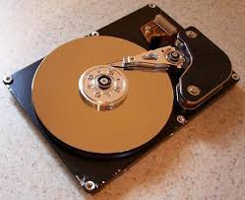
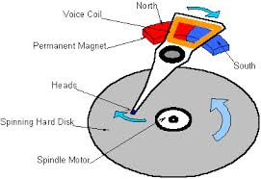
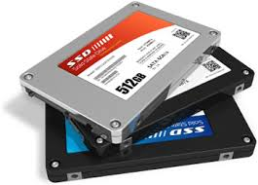

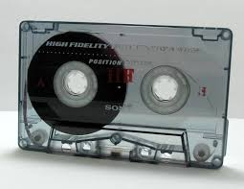
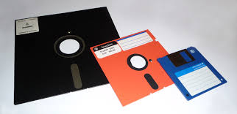
What’s below the surface ??
Application / Service
streams
High Level I/O
Low Level I/O
handles
Syscall
registers
File System
descriptors
I/O Driver
Commands and Data Transfers
Disks, Flash, Controllers, DMA

Slide 3
File Intro recall exercise
What is the namespace introduced by the file system?
Like an address space, but structured names, rather than flat addresses

Slide 4
C Low level I/O
Operations on File Descriptors – as OS object representing the state of a file
User has a “handle” on the descriptor
#include <fcntl.h>
#include <unistd.h>
#include <sys/types.h>
int open (const char *filename, int flags [, mode_t mode])
int close (int filedes)
Bit vector of:
Access modes (Rd, Wr, …)
Open Flags (Create, …)
Operating modes (Appends, …)
Bit vector of Permission Bits:
User|Group|Other X R|W|X
http://www.gnu.org/software/libc/manual/html_node/Opening-and-Closing-Files.html

Slide 5
C Low Level: standard descriptors
#include <unistd.h>
STDIN_FILENO - macro has value 0
STDOUT_FILENO - macro has value 1
STDERR_FILENO - macro has value 2
int fileno (FILE *stream)
FILE * fdopen (int filedes, const char *opentype)
Crossing levels: File descriptors vs. streams
Don’t mix them!

Slide 6
C Low Level Operations
#include <unistd.h>
#include <sys/types.h>
ssize_t read (int filedes, void *buffer, size_t maxsize)
- returns bytes read, 0 => EOF, -1 => error
ssize_t write (int filedes, const void *buffer, size_t size)
- returns bytes written
off_t lseek (int filedes, off_t offset, int whence)
int fsync (int fildes) – wait for i/o to finish
void sync (void) – wait for ALL to finish
When write returns, data is on its way to disk and can be read, but it may not actually be permanent!
ISO C: size_t is the preferred way to declare any arguments or variables that hold the size of an object.
ssize_t return value permits use of -1 to indicate error

Slide 7
A little example: lowio.c
#include <fcntl.h>
#include <unistd.h>
#include <sys/types.h>
int main() {
char buf[1000];
int fd = open("lowio.c", O_RDONLY, S_IRUSR | S_IWUSR);
ssize_t rd = read(fd, buf, sizeof(buf));
int err = close(fd);
ssize_t wr = write(STDOUT_FILENO, buf, rd);
}

Slide 8
And lots more !
TTYs versus files
Memory mapped files
File Locking
Asynchronous I/O
Generic I/O Control Operations
Duplicating descriptors
int dup2 (int old, int new)
int dup (int old)

Slide 9
What’s below the surface ??
Application / Service
streams
High Level I/O
Low Level I/O
handles
Syscall
registers
File System
descriptors
I/O Driver
Commands and Data Transfers
Disks, Flash, Controllers, DMA

Slide 10
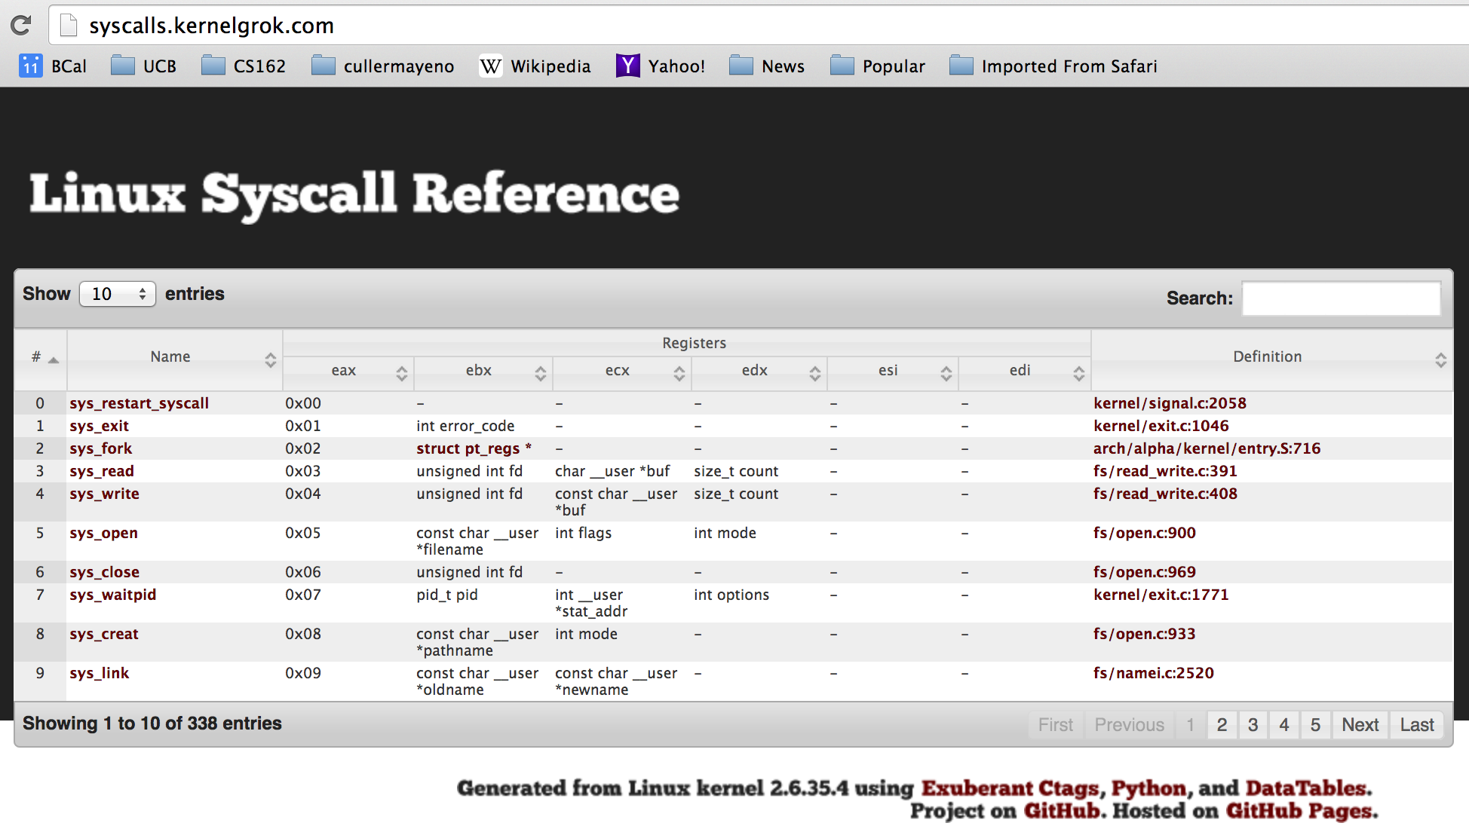
SYSCALL
Low level lib parameters are set up in registers and syscall instruction is issued

Slide 11
What’s below the surface ??
File descriptor number
- an int
Application / Service
streams
High Level I/O
Low Level I/O
handles
Syscall
registers
File System
descriptors
File Descriptors
- a struct with all the info about the files
I/O Driver
Commands and Data Transfers
Disks, Flash, Controllers, DMA

Slide 12
Another: lowio-std.c
#include <stdlib.h>
#include <stdio.h>
#include <string.h>
#include <unistd.h>
#include <sys/types.h>
#define BUFSIZE 1024
int main(int argc, char *argv[])
{
char buf[BUFSIZE];
ssize_t writelen = write(STDOUT_FILENO, "I am a process.\n", 16);
ssize_t readlen = read(STDIN_FILENO, buf, BUFSIZE);
ssize_t strlen = snprintf(buf, BUFSIZE,"Got %zd chars\n", readlen);
writelen = strlen < BUFSIZE ? strlen : BUFSIZE;
write(STDOUT_FILENO, buf, writelen);
exit(0);
}

Slide 13
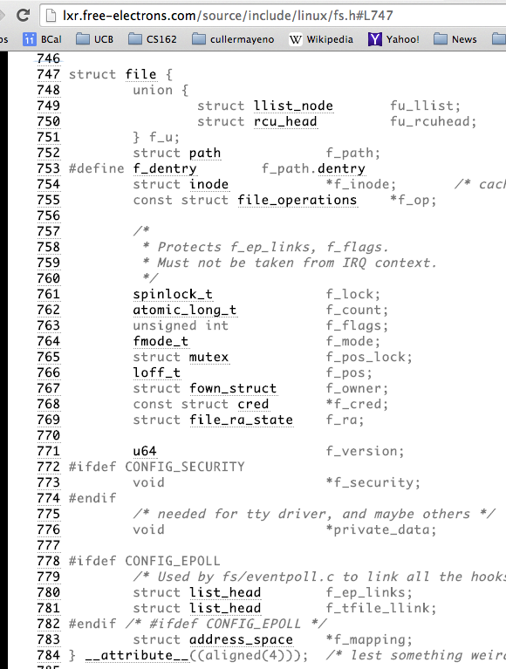
Internal OS File Descriptor
Internal Data Structure describing everything about the file
Where it resides
Its status
How to access it

Slide 14
File System: from syscall to driver
In fs/read_write.c
ssize_t vfs_read(struct file *file, char __user *buf, size_t count, loff_t *pos)
{
ssize_t ret;
if (!(file->f_mode & FMODE_READ)) return -EBADF;
if (!file->f_op || (!file->f_op->read && !file->f_op->aio_read))
return -EINVAL;
if (unlikely(!access_ok(VERIFY_WRITE, buf, count))) return -EFAULT;
ret = rw_verify_area(READ, file, pos, count);
if (ret >= 0) {
count = ret;
if (file->f_op->read)
ret = file->f_op->read(file, buf, count, pos);
else
ret = do_sync_read(file, buf, count, pos);
if (ret > 0) {
fsnotify_access(file->f_path.dentry);
add_rchar(current, ret);
}
inc_syscr(current);
}
return ret;
}

Slide 15
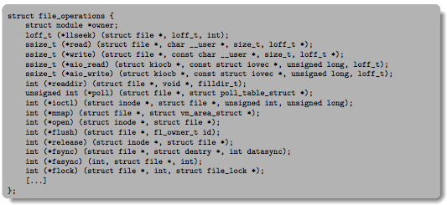
Low Level Driver
Associated with particular hardware device
Registers / Unregisters itself with the kernel
Handler functions for each of the file operations

Slide 16
So what happens when you fgetc?
Application / Service
streams
High Level I/O
handles
Low Level I/O
registers
Syscall
File System
descriptors
I/O Driver
Commands and Data Transfers
Disks, Flash, Controllers, DMA

Slide 17
Breather

Slide 18
Question
Process is an instance of a program executing.
The fundamental OS responsibility
Processes do their work by processing and calling file system operations
Are their any operations on processes themselves?
exit ?

Slide 19
pid.c
#include <stdlib.h>
#include <stdio.h>
#include <string.h>
#include <unistd.h>
#include <sys/types.h>
#define BUFSIZE 1024
int main(int argc, char *argv[])
{
int c;
pid_t pid = getpid(); /* get current processes PID */
printf("My pid: %d\n", pid);
c = fgetc(stdin);
exit(0);
}
ps anyone?

Slide 20
Can a process create a process ?
Yes
Fork creates a copy of process

Slide 21
fork1.c
#include <stdlib.h>
#include <stdio.h>
#include <string.h>
#include <unistd.h>
#include <sys/types.h>
#define BUFSIZE 1024
int main(int argc, char *argv[])
{
char buf[BUFSIZE];
size_t readlen, writelen, slen;
pid_t cpid, mypid;
pid_t pid = getpid(); /* get current processes PID */
printf("Parent pid: %d\n", pid);
cpid = fork();
if (cpid > 0) { /* Parent Process */
mypid = getpid();
printf("[%d] parent of [%d]\n", mypid, cpid);
} else if (cpid == 0) { /* Child Process */
mypid = getpid();
printf("[%d] child\n", mypid);
} else {
perror("Fork failed");
exit(1);
}
exit(0);
}

Slide 22
UNIX Process Management
UNIX fork – system call to create a copy of the current process, and start it running
No arguments!
UNIX exec – system call to change the program being run by the current process
UNIX wait – system call to wait for a process to finish
UNIX signal – system call to send a notification to another process
Notes:
UNIX splits creating a process into two steps, each of them a lot simpler.

Slide 23
fork2.c
…
cpid = fork();
if (cpid > 0) { /* Parent Process */
mypid = getpid();
printf("[%d] parent of [%d]\n", mypid, cpid);
tcpid = wait(&status);
printf("[%d] bye %d\n", mypid, tcpid);
} else if (cpid == 0) { /* Child Process */
mypid = getpid();
printf("[%d] child\n", mypid);
}
…

Slide 24
UNIX Process Management
Notes:
How is this used – typically, fork a process, child and parent are now both running the same program. One sets up the child program, and runs exec – becoming the new program
The parent, usually, waits for the child to finish

Slide 25
Shell
A shell is a job control system
Allows programmer to create and manage a set of programs to do some task
Windows, MacOS, Linux all have shells
Example: to compile a C program
cc –c sourcefile1.c
cc –c sourcefile2.c
ln –o program sourcefile1.o sourcefile2.o
./program
HW1

Slide 26
Signals – infloop.c
#include <stdlib.h>
#include <stdio.h>
#include <sys/types.h>
#include <unistd.h>
#include <signal.h>
void signal_callback_handler(int signum)
{
printf("Caught signal %d - phew!\n",signum);
exit(1);
}
int main() {
signal(SIGINT, signal_callback_handler);
while (1) {}
}
Got top?

Slide 27
Process races: fork.c
if (cpid > 0) {
mypid = getpid();
printf("[%d] parent of [%d]\n", mypid, cpid);
for (i=0; i<100; i++) {
printf("[%d] parent: %d\n", mypid, i);
// sleep(1);
}
} else if (cpid == 0) {
mypid = getpid();
printf("[%d] child\n", mypid);
for (i=0; i>-100; i--) {
printf("[%d] child: %d\n", mypid, i);
// sleep(1);
}
}

Slide 28
BIG OS Concepts so far
Processes
Address Space
Protection
Dual Mode
Interrupt handlers (including syscall and trap)
File System
Integrates processes, users, cwd, protection
Key Layers: OS Lib, Syscall, Subsystem, Driver
User handler on OS descriptors
Process control
fork, wait, signal --- exec

Slide 29
Code for this lecture
http://cs162.eecs.berkeley.edu/static/lectures/code04/fork.c
http://cs162.eecs.berkeley.edu/static/lectures/code04/fork1.c
http://cs162.eecs.berkeley.edu/static/lectures/code04/fork2.c
http://cs162.eecs.berkeley.edu/static/lectures/code04/infloop.c
http://cs162.eecs.berkeley.edu/static/lectures/code04/lowio-std.c
http://cs162.eecs.berkeley.edu/static/lectures/code04/lowio.c
http://cs162.eecs.berkeley.edu/static/lectures/code04/pid.c

