Slide 1
Recap – Home Stretch
David E. Culler
CS162 – Operating Systems and Systems Programming
http://cs162.eecs.berkeley.edu/
Lecture 43
December 10, 2014

Slide 2
Course Structure: Spiral
File Systems (8)
Address Space (4)
Concurrency (6)
Reliability, Security, Cloud (8)
Distributed Systems (8)
OS Concepts (3)
intro

Slide 3
What is an operating system?
Special layer of software that provides application software access to hardware resources
Convenient abstraction of complex hardware devices
Protected access to shared resources
Security and authentication
Communication amongst logical entities
appln
appln
appln
OS
Hardware

Slide 4



What is an Operating System?
Referee
Manage sharing of resources, Protection, Isolation
Resource allocation, isolation, communication
Illusionist
Provide clean, easy to use abstractions of physical resources
Infinite memory, dedicated machine
Higher level objects: files, users, messages
Masking limitations, virtualization
Glue
Common services
Storage, Window system, Networking
Sharing, Authorization
Look and feel

Slide 5
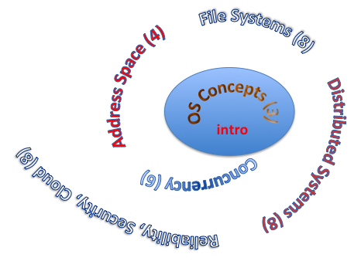
Core Concepts
Processes
Thread(s) + address space
Address Space
Protection
Dual Mode
Interrupt handlers
Interrupts, exceptions, syscall
File System
Integrates processes, users, cwd, protection
Key Layers: OS Lib, Syscall, Subsystem, Driver
User handler on OS descriptors
Process control
fork, wait, signal, exec
Communication through sockets
Integrates processes, protection, file ops, concurrency
Client-Server Protocol
Concurrent Execution: Threads
Scheduling

Slide 6
Threads
Process 1
Process N
threads
threads
Independently schedulable entity
Sequential thread of execution that runs concurrently with other threads
It can block waiting for something while others progress
It can work in parallel with others (ala cs61c)
Has local state (its stack) and shared (static data and heap)
Mem.
Mem.
…
IO
state
…
…
IO
state
CPU
state
CPU
state
CPU
state
CPU
state
CPU sched.
OS
1 thread at a time
CPU
(1 core)

Slide 7
Concurrency Coordination Landscape
Concurrent Applications
lecture 8
Shared Coordinated Objects
Bounded Queue
Flag
Ordered List
Dictionary
Barrier
Synchronization Variables
Monitors
Locks
Condition Variables
Semaphore
Atomic Operations
Interrupt Disable/Enable
Test-and-Set
Hardware
xchng
cmp&swap
Interrupts
Controllers
Multiple Processors
fetch&inc
LL + SC

Slide 8
Definitions
Synchronization: using atomic operations to ensure cooperation between threads
For now, only loads and stores are atomic
We’ll show that is hard to build anything useful with only reads and writes
Critical Section: piece of code that only one thread can execute at once
Mutual Exclusion: ensuring that only one thread executes critical section
One thread excludes the other while doing its task
Critical section and mutual exclusion are two ways of describing the same thing

Slide 9
Scheduling Summary
Scheduling: selecting a process from the ready queue and allocating the CPU to it
FCFS Scheduling:
Run threads to completion in order of submission
Pros: Simple (+)
Cons: Short jobs get stuck behind long ones (-)
Round-Robin Scheduling:
Give each thread a small amount of CPU time when it executes; cycle between all ready threads
Pros: Better for short jobs (+)
Cons: Poor when jobs are same length (-)
Shortest Remaining Time First (SRTF):
Run whatever job has the least remaining amount of computation to do
Pros: Optimal (average response time)
Cons: Hard to predict future, Unfair

Slide 10
Address Translation

Slide 11
Summary of Translation
Memory is a resource that must be multiplexed
Controlled Overlap: only shared when appropriate
Translation: Change virtual addresses into physical addresses
Protection: Prevent unauthorized sharing of resources
Simple Protection through segmentation
Base + Limit registers restrict memory accessible to user
Can be used to translate as well
Page Tables
Memory divided into fixed-sized chunks of memory
Offset of virtual address same as physical address
Multi-Level Tables
Virtual address mapped to series of tables
Permit sparse population of address space
Inverted page table: size of page table related to physical memory size

Slide 12
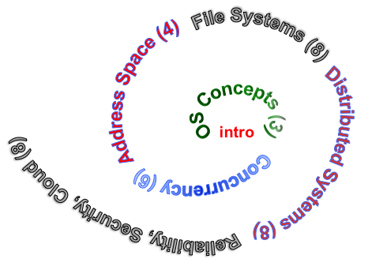
Objective
Dive deeper into the concepts and mechanisms of address translation
Enabler of many key aspects of operating systems
Protection
Multi-programming
Isolation
Memory resource management
I/O efficiency
Sharing
Inter-process communication
Debugging
Demand paging
Today: Linking, Segmentation, Paged Virtual Address

Slide 13
How to Implement Paging?
Virtual Address:
Virtual
Page #
Offset
PageTablePtr
page #0
V,R
Physical
Page #
Offset
page #1
V,R
page #1
V,R
page #2
V,R,W
Physical Address
PageTableSize
>
page #3
V,R,W
Check Perm
Access
Error
page #4
N
page #5
V,R,W
Access
Error
Page Table (One per process)
Resides in physical memory
Contains physical page and permission for each virtual page
Permissions include: Valid bits, Read, Write, etc
Virtual address mapping
Offset from Virtual address copied to Physical Address
Example: 10 bit offset ⇒ 1024-byte pages
Virtual page # is all remaining bits
Example for 32-bits: 32-10 = 22 bits, i.e. 4 million entries
Physical page # copied from table into physical address
Check Page Table bounds and permissions

Slide 14
Summary: Two-Level Paging
Virtual memory view
Page Tables
(level 2)
Physical memory view
1111 1111
stack
11 11101
10 11100
01 10111
00 10110
stack
1110 0000
1111 0000
1100 0000
Page Table
(level 1)
stack
111
110 null
101 null
100
011 null
010
001 null
000
11 null
10 10000
01 01111
00 01110
heap
1000 0000
heap
0111 000
11 01101
10 01100
01 01011
00 01010
data
data
0101 000
0100 0000
11 00101
10 00100
01 00011
00 00010
code
page2 #
code
0001 0000
0000 0000
0000 0000
page1 #
offset

Slide 15
What happens when …
Process
virtual address
physical address
MMU
page#
PT
instruction
frame#
retry
exception
page fault
offset
Operating System
update PT entry
Page Fault Handler
load page from disk
scheduler

Slide 16
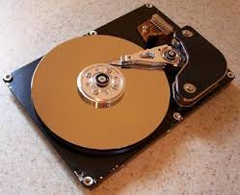
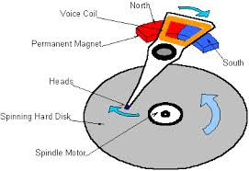



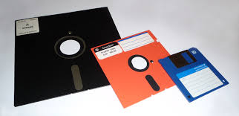
I/O & Storage Layers – Today
Application / Service
Operations and Interface
streams
High Level I/O
fopen, fread, fgets, …, fwrite, fclose on FILE *
Low Level I/O
handles
open, read, write, close on int & char *
Syscall
registers
EAX, EBX, … ESP
File System
descriptors
I/O Driver
Commands and Data Transfers
ld, st PIO ctrl regs, dma
Disks, Flash, Controllers, DMA

Slide 17
Recall: Components of a File System
File path
Directory
Structure
File Index
Structure
File number
Data blocks
…

Slide 18
I/O & Storage Layers
Application / Service
streams
High Level I/O
Low Level I/O
handles
#4 - handle
Syscall
registers
File System
descriptors
I/O Driver
Commands and Data Transfers
Data blocks
Disks, Flash, Controllers, DMA
…
Directory Structure

Slide 19
I/O Performance
Controller
300
Response
Time (ms)
User
Thread
I/O
device
200
Queue
[OS Paths]
100
Response Time = Queue + I/O device service time
Solutions?
Make everything faster ☺
More Decoupled (Parallelism) systems
multiple independent buses or controllers
Optimize the bottleneck to increase service rate
Use the queue to optimize the service
Do other useful work while waiting
Queues absorb bursts and smooth the flow
Admissions control (finite queues)
Limits delays, but may introduce unfairness and livelock
0
0%
100%
Throughput (Utilization)
(% total BW)

Slide 20
Little’s Law
N
arrivals
departures
B
L
In any stable system
Average arrival rate = Average departure rate
the average number of tasks in the system (N) is equal to the throughput (B) times the response time (L)
N (ops) = B (ops/s) x L (s)
Regardless of structure, bursts of requests, variation in service
instantaneous variations, but it washes out in the average
Overall requests match departures

Slide 21
File System Summary (1/2)
File System:
Transforms blocks into Files and Directories
Optimize for size, access and usage patterns
Maximize sequential access, allow efficient random access
Projects the OS protection and security regime (UGO vs ACL)
File defined by header, called “inode”
Multilevel Indexed Scheme
inode contains file info, direct pointers to blocks, indirect blocks, doubly indirect, etc..
NTFS uses variable extents, rather than fixed blocks, and tiny files data is in the header
4.2 BSD Multilevel index files
Inode contains pointers to actual blocks, indirect blocks, double indirect blocks, etc.
Optimizations for sequential access: start new files in open ranges of free blocks, rotational Optimization

Slide 22
File System Summary (2/2)
Naming: act of translating from user-visible names to actual system resources
Directories used for naming for local file systems
Linked or tree structure stored in files
File layout driven by freespace management
Integrate freespace, inode table, file blocks and directories into block group
Copy-on-write creates new (better positioned) version of file upon burst of writes
Deep interactions between memory management, file system, and sharing

Slide 23
Mid Term III

Slide 24
Using Paging to mmap files
Process
virtual address
physical address
MMU
page#
PT
instruction
frame#
offset
page fault
Operating System
Create PT entries
for mapped region
as “backed” by file
Page Fault Handler
File
scheduler
mmap file to region of VAS

Slide 25
Sharing through Mapped Files
VAS 1
VAS 2
0x000…
0x000…
instructions
instructions
data
data
File
heap
heap
Memory
stack
stack
OS
OS
0xFFF…
0xFFF…

Slide 26
Reliability and Availability
A system is reliable if it performs its intended function.
A system is available if it currently can respond to a request.
A storage system’s reliability is the probability that it will continue to be reliable for some specified period of time.
Its availability is the probability that it will be available at any given time.

Slide 27
Definitions
A system is reliable if it performs its intended function.
A system is available if it currently can respond to a request.
A storage system’s reliability is the probability that it will continue to be reliable for some specified period of time.
Its availability is the probability that it will be available at any given time.

Slide 28
The ACID properties of Transactions
Atomicity: all actions in the transaction happen, or none happen
Consistency: transactions maintain data integrity, e.g.,
Balance cannot be negative
Cannot reschedule meeting on February 30
Isolation: execution of one transaction is isolated from that of all others; no problems from concurrency
Durability: if a transaction commits, its effects persist despite crashes

Slide 29
Achieving File System Reliability
Problem posed by machine/disk failures
Transaction concept
Approaches to reliability
Careful sequencing of file system operations
Copy-on-write (WAFL, ZFS)
Journalling (NTFS, linux ext4) – Transactions within file system
Log structure (flash storage) – Transactions for user data too
Approaches to availability
RAID

Slide 30
Reliability Approach #2: Copy on Write File Layout
To update file system, write a new version of the file system containing the update
Never update in place
Reuse existing unchanged disk blocks
Seems expensive! But
Updates can be batched
Almost all disk writes can occur in parallel
Approach taken in network file server appliances (WAFL, ZFS)

Slide 31
Redo Logging
Prepare
Write all changes (in transaction) to log
Commit
Single disk write to make transaction durable
Redo
Copy changes to disk
Garbage collection
Reclaim space in log
Recovery
Read log
Redo any operations for committed transactions
Garbage collect log

Slide 32
Ex: Creating a file (as a transaction)
Find free data block(s)
Find free inode entry
Find dirent insertion point
-------------------------------
Write map (used)
Write inode entry to point to block(s)
Write dirent to point to inode
Free Space map
Data blocks
…
Inode table
Directory
entries
tail
head
done
pending
start
commit
Log in non-volatile storage (Flash or on Disk)

Slide 33
Performance
Log written sequentially
Often kept in flash storage
Asynchronous write back
Any order as long as all changes are logged before commit, and all write backs occur after commit
Can process multiple transactions
Transaction ID in each log entry
Transaction completed iff its commit record is in log

Slide 34
Two-Phase Locking (2PL)
1) Each transaction must obtain:
S (shared) or X (exclusive) lock on data before reading,
X (exclusive) lock on data before writing
2) A transaction can not request additional locks once it releases any locks
Thus, each transaction has a “growing phase” followed by a “shrinking phase”
Lock Point!
Growing
Phase
Shrinking
Phase
Avoid deadlock by acquiring locks in some lexicographic order

Slide 35
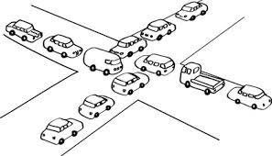
What’s a Deadlock?
Situation where all entities (e.g., threads, clients, …)
have acquired certain resources and
need to acquire additional resources,
but those additional resources are held some other entity that won’t release them

Slide 36
Summary: Deadlock
Four conditions for deadlocks
Mutual exclusion
Only one thread at a time can use a resource
Hold and wait
Thread holding at least one resource is waiting to acquire additional resources held by other threads
No preemption
Resources are released only voluntarily by the threads
Circular wait
∃ set {T₁, …, T_{n}} of threads with a cyclic waiting pattern
Starvation vs. Deadlock
Starvation: thread waits indefinitely
Deadlock: circular waiting for resources
Deadlock detection and preemption
Deadlock prevention
Loop Detection, Banker’s algorithm

Slide 37
Methods for Handling Deadlocks
Deadlock prevention: design system to ensure that it will never enter a deadlock
E.g., monitor all lock acquisitions
Selectively deny those that might lead to deadlock
Allow system to enter deadlock and then recover
Requires deadlock detection algorithm
E.g., Java JMX findDeadlockedThreads()
Some technique for forcibly preempting resources and/or terminating tasks
Ignore the problem and hope that deadlocks never occur in the system
Used by most operating systems, including UNIX
Resort to manual version of recovery

Slide 38
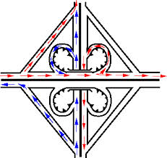
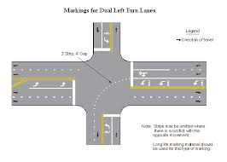
Techniques for Deadlock Prevention
Eliminate the Shared Resources
Eliminate the Mutual Exclusion
Eliminate Hold-and-Wait
Permit pre-emption
Eliminate the creation of circular wait
Dedicated resources to break cycles
Ordering on the acquisition of resources

Slide 39
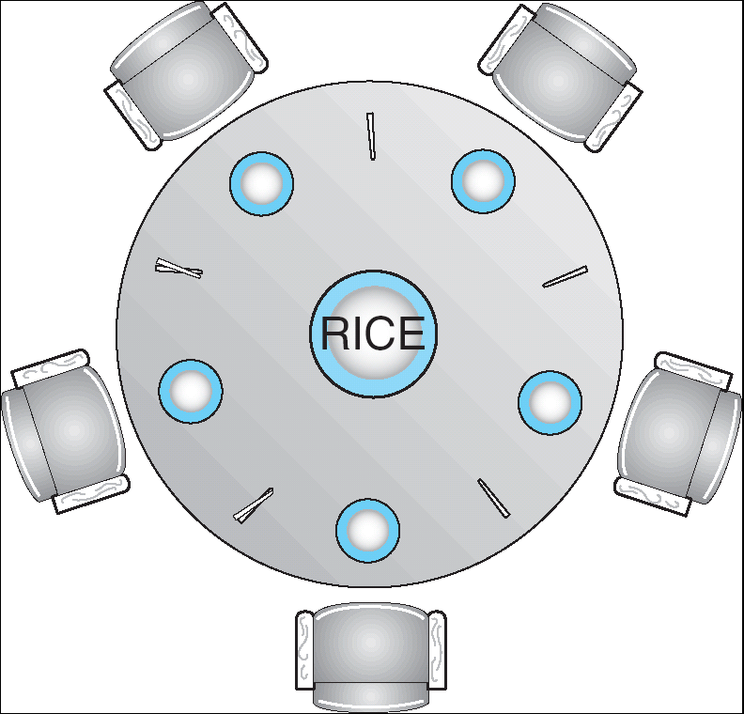
Ordered Acquisition to prevent cycle from forming
2
3
1
4
0
Suppose everyone grabs lowest first
Dependence graph is acyclic
Someone will fail to grab chopstick 0 !
How do you modify the rule to retain fairness ?
OS: define ordered set of resource classes
Acquire locks on resources in order
Page Table => Memory Blocks => …

Slide 40
Two-Phase Locking (2PL)
2PL guarantees that the dependency graph of a schedule is acyclic.
For every pair of transactions with a conflicting lock, one acquires it first → ordering of those two → total ordering.
Therefore 2PL-compatible schedules are conflict serializable.
Note: 2PL can still lead to deadlocks since locks are acquired incrementally.
An important variant of 2PL is strict 2PL, where all locks are released at the end of the transaction.

Slide 41
Transaction Isolation
Process A:
LOCK x, y
move foo from dir x to dir y
mv x/foo y/
Commit and Release x, y
Process B:
LOCK x, y and log
grep across x and y
grep 162 x/* y/* > log
Commit and Release x, y, log
grep appears either before or after move
Need log/recover AND 2PL to get ACID

Slide 42
Banker’s Algorithm Example
Banker’s algorithm with dining philosophers
“Safe” (won’t cause deadlock) if when try to grab chopstick either:
Not last chopstick
Is last chopstick but someone will have two afterwards
What if k-handed philosophers? Don’t allow if:
It’s the last one, no one would have k
It’s 2nd to last, and no one would have k-1
It’s 3rd to last, and no one would have k-2
…

Slide 43
What Is A Protocol?
A protocol is an agreement on how to communicate
Includes
Syntax: how a communication is specified & structured
Format, order messages are sent and received
Semantics: what a communication means
Actions taken when transmitting, receiving, or when a timer expires

Slide 44
Network System Modularity
Like software modularity, but:
Implementation distributed across many machines (routers and hosts)
Must decide:
How to break system into modules:
Layering
What functionality does each module implement:
End-to-End Principle: don’t put it in the network if you can do it in the endpoints.
Partition the system
Each layer solely relies on services from layer below
Each layer solely exports services to layer above
Interface between layers defines interaction
Hides implementation details
Layers can change without disturbing other layers

Slide 45
The E2E Concept
Traditional Engineering Goal: design the infrastructure to meet application requirements
Optimizing for Cost, Reliability, Performance, …
Challenge: infrastructure is most costly & difficult to create and evolves most slowly
Applications evolve rapidly, as does technology
End-to-end Design Concept
Utilize intelligence at the point of application
Infrastructure need not meet all application requirements directly
Only what the end-points cannot reasonably do themselves
Avoid redundancy, semantic mismatch, …
Enable applications and incorporate technological advance
Design for Change! - and specialization
Layers & protocols

Slide 46

Internet Protocol (IP)
Application
Present.
Session
Transport
Network
Datalink
Internet Protocol: Internet’s network layer
Service it provides: “Best-Effort” Packet Delivery
Tries it’s “best” to deliver packet to its destination
Packets may be lost
Packets may be corrupted
Packets may be delivered out of order
Physical
source
destination
IP network

Slide 47
The Internet Hourglass
SMTP
HTTP
DNS
NTP
Applications
TCP
UDP
Transport
Waist
IP
Data Link
Ethernet
SONET
802.11
Physical
Copper
Fiber
Radio
The Hourglass Model
There is just one network-layer protocol, IP
The “narrow waist” facilitates interoperability

Slide 48
Internet Layering – engineering for intelligence and change
ApplicationLayer
Any distributed protocol
(e.g., HTTP, Skype, p2p,
KV protocol in your project)
Data
Send segments to another
process running on same or
different node
Transport Layer
Data
Trans.
Hdr.
Send packets to another node
possibly located in a different
network
Network Layer
Data
Net.
Hdr.
Trans.
Hdr.
Send frames to other node
directly connected to same
physical network
Datalink Layer
Data
Frame
Hdr.
Net.
Hdr.
Trans.
Hdr.
Send bits to other node directly
connected to same physical
network
Physical Layer
101010100110101110

Slide 49
Internet Architecture: The Five Layers
Lower three layers implemented everywhere
Top two layers implemented only at hosts
Logically, layers interacts with peer’s corresponding layer
Application
Application
Transport
Transport
Network
Network
Network
Datalink
Datalink
Datalink
Physical
Physical
Physical
Host A
Router
Host B

Slide 50
Layering: Packets in Envelopes
Application Layer
Application Layer
Data
Data
Transport Layer
Trans.
Hdr.
Data
Trans.
Hdr.
Data
Transport Layer
Network Layer
Net.
Hdr.
Trans.
Hdr.
Data
Net.
Hdr.
Trans.
Hdr.
Data
Network Layer
Datalink Layer
Frame
Hdr.
Net.
Hdr.
Trans.
Hdr.
Data
Frame
Hdr.
Net.
Hdr.
Trans.
Hdr.
Data
Datalink Layer
Physical Layer
Physical Layer
101010100110101110
101010100110101110

Slide 51
Internet Transport Protocols
Application
Present.
Session
Transport
Datagram service (UDP)
No-frills extension of “best-effort” IP
Multiplexing/Demultiplexing among processes
Reliable, in-order delivery (TCP)
Connection set-up & tear-down
Discarding corrupted packets (segments)
Retransmission of lost packets (segments)
Flow control
Congestion control
Services not available
Delay and/or bandwidth guarantees
Sessions that survive change-of-IP-address
Network
Datalink
Physical

Slide 52
Transport Layer (4)
Application
Present.
Session
Service:
Provide end-to-end communication between processes
Demultiplexing of communication between hosts
Possible other services:
Reliability in the presence of errors
Timing properties
Rate adaption (flow-control, congestion control)
Interface: send message to “specific process” at given destination; local process receives messages sent to it
How are they named?
Protocol: port numbers, perhaps implement reliability, flow control, packetization of large messages, framing
Prime Examples: TCP and UDP
Transport
Network
Datalink
Physical

Slide 53
Sockets in concept
Client
Server
Create Server Socket
Create Client Socket
Bind it to an Address (host:port)
Connect it to server (host:port)
Listen for Connection
Accept connection
child
Connection Socket
Parent
Close Listen Socket
Close Connection Socket
write request
read request
read response
write response
Close Connection Socket
Close Client Socket
Close Server Socket

Slide 54
Open Connection: 3-Way Handshaking
If it has enough resources, server calls accept() to accept connection, and sends back a SYN ACK packet containing
Client’s sequence number incremented by one, (x + 1)
Why is this needed?
A sequence number proposal, y, for first byte server will send
Client (initiator)
Server
Active Open
connect()
listen()
SYN, SeqNum = x
Passive Open
accept()
SYN and ACK, SeqNum = y and Ack = x + 1
time
ACK, Ack = y + 1
allocate buffer space

Slide 55
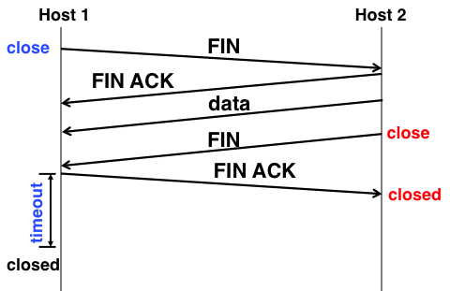
Recall: Connecting API to Protocol
Client
Server
Create Server Socket
Create Client Socket
Bind it to an Address (host:port)
Connect it to server (host:port)
SYN, SeqNum = x
Listen for Connection
time
SYN and ACK, SeqNum = y and Ack = x + 1
Accept connection
ACK, Ack = y + 1
Connection Socket
write request
read request
read response
write response
Close Client Socket
Close Connection Socket
Close Server Socket

Slide 56
Stop & Wait w/o Errors
Send; wait for ack; repeat
RTT: Round Trip Time (RTT): time it takes a packet to travel from sender to receiver and back
One-way latency (d): one way delay from sender and receiver
Sender
Receiver
1
d
RTT = 2*d
(if latency is
symmetric)
RTT
ACK 1
2
RTT
ACK 2
3
Time

Slide 57
Sliding Window
window = set of adjacent sequence numbers
The size of the set is the window size
Assume window size is n
Let A be the last ACK’d packet of sender without gap; then window of sender = {A+1, A+2, …, A+n}
Sender can send packets in its window
Let B be the last received packet without gap by receiver, then window of receiver = {B+1,…, B+n}
Receiver can accept out of sequence, if in window

Slide 58
Sliding Window w/o Errors
Throughput = W*packet_size/RTT
Unacked packets
in sender’s window
Out-o-seq packets
in receiver’s window
Window size (W) = 3 packets
{1}
1
{1, 2}
2
{}
{1, 2, 3}
3
{}
{2, 3, 4}
4
{}
{3, 4, 5}
5
.
.
.
{4, 5, 6}
6
.
.
.
Time
Sender
Receiver

Slide 59
Example: Sliding Window w/o Errors
Assume
Link capacity, C = 1Gbps
Latency between end-hosts, RTT = 80ms
packet_length = 1000 bytes
What is the window size W to match link’s capacity, C?
Solution
We want Throughput = C
Throughput = W*packet_size/RTT
C = W*packet_size/RTT
W = C*RTT/packet_size = 10⁹bps*80*10⁻³s/(8000b) = 10⁴ packets
Bandwidth-Delay Product
Window size ~ Bandwidth (Capacity) x delay (RTT/2)
Remember Little’s Law !

Slide 60
GBN Example with Errors
Out-o-seq packets
in receiver’s window
Window size (W) = 3 packets
1
2
{}
{}
{}
3
4
5
4 is
missing
Timeout
Packet 4
6
{5}
{5,6}
NACK 4
NACK 4
4
Why doesn’t sender retransmit packet 4 here?
5
Assume packet 4 lost!
6
{}
Sender
Receiver

Slide 61
TCP Flow Control
TCP: sliding window protocol at byte (not packet) level
Go-back-N: TCP Tahoe, Reno, New Reno
Selective Repeat (SR): TCP Sack
Receiver tells sender how many more bytes it can receive without overflowing its buffer
the AdvertisedWindow
The ACK contains sequence number N of next byte the receiver expects,
receiver has received all bytes in sequence up to and including N-1

Slide 62
TCP Flow Control
Sending Process
Receiving Process
TCP layer
1
3
TCP layer
OS
IP layer
IP layer
2
Three pairs of producer-consumer’s
sending process → sending TCP
Sending TCP → receiving TCP
receiving TCP → receiving process

Slide 63
Recap: TCP Flow Control
Sending Process
Receiving Process
LastByteWritten(350)
LastByteRead(100)
101, 350
201,300
201, 350
301,350
301, 350
101, 200
301, 350
LastByteAcked(200)
LastByteSent(350)
LastByteRcvd(350)
NextByteExpected(201)
{[1,100]}
Data[1,100]
AdvertisedWindow = MaxRcvBuffer – (LastByteRcvd – LastByteRead)
{[1,100]}
{[1,200]}
Data[101,200]
{[101,200]}
{[1,300]}
Data[201,300]
SenderWindow = AdvertisedWindow – (LastByteSent – LastByteAcked)
{101, 300}
{[201,350]}
Data[301,350]
{[101,200],[301,350]}
WriteWindow = MaxSendBuffer – (LastByteWritten – LastByteAcked)
{201, 350}
Ack=201, AdvWin = 50

Slide 64
Summary: Reliability & Flow Control
Flow control: three pairs of producer consumers
Sending process → sending TCP
Sending TCP → receiving TCP
Receiving TCP → receiving process
AdvertisedWindow: tells sender how much new data the receiver can buffer
SenderWindow: specifies how more the sender can transmit.
Depends on AdvertisedWindow and on data sent since sender received AdvertisedWindow
WriteWindow: How much more the sending application can send to the sending OS

Slide 65
Review: Remote Procedure Call
marshal args
Client
(caller)
call
Client
Stub
send
Packet
Handler
return
receive
unmarshal
ret vals
Machine A
Network
Network
Machine B
marshal args
Server
(callee)
return
Server
Stub
send
Packet
Handler
call
receive
unmarshal
ret vals

Slide 66
Six steps
The client calls the client stub. The call is a local procedure call, with parameters pushed on to the stack in the normal way.
The client stub packs the parameters into a message and makes a system call to send the message. Packing the parameters is called marshalling.
The client's local operating system sends the message from the client machine to the server machine.
The local operating system on the server machine passes the incoming packets to the server stub.
The server stub unpacks the parameters from the message. Unpacking the parameters is called unmarshalling.
Finally, the server stub calls the server procedure. The reply traces the same steps in the reverse direction
Notes:
What actually happens? Let’s take a guess. What’s the first thing that MUST happen for this to work. Lets say I have two comptuers A, and B and I want to call factorial from B, how would I do this. What do I need for this to work

Slide 67
Motivation for RPC
RPC’s can be used to communicate between processes on different machines or the same machine
Services can be run wherever it’s most appropriate
Access to local and remote services looks the same
Fault isolation: bugs are more isolated (build a firewall)
Enforces modularity: allows incremental upgrades of pieces of software (client or server)
Location transparent: service can be local or remote
Notes:
Why would we do this? Well… It’s very useful paradigm. We can have multiple services interact with eachother despite language barriers. At FB, the backend services were written in a combination of C++/Java/Ocaml ut they all just worked together because Facbeook built an RPC service called thrift that connects all of these together.

Slide 68
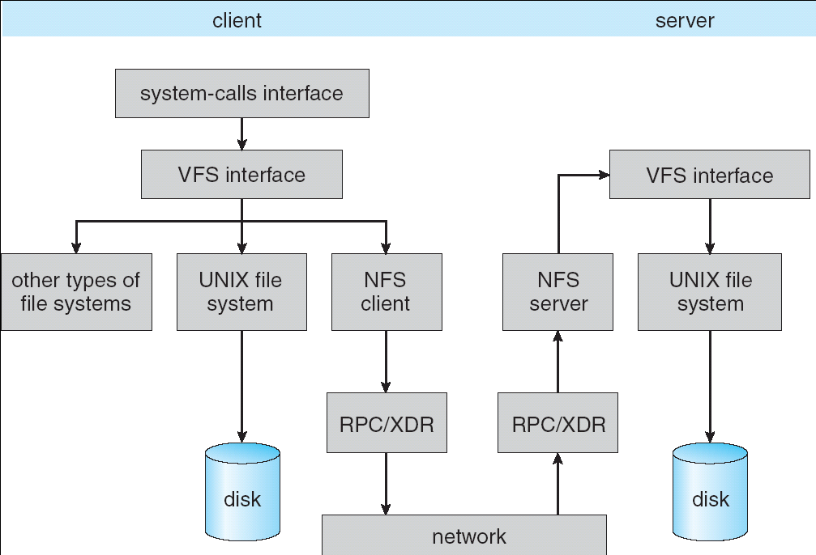
Review: Schematic View of NFS Architecture
Layering
RPC stubs
Marshaling
Notes:
This is the big picture of NFS
You already know system-call (open, read, write, delete, close), UFS + others, disk, RPC/XDR, Network
NFS runs on RPC
Let’s for now only look at …
External data representation
pause

Slide 69
Goals of NFS
Transparent File Access
Programs access remote files in the same way as local files
Programs cannot tell which file system is being used
Simple Crash Recovery
When file server crashes
When client crashes
When network is down
Adequate Performance
Not slower than other network utilities, e.g., rcp
Original NFS paper sets the goal 80% as fast as local disk
Notes:
Describe and explain why
Will look into first two in more details in two slides
Will not talk much about performance
pause

Slide 70
Transparent File Access
Don’t need to use different APIs for different file systems
Provide UNIX file system interface
open(), read(), write(), close(), mkdir(), etc.
Don’t need to know which file system is being used
Virtual File System and vnode
Abstraction layer for multiple file systems, including NFS
Don’t need to provide file-system-specific parameters during file operation
The idea of “early binding” doing mount
For NFS
Client only specifies server hostname when mounting the NFS
No need to know hostname while working on files
Notes:
Old programs should not need to be changed, new programs should not need to worry about it
Even all FS provide same API, you shouldn’t need to know …
FS has specific parameters, like NFS. Mount once with hostname
We will focus on firs point first
Pause, questions

Slide 71
NFS Design Principles
Stateless protocol: A protocol in which all information required to process a request is passed with request
Server keeps no state about client
Thus, if server crashed and restarted, requests can continue where left off (in many cases)
Idempotency: Performing requests multiple times has same effect as performing it exactly once, e.g., writing value to memory.
If server’s response doesn’t come back to client (e.g., network failure, server crashes and restarts)
Client simply retries the same request, which will have the same effect.
Even if the server already did the job, it can re-do it because of idempotency.
Notes:
Idempotency is ..
Increasing a counter is not idempotent
Why this is important
pause

Slide 72
The Shared Storage Abstraction
Information (and therefore control) is communicated from one point of computation to another by
The former storing/writing/sending to a location in a shared address space
And the second later loading/reading/receiving the contents of that location
Memory (address) space of a process
File systems
Dropbox, …
Google Docs, …
Facebook, …

Slide 73
What are you assuming?
Writes happen
Eventually a write will become visible to readers
Until another write happens to that location
Within a sequential thread, a read following a write returns the value written by that write
Dependences are respected
Here a control dependence
Each read returns the most recent value written to the location
A sequence of writes will be visible in order
Control dependences
Data dependences
May not see every write, but the ones seen are consistent with order written
A readers see a consistent order
It is as if the total order was visible to all and they took samples

Slide 74
Basic solution to multiple client replicas
Enforce single-writer multiple reader discipline
Allow readers to cache copies
Before an update is performed, writer must gain exclusive access
Simple Approach: invalidate all the copies then update
Who keeps track of what?

Slide 75
The Multi-processor/Core case
Memory
Cache
Cache
Cache
Proc
Proc
Proc
Interconnect is a broadcast medium
All clients can observe all writes and invalidate local replicas (write-thru invalidate protocol)

Slide 76
The Multi-processor/Core case
Memory
Cache
Cache
Cache
Proc
Proc
Proc
Write-Back via read-exclusive
Atomic Read-modify-write

Slide 77
NFS “Eventual” Consistency
Storage
Server
Flush on Close
GetAttr on files
Cache
Cache
Cache
Client
Client
Client
Stateless server allows multiple cached copies
Files written locally (at own risk)
Update Visibility by “flush on close”
GetAttributes on file ops to check modify since cache

Slide 78
NFS Caching Consistency
NFS protocol: weak consistency
Client polls server periodically to check for changes
Polls server if data hasn’t been checked in last 3-30 seconds (exact timeout it tunable parameter).
Thus, when file is changed on one client, server is notified, but other clients use old version of file until timeout.
What if multiple clients write to same file?
In NFS, can get either version (or parts of both)
Completely arbitrary!
F1 still ok?
cache
F1:V2
F1:V1
No: (F1:V2)
Client 1
Write
Server
cache
ACK
F1:V2
cache
F1:V2
Client 2
Notes:
To improve performance, clients and server cache file
Check once a while, so weak consistency
It’s hard to be perfect
pause

Slide 79
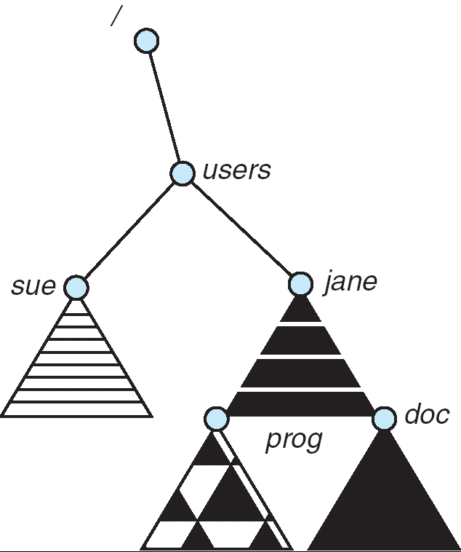
Naming
Naming choices:
Hostname:localname: Name files explicitly
No location or migration transparency
Mounting of remote file systems
System manager mounts remote file system by giving name and local mount point
Transparent to user: all reads and writes look like local reads and writes to user e.g. /users/sue/foo→/sue/foo on server
A single, global name space: every file in the world has unique name
Location Transparency: servers can change and files can move without involving user
mount
adj:/jane
mount
coeus:/sue
mount
adj:/prog
Notes:
If we look at the problem from another perspective, there are ..
We use 2nd one, we will talk about it in next slide
pause

Slide 80

Key Value Store
Handle huge volumes of data, e.g., PBs
Store (key, value) tuples
Used sometimes as a simpler but more scalable “database”
Also called Distributed Hash Tables (DHT)
Simple interface
put(key, value); // insert/write “value” associated with “key”
value = get(key); // get/read data associated with “key”
partition set of key-values across many machines
key, value
…

Slide 81
Challenges
…
Fault Tolerance: handle machine failures without losing data and without degradation in performance
Scalability:
Need to scale to thousands of machines
Need to allow easy addition of new machines
Consistency: maintain data consistency in face of node failures and message losses
Heterogeneity (if deployed as peer-to-peer systems):
Latency: 1ms to 1000ms
Bandwidth: 32Kb/s to 100Mb/s

Slide 82
Discussion: Iterative vs. Recursive Query
Master/Directory
Master/Directory
get(K14)
get(K14)
V14
K14
N3
N3
K14
N3
V14
get(K14)
get(K14)
Recursive
V14
Iterative
K14
V14
K14
V14
…
…
N1
N2
N3
N50
N1
N2
N3
N50
Recursive Query:
Advantages:
Faster, as typically master/directory closer to nodes
Easier to maintain consistency, as master/directory can serialize puts()/gets()
Disadvantages: scalability bottleneck, as all “Values” go through master/directory
Iterative Query
Advantages: more scalable
Disadvantages: slower, harder to enforce data consistency

Slide 83
Fault Tolerance
Replicate value on several nodes
Usually, place replicas on different racks in a datacenter to guard against rack failures
Master/Directory
put(K14, V14)
K5
N2
N1, N3
K14
N1,N3
K105
N50
put(K14, V14)
put(K14, V14), N1
K14
V14
K5
V5
K14
V14
K105
V105
…
N₁
N₂
N₃
N₅₀

Slide 84
Two Phase (2PC) Commit
2PC is a distributed protocol
High-level problem statement
If no node fails and all nodes are ready to commit, then all nodes COMMIT
Otherwise ABORT at all nodes
Developed by Turing award winner Jim Gray (first Berkeley CS PhD, 1969)

Slide 85
2PC Algorithm
One coordinator
N workers (replicas)
High level algorithm description
Coordinator asks all workers if they can commit
If all workers reply “VOTE-COMMIT”, then coordinator broadcasts “GLOBAL-COMMIT”,
Otherwise coordinator broadcasts “GLOBAL-ABORT”
Workers obey the GLOBAL messages

Slide 86
Failure Free Example Execution
coordinator
VOTE-REQ
GLOBAL-COMMIT
worker 1
worker 2
VOTE-COMMIT
worker 3
time

Slide 87
Detailed Algorithm
Coordinator Algorithm
Worker Algorithm
Coordinator sends VOTE-REQ to all workers
Wait for VOTE-REQ from coordinator
If ready, send VOTE-COMMIT to coordinator
If not ready, send VOTE-ABORT to coordinator
And immediately abort
If receive VOTE-COMMIT from all N workers, send GLOBAL-COMMIT to all workers
If doesn’t receive VOTE-COMMIT from all N workers, send GLOBAL-ABORT to all workers
If receive GLOBAL-COMMIT then commit
If receive GLOBAL-ABORT then abort

Slide 88
Example of Worker Failure
INIT
WAIT
coordinator
ABORT
COMM
timeout
GLOBAL-ABORT
VOTE-REQ
worker 1
VOTE-COMMIT
worker 2
worker 3
time

Slide 89
Durability
All nodes use stable storage* to store which state they are in
Upon recovery, it can restore state and resume:
Coordinator aborts in INIT, WAIT, or ABORT
Coordinator commits in COMMIT
Worker aborts in INIT, ABORT
Worker commits in COMMIT
Worker asks Coordinator in READY
* - stable storage is non-volatile storage (e.g. backed by disk) that guarantees atomic writes.

Slide 90
Multiple Servers
Storage
Server
Storage
Server
?
Client
What happens if cannot update all the replicas?
Availability => Inconsistency

Slide 91
Consistency (cont’d)
If concurrent updates (i.e., puts to same key) may need to make sure that updates happen in the same order
Master/Directory
put(K14, V14’) and put(K14, V14’’) reach N1 and N3 in reverse order
What does get(K14) return?
Undefined!
put(K14, V14’)
K5
N2
put(K14, V14’’)
K14
N1,N3
K105
N50
put(K14, V14’’)
put(K14, V14’)
put(K14, V14’')
put(K14, V14’)
K14
K14
V14
V14’
K5
V5
K14
K14
V14
V14’’
K105
V105
…
N₁
N₂
N₃
N₅₀

Slide 92
Consistency
Need to make sure that a value is replicated correctly
How do you know a value has been replicated on every node?
Wait for acknowledgements from every node
What happens if a node fails during replication?
Pick another node and try again
What happens if a node is slow?
Slow down the entire put()? Pick another node?
In general, with multiple replicas
Slow puts and fast gets

Slide 93
Consistency (cont’d)
Large variety of consistency models:
Atomic consistency (linearizability): reads/writes (gets/puts) to replicas appear as if there was a single underlying replica (single system image)
Think “one updated at a time”
Transactions
Eventual consistency: given enough time all updates will propagate through the system
One of the weakest form of consistency; used by many systems in practice
And many others: causal consistency, sequential consistency, strong consistency, …

Slide 94
Scaling Up Directory
Challenge:
Directory contains a number of entries equal to number of (key, value) tuples in the system
Can be tens or hundreds of billions of entries in the system!
Solution: consistent hashing
Associate to each node a unique id in an uni-dimensional space 0..2^{m}-1
Partition this space across m machines
Assume keys are in same uni-dimensional space
Each (Key, Value) is stored at the node with the smallest ID larger than Key

Slide 95
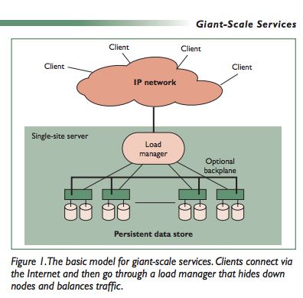
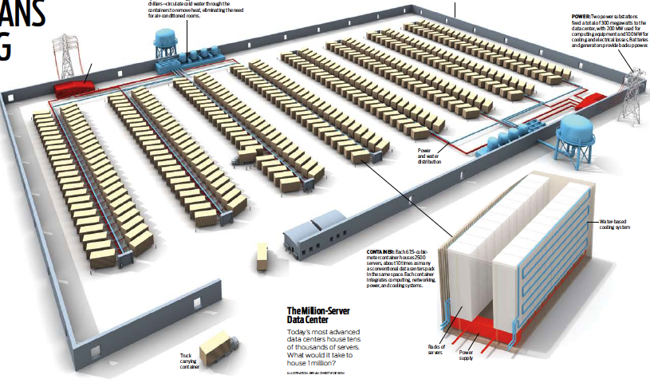
The Data Center as a System
Clusters became THE architecture for large scale internet services
Distribute disks, files, I/O, net, and compute over everything
Massive AND Incremental scalability
Search Engines the initial “Killer App”
Multiple components as Cluster Apps
Web crawl, Index, Search & Rank, Network, …
Global Layer as a Master/Worker pattern
GFS, HDFS
Map Reduce framework address core of search on massive scale – and much more
Indexing, log analysis, data querying
Collating, inverted indexes : map(k,v) => f(k,v),(k,v)
Filtering, Parsing, Validation
Sorting
Lessons from Giant-Scale Services, Eric Brewer, IEEE Computer, Jul 2001

Slide 96
GFS/HDFS Insights
Petabyte storage
Files split into large blocks (128 MB) and replicated across many nodes
Big blocks allow high throughput sequential reads/writes
Data striped on hundreds/thousands of servers
Scan 100 TB on 1 node @ 50 MB/s = 24 days
Scan on 1000-node cluster = 35 minutes
Failures will be the norm
Mean time between failures for 1 node = 3 years
Mean time between failures for 1000 nodes = 1 day
Use commodity hardware
Failures are the norm anyway, buy cheaper hardware
No complicated consistency models
Single writer, append-only data
Notes:
Large block: throughput, smaller metadata to central
Stripe: would take forever to read

Slide 97
MapReduce Insights
Restricted key-value model
Same fine-grained operation (Map & Reduce) repeated on huge, distributed (within DC) data
Operations must be deterministic
Operations must be idempotent/no side effects
Only communication is through the shuffle
Operation (Map & Reduce) output saved (on disk)

Slide 98
MapReduce Parallel Execution
Shamelessly stolen from Jeff Dean’s OSDI ‘04 presentation
http://labs.google.com/papers/mapreduce-osdi04-slides/index.html

Slide 99
MapReduce Pros
Distribution is completely transparent
Not a single line of distributed programming (ease, correctness)
Automatic fault-tolerance
Determinism enables running failed tasks somewhere else again
Saved intermediate data enables just re-running failed reducers
Automatic scaling
As operations as side-effect free, they can be distributed to any number of machines dynamically
Automatic load-balancing
Move tasks and speculatively execute duplicate copies of slow tasks (stragglers)
Notes:
Transparent: not a single line of code

Slide 100
MapReduce Cons
Restricted programming model
Not always natural to express problems in this model
Low-level coding necessary
Little support for iterative jobs (lots of disk access)
High-latency (batch processing)
Addressed by follow-up research and Apache projects
Pig and Hive for high-level coding
Spark for iterative and low-latency jobs
Notes:
Expressitivity; can however do graph algos, even simulate other parallel models (PRAM and BSP

Slide 101

UCB / Apache Spark Motivation
Complex jobs, interactive queries and online processing all need one thing that MR lacks:
Efficient primitives for data sharing
Stage 1
Stage 2
Stage 3
Query 1
Job 1
Job 2
Query 2
…
Query 3
Iterative job
Interactive mining
Stream processing

Slide 102
Examples
HDFS read
HDFS write
HDFS read
HDFS write
iter. 1
iter. 2
. . .
Input
HDFS read
query 1
result 1
query 2
result 2
Opportunity: DRAM is getting cheaper ➔ use main memory for intermediate results instead of disks
query 3
result 3
Input
. . .
Notes:
Each iteration is, for example, a MapReduce job

Slide 103
Spark Motivation
Complex jobs, interactive queries and online processing all need one thing that MR lacks:
Efficient primitives for data sharing
Problem: in MR, the only way to share data across jobs is using stable storage (e.g. file system) ➔ slow!
Stage 1
Stage 2
Stage 3
Query 1
Job 1
Job 2
Query 2
…
Query 3
Iterative job
Interactive mining
Stream processing

Slide 104
Security Requirements
Authentication
Ensures that a user is who is claiming to be
Data integrity
Ensure that data is not changed from source to destination or after being written on a storage device
Confidentiality
Ensures that data is read only by authorized users
Non-repudiation
Sender/client can’t later claim didn’t send/write data
Receiver/server can’t claim didn’t receive/write data

Slide 105
Using Symmetric Keys
Same key for encryption and decryption
Achieves confidentiality
Vulnerable to tampering and replay attacks
Plaintext (m)
m
Name: Passwd
Name: Passwd
Name: Passwd
Internet
Encrypt with
secret key
Decrypt with
secret key
Ciphertext
^%$#$%$%^#
^%$#$%$%^#
^%$#$%$%^#
Need integrity check and unique sequence number

Slide 106
Simple Public Key Authentication
Each side need only know the other side’s public key
No secret key need be shared
A encrypts a nonce (random num.) x
Avoid replay attacks, e.g., attacker impersonating client or server
B proves it can recover x
A can authenticate itself to B in the same way with nonce, y
Many more details to make this work securely in practice!
A
B
E({x, A}, Public_{B})
E({x, y, B}, Public_{A})
E({y, A}, Public_{B})
Notation: E(m,k) – encrypt message m with key k

Slide 107
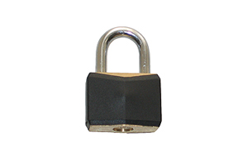
HTTPS Connection (SSL/TLS) cont’d
Browser
Amazon
Browser constructs a random session key K used for data communication
Private key for bulk crypto
Browser encrypts K using Amazon’s public key
Browser sends E(K, KA_{public}) to server
Browser displays
All subsequent comm. encrypted w/ symmetric cipher (e.g., AES128) using key K
E.g., client can authenticate using a password
Here’s my cert
~1 KB of data
K
E(K, KA_{public})
Agreed
K
E(password …, K)
E(response …, K)

Slide 108
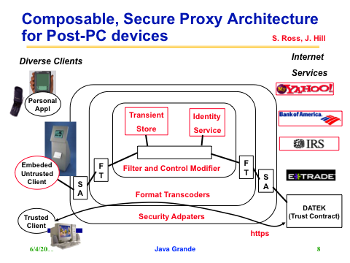
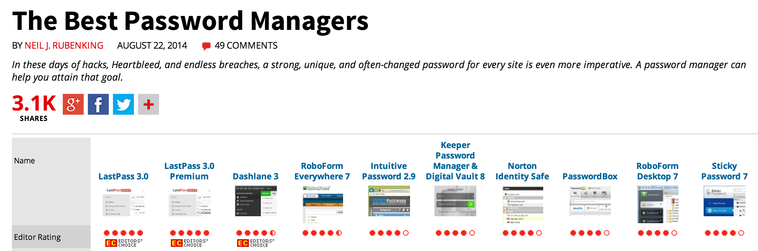
Security & Privacy in a Pervasive Web

