Slide 1
Kernel Threads
David E. Culler
CS162 – Operating Systems and Systems Programming
Lecture 7
Sept 15, 2014
Reading: A&D Ch4.4-10
HW 1 due today
Proj. 1 Pintos Threads out

Slide 2
Objectives
Solidify your understanding of threads as a concept.
Use of threads
in user level programs
in the kernel
Support processes and OS concurrency
Support user level threads
Develop your understanding of the implementation of threads in the kernel
You will develop it much further through project 1

Slide 3
Threads
Independently schedulable entity
Sequential thread of execution that runs concurrently with other threads
It can block waiting for something while others progress
It can work in parallel with others (ala cs61c)
Has local state (its stack) and shared (static data and heap)

Slide 4
Thread State
State shared by all threads in process/addr space
Content of memory (global variables, heap)
I/O state (file system, network connections, etc)
Execution Stack (logically private)
Parameters, temporary variables
Return PCs are kept while called procedures are executing
State “private” to each thread
CPU registers (including, program counter)
Ptr to Execution stack
Kept in TCB ≡ Thread Control Block
When thread is not running
Scheduler works on TCBs

Slide 5
Thread Lifecycle

Slide 6
Programmer vs. Processor View

Slide 7
Possible Executions

Slide 8
Thread Abstraction
Infinite number of processors
Threads execute with variable speed
Programs must be designed to work with any schedule
Notes:
Execution model: each thread runs on a dedicated virtual processor with unpredictable and variable speed.

Slide 9
A typical use case
Client Browser
- process for each tab
- thread to render page
- GET in separate thread
- multiple outstanding GETs
- as they complete, render portion
Web Server
- fork process for each client connection
- thread to get request and issue response
- fork threads to read data, access DB, etc
- join and respond

Slide 10
Kernel Use Cases
Thread for each user process
Thread for sequence of steps in processing I/O
Threads for device drivers
…

Slide 11
Per Thread State
Each Thread has a Thread Control Block (TCB)
Execution State: CPU registers, program counter (PC), pointer to stack (SP)
Scheduling info: state, priority, CPU time
Various Pointers (for implementing scheduling queues)
Pointer to enclosing process (PCB) – user threads
Etc (add stuff as you find a need)
OS Keeps track of TCBs in “kernel memory”
In Array, or Linked List, or …

Slide 12
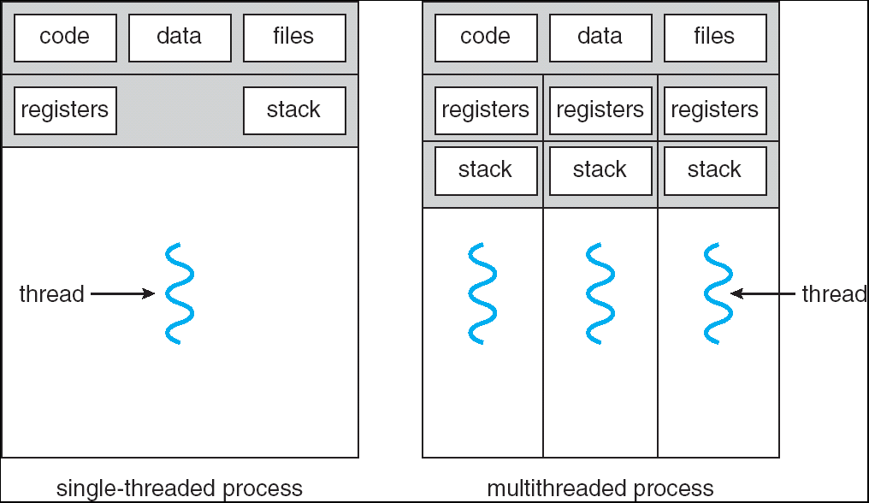
Single and Multithreaded Processes
Notes:
Sometimes need parallelism for a single job, and processes are very expensive – to start, switch between, and to communicate between

Slide 13
Supporting 1T and MT Processes
User
System
***
Notes:
Sometimes need parallelism for a single job, and processes are very expensive – to start, switch between, and to communicate between

Slide 14
Supporting 1T and MT Processes
User
System
***
***
Notes:
Sometimes need parallelism for a single job, and processes are very expensive – to start, switch between, and to communicate between

Slide 15
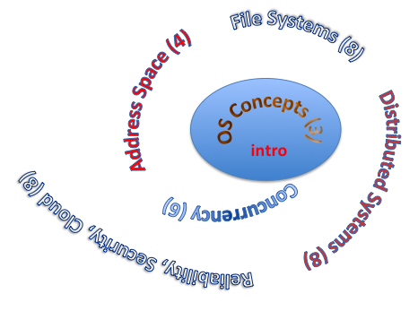
You are here… why?
Processes
Thread(s) + address space
Address Space
Protection
Dual Mode
Interrupt handlers
Interrupts, exceptions, syscall
File System
Integrates processes, users, cwd, protection
Key Layers: OS Lib, Syscall, Subsystem, Driver
User handler on OS descriptors
Process control
fork, wait, signal, exec
Communication through sockets
Integrates processes, protection, file ops, concurrency
Client-Server Protocol
Concurrent Execution: Threads
Scheduling

Slide 16
Perspective on ‘groking’ 162
Historically, OS was the most complex software
Concurrency, synchronization, processes, devices, communication, …
Core systems concepts developed there
Today, many “applications” are complex software systems too
These concepts appear there
But they are realized out of the capabilities provided by the operating system
Seek to understand how these capabilities are implemented upon the basic hardware.
See concepts multiple times from multiple perspectives
Lecture provides conceptual framework, integration, examples, …
Book provides a reference with some additional detail
Lots of other resources that you need to learn to use
man pages, google, reference manuals, includes (.h)
Section, Homework and Project provides detail down to the actual code AND direct hands-on experience

Slide 17
Operating System as Design
Word Processing
Compilers
Web Browsers
Email
Databases
Web Servers
Application / Service
Portable OS Library
OS
User
System Call
Interface
System
Portable OS Kernel
Software
Platform support, Device Drivers
Hardware
x86
PowerPC
ARM
PCI
Ethernet (10/100/1000)
802.11 a/b/g/n
SCSI
IDE
Graphics

Slide 18
Starting today: Pintos Projects
Process 1
Process 2
Process N
Groups almost all formed
Work as one!
10x homework
P1: threads & scheduler
P2: user process
Mem.
Mem.
Mem.
IO
state
IO
state
…
IO
state
CPU
state
CPU
state
CPU
state
CPU sched.
PintOS
CPU
(emulated)

Slide 19
MT Kernel 1T Process ala Pintos/x86
code
data
magic #
list
Kernel
priority
stack
status
User
tid
code
code
data
data
heap
***
heap
User
stack
User
stack
Each user process/thread associated with a kernel thread, described by a 4kb Page object containing TCB and kernel stack for the kernel thread

Slide 20
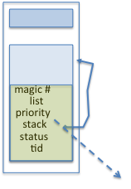
In User thread, w/ k-thread waiting
code
data
magic #
list
Kernel
priority
stack
status
User
tid
code
code
data
data
heap
***
heap
IP
User
stack
User
stack
SP
K SP
Proc Regs
PL: 3
x86 proc holds interrupt SP high system level
During user thread exec, associate kernel thread is “standing by”

Slide 21
In Kernel thread
code
data
magic #
list
Kernel
priority
stack
status
User
tid
code
code
data
data
heap
***
heap
IP
User
stack
User
stack
SP
K SP
Proc Regs
PL: 0
Kernel threads execute with small stack in thread struct
Scheduler selects among ready kernel and user threads

Slide 22
Thread Switch (switch.S)
code
data
magic #
list
Kernel
priority
stack
status
User
tid
code
code
data
data
heap
***
heap
IP
User
stack
User
stack
SP
K SP
Proc Regs
PL: 0
switch_threads: save regs on current small stack, change SP, return from destination threads call to switch_threads

Slide 23
Switch to Kernel Thread for Process
code
data
magic #
list
Kernel
priority
stack
status
User
tid
code
code
data
data
heap
***
heap
IP
User
stack
User
stack
SP
K SP
Proc Regs
PL: 0

Slide 24
Kernel->User
code
data
magic #
list
Kernel
priority
stack
status
User
tid
code
code
data
data
heap
***
heap
IP
User
stack
User
stack
SP
K SP
Proc Regs
PL: 3
iret restores user stack and PL

Slide 25
User->Kernel
code
data
magic #
list
Kernel
priority
stack
status
User
tid
code
code
data
data
heap
***
heap
IP
User
stack
User
stack
SP
K SP
Proc Regs
PL: 0
Mechanism to resume k-thread goes through interrupt vector

Slide 26
User->Kernel via interrupt vector
code
0
data
Kernel
User
code
code
255
intr vector
data
data
heap
***
heap
IP
User
stack
User
stack
SP
K SP
Proc Regs
PL: 3
Interrupt transfers control through the IV (IDT in x86)
iret restores user stack and PL

Slide 27
Pintos Interrupt Processing
stubs
Wrapper for generic handler
***
0
intr_entry:
save regs as frame
set up kernel env.
call intr_handler
intr_exit:
restore regs
iret
push 0x20 (int #)
jmp intr_entry
0x20
push 0x20 (int #)
jmp intr_entry
***
255
Hardware interrupt vector
stubs.S

Slide 28
Recall: cs61C THE STACK FRAME

Slide 29
Pintos Interrupt Processing
interrupt.c
Wrapper for generic handler
Intr_handler(*frame)
- classify
- dispatch
- ack IRQ
- maybe thread yield
stubs
***
0
intr_entry:
save regs as frame
set up kernel env.
call intr_handler
intr_exit:
restore regs
iret
push 0x20 (int #)
jmp intr_entry
0x20
push 0x20 (int #)
jmp intr_entry
0
timer_intr(*frame)
tick++
thread_tick()
***
255
0x20
Hardware interrupt vector
stubs.S
timer.c
Pintos intr_handlers

Slide 30
Timer may trigger thread switch
thread_tick
Updates thread counters
If quanta exhausted, sets yield flag
thread_yield
On path to rtn from interrupt
Sets current thread back to READY
Pushes it back on ready_list
Calls schedule to select next thread to run upon iret
Schedule
Selects next thread to run
Calls switch_threads to change regs to point to stack for thread to resume
Sets its status to RUNNING
If user thread, activates the process
Returns back to intr_handler

Slide 31
Pintos Return from Processing
interrupt.c
Wrapper for generic handler
Intr_handler(*frame)
- classify
- dispatch
- ack IRQ
- thread yield
stubs
***
0
intr_entry:
save regs as frame
set up kernel env.
call intr_handler
intr_exit:
restore regs
iret
push 0x20 (int #)
jmp intr_entry
0x20
push 0x20 (int #)
jmp intr_entry
0
timer_intr(*frame)
tick++
thread_tick()
***
255
0x20
Hardware interrupt vector
stubs.S
timer.c
thread_yield()
- schedule
Resume Some Thread
schedule()
- switch
Pintos intr_handlers

Slide 32
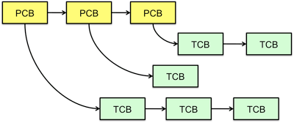
Multithreaded Processes
PCB may be associated with multiple TCBs:
Switching threads within a process is a simple thread switch
Switching threads across blocks requires changes to memory and I/O address tables.

Slide 33
The Next Big Question
So how do threads cooperate & coordinate?
Synchronization operations
High level structured to low level unstructured
Disabling interrupts is the lowest and most brute force
Eliminates interleaving in short sections of OS code

Slide 34
Perspectives

Slide 35
The Numbers
Context switch in Linux: 3-4 μsecs (Current Intel i7 & E5).
Thread switching faster than process switching (100 ns).
But switching across cores about 2x more expensive than within-core switching.
Context switch time increases sharply with the size of the working set*, and can increase 100x or more.
* The working set is the subset of memory used by the process in a time window.
Moral: Context switching depends mostly on cache limits and the process or thread’s hunger for memory.

Slide 36
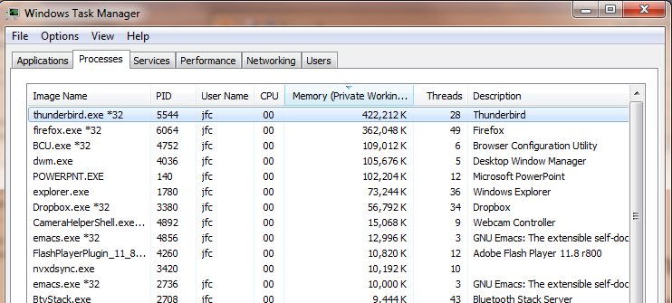
The Numbers
Many process are multi-threaded, so thread context switches may be either within-process or across-processes.

Slide 37
Threads in a Process
Threads are useful at user-level
Parallelism, hide I/O latency, interactivity
Option A (early Java): user-level library, within a single-threaded process
Library does thread context switch
Kernel time slices between processes, e.g., on system call I/O
Option B (Linux, MacOS, Windows): use kernel threads
System calls for thread fork, join, exit (and lock, unlock,…)
Kernel does context switching
Simple, but a lot of transitions between user and kernel mode
Option C (Windows): scheduler activations
Kernel allocates processors to user-level library
Thread library implements context switch
System call I/O that blocks triggers upcall
Option D: Asynchronous I/O

Slide 38
Classification
One
Many
# of addr spaces:
# threads
Per AS:
One
MS/DOS, early Macintosh
Traditional UNIX
Many
Embedded systems (Geoworks, VxWorks, JavaOS,etc)
JavaOS, Pilot(PC)
Mach, OS/2, HP-UX, Win NT to 8, Solaris, OS X, Android, iOS
Real operating systems have either
One or many address spaces
One or many threads per address space

Slide 39
OS Archaeology
Because of the cost of developing an OS from scratch, most modern OSes have a long lineage:
Multics → AT&T Unix → BSD Unix → Ultrix, SunOS, NetBSD,…
Mach (micro-kernel) + BSD → NextStep → XNU → Apple OSX, iphone iOS
Linux → Android OS
CP/M → QDOS → MS-DOS → Windows 3.1 → NT → 95 → 98 → 2000 → XP → Vista → 7 → 8 → phone → …
Linux → RedHat, Ubuntu, Fedora, Debian, Suse,…
Notes:
Multics: MIT, GE, Bell Labs, 1969
Revolutionary but “bloated” at 135kB
Famous “failures”: Multics, Mach, NextStep: innovative but too flawed to succeed.
Microsoft established itself by writing an OS to compete with CP/M which IBM couldn’t negotiate with its author. They instead bought QDOS from a small code author who had written it from the CP/M manual.
Interestingly, there were some other OSes that didn’t have such a long lineage (e.g. IBM OS/2)

Slide 40
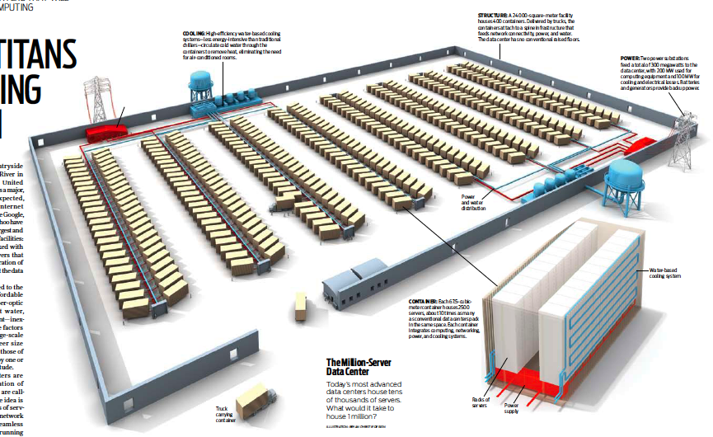
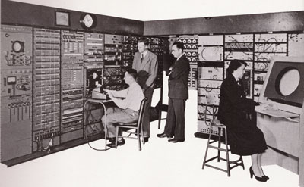

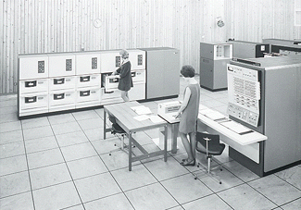
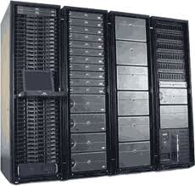
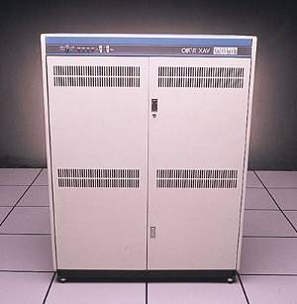
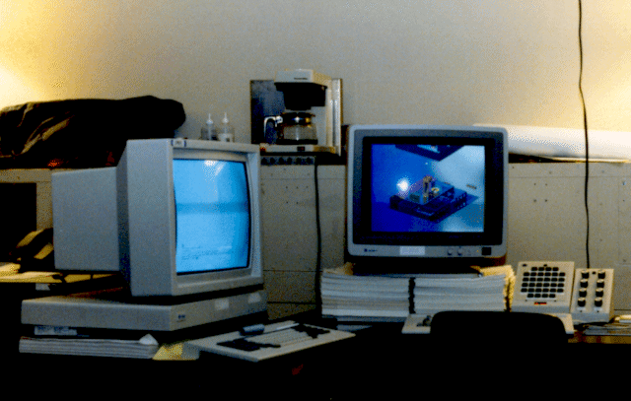

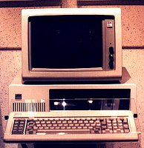





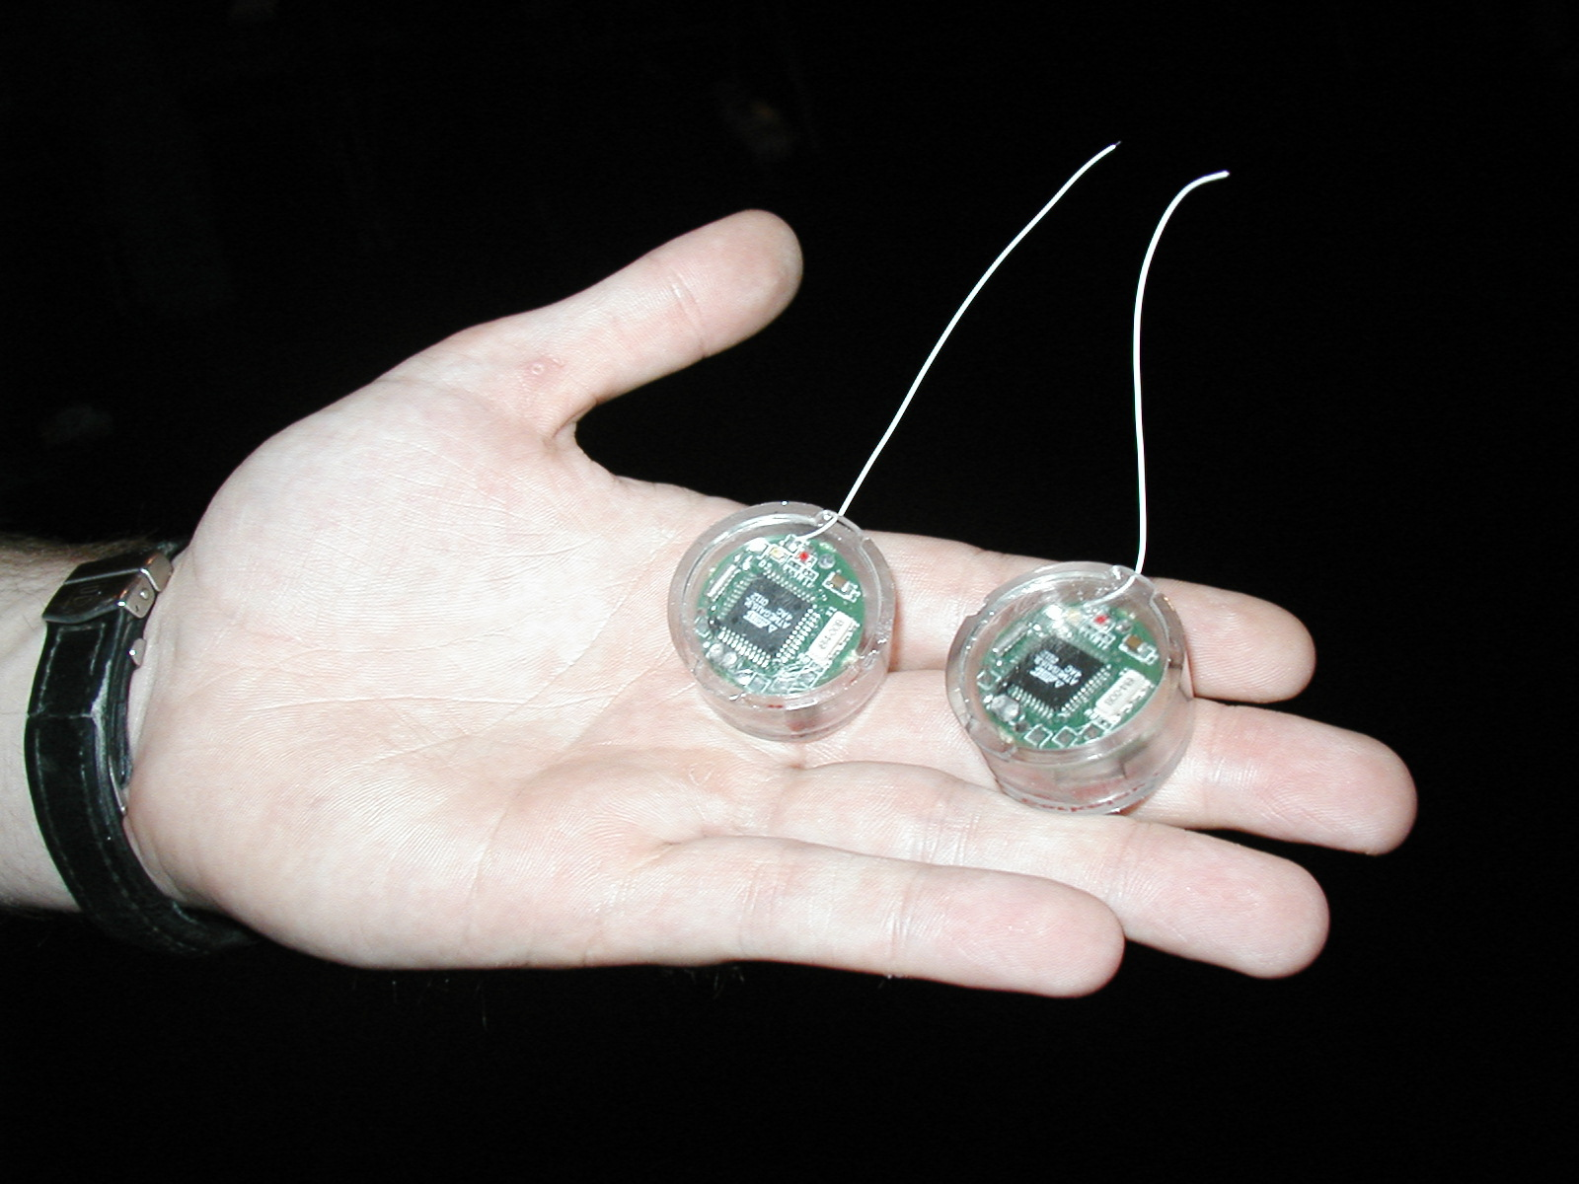
Dramatic change
Computers
Per Person
Number crunching, Data Storage, Massive Services,
Mining
1:10⁶
Mainframe
Mini
1:10³
Workstation
Productivity,
Interactive
PC
Laptop
1:1
PDA
Cell
Streaming from/to the physical world
10³:1
years
Mote!
The Internet of Things!
Bell’s Law: new computer class per 10 years

Slide 41
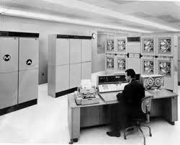
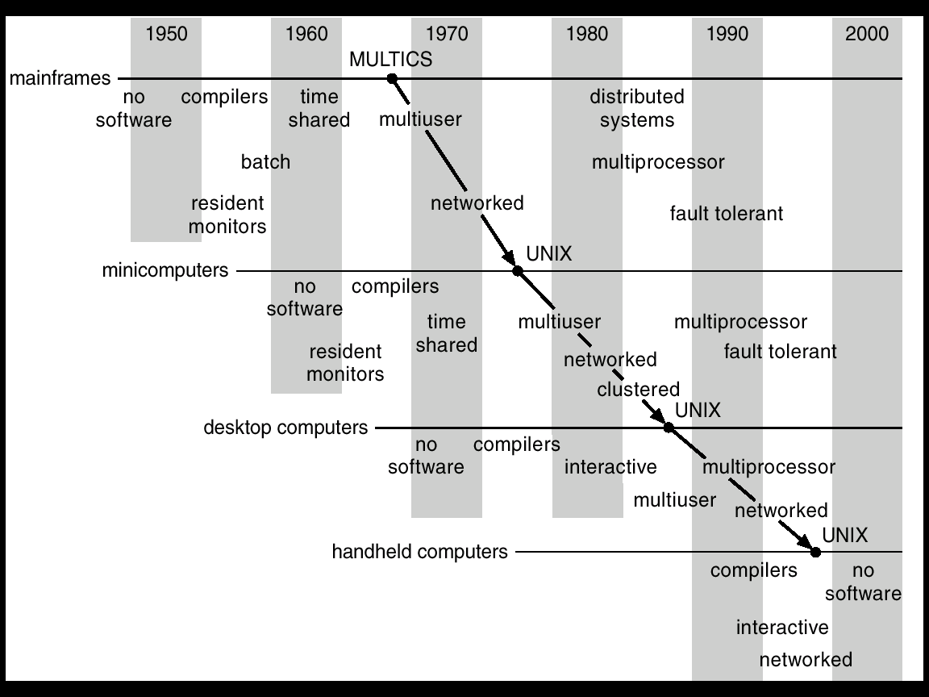
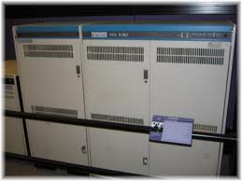

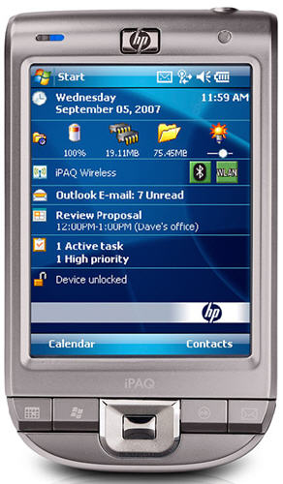
Migration of OS Concepts and Features

Slide 42
Recall: (user) Thread Operations
thread_fork(func, args)
Create a new thread to run func(args)
Pintos: thread_create
thread_yield()
Relinquish processor voluntarily
Pintos: thread_yield
thread_join(thread)
In parent, wait for forked thread to exit, then return
thread_exit
Quit thread and clean up, wake up joiner if any
Pintos: thread_exit
http://cs162.eecs.berkeley.edu/static/lectures/code06/pthread.c

Slide 43
Example: pthreads.c

