Slide 1
Export result (CSV)
TEAM A3 PPT
TEAM A3
Dept. of Photonics & Nanoelectronics
장희령, 지요섭, 김건우

Slide 2
Review
Last week’s mission
Result & Discussion
Q & A
INDEX
Export result (CSV)

Slide 3
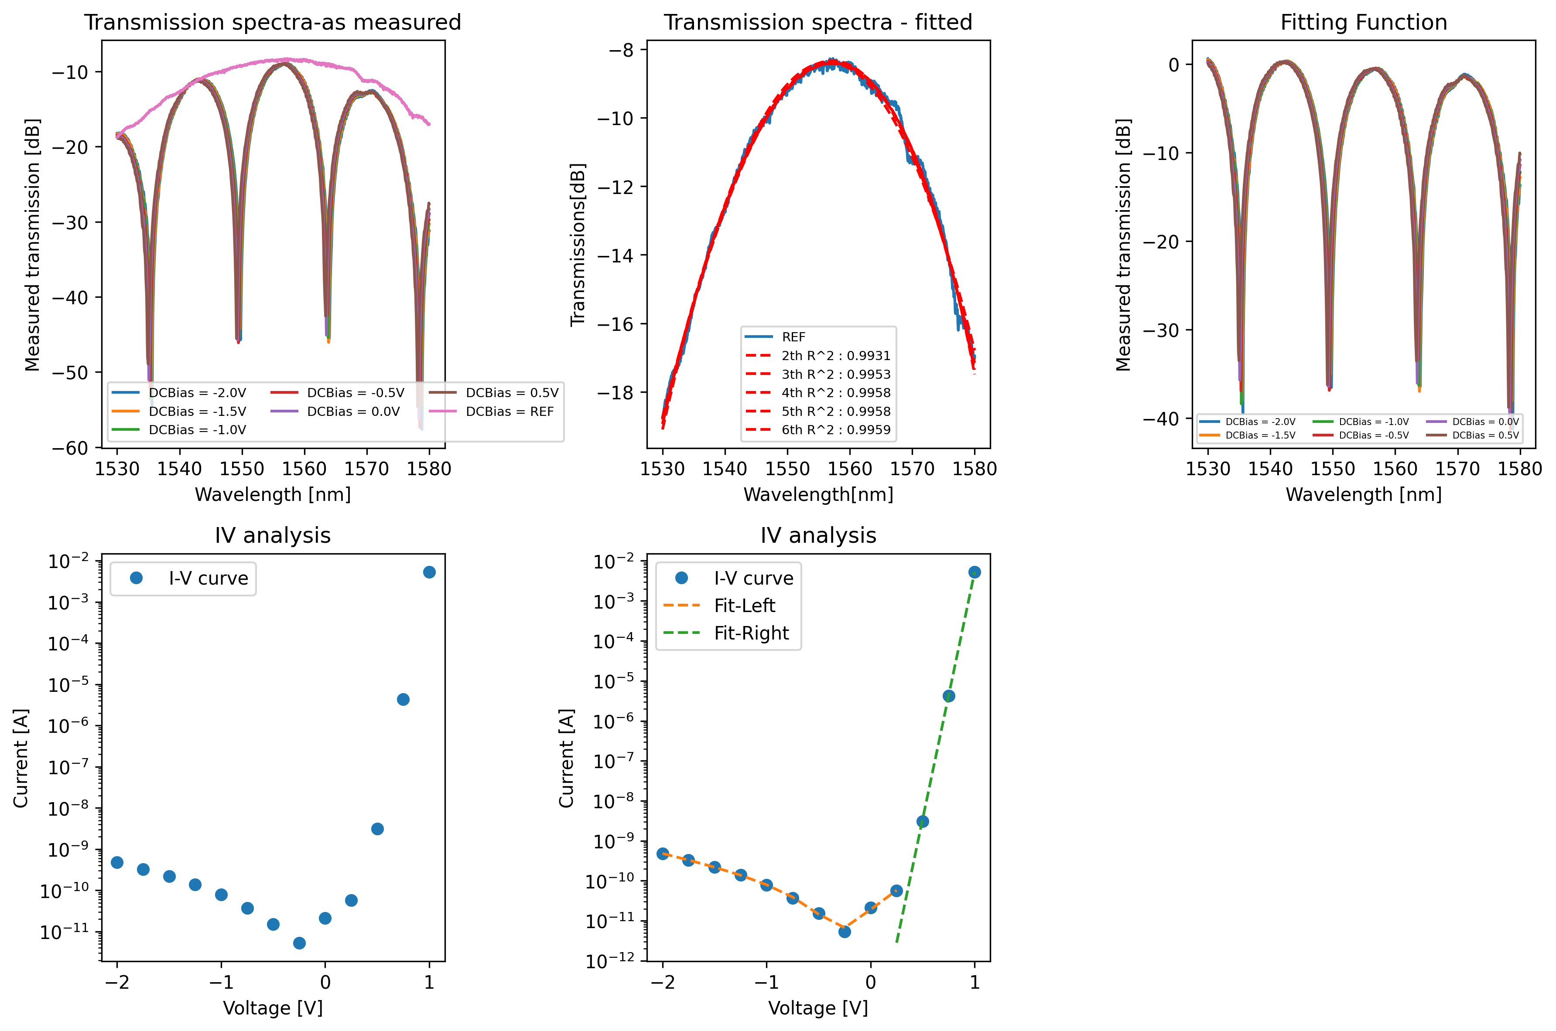
Review
TEAM A3 PPT

Slide 4

Last week's mission
TEAM A3 PPT
ㅇㅇㅇㅇ

Slide 5

Plt.savefig()
TEAM A3 PPT
CODE
RESULT

Slide 6
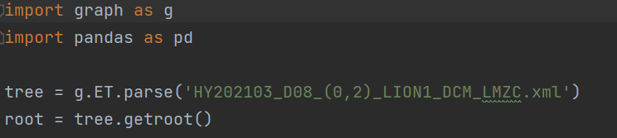
IMPORT
TEAM A3 PPT
CODE

Slide 7
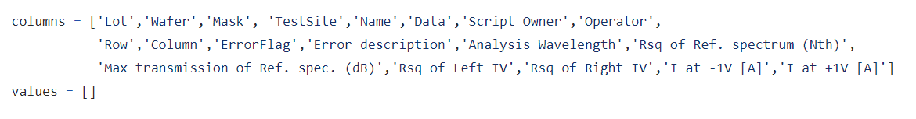
Column
TEAM A3 PPT
CODE

Slide 8
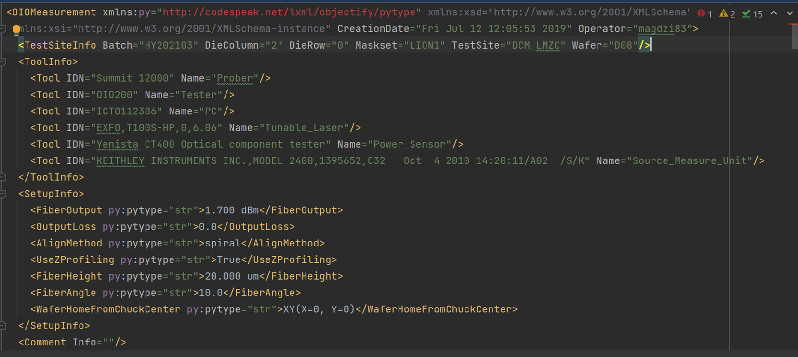
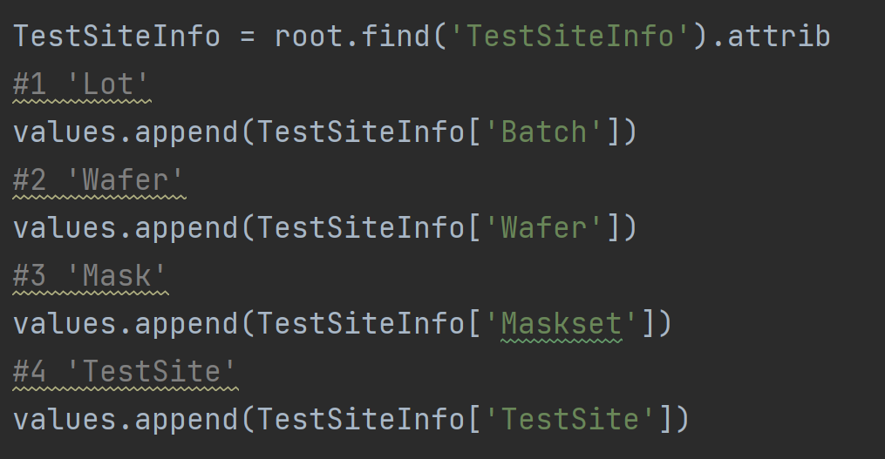
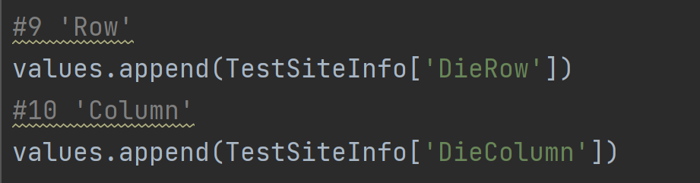
Value #1~#4, #9,#10
TEAM A3 PPT
CODE

Slide 9
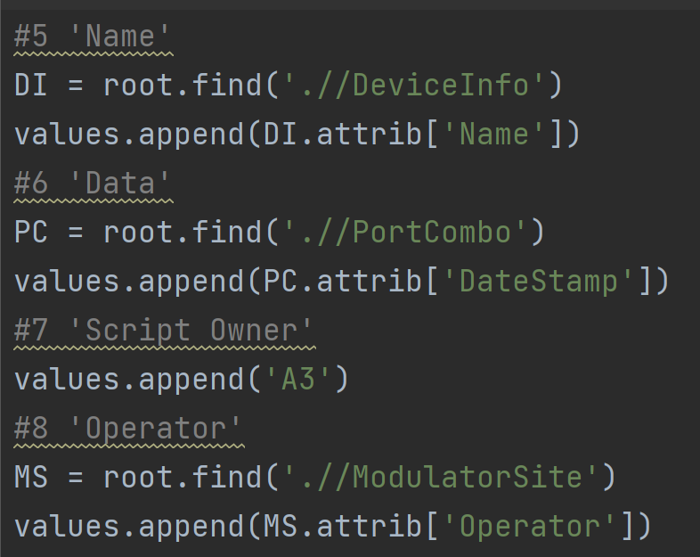

Values #5~#8
TEAM A3 PPT
CODE
XML

Slide 10
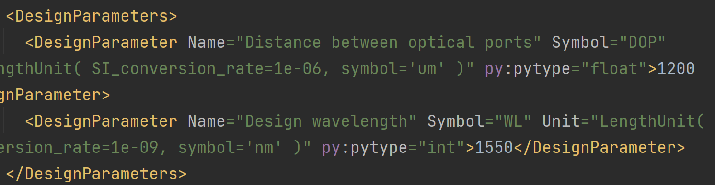
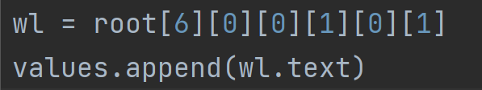
Analysis Wavelength
TEAM A3 PPT
Same tag name
CODE
Method 1: ‘Index'
Method 2: ‘@attribute name=attribute value’

Slide 11
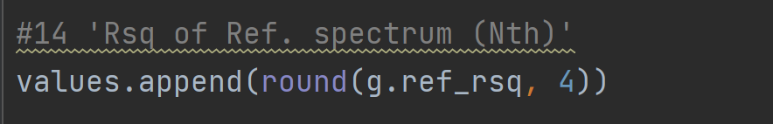
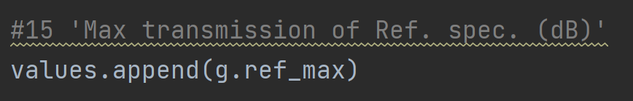

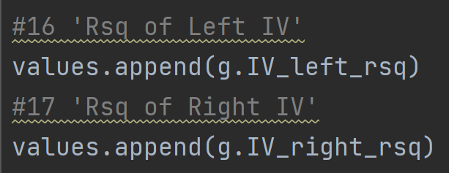
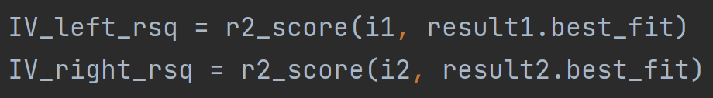
Data analysis values
TEAM A3 PPT
CODE
※ ref_rsq: R-squared value of REF fitting graph
※ ref_max: Max value of REF fitting graph
※ IV_left&right_rsq: R-squared values of the left and right IV curve fitting graphs

Slide 12
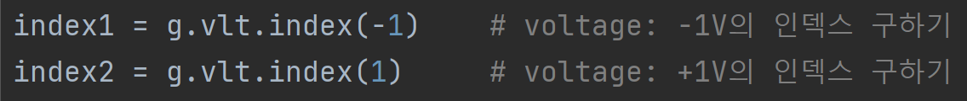
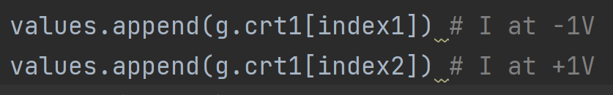
Current values at -1 and +1 volts (row data)
TEAM A3 PPT
CODE
※vlt: list of voltages
※crt1: list of currents

Slide 13
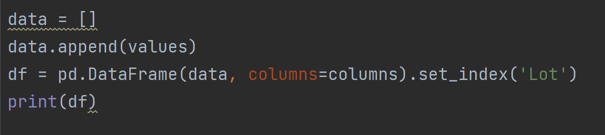
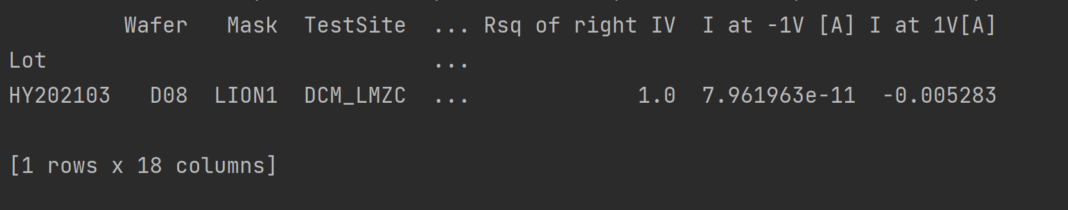
Create table
TEAM A3 PPT
CODE
RESULT

Slide 14

Saving the file in ‘csv’ format
TEAM A3 PPT
CODE
File name
RESULT

Slide 15
Result & Discussion
TEAM A3 PPT

Slide 16

Thank you
TEAM A3 PPT
Source: https://img1.daumcdn.net/thumb/R1280x0/?scode=mtistory2&fname=https%3A%2F%2Fblog.kakaocdn.net%2Fdn%2FmvI0C%2Fbtq57oVfCGM%2FPqiCigr0LNOsZDpdgcRLY0%2Fimg.jpg

