Slide 1
LMZ Data Analyzer
TEAM A3 PPT
TEAM A3
Dept. of Photonics & Nanoelectronics
장희령, 지요섭, 김건우

Slide 2
What is the problem?
How to solve?
Results
How to use?
INDEX
LMZ Data Analyzer

Slide 3


What does the client want?
What is the problem?
Black Box

Slide 4
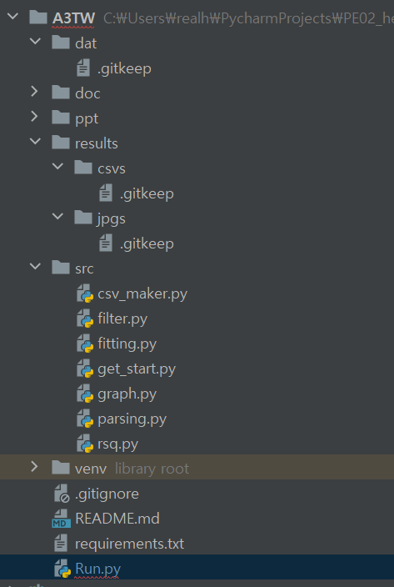
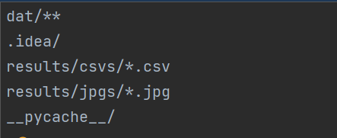
.gitignore
How to solve?
CODE

Slide 5
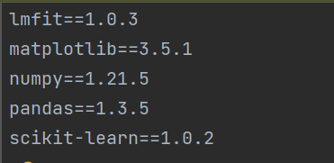
requirements.txt
How to solve?
CODE

Slide 6
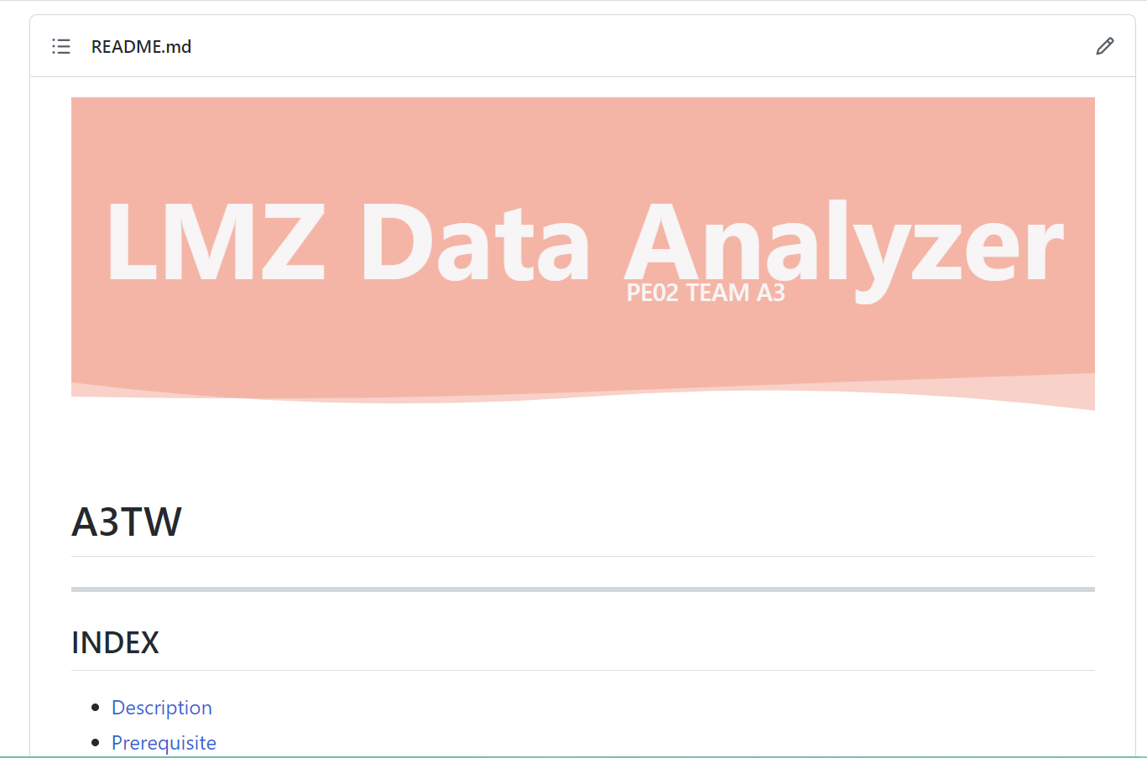
README.md
How to solve?
CODE

Slide 7






Module
How to solve?
csv_maker.py
filter.py
project
data
1.xml
n.xml
fitting.py
src
get_start.py
Run.py
graph.py
results
csvs
.csv
parsing.py
jpgs
rsq.py
.jpg

Slide 8
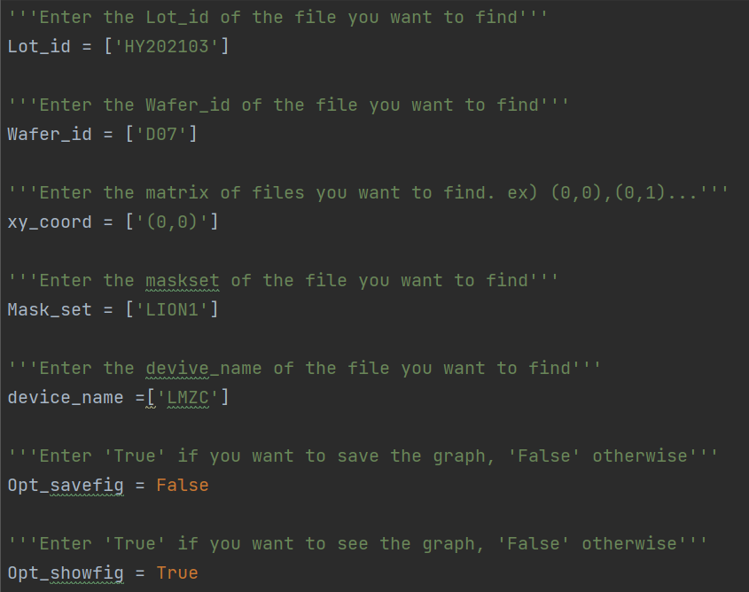
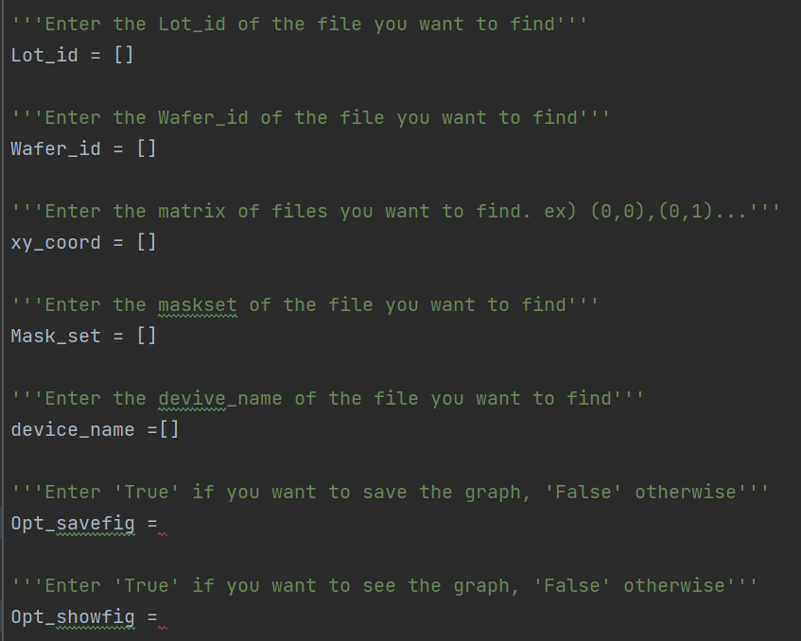
Run.py
How to solve?
CODE

Slide 9
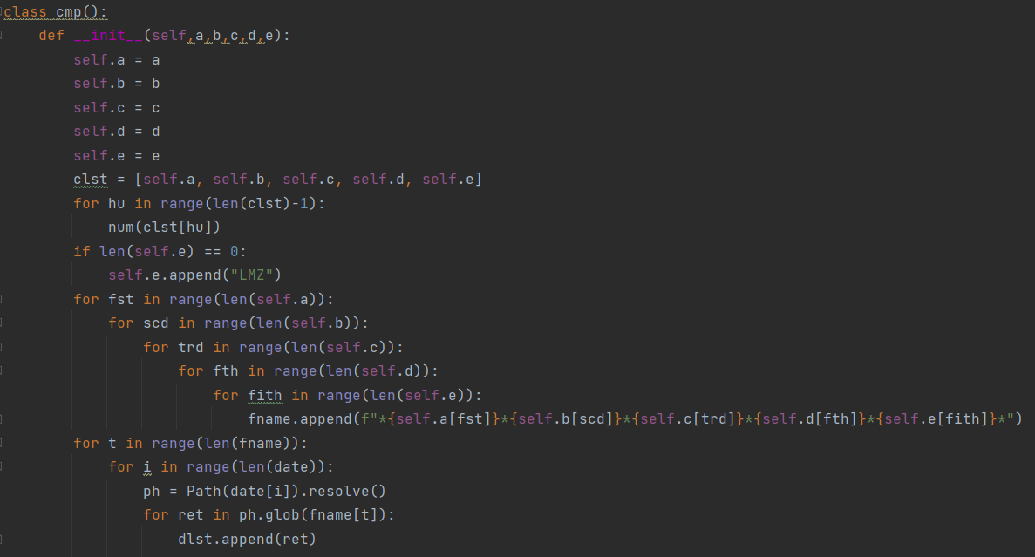
SRC / filter.py
How to solve?
CODE

Slide 10
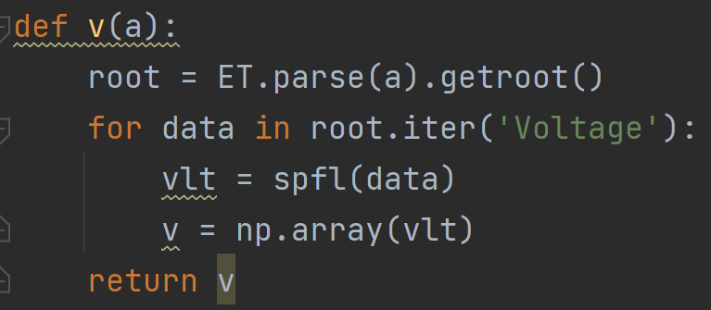
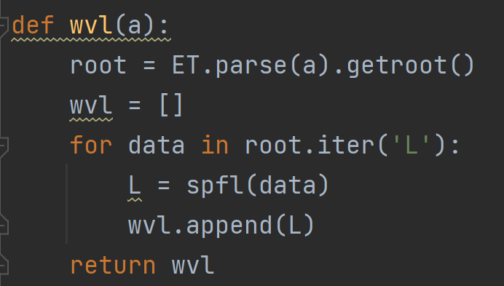
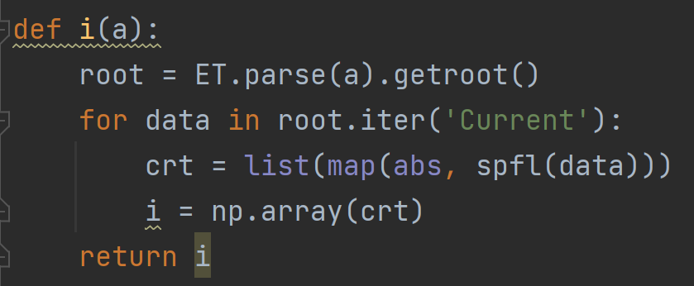
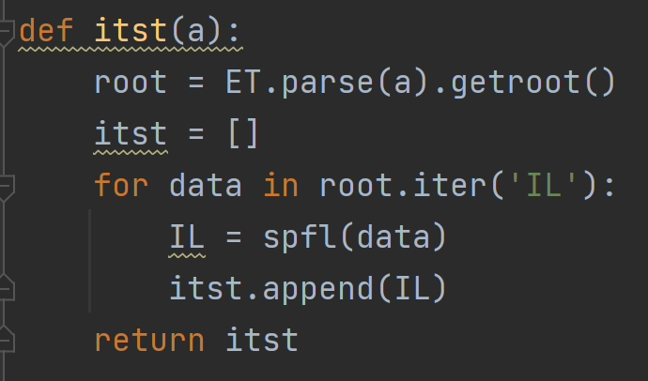
SRC / parsing.py
How to solve?
CODE

Slide 11
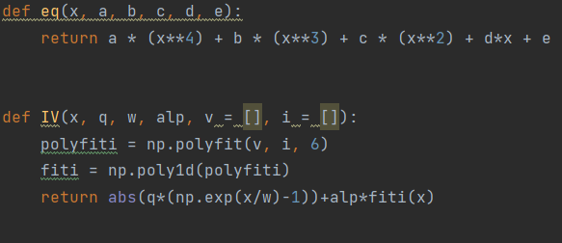
SRC / fitting.py
How to solve?
CODE

Slide 12
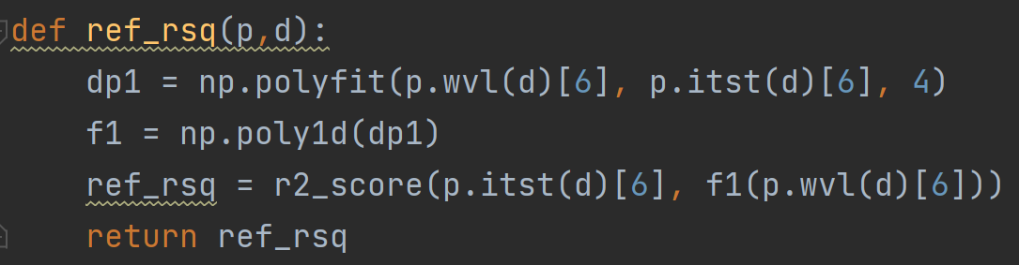
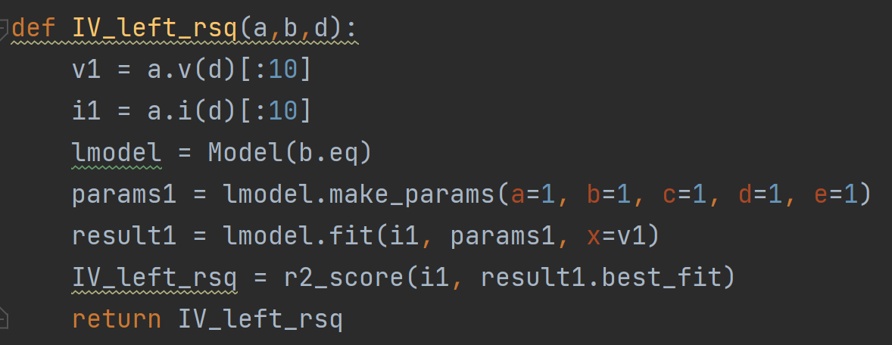
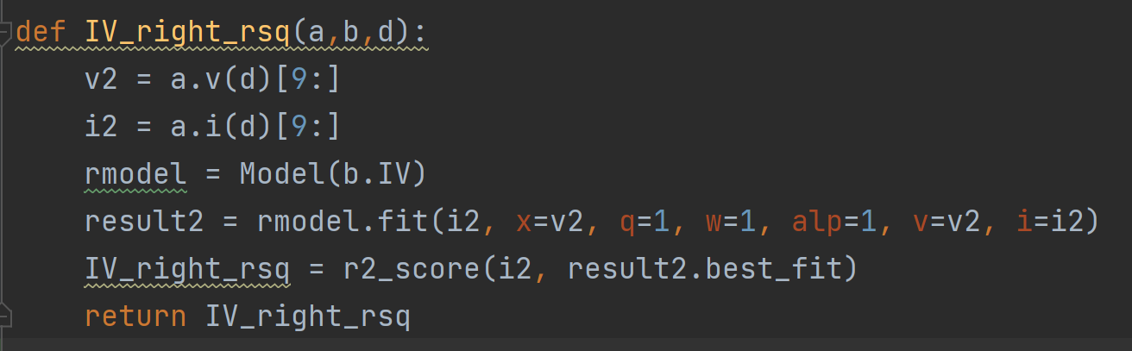
SRC / rsq.py
How to solve?
CODE

Slide 13
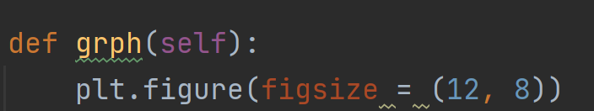





SRC / graph.py
How to solve?
CODE
Transmission spectra-as measured Code
Transmission spectra – Raw & Fit Code
Processed interference spectrum Code
I-V Curve Code
I-V Curve Raw & Fit Code

Slide 14
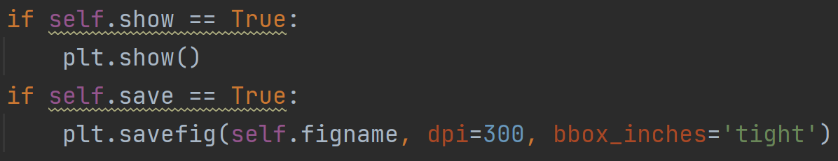
SRC / graph.py
How to solve?
CODE

Slide 15
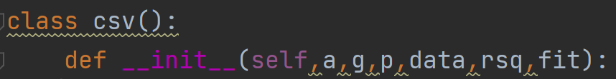
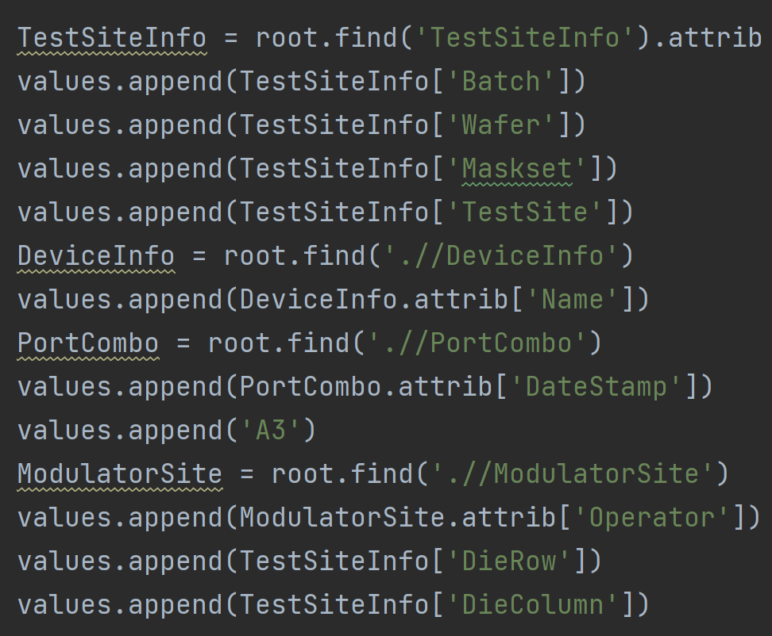
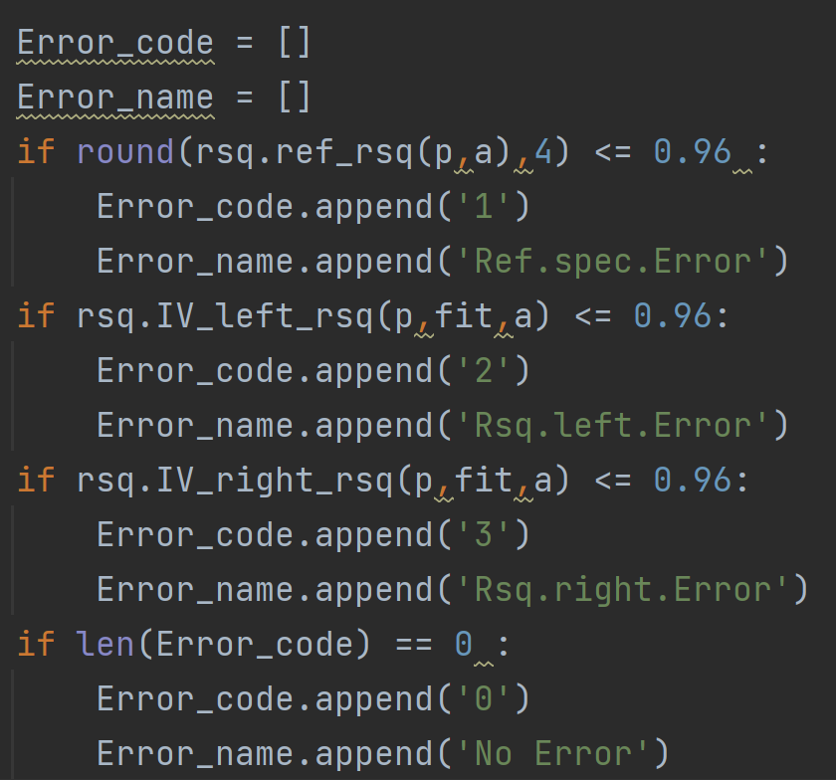
SRC / csv_maker.py
How to solve?
CODE

Slide 16
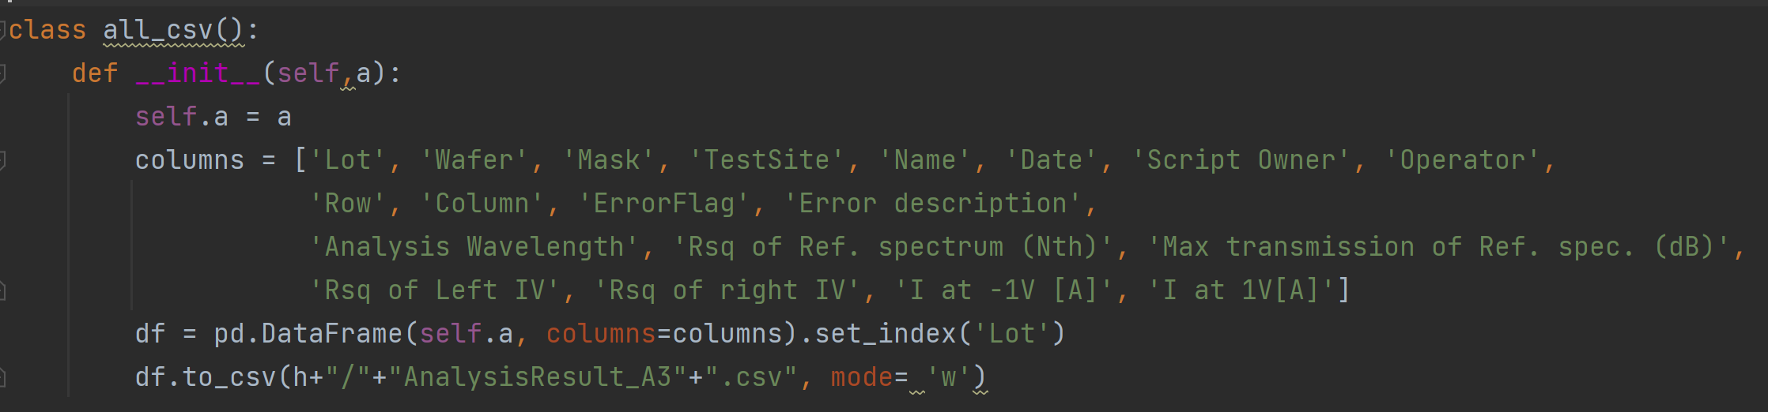
SRC / csv_maker.py
How to solve?
CODE

Slide 17
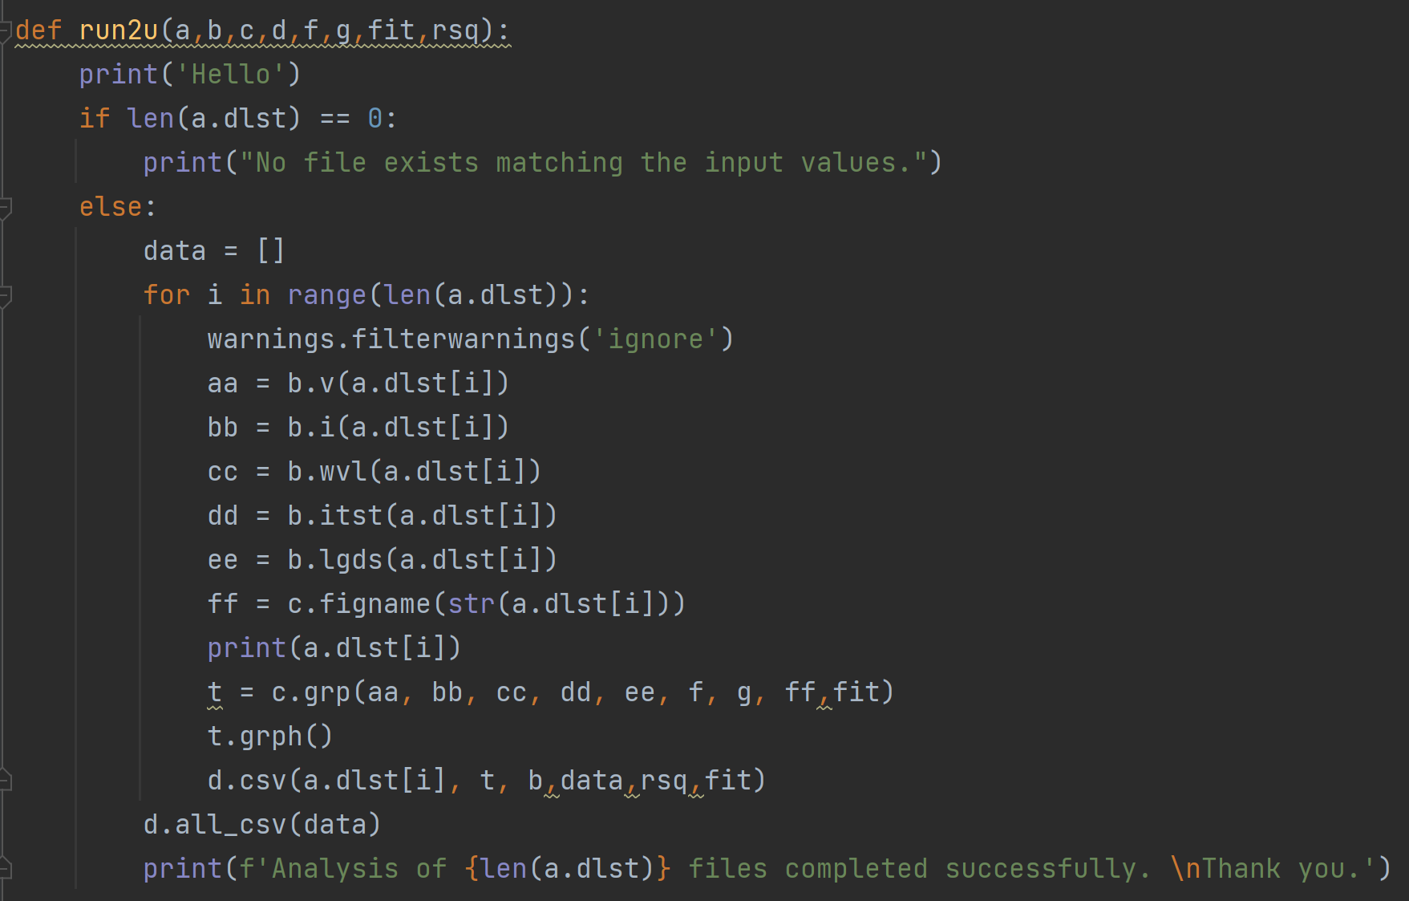
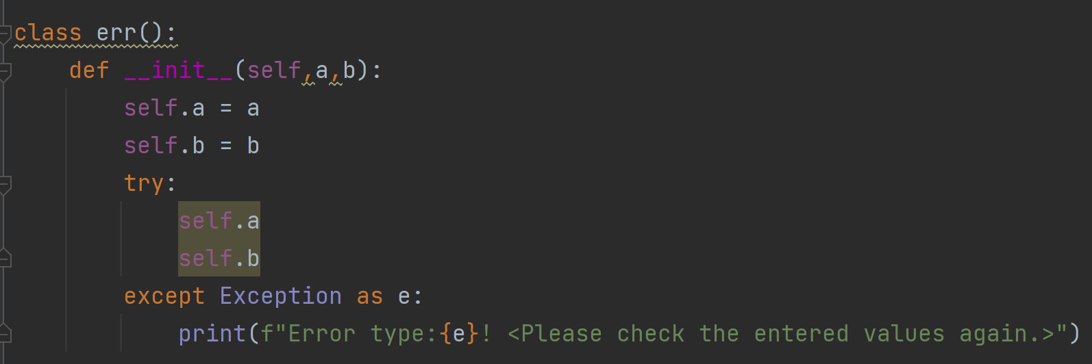
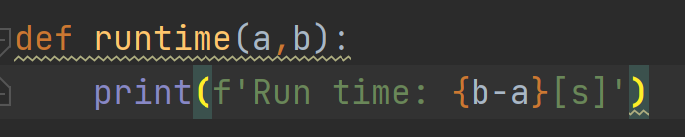
SRC / get_start.py
How to solve?
CODE

Slide 18
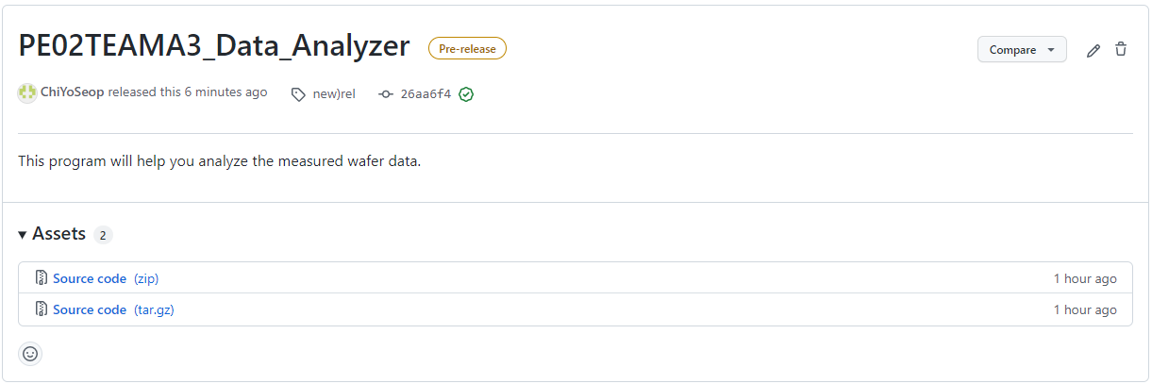

How can the client use it?
How to use?

Slide 19


Put the data you want to analyze into the 'dat' folder.
How to use?
dat

Slide 20
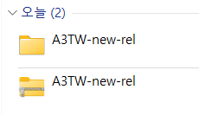
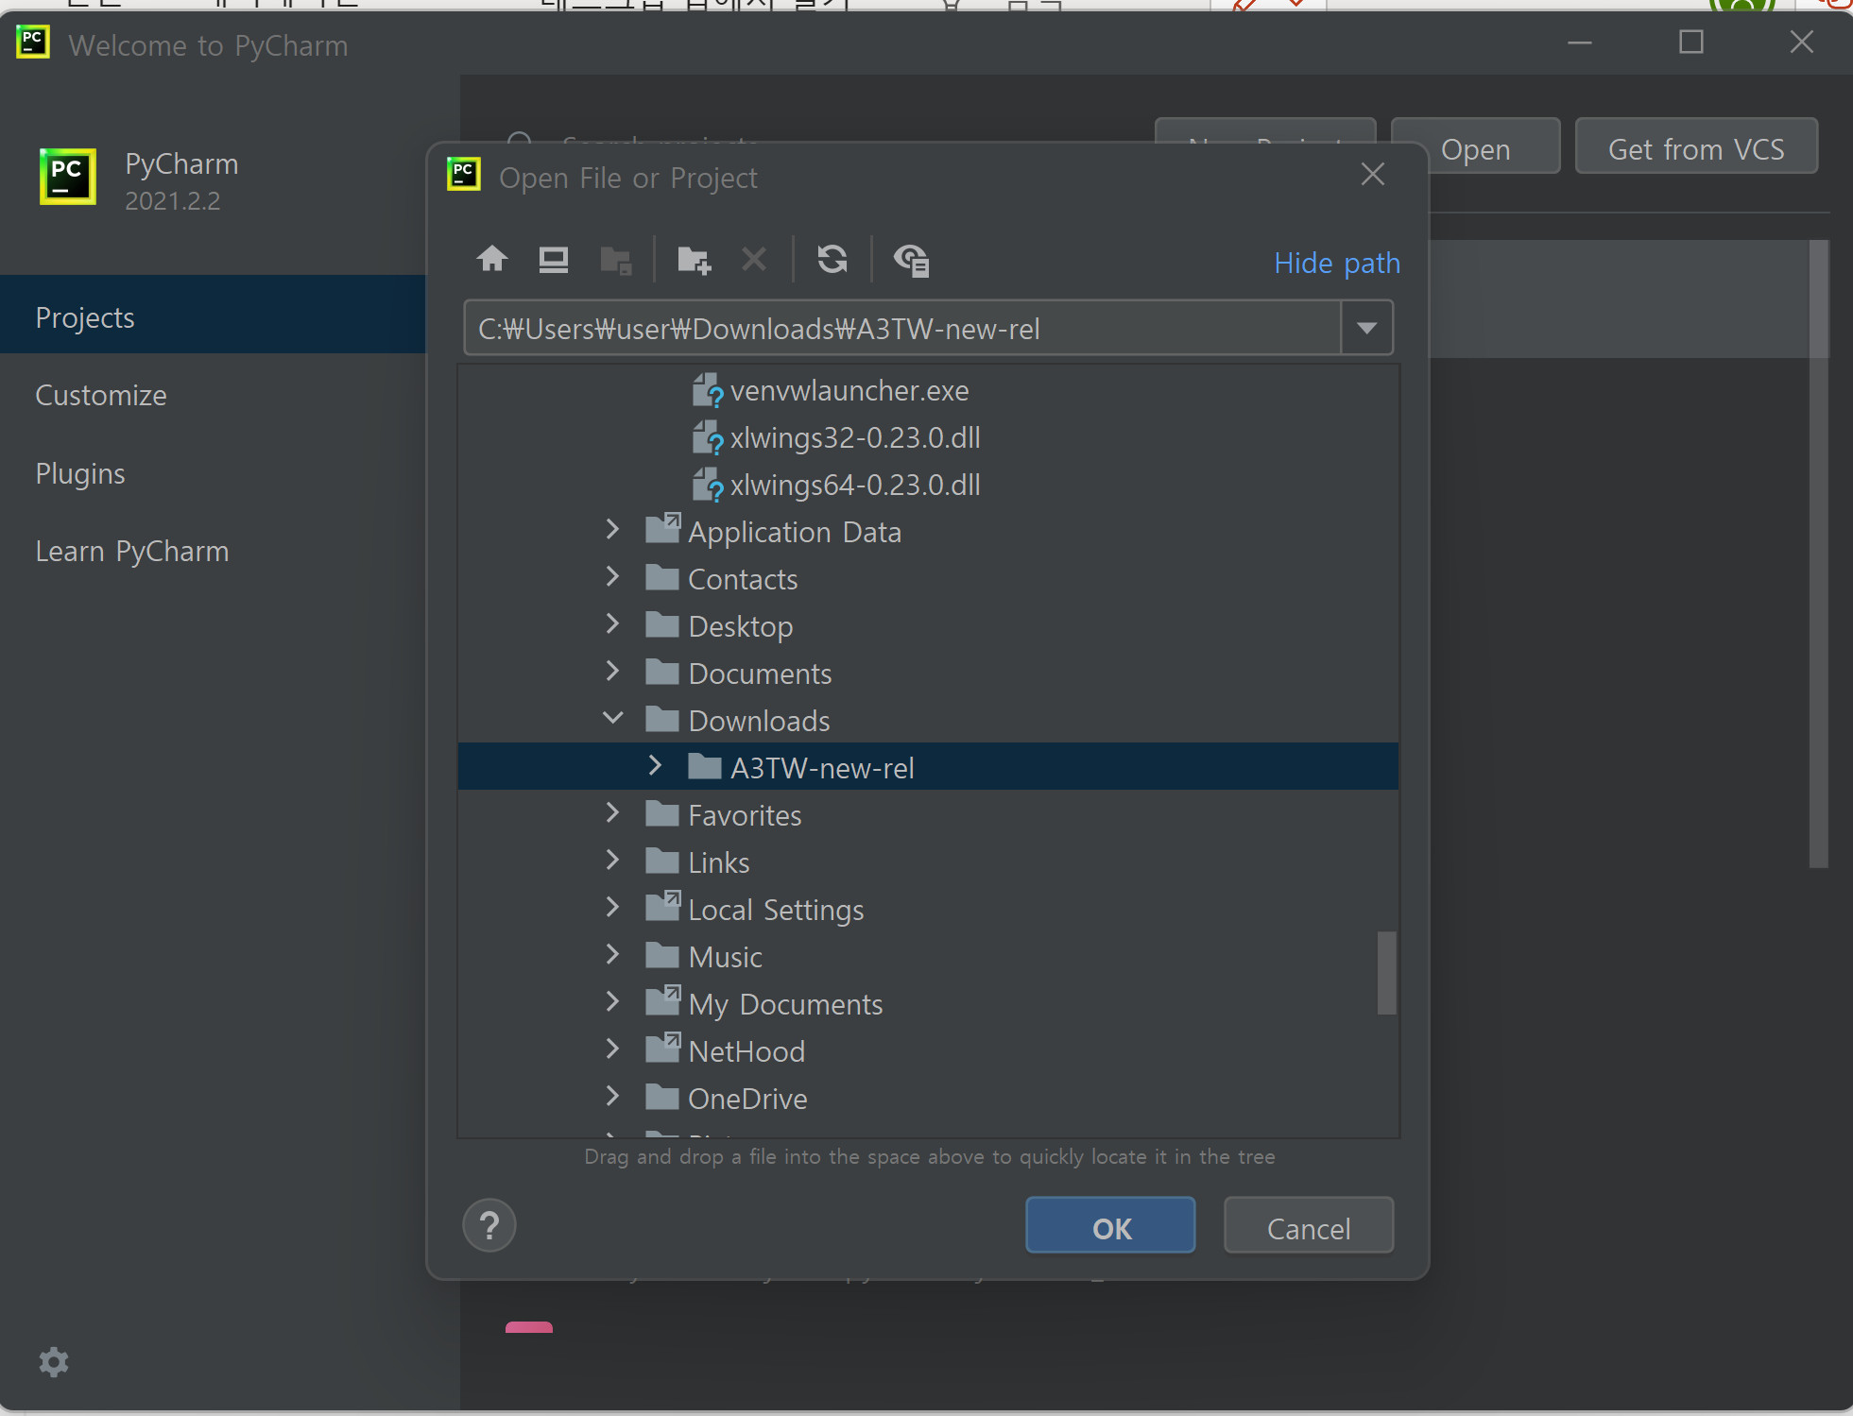
Open the file using PyCharm
How to use?

Slide 21
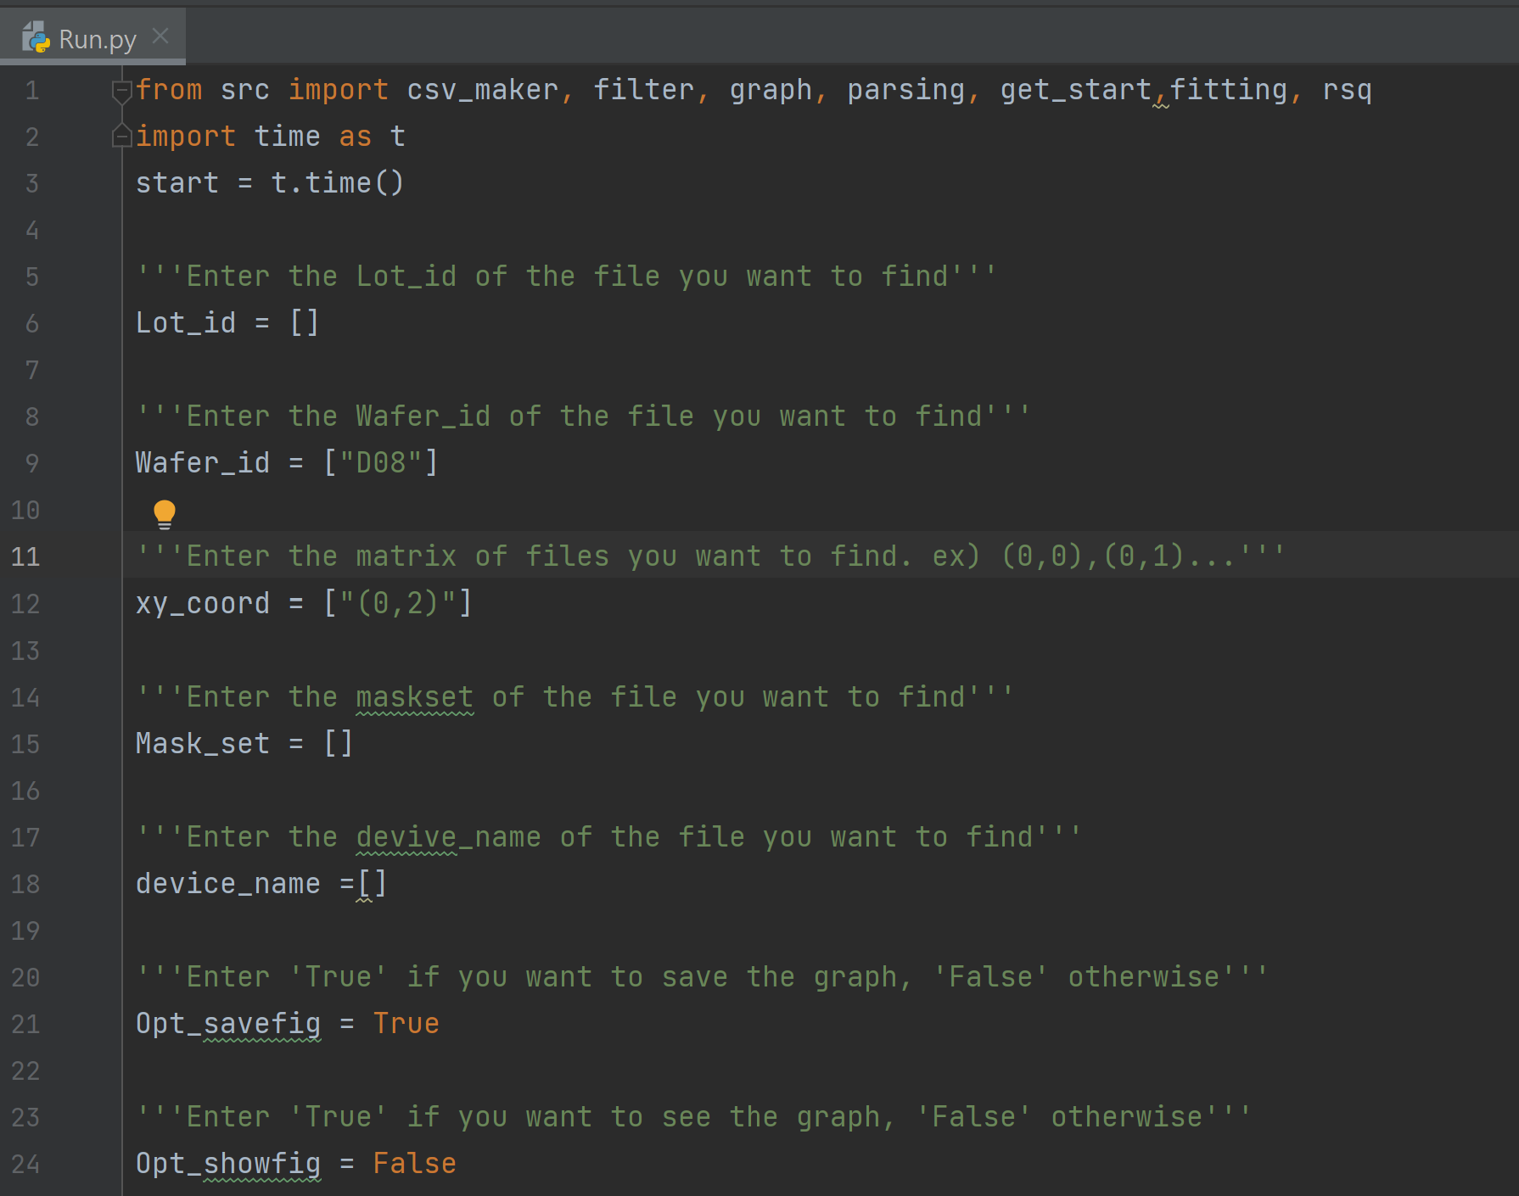
Enter the values in Run.py
How to use?

Slide 22
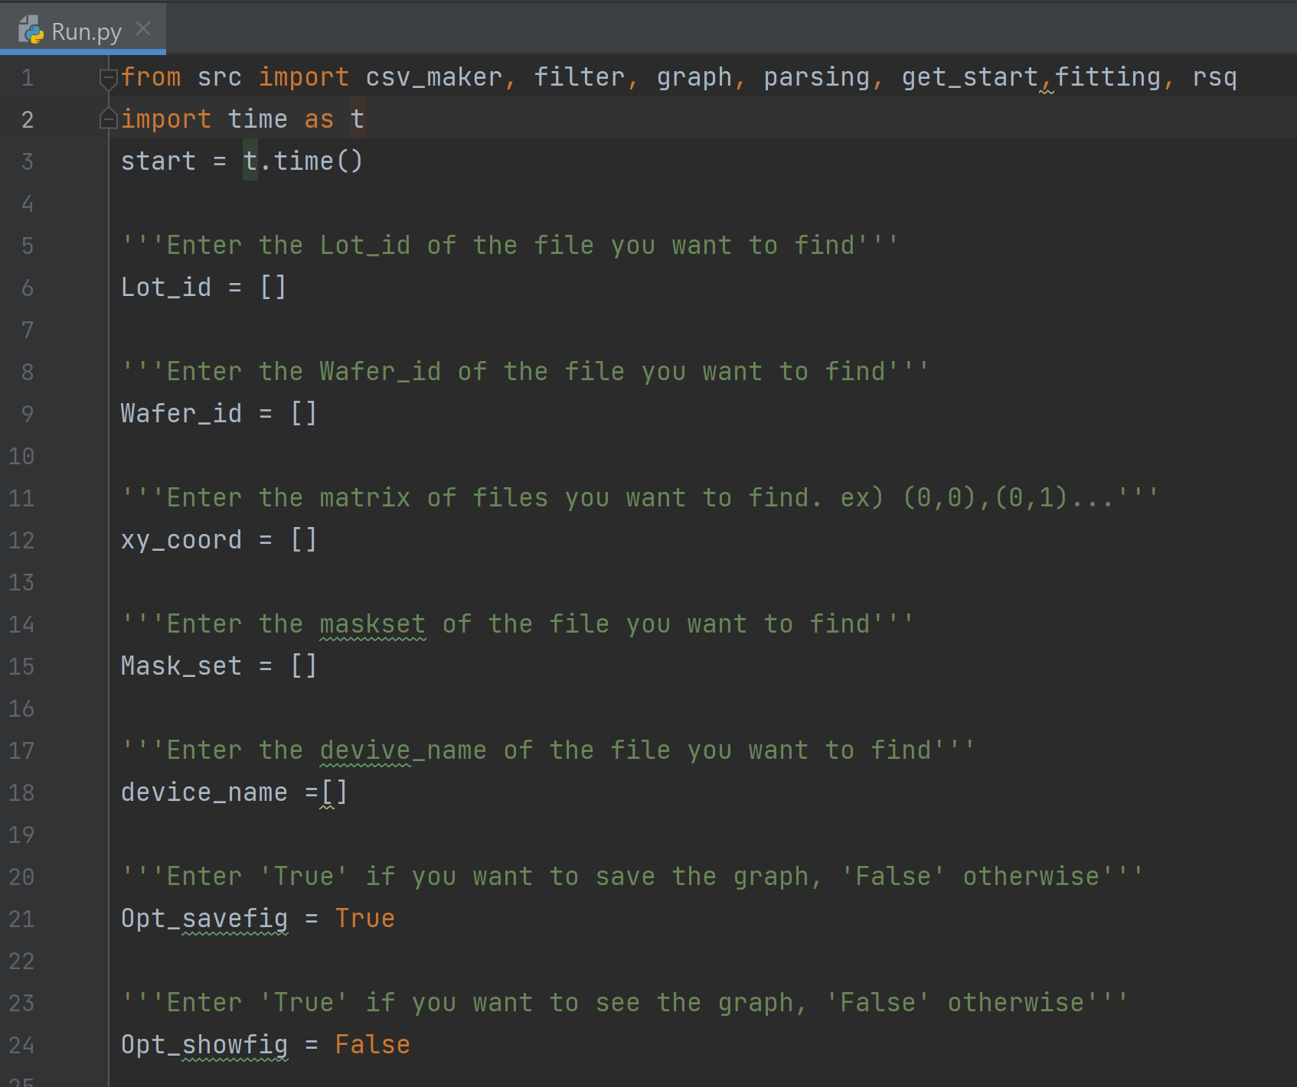
EX) Analyze all 'LMZ' data
How to use?
Run.py

Slide 23
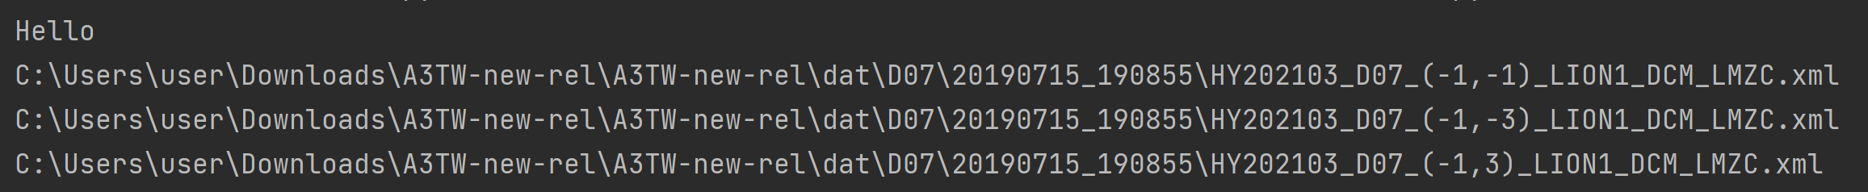
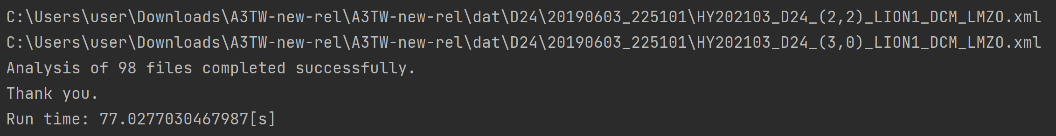
EX) Analyze all 'LMZ' data
How to use?
Results
.
.
.

Slide 24
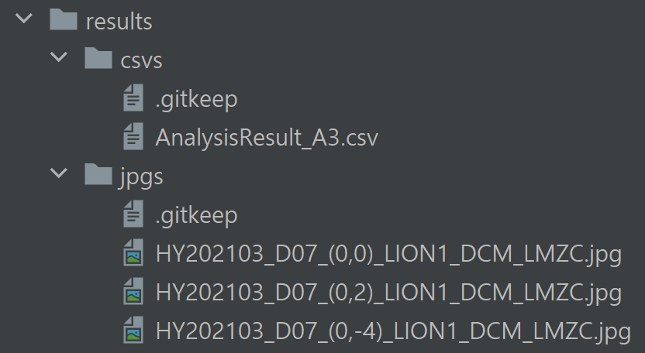
Check the results
How to use?

Slide 25
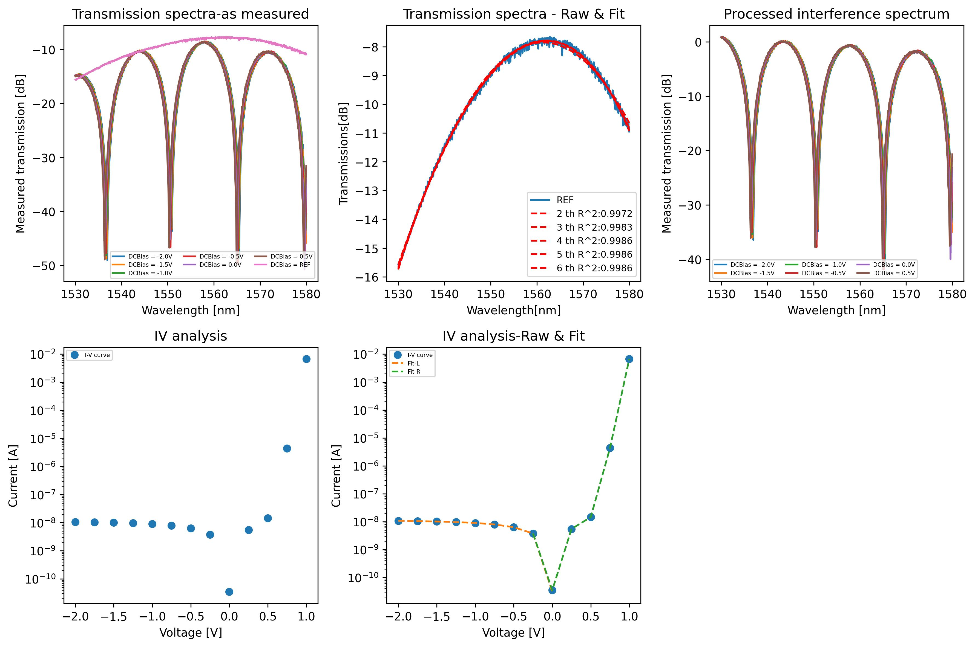
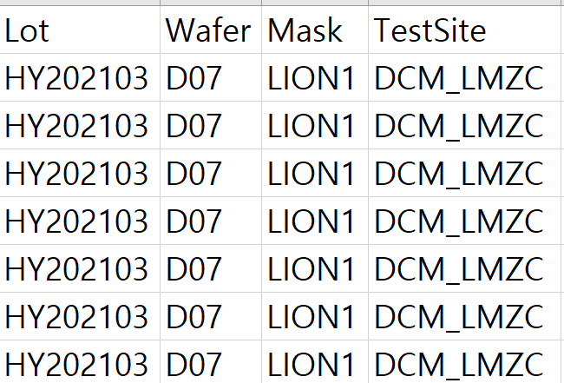
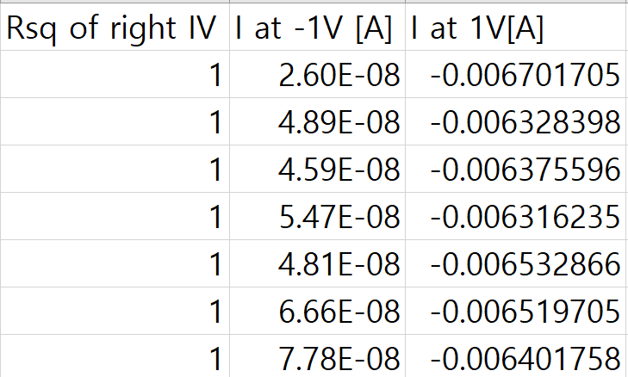
Results
Results
jpg
csv
...

Slide 26

Thank you
TEAM A3 PPT
Source: https://img1.daumcdn.net/thumb/R1280x0/?scode=mtistory2&fname=https%3A%2F%2Fblog.kakaocdn.net%2Fdn%2FmvI0C%2Fbtq57oVfCGM%2FPqiCigr0LNOsZDpdgcRLY0%2Fimg.jpg

