Slide 1
COMPS203F
Topic 02:
Integrated Development Environment
Terri Wong
Notes:
MT201F Computing Fundamentals with Java

Slide 2
IDE
Integrated Development Environment (IDE)
  platform for program development
  project creation and program editing (syntax highlights, ...)
  compilation and execution
  debugging
Increases programmer productivity
IDE: NetBeans (version 12 in 2021)
  https://netbeans.apache.org/download/index.html
  All the installation details will be covered in the lab session.

Slide 3
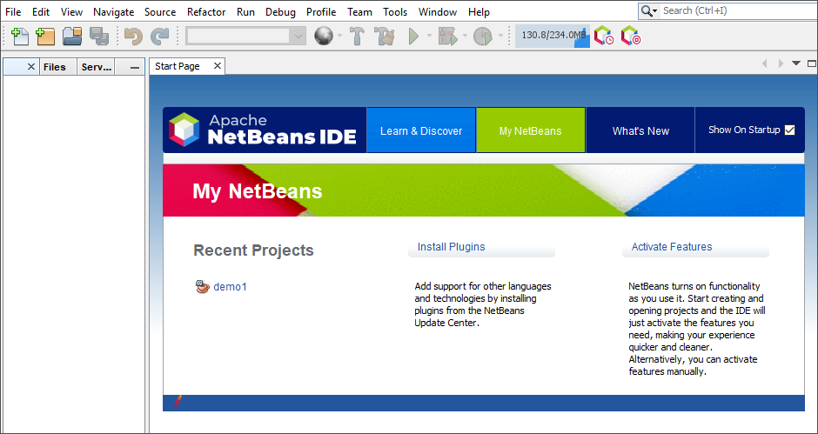
NetBeans Start Page

Slide 4
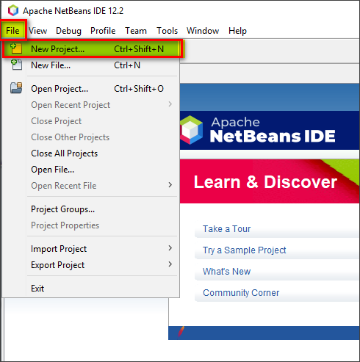
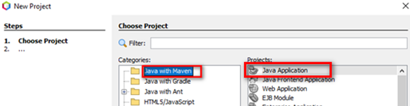
Project Creation
Works with projects
a project may have many classes
Choose
"File > New Project "
to start a new project
a new windows appears, the default project type "Java Application" is fine, so click the "Next >" button

Slide 5
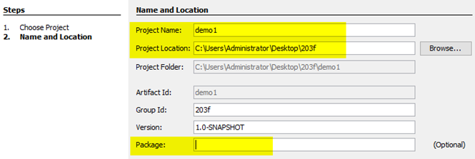
Project Creation
Then choose your project name, I use “demo1" here
optionally you can change the location of the project
click "Finish"

Slide 6
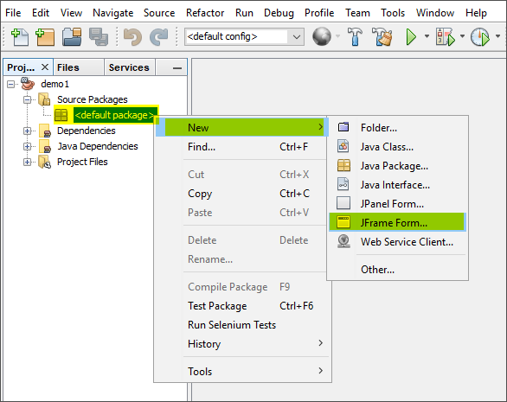
GUI Builder
You can create a JFrame by right-clicking "Source Packages" > New > JFrame Form...
A new window appears. Use "JFrameDemo" as the class name and click "Finish"

Slide 7
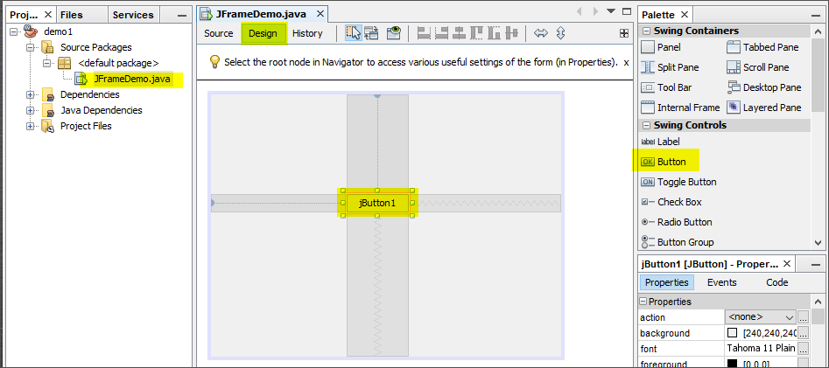
Design View
a new tab appears and the window is updated
you can drag a button on the right side to the grey rectangular area in the middle part.

Slide 8

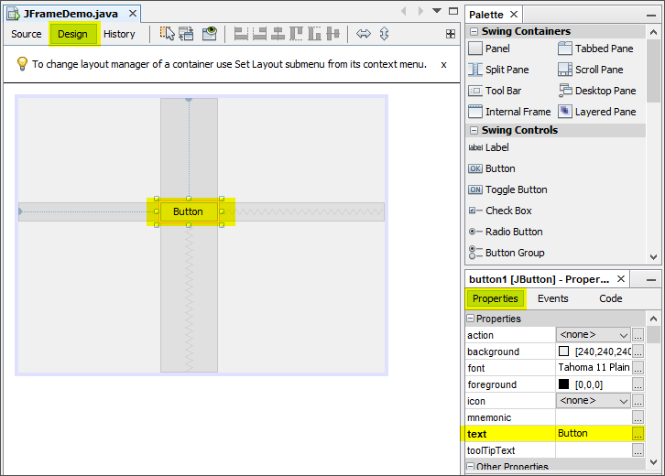
Design View
You can change the text on the button using the "Properties" area on the right
Or you can right-click and "Edit Text"

Slide 9
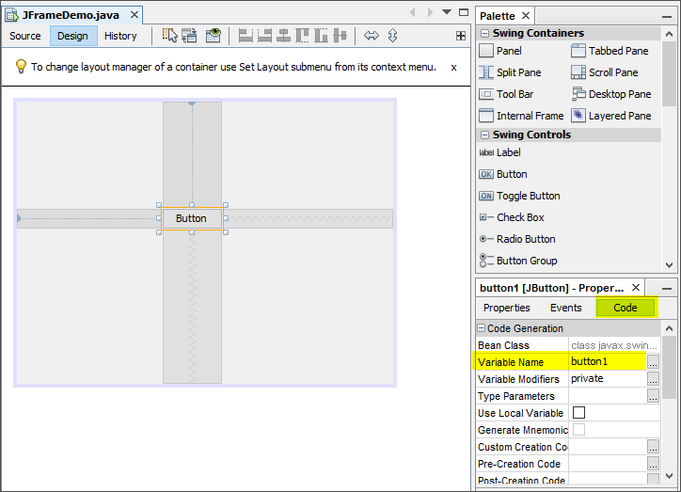
Design View
You can change the variable name of the button using the "Code" area on the right

Slide 10
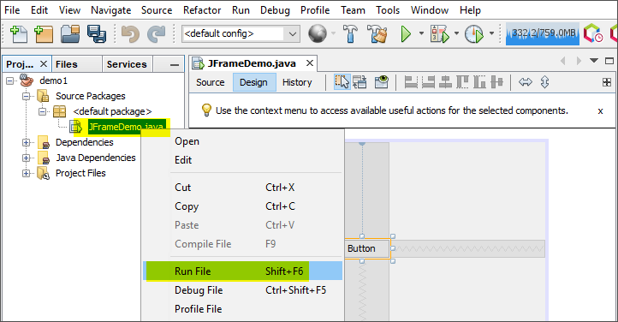
Run the Project
Right click the file name JFrameDemo.java and choose Run File

Slide 11

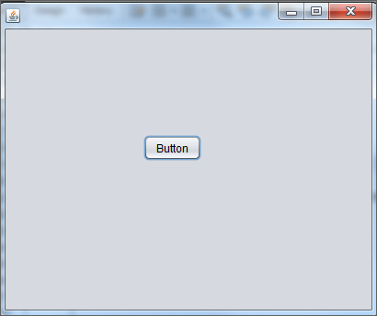
Project Output

Slide 12
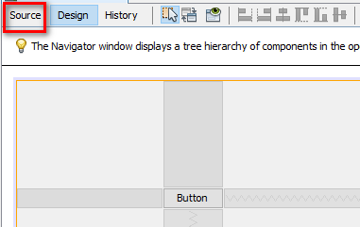
Source View
What you have seen is the "Design view"
Click "Source" to see the Java source code generated.

Slide 13
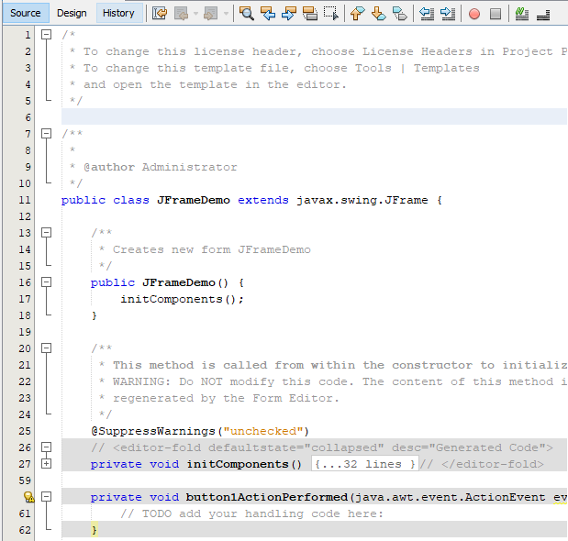
Source View

Slide 14
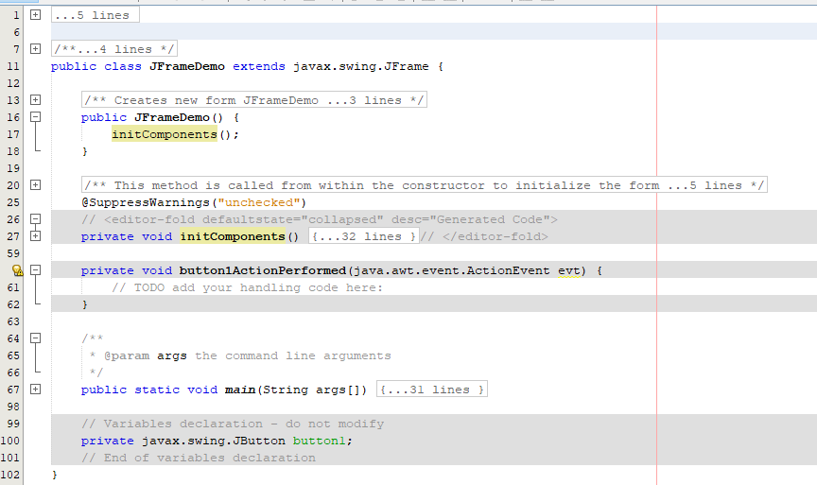
Source Code Generated

Slide 15
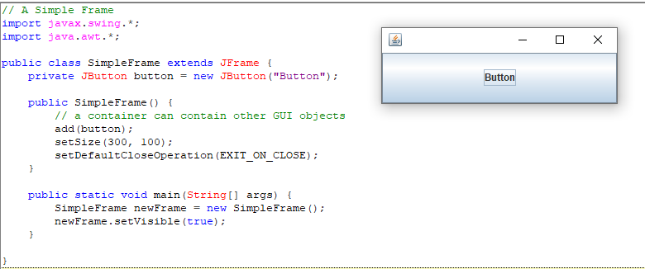
Compared with Simple Frame (SimpleFrame.java) using Crimson IDE

Slide 16
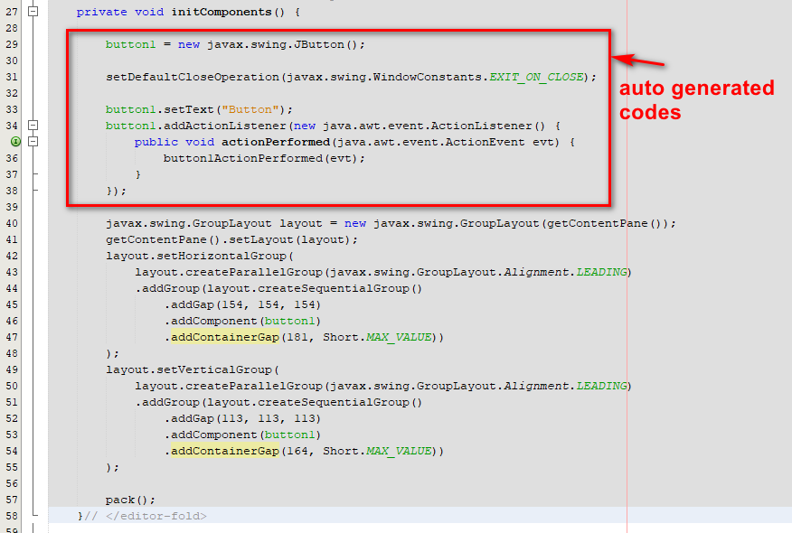
Source Code Generated: Method initComponents()

Slide 17
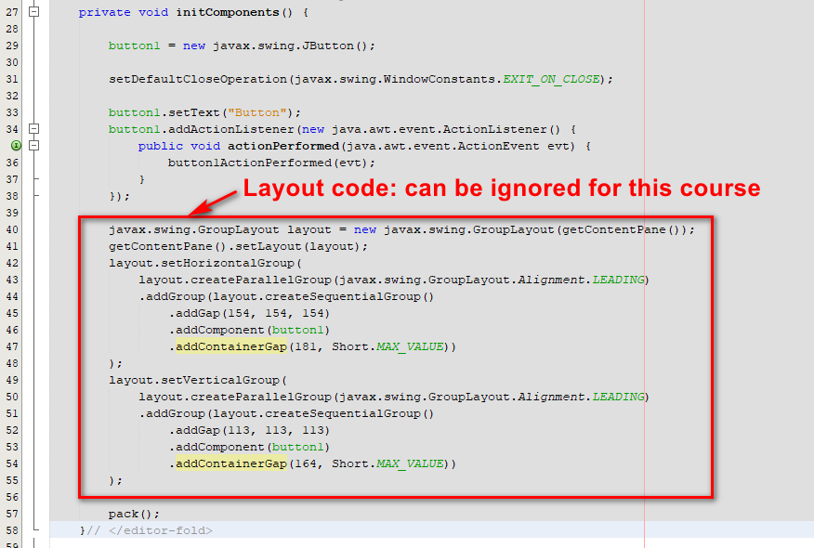
Source Code Generated: Method initComponents()

Slide 18
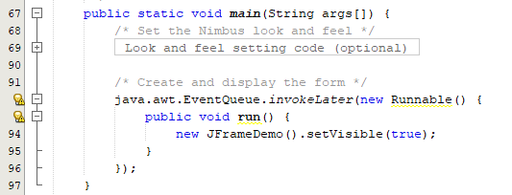
Source Code Generated:
Method main()

Slide 19
Compared with Simple Frame:
Method main()

Slide 20
Other GUI components
You can design the GUI in an easy way using the IDE
The advantages of using IDE are
  components can be placed in more precise positions
  debugging facilities available, and more ...
Disadvantages: startup slower, more disk space used, variables declared put near the end, ...
Go the lab sessions to learn other features
More on GroupLayout (optional), refer to
https://docs.oracle.com/javase/tutorial/uiswing/layout/group.html

