Slide 1
COMPS312F
Tutorial #01
Java NetBeans
COMPS312F Tutorial #01

Slide 2
Java NetBeans
You need to use Java NetBeans to prepare Java programs in this course.
Before you can create a Java file, you need to create a project in NetBeans.
This is done by following the link:
  File -> New Project
COMPS312F Tutorial #01

Slide 3
Creating Project in NetBeans
Then a new window would appear.
This would enable you to choose the type of project you want to create.
At this moment, you would select “Java” on the left window and “Java Application” on the right window.
Then press the “Next” button.
COMPS312F Tutorial #01

Slide 4
Creating Project in NetBeans
Then, you need to provide the project name and the location where you want the project files to be stored.
If you have brought along a USB drive or a floppy, please specify the location to be on the USB drive or the floppy.
Otherwise your work will be lost after leaving the computer.
Let's assume that the new project name is “MyProject”.
COMPS312F Tutorial #01

Slide 5
Creating Files in a Project
By default, a file called “MyProject.java” would be created for you.
You can uncheck “Create Main Class” to avoid creating this file.
To create a java file, follow the link:
  File -> New File.
Then, you need to select the type of file you want to create.
For a Java class, select “Java” on the left window, select “Java Class” on the right window.
COMPS312F Tutorial #01

Slide 6
Creating Files in a Project
Then, you need to specify the name of the class.
  Let's assume that the class we want to create is “MyClass”.
You can specify the package which the class is in.
  Let’s set the package to “myProject”.
Then, press the “Finish” button.
After that, an entry for “MyClass.java” would appear in the top left window and the contents of the file is shown on the right window.
COMPS312F Tutorial #01

Slide 7
Creating Files in a Project
The file would contain the following lines:
/* some comments… */
package myProject;
/* some comments… */
public class MyClass {
}
COMPS312F Tutorial #01

Slide 8
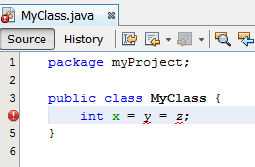
Editing Java file
You can then add your code inside the file.
If your code contains syntax errors, then the errors will be shown underlined with wave lines.
There will be a red exclamation mark on the file name and the corresponding line.
COMPS312F Tutorial #01

Slide 9
Compiling Java files
To compile the file you just edited:
  Press “F9”; OR
  Follow the link:
    Run -> Compile File
COMPS312F Tutorial #01

Slide 10
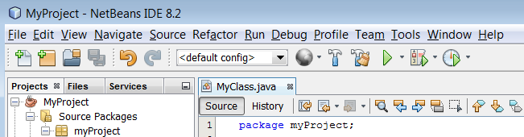
Compiling Java files
Files in a project may depend on each other.
So if you have made changes to a file, then all files that use the class in the former file have to be compiled again.
To do so, you can:
  Press “F11”; or
  Follow the link:
    Run -> Build Project (MyProject)
  Press the button on the tool bar:
COMPS312F Tutorial #01

Slide 11
Clean and build project
The last method sometimes fails in that when you make some changes to a file and another file used this file does not get compiled.
In this case, you may need to force a recompilation of all files in the project.
This is done by doing the followings:
  Press “shift-F11”; or
  Follow the link:
    Run -> Clean and Build Project (MyProject)
  Press the following button on the tool bar:
COMPS312F Tutorial #01

Slide 12
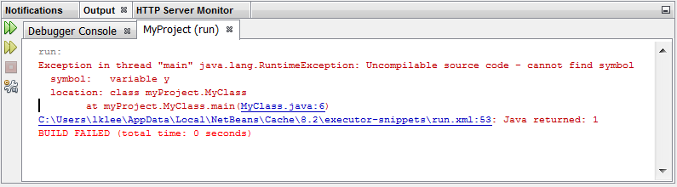
Compilation errors
If your program contains syntax errors, the errors will be shown in the lower window.
You can click at the errors and the places where errors occur will be shown in the editor window.
COMPS312F Tutorial #01

Slide 13
Debugging Java programs
It is difficult to write a correct program in one go especially when you are writing a large program.
So it is important that you know how to debug a program.
The most primitive way of debugging a program is to insert some print statements to show the status of the program at different states.
COMPS312F Tutorial #01

Slide 14
Debugging Java programs
However, with NetBeans, you can actually set breakpoints in your code so that the program will be stopped at certain point to enable you to check the contents of different variables.
You can even execute the Java statements line by line so that you can watch how the status of the program changes.
COMPS312F Tutorial #01

Slide 15
Debugging Java programs
To debug the Java file you have just edited, you can do one of the followings:
  Press “ctrl-shift-F5”; or
  Follow the link:
    Debug -> Debug File
COMPS312F Tutorial #01

Slide 16
Debugging Java programs
Once you have started the debugging process, the program will be compiled and then executed.
So you do not need to explicitly compile the file before debugging.
However, sometimes you need to do a clean compilation because of the problem mentioned previously.
COMPS312F Tutorial #01

Slide 17
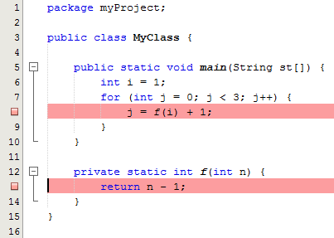
Setting breakpoints
A breakpoint is a point where execution will stop when you debug a program.
To set a breakpoint, you just need to click on the left margin of the place where you want the execution to stop.
Once the breakpoint is set, you can see a small pink square at the left margin.
COMPS312F Tutorial #01

Slide 18
Removing breakpoints
You can remove a breakpoint by clicking at it again.
COMPS312F Tutorial #01

Slide 19
Viewing local variables
When the program is stopped at a breakpoint, the left window shows the tag “Debugging” and the lower right window shows two tags: “Variables”, “Breakpoints”.
COMPS312F Tutorial #01

Slide 20
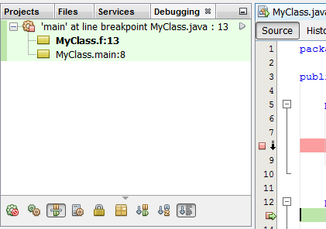
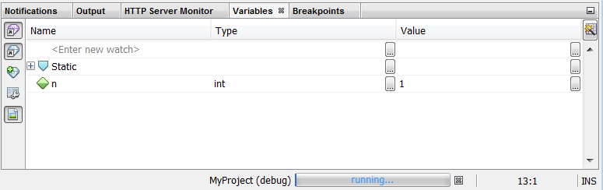
Viewing local variables
COMPS312F Tutorial #01

Slide 21
Call stack
The “Debugging” tag shows the call stack, which lists out all the methods in the stack.
So if you have method A calling method B, then, you would see method B on top of method A in the call stack window.
COMPS312F Tutorial #01

Slide 22
Viewing local variables
You can click at a particular method in the call stack if you want to view the local variables of that method.
The local variables of that method are shown in the “Variables” tag in the lower right window.
If the variable is an object, you can click on a “+” button to expand it to view the values of its attributes.
COMPS312F Tutorial #01

Slide 23
Watches
In the Variables tag window, you can create a new watch (see the circled button below).
This allows you to specify any expression you want to view and then NetBeans will evaluate the expression and shows the value.
COMPS312F Tutorial #01

Slide 24

Step-by-step execution
When the program is stopped, you can execute the next statement by doing any of the followings:
  Press “F8”; or
  Follow the link:
    Debug -> Step Over
  Press the following button on the tool bar:
COMPS312F Tutorial #01

Slide 25
Stepping into a method
When the program is stopped at a point where the statement is calling a method, then, you can step into it by doing one of the followings:
  Press “F7”; or
  Follow the link:
    Debug -> Step Into
  Press the following button on the tool bar:
COMPS312F Tutorial #01

Slide 26
Getting out of a method
If you want to get out of a method, you can do the followings:
  Press “ctrl-F7”; or
  Follow the link:
    Debug -> Step Out
COMPS312F Tutorial #01

Slide 27
Run to cursor
When a program is stopped at one point and you want execution to resume until certain point, then you can first click at the point where you want to stop again and then do one of the followings:
  Press F4; or
  Follow the link:
    Debug -> Run to Cursor
  Press the following button on the tool bar:
COMPS312F Tutorial #01

