Slide 1
Lecture 1
COMPS320F Database Management
Introduction to Databases
Terri Wong
School of Science and Technology

Slide 2
Introduction
Lecture: 2 hours / week
Lab/tutorial: 2 hours / week
Lecturer: Terri Wong
Email: twong@hkmu.edu.hk
Phone: 27686834
Tutor: Hugh Luk
Email: thluk@hkmu.edu.hk
Phone: 27686433

Slide 3
Course Content
Introduction to Databases
Database Environment
Database Architectures
The Relational Model
SQL: Data Manipulation
SQL: Data Definition
Advanced SQL
Entity-Relationship Modeling
Case Study

Slide 4
Intended Learning Outcomes
Upon completion of this course, students should be able to:
Describe essential principles and concepts of database management systems.
Perform data manipulation and extraction tasks effectively using SQL.
Utilize the relational model solving data modelling problems.

Slide 5
Assessment
Overall Continuous Assessment OCAS (30%)
2 Tests (each 15%) [Individual]
3-hour written Examination (70%)
To obtain a Pass Grade, normally you should obtain at least 40% in the 3 scores below:
OCAS, exam score (ES) and the overall course score (CS)

Slide 6
Software
Oracle (www.oracle.com )
PostgreSQL (www.postgresql.org)

Slide 7
Text book
Connolly, T and Begg, C, Database Systems: A practical Approach to Design, Implementation, and Management (6th ed.), Boston: Pearson Education.

Slide 8
Lecture 1 - Content
In this lecture, you will learn
Traditional file-based systems
Database Management System (DBMS)
Major components of the DBMS environment

Slide 9
What is a database system?
Database
a shared collection of logically related data, and a description of this data, designed to meet the information needs of an organization.
E.g., Student and teacher records, course details
Database Management System (DBMS)
Collection of programs accessing database through DBMS
E.g., Oracle, PostgreSQL, MS SQL Server, MySQL and MS Access.
Notes:
Collection of related data
Software managing database
Collection of programs accessing database through DBMS

Slide 10
Examples of Database Applications
Studying at university
Purchases from the supermarket
Booking a holiday online
Using the library
Purchases using your credit card
…

Slide 11
File-Based System
Collection of application programs that perform services for the end users.
E.g., a Java program to retrieve student records from a text file (*.txt)
Each program defines and manages its own data.
Why study it?
Avoid its problems
Help in converting it to DB system

Slide 12
Example: DreamHome (property agent)
Sales Department : selling and renting of properties
Contracts Department : handling the lease agreement associated with properties for rent

Slide 13
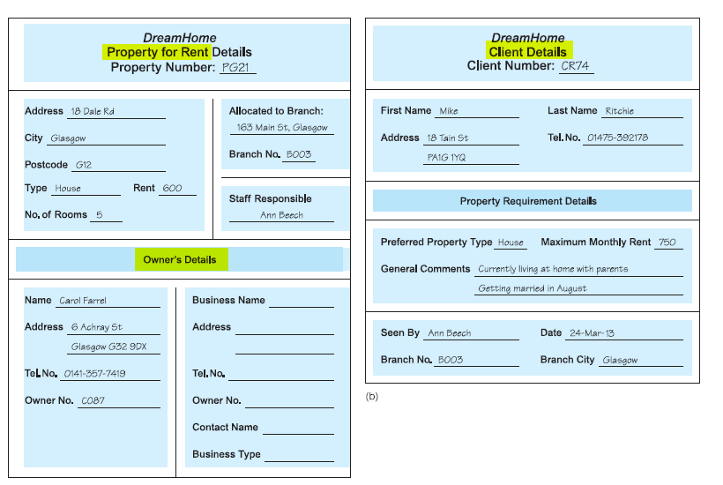
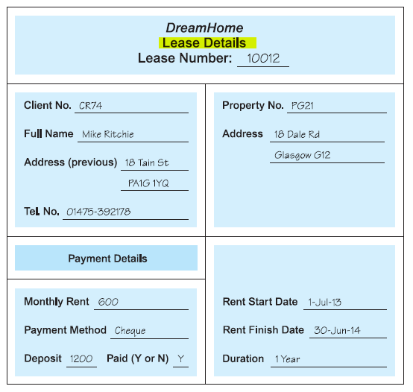
Sales Department forms:
Property for Rent Details form
Client Details form
Contracts Department form:
Lease Details form

Slide 14
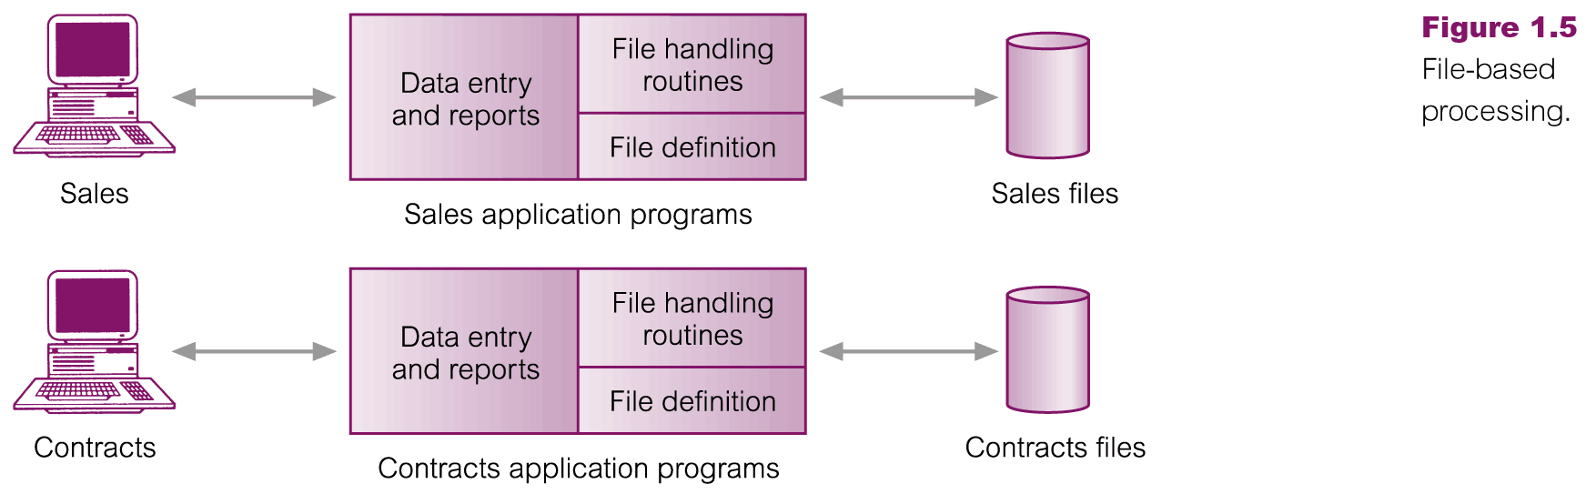
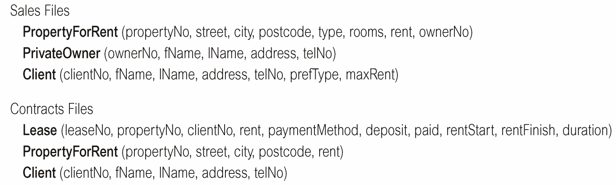
File-Based Processing
Limitations
Data isolation
Sales and contracts files (i.e. text files) stored in different locations physically.
Data duplication
i.e. John & Mary appeal in both files
Data depending on program code
i.e. java files to access the text files
Many programs to be maintained
Many java files needed to handle the data from storing, retrieving, updating, etc.
John
Aline
Mike
Mary
John
Mary

Slide 15
Limitations of File-Based Approach
Separation and isolation of data
Each program maintains its own set of data.
Users of one program may be unaware of potentially useful data held by other programs.
Duplication of data
Same data is held by different programs.
Wasted space and potentially different values and/or different formats for the same item.

Slide 16
Limitations of File-Based Approach cont.
Data dependence
File structure is defined in the program code.
Incompatible file formats
Programs are written in different languages, and so cannot easily access each other’s files.
Fixed Queries/Many application programs
Programs are written to satisfy particular functions.
Any new requirement needs a new program.

Slide 17
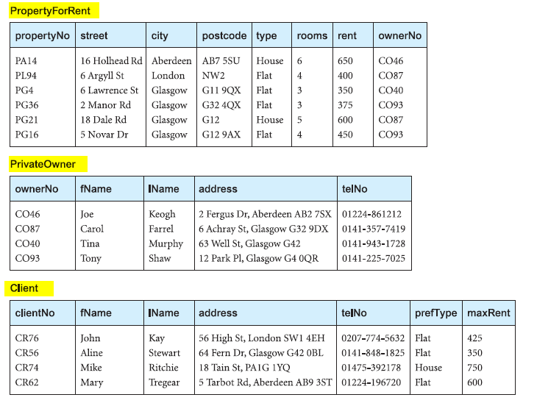
Database
Shared collection of logically related data (and a description of this data), designed to meet the information needs of an organization.

Slide 18
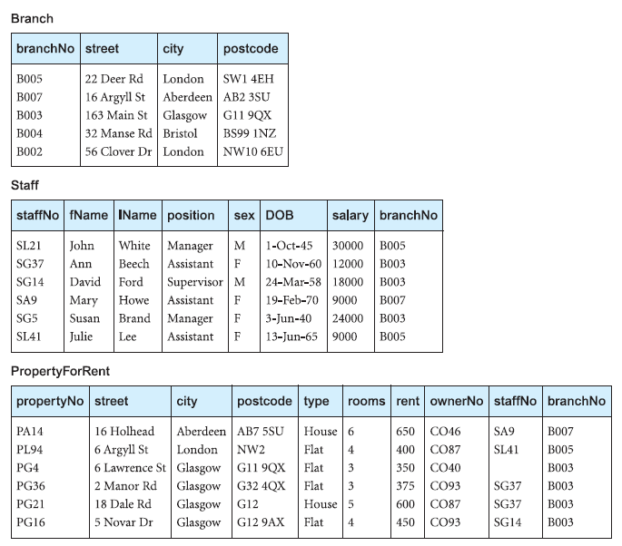
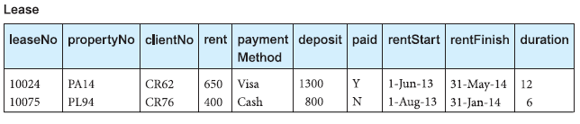
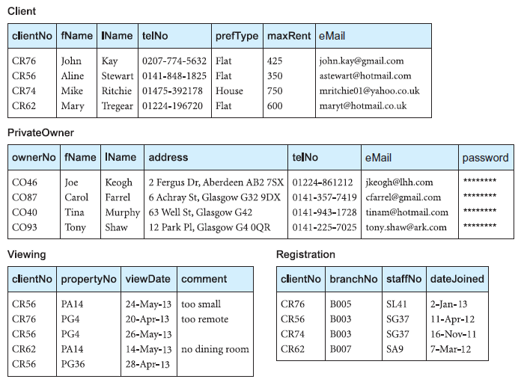
Example: DreamHome (property agent)

Slide 19
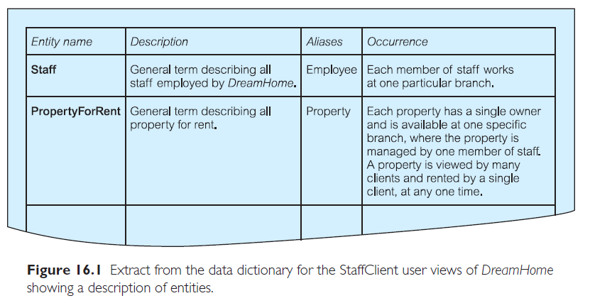
Database
System catalog (metadata) provides description of data to enable program–data independence.

Slide 20
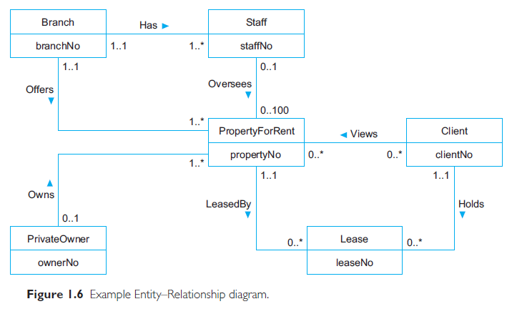
Database
Logically related data comprises entities, attributes, and relationships of an organization’s information.
For part of the DreamHome case study. It consists of:
six entities (the rectangles):
Branch, Staff, PropertyForRent, Client, PrivateOwner, and Lease;
seven relationships (the names adjacent to the lines):
Has, Offers, Oversees, Views, Owns, LeasedBy, and Holds;
six attributes, one for each entity:
branchNo, staffNo, propertyNo, clientNo, ownerNo, and leaseNo.

Slide 21
Database Management System (DBMS)
A software system that enables users to define, create, maintain, and control access to the database.
(Database) application program: a computer program that interacts with database by issuing an appropriate request (SQL statement) to the DBMS.

Slide 22
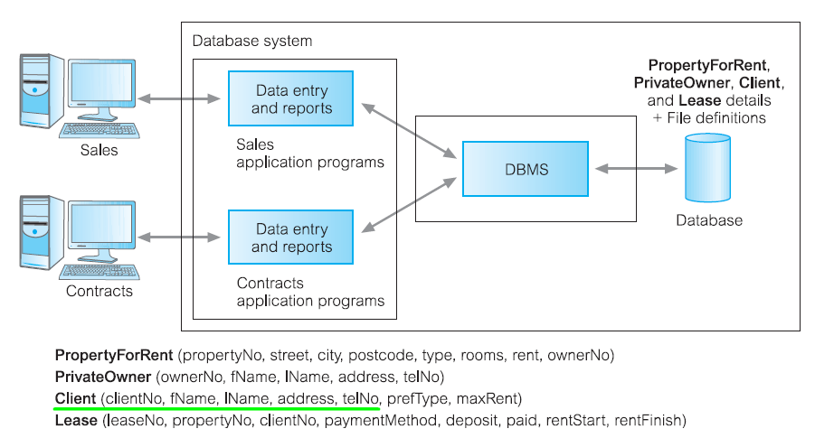
Database Management System (DBMS)

Slide 23
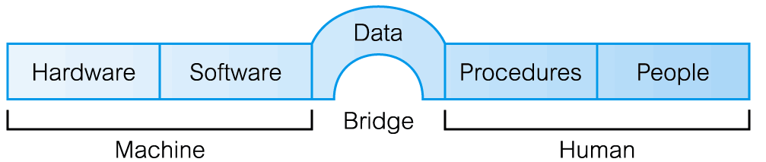
Components of DBMS Environment

Slide 24
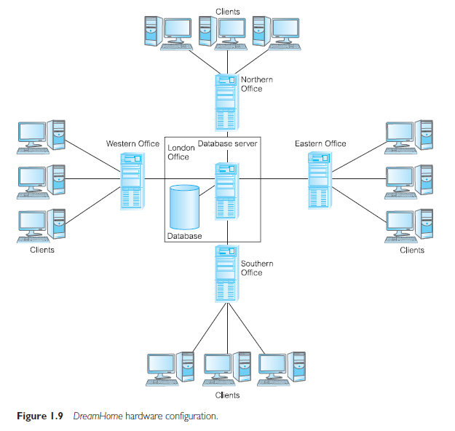
Components of DBMS Environment
Hardware
Can range from a PC to a network of computers.
i.e. a client–server architecture:
the backend is the server and the frontends are the clients.
Software
DBMS, operating system, network software (if necessary) and also the application programs.
Data
Used by the organization and a description of this data called the schema.

Slide 25
Components of DBMS Environment
Procedures
Instructions and rules that should be applied to the design and use of the database and DBMS. i.e. the instructions on how to:
Log on to the DBMS.
Use a particular DBMS facility or application program.
Start and stop the DBMS.
Make backup copies of the database.
People
Discuss next…

Slide 26
Roles in the Database Environment
Notice the word roles, they can be the same person as:
Data Administrator (DA) – higher level
responsible for the management of the data resource and database planning
Database Administrator (DBA) – technical
responsible for maintenance of the operational system
Database Designers
Logical - identifying the data and the relationships between the data
Physical - decides how the logical database design is to be physically realized i.e. mapping, storage structures, security measures, etc.

Slide 27
Roles in the Database Environment cont.
Application Programmers
Implement the application programs that provide the required functionality for the end-users i.e. retrieving data, inserting, updating, and deleting data.
End Users (“clients” of the database)
Naive users
typically unaware of the DBMS
invoke database operations by entering simple commands or choosing options from a menu
Sophisticated users
may use a high-level query language such as SQL to perform the required operations.
Some sophisticated end-users may even write application programs for their own use

Slide 28
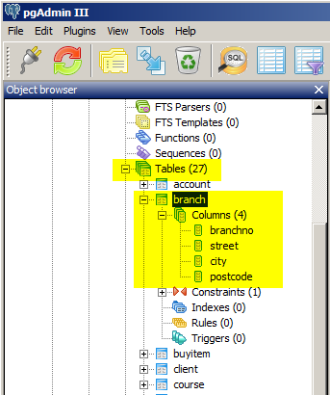
Database Languages
Data Definition Language (DDL)
Allows the DBA or user to describe and name entities, attributes, and relationships required for the application
plus any associated integrity and security constraints.
The result of the compilation of the DDL statements is a set of tables stored in special files collectively called the system catalog.
i.e. a SQL DDL for creating table branch
CREATE TABLE branch
(branchNo char(5) PRIMARY KEY,
street varchar(35),
city varchar(10),
postcode varchar(10)
);

Slide 29
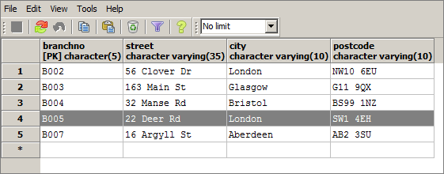
Database Languages
Data Manipulation Language (DML)
Provides basic data manipulation operations on data held in the database.
insertion of new data into the database;
modification of data stored in the database;
retrieval of data contained in the database;
deletion of data from the database.
i.e. SQL DML of branch
INSERT INTO branch VALUES('B005','22 Deer Rd','London','SW1 4EH');
SELECT * from branch;

Slide 30
Data Model
An integrated collection of concepts for describing and manipulating data, relationships between data, and constraints on the data in an organization.
Provides the basic concepts and notations that will allow database designers and end-users to communicate unambiguously and accurately their understanding of the organizational data.
Record-based Model:
Relational Data Model
Network Data Model
Hierarchical Data Model

Slide 31
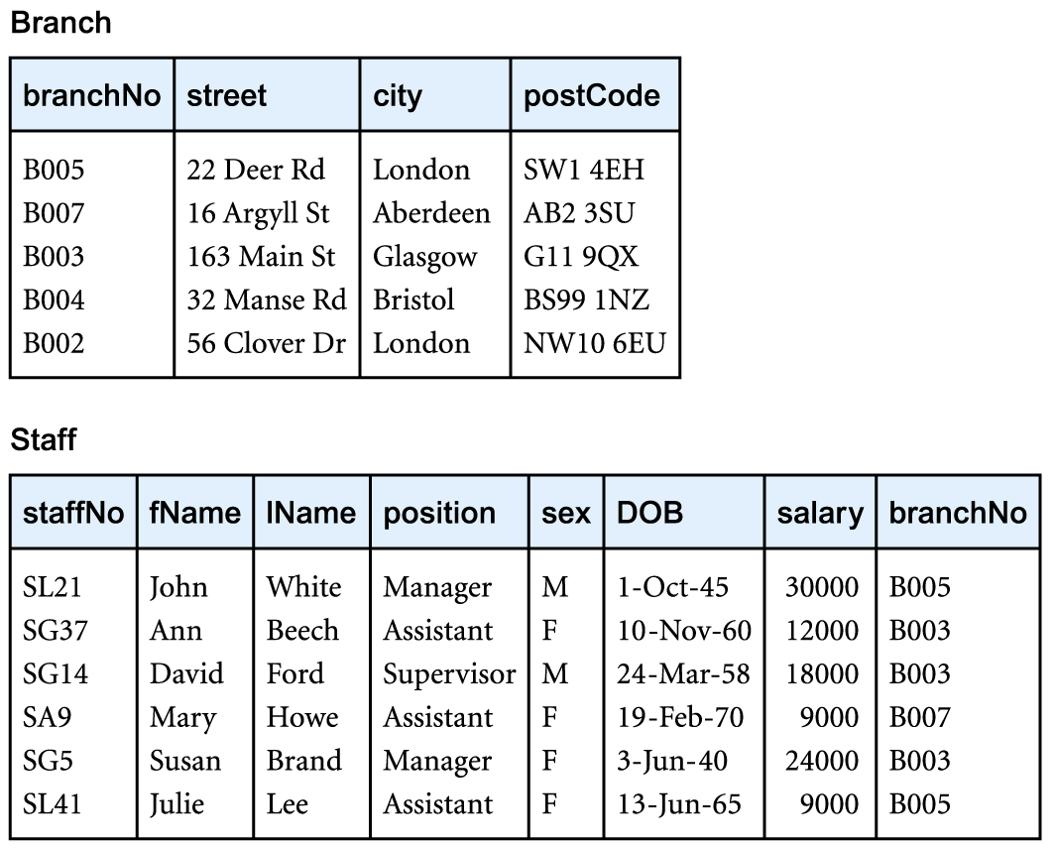
Relational Data Model
branchNo is the primary key of Branch table (parent table)
staffNo is the primary key of Staff table.
The branchNo in Staff table is the foreign key references Branch table.

Slide 32
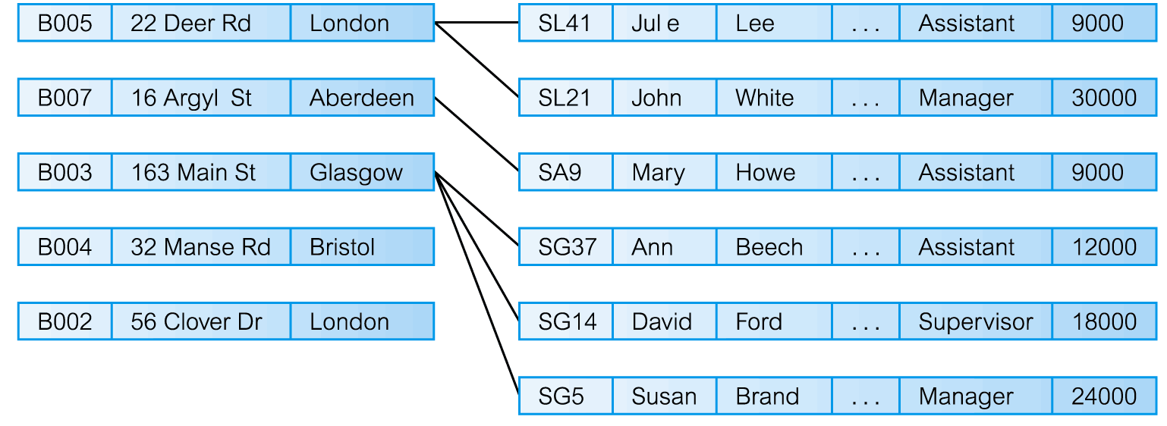
Network Data Model

Slide 33
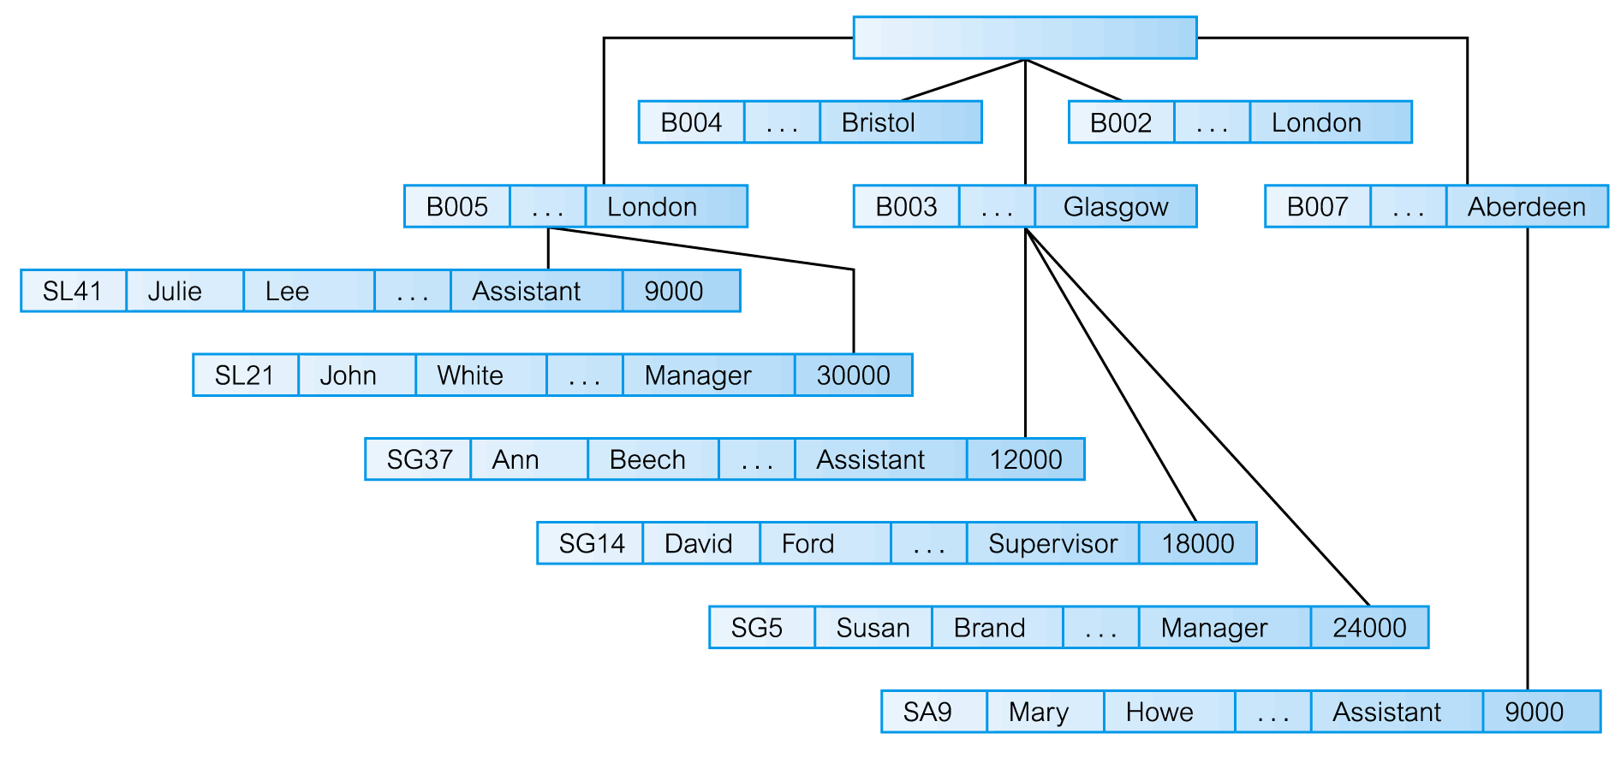
Hierarchical Data Model

Slide 34
Reference
Chapter 1 and 2 of Connolly, T and Begg, C, Database Systems: A practical Approach to Design, Implementation, and Management (6th ed.), Boston: Pearson Education.

