Slide 1
Lecture 2
COMPS320F Database Management
2021.9.27 Jiawei Wang (16:00 – 18:00)
The Relational Model
Terri Wong
School of Science and Technology

Slide 2
Content
Terminology of relational model.
How tables are used to represent data.
Connection between mathematical relations and relations in the relational model.
Properties of database relations.
How to identify Candidate keys (CK), Primary keys (PK), and Foreign keys (FK).
Meaning of entity integrity and referential integrity.
Purpose and advantages of views.

Slide 3
Relational Model Terminology
A relation is a table with columns and rows.
Only applies to logical structure of the database, not the physical structure.
Attribute is a named column of a relation.
Domain is the set of allowable values for one or more attributes.

Slide 4
Relational Model Terminology
Tuple is a row of a relation.
Degree is the number of attributes in a relation.
Cardinality is the number of tuples in a relation.
Relational Database is a collection of normalized relations with distinct relation names. (Duplicated relation names not allowed)

Slide 5
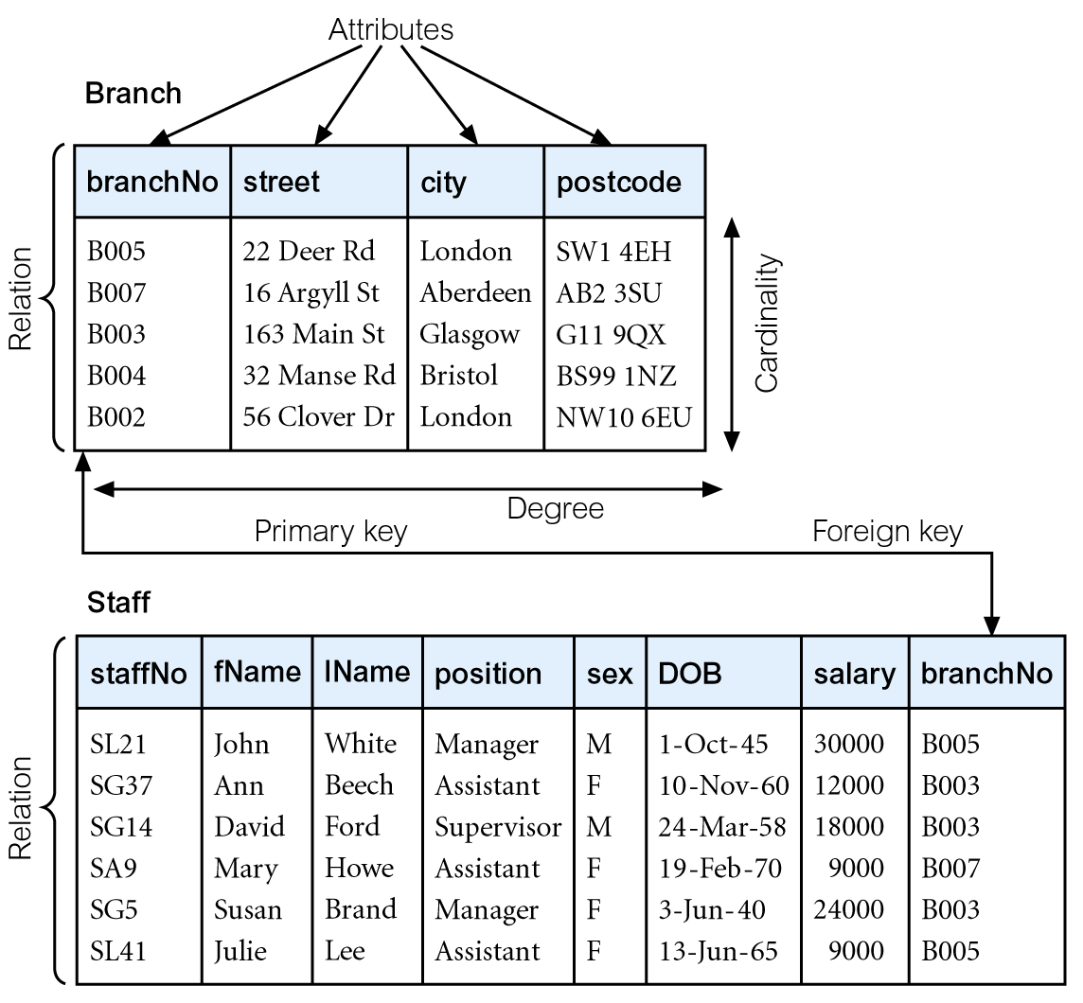
Instances of Branch and Staff Relations
staffNo (FK) X
=> For a cell storing more than one value (not allowed in relational database / relational model.
=> Expanding of attributes
=> Each tuple has a unique primary key
=> Add branchNo into staff relations as FK

Slide 6
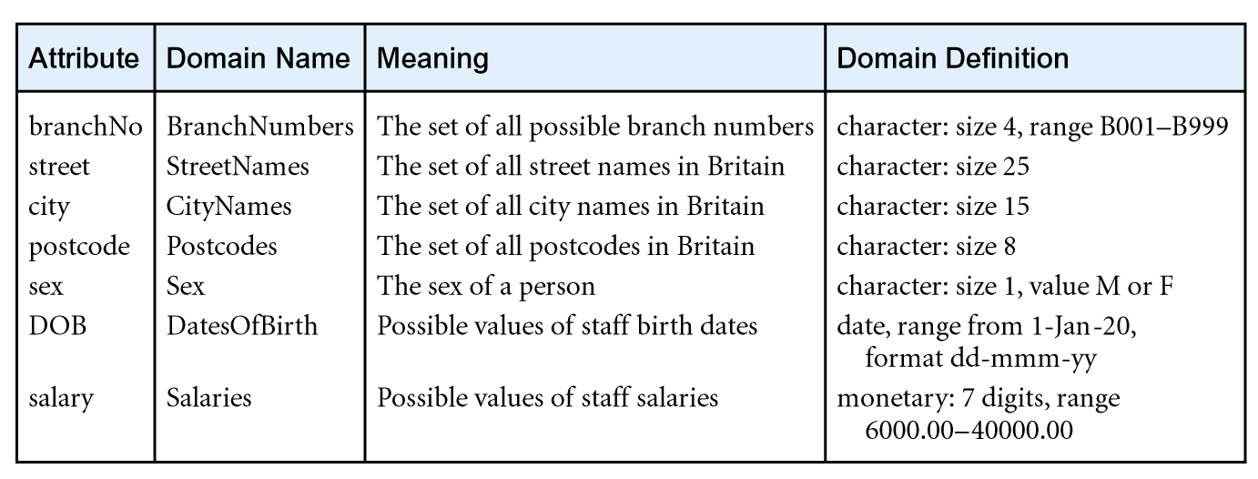
Examples of Attribute Domains
=> How do we represent the attributes

Slide 7
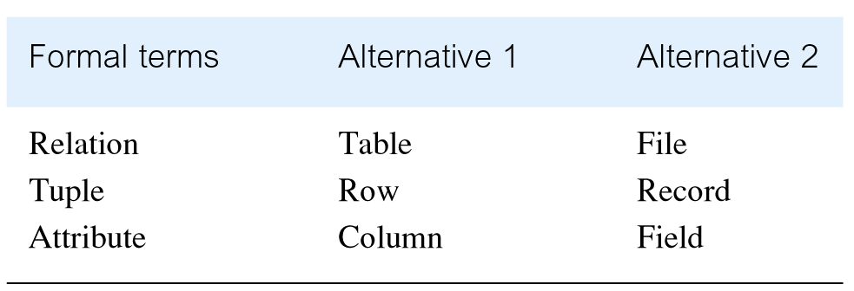
Alternative Terminology for Relational Model (别名)

Slide 8
Database Relations
Relation schema
Named relation defined by a set of attribute and domain name pairs.
Relational database schema
Set of relation schemas, each with a distinct name.
University (database schema) => relation schema i.e., student, staff, course, etc.

Slide 9
Properties of Relations (Table)
Relation name is distinct from all other relation names in relational schema.
Each cell of relation contains exactly one atomic (single) value.
Each attribute has a distinct name.
Values of an attribute are all from the same domain.
=> i.e., HKMU only stores students details from HKMU only

Slide 10
Properties of Relations
Each tuple is distinct; there are no duplicate tuples.
Order of attributes has no significance.
Order of tuples has no significance, theoretically.

Slide 11
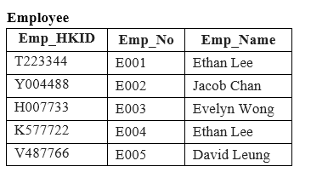
Relational Keys
Superkey
An attribute, or set of attributes, that uniquely identifies a tuple within a relation.
The set of attributes which can uniquely identify rows of the employee table, which are:
{Emp_HKID}
{Emp_No}
{Emp_HKID, Emp_No}
{Emp_HKID, Emp_Name}
{Emp_HKID, Emp_No, Emp_Name}
{Emp_No, Emp_Name}

Slide 12
Relational Keys
Candidate Key
Superkey (K) such that no proper subset is a superkey within the relation.
In each tuple of R, values of K uniquely identify that tuple (uniqueness).
No proper subset of K has the uniqueness property (irreducibility).
The minimal superkeys with no redundant attributes, which are:
{Emp_HKID}
{Emp_No}
[Note]
Only these two sets are candidate keys as all other sets are having redundant attributes that are not necessary for unique identification.
In the above example, we have not chosen {Emp_HKID, Emp_Name} as candidate key because {Emp_HKID} alone can identify a unique row in the table and Emp_Name is redundant.

Slide 13
Relational Keys
This semester: Only one to many or one to one relationship
Primary Key
Candidate key selected to identify tuples uniquely within relation.
So Either {Emp_HKID} or {Emp_No} can be the primary key.
Usually {Emp_No} will be selected as primary key which is more convenient to use within the company.
{Emp_No}
Alternate Keys
Candidate keys that are not selected to be primary key.
{Emp_HKID}
[Note] - If the table only contains ONE candidate key which has already selected as primary key, leaving no other candidate key left, in this case there will be no alternate key for such table.

Slide 14
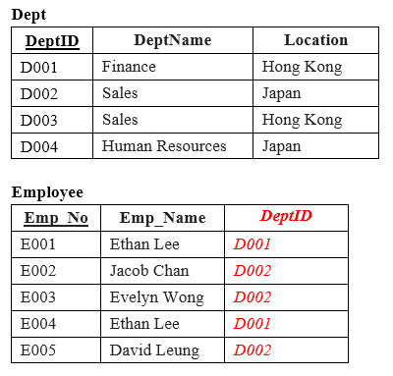
Relational Keys
Foreign Key
Attribute, or set of attributes, within one relation that matches candidate key of some (possibly same) relation.
For table Dept:
Primary key:
{DeptID}
Foreign Key:
Nil
For table Employee:
Primary key:
{Emp_No}
Foreign Key:
The {DeptID} in Employee table is the foreign key references Dept table.

Slide 15
Relationship between the keys
Super keys
(may not be minimal)
=> Most possible and unique search keys
Candidate keys (minimal)
Primary key [selected one]
Alternate keys
Foreign keys
= selected PK(s) of other tables

Slide 16
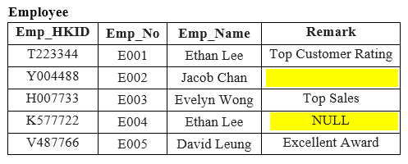
Integrity Constraints
Empty values in cells
Null
Represents value for an attribute that is currently unknown or not applicable for tuple.
Deals with incomplete or exceptional data.
Represents the absence of a value and is not the same as zero or spaces, which are values.
Both are NULL values

Slide 17
Integrity Constraints
Entity Integrity
In a base relation, no attribute of a primary key can be null.
Referential Integrity
If foreign key exists in a relation, foreign key value must match a candidate key value of some tuple in its home relation.

Slide 18
Integrity Constraints
General Constraints
Additional rules specified by users or database administrators that define or constrain some aspect of the enterprise.
i.e. the length of Emp_No consists exactly 5 characters starting with capital letter E.

Slide 19
Views
Base Relation
Named relation corresponding to an entity in conceptual schema, whose tuples are physically stored in database.
View
Dynamic result of one or more relational operations operating on base relations to produce another relation.

Slide 20
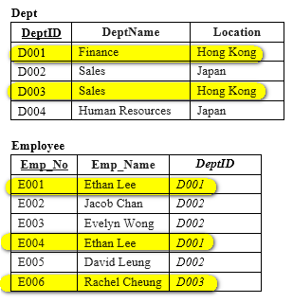
Views
A virtual relation that does not necessarily actually exist in the database but is produced upon request, at time of request.
Contents of a view are defined as a query on one or more base relations.
Views are dynamic, meaning that changes made to base relations that affect view attributes are immediately reflected in the view.
i.e. a view may be created for employees from Hong Kong to retrieve sales and finance data of Hong Kong region only.

Slide 21
Purpose of Views
Provides powerful and flexible security mechanism by hiding parts of database from certain users.
Permits users to access data in a customized way, so that same data can be seen by different users in different ways, at same time.
Can simplify complex operations on base relations.

Slide 22
Updating Views
All updates to a base relation should be immediately reflected in all views that reference that base relation.
If view is updated, underlying base relation should reflect change.

Slide 23
Reference
Chapters 4 of Connolly, T and Begg, C (2015), Database Systems: A practical Approach to Design, Implementation, and Management (6th ed.), Boston: Pearson Education.

