Slide 1
Lecture 3
COMPS320F Database Management
2021.10.4 Jiawei Wang
SQL: Data Manipulation Part I
Terri Wong
School of Science and Technology

Slide 2
Content
Purpose and importance of SQL.
How to retrieve data from database using SELECT and:
Use compound WHERE conditions.
Sort query results using ORDER BY.
Use aggregate functions.
Group data using GROUP BY and HAVING.
Use subqueries.

Slide 3
Content
Join tables together.
Perform set operations (UNION, INTERSECT, EXCEPT).
How to update database using INSERT, UPDATE, and DELETE.

Slide 4
Database Language
Ideally, database language should allow user to:
create the database and relation structures;
perform insertion, modification, deletion of data from relations;
perform simple and complex queries.
Must perform these tasks with minimal user effort and command structure/syntax must be easy to learn.
It must be portable.

Slide 5
SQL
SQL is a transform-oriented language with 2 major components:
A DML for retrieving and updating data. Manipulating Language (操控)
A DDL for defining database structure.
Create Table Statement
Create Table / View
Alter Table / view

Slide 6
SQL
Consists of standard English words:
1) CREATE TABLE Staff(staffNo VARCHAR(5),
lName VARCHAR(15),
salary DECIMAL(7,2));
2) INSERT INTO Staff VALUES (‘SG16’, ‘Brown’, 8300);
3) SELECT staffNo, lName, salary
FROM Staff
WHERE salary > 10000;
Case Insensitive

Slide 7
Writing SQL Commands
Most components of an SQL statement are case insensitive, except for literal character data.
More readable with indentation and lineation:
Each clause should begin on a new line.
Start of a clause should line up with start of other clauses.
If clause has several parts, should each appear on a separate line and be indented under start of clause.

Slide 8
Literals
Literals are constants used in SQL statements.
All non-numeric literals must be enclosed in single quotes e.g. ‘L’, or ‘London’, etc.
All numeric literals must not be enclosed in quotes
e.g. 6, or 650, or 650.5, etc.

Slide 9
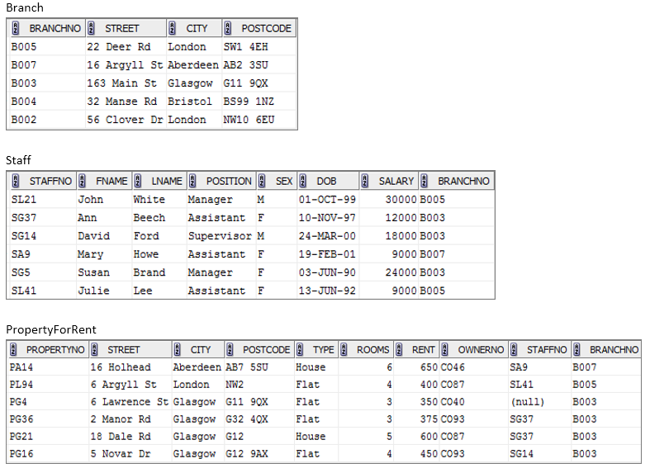
Sample Schema: DreamHome (property agent)
http://learn.ouhk.edu.hk/~t810870/320f/lecture/

Slide 10
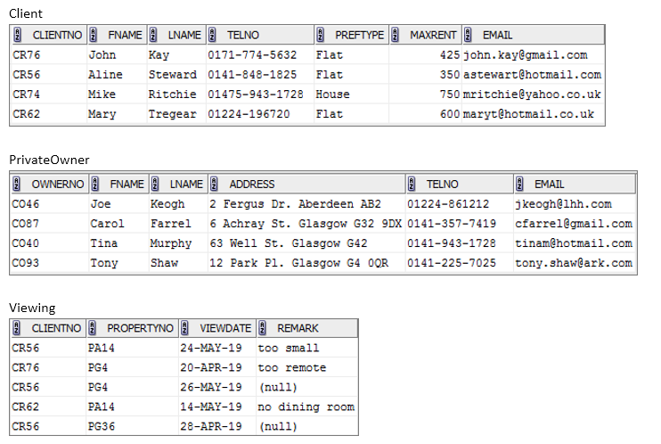
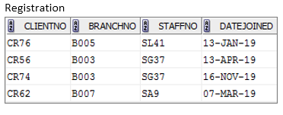

Slide 11
SELECT Statement
FROM Specifies table(s) to be used.
WHERE Filters rows.
GROUP BY Forms groups of rows with same column value.
HAVING Filters groups subject to some condition.
SELECT Specifies which columns are to appear in output.
ORDER BY Specifies the order of the output.
Must Exist
optional

Slide 12
Example 1 All Columns, All Rows
List full details of all staff.
SELECT staffNo, fName, lName, address,
position, sex, DOB, salary, branchNo
FROM Staff;
Can use * as an abbreviation for ‘all columns’:
SELECT *
FROM Staff;
Which columns to be selected
Which Table to be selected

Slide 13
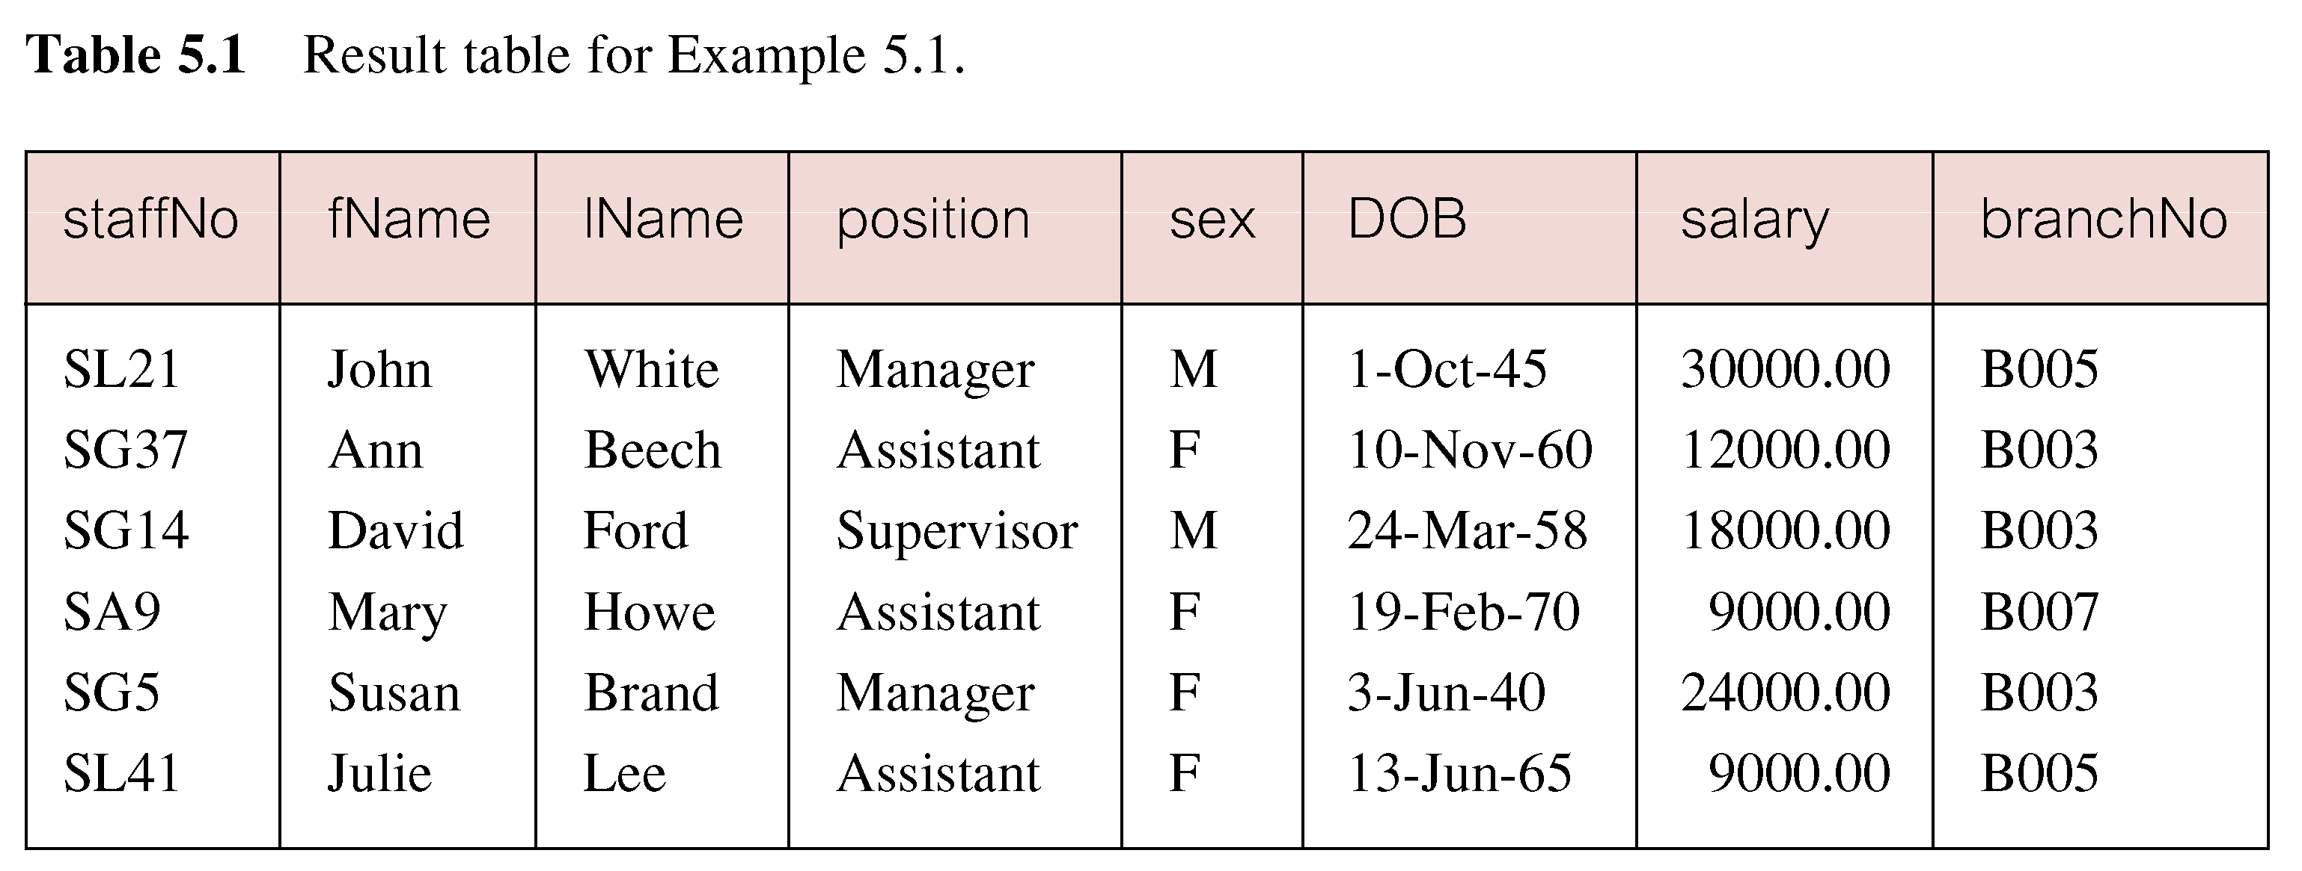
Example 1 All Columns, All Rows

Slide 14
Example 2 Specific Columns, All Rows
Produce a list of salaries for all staff, showing only staff number, first and last names, and salary.
SELECT staffNo, fName, lName, salary
FROM Staff;

Slide 15
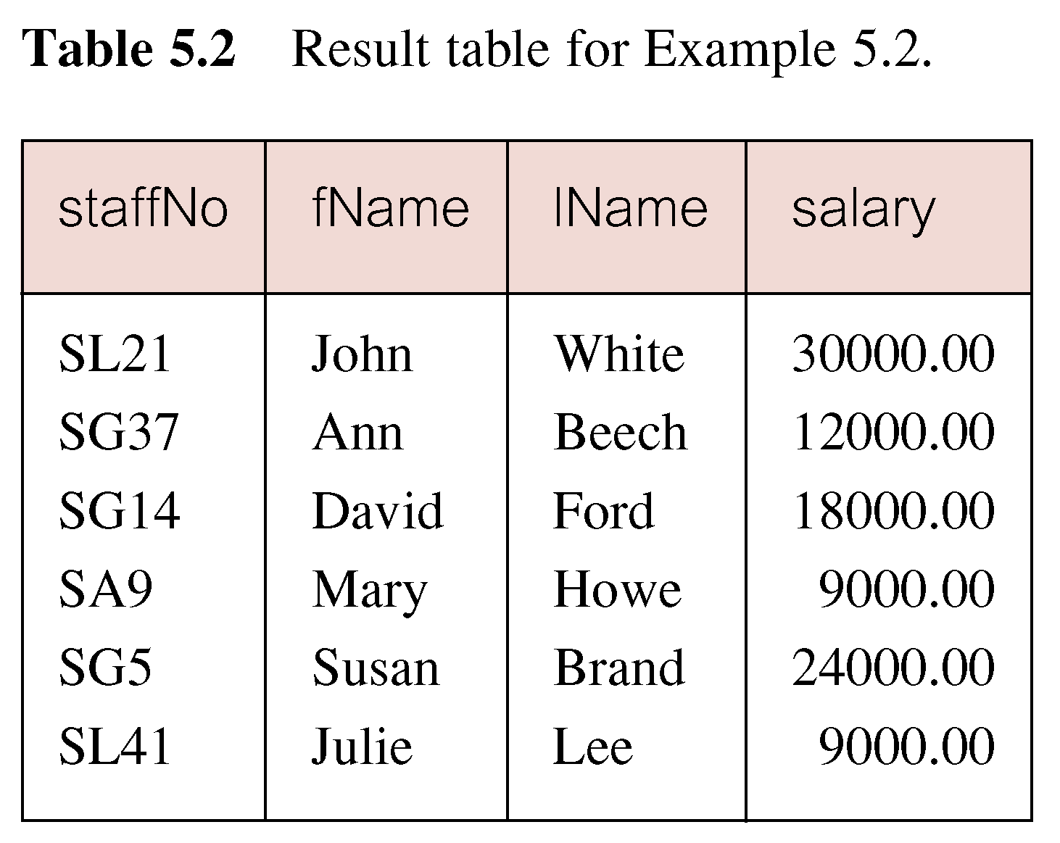
Example 2 Specific Columns, All Rows

Slide 16
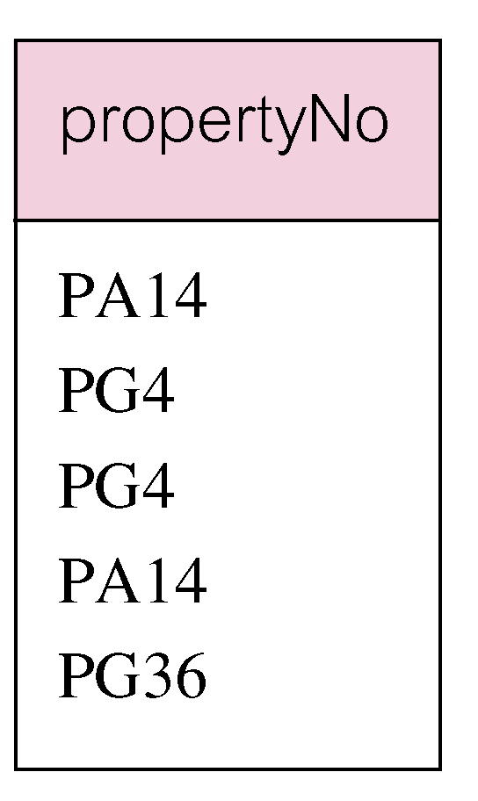
Example 3 Use of DISTINCT
List the property numbers of all properties that have been viewed.
SELECT propertyNo
FROM Viewing;

Slide 17
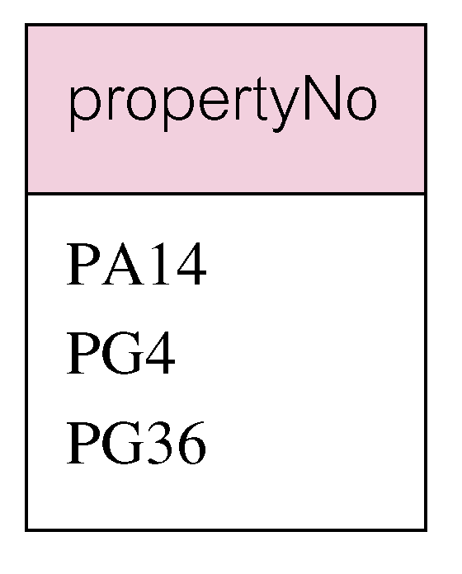
Example 3 Use of DISTINCT
Use DISTINCT to eliminate duplicates:
SELECT DISTINCT propertyNo
FROM Viewing;
Note no duplicate values of ‘PA14’ and ‘PG4’ in the result set

Slide 18
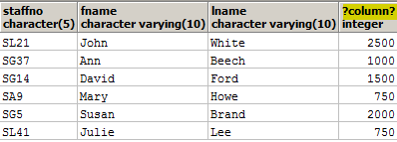
Example 4 Calculated Fields
Produce list of monthly salaries for all staff, showing staff number, first/last name, and salary.
SELECT staffNo, fName, lName, salary/12
FROM Staff;

Slide 19
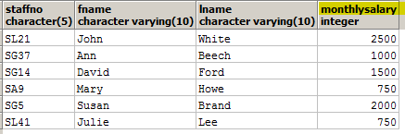
Example 4 Calculated Fields
To name column, use AS clause:
SELECT staffNo, fName, lName,
salary/12 AS monthlySalary
FROM Staff;

Slide 20
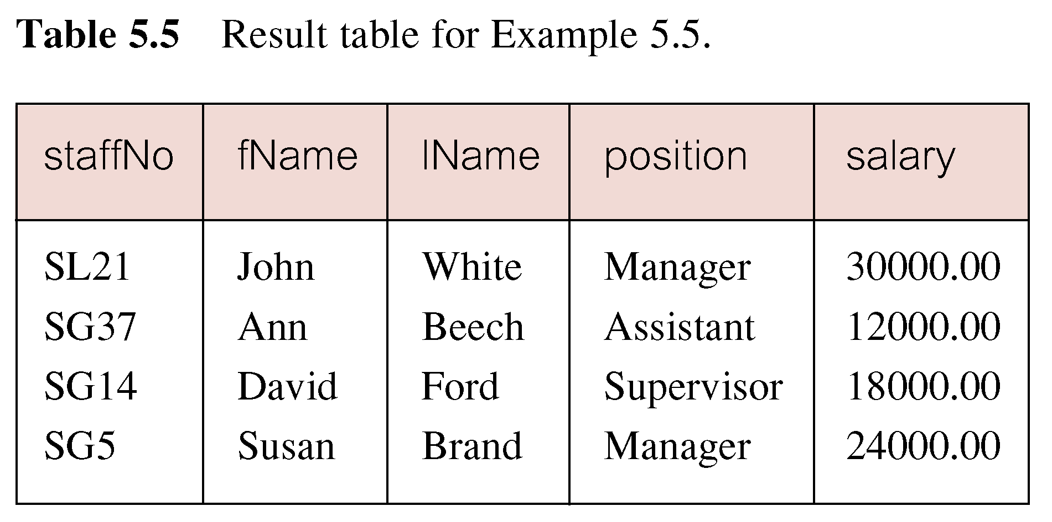
Example 5 Comparison Search Condition
List all staff with a salary greater than 10,000.
SELECT staffNo, fName, lName, position, salary
FROM Staff
WHERE salary > 10000;

Slide 21

Example 6.1 Compound Comparison Search Condition
List addresses of all branch offices in London or Glasgow.
SELECT *
FROM Branch
WHERE city = ‘London’ OR city = ‘Glasgow’;

Slide 22
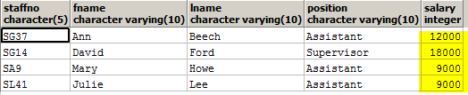
Example 6.2 Compound Comparison Search Condition
List all staff with a salary greater less than 20,000 or greater than 30,000.
SELECT staffNo, fName, lName, position, salary
FROM Staff
WHERE salary < 20000 OR salary > 30000;

Slide 23
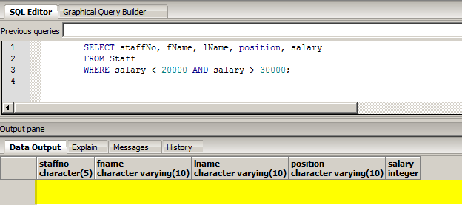
Question
Why the following query returns no result set?
SELECT staffNo, fName, lName, position, salary
FROM Staff
WHERE salary < 20000 AND salary > 30000;

Slide 24
Example 7.1 Range Search Condition
List all staff with a salary between 20,000 and 30,000.
SELECT staffNo, fName, lName, position, salary
FROM Staff
WHERE salary BETWEEN 20000 AND 30000;
Note: BETWEEN test includes the endpoints of range.

Slide 25
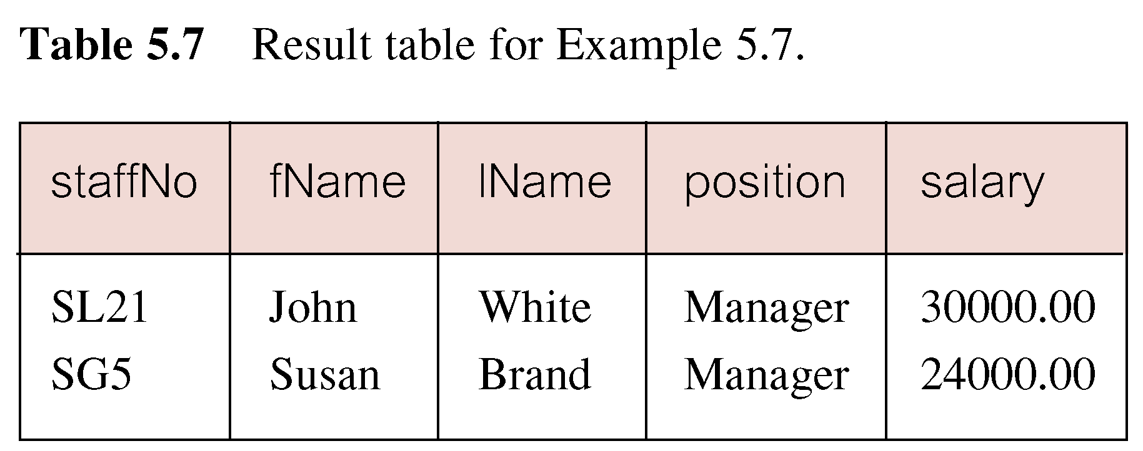
Example 7 Range Search Condition

Slide 26

Example 7.2 Range Search Condition
Also a negated version NOT BETWEEN.
SELECT staffNo, fName, lName, position, salary
FROM Staff
WHERE salary>=20000 AND salary <= 30000;
It is possible not selecting colume salary in select statement
=> The reason to include it is to provide a better way for checking in output

Slide 27
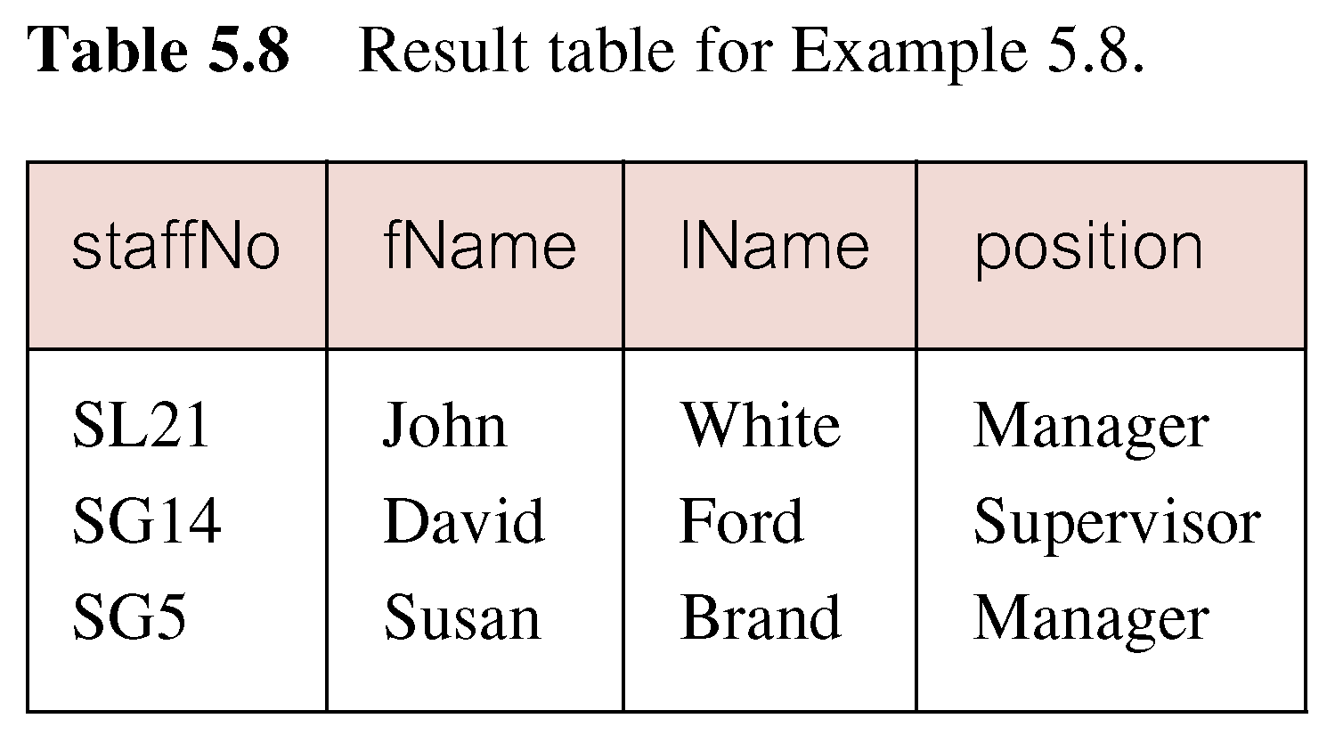
Example 8 Set Membership
List all managers and supervisors.
SELECT staffNo, fName, lName, position
FROM Staff
WHERE position IN (‘Manager’, ‘Supervisor’);

Slide 28
Example 8 Set Membership
There is a negated version (NOT IN).
IN does not add much to SQL’s expressive power. Could have expressed this as:
SELECT staffNo, fName, lName, position
FROM Staff
WHERE position=‘Manager’ OR
position=‘Supervisor’;
Note: IN is more efficient when set contains many values.

Slide 29
Example 9 Pattern Matching
SQL has two special pattern matching symbols:
%: sequence of zero or more characters;
_ (underscore): any single character.
LIKE ‘%Glasgow%’ means a sequence of characters of any length containing ‘Glasgow’.

Slide 30
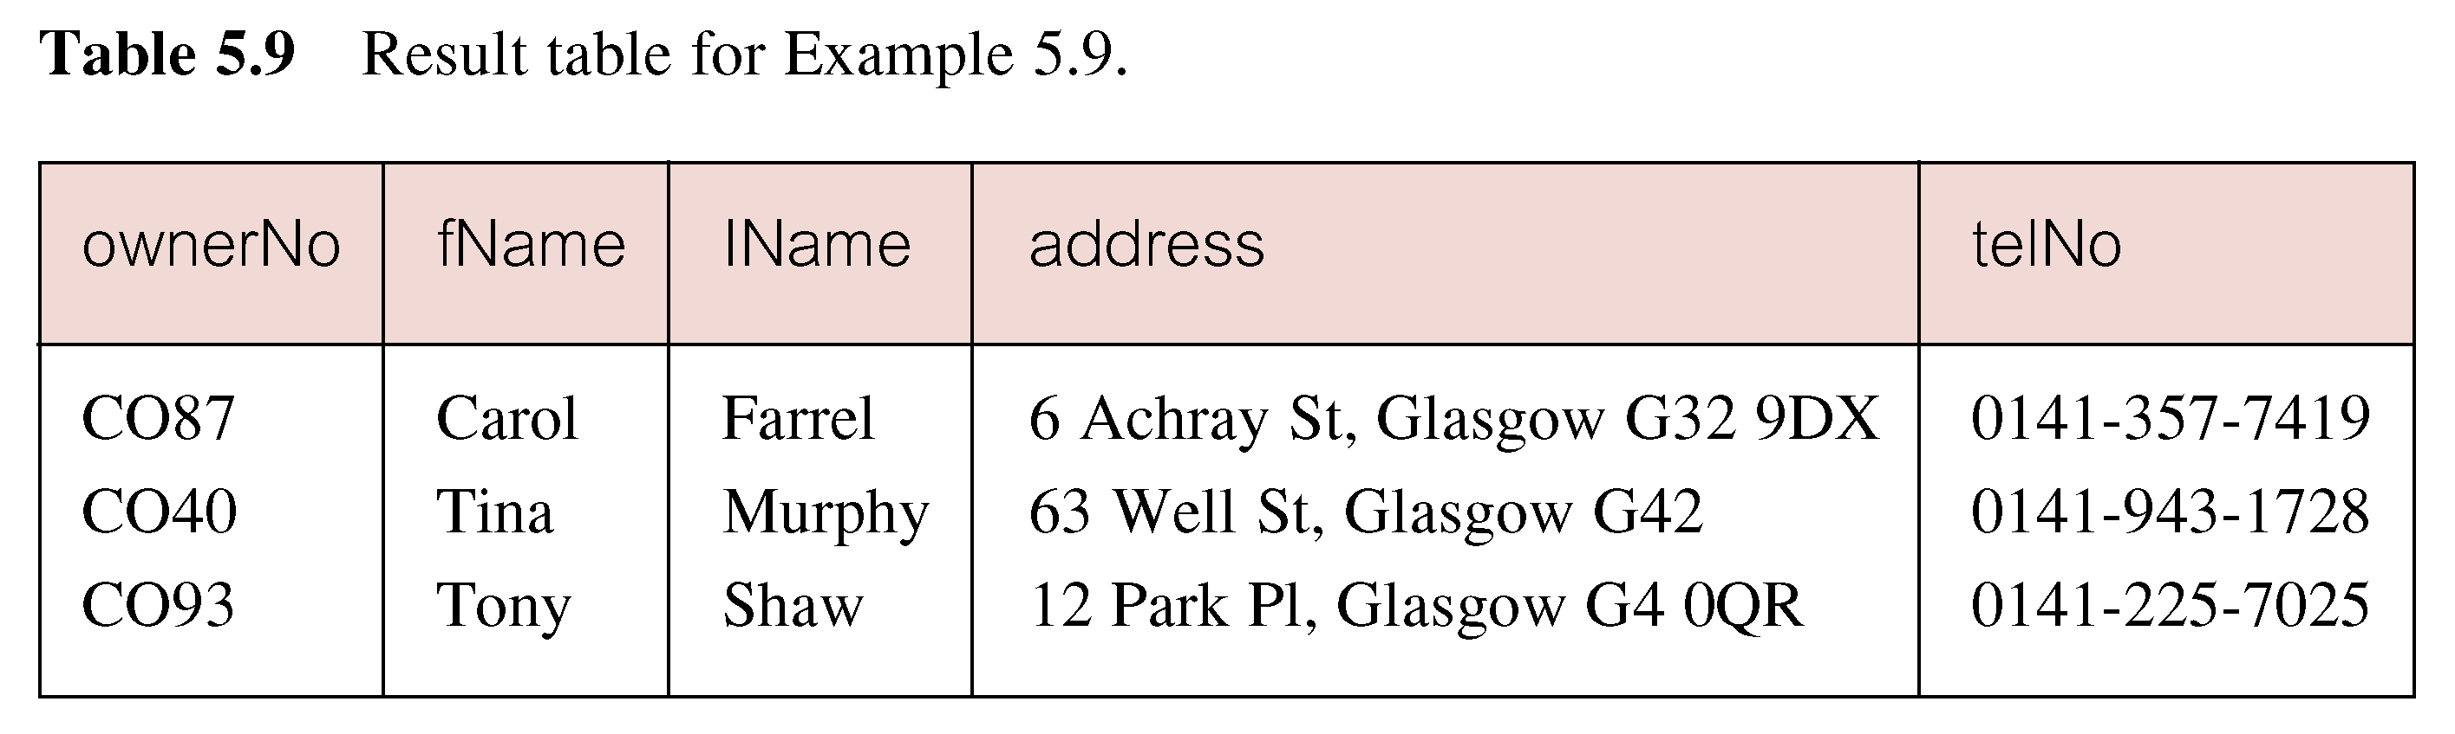
Example 9.1 Pattern Matching
Find all owners with the string ‘Glasgow’ in their address.
SELECT ownerNo, fName, lName, address, telNo
FROM PrivateOwner
WHERE address LIKE ‘%Glasgow%’;

Slide 31

Example 9.2 Pattern Matching
Find all staff having the character ‘n’ as the last character in their first names.
SELECT staffNo, fName, lName, position, salary
FROM Staff
WHERE fname like '%n';

Slide 32

Example 9.3 Pattern Matching
Find all staff having one single character ending with the string ‘nn’ as the last two characters in their first names.
SELECT staffNo, fName, lName, position, salary
FROM Staff
WHERE fname like ‘_nn';

Slide 33

Question
Show clientNo, fname, email of clients whose email addresses are from Hotmail accounts.
SELECT
FROM
WHERE

Slide 34
Answer
Show clientNo, fname, email of clients whose email addresses are from Hotmail accounts.
select clientNo, fname, email
from client
where email like '%@hotmail%';

Slide 35

Question
Show clientNo, fname, email of clients whose email addresses are from Hotmail accounts in UK only.
SELECT
FROM
WHERE

Slide 36
Answer
Show clientNo, fname, email of clients whose email addresses are from Hotmail accounts in UK only.
select clientNo, fname, email
from client
where email like '%@hotmail%uk';

Slide 37


Example 10 NULL Search Condition
List details of all viewings on property PG4 where a comment has not been supplied.
There are 2 viewings for property PG4, one with and one without a comment.
SELECT clientNo, viewDate, remark
FROM Viewing
WHERE propertyNo = 'PG4' ;
Have to test for null explicitly using special keyword IS NULL:
SELECT clientNo, viewDate, remark
FROM Viewing
WHERE propertyNo = 'PG4'
AND remark IS NULL;

Slide 38

Example 10 NULL Search Condition
Negated version (IS NOT NULL) can test for non-null values.
SELECT clientNo, viewDate, remark
FROM Viewing
WHERE propertyNo = 'PG4'
AND remark IS NOT NULL;

Slide 39
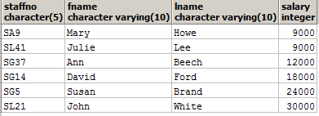
Example 11 Single Column Ordering
List salaries for all staff, arranged in ascending order of salary.
SELECT staffNo, fName, lName, salary
FROM Staff
ORDER BY salary;

Slide 40
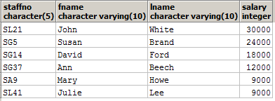
Example 11 Single Column Ordering
List salaries for all staff, arranged in descending order of salary.
SELECT staffNo, fName, lName, salary
FROM Staff
ORDER BY salary desc;

Slide 41
Example 12 Multiple Column Ordering
Produce abbreviated list of properties in order of property type.
SELECT propertyNo, type, rooms, rent
FROM PropertyForRent
ORDER BY type;

Slide 42
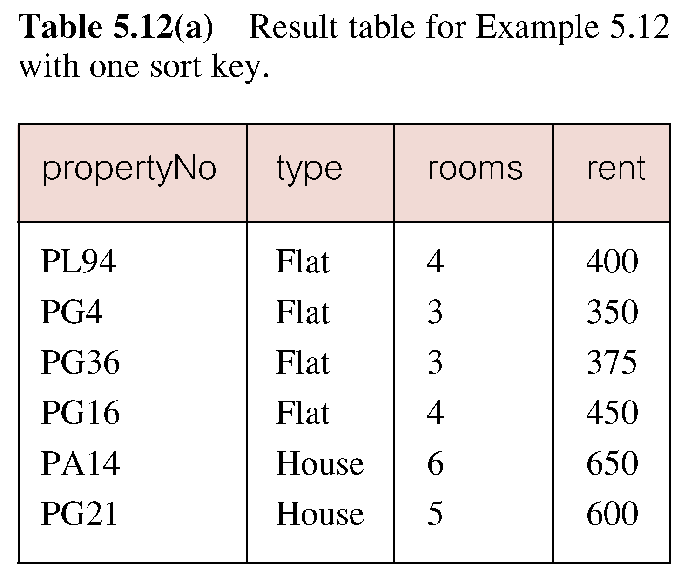
Example 12 Multiple Column Ordering

Slide 43
Example 12 Multiple Column Ordering
Four flats in this list - as no minor sort key specified, system arranges these rows in any order it chooses.
To arrange in order of rent, specify minor order:
SELECT propertyNo, type, rooms, rent
FROM PropertyForRent
ORDER BY type, rent DESC;

Slide 44
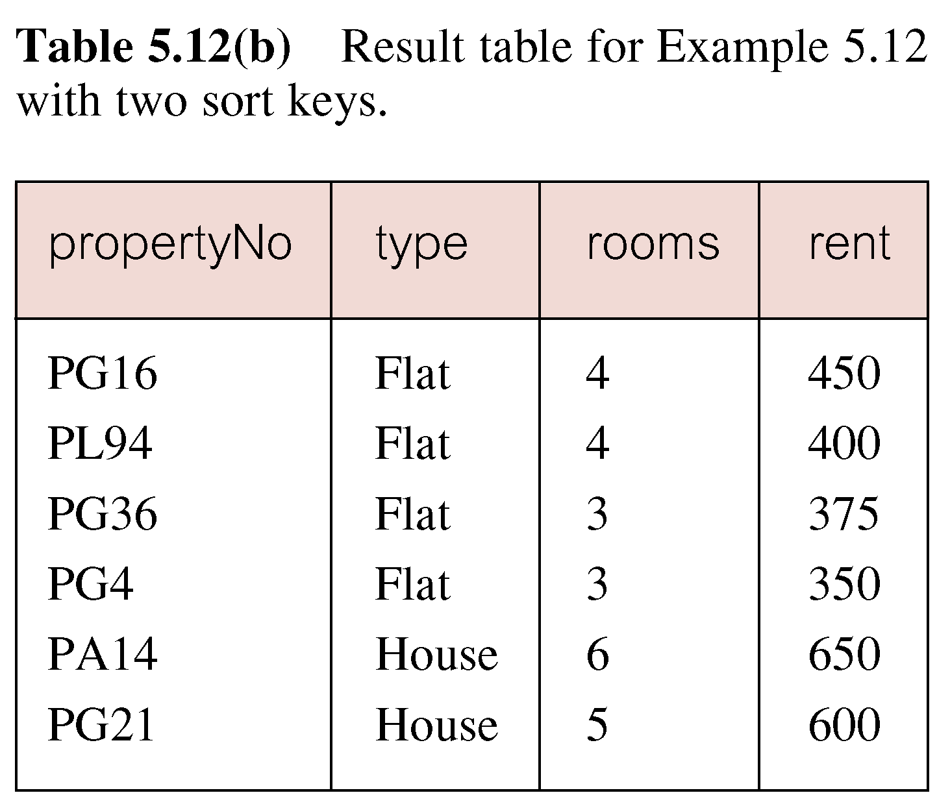
Example 12 Multiple Column Ordering

Slide 45
SELECT Statement - Aggregates
ISO standard defines five aggregate functions:
COUNT returns number of values in specified column.
SUM returns sum of values in specified column.
AVG returns average of values in specified column.
MIN returns smallest value in specified column.
MAX returns largest value in specified column.
Output: One Line

Slide 46
SELECT Statement - Aggregates
Each operates on a single column of a table and returns a single value.
COUNT, MIN, and MAX apply to numeric and non-numeric fields, but SUM and AVG may be used on numeric fields only.
Apart from COUNT(*), each function eliminates nulls first and operates only on remaining non-null values.

Slide 47
SELECT Statement - Aggregates
COUNT(*) counts all rows of a table, regardless of whether nulls or duplicate values occur.
Can use DISTINCT before column name to eliminate duplicates.
DISTINCT has no effect with MIN/MAX, but may have with SUM/AVG.

Slide 48
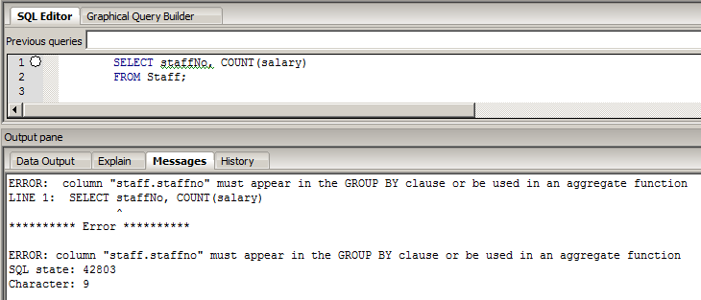
SELECT Statement - Aggregates
Aggregate functions can be used only in SELECT list and in HAVING clause.
If SELECT list includes an aggregate function and there is no GROUP BY clause, SELECT list cannot reference a column without an aggregate function. For example, the following is illegal:
SELECT staffNo, COUNT(salary)
FROM Staff;

Slide 49
Question
What is the outputs of the following statements:
select count(*) from viewing;
select count(remark) from viewing;

Slide 50


Answer
What is the outputs of the following statements:
select count(*) from viewing;
Note: COUNT(*) counts all rows of a table, regardless of whether nulls or duplicate values occur.
select count(remark) from viewing;
Note: the NULL values are eliminated in aggregate functions

Slide 51
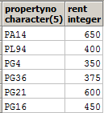
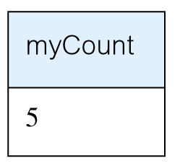
Example 13 Use of COUNT(*)
How many properties cost more than £350 per month to rent?
SELECT COUNT(*) AS myCount
FROM PropertyForRent
WHERE rent > 350;
select propertyNo, rent from propertyForRent;

Slide 52


Example 14 Use of COUNT(DISTINCT)
How many different properties viewed in May 19?
SELECT COUNT(DISTINCT propertyNo) AS myCount
FROM Viewing
WHERE viewDate BETWEEN '1-May-19' AND '31-May-19';
Note: without keyword distinct
SELECT COUNT(propertyNo) AS myCount
FROM Viewing
WHERE viewDate BETWEEN '1-May-19' AND '31-May-19';

Slide 53
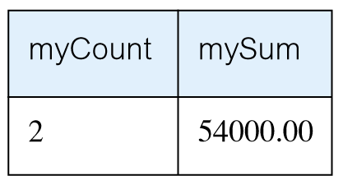
Example 15 Use of COUNT and SUM
Find number of Managers and sum of their salaries.
SELECT COUNT(staffNo) AS myCount, SUM(salary) AS mySum
FROM Staff
WHERE position = ‘Manager’;

Slide 54
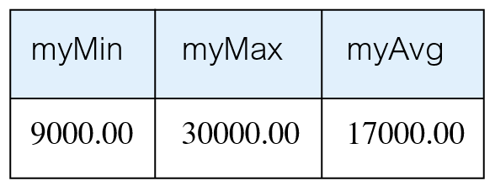
Example 16 Use of MIN, MAX, AVG
Find minimum, maximum, and average staff salary.
SELECT MIN(salary) AS myMin,
MAX(salary) AS myMax,
AVG(salary) AS myAvg
FROM Staff;

Slide 55
Reference
Chapter 6 of Connolly, T and Begg, C, Database Systems: A practical Approach to Design, Implementation, and Management (6th ed.), Boston: Pearson Education.

