Slide 1
Lecture 4
COMPS320F Database Management
SQL: Data Manipulation Part II
Terri Wong
School of Science and Technology

Slide 2
SELECT Statement - Grouping
Use GROUP BY clause to get sub-totals.
SELECT and GROUP BY closely integrated: each item in SELECT list must be single-valued per group, and SELECT clause may only contain:
  column names
  aggregate functions
  constants
  expression involving combinations of the above.

Slide 3
SELECT Statement - Grouping
All column names in SELECT list must appear in GROUP BY clause unless name is used only in an aggregate function.
If WHERE is used with GROUP BY, WHERE is applied first, then groups are formed from remaining rows satisfying predicate.
ISO considers two nulls to be equal for purposes of GROUP BY.

Slide 4
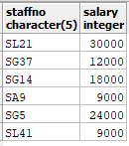

Example 17 Revisit of Aggregated Functions
Find number of staff and their total salaries.
  SELECT COUNT(staffNo) AS myCount,
  SUM(salary) AS mySum
  FROM Staff;
SELECT staffNo, salary FROM Staff;

Slide 5
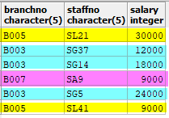
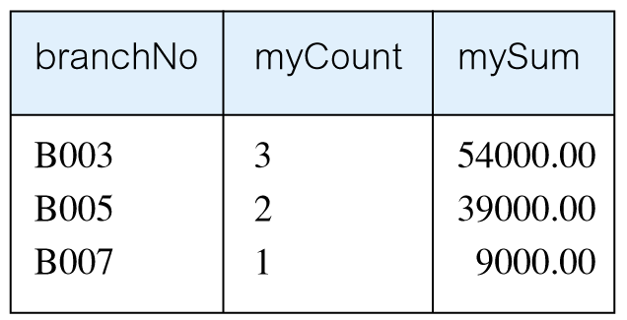
Example 17 Use of GROUP BY
Find number of staff in each branch and their total salaries.
  SELECT branchNo,
  COUNT(staffNo) AS myCount,
    SUM(salary) AS mySum
    FROM Staff
    GROUP BY branchNo
    ORDER BY branchNo;
SELECT branchNo, staffNo, salary FROM Staff;

Slide 6
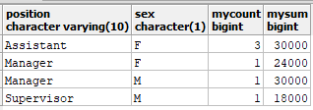
Example 17 Use of GROUP BY
Find number of staff and their total salaries in each position and sex.
  SELECT position, sex,
  COUNT(staffNo) AS myCount,
  SUM(salary) AS mySum
  FROM Staff
  GROUP BY position, sex
  ORDER BY position;

Slide 7
Restricted Groupings – HAVING clause
HAVING clause is designed for use with GROUP BY to restrict groups that appear in final result table.
Similar to WHERE, but WHERE filters individual rows whereas HAVING filters groups.
Column names in HAVING clause must also appear in the GROUP BY list or be contained within an aggregate function.

Slide 8
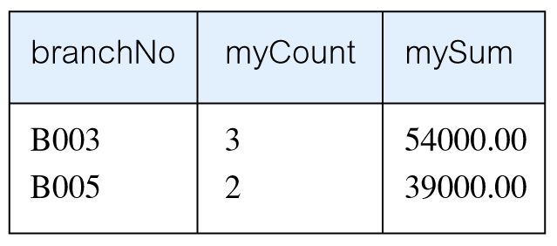
Example 18 Use of HAVING
For each branch with more than 1 member of staff, find number of staff in each branch and sum of their salaries.
  SELECT branchNo,
  COUNT(staffNo) AS myCount,
    SUM(salary) AS mySum
    FROM Staff
    GROUP BY branchNo
    HAVING COUNT(staffNo) > 1
    ORDER BY branchNo;

Slide 9
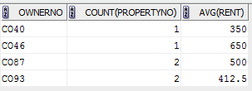
Question 1
Find owner no., the number of property (using property no.) and the average of rent for each owner sorted by owner no. in descending order
SELECT
FROM
GROUP BY
ORDER BY

Slide 10
Answer
Find owner no., the number of property (using property no.) and the average of rent for each owner sorted by owner no. in descending order
SELECT ownerNo, COUNT(propertyNo), AVG(rent)
FROM propertyForRent
GROUP BY ownerNo
ORDER BY ownerNo;

Slide 11
Question 2
What does the following SQL statement returns?
SELECT ownerNo, COUNT(propertyNo) as prop_Count, AVG(rent) prop_Avg
FROM propertyForRent
GROUP BY ownerNo
HAVING COUNT(propertyNo) > 1
ORDER BY prop_Avg desc;

Slide 12

Answer
What does the following SQL statement returns?
SELECT ownerNo, COUNT(propertyNo) as prop_Count, AVG(rent) prop_Avg
FROM propertyForRent
GROUP BY ownerNo
HAVING COUNT(propertyNo) > 1
ORDER BY prop_Avg desc;

Slide 13
Subqueries
Some SQL statements can have a SELECT embedded within them.
A subselect can be used in WHERE and HAVING clauses of an outer SELECT, where it is called a subquery or nested query.
Subselects may also appear in INSERT, UPDATE, and DELETE statements.

Slide 14
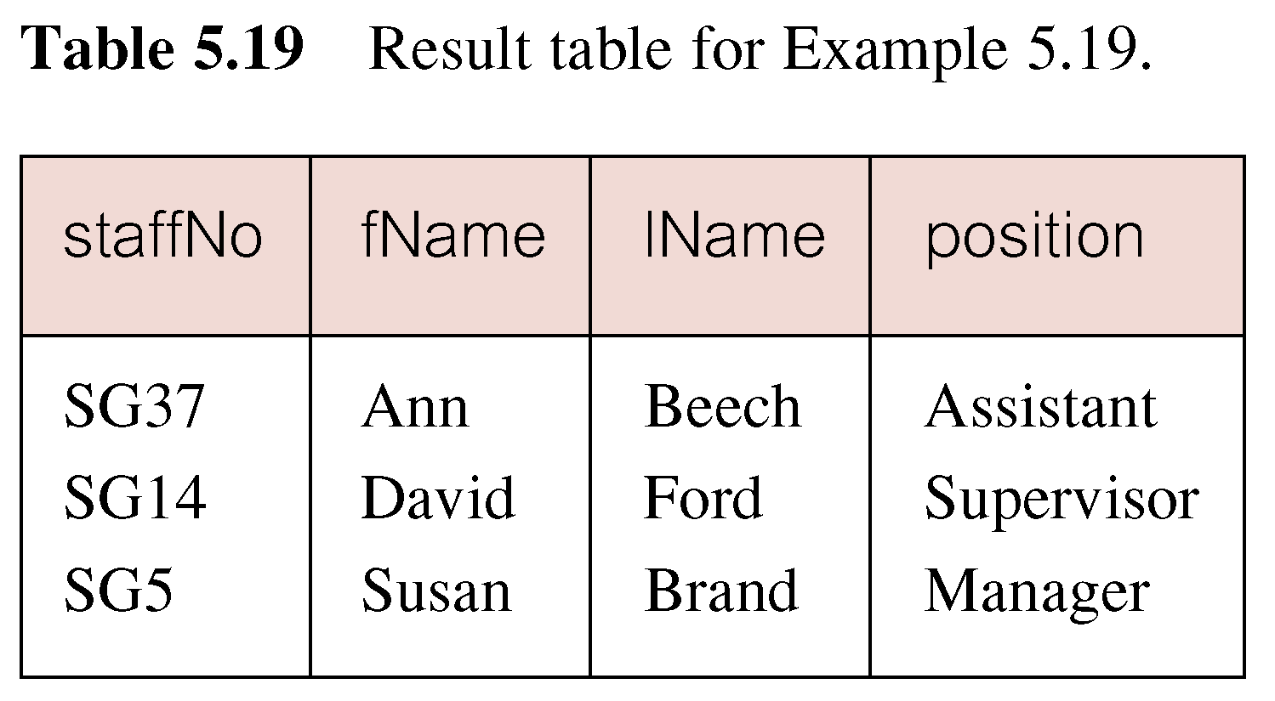
Example 19 Subquery with Equality
List staff who work in branch at ‘163 Main St’.
SELECT staffNo, fName, lName, position
  FROM Staff
  WHERE branchNo =
  (SELECT branchNo
  FROM Branch
  WHERE street = ‘163 Main St’);

Slide 15
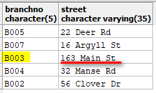
Example 19 Subquery with Equality
Inner SELECT finds branch number for branch at ‘163 Main St’ (‘B003’).
SELECT staffNo, fName, lName, position
  FROM Staff
  WHERE branchNo =
  (SELECT branchNo
  FROM Branch
  WHERE street = ‘163 Main St’);
select branchNo, street from branch;

Slide 16
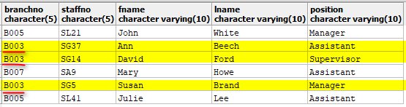
Example 19 Subquery with Equality
Outer SELECT then retrieves details of all staff who work at this branch.
Outer SELECT then becomes:
  SELECT staffNo, fName,
  lName, position
  FROM Staff
  WHERE branchNo = ‘B003’;
SELECT branchNo, staffNo, fName, lName, position FROM Staff;

Slide 17
Example 19 Subquery with Equality

Slide 18


Example 20 Subquery with Aggregate
List all staff whose salary is greater than the average salary.
  SELECT staffNo, fName, position, salary
  FROM Staff
  WHERE salary >
    (SELECT AVG(salary)
    FROM Staff);
    SELECT AVG(salary) FROM Staff

Slide 19

Example 20 Subquery with Aggregate
List all staff whose salary is greater than the average salary, and show by how much.
  SELECT staffNo, fName, position,
  salary - (SELECT AVG(salary) FROM Staff) As SalDiff
  FROM Staff
  WHERE salary >
  (SELECT AVG(salary)
  FROM Staff);

Slide 20
Example 20 Subquery with Aggregate
Cannot write ‘WHERE salary > AVG(salary)’
Instead, use subquery to find average salary (17000), and then use outer SELECT to find those staff with salary greater than this:
  SELECT staffNo, fName, position,
  salary - 17000 As salDiff
  FROM Staff
  WHERE salary > 17000;

Slide 21
ANY/SOME and ALL
ANY and ALL may be used with subqueries that produce a single column of numbers.
With ALL, condition will only be true if it is satisfied by all values produced by subquery.
With ANY, condition will be true if it is satisfied by any values produced by subquery.
If subquery is empty, ALL returns true, ANY returns false.
SOME may be used in place of ANY.

Slide 22


Example 21 Use of ANY/SOME
List staff who work in London.
SELECT staffNo, fName, position, branchNo
FROM Staff
WHERE branchNo =
(SELECT branchNo
FROM Branch
WHERE city = 'London');
SELECT branchNo, city
FROM Branch
WHERE city = 'London';

Slide 23
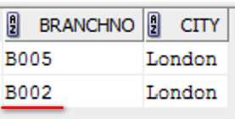

Example 22 Use of ANY/SOME
List staff who work in London.
SELECT staffNo, fName, position, branchNo
FROM Staff
WHERE branchNo = ANY
(SELECT branchNo
FROM Branch
WHERE city = 'London');
Note: BranchNo B002 does not
necessarily exist in table Staff
SELECT branchNo, city
FROM Branch
WHERE city = 'London';

Slide 24

Example 23 Use of ALL
List staff who work in London.
SELECT staffNo, fName, lName, position
FROM Staff
WHERE branchNo = ALL
(SELECT branchNo
FROM Branch
WHERE city = 'London');
Note: no values returned!
Because both branchNo B005 and B002 MUST exist in table Staff
SELECT branchNo, city
FROM Branch
WHERE city = 'London';

Slide 25


Example 23 Use of ALL
List staff who work in Glasgow.
SELECT staffNo, fName, lName, position
FROM Staff
WHERE branchNo = ALL
(SELECT branchNo
FROM Branch
WHERE city = 'Glasgow');
Note: there are values returned!
SELECT branchNo, city
FROM Branch
WHERE city = 'Glasgow';

Slide 26

Example 23 Use of ALL
Find staff whose salary is larger than salary of every member of staff at branch B003.
SELECT staffNo, fName, position, salary
FROM Staff
WHERE salary > ALL
(SELECT salary
FROM Staff
WHERE branchNo = 'B003');
Alternative version:
SELECT staffNo, fName, position, salary
FROM Staff
WHERE salary >
(SELECT MAX(salary)
FROM Staff
WHERE branchNO = 'B003');

Slide 27
Multi-Table Queries
Can use subqueries provided result columns come from same table.
If result columns come from more than one table must use a join.
To perform join, include more than one table in FROM clause.
Use comma as separator and typically include WHERE clause to specify join column(s).

Slide 28
Multi-Table Queries
Also possible to use an alias for a table named in FROM clause.
Alias is separated from table name with a space.
Alias can be used to qualify column names when there is ambiguity.

Slide 29
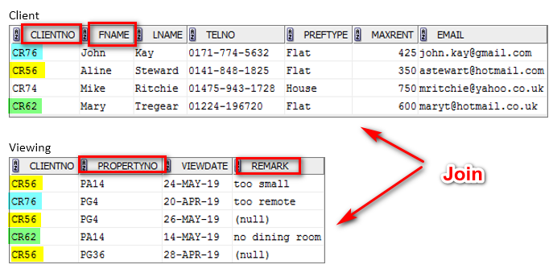
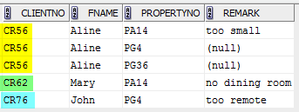
Example 24 Simple Join
List client No., first name of clients, propertyNo and remark who have viewed a property.
SELECT c.clientNo, fName,
  propertyNo, remark
  FROM Client c, Viewing v
  WHERE c.clientNo = v.clientNo;
  Note: only those rows from both tables that have identical values in the clientNo columns (c.clientNo = v.clientNo) are included in result.

Slide 30
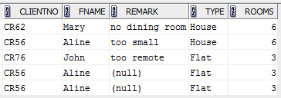
Example 25 Three Table Join
List client No., first name of clients, remark, property type and rooms who have viewed a property.
SELECT c.clientNo, fname, remark, type, rooms
FROM Client c, Viewing v, PropertyForRent p
WHERE c.clientNo = v.clientNo
AND v.propertyNo = p.propertyNo;

Slide 31
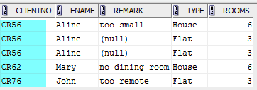
Example 26 Sorting a join
List client No., first name of clients, remark, property type and rooms who have viewed a property.
SELECT c.clientNo, fname, remark, type, rooms
FROM Client c, Viewing v, PropertyForRent p
WHERE c.clientNo = v.clientNo
AND v.propertyNo = p.propertyNo
ORDER by c.clientNo;

Slide 32
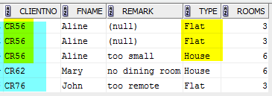
Example 26 Sorting a join
List client No., first name of clients, remark, property type and rooms who have viewed a property.
SELECT c.clientNo, fname, remark, type, rooms
FROM Client c, Viewing v, PropertyForRent p
WHERE c.clientNo = v.clientNo
AND v.propertyNo = p.propertyNo
ORDER by c.clientNo, type;

Slide 33
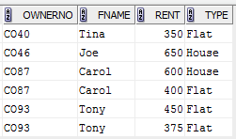
Question 3
List owner no., fname, rent, type of the owners’ properties sorted by owner no. (ascending order) and rent (descending order)
SELECT
FROM
WHERE
ORDER BY

Slide 34
Answer
List owner no., fname, rent, type of the owners’ properties sorted by owner no. (ascending order) and rent (descending order)
SELECT o.ownerNo, fname, rent, type
FROM privateOwner o, propertyForRent p
WHERE o.ownerNo = p.ownerNo
ORDER BY o.ownerNo, rent desc;

Slide 35
Question 4
Rewrite the following statement using simple join operation instead.
SELECT staffNo, fName, position, branchNo
FROM Staff
WHERE branchNo = ANY
(SELECT branchNo
FROM Branch
WHERE city = 'London');

Slide 36
Answer
SELECT s.staffNo, fName, position, s.branchNo
FROM Staff s, branch b
WHERE s.branchNo = b.branchNo
AND city = 'London';

Slide 37
Alternative Answer
SELECT s.staffNo, fName, position, b.branchNo
FROM Staff s, branch b
WHERE s.branchNo = b.branchNo
AND city = 'London';
Note: since both tables Staff and Branch contain column branchNo, using either s.branchNo or b.branchNo is valid

Slide 38
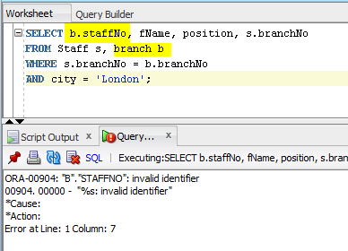
Wrong Answer
SELECT b.staffNo, fName, position, s.branchNo
FROM Staff s, branch b
WHERE s.branchNo = b.branchNo
AND city = 'London';
Note: there is no column staffNo in table branch!

Slide 39
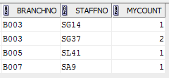
Example 27 Multiple Grouping Columns
Find number of properties handled by each staff member.
SELECT s.branchNo, s.staffNo, COUNT(*) AS myCount
  FROM Staff s, PropertyForRent p
  WHERE s.staffNo = p.staffNo
  GROUP BY s.branchNo, s.staffNo
  ORDER BY s.branchNo, s.staffNo;

Slide 40
Reference
Chapter 6 of Connolly, T and Begg, C, Database Systems: A practical Approach to Design, Implementation, and Management (6th ed.), Boston: Pearson Education.

