Slide 1
Lecture 5
COMPS320F Database Management
SQL: Data Manipulation Part III
Terri Wong
School of Science and Technology

Slide 2
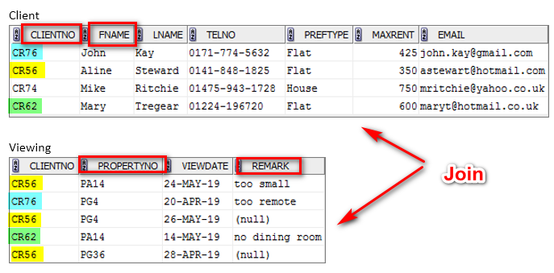
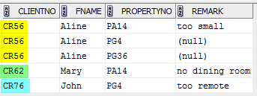
Revisit: Example 24 Simple Join
List client No., first name of clients, propertyNo and remark who have viewed a property.
SELECT c.clientNo, fName,
propertyNo, remark
FROM Client c, Viewing v
WHERE c.clientNo = v.clientNo;
Note: only those rows from both tables that have identical values in the clientNo columns (c.clientNo = v.clientNo) are included in result.

Slide 3
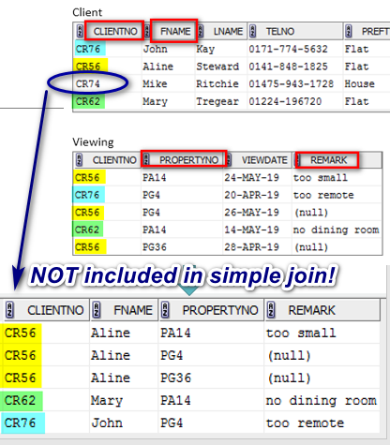
Revisit: Example 24 Simple Join
SELECT c.clientNo, fName,
propertyNo, remark
FROM Client c, Viewing v
WHERE c.clientNo = v.clientNo;
The question here is:
How to flexibly include the unmatched values in the result set?
The answer is:
Using Outer Join Operators

Slide 4
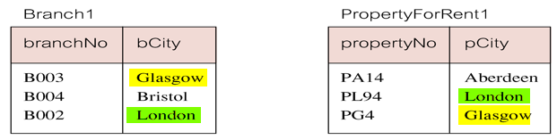
Simple Join
If one row of a joined table is unmatched, row is omitted from result table.
Result table has two rows where cities are same.
Consider following tables:

Slide 5
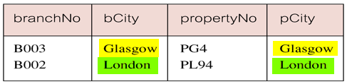
Simple Join
The simple join of these two tables:
SELECT b.*, p.*
FROM Branch1 b, PropertyForRent1 p
WHERE b.bCity = p.pCity;

Slide 6
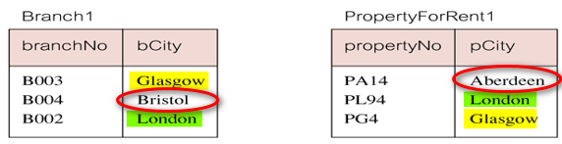
Outer Joins
Outer join operations retain rows that do not satisfy the join condition.
There are no rows corresponding to branches in Bristol and Aberdeen.
To include unmatched rows in result table, use an Outer join.

Slide 7
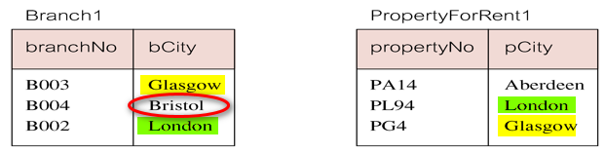
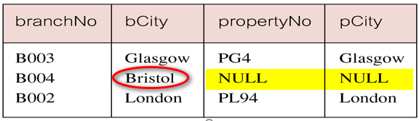
Example 28 Left Outer Join
List branches and properties that are in same city along with any unmatched branches.
SELECT b.*, p.*
FROM Branch1 b LEFT JOIN
PropertyForRent1 p ON b.bCity = p.pCity;

Slide 8
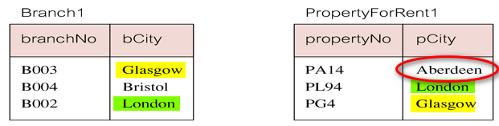
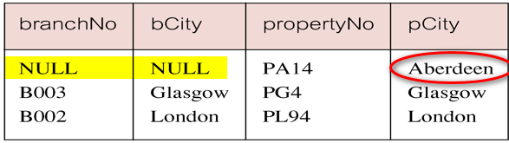
Example 29 Right Outer Join
List branches and properties in same city and any unmatched properties.
SELECT b.*, p.*
FROM Branch1 b RIGHT JOIN
PropertyForRent1 p ON b.bCity = p.pCity;

Slide 9
Example 30 Full Outer Join
List branches and properties in same city and any unmatched branches or properties.
SELECT b.*, p.*
FROM Branch1 b FULL JOIN
PropertyForRent1 p ON b.bCity = p.pCity;

Slide 10
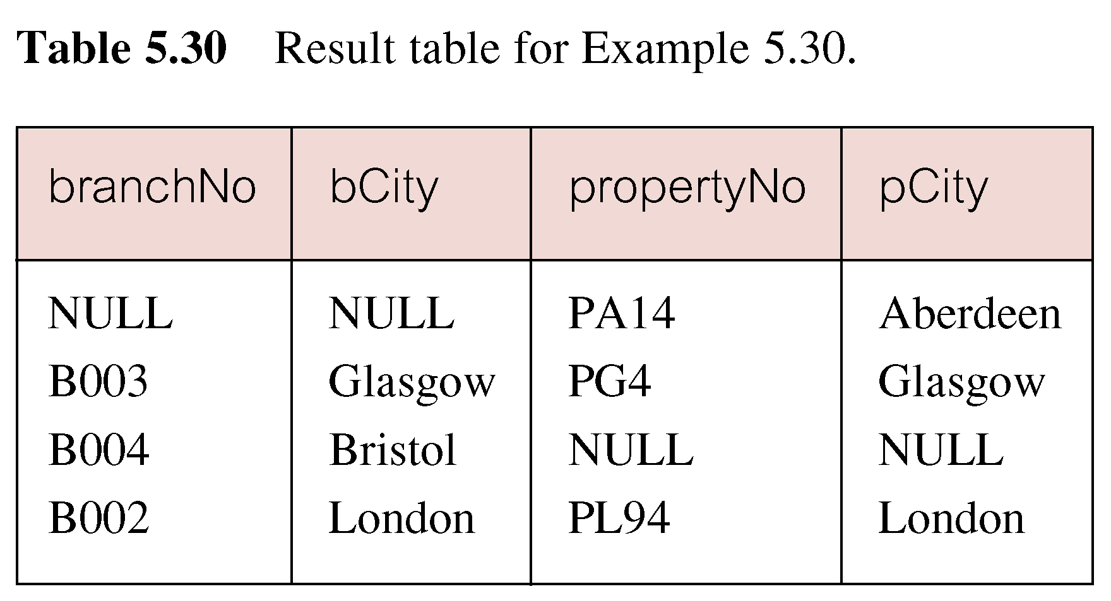
Example 30 Full Outer Join
Includes rows that are unmatched in both tables.
Unmatched columns are filled with NULLs.

Slide 11
EXISTS and NOT EXISTS
EXISTS and NOT EXISTS are for use only with subqueries.
Produce a simple true/false result.
True if and only if there exists at least one row in result table returned by subquery.
False if subquery returns an empty result table.
NOT EXISTS is the opposite of EXISTS.

Slide 12
EXISTS and NOT EXISTS
As (NOT) EXISTS check only for existence or non-existence of rows in subquery result table, subquery can contain any number of columns.
Common for subqueries following (NOT) EXISTS to be of form:
(SELECT * ...)

Slide 13

Example 31 Query using EXISTS
Find all staff who work in a London branch.
SELECT staffNo, fName, lName, position
FROM Staff s
WHERE EXISTS
(SELECT *
FROM Branch b
WHERE s.branchNo = b.branchNo
AND city = 'London');

Slide 14
Example 31 Query using EXISTS
Could also write this query using join construct:
SELECT staffNo, fName, lName, position
FROM Staff s, Branch b
WHERE s.branchNo = b.branchNo
AND city = 'London';

Slide 15
Question
What is the result set if the previous statement using Exists changed to:
SELECT staffNo, fName, lName, position
FROM Staff s
WHERE EXISTS
(SELECT *
FROM Branch b
WHERE city = 'London');

Slide 16
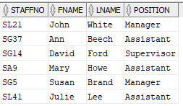
Answer - Result Set

Slide 17
Explanation
Note, search condition s.branchNo = b.branchNo is necessary to consider correct branch record for each member of staff.
If omitted, would get all staff records listed out because subquery:
SELECT * FROM Branch WHERE city='London'
would always be true and query would be:
SELECT staffNo, fName, lName, position
FROM Staff s

Slide 18
Union, Intersect, and Difference (Except)
Can use normal set operations of Union, Intersection, and Difference to combine results of two or more queries into a single result table.
Union of two tables, A and B, is table containing all rows in either A or B or both.
Intersection is table containing all rows common to both A and B.
Difference is table containing all rows in A but not in B.
Two tables must be union compatible.

Slide 19
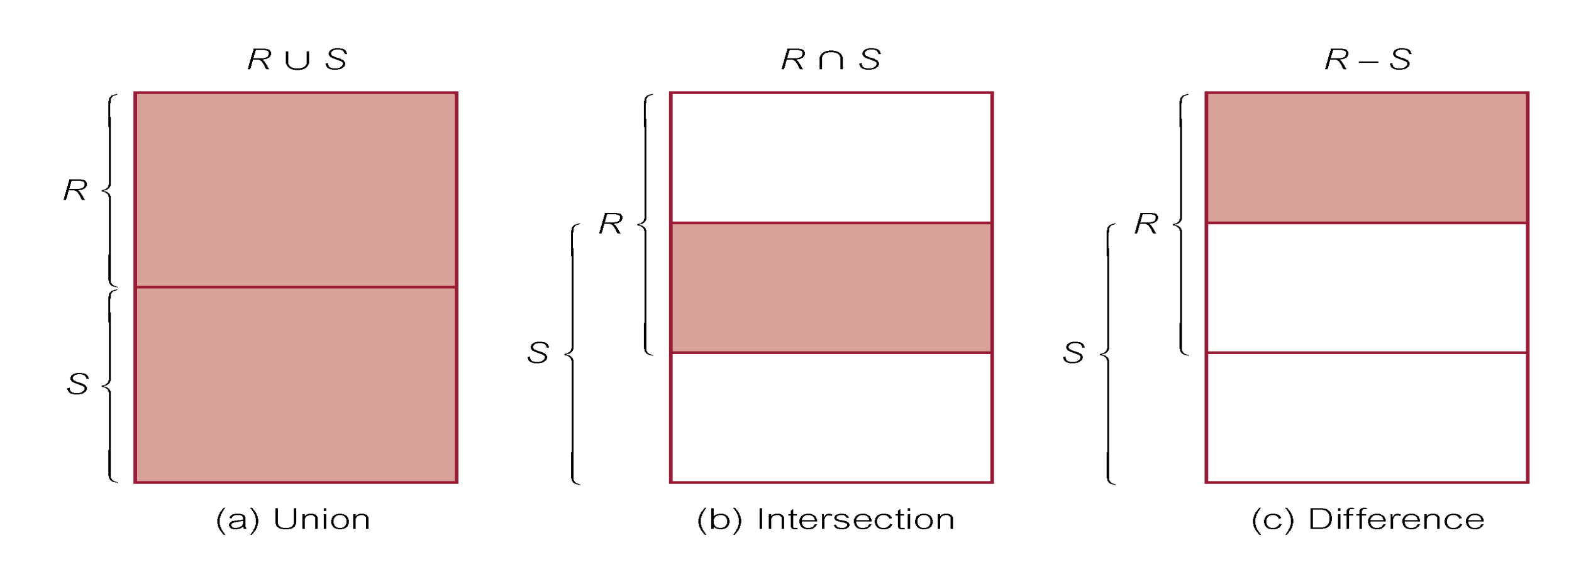
Union, Intersect, and Difference (Except)

Slide 20
Example 32 Use of UNION
List all cities where there is either a branch office or a property.
(SELECT city
FROM Branch
WHERE city IS NOT NULL) UNION
(SELECT city
FROM PropertyForRent
WHERE city IS NOT NULL);

Slide 21
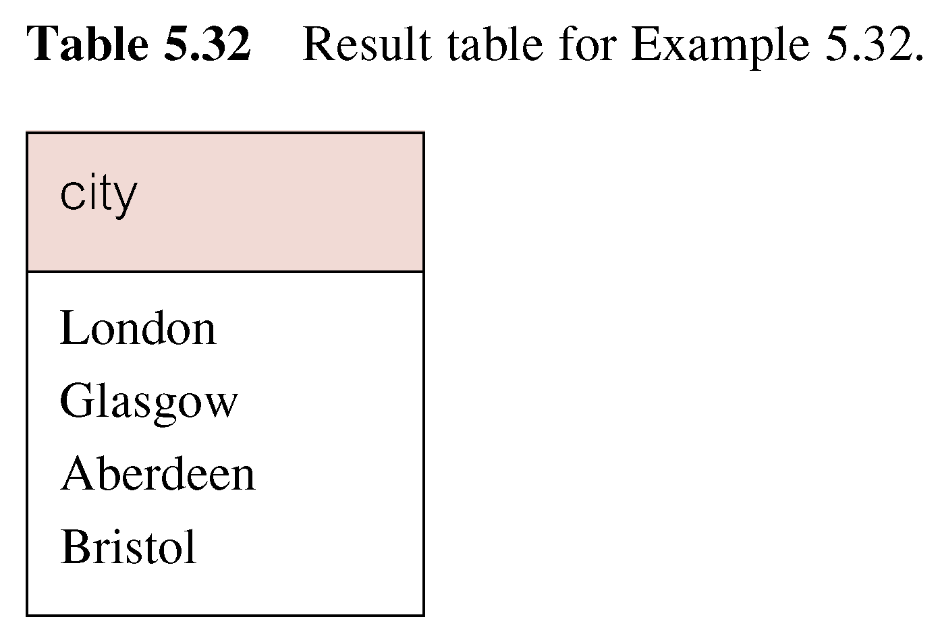
Example 32 Use of UNION
Produces result tables from both queries and merges both tables together.

Slide 22
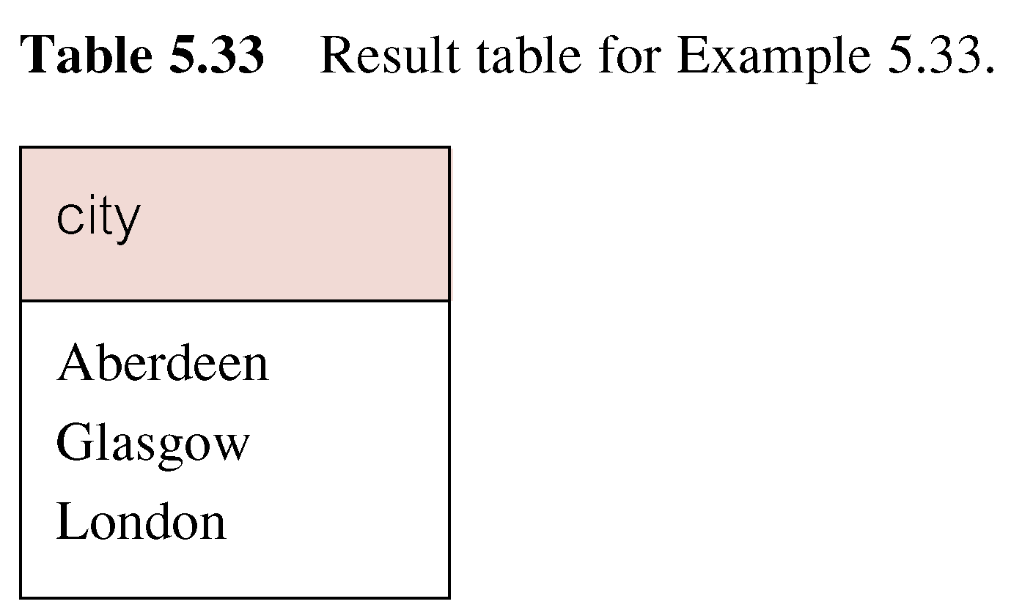
Example 33 Use of INTERSECT
List all cities where there is both a branch office and a property.
(SELECT city FROM Branch)
INTERSECT
(SELECT city FROM PropertyForRent);

Slide 23
Example 33 Use of INTERSECT
Could rewrite this query without INTERSECT operator:
SELECT b.city
FROM Branch b , PropertyForRent p
WHERE b.city = p.city;
Or:
SELECT DISTINCT city FROM Branch b
WHERE EXISTS
(SELECT * FROM PropertyForRent p
WHERE p.city = b.city);

Slide 24
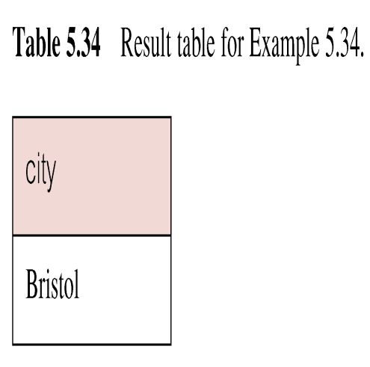
Example 34 Use of EXCEPT
List of all cities where there is a branch office but no properties.
(SELECT city FROM Branch)
EXCEPT
(SELECT city FROM PropertyForRent);

Slide 25
Example 34 Use of EXCEPT
Could rewrite this query without EXCEPT:
SELECT DISTINCT city FROM Branch
WHERE city NOT IN
(SELECT city FROM PropertyForRent);
Or
SELECT DISTINCT city FROM Branch b
WHERE NOT EXISTS
(SELECT * FROM PropertyForRent p
WHERE p.city = b.city);

Slide 26
INSERT
INSERT INTO TableName [ (columnList) ]
VALUES (dataValueList)
columnList is optional; if omitted, SQL assumes a list of all columns in their original CREATE TABLE order.
Any columns omitted must have been declared as NULL when table was created, unless DEFAULT was specified when creating column.

Slide 27
INSERT
dataValueList must match columnList as follows:
number of items in each list must be same;
must be direct correspondence in position of items in two lists;
data type of each item in dataValueList must be compatible with data type of corresponding column.

Slide 28
Example 35 INSERT … VALUES
Insert a new row into Staff table supplying data for all columns.
INSERT INTO Staff
VALUES ('SG16', 'Alan', 'Brown', 'Assistant', 'M', Date’2000-05-25', 8300, 'B003');

Slide 29
Example 36 INSERT using Defaults
Insert a new row into Staff table supplying data for all mandatory columns.
INSERT INTO Staff (staffNo, fName, lName,
position, salary, branchNo)
VALUES ('SG44', 'Anne', 'Jones',
'Assistant', 8100, 'B003');
Or
INSERT INTO Staff
VALUES ('SG44', 'Anne', 'Jones', 'Assistant', NULL,
NULL, 8100, 'B003');

Slide 30
INSERT … SELECT
Second form of INSERT allows multiple rows to be copied from one or more tables to another:
INSERT INTO TableName [ (columnList) ]
SELECT ...

Slide 31
Example 37a INSERT … SELECT
Assume there is a table branch_London that contains the branch records of London
CREATE TABLE branch_London
(branchNo char(5) PRIMARY KEY,
street varchar(35),
city varchar(10),
postcode varchar(10)
);

Slide 32

Example 37a INSERT … SELECT
Populate branch_London using branch table
INSERT INTO branch_London
(SELECT *
FROM branch
WHERE city = 'London’);
SELECT * FROM branch_London;

Slide 33
Example 37b CREATE TABLE …AS SELECT
The two steps shown in example 37a (using create table and insert SQL statements) can be combined into one single statement as below:
create table branch_London
as select *
from branch
where city = 'London';
select * from branch_London;

Slide 34
UPDATE
UPDATE TableName
SET columnName1 = dataValue1
[, columnName2 = dataValue2...]
[WHERE searchCondition]
TableName can be name of a base table or an updatable view.
SET clause specifies names of one or more columns that are to be updated.

Slide 35
UPDATE
WHERE clause is optional:
if omitted, named columns are updated for all rows in table;
if specified, only those rows that satisfy searchCondition are updated.
New dataValue(s) must be compatible with data type for corresponding column.

Slide 36
Example 38/39 UPDATE All Rows
Give all staff a 3% pay increase.
UPDATE Staff
SET salary = salary*1.03;
Give all Managers a 5% pay increase.
UPDATE Staff
SET salary = salary*1.05
WHERE position = 'Manager';

Slide 37
Example 40 UPDATE Multiple Columns
Promote David Ford (staffNo='SG14') to Manager and change his salary to £18,000.
UPDATE Staff
SET position = 'Manager', salary = 18000
WHERE staffNo = 'SG14';

Slide 38
DELETE
DELETE FROM TableName
[WHERE searchCondition]
TableName can be name of a base table or an updatable view.
searchCondition is optional; if omitted, all rows are deleted from table. This does not delete table. If search_condition is specified, only those rows that satisfy condition are deleted.

Slide 39
Example 41/42 DELETE Specific Rows
Delete all viewings that relate to property PG4.
DELETE FROM Viewing
WHERE propertyNo = 'PG4';
Delete all records from the Viewing table.
DELETE FROM Viewing;

Slide 40
Reference
Chapter 6 of Connolly, T and Begg, C, Database Systems: A practical Approach to Design, Implementation, and Management (6th ed.), Boston: Pearson Education.

