Slide 1
Traffic System Project Course Name: Computer Graphics Sessional Course Teacher: Lomat Haider Chowdhury Group Members: Angraj MD Sargia Showrav CSE 06607820 Sajib Kotal CSE 06607811

Slide 2
Objective
In this project we aim to develop a fully working Traffic Simulator. Where Every traffic signal and Vehicles can be controlled by user.

Slide 3
Project analysis slide 2
Project Feature
Traffic Light
Weather Animation
Car , Bus, Road , Zebra crossing
School ,Home Tree
Traffic system
Traffic Light control keyboard function
Mouse Function
Student crossing the road
City, Cloud , Sun, Hill

Slide 4
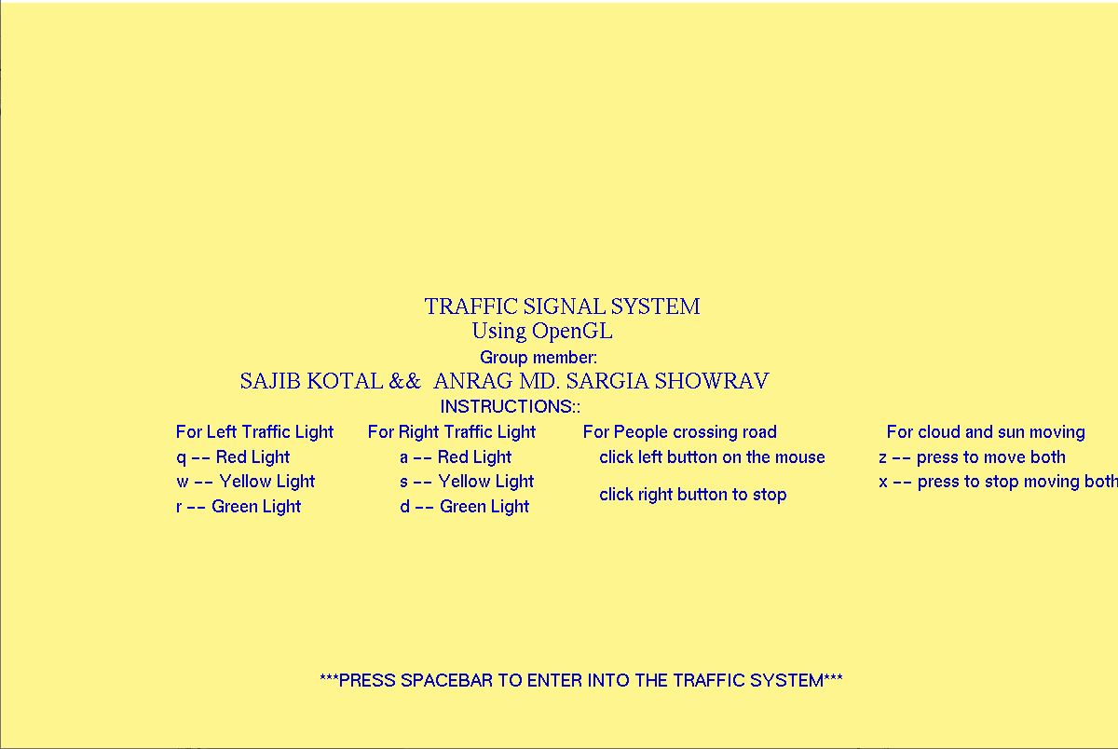
User Guide

Slide 5
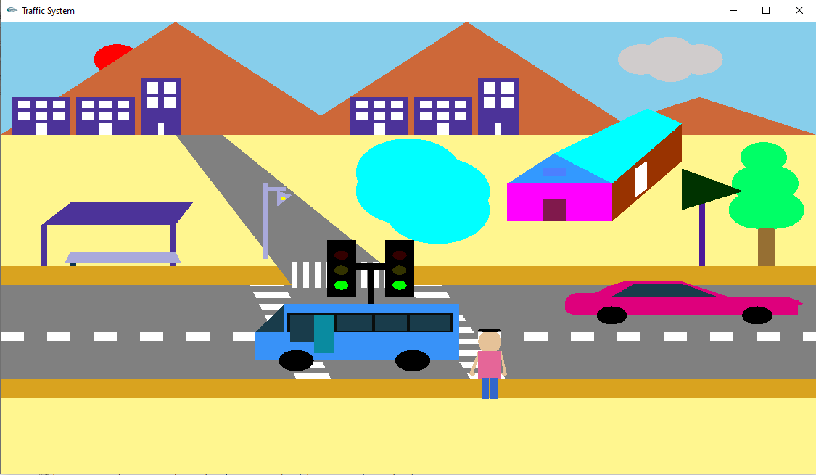
Traffic Signal Green

Slide 6
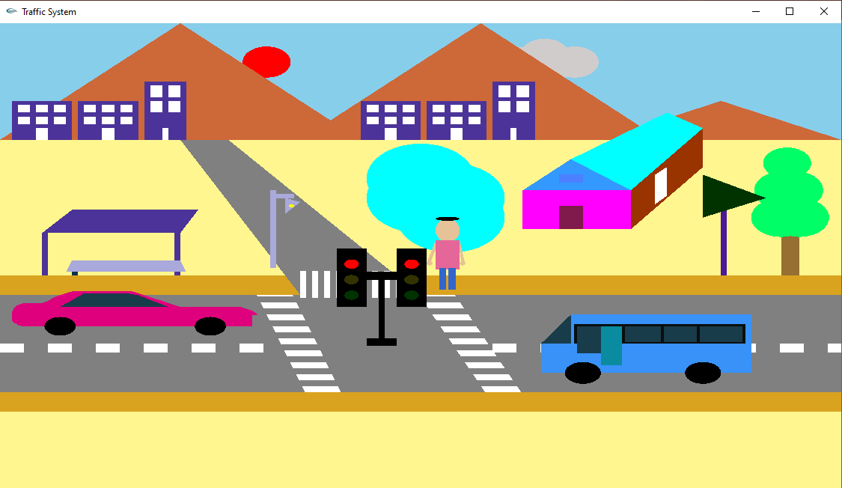
Traffic Signal Red

Slide 7
Problem Faced
1.Translating Several objects with maintaining proper connection between them.
2. Creating a continuous flow of animations.
3.Creating a continuous flow of traffic.
4. Scaling the objects with respect to window size.

Slide 8
5. Creating a instruction window for user.
6.Creating road strips
7. Controlling the traffic respect to the color of traffic light
8. Distribution of work in different window for group members.

Slide 9
Overcome the problem
At first to overcome every problem we faced ,we had to learn from class and watching recorded videos .
1 . We had to translate the object with the assume average value.. Then we had to iterate the objects to translate into desired position
For the continuous animation firstly we implemented the basic open gl animation logic. Then we implemented the basic programming logic we knew to work the thing
The same logic we used for traffic.
4. We had to scale the objects with initial guess and iterate the values.
.

Slide 10
With the help to internet we were able to learn how to create continuous line and then we implemented the lines as roads strips.
We had to create arrays that keeps the light signal and behave with every light change.
7.We discussed every problem on the topic and works with different parts. Then finally merge them into a single window.

Slide 11
Project Speciality
This project gives much a like a real traffic simulator vibe.
The vehicles accurately responds to the keypress.
Also the roadcrossing makes it much real for simulation.
The other objects also responds with the
Perspective Features.

Slide 12
Drawbacks
This is a 2d model. So the project fails to give a 3d perspective to look
much like real world traffic system .
Lighting system for individual object was not possible and time consuming.

Slide 13
Project Ambitions
Plays horns of vehicles pressing any key
Lighting control for every object using keyboard operation
Creating a 3d view of the traffic system

Slide 14
Project analysis slide 3
Feature descriptions
Student crossing road
Traffic light
Road and Zebra crossing
Car and Bus
Cloud ,hill , lamppost , school , bulding
For drawing using traffic_light function including boolian function for keyboard function.
. Using roadstrep function ,zebra function
For drawing Using void car and bus function.
For moving car and bus using carchalao and buschalao function
When is occurring traffic signal student crossing the road.
Cloud moving in the sky.

Slide 15
Project analysis slide 4
We learned
What is openGl
2d and 3d shape
Line , triangle , quad, polygon , circle
Audio and lighting function
Keyboard function and mouse function
Object Moving,
Animation
IdleFunction, displayfunction,repostdisplayfunction

Slide 16
Project analysis slide 6
Communicate each other
.sharing the knowledge
Contact by phone call.
.keep saving the code
Arranging ZOOM meeting .
Messaging and sharing short code.
Searching the net for getting idea.

Slide 17
Thank You

