Slide 1
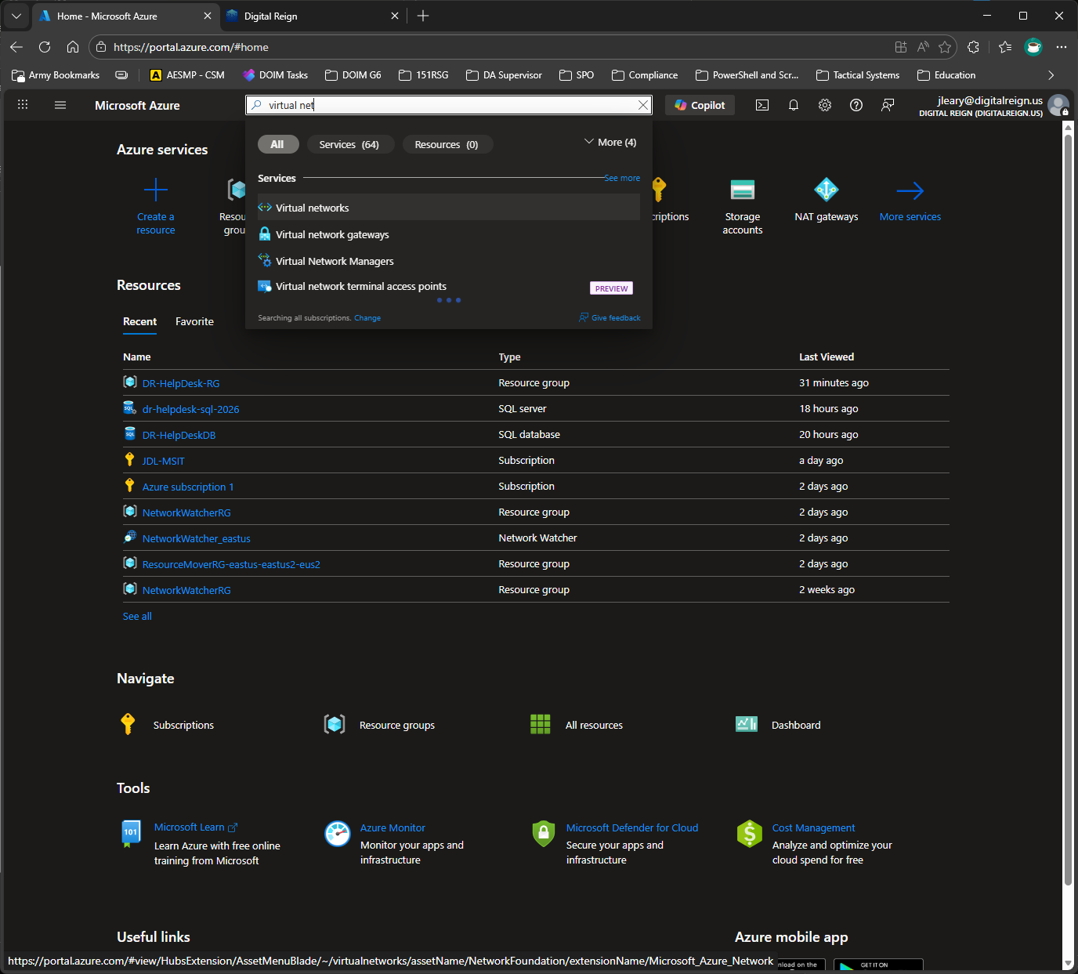
Already started DB, but don’t want to get too far.
Virtual Network up first. We want security and segments for different data/services to live on.

Slide 2
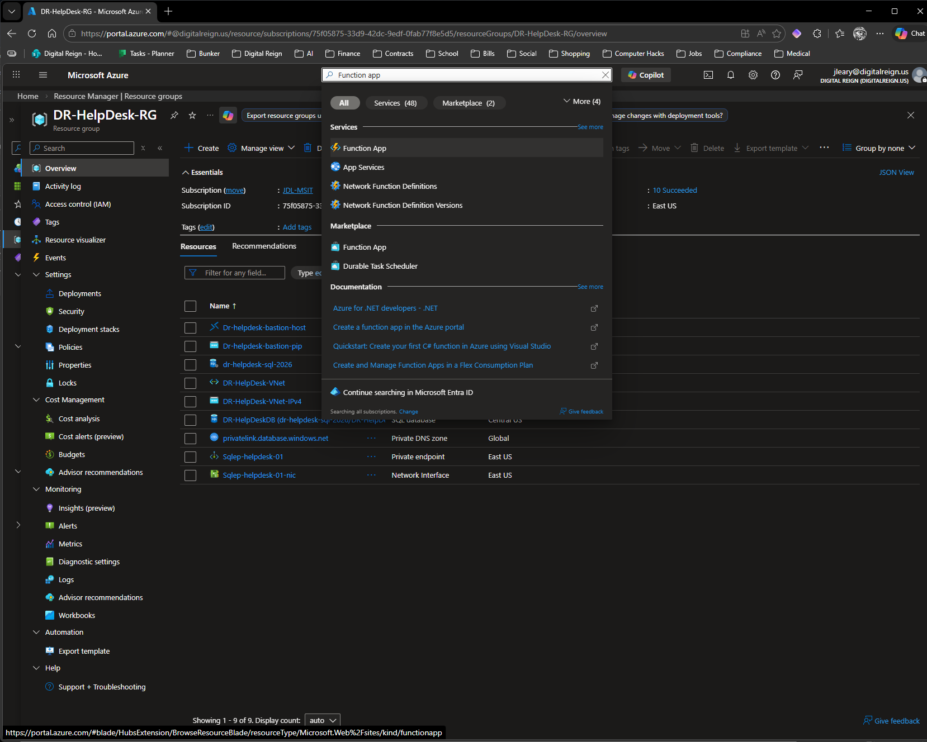
Adding Azure Functions app

Slide 3
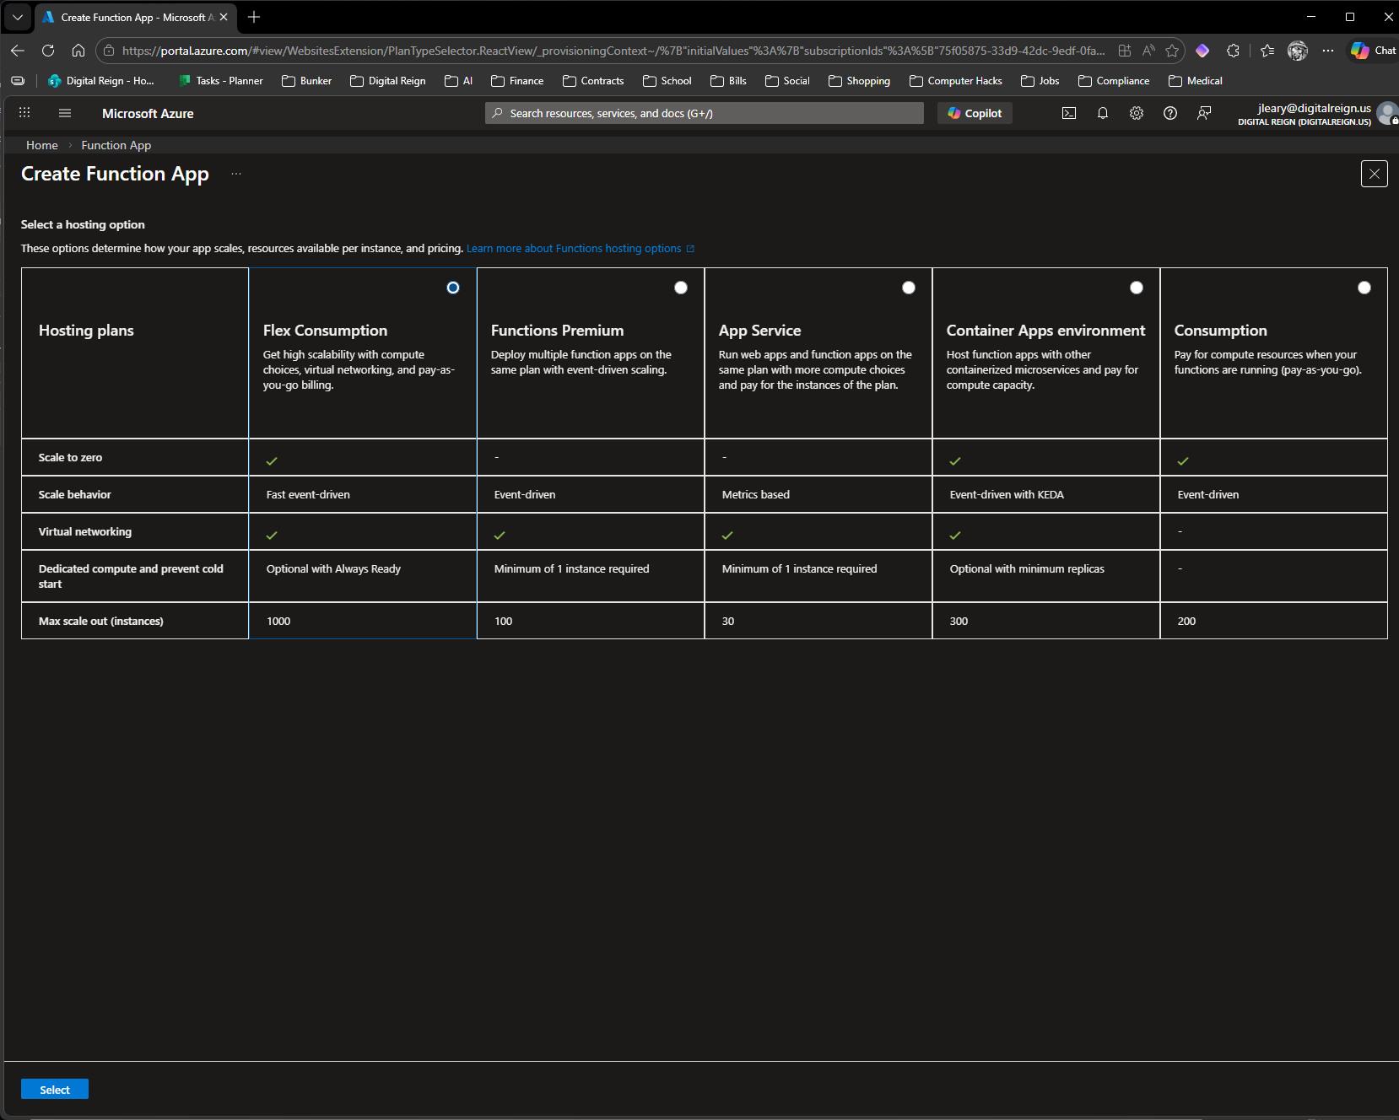

Slide 4
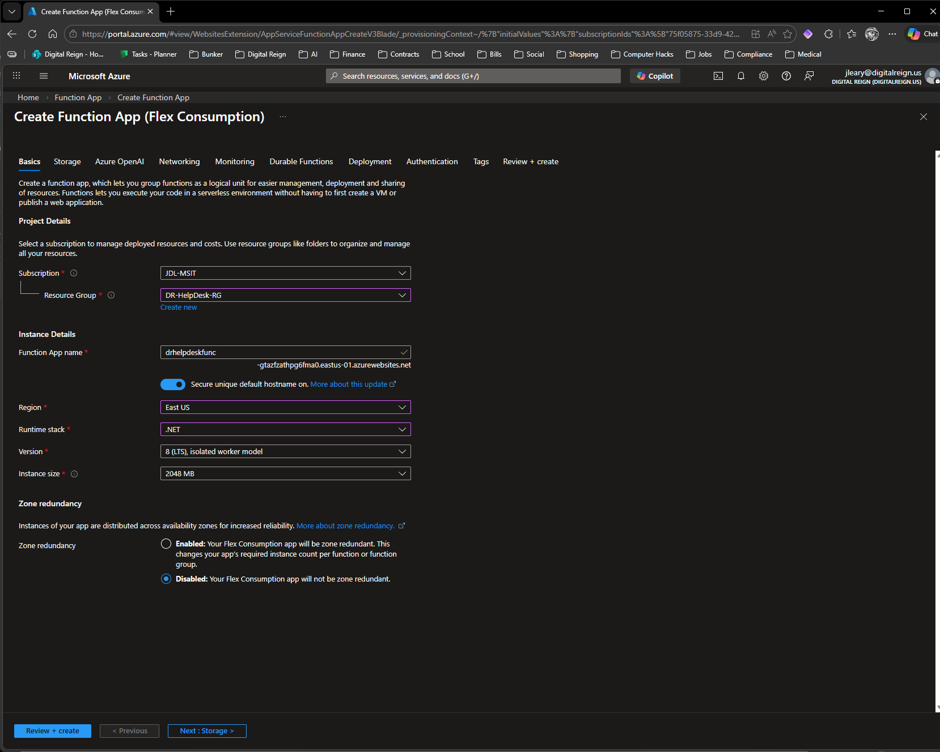

Slide 5
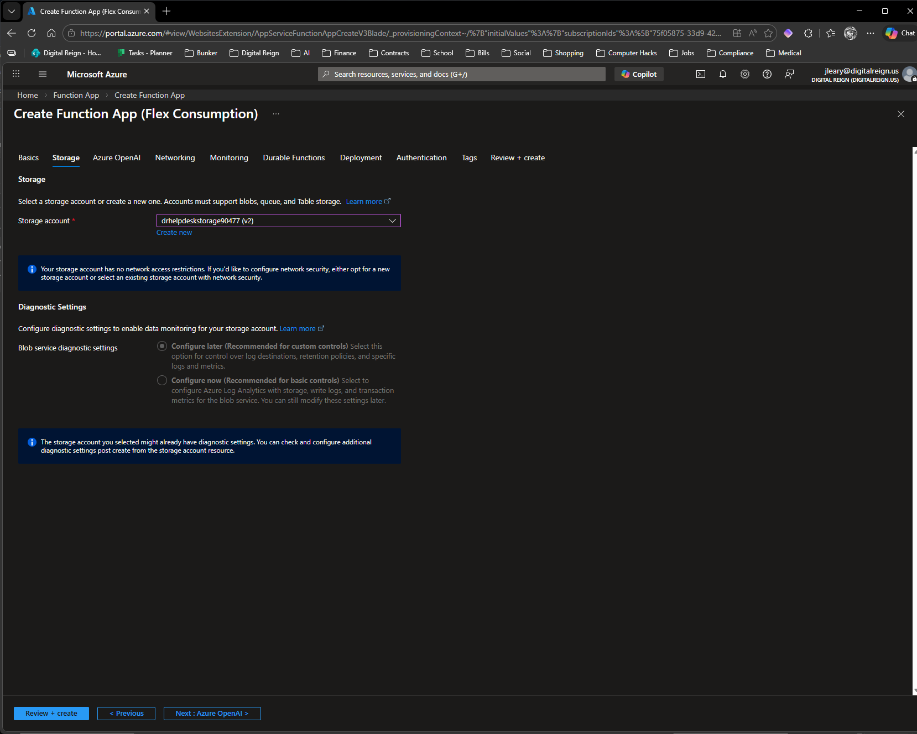

Slide 6
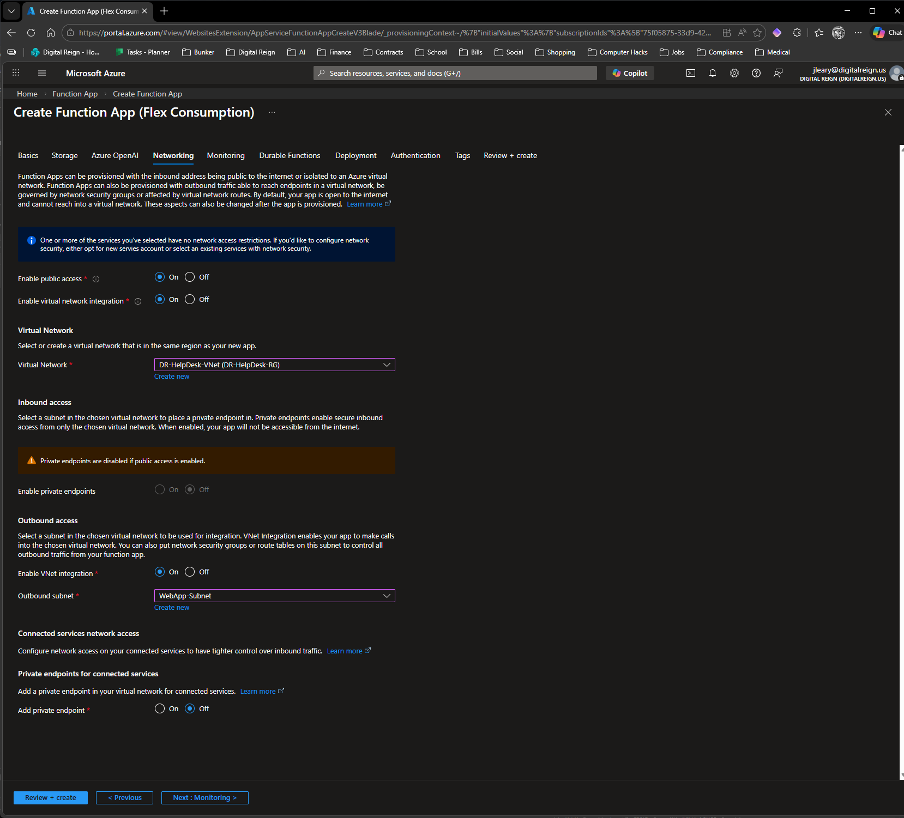
Scary! Had to read this over a few times. I need Outbound public access to SQL over the vnet and Inbound public for testing.

Slide 7
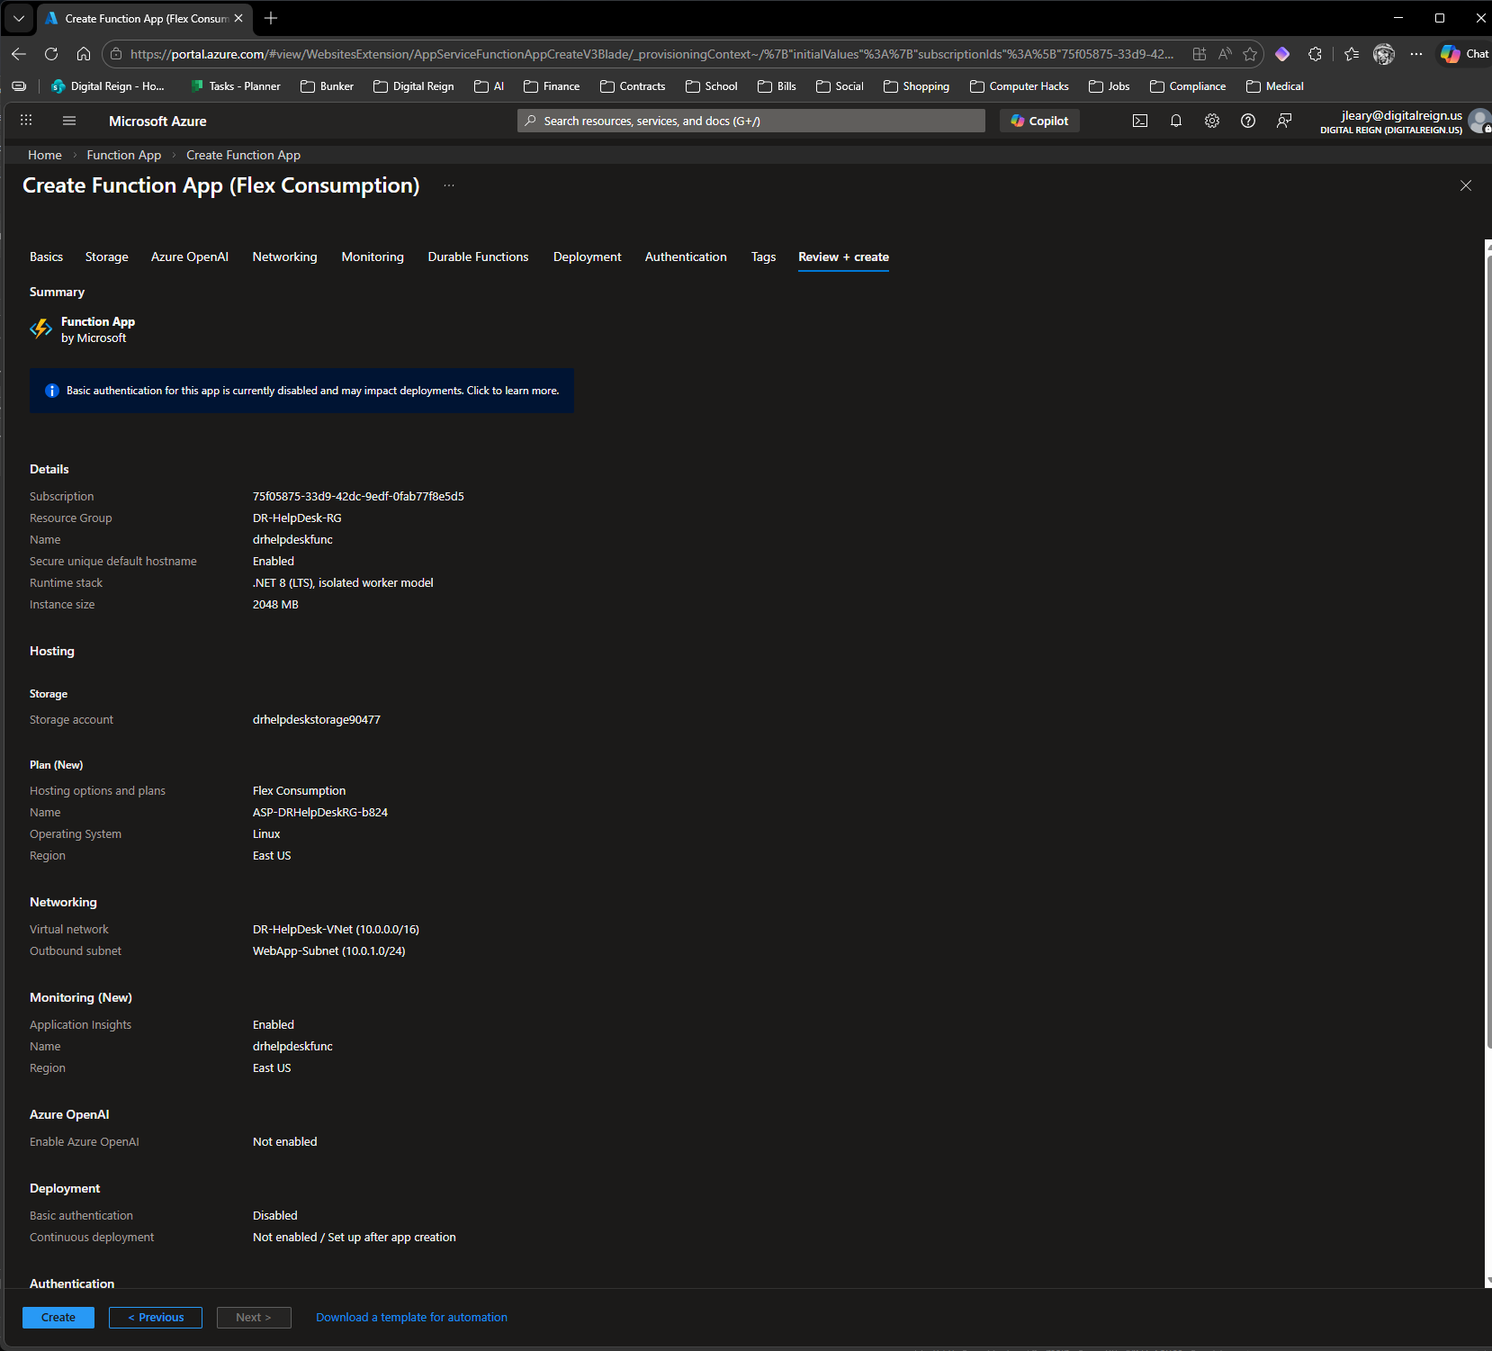

Slide 8
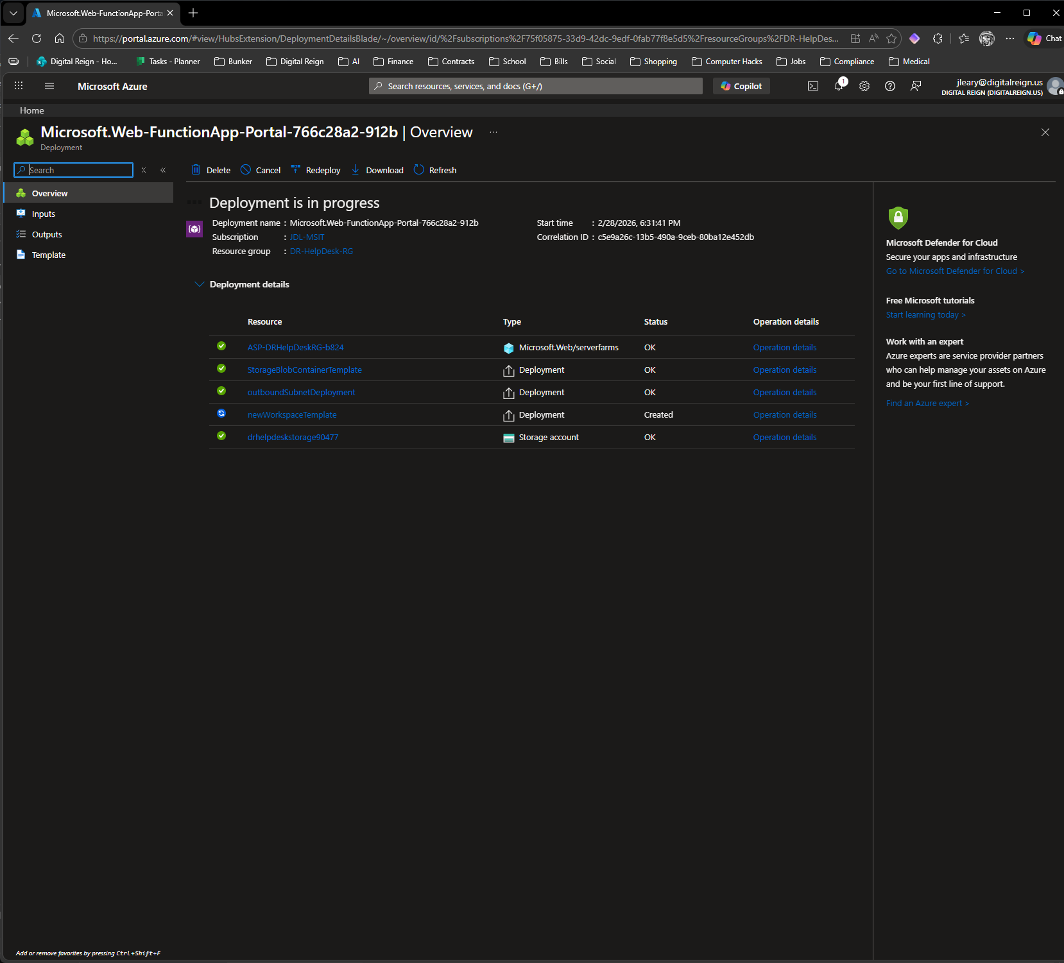

Slide 9
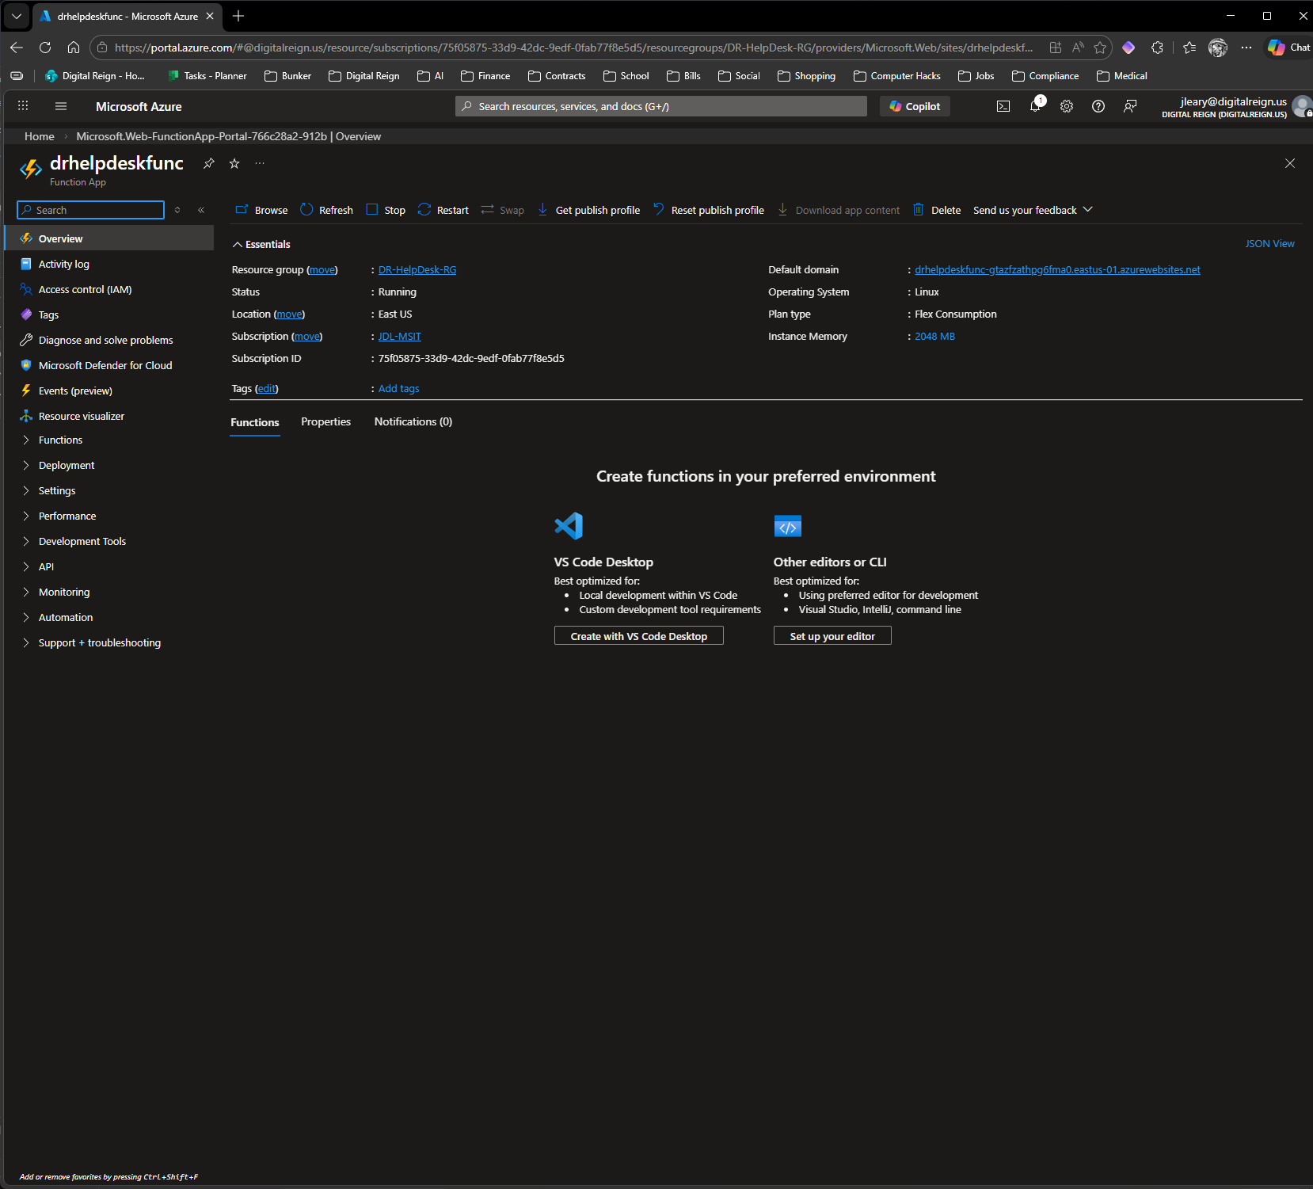

Slide 10
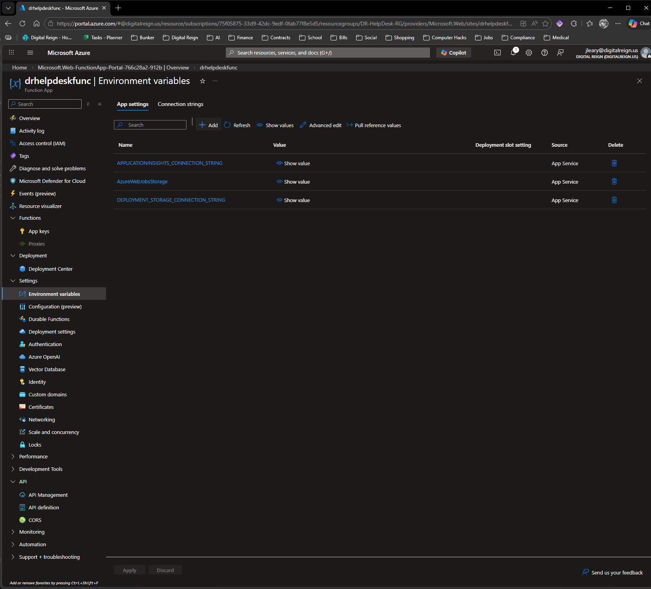

Slide 11
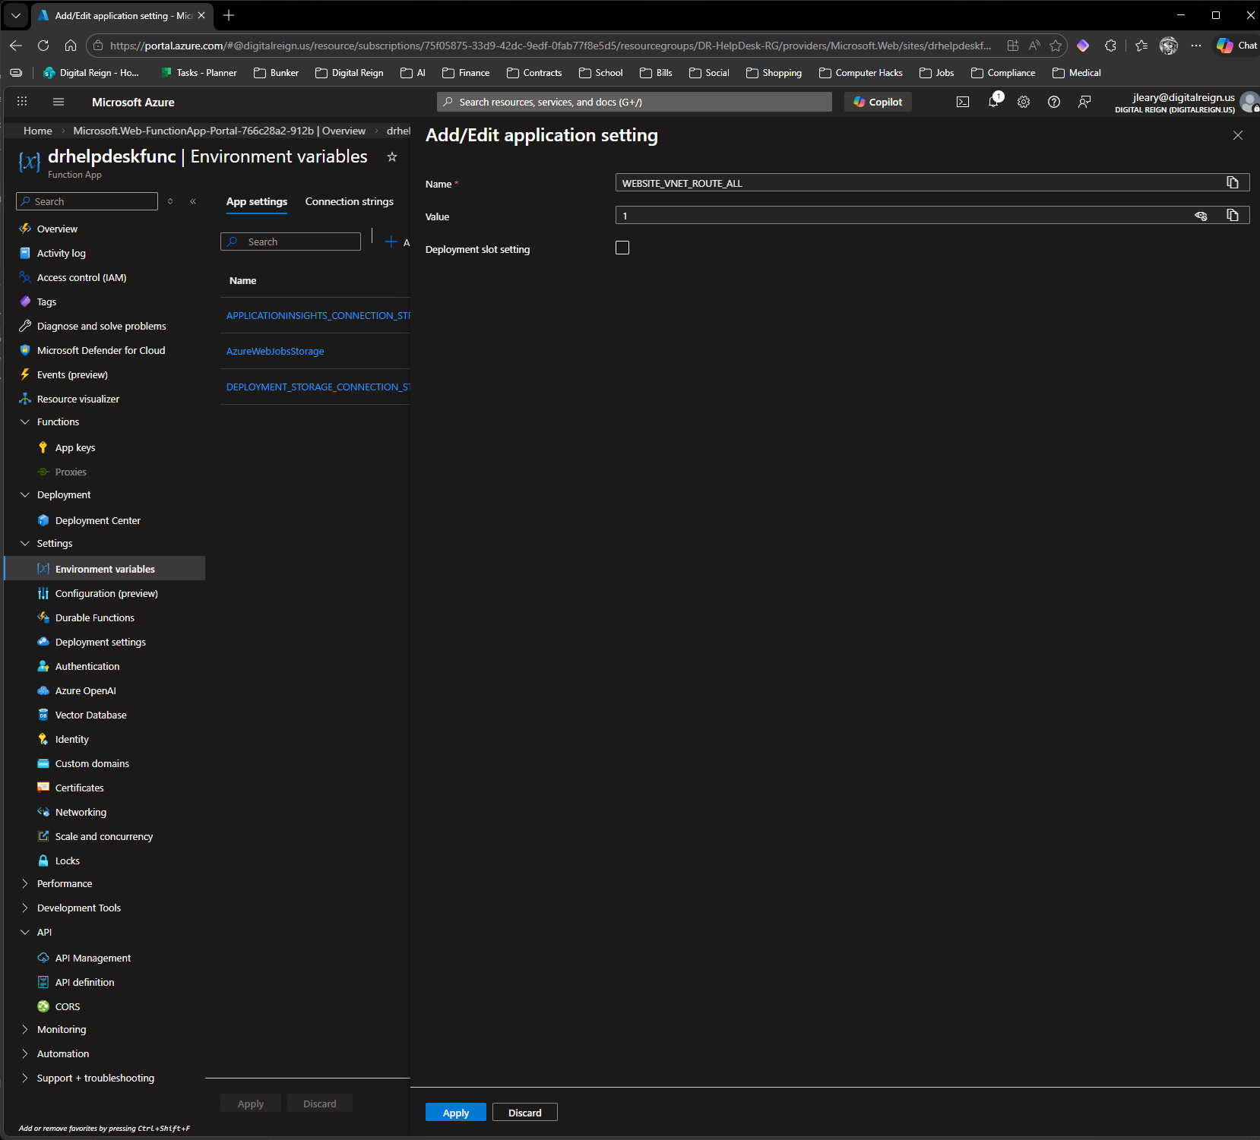
Add the WEBSITE_VNET_ROUTE_ALL to Enviropnment vars.
Purpose of WEBSITE_VNET_ROUTE_ALL=1
This is a special app setting for Azure App Service / Azure Functions when you have VNet Integration enabled.
Default behavior (0 or not set): Only private outbound traffic (RFC 1918 addresses like 10.x.x.x, 172.16.x.x, 192.168.x.x) is sent through your VNet/subnet. All public internet traffic goes straight out to the internet.
When set to 1: ALL outbound traffic from your Function App (private + public internet) is forced through the VNet integration subnet (in your case, WebApp-Subnet).
Why we set it for your project:
Your SQL connection string uses the public-looking name dr-helpdesk-sql-2026.database.windows.net.
That name resolves (via your private DNS zone) to a private IP in Database-Subnet.
Setting this to 1 guarantees the traffic is routed correctly through the VNet → hits the Private Endpoint reliably.
It also handles DNS resolution, storage account access (for Functions runtime), and any other outbound calls consistently.
Without it, you can sometimes hit intermittent “cannot reach SQL” or DNS issues, especially with cross-region setups like yours (East US VNet → Central US SQL).
It’s the standard, battle-tested way to make private SQL + Functions work smoothly.

Slide 12
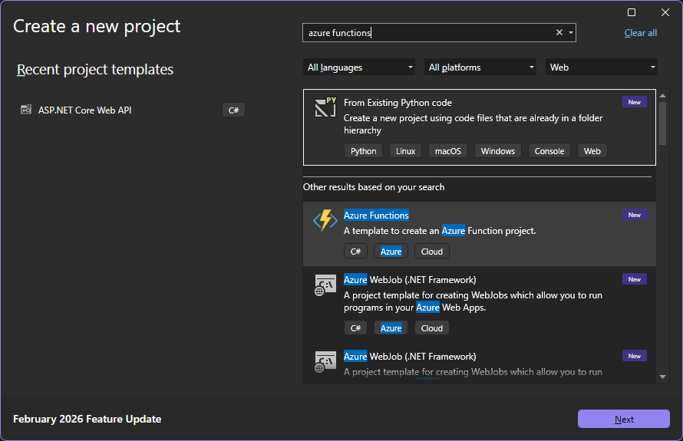

Slide 13
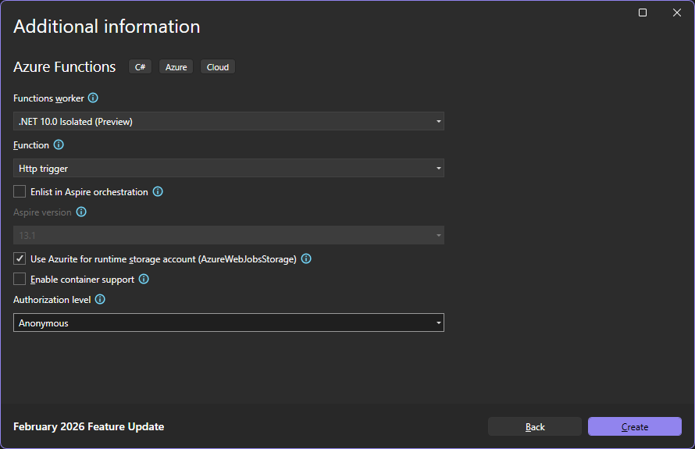

Slide 14
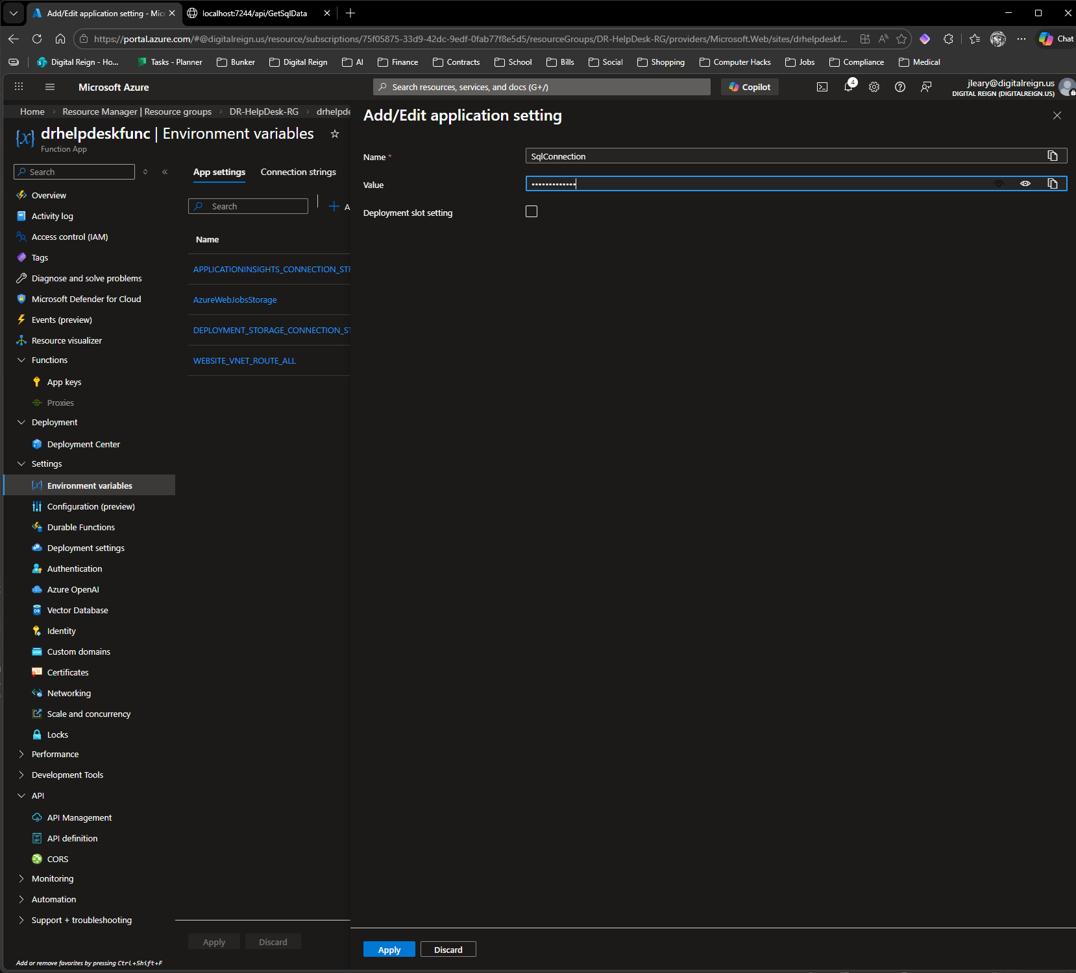
Add the SQL connection string as an environment var in app

Slide 15
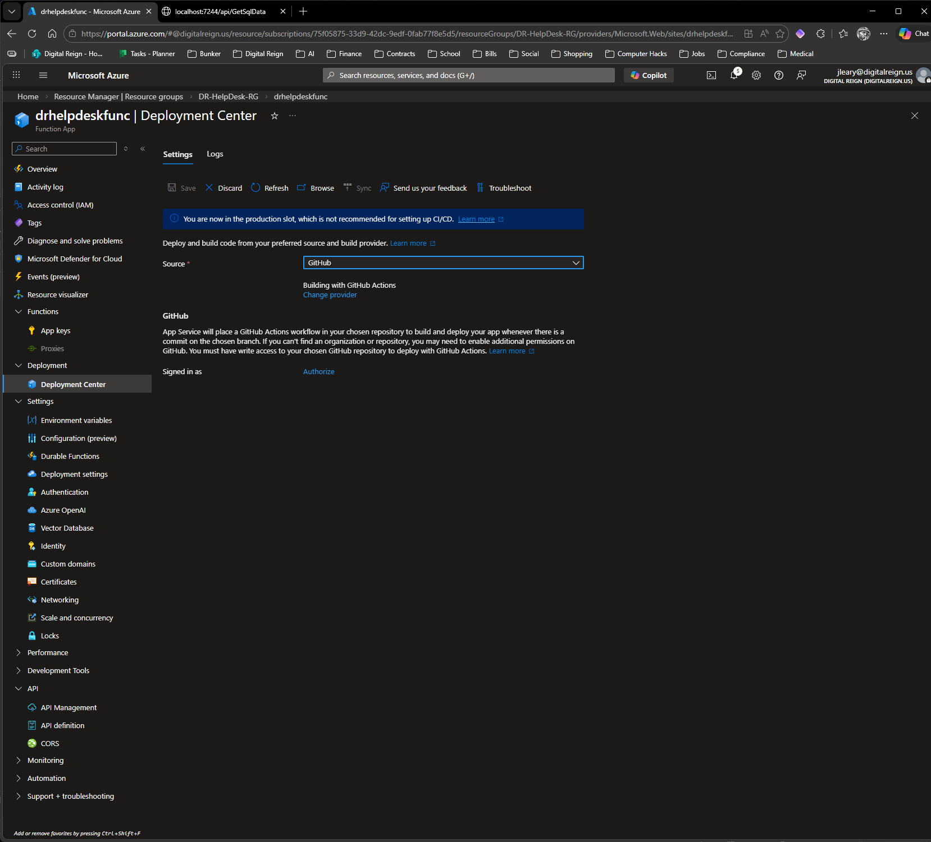
Authorize GitHub
App Service will place a GitHub Actions workflow in your chosen repository to build and deploy your app whenever there is a commit on the chosen branch. If you can't find an organization or repository, you may need to enable additional permissions on GitHub. You must have write access to your chosen GitHub repository to deploy with GitHub Actions.

Slide 16
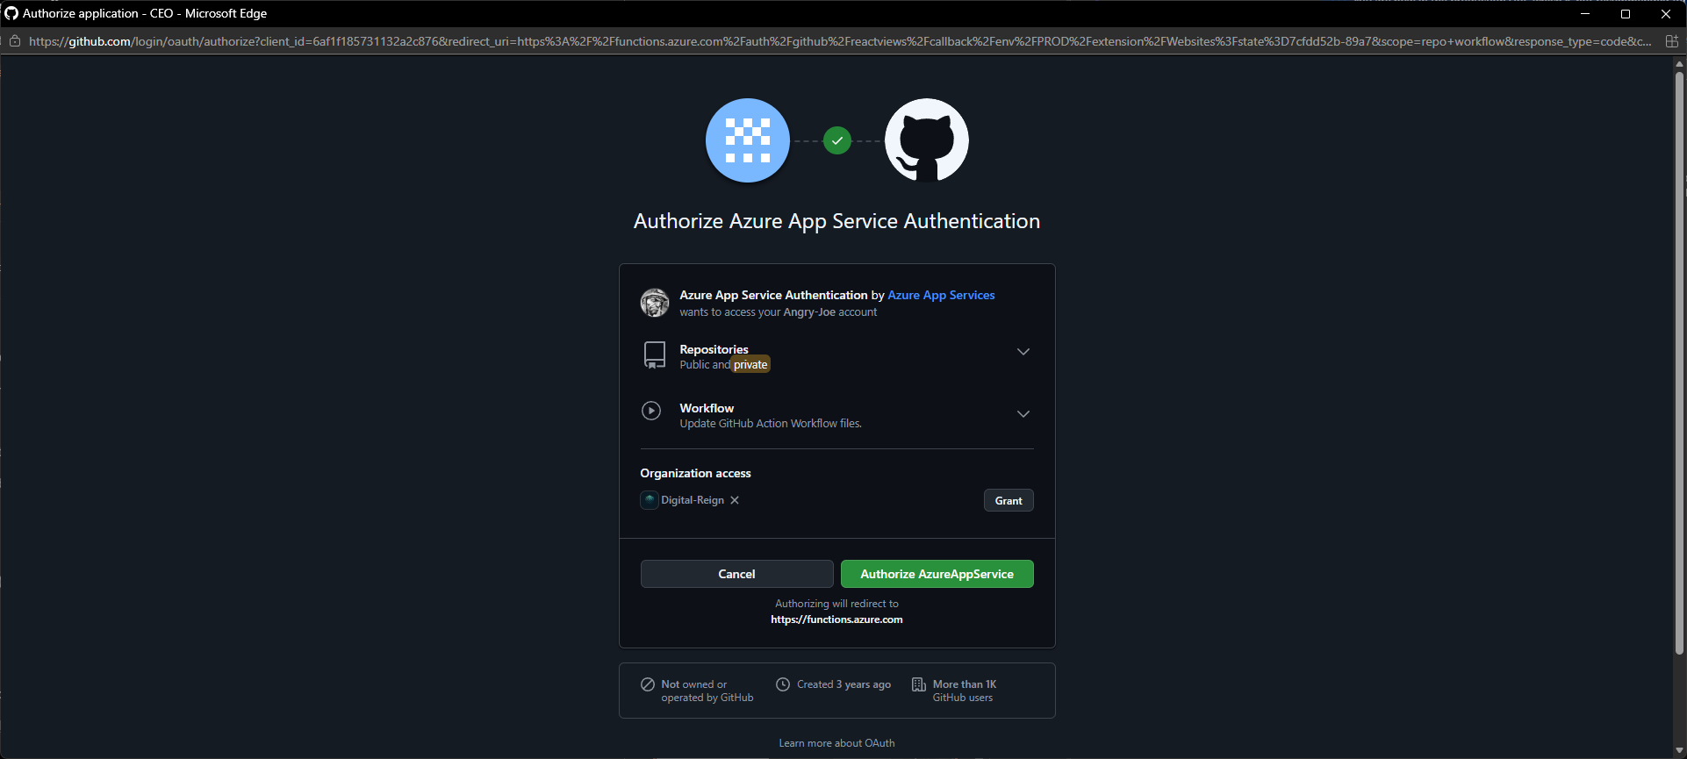

Slide 17
Step | Action | Details
1. Download the Publish Profile | Go to the Azure Portal. Navigate to your dr-helpdesk-webapp App Service. On its Overview page, find and click the "Download publish profile" button. | A file named dr-helpdesk-webapp.PublishSettings will be downloaded. This is a simple text file containing XML credentials.
2. Go to GitHub Secrets | Open your GitHub repository in a web browser. Go to the Settings tab. In the left menu, under "Security", click on Secrets and variables > Actions. | This is the secure vault where you can store sensitive information for your workflows.
3. Create a New Secret | Click the "New repository secret" button. | You'll be presented with two text boxes: "Name" and "Value".
4. Store the Secret | In the Name box, type exactly: AZURE_WEBAPP_PUBLISH_PROFILE Now, open the .PublishSettings file you downloaded in a text editor (like Notepad). Copy the entire contents of the file. Paste that entire block of text into the Value (or Secret) box on GitHub. | This name is case-sensitive and must match what our workflow file expects.
5. Save the Secret | Click the "Add secret" button. | Your secret is now securely stored and ready for the workflow to use.
Finishing GitHub auth

Slide 18
Phase 2: Create the Workflow File
Now we create the "recipe" file that tells GitHub Actions how to build and deploy your app.
Step | Action | Details
1. Go to the "Actions" tab | In your GitHub repository, click on the Actions tab at the top. | GitHub might suggest some common workflow templates.
2. Create a New Workflow | Click the "set up a workflow yourself" link. | This will open a new page where you can create a new file. The file will be pre-named main.yml and will be placed in a new folder called .github/workflows/. This is the correct location.
3. Paste the Workflow Code | Delete the boilerplate content that GitHub provides and paste the following code into the editor. I have configured it specifically for your project structure.

Slide 19
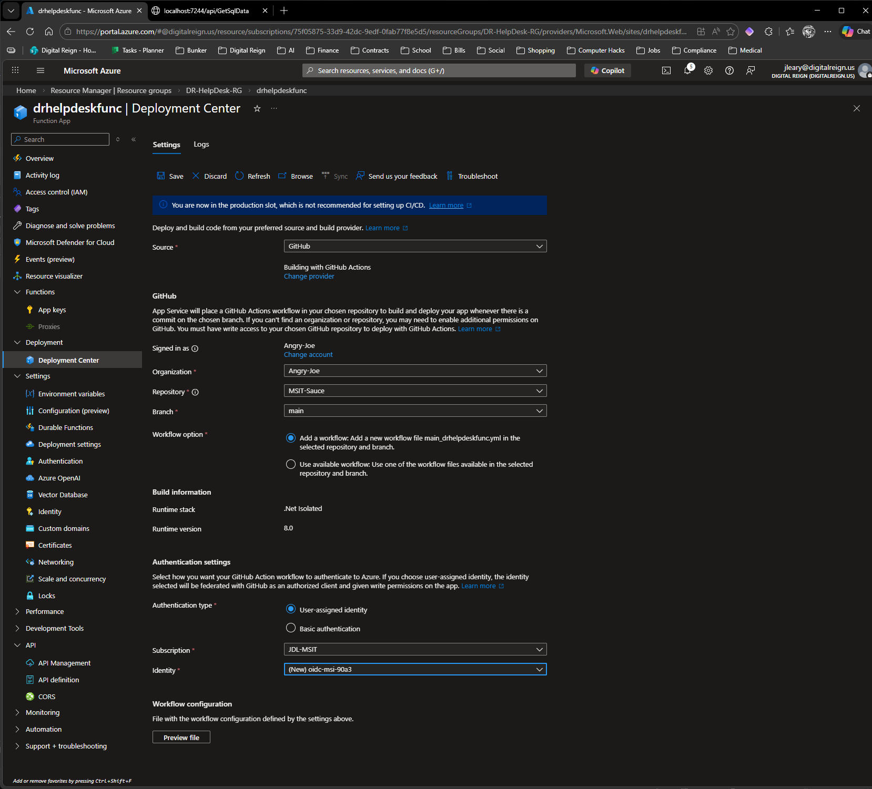
Finishing GitHub auth

Slide 20
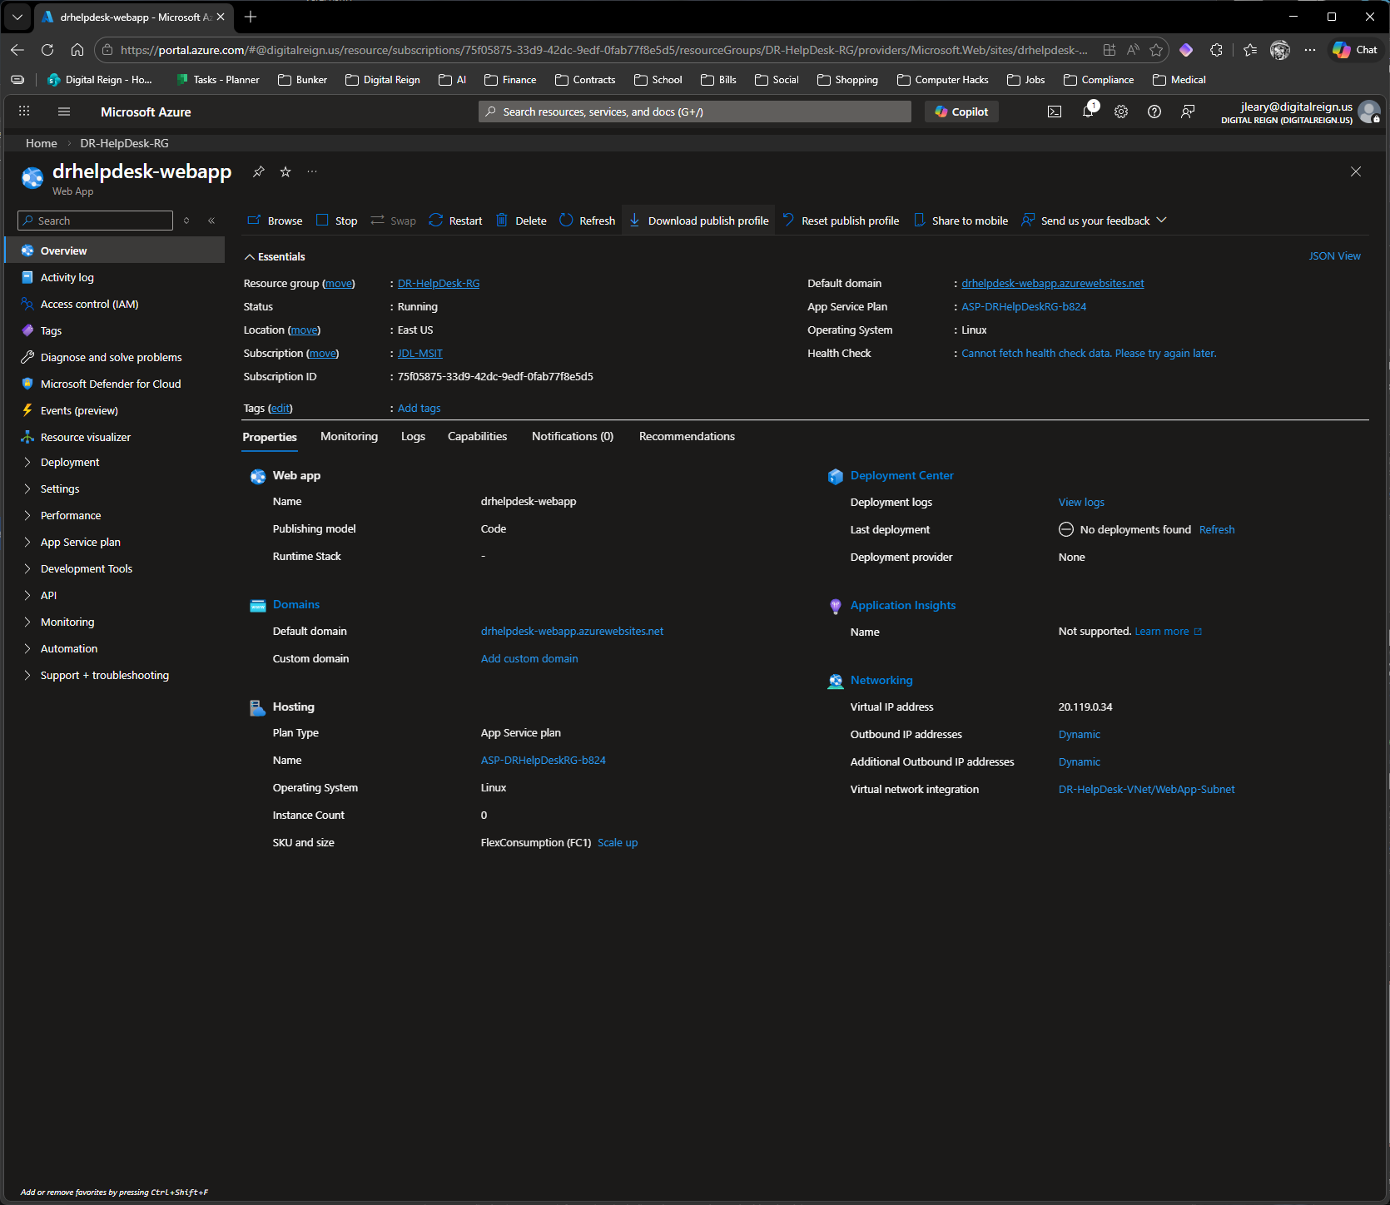
Connecting web app to GitHub

Slide 21
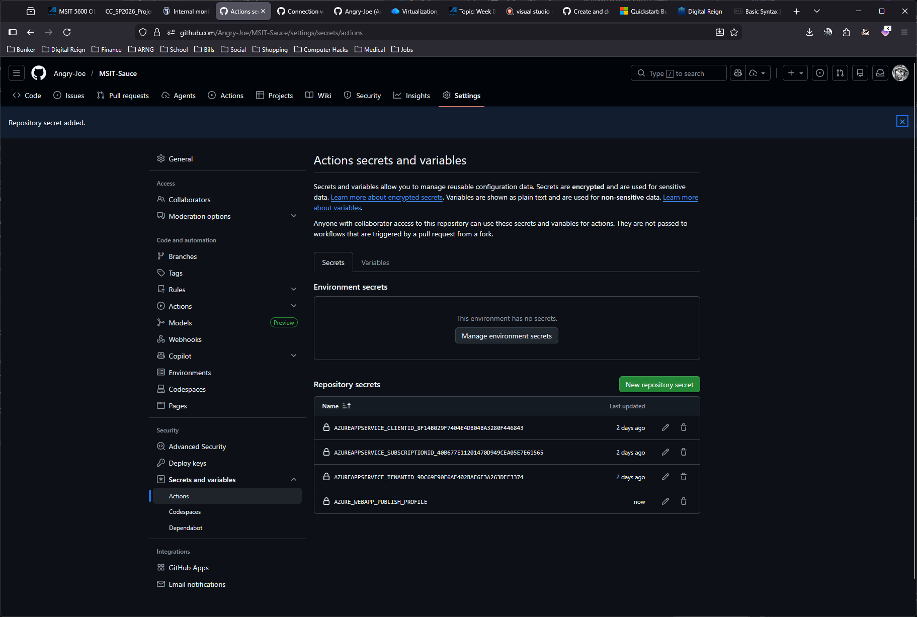

Slide 22
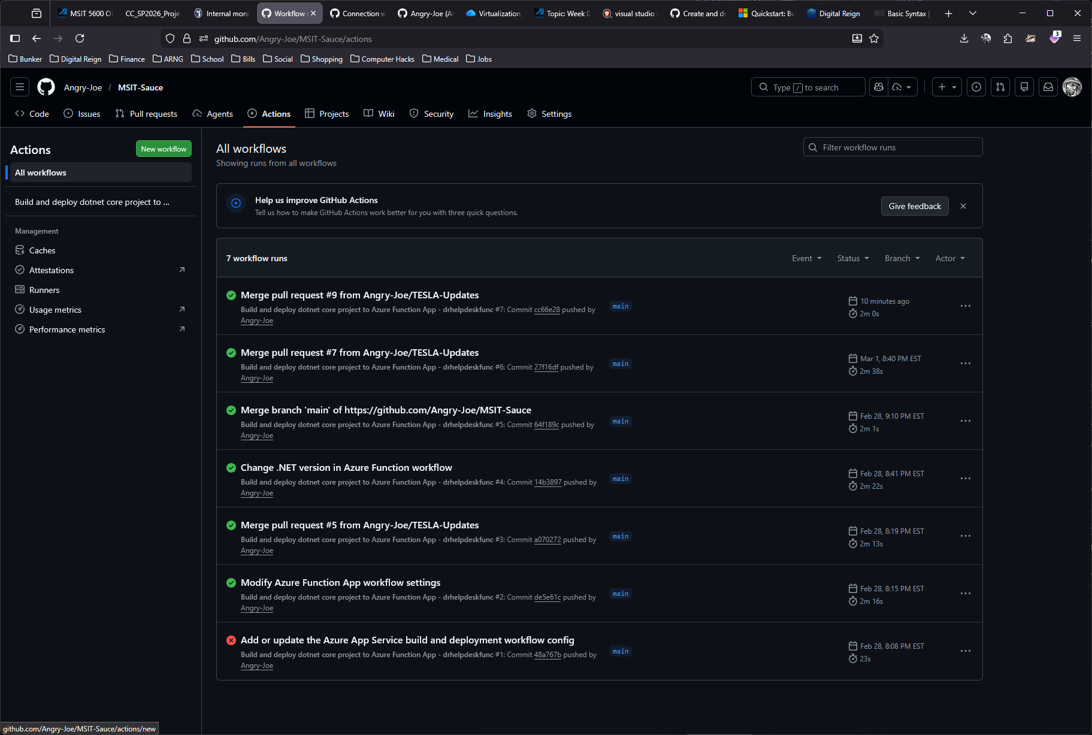

Slide 23
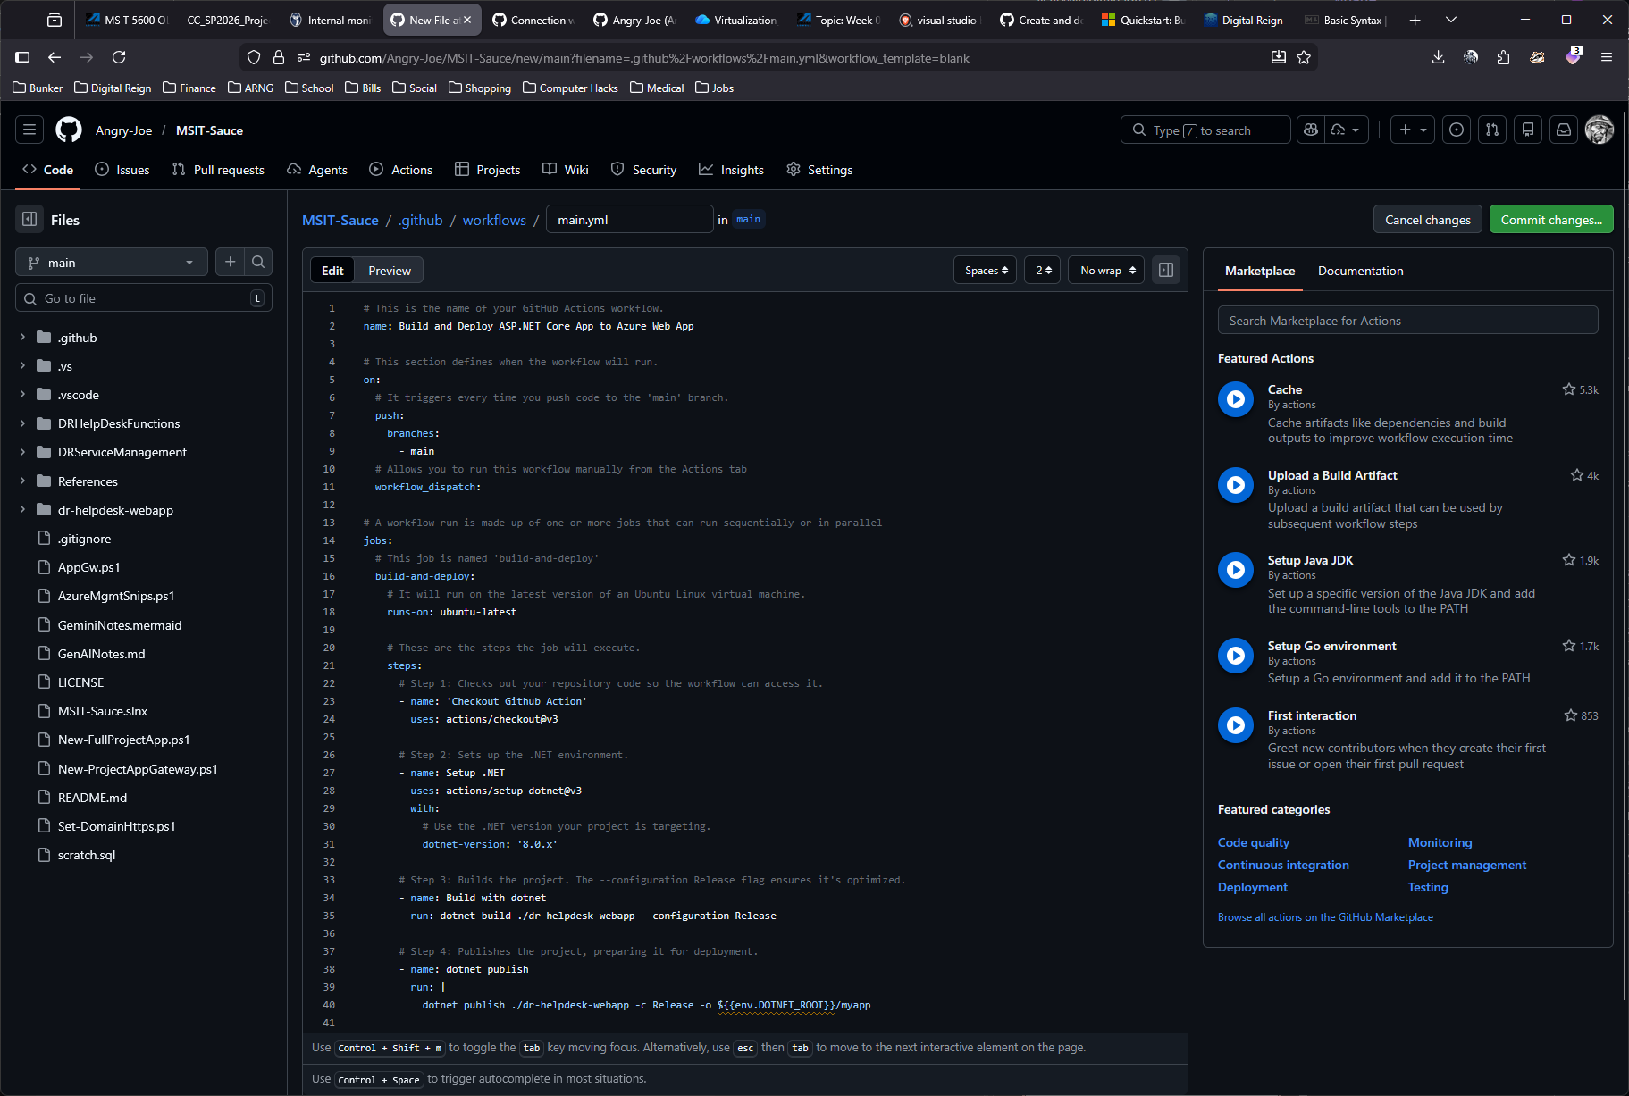

Slide 24
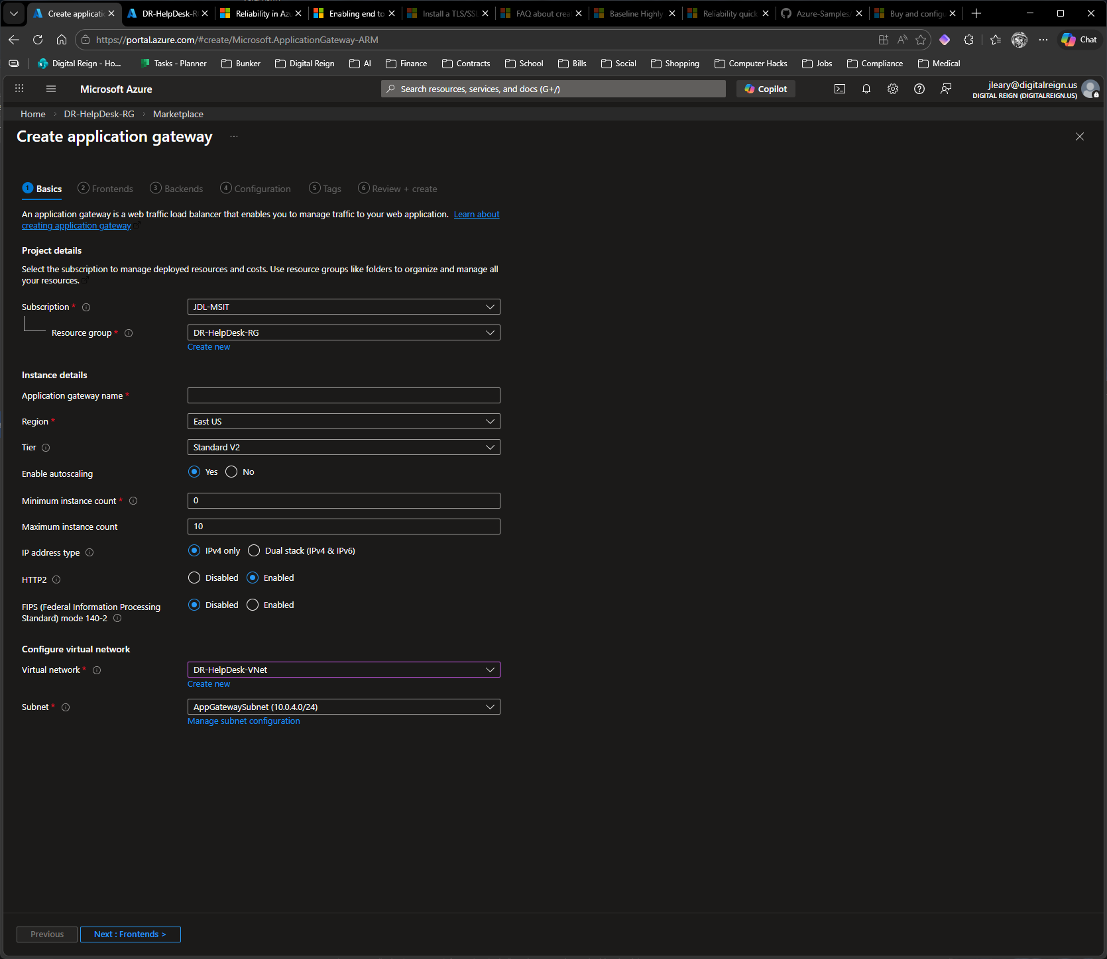
New App GW

