Slide 1


BIG DATA ANALYSIS · COURSE PROJECT
THE TEAM
Doppel
Angshuman Track 1
Generation: builds and tunes the generators
Md Rayyan Track 2
Which synthetic health-record generator is realistic, useful and private?
Evaluation: metrics, attacks and the dashboard
Anoushka Track 3
A controlled benchmark of nine generators on real ICU records, 180 runs
Data: cleaning, validation and the split
Anshuman CE Track 4
Systems: Docker, Kubernetes, delivery
Notes:
Good morning. Our project is called Doppel, after doppelganger: a copy that looks like the original but isn't. We asked whether a generator can produce synthetic patient records that look real, are useful for building a prediction model, and still protect the patients it learned from. We answered it with a controlled benchmark: nine generator settings, one real ICU dataset, the same tests for all, repeated twenty times. The four tracks are on the right.

Slide 2
Why synthetic health data, and why it is hard
Patient records are some of the most valuable data in medicine, and the hardest to share.
WHAT A SYNTHETIC RECORD LOOKS LIKE
Age
Sex
Care unit
Stay
Main diagnosis
Died
The barrier: privacy law and ethics review limit access. Even de-identified MIMIC-III is released only to credentialed researchers [1].
The promise: synthetic data, new artificial records that keep the patterns but contain no real patient.
85
F
MICU
21.8 d
Volvulus of intestine
no
62
F
SICU
4.7 d
Pneumonia
no
89
F
TSICU
4.8 d
Septicemia
yes
Realistic?
Useful?
Private?
66
M
TSICU
0.8 d
Respiratory failure
yes
Does it look like the real records?
Does a model trained on it work on real patients?
Can an attacker find who it learned from?
None of these patients exists. Generated by our tuned Gaussian copula from 94 real admissions; 6 of 56 columns shown.
The catch: copying a real patient passes the first two tests and fails the third.
RESEARCH QUESTION
Why a benchmark: published comparisons each use their own dataset, attacks and task, so their numbers cannot be compared [10, 11].
On one real ICU dataset, under one fixed protocol, which generator gives the best balance of realism, usefulness and privacy?
Project Doppel Problem · Method · Results · Close
2 / 10
Notes:
Hospital records are exactly what you need to build clinical prediction models, and the most sensitive data there is. Synthetic data is the proposed way out. On the right are four rows our best generator produced: plausible, but none of these people exists. To be worth releasing, synthetic data must pass three tests at once: realistic, useful and private. The catch is that copying a real patient passes the first two and fails the third. Since existing papers each use their own setup, we asked the question at the bottom under one fixed protocol.

Slide 3
Approach: fix everything except the generator
1 Prepare TRACK 3
2 Generate TRACK 1
3 Evaluate TRACK 2
4 Deliver TRACK 4
7 raw tables, one clean row per admission
9 settings × 20 seeds = 180 tables
fidelity, utility, three privacy attacks
Docker, Kubernetes Jobs, dashboard
Held fixed: dataset and patient split · metrics · attacks · 20 seeds (42–61) · Docker image Varied: the generator
129 REAL ICU ADMISSIONS, MIMIC-III DEMO [2]
56 COLUMNS PER ADMISSION
Training: 94
80 patients, 34 deaths (36%)
Held out: 35
20 patients, 6 deaths (17%)
Labs (40) mean and abnormal share of 20 common tests
Demographics (4) age, sex, ethnicity
Stay (4) admission type, care unit, stay lengths
Diagnoses (3) primary ICD-9 code, count, full code set
Outcomes (2) in-hospital death (target), readmission
Keys (3) IDs and split label, not modelled
died
survived, training
survived, held out
one patient, 15 stays
Project Doppel Problem · Method · Results · Close
3 / 10
Notes:
Our method is a controlled experiment, and the top row shows how the four tracks fit together. Track 3 prepares one clean table, Track 1 trains the generators, my track evaluates every synthetic table, and Track 4 packages it in containers. Everything except the generator is held fixed. The data is the open MIMIC-III demo: 129 admissions, each square is one, red ones died in hospital. We split by patient. Two caveats are visible: only six held-out deaths, and one patient with fifteen stays, the outlined squares.

Slide 4
Nine generator settings, three measures
less capacity: cannot memorise
more capacity: can memorise
Floor
Gaussian copula
CTGAN
TVAE
Tabular diffusion
1 setting · baseline
3 settings · statistical [3, 4]
2 settings · GAN [5]
1 setting · autoencoder [5]
2 settings · TabDDPM-style [6]
Samples each column on its own: no relationships at all.
Column distributions joined by one correlation matrix, shrunk toward independence.
A generator and a critic trained against each other.
Decodes new rows from a learned code; known to copy rows.
Learns to turn noise back into rows, step by step.
independent columns
shrink 0.668 · 0.25 · 0.10 (tuned)
default · small 64×64 network
300 epochs
3,000 steps · 1,000 + dropout
Fidelity Does it look real?
Utility Does a model trained on it work?
Privacy Can an attacker find its patients?
Jensen–Shannon distance per column [12], and the gap between real and synthetic correlation matrices.
Train LR and RF on synthetic data, predict in-hospital death for 35 real held-out admissions. Trained on real data: 0.658.
Membership attack [7]: real records close to a synthetic one are guessed to be members. Three distances, the worst one counts.
lower is better · 0 = identical
AUROC, higher is better
AUROC, lower is better · 0.5 = chance
Every generator fits a 110-column encoding of only 94 rows. Results are means of 20 seeds; differences tested with Welch’s t-test.
Project Doppel Problem · Method · Results · Close
4 / 10
Notes:
Five families, nine settings, ordered from rigid to flexible. The floor samples each column independently, deliberately dumb. The Gaussian copula is a classic statistical model; its shrinkage controls how much correlation it keeps, and Track 1 tuned it to 0.10. Then three neural families: CTGAN, TVAE, which is known to copy rows and so tests our attacks, and a TabDDPM-style diffusion model. Below are the three measures, one per test. For privacy we run three different membership attacks and always report the strongest. Note the constraint: 110 encoded columns but only 94 rows.

Slide 5
Result 1 · Columns are easy; relationships are not
Column shapes Jensen–Shannon distance, lower is better
Relationships between columns correlation error, lower is better
The floor matches every column (0.016) but keeps no relationships (0.163). The tuned copula keeps the most (0.102). Every neural setting is 2.6 to 23× further from the real columns, and CTGAN and plain diffusion (0.165 to 0.174) keep fewer relationships than the floor.
Project Doppel Problem · Method · Results · Close
5 / 10
Notes:
First, realism. Column by column, the floor and the three copulas are near perfect at 0.016, which is no surprise for the floor since it copies each column's distribution by design. The neural models are 2.6 to 23 times further away. The right chart matters more: relationships between columns. The floor has none, the tuned copula keeps the most, and CTGAN and the diffusion model are actually worse than the floor here.

Slide 6
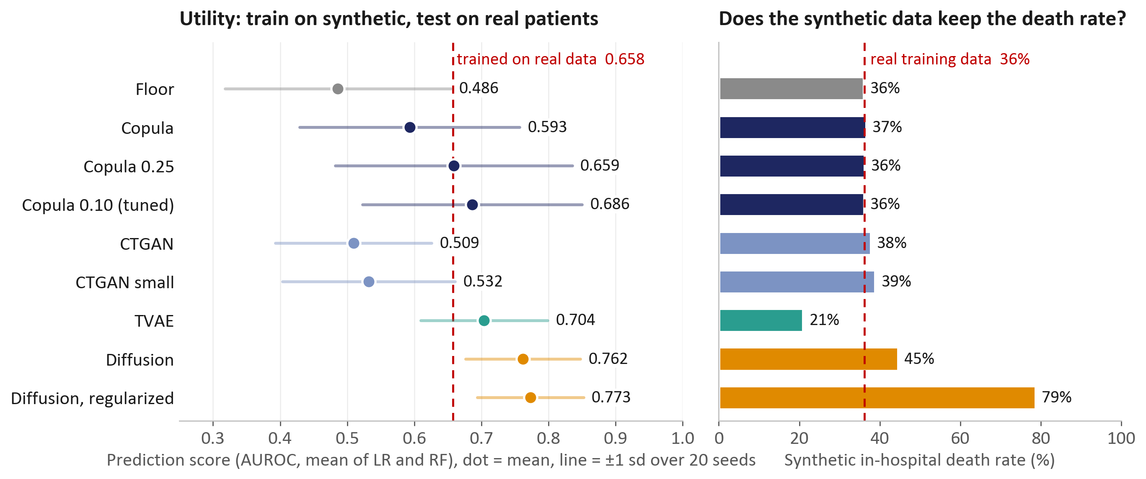
Result 2 · The top scores come from distorted data
Read with care: with 6 held-out deaths, scores swing ±0.08 to 0.18 between seeds. The tuned copula (0.686) is statistically level with TVAE (p = 0.68) and diffusion (p = 0.08), and it is the only one of them that keeps the real death rate.
Project Doppel Problem · Method · Results · Close
6 / 10
Notes:
Second, usefulness. Each dot is the average prediction score over twenty runs; the line shows how much it moves, a lot, because there are only six held-out deaths. The two diffusion models score highest, even above models trained on real data, which should make you suspicious. The right panel shows why: regularized diffusion kills 79 percent of its synthetic patients against a real 36, and TVAE only 21. The copulas keep the real rate, and the tuned copula is statistically level with TVAE and diffusion.

Slide 7
Result 3 · Diffusion gives away its training records
36%
Training records flagged at 1% false alarms higher is worse
of the diffusion model’s training records are flagged by an attacker allowed only one false alarm per hundred. Random guessing flags 1%.
Regularizing is not a fix: it lowers the rate to 21%, but its synthetic patients die 79% of the time.
WE TESTED THE ATTACK FIRST
Releasing unseen real patients scores 0.50 and exact copies 1.00. TVAE, a known copier, ranks above every non-leaking generator (p < 0.001).
Project Doppel Problem · Method · Results · Close
7 / 10
Notes:
Third, privacy, and the most striking number. Average scores can hide a few very exposed patients, so following Carlini and colleagues we ask: if the attacker may wrongly accuse only one person in a hundred, how many training records does it find? For the copulas, two to four percent. For diffusion, 36 percent, more than one in three. Regularizing brings it to 21, at the cost of a wrong death rate. And we tested the attack itself first: unseen real patients give 0.50, exact copies 1.00, and it correctly flags TVAE, a model known to copy rows.

Slide 8
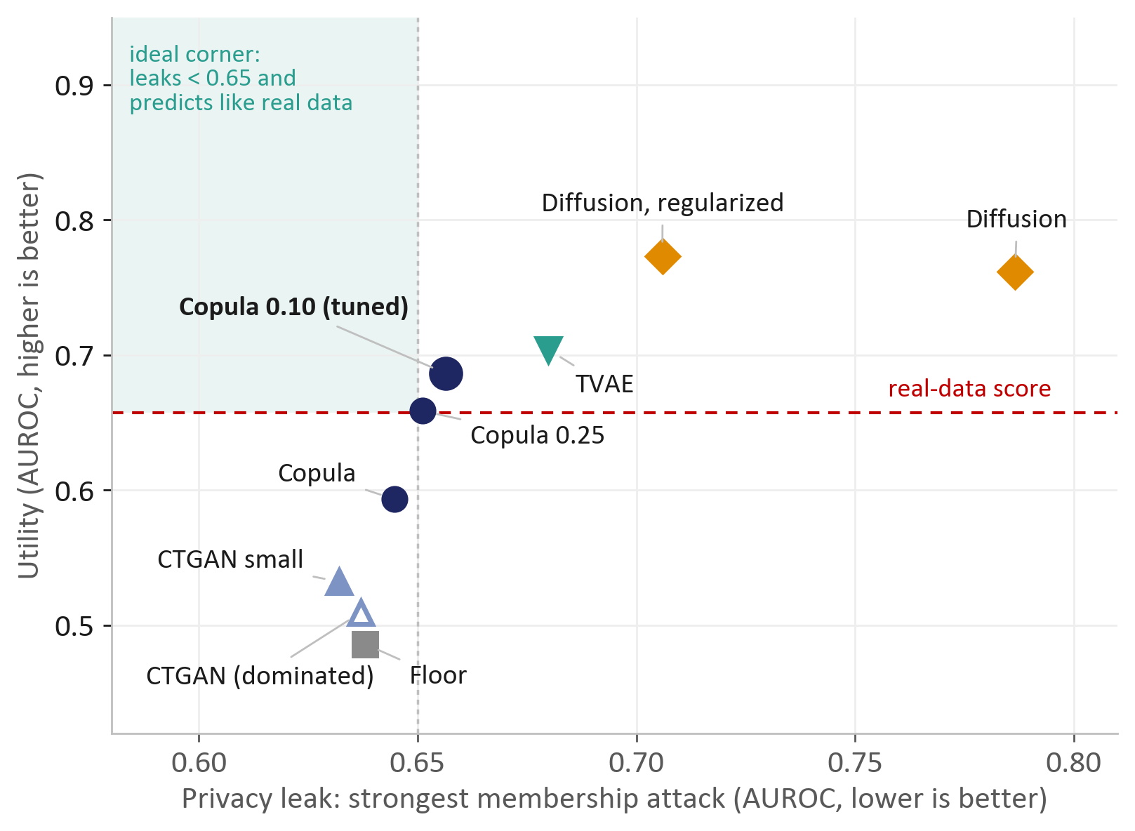
Result 4 · The tuned copula gives the best balance
VERDICT: TUNED GAUSSIAN COPULA
0.102
correlation error
best of all nine settings
0.686
prediction score
level with TVAE’s 0.704 (p = 0.68)
0.656
attack AUROC
below TVAE 0.680 and diffusion 0.787
WHY THE SIMPLEST MODEL WINS
With 110 encoded columns and only 94 rows, a neural network can store the training set. The copula only learns column shapes and one correlation matrix, so it cannot memorise a patient. Lowering its shrinkage from 0.668 to 0.10 raised utility by 0.09 for only 0.011 more leakage.
Nothing sits in the ideal corner. 8 of 9 settings are on the three-way Pareto frontier; without the utility axis, TVAE and both diffusion models never are.
Project Doppel Problem · Method · Results · Close
8 / 10
Notes:
Putting usefulness against leakage, the ideal corner is empty. TVAE and diffusion buy their score with leakage; CTGAN and the floor leak least but predict least; the copulas sit between, and the tuned one is closest to the corner. Eight of nine are on the Pareto frontier, but remove utility and TVAE and diffusion drop off completely: their only strength is a score we saw is inflated. So our verdict is the tuned Gaussian copula. It wins because, with more columns than rows, flexible networks can memorise and the copula cannot.

Slide 9
Conclusion, limits and next steps
WHAT WE FOUND
LIMITS → NEXT STEPS
1
Capacity is a privacy risk on small data.
Small data: 94 admissions, 80 patients
The flexible models scored higher by staying close to real patients.
→ rerun on full MIMIC-III or MIMIC-IV
Noisy utility: only 6 held-out deaths
2
A tuned Gaussian copula gave the best balance.
→ a larger held-out set, repeated splits
Best relationships, utility level with TVAE, and less leakage.
One patient is 15 of 35 held-out stays
→ repeat the test without that patient
3
Privacy must be measured, not assumed.
A low attack score is not proof of safety [9]
Test attacks against known answers; a low score means “not found”, not “safe”.
→ add density-based and release-only attacks
Thank you. Questions?
Live dashboard
doppel-six.vercel.app
Code and documents
github.com/Ganglet/Doppel
Project Doppel Problem · Method · Results · Close
9 / 10
Notes:
Three takeaways. On small clinical data, model capacity is itself a privacy risk. The tuned Gaussian copula gave the best balance of the three tests. And privacy has to be measured with attacks that are themselves checked. We are also clear about the limits: one small dataset, noisy prediction scores, one patient dominating the held-out set, and attacks that can only show risk, not rule it out. Each points to a next step. Thank you; every number is on the live dashboard.

Slide 10
References
[1] A. E. W. Johnson et al., “MIMIC-III, a freely accessible critical care database,” Scientific Data, vol. 3, 160035, 2016.
[2] A. Johnson, T. Pollard, R. Mark, “MIMIC-III Clinical Database Demo (v1.4),” PhysioNet, 2019. doi:10.13026/C2HM2Q
[3] N. Patki, R. Wedge, K. Veeramachaneni, “The Synthetic Data Vault,” IEEE DSAA, 2016.
[4] O. Ledoit, M. Wolf, “A well-conditioned estimator for large-dimensional covariance matrices,” J. Multivariate Analysis, 88(2), 2004.
[5] L. Xu, M. Skoularidou, A. Cuesta-Infante, K. Veeramachaneni, “Modeling tabular data using conditional GAN,” NeurIPS, 2019.
[6] A. Kotelnikov, D. Baranchuk, I. Rubachev, A. Babenko, “TabDDPM: Modelling tabular data with diffusion models,” ICML, 2023.
[7] R. Shokri, M. Stronati, C. Song, V. Shmatikov, “Membership inference attacks against machine learning models,” IEEE S&P, 2017.
[8] N. Carlini, S. Chien, M. Nasr, S. Song, A. Terzis, F. Tramèr, “Membership inference attacks from first principles,” IEEE S&P, 2022.
[9] G. Ganev, E. De Cristofaro, “The inadequacy of similarity-based privacy metrics: privacy attacks against ‘truly anonymous’ synthetic datasets,” IEEE S&P, 2025.
[10] C. Yan et al., “A multifaceted benchmarking of synthetic electronic health record generation models,” Nature Communications, 13, 2022.
[11] X. Chen, Z. Wu, X. Shi, H. Cho, B. Mukherjee, “Generating synthetic electronic health record data: a methodological scoping review with benchmarking on phenotype data and open-source software,” JAMIA, 32(7), 2025.
[12] J. Lin, “Divergence measures based on the Shannon entropy,” IEEE Trans. Information Theory, 37(1), 1991.
[13] J. C. Gower, “A general coefficient of similarity and some of its properties,” Biometrics, 27(4), 1971.
All charts: own analysis of the 180 evaluation runs. Logos: SVKM’s NMIMS.
Project Doppel Problem · Method · Results · Close
10 / 10
Notes:
These are the sources cited on the slides: the dataset, the three generator families, the attack methods and the benchmarks we compare against. Every chart comes from our own runs.

