Slide 1
STEGANOGRAPHY ART OF HIDDING INFORMATION……
NAME:ANKITA GUPTA
COMPUTER SCIENCE AND ENGINEERING
3RD YEAR
11900113011

Slide 2
PRESENTATION OUTLINE
STEGANOGRAPHY
INTRODUCTION
HISTORY
GENERAL DIAGRAM
TECHNIQUES OF STEGANOGRAPHY
IMAGE STEGANOGRAPHY
TEXTUAL STEGANOGRAPHY
APPLICATION OF STEGANOGRAPHY
ADVANTAGE OF STEGANOGRAPHY
DISADVANTAGE OF STEGANOGRAPHY

Slide 3
WHAT IS STEGANOGRAPHY?
STEGANOGRAPHY LITERALLY MEANS “COVERED WRITING”
DEFINATION:
IT IS AN ART AND SCIENCE OF HIDDING INFORMATION BY EMBEDDING IT IN SOME OTHER DATA.
GOALS:
TO HIDE A SECRET MESSAGE WITHIN OTHER OBJECT.
DO IT IN SUCH A WAY THAT PRESENCE OF MESSAGE IS NOT VISIBLE.

Slide 4



HISTORY
INVISIBLE INK
MICRODOTS:
DOTS WHICH ARE PRINTED ON THE PAPER
AND ONLY VISIBLE BY USING
MICROSCOPE.
A PERSON’S HEAD

Slide 5
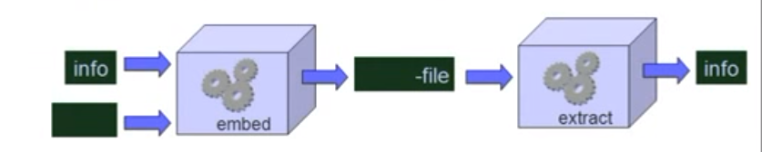
GENERAL DIAGRAM OF STEGANOGRAPHY
The cover provides a host for transporting the hidden info.

Slide 6
Steganography carriers
MOST ATTRACTIVE MULTIMEDIA OBJECTS ARE:
IMAGE STEGANOGRAPHY
TEXTUAL STEGANOGRAPHY
AUDIO STEGANOGRAPHY
VIDEO STEGANOGRAPY

Slide 7
IMAGE STEGANOGRAPHY
DIGITAL IMAGES ARE MADE UP OF PIXELS
8-BIT AND 24-BIT IMAGES ARE COOMON.
THE LARGER THE IMAGES SIZE, THE MORE INFORMATION YOU CAN HIDE.
REASON FOR USING DIGITAL IMAGES:
IT IS MOST WIDELY USED MEDIUM TODAY.
THIS FIELD IS EXPECTED TO CONTINOALLY GROW AS COMPUTER GRAPHICS POWER ALSO GROW.
TWO TYPES OF COMPRESSION:
LOSSLESS(gif)
LOSSY(jpeg)

Slide 8
Techniques of digital steganography
LSB[LEAST SIGNIFICANT BIT]
FILTERING AND MASKING
ALGORITHMS AND TRANSFORMATION

Slide 9
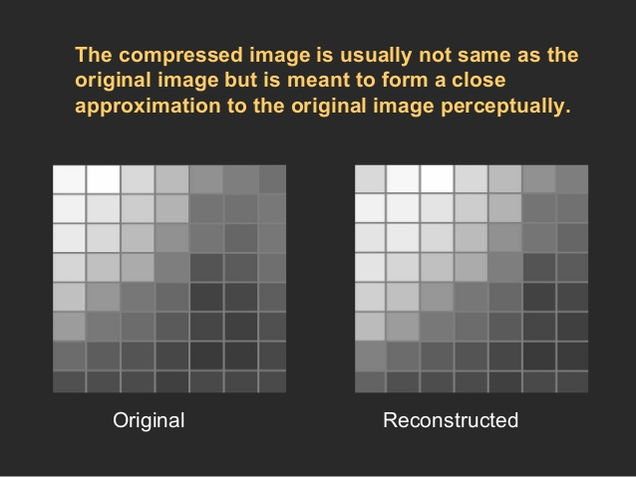
LEAST SIGNIFICANT BIT
THE MOST COMMON AND POPULAR METHOD OF MORDERN DAY STEGANOGRAPHY IS TO MAKE USE OF THE LSB OF A PIXEL’S INFORMATION.
THE TECHINQUE WORKS BEST WHEN THE IMAGE FILE IS LARGER THEN THE MESSAGE FILE AND THE IMAGE GREY SCALE LIKE..

Slide 10
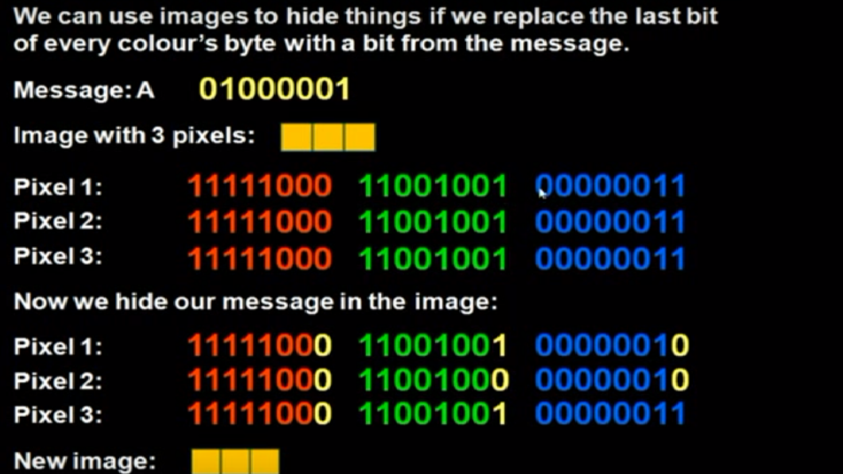

Slide 11
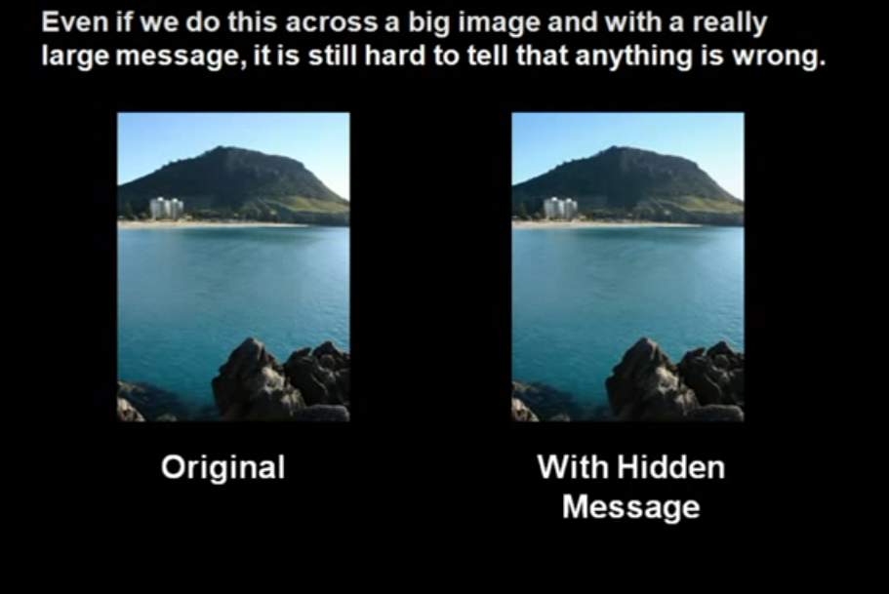

Slide 12
ADVANTAGES OF THE LSB INSERTION
A MAJOR ADVANTAGE OF LSB ALGORITHM IS IT IS QUICK AND EASY.
LSB INSERTION IS SECURE.
THEORETICALLY, A SMALL CHANGE IN LSB SHOULD NOT AFFECT THE OVERALL REPRESNTAION OF THE NUMBER SIGNIFICANTLY.
LOSSLESS ALGORITHM.
NO VISUAL CHANGE IN MEDIA.

Slide 13
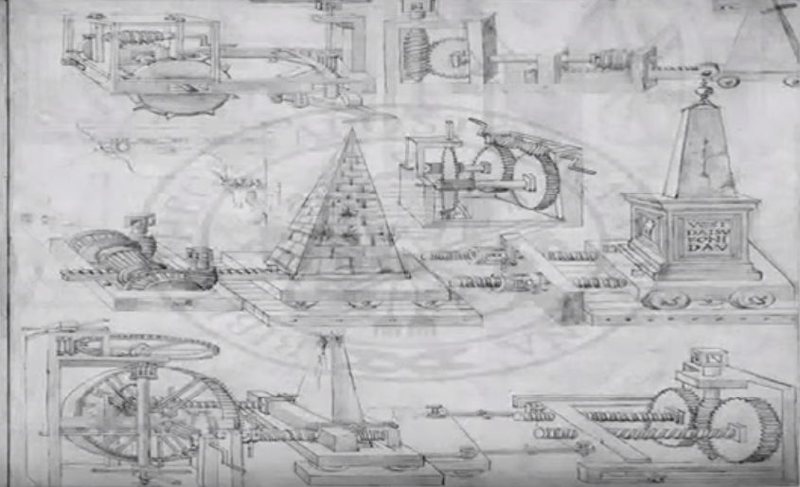
Masking and filtering
MASKING AND FILTERING IS WHERE INFORMATION IS HIDDEN INSIDE OF A IMAGE
USING DIGITAL WATERMARKS THAT INCLUDE INFORMATION SUCH AS COPYRIGHT,
OWNERSHIP OR LICENSES.
THE PURPOSE IS DIFFERENT FOR TRADITIONAL STEGANOGRAPHY SINCE IT IS ADDING AN ATTRIBUTE TO THE COVER IMAGE THUS EXTENDING THE AMOUNT OF INFORMATION PRESENTED.

Slide 14
TEXTUAL STEGANOGRAPHY
IT IS ALSO CALLED NULL CIPHE MESSAGE.
THE PREMISE FOR THE NULL CIPHER IS TO HIDE AN IMPORTANT MESSAGE WITHIN AN UNINTERSTING AND INNOCENT MESSAGE.
“PRESIDENT'S EMBARGO RULING SHOULD HAVE IMMEDIATE NOTICE. GRAVE SITUATION AFFECTING INTERNATIONAL LAW. STATEMENT FORESHADOWS RUIN OF MANY NEUTRALS. YELLOW JOURNALS UNIFYING NATIONAL EXCITEMENT IMMENSELY.”
“ PERSHING SAILS FROM NY JUNE 1”

Slide 15
application
Modern Printers
Steganography is used by leading manufacturers in digital & laser
printers, including HP and Xerox. Here, tiny yellow dots are added to
each page. The dots are barely visible and contain encoded printer
serial numbers, as well as date and time stamps.
Digital Watermarking
Steganography is used for digital watermarking, where a message is
hidden in an image so that its source can be tracked or verified.
e-mail Spam
e-mail messages is encrypted steganographically. Coupled with
the "chaffing and winnowing" technique, a sender gets messages
out and cover their tracks all at once.

Slide 16
Advantage of steganography
IT IS USED IN SUCH A WAY OF HIDING NOT THE INFORMATION BUT THE PASSWORD TO REACH THAT INFORMATION.
DIFFICULT TO DETECT ONLY RECIEVER CAN DETECT.
CAN BE APPLIED DIFFERENTLY IN DIGITAL IMAGE,AUDIO & VIDEO FILE.
IT CAN BE DONE FASTER WITH THE LARGE NUMBER OF SOFTWARE’S.

Slide 17
DISADVANTAGE OF STEGANOGRAPHY
IN SENDING AND RECEIVING INFORMATION CAN BE LEAKED.
THE CONFIDENTIALITY OF INFORMATION IS MAINTAINED BY THE ALGORITHMS AND IF THE ALGORITHMS ARE KNOWN THEN ITS ALL OVER.
IF THIS TECHNIQUE IS GONE IN THE WRONG HANDS LIKE HACKERS,TERRORIST,CRIMINALS THEN THIS CAN BE VERY MUCH DANGEROUS FOR ALL.

Slide 18
THANK YOU

