Slide 1

Automated Bug Reporting and Severity Classification Using Machine Learning and Playwright Test Automation
M.Tech Final Year Project
Presented by: Student Name (Roll No.)
Guide: Guide Name · Department, College Name
Notes:
Good morning. My project is about automating the most repetitive part of software testing: turning a failing test into a bug report. The system runs Playwright browser tests, captures every failure automatically, predicts its severity with a machine learning model, stores it in a database, and shows everything on a web dashboard.

Slide 2
Agenda
01
Problem statement
06
Automated bug capture
02
Objectives
07
ML severity classification
03
System architecture
08
Storage and dashboard
04
Technology stack
09
Flaky tests and email alerts
05
Application under test
10
Results and conclusion
Notes:
This is the flow of the presentation: the problem, the objectives, how the system is designed, how each part is implemented, and finally the results.

Slide 3




Manual bug reporting is slow and inconsistent
Repetitive manual effort
Testers copy errors, take screenshots and write every report by hand
THE IDEA
Let the test framework report, classify and track its own failures automatically
Subjective severity
Critical vs Major vs Minor depends on who reads the failure
Scattered information
Failures live in logs and chats, with no history or traceability
No manual bug reports
Consistent ML-based severity
One traceable database
Flaky tests waste time
Tests that pass and fail at random hide real defects
Notes:
In manual testing, every failure means reading the error, taking a screenshot, writing a report, deciding severity and logging it in a tracker. Severity is subjective, information is scattered, and flaky tests make people doubt real failures. The idea of this project is to let the test framework do all of this automatically.

Slide 4







Project objectives
01
02
03
04
Automated bug logging
ML severity classification
Central SQLite storage
Web dashboard
Error, screenshot, timestamp and module from each failure
Critical / Major / Minor from labelled error messages
All defects and test-run summaries, fully traceable
View, filter, search and update bug status
05
06
07
08
Defect analytics
Flaky test detection
Critical email alerts
End-to-end pipeline
Bugs per module, severity mix, 14-day trend
Tests that pass and fail across multiple runs
Automatic notification for every Critical bug
Test → detection → ML → storage → dashboard
Notes:
These are the eight objectives of the project. Each one is implemented as a separate module, and the last objective connects all of them into one automated pipeline.

Slide 5

System architecture
Playwright tests
16 tests · 5 modules
Custom reporter
captures each failure
ML classifier
Naive Bayes severity
SQLite database
runs · results · bugs
Web dashboard
Express + Chart.js
Email alert
Flaky detector
HTML report
when severity is Critical
pass/fail history of all runs
shareable results report
Every failure follows the same automated path: there is no manual step between a failing test and a classified, stored, visible bug.
Notes:
This is the architecture. Playwright runs the tests. A custom reporter plugged into Playwright receives every result and captures failures. The ML classifier predicts severity. Everything is stored in SQLite, and the dashboard reads from the database. Three side outputs: an email for Critical bugs, flaky detection from the run history, and an HTML results report.

Slide 6




Technology stack
Playwright 1.64.1
Express 5 + EJS
Browser test automation (latest version)
Web dashboard and status updates
TypeScript + Node.js 22
Chart.js 4.5
One language for every component
Module, severity and trend charts
Naive Bayes (from scratch)
Nodemailer
Severity classification, no black box
SMTP email alerts for Critical bugs
SQLite (better-sqlite3)
dotenv
Serverless, single-file defect store
Credentials and ports kept outside the code
Notes:
The whole project is written in TypeScript. Playwright 1.64.1, the latest version, runs the browser tests. The Naive Bayes model is written from scratch so every step can be explained. SQLite stores the data, Express and Chart.js power the dashboard, and Nodemailer sends email alerts.

Slide 7
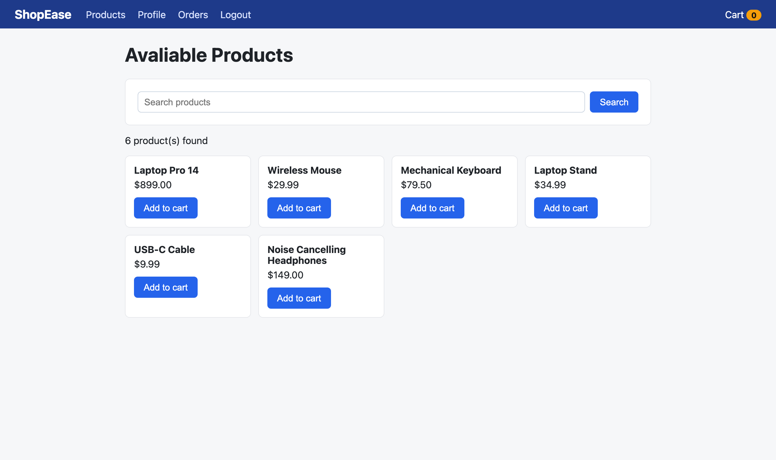
Application under test: ShopEase
Module | Seeded defect | Expected
Login | Apostrophe in username causes SQL error | ● Critical
Search | Search is case-sensitive | ● Major
Search | Heading typo "Avaliable Products" | ● Minor
Cart | Total drops the cents (parseInt) | ● Major
Cart | Add-to-cart API has random delay | ● Flaky
Checkout | Payment gateway returns HTTP 500 | ● Critical
Profile | Label typo "Adress", grey button | ● Minor
Profile | Order history JavaScript crash | ● Critical
Profile | Profile save API has random delay | ● Flaky
Demo web shop built for this project, with defects seeded on purpose in 5 modules
Notes:
To have realistic failures, I built a demo shop called ShopEase with five modules. I seeded defects of different severities: a SQL error on login and a payment crash are Critical, wrong calculations are Major, typos and colours are Minor. Two APIs have random delays to create flaky tests.

Slide 8



Objective 1: automated bug capture
Captured for every failure
onBegin()
New row in test_runs for this execution
Error message
Screenshot
onTestEnd(test, result)
Assertion, expected vs received
Page at the moment of failure
Store the result; on failure capture details, predict severity, save the bug
onEnd()
Timestamp
Module
Save run summary; email alert for each new Critical bug
e.g. 2026-10-21 10:29:35
From the test tag, e.g. @Checkout
Custom Playwright reporter: bugReporter.ts
Same failure again? Occurrence count + 1 (fingerprint), no duplicate bug
Notes:
Playwright lets us plug in our own reporter. onBegin creates a run. onTestEnd stores every result, and for a failure it captures the error message, the screenshot, the timestamp and the module, which comes from the test tag. onEnd saves the summary and sends alerts. A fingerprint of test name plus error text prevents duplicate bugs across runs.

Slide 9
Objective 2: ML severity classification
Raw error
Playwright failure message
Clean
Drop colour codes, Locator / Timeout lines
Normalise
Lowercase; 500 → http500; numbers → num
Tokenise
Split words, remove stop-words
Bigrams
payment_gateway, server_error
Predict
Severity + confidence %
Multinomial Naive Bayes
P(class | message) ∝ P(class) × Π P(token | class)
Laplace smoothing (α = 1): unseen words never give zero probability
Log-probabilities avoid numeric underflow
Softmax turns scores into a confidence %
Written from scratch in TypeScript
Notes:
Severity is predicted from the error text. First the message is cleaned: colour codes and the Locator and Timeout lines that appear in every Playwright failure are removed. Then it is lower-cased, HTTP codes become tokens like http500, and words plus word pairs become features. A Multinomial Naive Bayes model, written from scratch, picks the most probable class. The training set has 179 labelled messages.

Slide 10
Model evaluation
86.1%
Confusion matrix (36 test samples)
Actual ↓ | Crit | Maj | Min
Critical | 11 | 2 | 0
Major | 0 | 12 | 0
Minor | 0 | 3 | 8
Hold-out accuracy (80/20 split)
87.2%
5-fold cross-validation (mean)
Columns = predicted. Most errors are Minor or Critical messages predicted as Major, the "middle" class.
10 / 10
Real Playwright failures classified correctly
Notes:
The model was evaluated two ways: a stratified 80/20 split gives 86.1% accuracy and 5-fold cross-validation gives 87.2%. Critical has 100% precision, so when the model says Critical it is always right. Most mistakes push Minor or Critical messages into Major, the middle class. On the ten real failures from the demo app, all ten severities were correct.

Slide 11

Objective 3: centralized SQLite database
test_runs
test_results
bugs
bug_history
One row per execution
One row per test per run
One row per unique defect
Every status change
id
started_at
status
total, passed
failed, skipped
duration_ms
new_bugs
run_id → test_runs
test_key
module
status
duration_ms
error_message
executed_at
fingerprint
module
error_message
screenshot_path
severity
confidence
status, occurrences
bug_id → bugs
old_status
new_status
changed_at
One file (data/bugs.db): every run, test result, bug and status change is stored and traceable
Notes:
Everything is stored in one SQLite file with four tables. test_runs holds run summaries, test_results holds every result of every run, which is needed for flaky detection, bugs holds unique defects with severity and confidence, and bug_history records every status change for traceability.

Slide 12
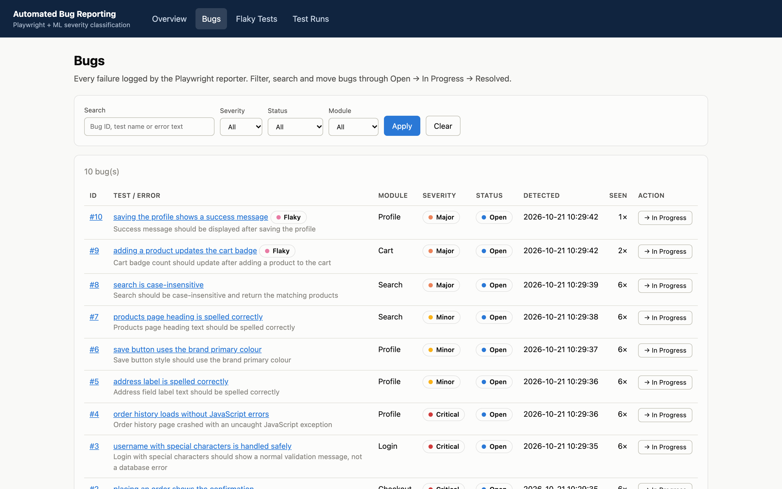



Objective 4: web dashboard for bug management
Filter
By severity, status and module
Search
Bug ID, test name or error text
Bug details
Error, screenshot, ML confidence, history
Status workflow
Open
In Progress
Resolved
Every change is saved in bug_history
Notes:
This is the dashboard. The bug list can be filtered by severity, status and module, and searched by ID, test name or error text. Each bug has a details page with the error, screenshot, ML confidence and history. Bugs move from Open to In Progress to Resolved, and every change is recorded.

Slide 13
Objective 5: defect analytics
Notes:
The overview page has three charts. Bugs per module shows that Profile has the most defects. Severity distribution shows the ML predictions. The 14-day trend shows new bugs per day; in this run all ten bugs were found on the first day of testing, so the trend has one bar. On a real project the chart fills up as tests run every day.

Slide 14
Objective 6: flaky test detection
Detected in 6 runs of the demo suite
Rule (last 10 runs, minimum 3)
Flaky test | Fail rate | Flip rate | History
Cart: adding a product updates the cart badge | 33% | 80% | PFPFPP
Profile: saving the profile shows a success message | 17% | 40% | PFPPPP
Flaky: passed at least once and failed at least once
Consistently failing: failed every run: a real defect
Stable: passed every run
All 16 tests by verdict
Example history P F P F P P
2
8
6
Failure rate = fails / runs = 2/6 = 33%
Flip rate = result changes / (runs − 1) = 4/5 = 80%
Retries disabled: flakiness is measured, not hidden
Flaky
Consistently failing
Stable
The consistently failing tests are real defects, not flakiness
Notes:
A flaky test passes and fails on the same code. The detector reads the stored results of the last ten runs. If a test has both passes and failures, it is flaky. Failure rate and flip rate describe how unstable it is. Playwright retries are disabled on purpose, because retries would hide flakiness. Both seeded flaky tests were detected, and the consistently failing tests were correctly classified as real defects.

Slide 15
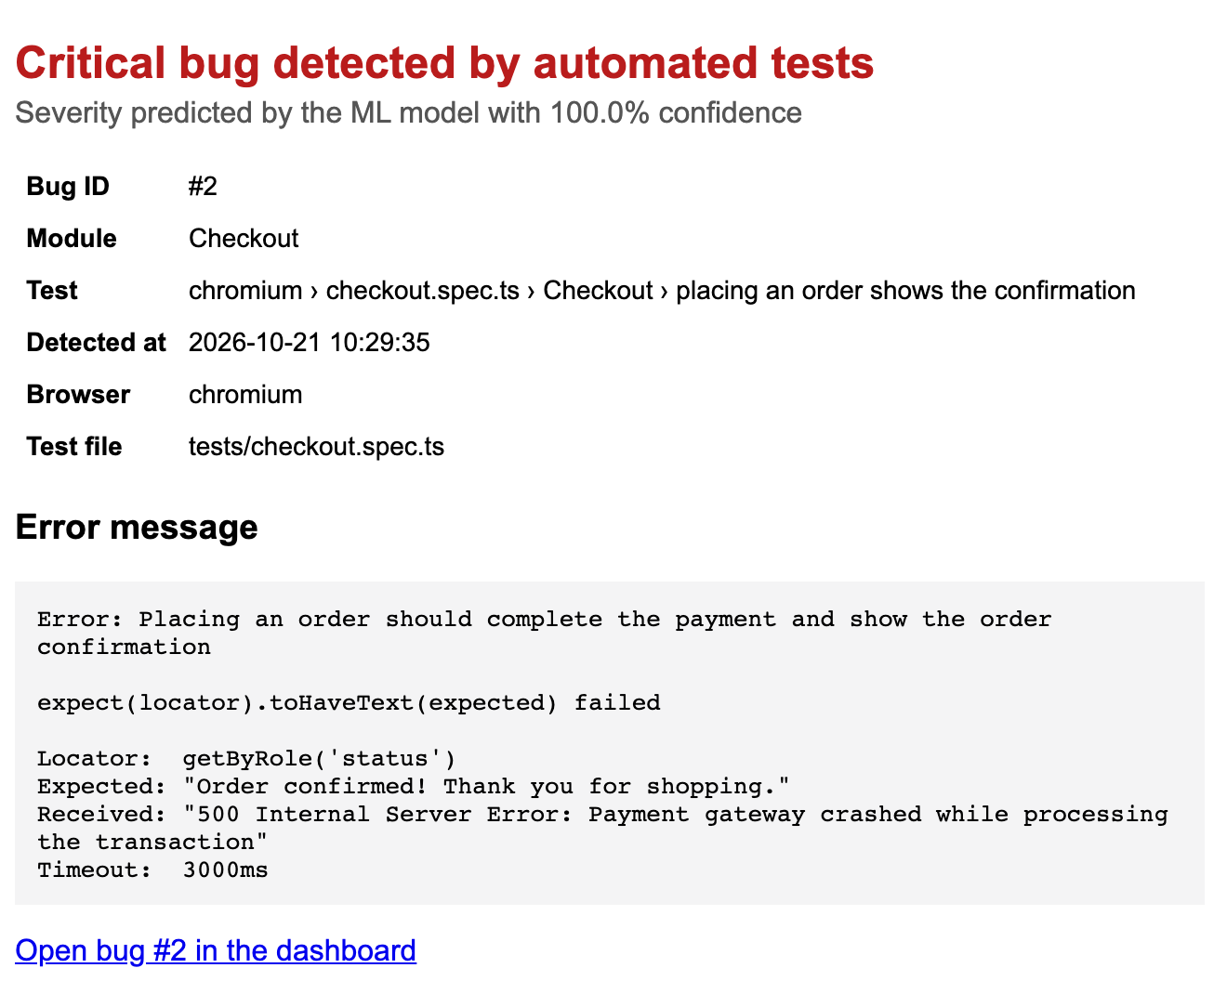
Objective 7: email alerts for Critical bugs
1
ML predicts Critical
for a newly detected bug
2
Nodemailer sends the email
SMTP, e.g. Gmail with an App Password
3
Team is notified
details, dashboard link, screenshot attached
Sent once per new Critical bug, never again for repeats
No SMTP configured: saved as HTML preview in reports/alerts/
Notes:
When the model predicts Critical for a new bug, Nodemailer sends an email over SMTP with the bug details, a link to the dashboard and the screenshot attached. Repeat failures of the same bug do not send new emails. Without SMTP settings, the same email is saved as an HTML preview so the feature can still be demonstrated.

Slide 16
Objective 8: end-to-end pipeline results
96
10
test executions in 6 runs
unique bugs logged automatically
0
10/10
manual bug reports written
severities predicted correctly
2
3
flaky tests detected
Critical alerts generated
Failures vary between 8 and 10 per run only because of the 2 flaky tests
Notes:
Running the complete pipeline: 6 runs and 96 test executions. Ten unique bugs were logged with zero manual reports, all ten severities were correct, both flaky tests were found, and three Critical alerts were generated. The chart shows passed and failed tests per run; the number of failures changes only because of the two flaky tests.

Slide 17


Conclusion and future scope
Conclusion
Future scope
All 8 objectives implemented and verified
Bug reporting fully automated: zero manual effort
ML severity: 87.2% cross-validated accuracy
Flaky tests separated from real defects
Every bug traceable from test to resolution
Larger real-world dataset; compare SVM, logistic regression, transformers
Automatic Jira / GitHub Issues tickets
Slack / Teams notifications
CI/CD integration (GitHub Actions)
Clustering similar failures for root cause
Notes:
In conclusion, all eight objectives were implemented and verified end to end. Bug reporting needs no manual effort, severity is predicted consistently, and flaky tests are separated from real defects. In future, the model can be trained on a larger real dataset and compared with other algorithms, and the system can create tickets in Jira, notify Slack and run in CI on every commit.

Slide 18
Thank you
Questions?
Live demo: npm run pipeline → npm run dashboard
Source code: github.com/AngshumanRay/playwright-ml-bug-reporter
Notes:
Thank you. I am happy to answer questions, and I can show a live demo: the pipeline runs the tests, and the dashboard shows the results.

