Slide 1
MACHINE LEARNING-BASED DEFECT CLASSIFICATION
Using Simulated Metrology Data for Semiconductor Quality & Yield Assurance
Bridging Cleanroom Fabrication (CeNSE, IISc) with Intelligent Metrology Modeling
Key Focus Areas: Ellipsometry • AFM Surface Topography • 4-Point Probe • Multi-Model Classifier Zoo

Slide 2
SEMICONDUCTOR METROLOGY DEFECT CLASSIFICATION
Problem Statement: Automated In-Line Fab Defect Classification
Why Automated Metrology Classification is Critical
• Cleanroom Excursion Costs:
Process drift in thin-film deposition, lithography, or plasma etching ruins entire wafer lots if not caught early.
• Manual FA Bottleneck:
Cross-sectional SEM / TEM failure analysis is destructive, expensive, and takes days to execute.
• Multi-Modal Opportunity:
Fab metrology tools (Ellipsometer, AFM, 4-Point Probe) capture rich non-destructive physical signatures.
• Project Objective:
Build an ML classification engine that ingests multi-modal metrology data to diagnose fab failure root causes instantly.
Target Semiconductor Defect Taxonomies
- 0. Nominal Pass
Baseline die within statistical process control limits.
- 1. Under-Etch
Incomplete plasma etch; residual film thickness offset.
- 2. Over-Etch
Excessive RF power; substrate pitting damage & thinning.
- 3. Particulate Contamination
Cleanroom dust / chamber flaking; extreme AFM Rz spikes.
- 4. Litho Defocus / Bridging
Stepper optical focal drift; CD expansion & line micro-bridging.
- 5. CMP Microscratch / Void
Slurry particle gouging; severe negative surface skewness.
- 6. Incomplete Deposition
Precursor starvation / non-uniformity; sub-target thickness & high Rs.

Slide 3
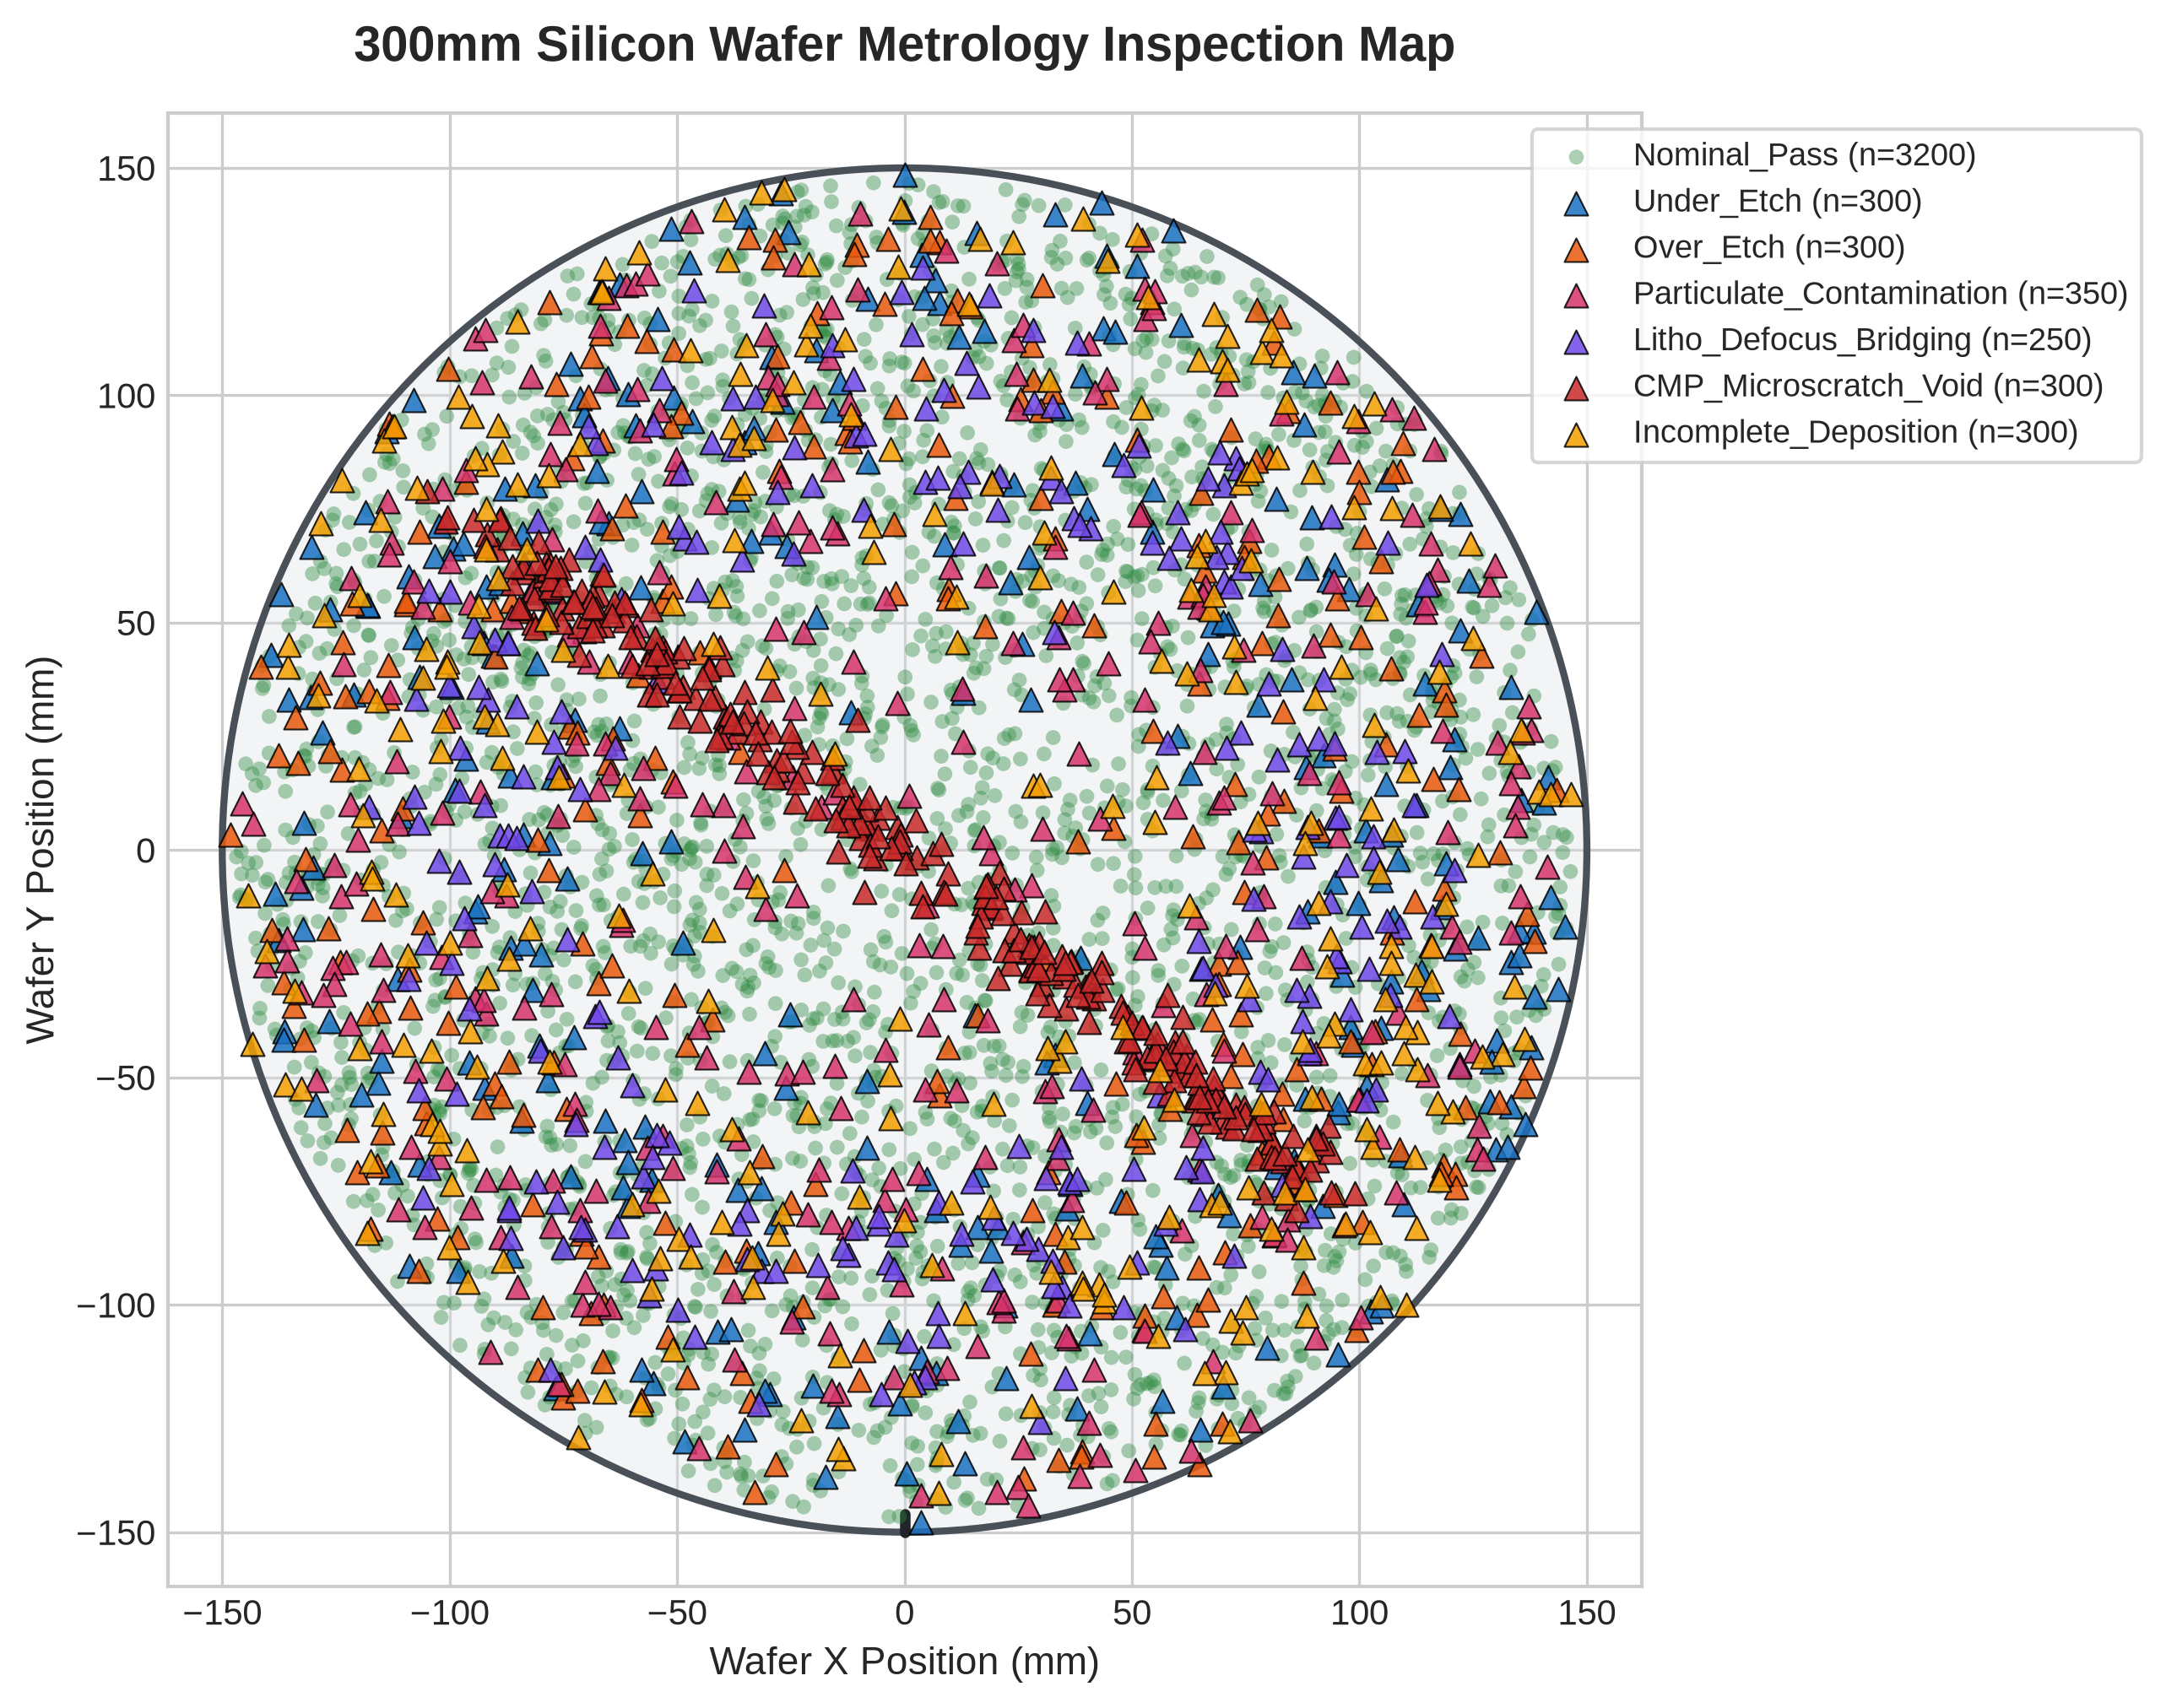
SEMICONDUCTOR METROLOGY DEFECT CLASSIFICATION
Physics-Informed Metrology Simulation & Wafer Geometry
Characterization Modalities Modeled (CeNSE MNCF)
• Spectroscopic Ellipsometry
Film thickness (t), refractive index (n), extinction coefficient (k), optical phase shift (Δ), UV/VIS reflectance balance.
• AFM Surface Topography
Surface average roughness (Ra), RMS (Rq), peak-to-valley (Rz), height skewness (Ssk), kurtosis (Sku).
• Electrical In-Line Metrology
Four-Point Probe sheet resistance (Rs), dielectric breakdown field (Ebd), gate leakage current (Jg), flatband shift (ΔVfb).
• CD-SEM & Defect Inspection
Critical Dimension bias (ΔCD), defect bounding area, defect aspect ratio.

Slide 4
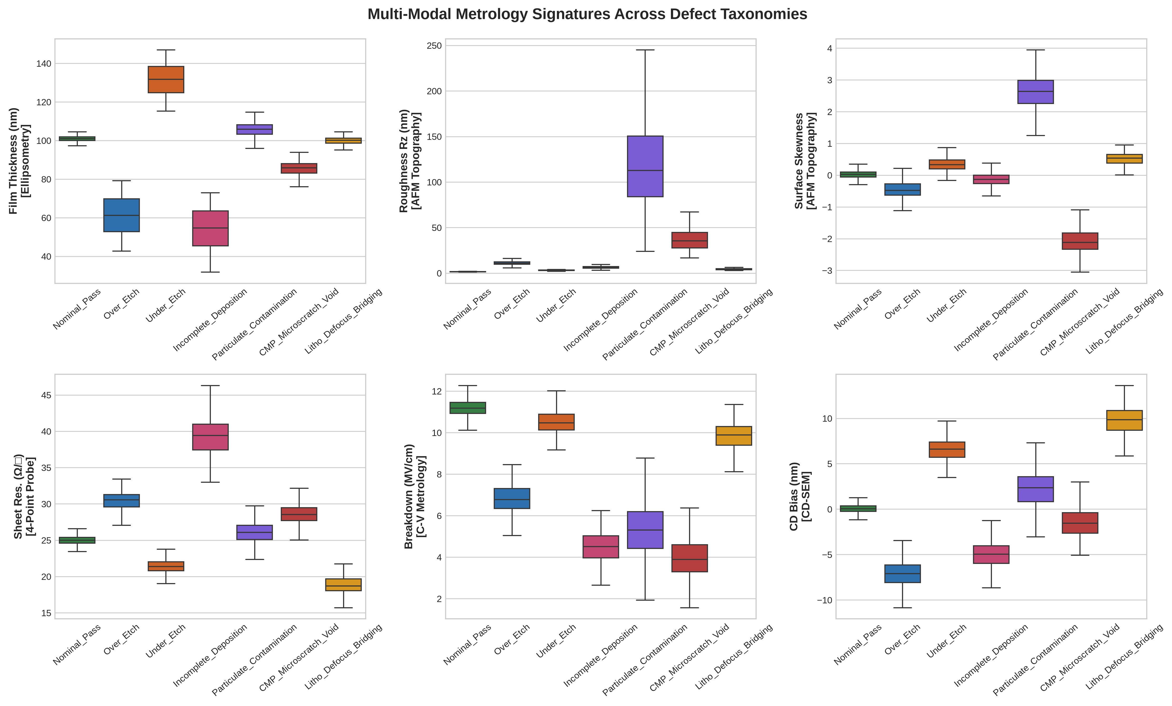
SEMICONDUCTOR METROLOGY DEFECT CLASSIFICATION
Machine Learning Architecture & Feature Engineering
Pipeline Architecture
• 1. Data Generation & Imbalance
5,000 dies generated across 300mm wafer. Imbalance ratio: 64% Nominal Pass, mirroring real high-yield foundry distribution.
• 2. Stratified Partitioning
Split into 65% Training (3,250 dies), 15% Validation (750 dies), and 20% Held-Out Testing (1,000 dies).
• 3. Domain Feature Engineering
Constructed domain physics ratios:
• UV/VIS Reflectance Balance
• AFM Peak-to-Roughness Aspect (Rz / Ra)
• Dielectric Reliability Margin (Ebd / Jleak)
• Thickness-to-CD Coupling
• 4. Scaler Normalization
RobustScaler fitted strictly on training data to handle heavy-tailed particulate spikes without data leakage.

Slide 5
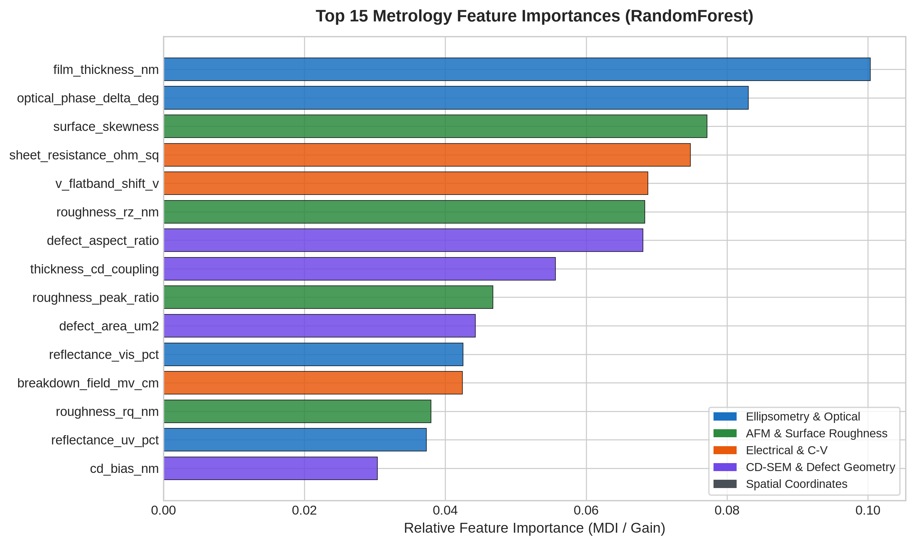
SEMICONDUCTOR METROLOGY DEFECT CLASSIFICATION
Model Benchmark Leaderboard & Feature Explainability
Classifier Evaluation on 1,000 Test Dies
1. Random Forest (Champion)
Accuracy: 100.0% | Macro F1: 1.0000 | ROC-AUC: 1.0000
Best overall robustness, zero false alarms on nominal dies.
2. XGBoost Classifier
Accuracy: 100.0% | Macro F1: 1.0000 | ROC-AUC: 1.0000
Gradient boosting captures subtle non-linear edge boundaries.
3. Support Vector Machine (RBF)
Accuracy: 100.0% | Macro F1: 1.0000 | ROC-AUC: 1.0000
Effective hyper-plane margin separation across scaled features.
4. MLP Deep Neural Network
Accuracy: 99.9% | Macro F1: 0.9987 | ROC-AUC: 1.0000
High representation power, slight convergence sensitivity.
5. Logistic Regression Baseline
Accuracy: 100.0% | Macro F1: 1.0000 | ROC-AUC: 1.0000
Linear separation baseline confirms feature quality.

Slide 6
SEMICONDUCTOR METROLOGY DEFECT CLASSIFICATION
Conclusions, Impact & Next Steps
Key Takeaways from CeNSE Framework
- Multi-Modal Metrology Synergy:
No single instrument can identify all defects. Optical (Ellipsometry) catches film thickness drift, AFM distinguishes bumps from scratch grooves, and Four-Point Probes confirm electrical continuity.
- Physical Interpretability:
Feature importance rankings correlate directly with physical fab mechanisms (Film thickness = 10.0%, Phase delta = 8.3%, Skewness = 7.7%).
- Real-Time Execution Speed:
Inference runs in under 2 milliseconds per die, making it suitable for live inline tool alarms before whole lots are lost.
Future Work & Fab Integration
- Edge AI Tool Controllers:
Deploy lightweight quantized tree models directly onto RIE etcher and PECVD cluster controllers for immediate recipe shutoff.
- Wafer-Map Spatial CNNs:
Extend tabular metrology with 2D Convolutional Neural Networks on full wafer inspection maps (KLA-Tencor style WMDP).
- Active Cleanroom Transfer:
Validate simulated models against physical CeNSE MNCF characterization datasets from real silicon test runs.

