Slide 1
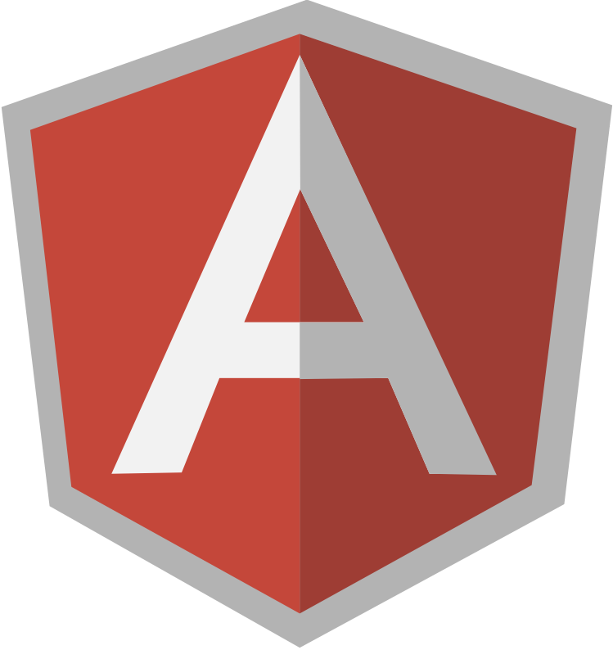
AngularJS
workshop

Slide 2
What is AngularJS?
AngularJS is a client-side MVC framework written in JavaScript. It runs in a web browser and greatly helps us - developers - to write modern, single-page, AJAX-style web applications.

Slide 3
The Framework
AngularJS is a recent addition to the client-side MVC frameworks list yet it has managed to attract a lot of attention, why?
mostly due to its innovative templating system, ease of development and very solid engineering practices.

Slide 4
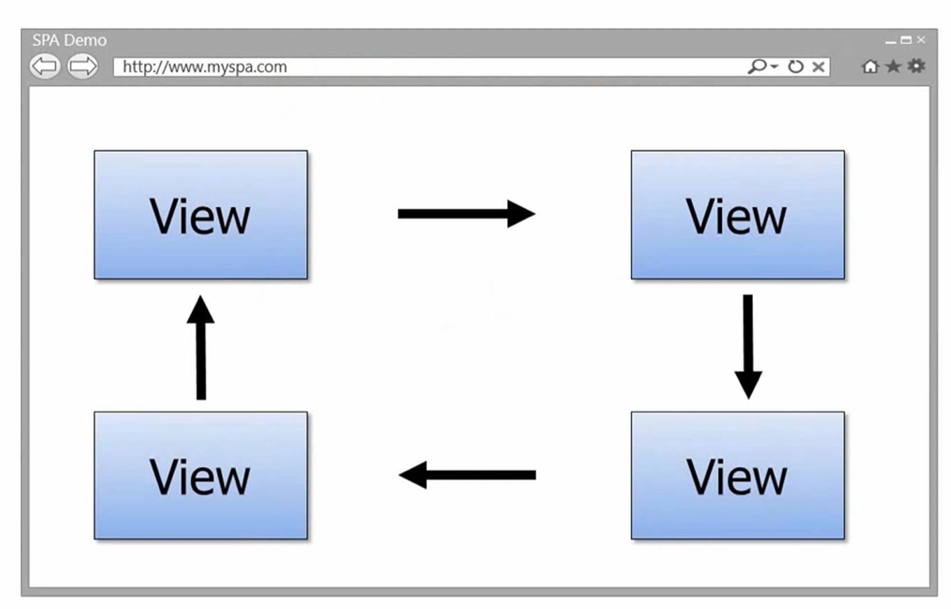
Single Page Application (SPA)

Slide 5
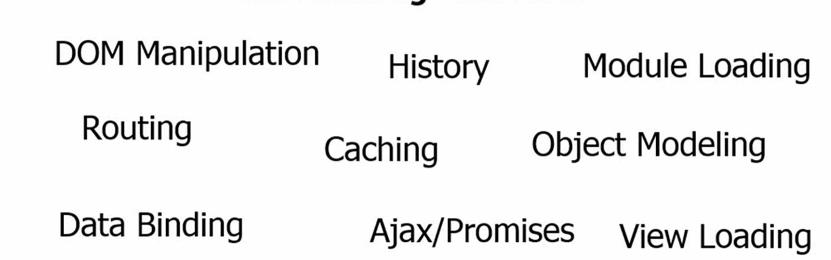
The Challenges with SPAs

Slide 6
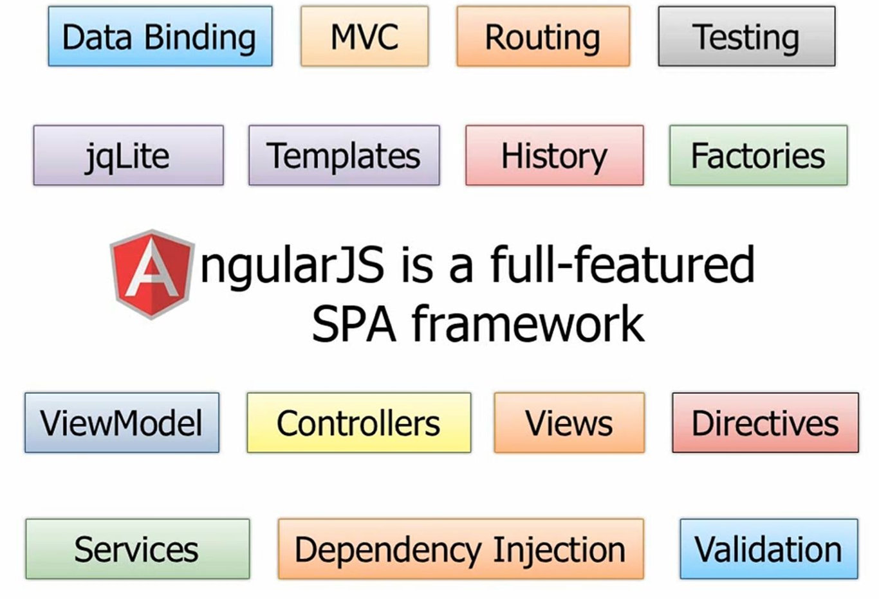
AngularJS – Full-featured SPA framework

Slide 7
Why Angular ?
2-way Data Binding
Dependency Injection (DI)
Templating
Testing
Directives

Slide 8
Angular – Hello World !!!
Live Coding

Slide 9
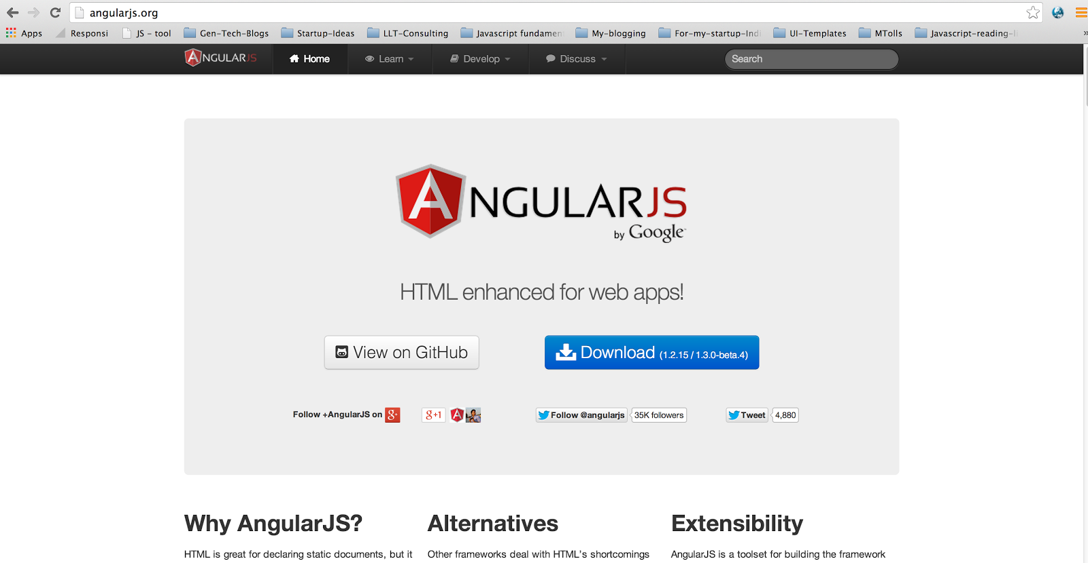
AngularJS.org

Slide 10
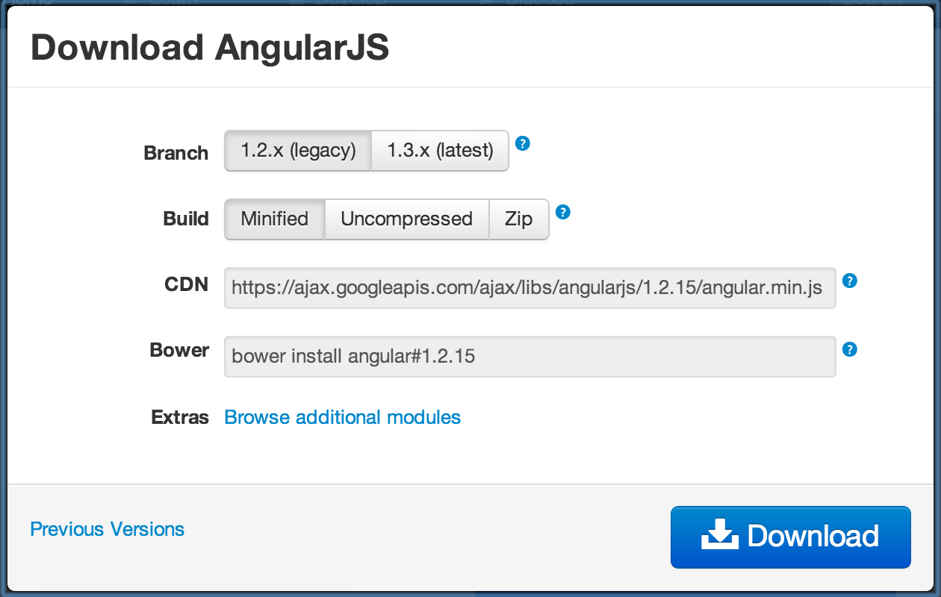
Download AngularJS

Slide 11

Views, Controllers and Scope

Slide 12
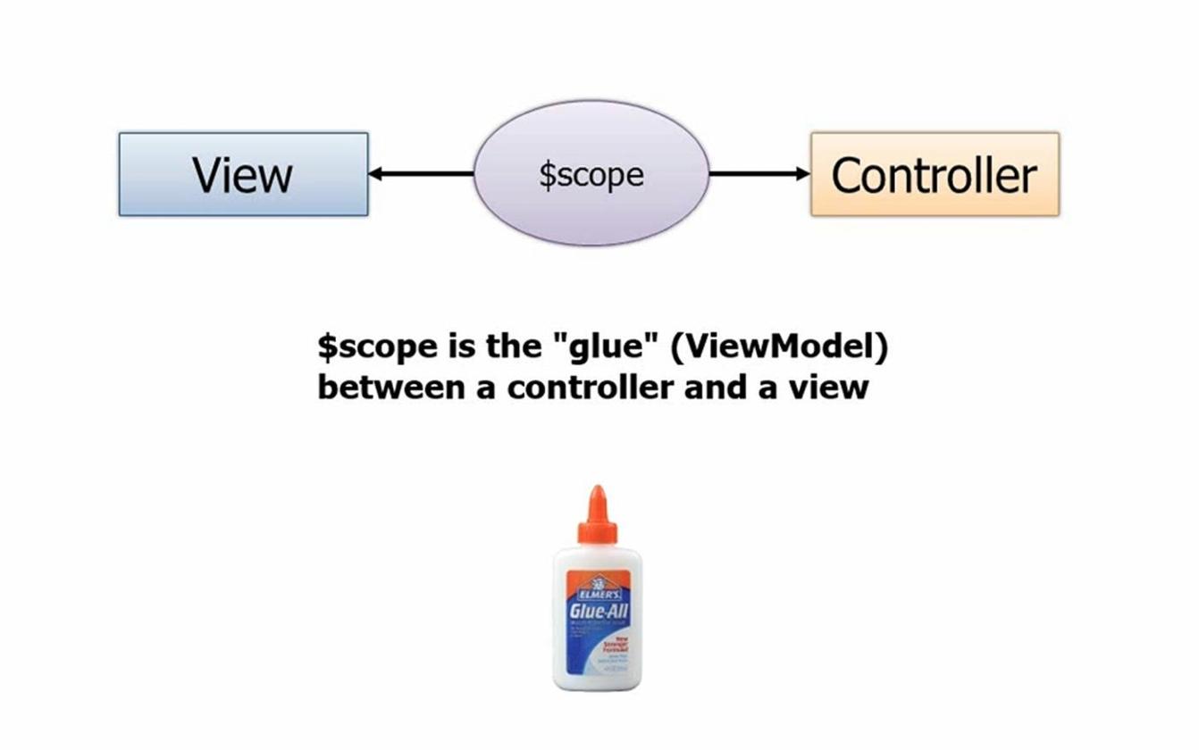
Views, Controllers and Scope

Slide 13
Creating a View and Controller
Live Coding

Slide 14
Features and Code Organization

Slide 15
Topics Covered
MVC in AngularJS terms.
Module
Looping through an array
Singletons of AngularJS
Factory
Service
Constant
Value

Slide 16
MVC in AngularJS terms.
View = HTML templates
Controller= JavaScript function
Model= JSON object on $scope

Slide 17
Module
Container!
Comparable to namespace

Slide 18
Controller
$scope

Slide 19
Looping through Arrays in view
ng-repeat
filter

Slide 20
Singleton objects in AngularJS
Factory
Service
What is the difference?

Slide 21
Constant and Value
Constant
Value
What is the difference?

Slide 22
Promises
Promise as an interface for interacting with an object that represents the result of an action that is performed asynchronously, and may or may not be finished at any given point in time.

Slide 23
Configuration and Routing
Config blocks
Runs as soon as a module kicks off
No services, factories or values are ready yet
Can use providers and constants
Used to configure the app
E.g., Configuring routes

Slide 24
Routing
To add support for multiple views
Defined in a separate module – ngRoute
Reloads a portion of the page with support to switch between the pages using browser back and forward
Can pass parameters

Slide 25
Routing
Demo on Config and Routing

Slide 26
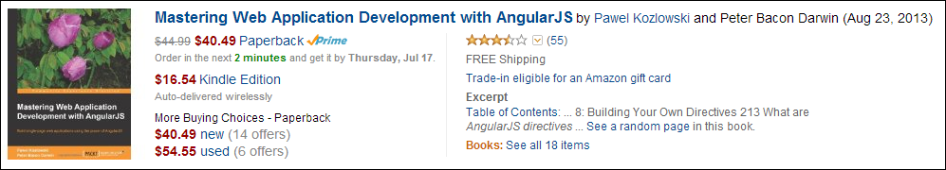
Directives
Extending HTML
Teaching new tricks to HTML
Some even say HTML5 + Angular JS = HTML6
Embraces clean code
Keeps markup and code separated
Fluent mark-up
Re-usable
Allows one to create Domain Specific Language
Domain specific HTML elements for your app
e.g., <book book-id=“123456” />

Slide 27
Directives
Live Coding

Slide 28
Directives
What we saw is just tip of an iceberg
A separate session on directives soon….

Slide 29
Unit Testing
Angular JS embraces testing
Any dependency can be easily mocked if DI is used well
Can test using Jasmine, QUnit, Mocha or any testing framework
angular-mocks.js has mocks of some of the commonly used built-in services

Slide 30
Unit Testing
Demos on testing using Jasmine

Slide 31
Twitter:
Srini Kusunam - @skusunam Kotaru Keerti - @kvkirthyRavi Kiran - @Sravi_Kiran sravi-kiran.blogspot.com

