Slide 1
Improving Decision-Making under Uncertainty: A Data-Driven Robust Optimization Framework with Machine Learning
Ting-Yu Liao (Angus), Pin-Ying, Zhu (Pollie)
2025/01/02

Slide 2
Outline
Introduction
Methodology
Numerical experiment
Simulation result
Conclusion

Slide 3

Introduction
Imagine you are a decision-maker but don’t know what will happen tomorrow…
How many to order…?
How many to store…?
How many to produce…?
How many products will be needed…?

Slide 4

Introduction
Due to the uncertain demand, your brain will explode because you really don't know how to make the decision...
Resolve the problem that the manager can’t make an appropriate decision to increase service level due to uncertain demand!!

Slide 5
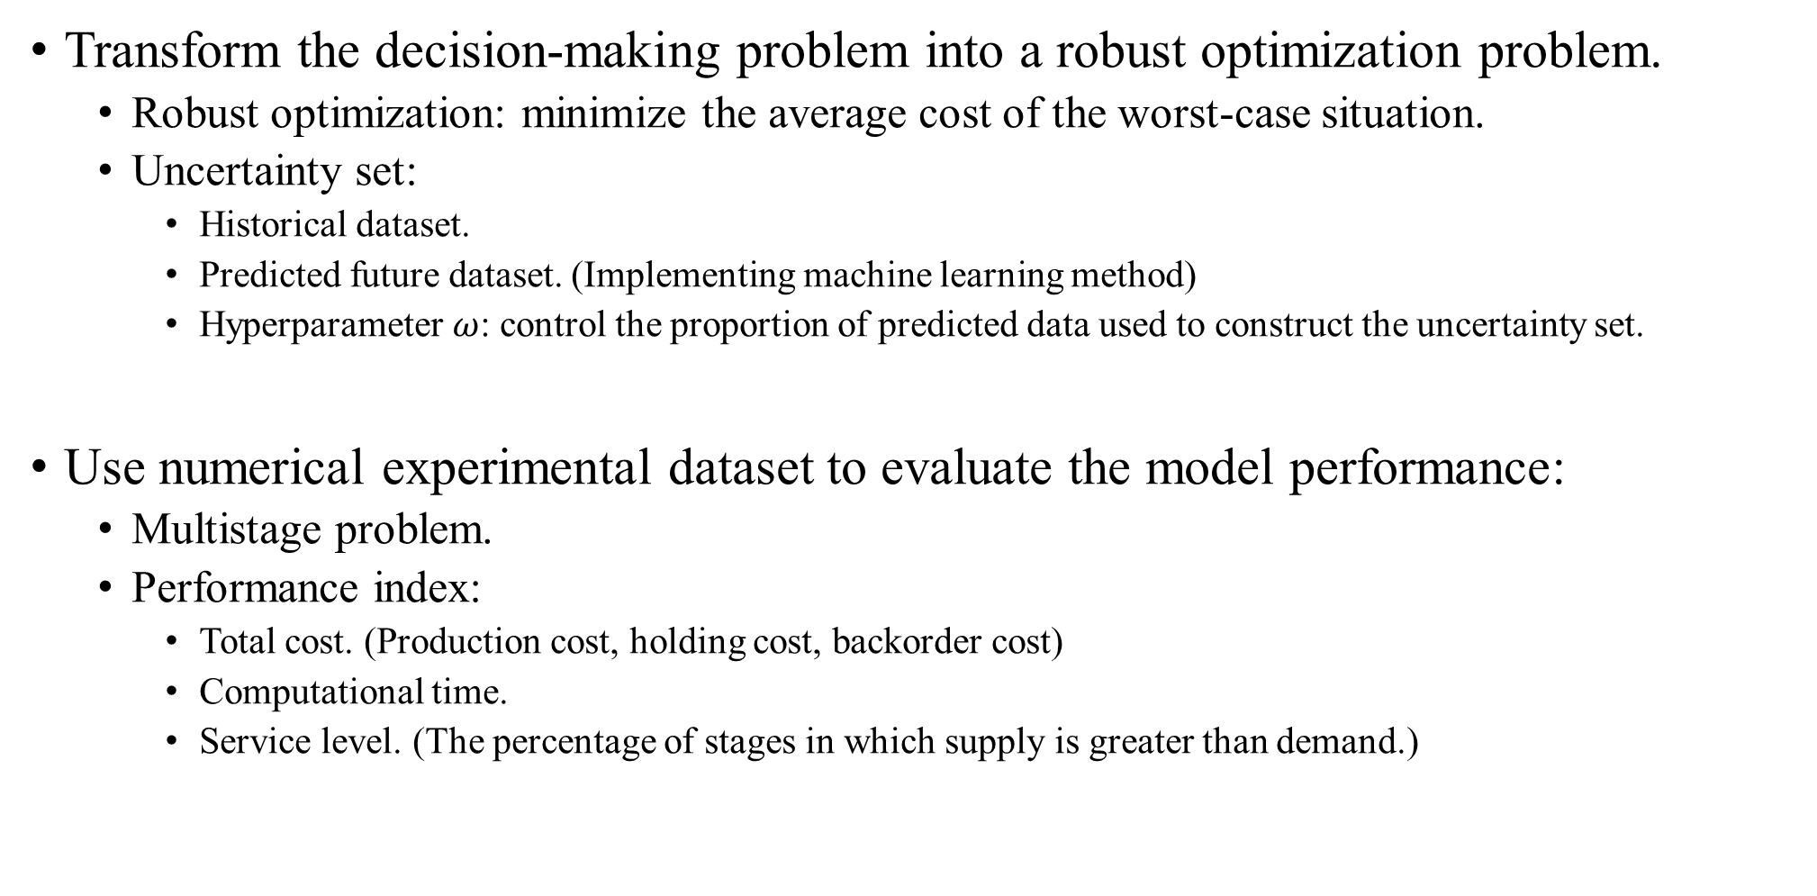
Methodology
Transform the decision-making problem into a robust optimization problem.
Robust optimization: minimize the average cost of the worst-case situation.
Uncertainty set:
Historical dataset.
Predicted future dataset. (Implementing machine learning method)
Hyperparameter $ω$: control the proportion of predicted data used to construct the uncertainty set.
Use numerical experimental dataset to evaluate the model performance:
Multistage problem.
Performance index:
Total cost. (Production cost, holding cost, backorder cost)
Computational time.
Service level. (The percentage of stages in which supply is greater than demand.)

Slide 6


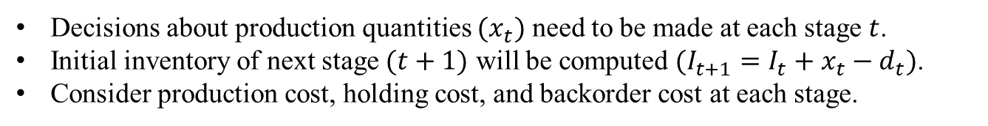

Numerical experiment
Stage1
Stage2
Stage3
…
Stage $T−2$
Stage $T−1$
Stage $T$
Decisions about production quantities $(x_{t})$ need to be made at each stage $t$.
Initial inventory of next stage $(t+1)$ will be computed $(I_{t+1}=I_{t}+x_{t}−d_{t})$.
Consider production cost, holding cost, and backorder cost at each stage.
Minimize the total cost!

Slide 7
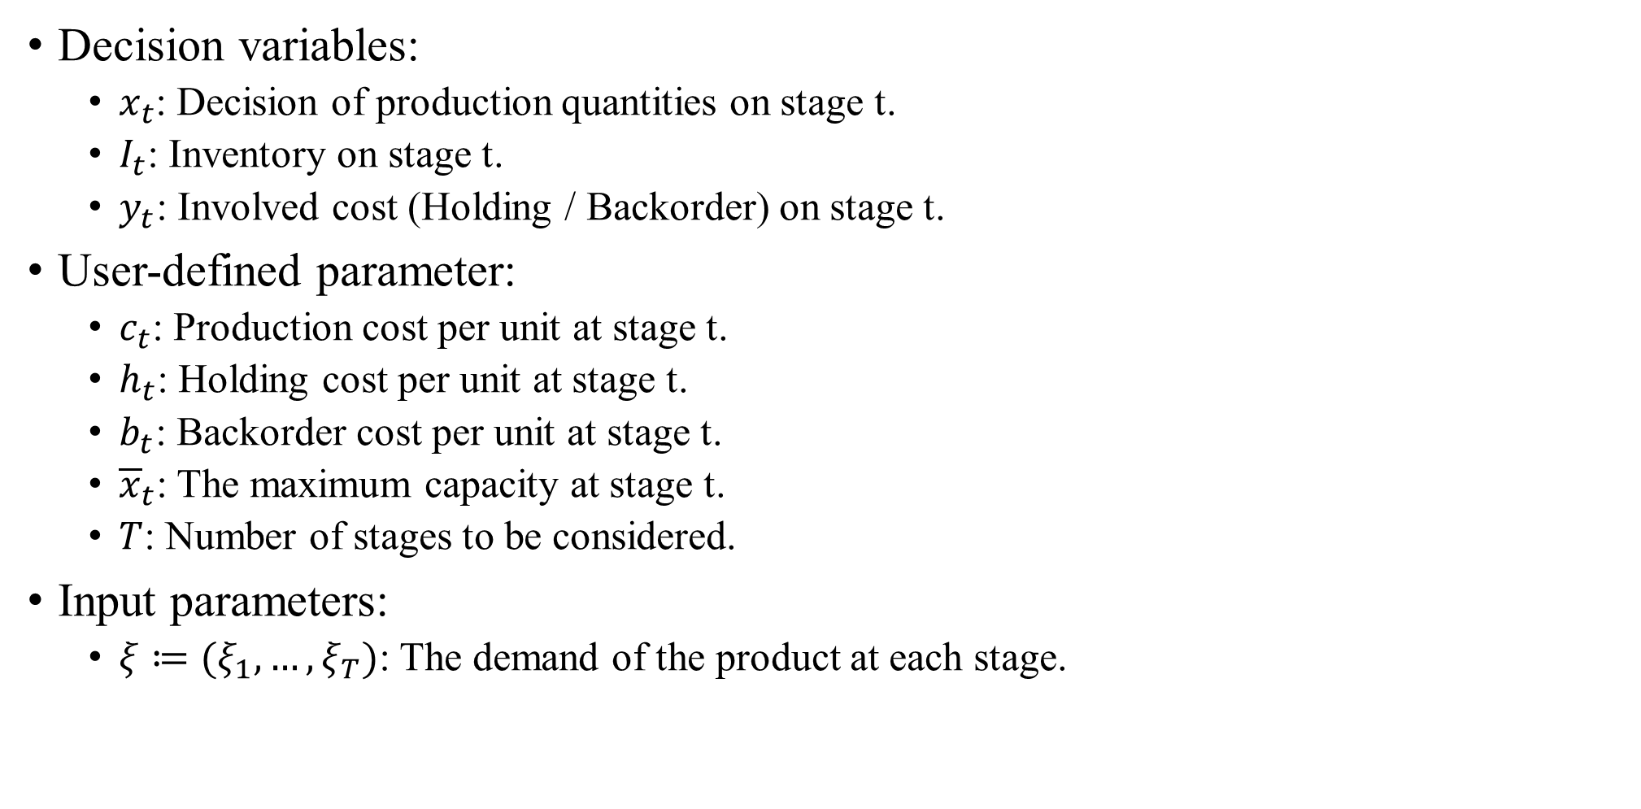
Mathematical model
Decision variables:
$x_{t}$: Decision of production quantities on stage t.
$I_{t}$: Inventory on stage t.
$y_{t}$: Involved cost (Holding / Backorder) on stage t.
User-defined parameter:
$c_{t}$: Production cost per unit at stage t.
$h_{t}$: Holding cost per unit at stage t.
$b_{t}$: Backorder cost per unit at stage t.
${\overline{x}}_{t}$: The maximum capacity at stage t.
$T$: Number of stages to be considered.
Input parameters:
$ξ≔(ξ_{1},…,ξ_{T})$: The demand of the product at each stage.

Slide 8
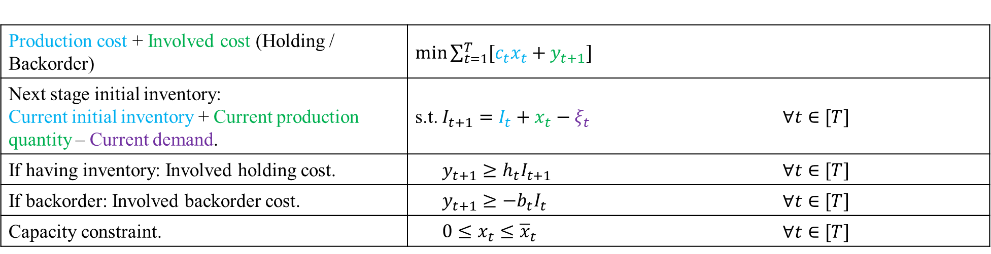
Mathematical model
Production cost + Involved cost (Holding / Backorder) | $\min{\sum_{t=1}^{T}{[c_{t}x_{t}+y_{t+1}]}}$
Next stage initial inventory: Current initial inventory + Current production quantity – Current demand. | s.t. $I_{t+1}=I_{t}+x_{t}−ξ_{t}$ | $∀t∈[T]$
If having inventory: Involved holding cost. | $y_{t+1}≥h_{t}I_{t+1}$ | $∀t∈[T]$
If backorder: Involved backorder cost. | $y_{t+1}≥{−b}_{t}I_{t}$ | $∀t∈[T]$
Capacity constraint. | $0≤x_{t}≤{\overline{x}}_{t}$ | $∀t∈[T]$

Slide 9
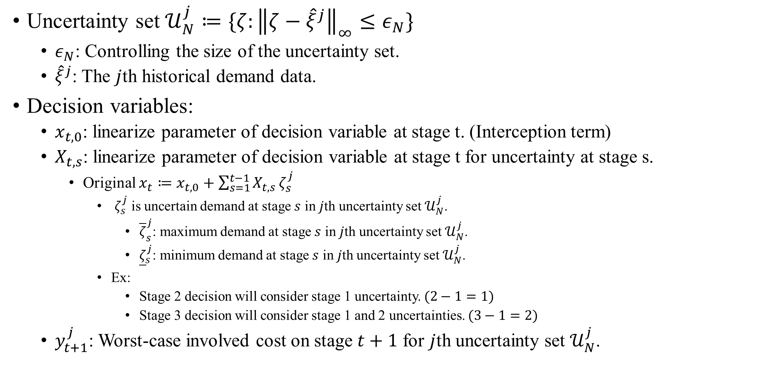
Robust optimization model
Uncertainty set $𝒰_{N}^{j}≔\{ζ:{\left\|ζ−{\hat{ξ}}^{j}\right\|}_{∞}≤ε_{N}\}$
$ε_{N}$: Controlling the size of the uncertainty set.
${\hat{ξ}}^{j}$: The $j$th historical demand data.
Decision variables:
$x_{t, 0}$: linearize parameter of decision variable at stage t. (Interception term)
$X_{t,s}$: linearize parameter of decision variable at stage t for uncertainty at stage s.
Original $x_{t}≔x_{t, 0}+\sum_{s=1}^{t−1}{X_{t,s}}ζ_{s}^{j}$
$ζ_{s}^{j}$ is uncertain demand at stage $s$ in $j$th uncertainty set $𝒰_{N}^{j}$.
${\overline{ζ}}_{s}^{j}$: maximum demand at stage $s$ in $j$th uncertainty set $𝒰_{N}^{j}$.
${\underline{ζ}}_{s}^{j}$: minimum demand at stage $s$ in $j$th uncertainty set $𝒰_{N}^{j}$.
Ex:
Stage 2 decision will consider stage 1 uncertainty. $(2−1=1)$
Stage 3 decision will consider stage 1 and 2 uncertainties. $(3−1=2)$
$y_{t+1}^{j}$: Worst-case involved cost on stage $t+1$ for $j$th uncertainty set $𝒰_{N}^{j}$.

Slide 10
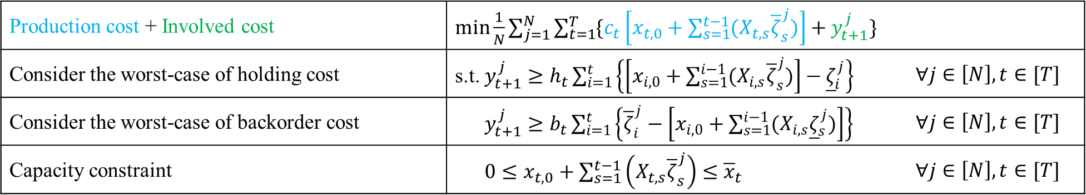
Robust optimization model
Robust optimization: minimize the average cost of the worst-case situation.
Production cost + Involved cost | $\min{\frac{1}{N}\sum_{j=1}^{N}{\sum_{t=1}^{T}{\{c_{t}\left[x_{t, 0}+\sum_{s=1}^{t−1}{(X_{t,s}{\overline{ζ}}_{s}^{j})}\right]+y_{t+1}^{j}\}}}}$
Consider the worst-case of holding cost | s.t. $y_{t+1}^{j}≥h_{t}\sum_{i=1}^{t}{\left\{\left[x_{i, 0}+\sum_{s=1}^{i−1}{(X_{i,s}{\overline{ζ}}_{s}^{j})}\right]−{\underline{ζ}}_{i}^{j}\right\}}$ | $∀j∈\left[N\right],t∈[T]$
Consider the worst-case of backorder cost | $y_{t+1}^{j}≥b_{t}\sum_{i=1}^{t}{\left\{{\overline{ζ}}_{i}^{j}−\left[x_{i, 0}+\sum_{s=1}^{i−1}{(X_{i,s}{\underline{ζ}}_{s}^{j})}\right]\right\}}$ | $∀j∈\left[N\right],t∈[T]$
Capacity constraint | $0≤x_{t, 0}+\sum_{s=1}^{t−1}{\left(X_{t,s}{\overline{ζ}}_{s}^{j}\right)}≤{\overline{x}}_{t}$ | $∀j∈\left[N\right],t∈[T]$
Reference:
Dimitris Bertsimas, Shimrit Shtern, Bradley Sturt (2023) A Data-Driven Approach to Multistage Stochastic Linear Optimization. Management Science 69(1):51-74. https://doi.org/10.1287/mnsc.2022.4352

Slide 11
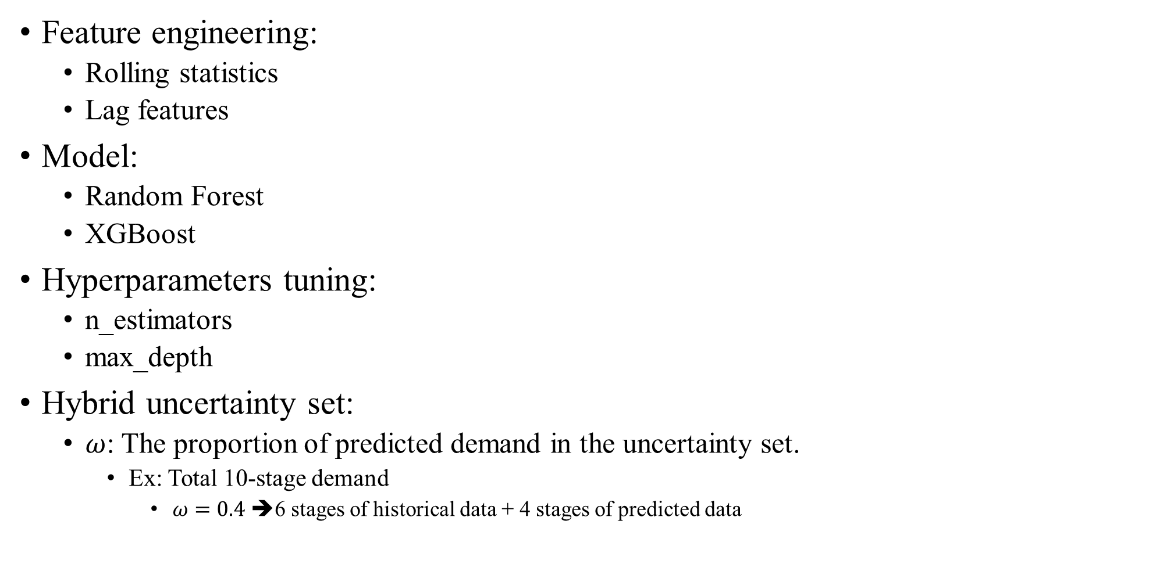
Machine learning method
Feature engineering:
Rolling statistics
Lag features
Model:
Random Forest
XGBoost
Hyperparameters tuning:
n_estimators
max_depth
Hybrid uncertainty set:
$ω$: The proportion of predicted demand in the uncertainty set.
Ex: Total 10-stage demand
$ω=0.4$ ➔6 stages of historical data + 4 stages of predicted data

Slide 12
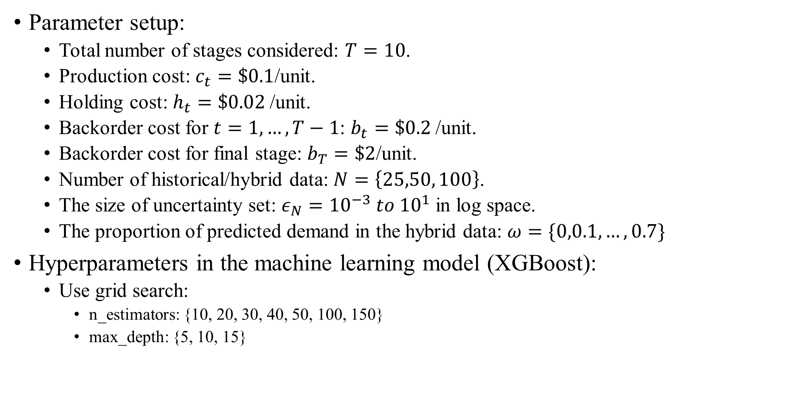
Result
Parameter setup:
Total number of stages considered: $T=10$.
Production cost: $c_{t}=\$0.1$/unit.
Holding cost: $h_{t}=\$0.02$/unit.
Backorder cost for $t=1, …, T−1$: $b_{t}=\$0.2$/unit.
Backorder cost for final stage: $b_{T}=\$2$/unit.
Number of historical/hybrid data: $N=\left\{25,50, 100\right\}$.
The size of uncertainty set: $ε_{N}={10}^{−3} to {10}^{1}$ in log space.
The proportion of predicted demand in the hybrid data: $ω=\{0,0.1,…,0.7\}$
Hyperparameters in the machine learning model (XGBoost):
Use grid search:
n_estimators: {10, 20, 30, 40, 50, 100, 150}
max_depth: {5, 10, 15}

Slide 13
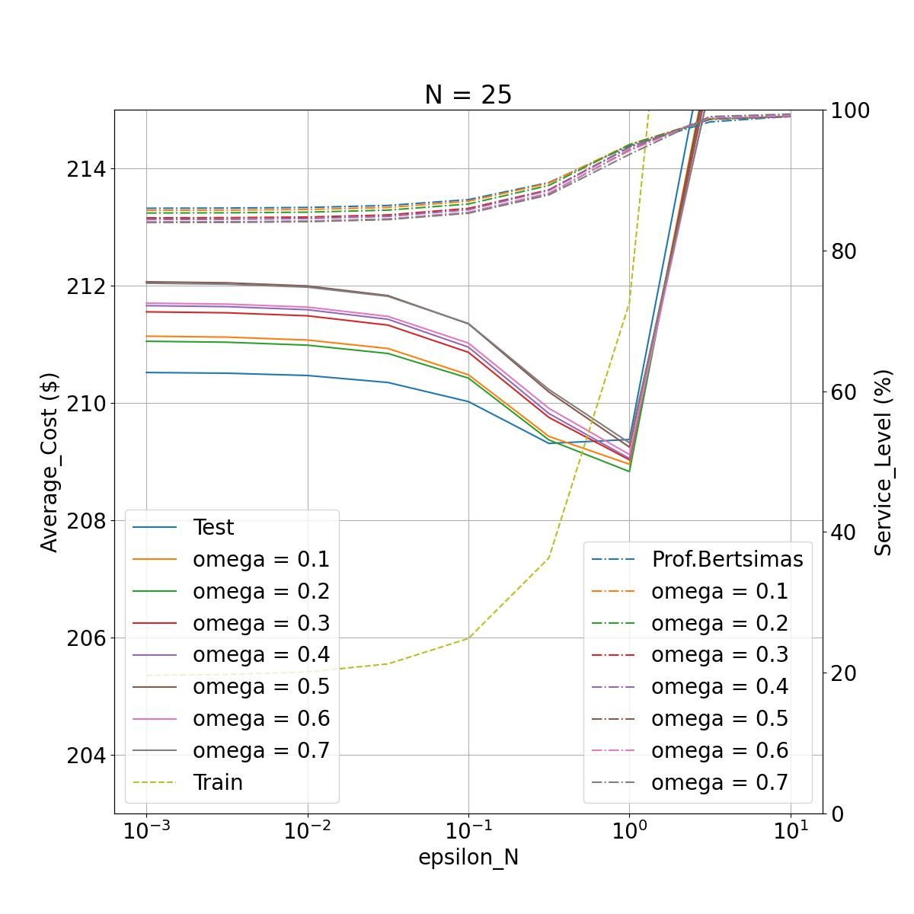

Result ($N=25)$
Recall
Training data: Historical demand.
Testing data: Future demand.
Solid line: Testing cost.
Dash line: Training cost.
Dash dot line: Service level.
Zoom in.
No robustness:
Overfitting, the model can’t make a good decision on future demand.
Uncertainty set too big:
Too cautious, produce too many products, leading to higher production and holding costs.

Slide 14
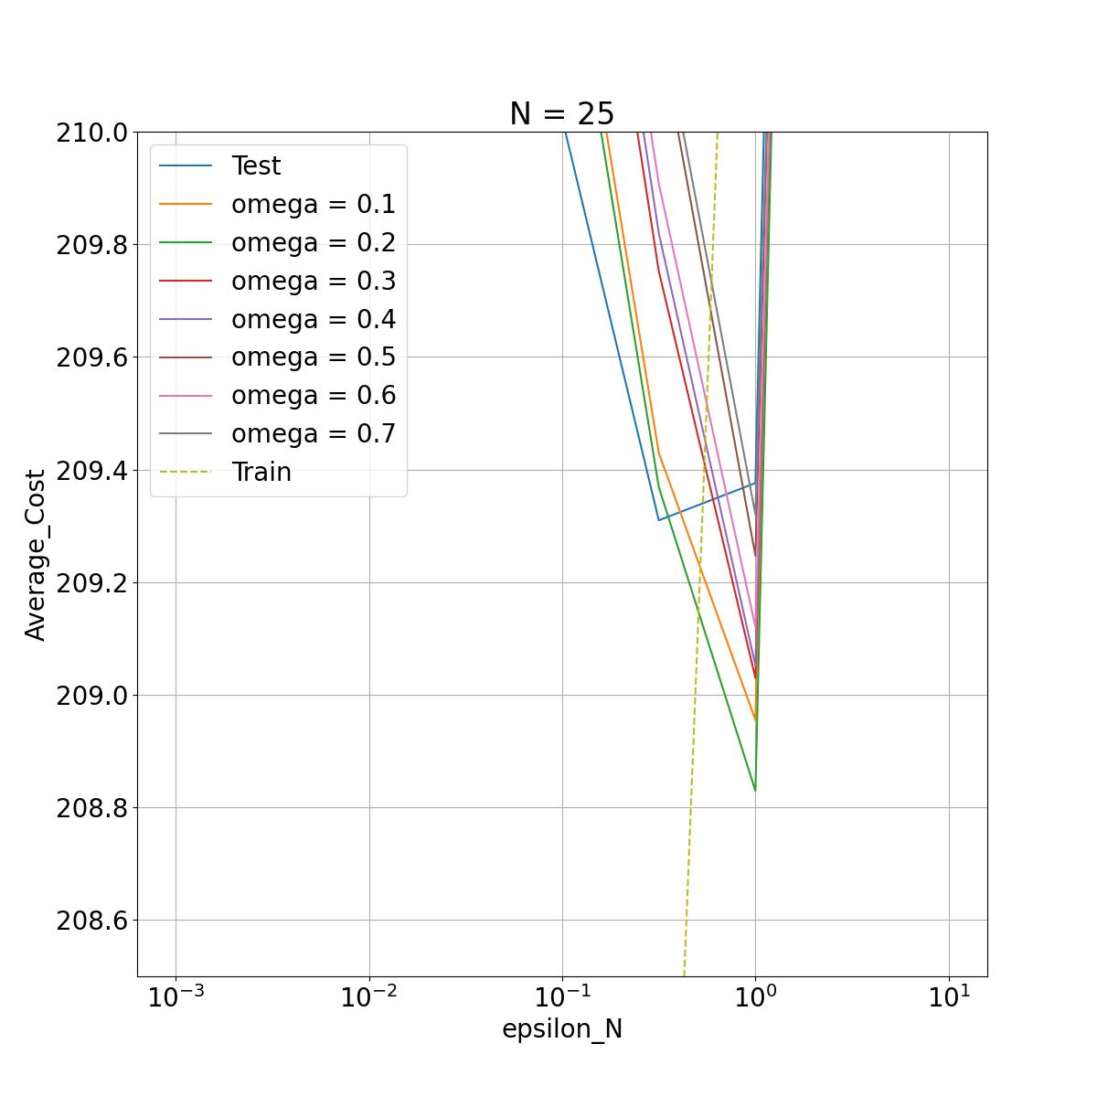
Result ($N=25)$
Recall
Training data: Historical demand.
Testing data: Future demand.
Solid line: Testing cost.
Dash line: Training cost.
Integrating the machine learning method helps reduce the testing cost. The minimum testing cost is lower than the one without using the machine learning method.
Minimum cost without the machine learning method.

Slide 15
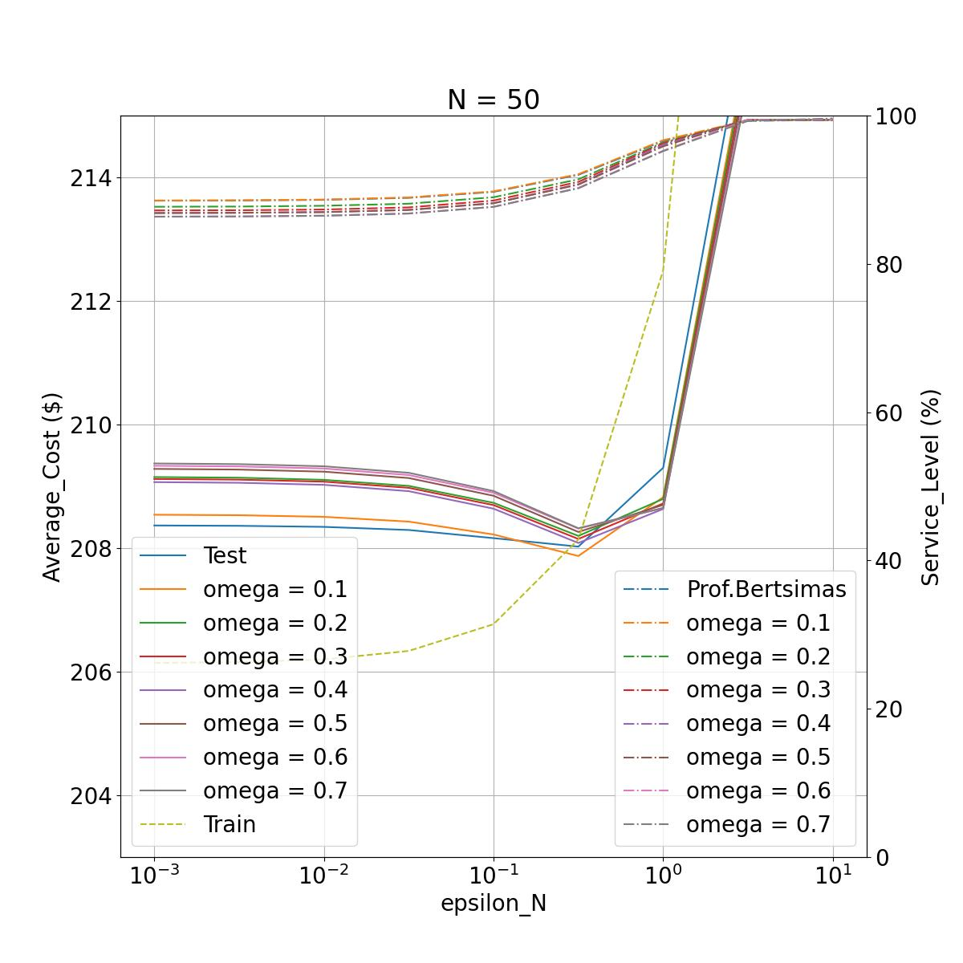
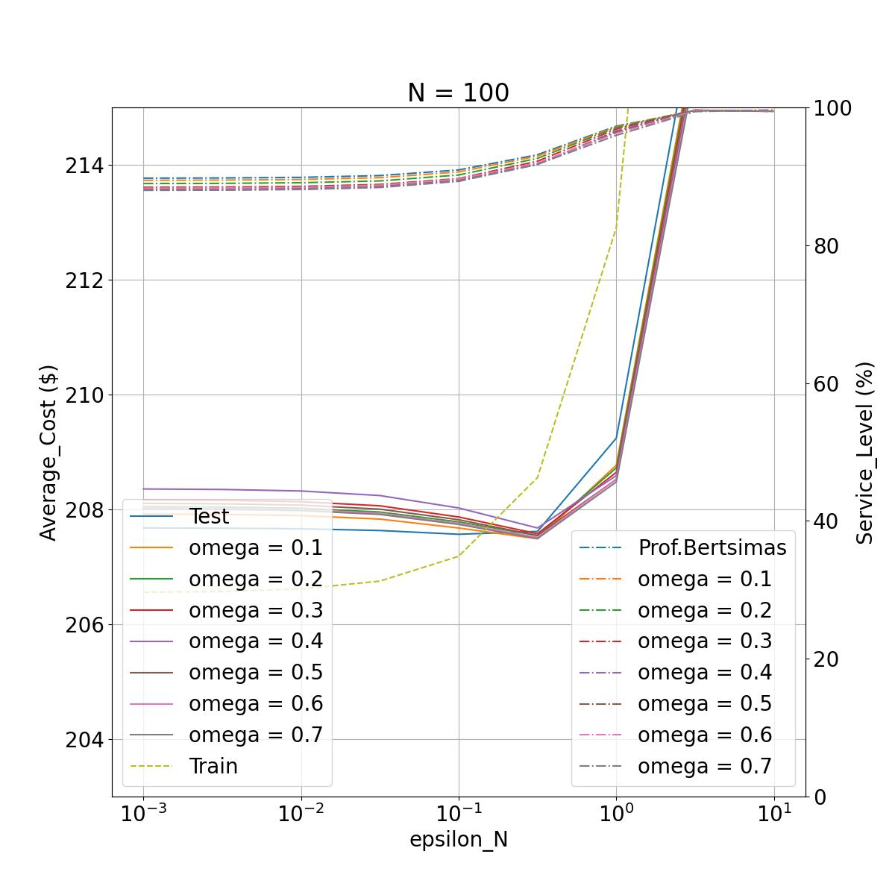

Same situation when $N=50$ and $N=100$

Slide 16
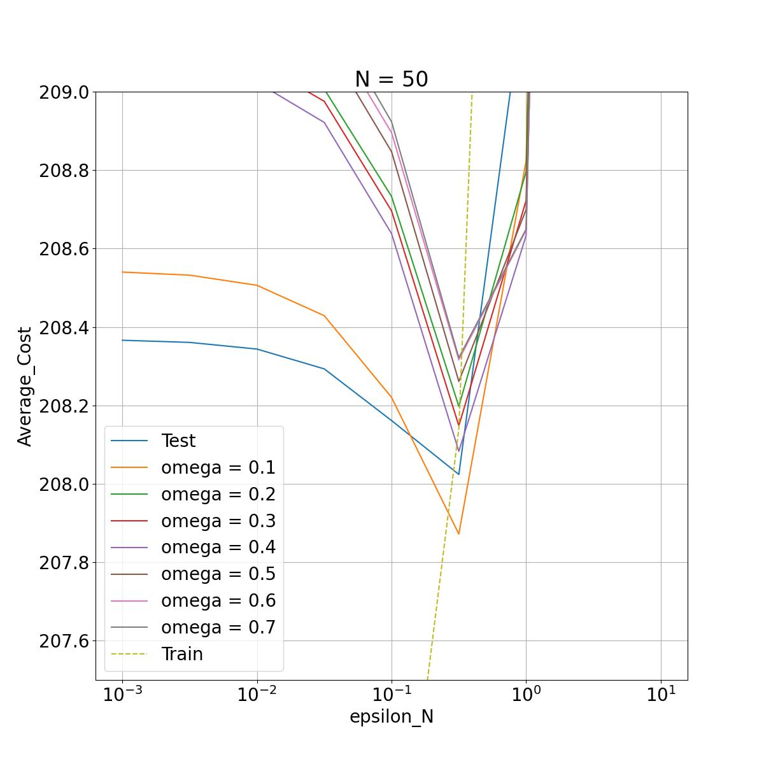
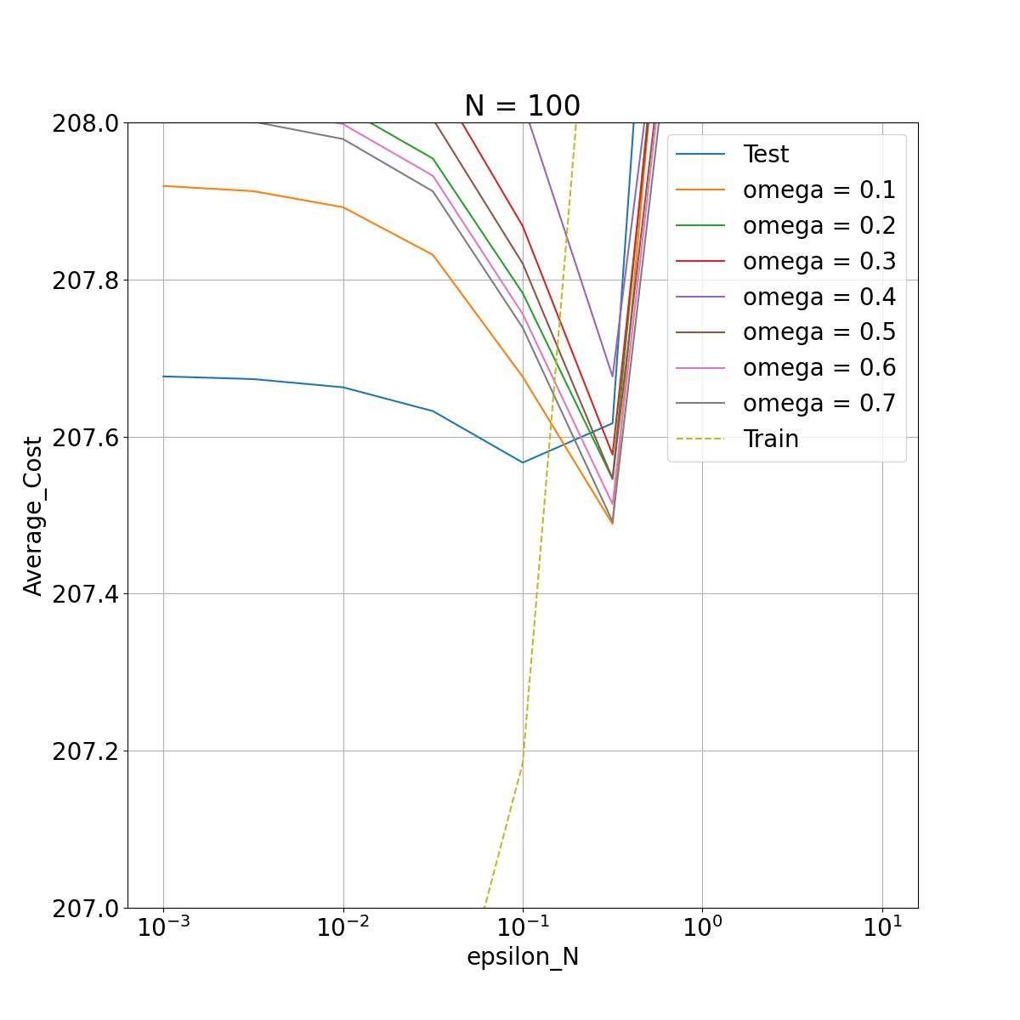
Same situation when $N=50$ and $N=100$
Minimum cost without the machine learning method.

Slide 17
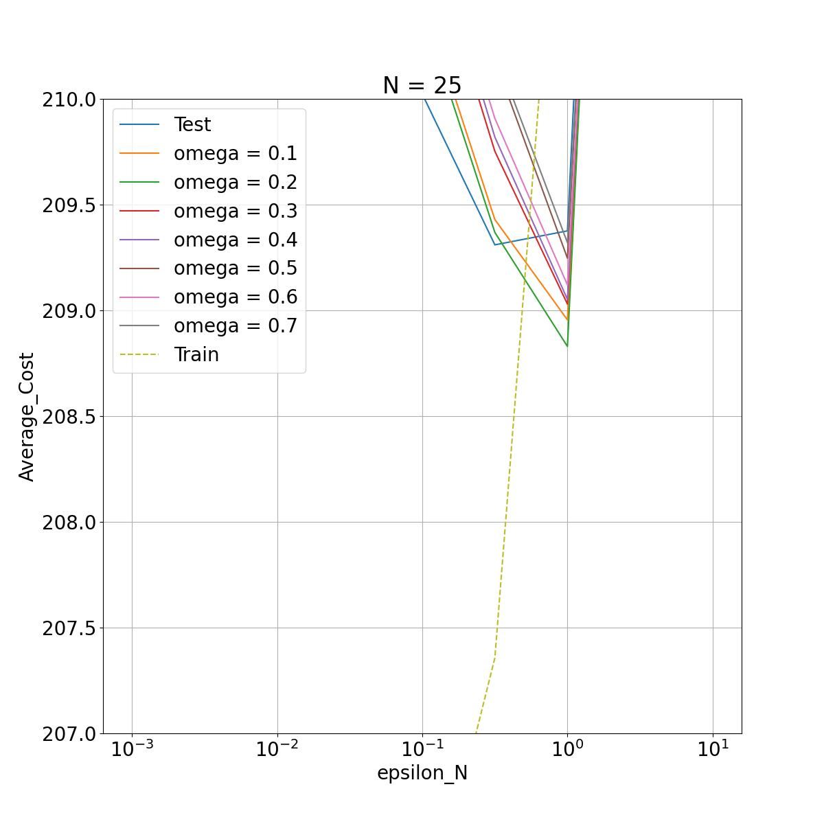
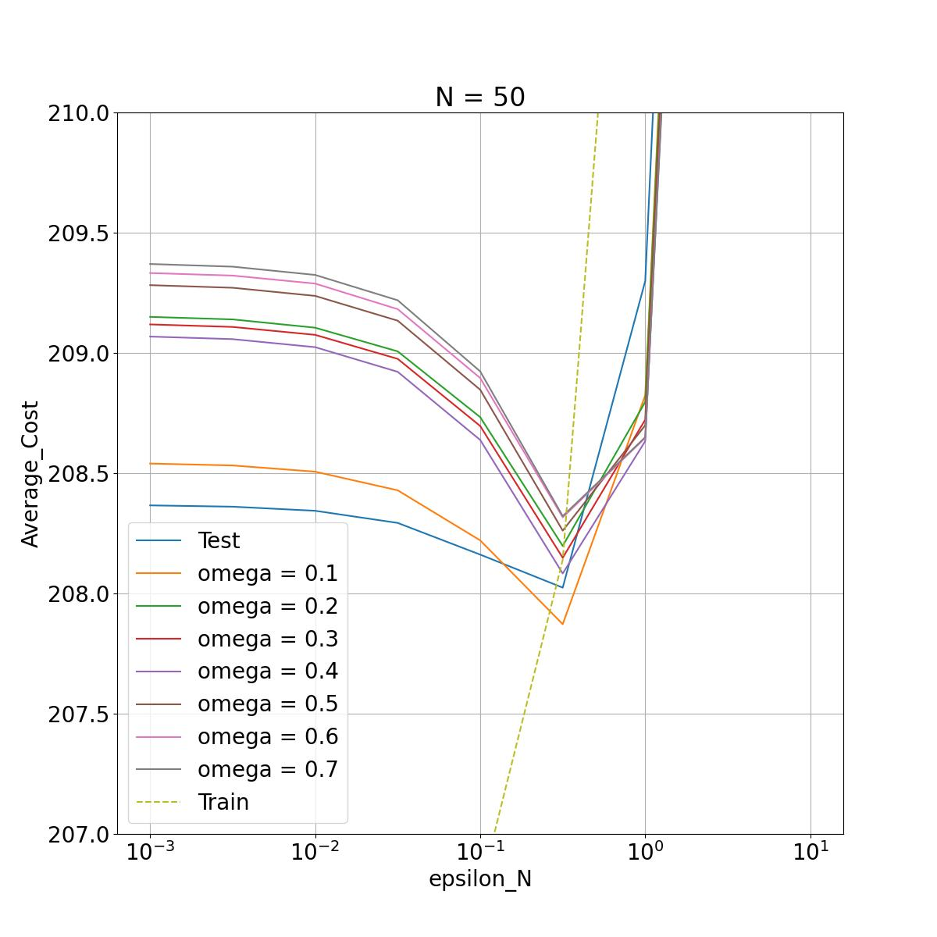
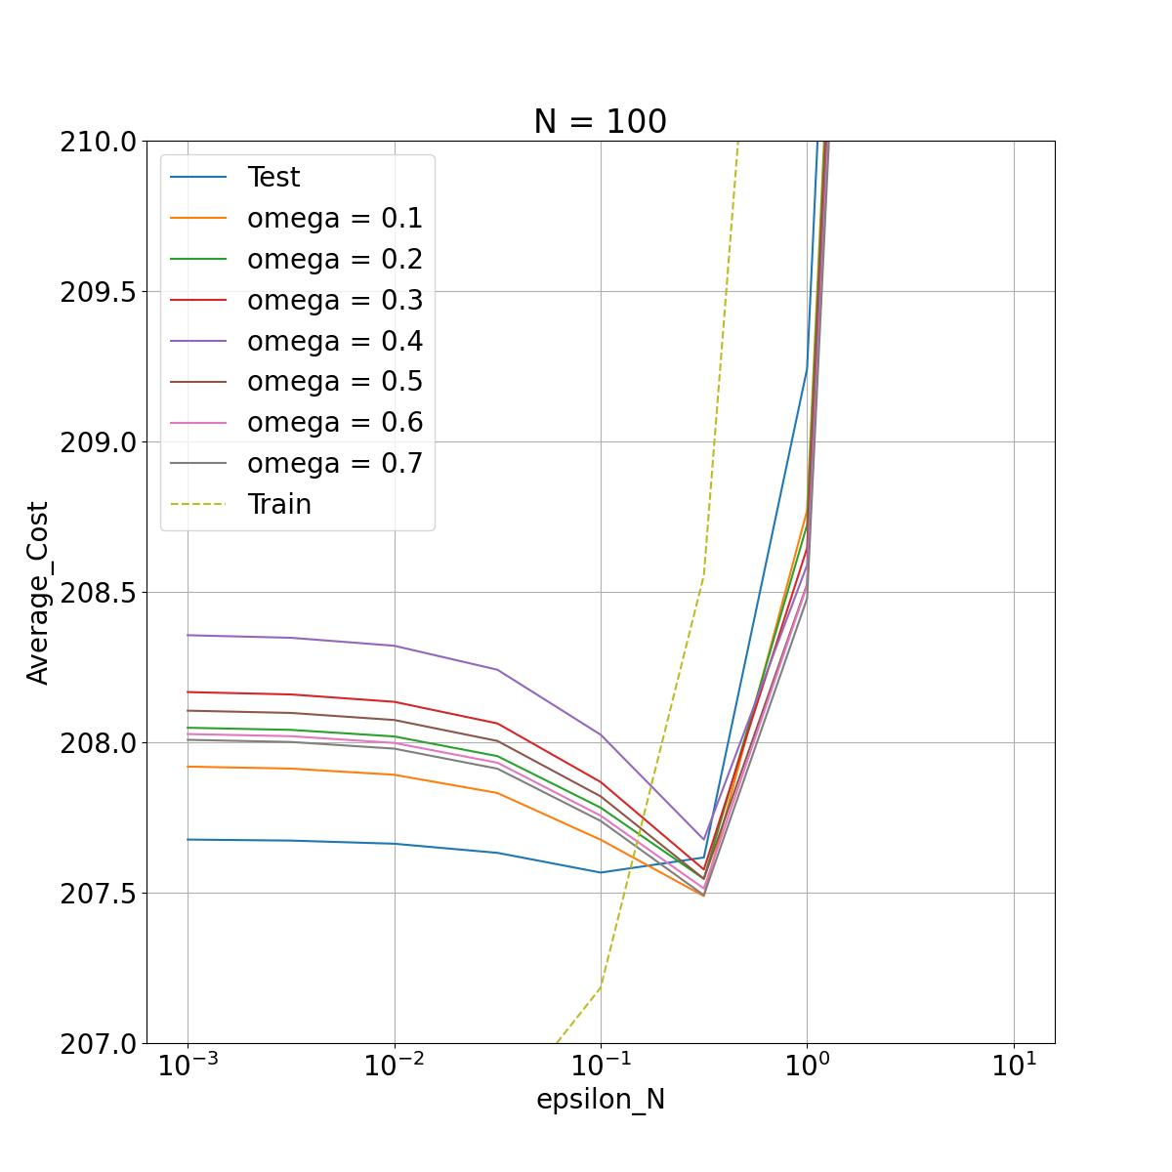
Result
Recall
Training data: Historical demand.
Testing data: Future demand.
When the number of uncertainty sets (hybrid data) increases, the minimum testing cost will be reduced.
Solid line: Testing cost.
Dash line: Training cost.

Slide 18
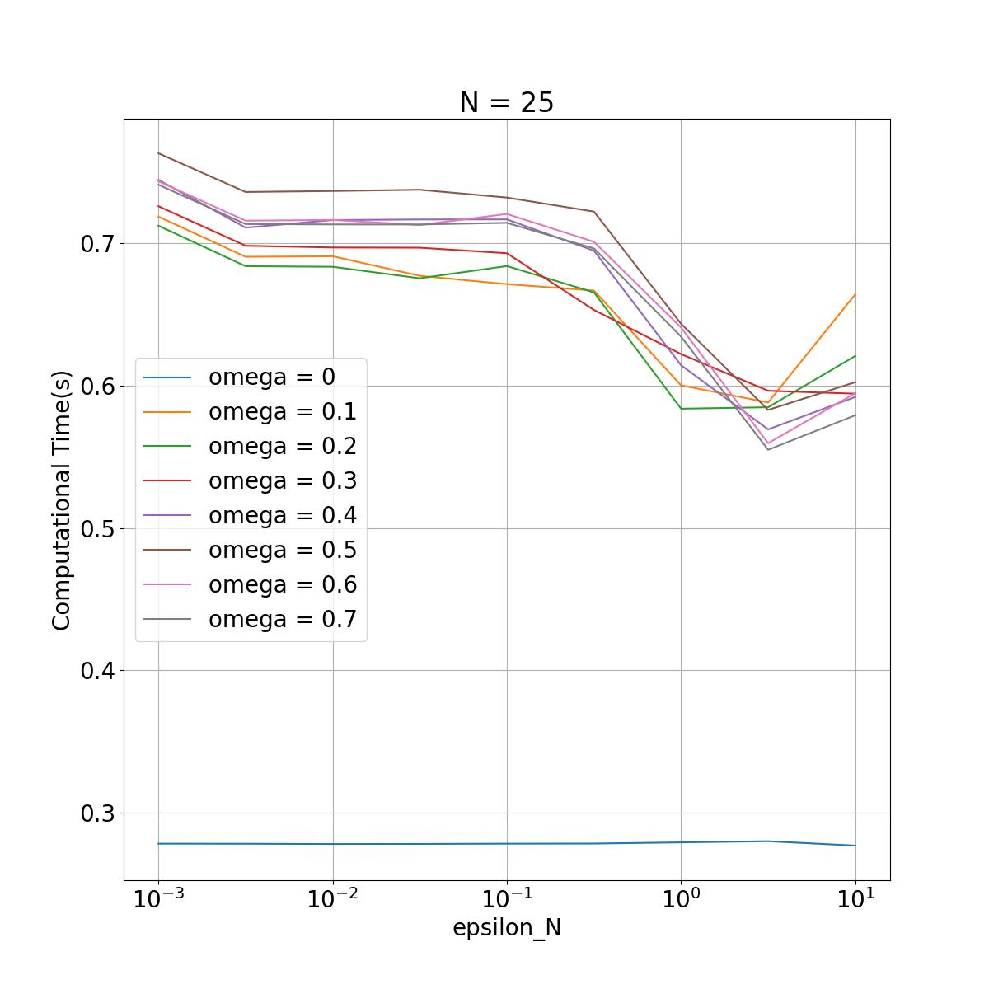
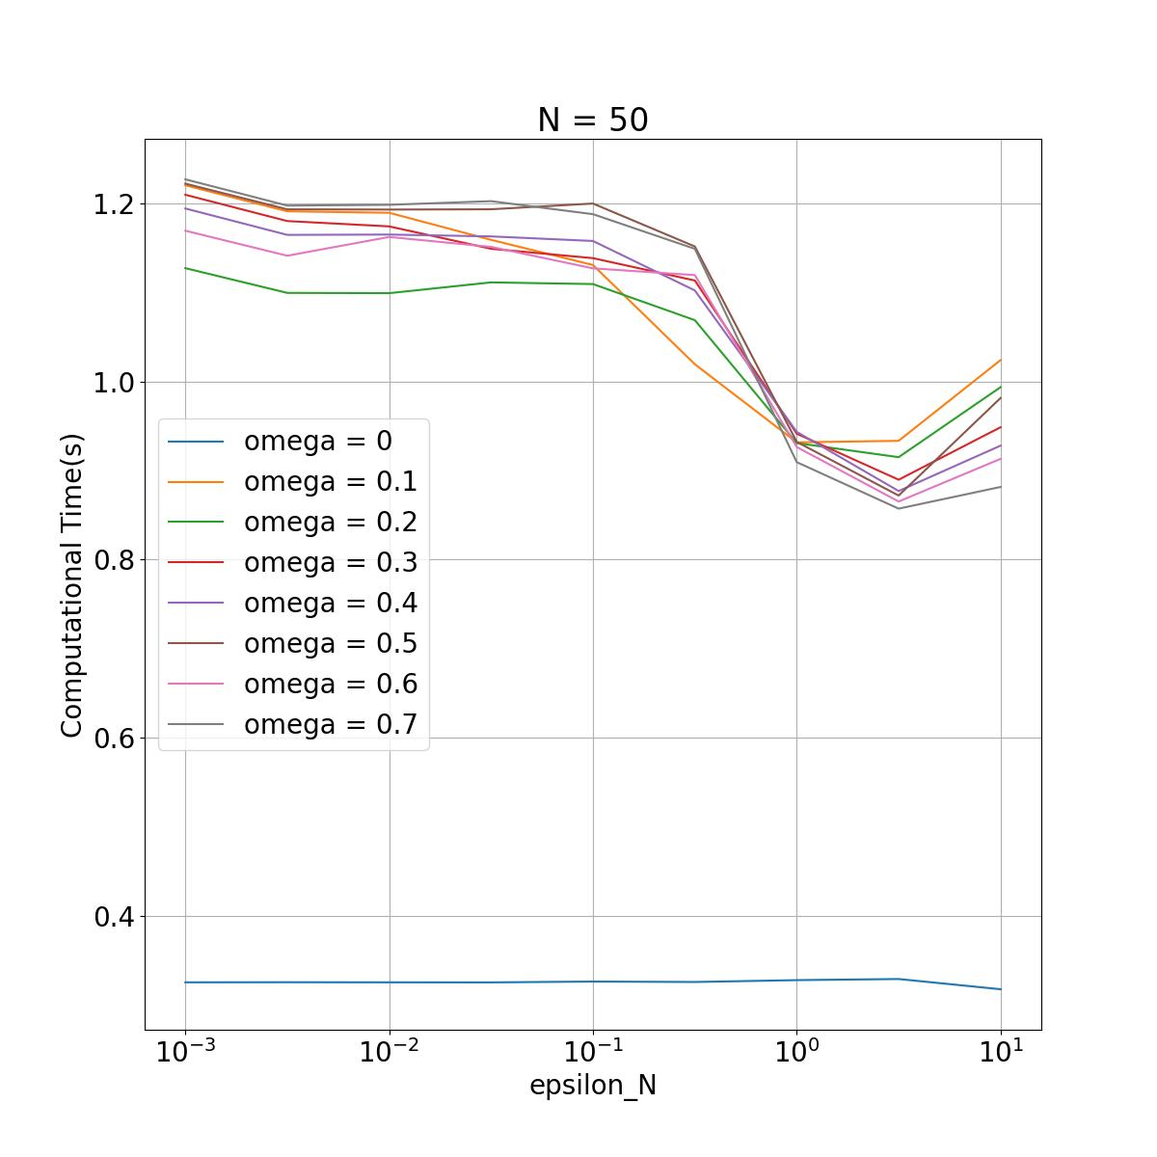
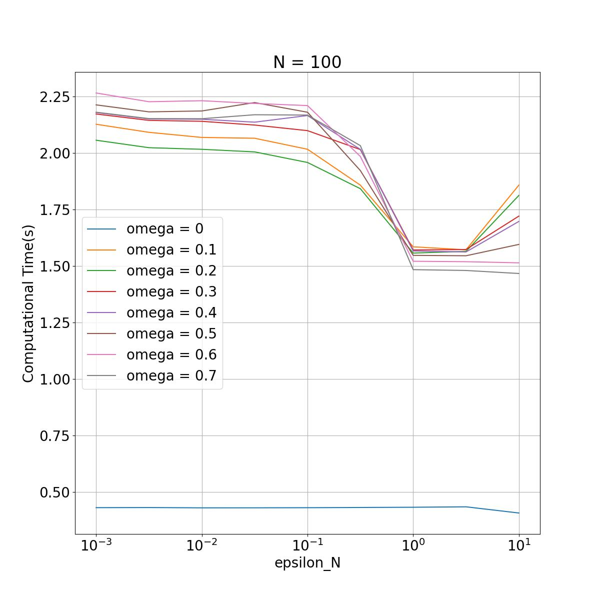
Result
The average computational time for the optimal situation only needs less than 2 seconds.

Slide 19
Conclusion
When the future demand is uncertain, the proposed method can:
Make a robust decision that results in a higher service level and lower total cost.
Highly practical since it can be applied to any manufacturing and retail industry.
Highly efficient since it only needs less than 2 seconds to make the decision.

Slide 20
Thank you.

Slide 21
Numerical experiment #1
Ending inventory of the first half of the week will be computed.
Ending inventory of the week will be computed.
Sunday
Monday
Tuesday
Wednesday
Thursday
Friday
Saturday
Decide the production quantities sent to each retailer and the warehouse.
Decide the replenishment quantities sent from the warehouse to each retailer.
The end of the week: Holding cost for each retailer and the warehouse,
Back ordering cost for each retailer.
Minimize the total cost of the week!

Slide 22
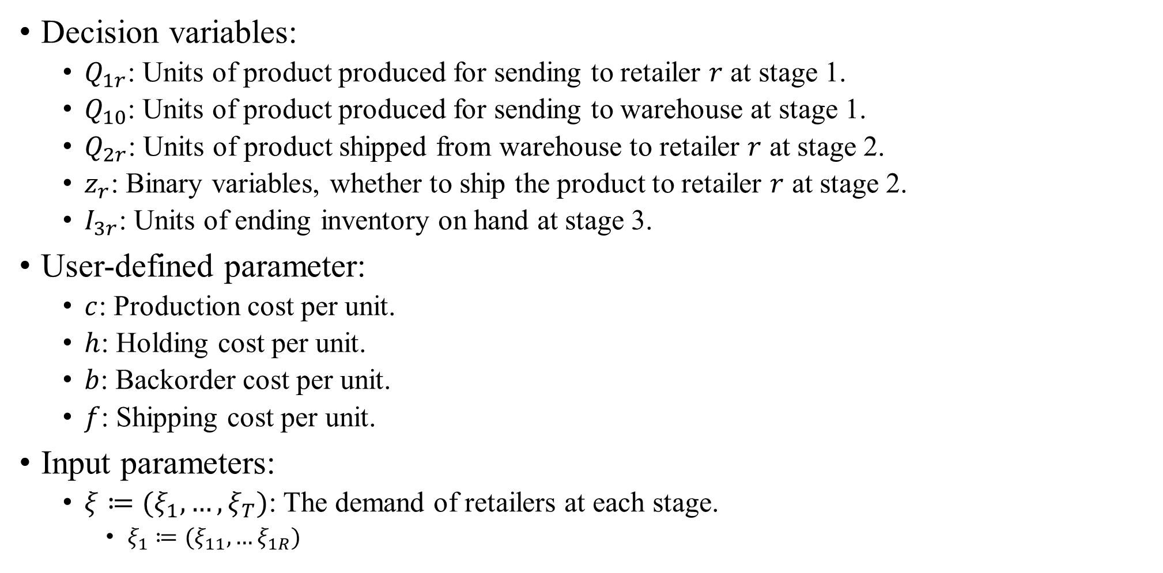
Mathematical model
Decision variables:
$Q_{1r}$: Units of product produced for sending to retailer $r$ at stage 1.
$Q_{10}$: Units of product produced for sending to warehouse at stage 1.
$Q_{2r}$: Units of product shipped from warehouse to retailer $r$ at stage 2.
$z_{r}$: Binary variables, whether to ship the product to retailer $r$ at stage 2.
$I_{3r}$: Units of ending inventory on hand at stage 3.
User-defined parameter:
$c$: Production cost per unit.
$h$: Holding cost per unit.
$b$: Backorder cost per unit.
$f$: Shipping cost per unit.
Input parameters:
$ξ≔(ξ_{1},…,ξ_{T})$: The demand of retailers at each stage.
$ξ_{1}≔(ξ_{11},…ξ_{1R})$

Slide 23
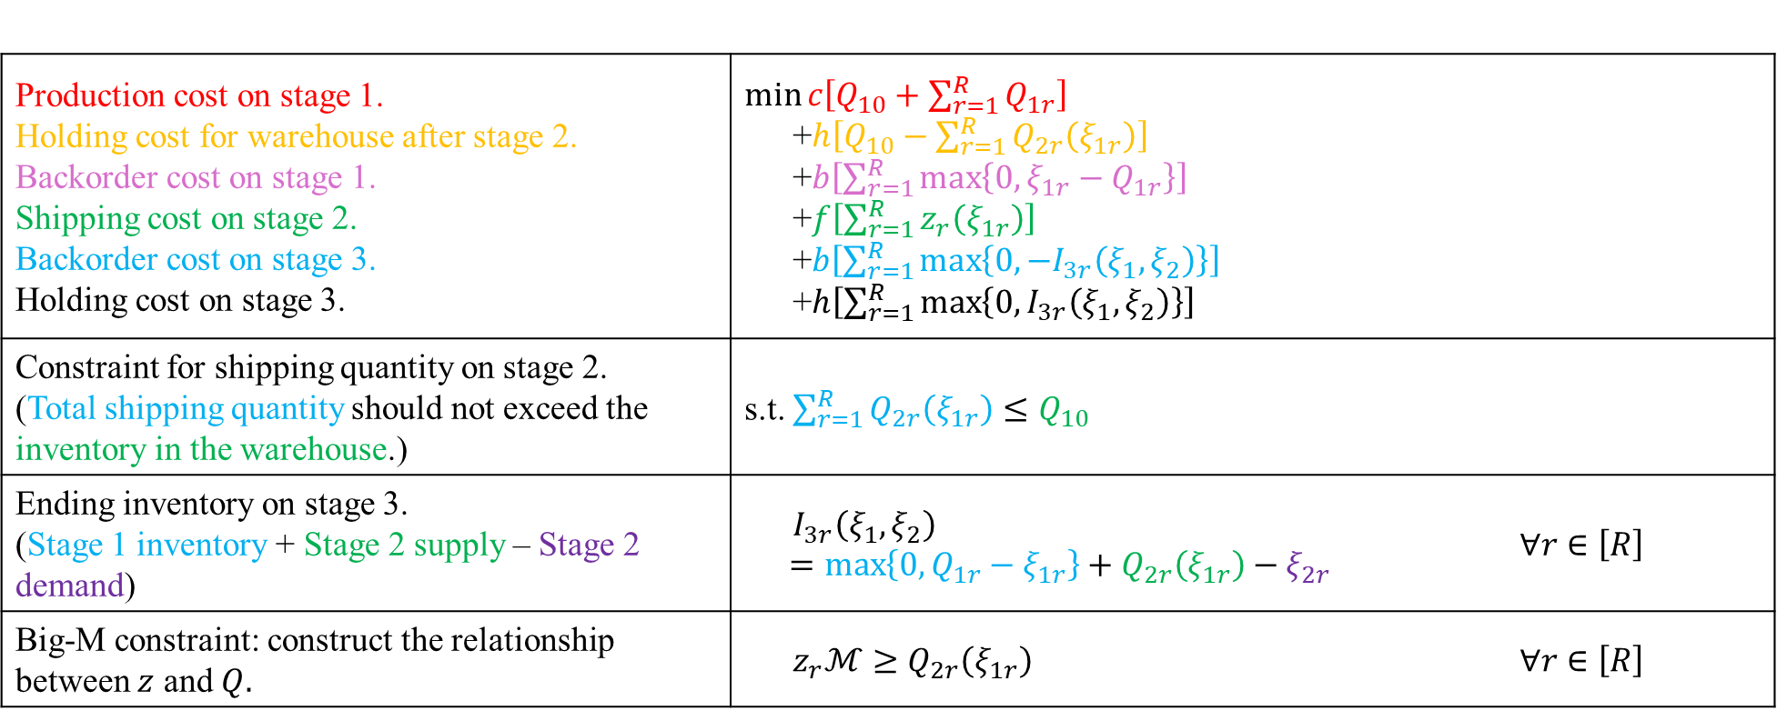
Mathematical model
Production cost on stage 1. Holding cost for warehouse after stage 2. Backorder cost on stage 1. Shipping cost on stage 2. Backorder cost on stage 3. Holding cost on stage 3. | $\min{c\left[Q_{10}+\sum_{r=1}^{R}{Q_{1r}}\right]}$ +$h\left[Q_{10}−\sum_{r=1}^{R}{Q_{2r}\left(ξ_{1r}\right)}\right]$ +$b\left[\sum_{r=1}^{R}{\max\left\{0,ξ_{1r}−Q_{1r}\right\}}\right]$ +$f\left[\sum_{r=1}^{R}{z_{r}\left(ξ_{1r}\right)}\right]$ +$b\left[\sum_{r=1}^{R}{\max\left\{0, −I_{3r}\left(ξ_{1},ξ_{2}\right)\right\}}\right]$ +$h\left[\sum_{r=1}^{R}{\max\left\{0, I_{3r}\left(ξ_{1},ξ_{2}\right)\right\}}\right]$
Constraint for shipping quantity on stage 2. (Total shipping quantity should not exceed the inventory in the warehouse.) | s.t. $\sum_{r=1}^{R}{Q_{2r}\left(ξ_{1r}\right)}≤Q_{10}$
Ending inventory on stage 3. (Stage 1 inventory + Stage 2 supply – Stage 2 demand) | $$I_{3r}\left(ξ_{1},ξ_{2}\right)=\max\left\{0,Q_{1r}−ξ_{1r}\right\}+Q_{2r}\left(ξ_{1r}\right)−ξ_{2r}$$ | $$∀r∈\left[R\right]$$
Big-M constraint: construct the relationship between $z$ and $Q.$ | $z_{r}ℳ≥Q_{2r}\left(ξ_{1r}\right)$ | $$∀r∈\left[R\right]$$
M is a very big constant.
If z = 1, there is no constraint on the value of Q, it can be zero or non-zero;
If z = 0, Q should be zero.

Slide 24
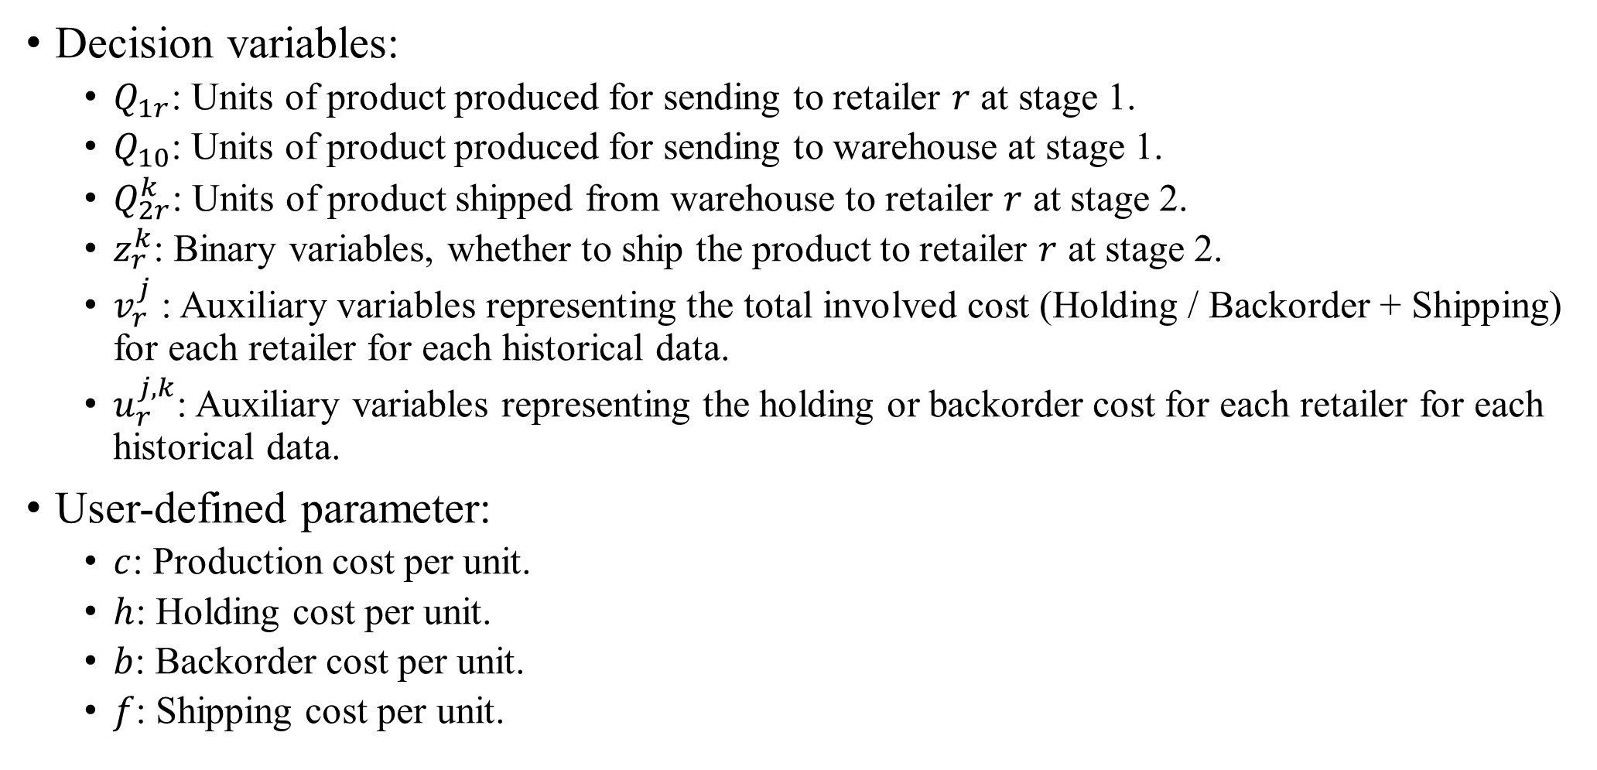
Robust optimization model
Decision variables:
$Q_{1r}$: Units of product produced for sending to retailer $r$ at stage 1.
$Q_{10}$: Units of product produced for sending to warehouse at stage 1.
$Q_{2r}^{k}$: Units of product shipped from warehouse to retailer $r$ at stage 2.
$z_{r}^{k}$: Binary variables, whether to ship the product to retailer $r$ at stage 2.
$v_{r}^{j}$: Auxiliary variables representing the total involved cost (Holding / Backorder + Shipping) for each retailer for each historical data.
$u_{r}^{j,k}$: Auxiliary variables representing the holding or backorder cost for each retailer for each historical data.
User-defined parameter:
$c$: Production cost per unit.
$h$: Holding cost per unit.
$b$: Backorder cost per unit.
$f$: Shipping cost per unit.

Slide 25
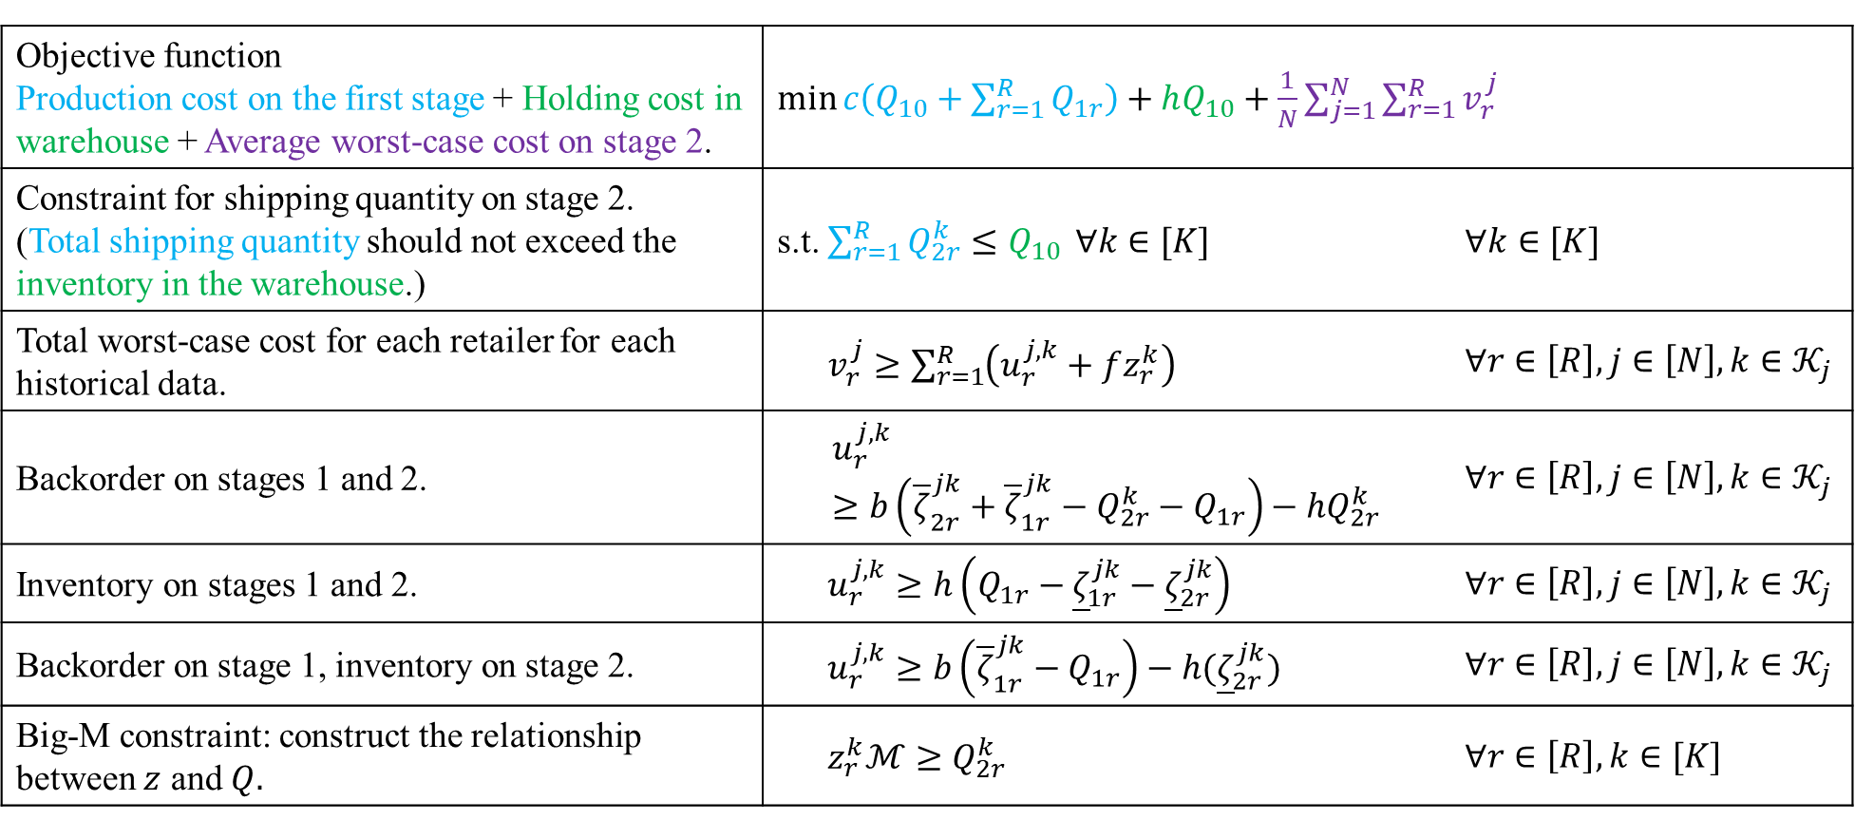
Robust optimization model
Robust optimization: minimize the average cost of the worst-case situation.
Objective function Production cost on the first stage + Holding cost in warehouse + Average worst-case cost on stage 2. | $\min{c\left(Q_{10}+\sum_{r=1}^{R}{Q_{1r}}\right)+hQ_{10}+\frac{1}{N}\sum_{j=1}^{N}{\sum_{r=1}^{R}{v_{r}^{j}}}}$
Constraint for shipping quantity on stage 2. (Total shipping quantity should not exceed the inventory in the warehouse.) | s.t. $\sum_{r=1}^{R}{Q_{2r}^{k}}≤Q_{10}$ $∀k∈[K]$ | $∀k∈[K]$
Total worst-case cost for each retailer for each historical data. | $v_{r}^{j}≥\sum_{r=1}^{R}{\left(u_{r}^{j,k}+fz_{r}^{k}\right)}$ | $∀r∈\left[R\right],j∈\left[N\right],k∈𝒦_{j}$
Backorder on stages 1 and 2. | $$u_{r}^{j,k}≥b\left({\overline{ζ}}_{2r}^{jk}+{\overline{ζ}}_{1r}^{jk}−Q_{2r}^{k}−Q_{1r}\right)−hQ_{2r}^{k}$$ | $∀r∈\left[R\right],j∈\left[N\right],k∈𝒦_{j}$
Inventory on stages 1 and 2. | $u_{r}^{j,k}≥h\left(Q_{1r}−{\underline{ζ}}_{1r}^{jk}−{\underline{ζ}}_{2r}^{jk}\right)$ | $∀r∈\left[R\right],j∈\left[N\right],k∈𝒦_{j}$
Backorder on stage 1, inventory on stage 2. | $u_{r}^{j,k}≥b\left({\overline{ζ}}_{1r}^{jk}−Q_{1r}\right)−h({\underline{ζ}}_{2r}^{jk})$ | $∀r∈\left[R\right],j∈\left[N\right],k∈𝒦_{j}$
Big-M constraint: construct the relationship between $z$ and $Q.$ | $z_{r}^{k}ℳ≥Q_{2r}^{k}$ | $∀r∈\left[R\right],k∈[K]$

Slide 26
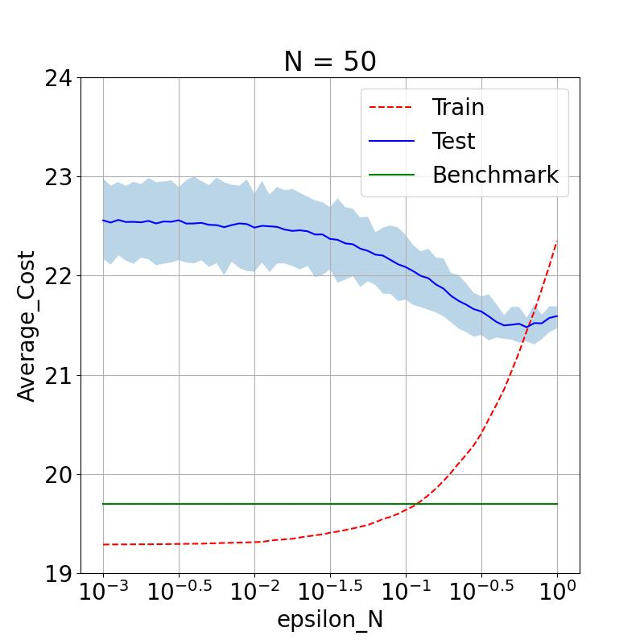
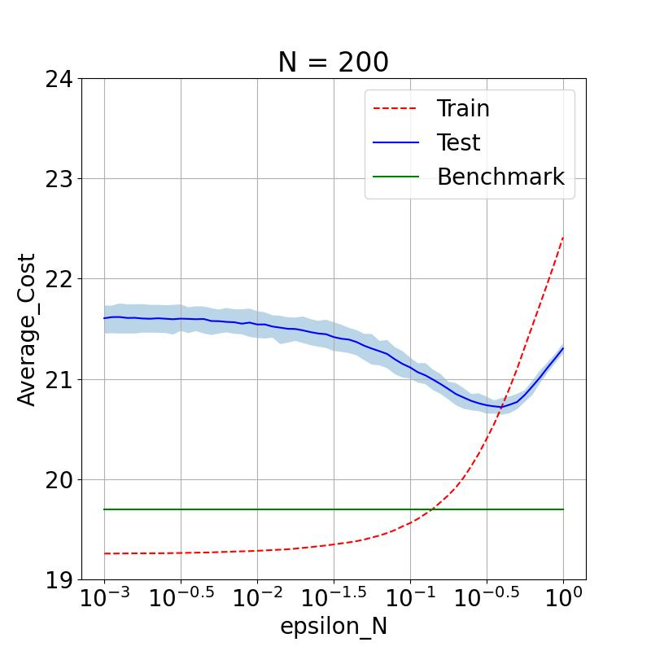
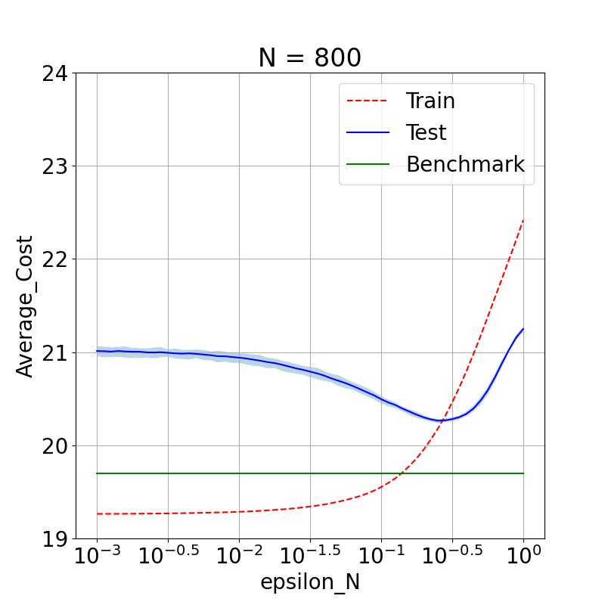
Result #1
Consider 3 retailers, no shipping cost, production cost $0.25/unit, holding cost $0.05/unit, backorder cost $0.5/unit.
The average result over 50 simulations, considers 10,000 testing data.
50 Training data
200 Training data
800 Training data
When the number of training data increases, the total cost will be lower.

