Slide 1
Heap
助教: 王子倫

Slide 2
概念
Heap是完整二元樹(complete binary tree)的一個主要應用，
常用來實作優先權佇列(Priority Queue)
此種佇列中，要刪除的元素是擁有最高(或最低)優先權的那些元素
每個節點的鍵值都不比子節點的值小(或大)

Slide 3
概念 from 1
1
7
Min Heap
2
18
3
15
4
24
5
62
6
22
7
17
8
9
79
26

Slide 4
概念 from 1
1
7
Min Heap
2
18
3
15
X= 4
24
5
62
6
22
7
17
8
9
79
26
2x
2x+1

Slide 5
概念 from 0
0
7
Min Heap
1
18
2
15
3
24
4
62
5
22
6
17
7
8
79
26

Slide 6
概念 from 0
0
7
Min Heap
1
18
2
15
X= 3
24
4
62
5
22
6
17
7
8
79
26
2x+1
2x+2

Slide 7
概念
0
7
Min Heap
7
1
18
2
15
18
15
3
24
4
62
5
22
6
17
24
62
22
17
7
8
79
26
79
26
 |  |  |  |  |  |  |  |  | …
0 | 1 | 2 | 3 | 4 | 5 | 6 | 7 | 8 | …

Slide 8
Insert
0
7
Min Heap
heap.insert(3);
1
18
2
15
3
24
4
62
5
22
6
17
7
8
9
79
26
7 | 18 | 15 | 24 | 62 | 22 | 17 | 79 | 26 |  | …

Slide 9
Insert
0
7
Min Heap
heap.insert(3);
1
18
2
15
3
24
4
5
22
6
17
62
3 < 62
7
8
9
79
26
62
7 | 18 | 15 | 24 |  | 22 | 17 | 79 | 26 |  | …

Slide 10
Insert
0
7
Min Heap
heap.insert(3);
1
18
2
15
18
3 < 18
3
24
4
5
22
6
17
7
8
9
79
26
62
7 |  | 15 | 24 |  | 22 | 17 | 79 | 26 | 62 | …
18

Slide 11
Insert
0
Min Heap
7
heap.insert(3);
1
2
15
3 < 7
3
24
4
18
5
22
6
17
7
8
9
79
26
62
7
 |  | 15 | 24 | 18 | 22 | 17 | 79 | 26 | 62 | …

Slide 12
Insert
要Insert的位置在最前面
0
Min Heap
3
heap.insert(3);
1
7
2
15
3
24
4
18
5
22
6
17
7
8
9
79
26
62
3
 | 7 | 15 | 24 | 18 | 22 | 17 | 79 | 26 | 62 | …

Slide 13
Insert
0
3
Min Heap
heap.insert(3);
1
7
2
15
3
24
4
18
5
22
6
17
7
8
9
79
26
62
3 | 7 | 15 | 24 | 18 | 22 | 17 | 79 | 26 | 62 | …

Slide 14
Delete
0
3
Min Heap
heap.delete();
1
7
2
15
3
24
4
18
5
22
6
17
7
8
9
79
26
62
3 | 7 | 15 | 24 | 18 | 22 | 17 | 79 | 26 | 62 | …

Slide 15
Delete
0
3
Min Heap
heap.delete();
1
7
2
15
3
24
4
18
5
22
6
17
7
8
9
79
26
62
62
3 | 7 | 15 | 24 | 18 | 22 | 17 | 79 | 26 | 62 | …
temp

Slide 16
Delete
0
Min Heap
3
heap.delete();
1
7
2
15
3
24
4
18
5
22
6
17
7
8
79
26
3
3 | 7 | 15 | 24 | 18 | 22 | 17 | 79 | 26 | 62 | …
temp
62

Slide 17
Delete
0
Min Heap
heap.delete();
1
7 < 15
2
15
7
3
24
4
18
5
22
6
17
7
8
79
26
 |  | 15 | 24 | 18 | 22 | 17 | 79 | 26 | 62 | …
7
temp
62

Slide 18
Delete
0
7
Min Heap
heap.delete();
1
2
15
3
24
4
5
22
6
17
24 > 18
18
7
8
79
26
18
7 |  | 15 | 24 |  | 22 | 17 | 79 | 26 | 62 | …
temp
62

Slide 19
Delete
0
7
Min Heap
heap.delete();
1
18
2
15
3
24
4
5
22
6
17
62
7
8
79
26
7 | 18 | 15 | 24 |  | 22 | 17 | 79 | 26 | 62 | …
temp
62

Slide 20
Delete
0
7
Min Heap
heap.delete();
1
18
2
15
3
24
4
62
5
22
6
17
7
8
79
26
7 | 18 | 15 | 24 | 62 | 22 | 17 | 79 | 26 | 62 | …

Slide 21
Delete
0
7
Min Heap
heap.delete();
1
18
2
15
3
24
4
62
5
22
6
17
7
8
79
26
7 | 18 | 15 | 24 | 62 | 22 | 17 | 79 | 26 | 62 | …

Slide 22
課堂練習(12/8 21:00)
請把1207_from 0.cpp的整個程式
修改成Max Heap
(函式名稱也要修改)
檔名仍然是 學號(不要s).cpp

Slide 23
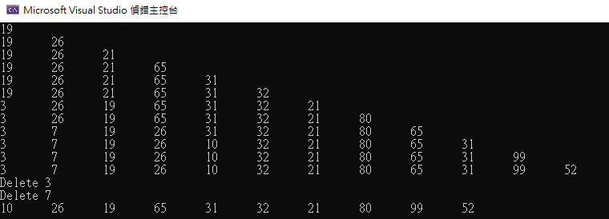
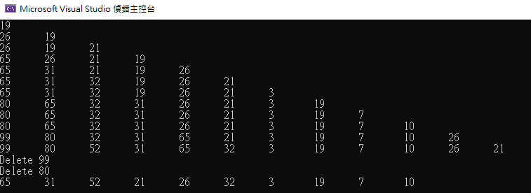
輸出範例
修改前
修改後

