Slide 1
Sort
助教: 王子倫

Slide 2

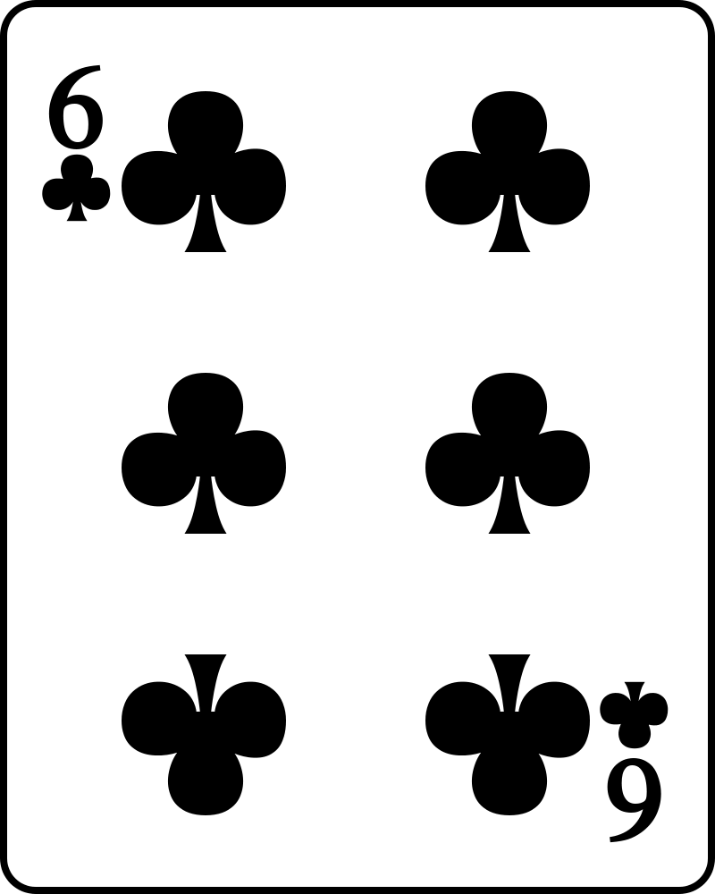
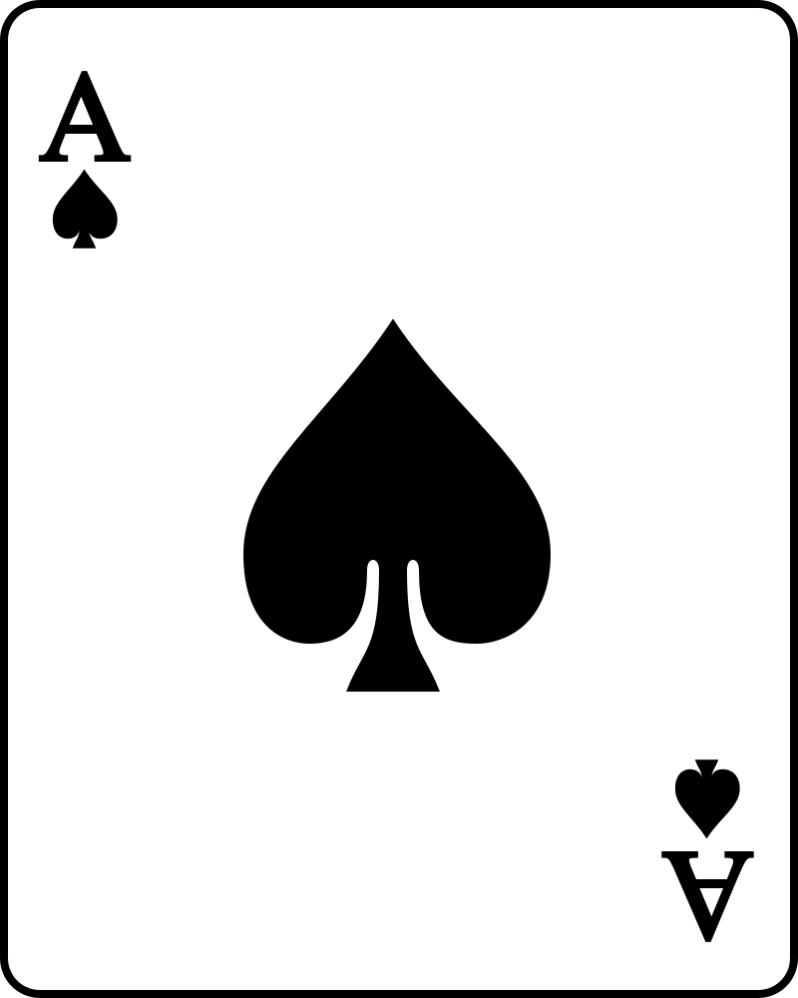
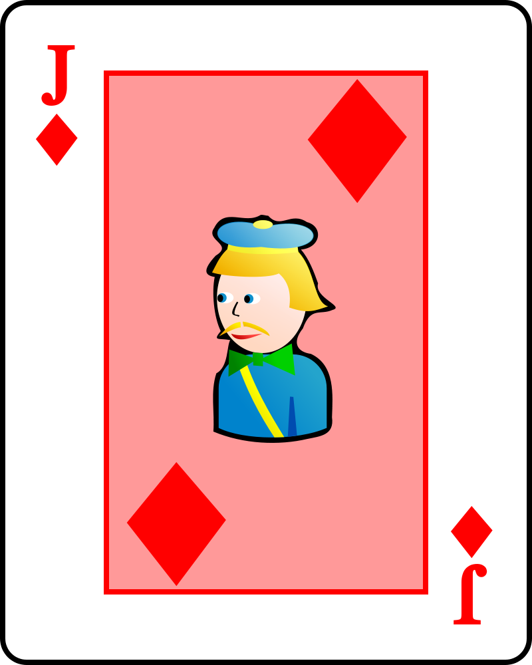
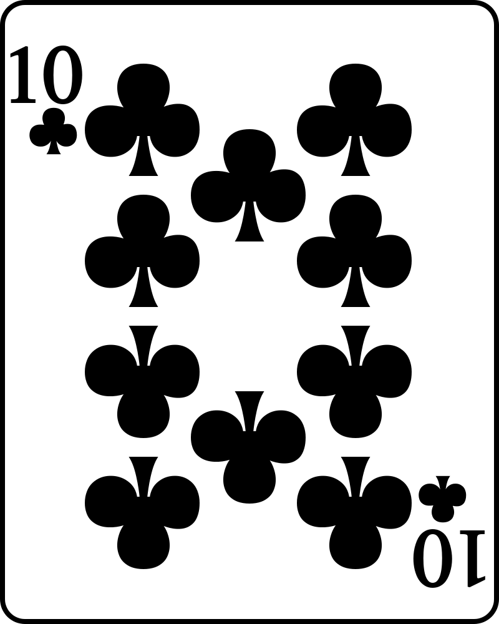
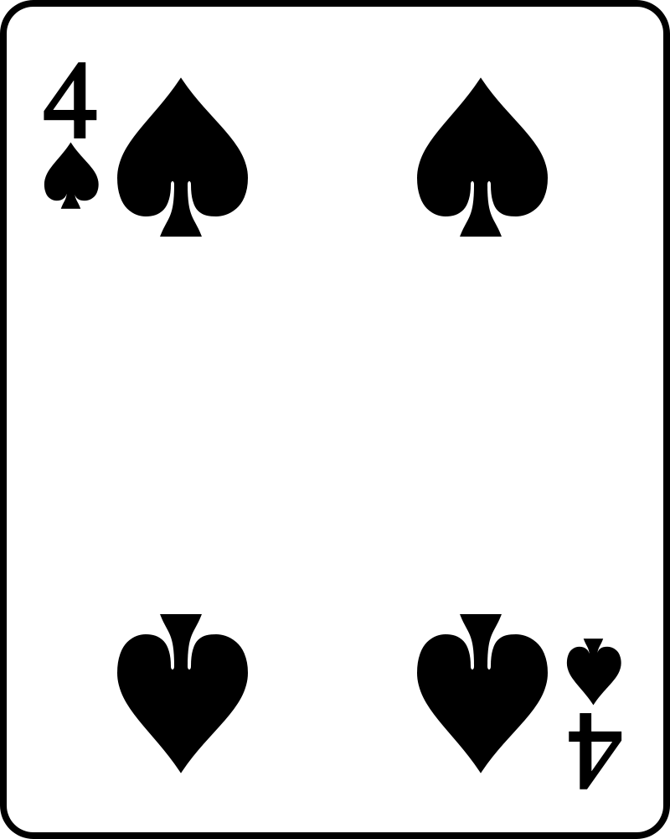
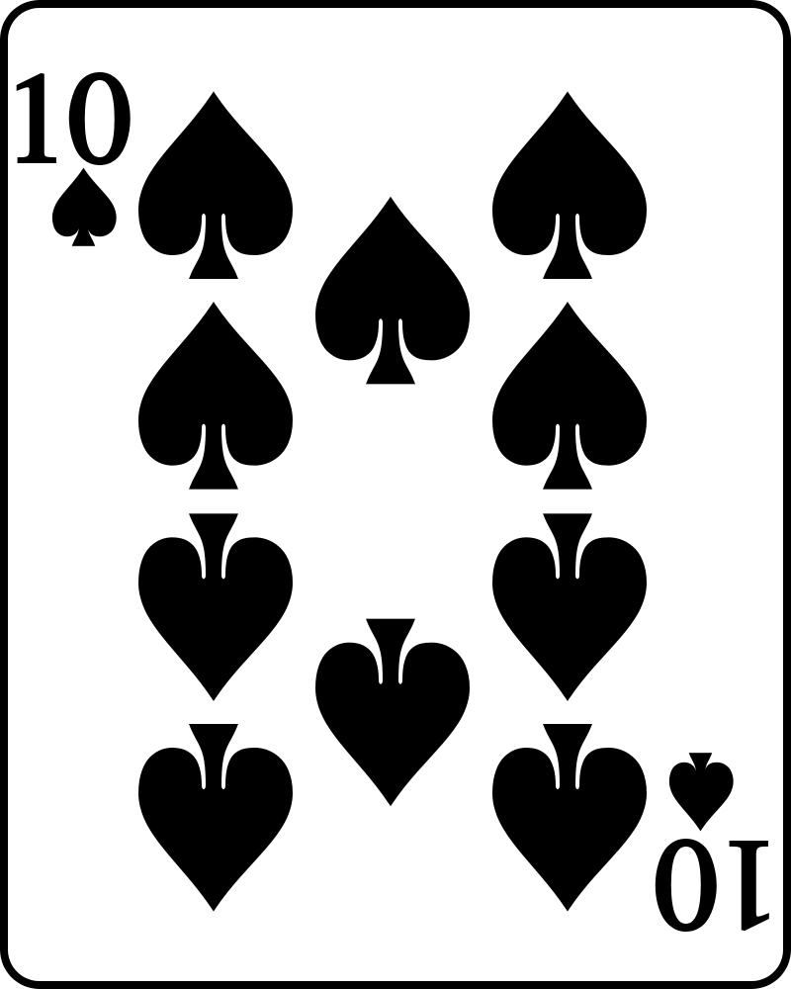
Bubble Sort
i = 0

Slide 3
Bubble Sort
i = 0

Slide 4
Bubble Sort
i = 1

Slide 5
Bubble Sort
i = 1

Slide 6
Bubble Sort
i = 2

Slide 7
Bubble Sort
i = 2

Slide 8
Bubble Sort
i = 3

Slide 9
Bubble Sort
i = 3

Slide 10
Insertion Sort

Slide 11
Insertion Sort
i = 0

Slide 12
Insertion Sort
i = 0

Slide 13
Insertion Sort
i = 1

Slide 14
Insertion Sort
i = 1

Slide 15
Insertion Sort
i = 3

Slide 16
Insertion Sort
i = 3

Slide 17
Insertion Sort
i = 3

Slide 18
Insertion Sort
i = 4

Slide 19
Insertion Sort
i = 4

Slide 20
Insertion Sort
i = 5

Slide 21
Insertion Sort
i = 5

Slide 22
Selection Sort

Slide 23
Selection Sort
i = 0

Slide 24
Selection Sort
i = 0

Slide 25
Selection Sort
i = 1

Slide 26
Selection Sort
i = 1

Slide 27
Selection Sort
i = 2

Slide 28
Selection Sort
i = 2

Slide 29
Selection Sort
i = 3

Slide 30
Selection Sort
i = 3

Slide 31
Selection Sort
i = 4

Slide 32
Selection Sort
i = 5

Slide 33
Quick Sort
若要排序結果為Ascending， 可以先在最左邊設定一個基準點(Pivot key)，然後設置兩個變數i和j，
i和j分別在最左邊和最右邊，
重複下列動作直到i和j相遇:
j從右邊往左邊找一個值 < 基準點
i從左邊往右邊找一個值>=基準點
i和j 交換
將i和j相遇的位置的值與基準點互換。 再分別從基準點的兩邊資料做子循環。

Slide 34
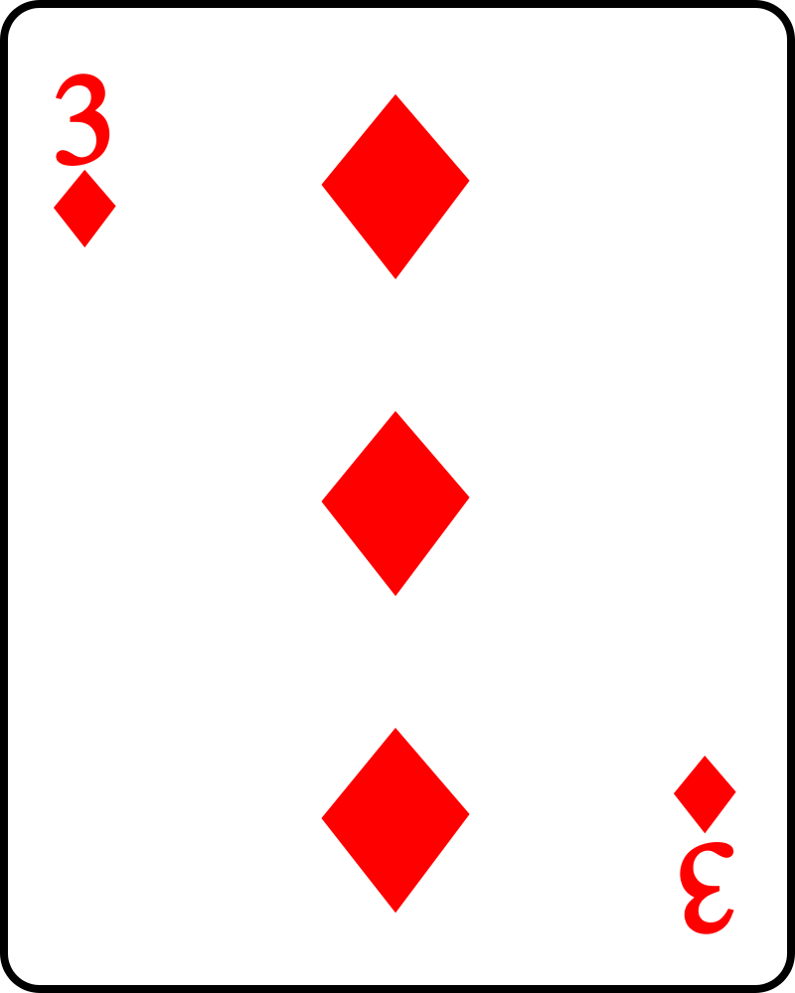
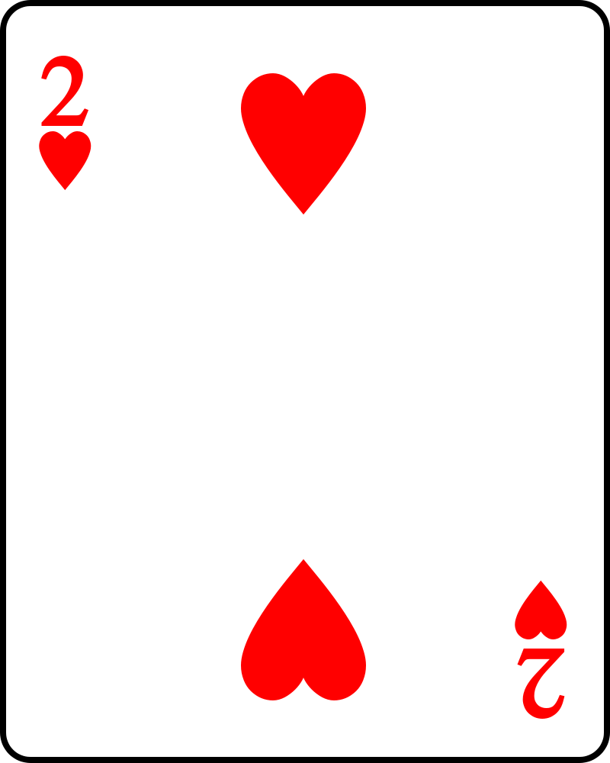
Quick Sort

Slide 35
Quick Sort
key
i
j

Slide 36
Quick Sort
key
i
j

Slide 37
Quick Sort
key
i
j

Slide 38
Quick Sort
key
i
j

Slide 39
Quick Sort
key
i
j

Slide 40
Quick Sort
key
i
j

Slide 41
Quick Sort

Slide 42
Quick Sort
key
i
j

Slide 43
Quick Sort
key
i
j

Slide 44
Quick Sort
key
i
j

Slide 45
Quick Sort
key
i
j

Slide 46
Quick Sort
key
i
j

Slide 47
Quick Sort
i
j

Slide 48
Quick Sort

Slide 49
Quick Sort
key
i
j

Slide 50
Quick Sort
key
i
j

Slide 51
Quick Sort
key
i
j

Slide 52
Quick Sort
key
i
j

Slide 53
Quick Sort
key
i
j

Slide 54
Quick Sort

Slide 55
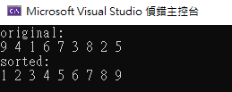
課堂練習(12/29 21:00)
完成函式quickSort

