Slide 1

COMP3211 Software Engineering
Presentation Group 96
Koon Him MOO
WU Jia sheng
Ho Yu YIP
Sarah Bless Sarmiento Monsod

Slide 2
Content
System Requirements:
2. Design Document
3. The strategy adopted when preparing high-quality unit tests

Slide 3
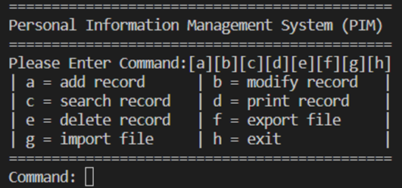
System Functional Requirements
Needs of the PIM
A panel which allow the user to modify multiple types of personal information records, which include the function of creating, editing, and deleting records
A record which is used to keep the data in the data item in a consistent state, that after user modify or search PIRs, or import or export files, record is keep update and save in the system

Slide 4
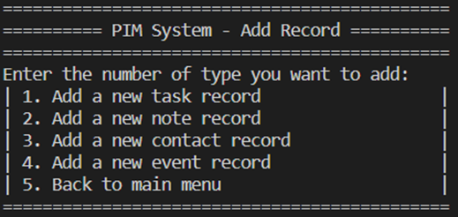
System Functional Requirements
Creation of the PIM
A menu which allow the user to choose whether they want to create plain texts, tasks, events or contacts
By creating the plain notes, the user can type the content for quick notes, which the system receives what user type and save it in record
By creating new tasks, the user can type and save the content for description and set up the date for the deadline, which the system receives what user type and save it in record
By creating new events, the user can type and save the content for descriptions, set up the date and time for starting time, which the system receives what user type and save it in record
By creating new contacts, the user can type and save the content for the corresponding names, addresses, and mobile numbers, which the system receives what user type and save it in record

Slide 5
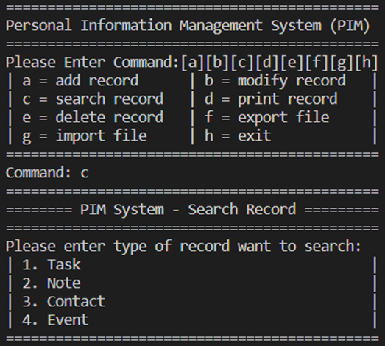
System Functional Requirements
Search information of PIRs in PIM
The PIM should allow the user to search for PIRs based on criteria concerning their types and the data stored in their fields, which let the user to choose the type of PIRs.
The system should identify the criteria and keyword that the user type, search the data that contain the keyword in record and match the criteria, and display the result to the user.

Slide 6
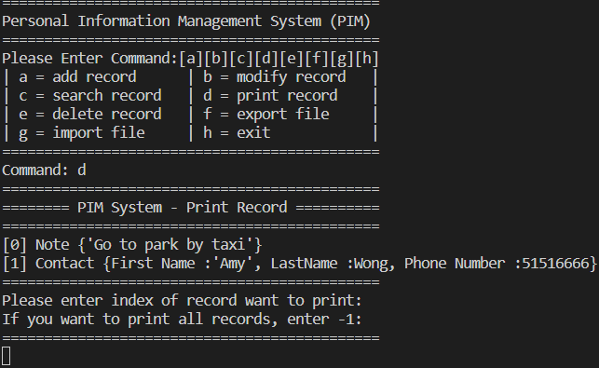
System Functional Requirements
Print information of PIRs in PIM
The PIM should allow the user to printing out detailed information about a specific PIR or all PIRs
The system will show all the existing PIRs by using index to identify them, let the user to choose which PIR want to print out all the information in specific PIR or all PIRs by typing the index
The system should identify the index and print out the required information in PIRs in record.

Slide 7
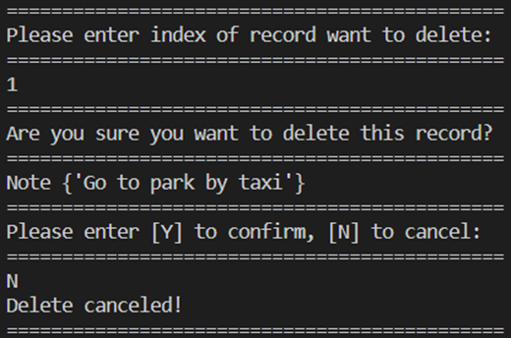
System Functional Requirements
Delete PIRs in PIM
The PIM should allow the user to delete the specified PIR
The system will show all the existing PIRs by using index to identify them, let the user to choose which PIR want to delete PIR by typing the index, and the system should identify the index, and delete required PIRs in record.

Slide 8
System Functional Requirements
Stores PIRs in file
The PIM should allow the user to store the PIRs in a file
The system will require the user to enter new file name for the file by typing
The system should combine the user type and “.pim” for storing the file
Load PIR’s file
The PIM should allow the user to load the PIRs in a file with the extension name “.pim”
The system will require the user to enter new file name for the file plus “.pim” by typing
The system should load the required file to the PIM and load all the record in that file, and save to the record in PIM

Slide 9


System Non-Functional Requirements
Check the user input:
is it meet the requirement of Capital letter or small letter
date is “xx/xx/xxxx”
time is “xx:xx”

Slide 10
System Non-Functional Requirements
Automatically add the extension name “.pim” for storing the PIR’s file
When user store the file, the system should automatically combine the user keyword and the extension name “.pim”
To prevent user forget add “.pim” when saving the file

Slide 11
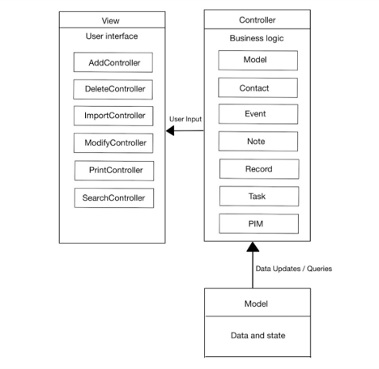
Overall Design
System Architecture
Architecture Pattern : MVC architectural pattern
Model:
Represents data and business logic
Classes: Contact, Event, Note, Record, Task, PIM
View:
Represents the user interface
Controller classes: AddController, DeleteController, ImportController, ModifyController, PrintController, SearchController
Controller:
Acts as an intermediary between Model and View
Handles user input and updates the View
Controller classes mentioned above control information flow
Notes:
Today, I'm going to present to you the design of our Personal Information Management (PIM) system.
To support the group of requirements in our PIM system, we have adopted the MVC architectural pattern, which stands for Model-View-Controller. This pattern provides a solid foundation for organizing our system's components and functionalities.
Let's start with the Model component. In our design, the Model represents the data and business logic of our PIM system. We have classes such as Contact, Event, Note, Record, Task, and PIM, which handle the storage, manipulation, and retrieval of personal information within the system.
Moving on to the View component, it represents the user interface of our PIM system. We have specialized controller classes like AddController, DeleteController, ImportController, ModifyController, PrintController, and SearchController. These controllers handle the presentation and interaction with the user, allowing them to add, delete, modify, print, and search for personal information.
Acting as the bridge between the Model and View, the Controller component plays a crucial role in our system. It handles user input, processes it, and updates the View accordingly. The mentioned controller classes control the flow of information between the Model and View based on user actions, ensuring a seamless user experience.
By utilizing the MVC pattern in our PIM system design, we achieve several benefits. The separation of concerns allows us to modify the data storage, user interface, and user interactions independently, making our system more flexible and maintainable over time.
In conclusion, our design for the PIM system follows the MVC architectural pattern, providing a robust and efficient structure. It ensures a clear division of responsibilities, allowing us to manage personal information effectively and deliver a seamless user experience.

Slide 12
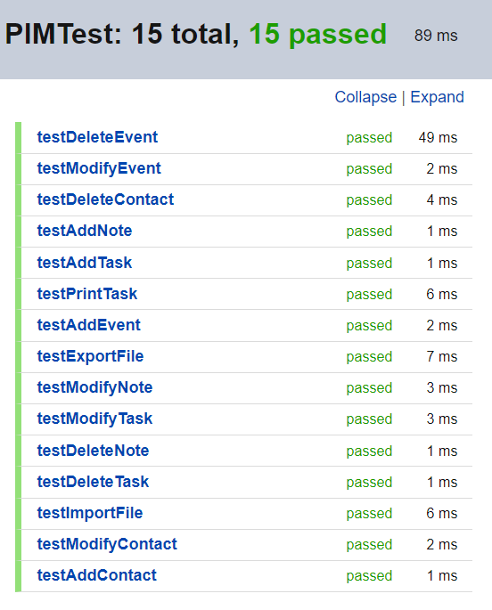
The strategy adopted when preparing high-quality unit tests
Unit Testing
Our code you is a test suite for our Personal Information Manager (PIM) application. It contains several test methods that test various functionalities of the PIM, such as adding, modifying, and deleting different types of records (tasks, notes, contacts, and events), printing records, and exporting/importing data from files.
The test methods simulate user input using the systemInMock object and verify the expected behavior of the PIM application by asserting the results using assertEquals and assertTrue statements.
Overall, the code demonstrates a unit testing approach to ensure the correctness of the PIM application's functionalities.

Slide 13
That’s it for our presentation
Thank you

