Slide 1
Building a high-frequency trading algorithm using an ordinary differential equation recurrent neural network

Slide 2
Financial markets
A place to buy and sell assets.
Stocks, bonds, options, foreign currencies etc.
The exchange is the mechanism with which traders’ orders are matched with each other.
Most work using continuous double auction
Notes:
CDA is fixed duration auction mechanism by which multiple buyers and sellers compete to buy and sell goods.
Buyers and sellers can enter orders at any time.

Slide 3
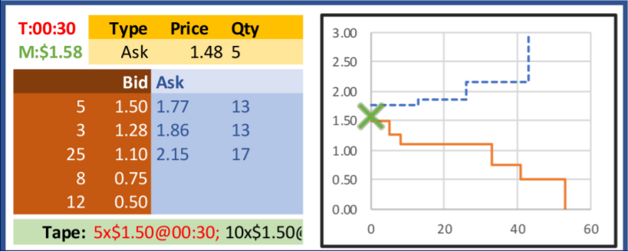
Limit order book
Notes:
Orders added using “limit orders” representing an instruction to buy or sell at a particular price or better.
Level 1 (top-of-book) = only best (highest) bid, and best (lowest) ask along with corresponding quantities.
Level 2 = shows not only top of book but any number of other orders in the book as well.
When bid and ask offers cross over, a transaction occurs.

Slide 4
High-frequency trading
HFT is a method of trading in these exchanges.
Characterised by high speeds, high turnover rates and high order-to-trade ratios.
Analyse high frequency tick data from LOB.
Can we predict the short-term price direction of a stock by analysing recent LOB ticks?
Notes:
Usually run on very powerful computers geographically near to the exchange (latency is everything)

Slide 5
Can deep learning be applied to hft?
CNN-LSTMs have been used with some success by capturing the spatial structure of entire LOB. DeepLOB, Zhang et al. 2019
Deep reinforcement learning, Briola et al. 2016
LSTMs have shown impressive results. Cont et al. 2018, Tu 2020
Full access to the LOB is hard to come by.
LSTMs work best on regularly sampled time series data but fail to account for arbitrary time lags between samples.
Notes:
Many widely accepted studies show that financial markets are to some extent predictable.
General agreement that stocks behave in complex ways, with highly nonlinear relationships.
Deep learning is able to capture arbitrary nonlinear relationships with little, or no, prior knowledge regarding the input data.
Potentially more powerful than simple statistical techniques like mean reversion.

Slide 6
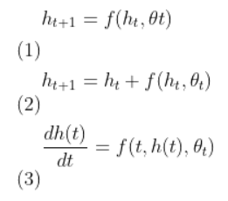
Neural ODE
Duvenaud et al. 2018
Let fully-connected neural network represent an ordinary differential equation
Neural ODE represents the progression of the hidden state continuously.
Solve the ODE numerically using methods like euler, dopri, rk4 etc.
Notes:
ODE is a simple equation relating a function f of one variable to its derivatices.
No partial derivatives.
To solve an ODE is to determine the function (or functions) that satisfy the equation.
ODE solvers make an approximation of a function by using iterative step processes.
In Euler’s method, we use known observations of the underlying function (data points) and step in the direction of the gradient (function we know).
No discrete layers as in a regular neural network, the depth is essentially learnt using backprop through the ODE solver.
Completely continuous neural network.
Intuition behind what inspired the paper is in technical background.

Slide 7
Ode-lstm
Continuous nature of Neural ODE is perfect for modelling time (irregularly sampled data).
ODE-LSTM proposed by Lechnar and Hasani in December 2020.
Leaves the memory of LSTM cell untouched to allow for learning long-term dependencies.
Includes an ODE layer which can be solved as initial value problem from t0 to t1.
Incorporates the arbitrary time lag using continuous neural network.

Slide 8
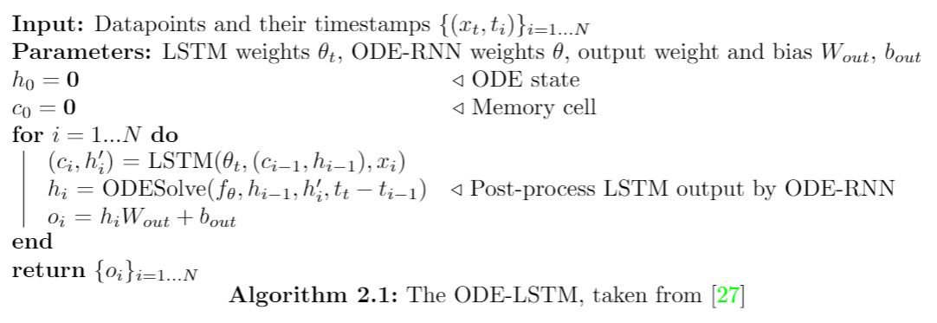
ODE-Lstm

Slide 9
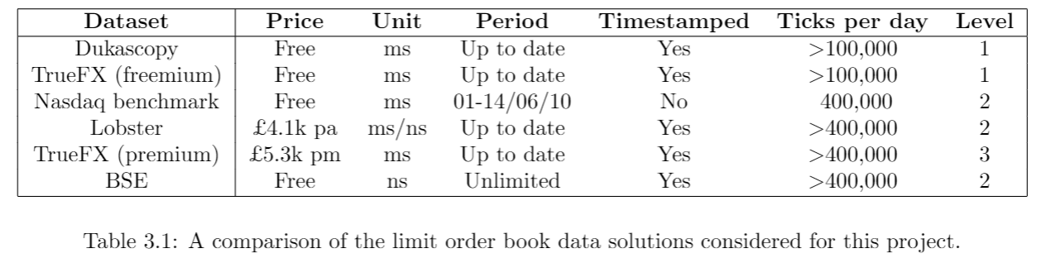
Data selection
Notes:
Emailed authors of the Nasdaq benchmark paper and they said it Nasdaq wouldn’t allow the timestamps to be included to prevent full reconstruction of LOB.

Slide 10
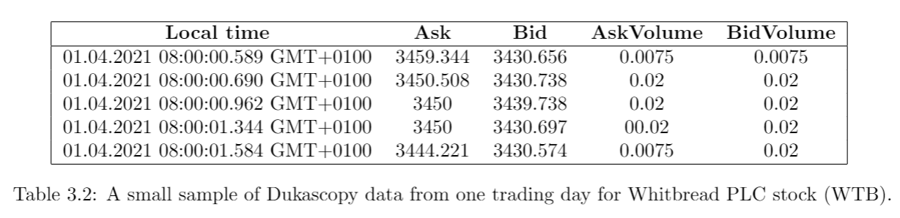
Data selection
Notes:
Dukascopy Bank is a Swiss company providing online/mobile trading, banking and financial services.
They have a electronic communication network (exchange) called SwissFX.
They offer top-of-book data to the public.

Slide 11
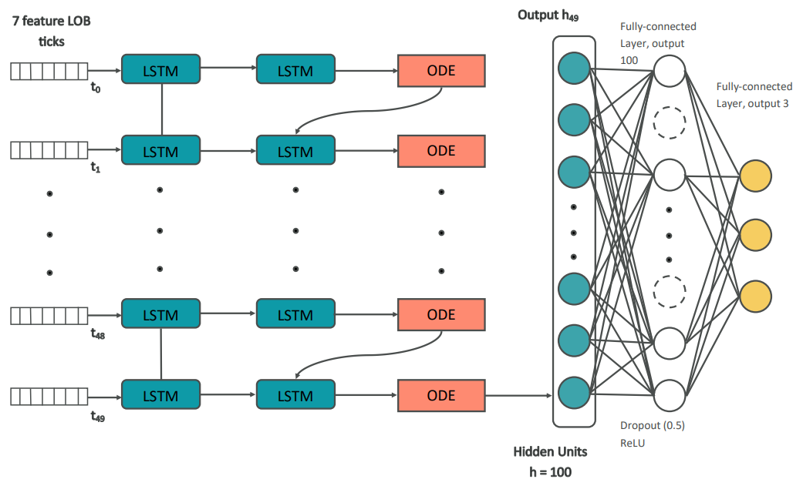
Network architecture
Notes:
Data was normalised with min-max.
Also used batch norm layer.
ODE is 100 to 100 sequential layer with tanh activation, rk4 solver.
Tested network architecture on human activity recognition dataset and was able to achieve 92% accuracy (compared to 89% achieved by original paper).
Some feature extraction improved performance.
Aims to predict 20, 50, and 100 ticks in advance.
Smoothed using exponential running averages for labels.
Can show a graph of what the labelling looks like if needed.
Also built a standard LSTM which was much simpler given PyTorch off-the-shelf implementations.
There is now also a flag in the initialization parameters of the model that allow you to turn off and on the ODE.
Can go into implementation detail like Python libraries used: PyTorch lightning, TorchDyn, PyTorch, Numpy, Seaborn, Pandas, Matplotlib.

Slide 12
evaluation
Preliminary results yet to show a significant improvement to standard LSTM.
Training times are very long, even on BluePebble GPUs.
Train and test samples not as big as I would want.
Does achieve ~70% accuracy.
Metrics for evaluation are accuracy, precision, recall, F1-score.
Trading simulation in progress.
Notes:
Implemented ODE-LSTM from scratch using a couple of different libraries.
Precision is how many class correctly declared out of all instances where the algorithm detected the class.
Recall Is fraction of classes correctly declared for a class out of all occurrences of that class.
F1 is combination of both.
Inclusion of false positives and false negatives makes for better measure than plain accuracy.
Trading simulator will use real data and can be run in real time or sped up.
Might consider parallelizing to compete algorithms against each other.
Will also do speed tests of the implementation of the models in a trading simulation.

Slide 13
Thank you

