Slide 1
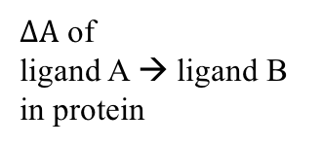
Workflow
1. Classical MD
Gaussian 09
RESP charge
Frcmod file
AMBER FF14SB
Prmtop_A
Inpcrd_A
Classical MD
Prmtop_A
Rst_A
Ligand A PDB
+ Protein PDB
AmberTools16
GAFF 1.8
SPC/E water + Na⁺ Cl⁻ ions
5ns NPT equilibration
2. TI topology preparation
Prmtop_A
Rst_A
ambpdb
tleap
Prmtop_AB
Inpcrd_AB
Equilibrated protein-ligand A PDB
+ Ligand B PDB
Parmed.py
1ns NVT equilibration
5ns NVT sampling
3. TI calculation
lambda= 0.00922
lambda= 0.00922
Minimization
~ps NVT heating 0 to 300 K
1ns NPT equilibration at 300 K
....
….
….
….
….
$∆A$ of
ligand A → ligand B in protein
Prmtop_AB
Inpcrd_AB
Structure,
No velocity
12 lambda
lambda=0.5

