Slide 2
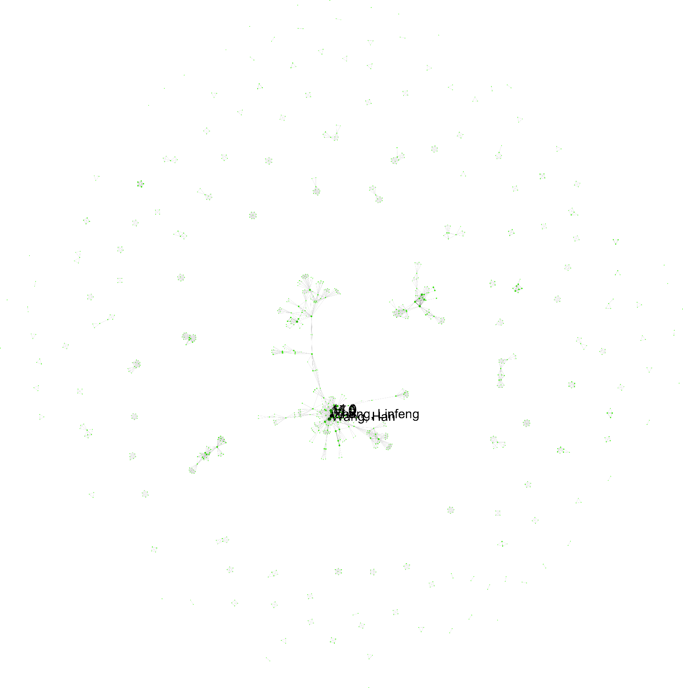

Slide 3
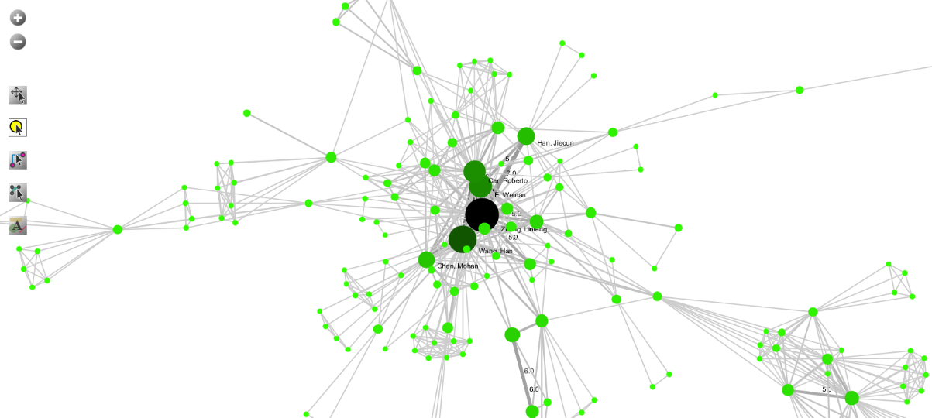

Slide 4

Zhang Linfeng
Wang Han
E Weinan
Roberto Car
Han Jiequn
Chen Mohan

Slide 5
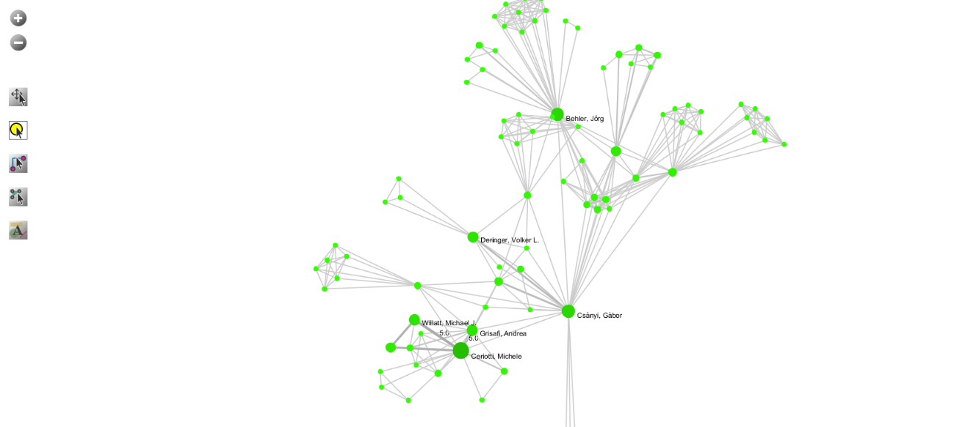

Slide 6
Ceriotti Michele
SOAP-based ML-potentials
Willatt Michael J.
SOAP-based ML-potentials
Grisafi Andrea
SOAP-based ML-potentials
Laboratory of Computational Science and Modeling, IMX, Ecole Polytechnique Federale de Lausanne, 1015 Lausanne, Switzerland
Csányi Gábor
SOAP-based ML-potentials
Department of Engineering, University of Cambridge
Deringer Volker L.
SOAP
Associate Professor, University of Oxford
Behler Jörg
BPNN
Universität Göttingen, Institut für Physikalische Chemie, Theoretische Chemie, Tammannstraße 6, 37077 Göttingen, Germany

Slide 7
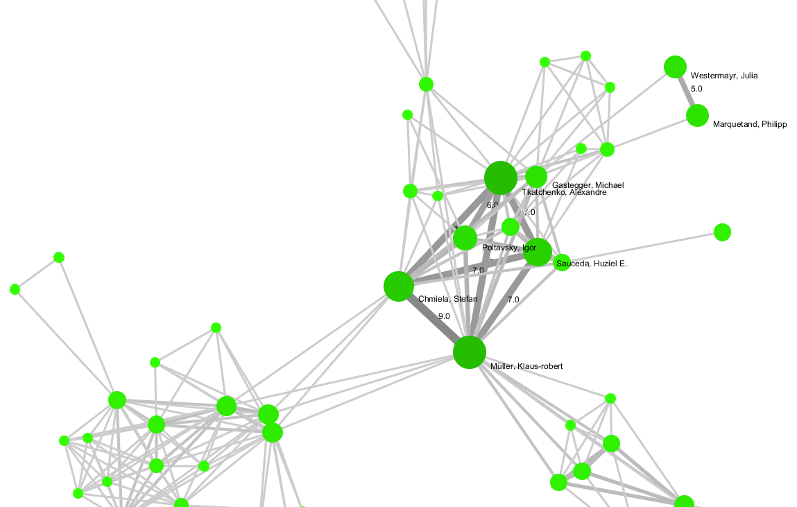

Slide 8
Müller Klaus-robert
GDML, SchNet
Technische University at Berlin & Korea University & Google Brain & MPII
Tkatchenko Alexandre
Poltavsky Lgor
SchNet
Department of Physics and Materials Science, University of Luxembourg, L-1511 Luxembourg City, Luxembourg
Gastegger Michael
&Oliver T. Unke: SpookyNet
&K. T. Schütt: SchNet
Sauceda Huziel E.
Chmiela Stefan
SchNet
Technische University at Berlin, 10587 Berlin, Germany
Marquetand Philipp
Institute of Theoretical Chemistry, Faculty of Chemistry, University of Vienna, Währinger Str. 17, 1090 Vienna, Austria
&Roland Lindh: OpenMolcas
Department of Chemistry − BMC, Uppsala University, P.O. Box 576, SE-751 23 Uppsala, Sweden
&Jesús González-Vázquez: SHARC
(ab Initio Molecular Dynamics with Surface Hopping in the Adiabatic Representation Including Arbitrary Couplings)
Universidad Autónoma de Madrid

Slide 9
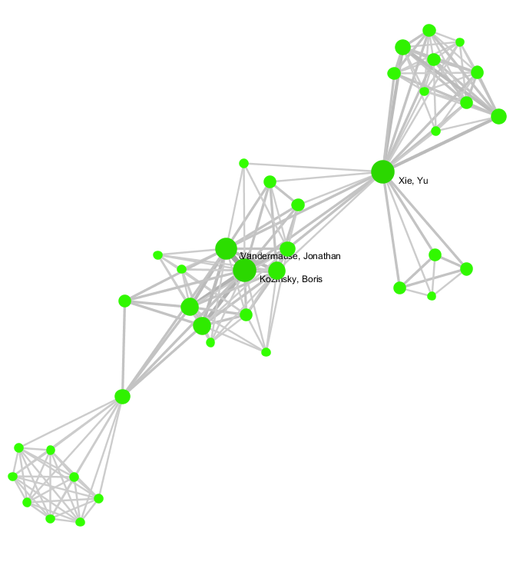

Slide 10
Vandermause Jonathan
Technische University at Berlin & Korea University & Google Brain & MPII
FLARE
(active learning algorithm for Kernel-GPR)
GDML, SchNet
Jonathan P. Mailoa & Boris Kozinsky: BP-DCF
(direct covariant force)
MIT & Harvard

Slide 11
Collaboration centers : 都是做方法的

Slide 12
DP
SchNet
Müller Klaus-robert
Technische University at Berlin & Korea University & Google Brain & MPII
Tkatchenko Alexandre
Poltavsky Lgor
Department of Physics and Materials Science, University of Luxembourg, L-1511 Luxembourg City, Luxembourg
K. T. Schütt
Sauceda Huziel E.
Chmiela Stefan
Technische University at Berlin, 10587 Berlin, Germany
SpookyNet
Oliver T. Unke
Technische University at Berlin, 10587 Berlin, Germany
OpenMolcas
Marquetand Philipp
Institute of Theoretical Chemistry, Faculty of Chemistry, University of Vienna, Währinger Str. 17, 1090 Vienna, Austria
Roland Lindh
Department of Chemistry − BMC, Uppsala University, P.O. Box 576, SE-751 23 Uppsala, Sweden
SHARC
Marquetand Philipp
Institute of Theoretical Chemistry, Faculty of Chemistry, University of Vienna, Währinger Str. 17, 1090 Vienna, Austria
Jesús González-Vázquez
Universidad Autónoma de Madrid
SOAP
Ceriotti Michele
Willatt Michael J.
Grisafi Andrea
Laboratory of Computational Science and Modeling, IMX, Ecole Polytechnique Federale de Lausanne, 1015 Lausanne, Switzerland
Csányi Gábor
Department of Engineering, University of Cambridge
Deringer Volker L.
University of Oxford
BPNN
Behler Jörg
Universität Göttingen, Institut für Physikalische Chemie, Theoretische Chemie, Tammannstraße 6, 37077 Göttingen, Germany
FLARE & GDML & SchNet
Vandermause Jonathan
MIT & Harvard
BP-DCF
Jonathan P. Mailoa & Boris Kozinsky:
MIT & Harvard

