Slide 1
The way to measure body fat %
Jiawei Huang, Xiaofeng Wang, Yiran Wang
STAT 628
Module 2

Slide 2
Our Goal
Make the application user-friendly enough
Select the model which is both accurate and concise
Model Type: Simple Linear Model

Slide 3
Content
Data description
Data cleaning
Model selection
Model diagnostics
Strengths and Weaknesses
Conclusion

Slide 4
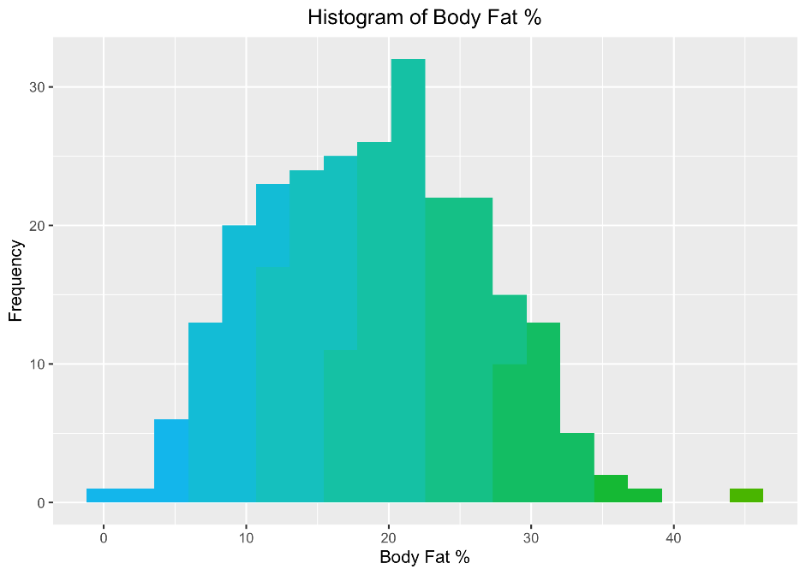
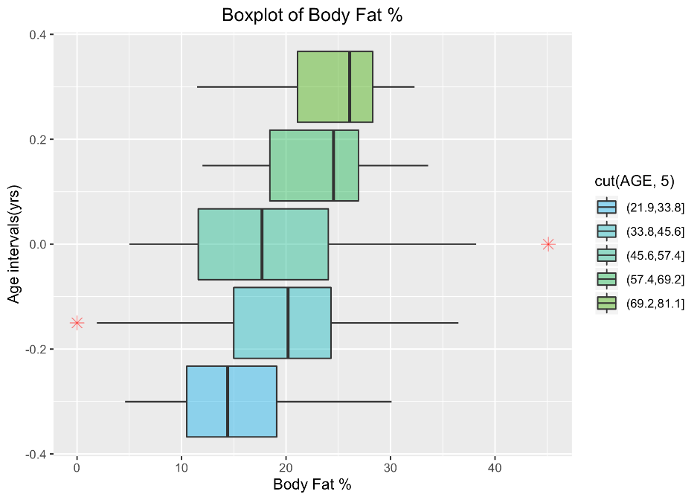
Step 1: Data description
Data description
1. We tried several visualization methods including histogram and boxplot. Outliers appear, some of which are strange but reasonable, while others are weird, which indicates the requirement for data cleaning.

Slide 5
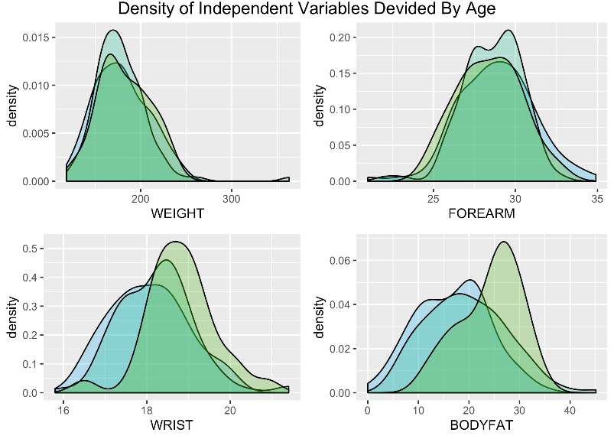
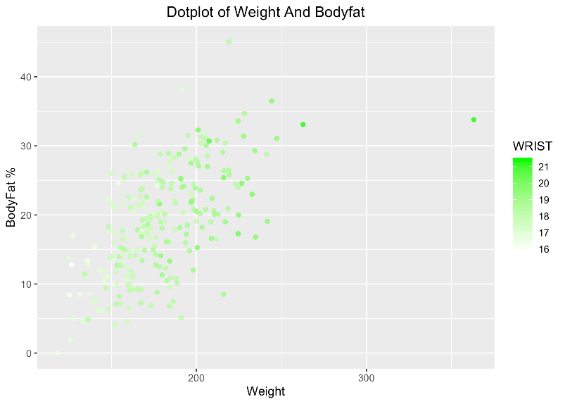
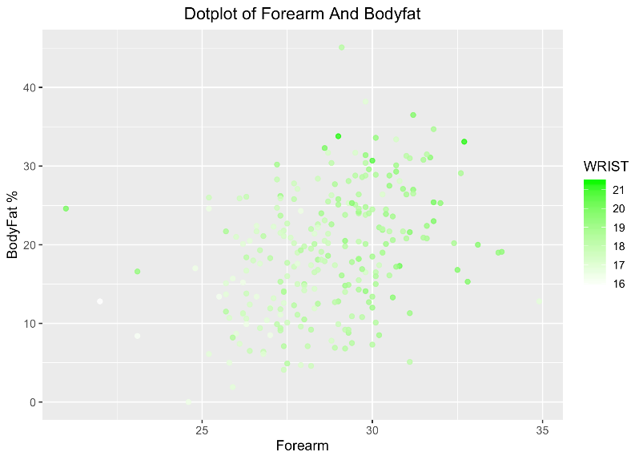
Step 1: Data description
2. In order to show the distribution of these explanatory variables, we also employed several kinds of figures, such as density plot and dot plot. These plots display the patterns and illustrate the existence of relationship between body fat % and other factors.

Slide 6
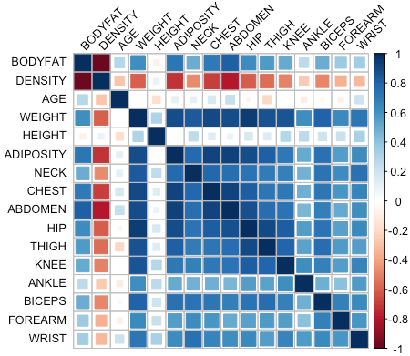
Step 1: Data description
3. Correlation plot is utilized considering the multicollinearity influence. From the plot below, many variables are highly correlated, indicating the importance of assess multicollinearity and use methods like stepwise to release the side-effect.

Slide 7
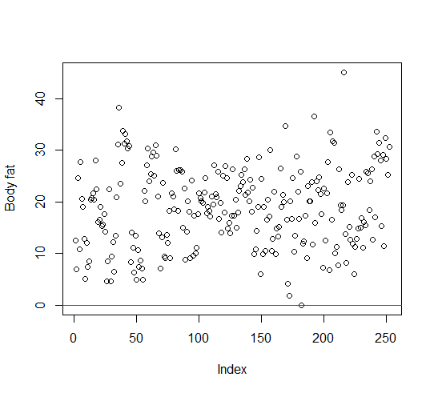
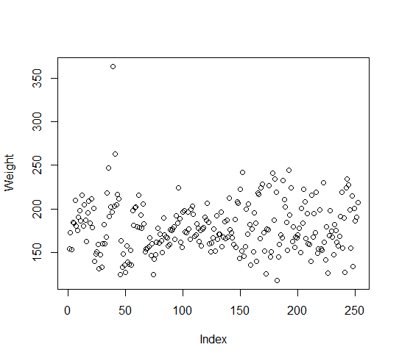
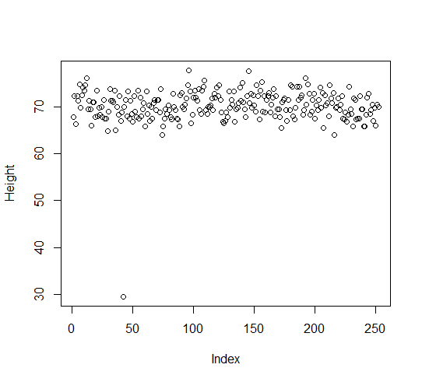
Step 2: Data cleaning
Data cleaning
1.First, look into the greatest and smallest value of every variable. Then delete the data which people can’t be. Remove No.182 (Bodyfat=0), No.39 (Weight= 363.15), No.42 (Height=29.50)

Slide 8
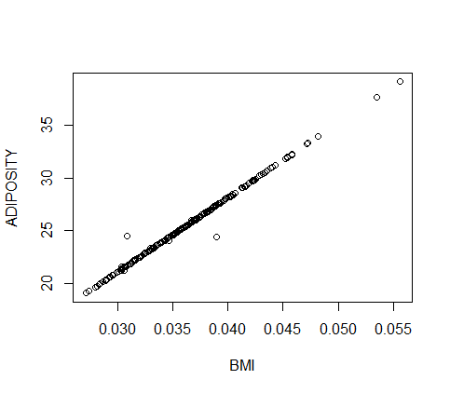
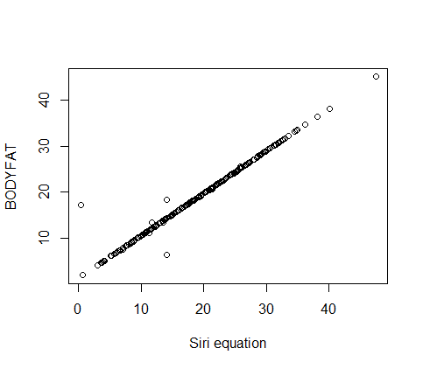
Step 2: Data cleaning
2.Second, Use the relationship between variables to find outliers.
BMI~Height²(m²)/Weight(kg) (Remove No.163,No.221)
Bodyfat~(495/Density)-450 (Remove No,48, No.76, No.96)

Slide 9
Caution
Why we don’t refit these data?
1. We don’t know whether it’s real data or maybe just wrongly typed.
2. We want to build a model that can apply to common people.

Slide 10
Step 3: Model selection
1. For conciseness
Three common variables: Height, Weight, Age
2. For accuracy
Remove BMI(related to other variables), use BIC to select the accurate model.
Selected variables: Abdomen, Weight, Wrist, Biceps
3. For both
Delete the insignificant variables in Model 2 and then use BIC again
Selected variables: Abdomen, Weight, Wrist

Slide 11
Caution
In case of the square and interaction, we do anova to compare the different model
Model 1: using all variables to fit the model
Model 2: using all variables and their square to fit the model
Model 3: using all variables and their interactions to fit the model
No. | Res.Df | RSS | Df | Sum of Sq | F | Pr(>F)
1 | 229 | 3487.3
2 | 215 | 3233.7 | 14 | 253.66 | 1.1417 | 0.3277
3 | 138 | 2190.1 | 77 | 1043.58 | 0.8540 | 0.7756

Slide 12
Step 3: Model selection
We use three key index to choose the best model
1.adj R²
2.number of variables
3.Cross Vaildation
In the end, we choose the last model as our final model
Bodyfat=0.8914*Abdomen-0.0922*Weight-1.1628*Wrist-25.7672
 | Adj R² | Number of variables | CV | True MSE
Simplest Model | 0.5713 | 3 | 25.4 | 24.8
BIC selected Model | 0.7329 | 4 | 15.8 | 15.4
Final Model | 0.7297 | 3 | 15.9 | 15.6

Slide 13
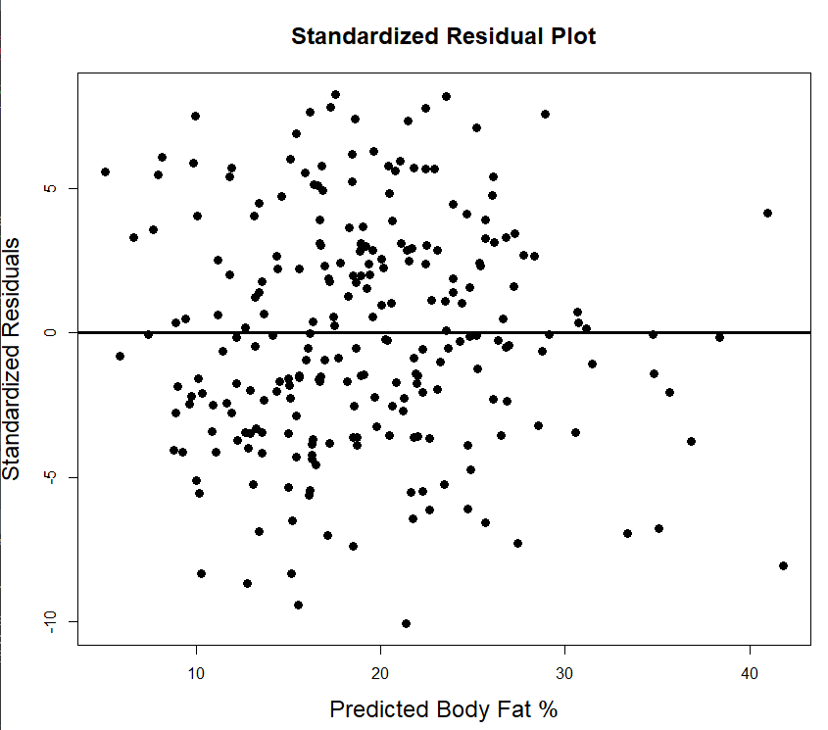
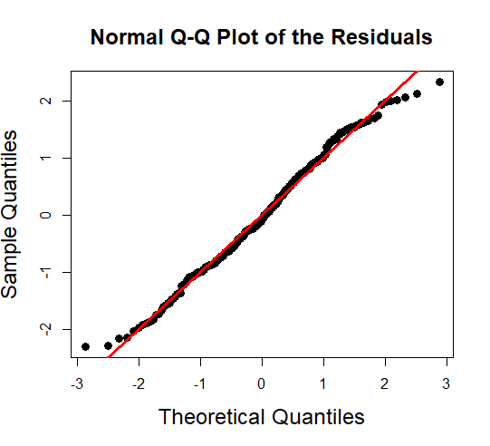
Step 4: Model diagnostics
1. First, check the multicollinearity, by the VIF value below, it doesn’t have severe multicollinearity.
2. Check linearity, homoscedasticity, outliers for Y and Normality
ABDOMEN | WEIGHT | WRIST
4.23 | 5.71 | 2.14

Slide 14
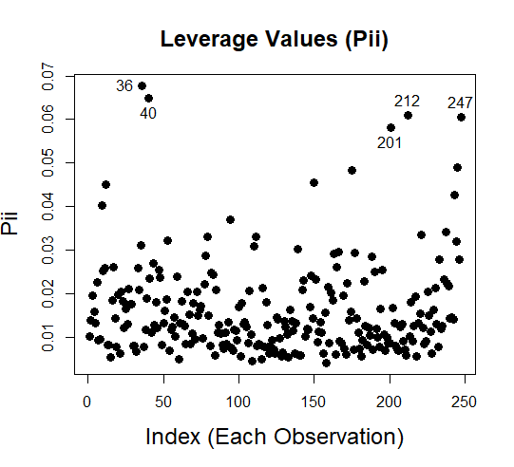
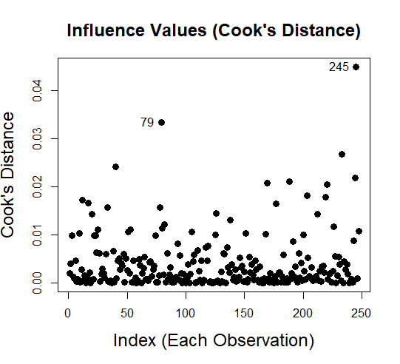
Step 4: Model diagnostics
3. Check leverage and influential points

Slide 15
Strengths and Weaknesses
Strengths:
1. Our model achieves both conciseness and accuracy, which is a simple linear model and requires only 3 inputs and yields a high accuracy.
2. As it’s based on a small data set, our model excluded potential outliers and influence points, yielding a widely application.
3. The assumptions of SLR hold for our model: Homoscedasticity, linearity and no multicollinearity.

Slide 16
Strengths and Weaknesses
Weakness:
1. The data set is small and , biased with only males’ data which may reduce the robustness, limit the application and impact the prediction accuracy.
2. Some outliers are deleted, which may contain important information.

Slide 17
Conclusion
Final model
Body fat %=0.8914*Abdomen-0.0922*Weight-1.1628*Wrist-25.7672
Rule of thumb
Body fat %=Abdomen-0.1*Weight-1.2*Wrist-26
while other variables don’t change,1 cm increase in abdomen, the model predicts that body fat % will increase, on average, by 1
Simple, accurate

Slide 18
Thank you !

