Slide 1
ACC5AAI ADVANCED ACCOUNTING ISSUES
Introduction and topic 1

Slide 2
Unit objectives
To promote an understanding of, and to critically examine:
  theories relevant to EXTERNAL reporting of financial information, including:
    theories of accounting regulation
    prescriptive (‘normative’) accounting theories/frameworks
    explanatory and/or predictive (‘positive’) theories of accounting policy choice
  the treatment of asset revaluations and impairments, intangible assets, provisions and contingent liabilities, and leases

Slide 3
What is theory?
‘set of ideas to explain something’
‘logical reasoning underlying a phenomena or belief’ (not just a ‘hunch’)
a set of ideas which have not been demonstrated to be untrue
examples:
Notes:
Objective: to encourage you to think about how and why theories develop
Socialism vs capitalism Based on different economic and social views/beliefs
Socialism: advocates that society as a whole should own and control the means of production, and distribution of wealth
Capitalism: capital and production is primarily in private hands (belief in markets; belief that providers of capital should be rewarded better than providers of labour)
Christianity vs Theory of Evolution: based on a completely different set of ideas/beliefs to the Christian faith in which God is believed to have created the world and life.

Slide 4
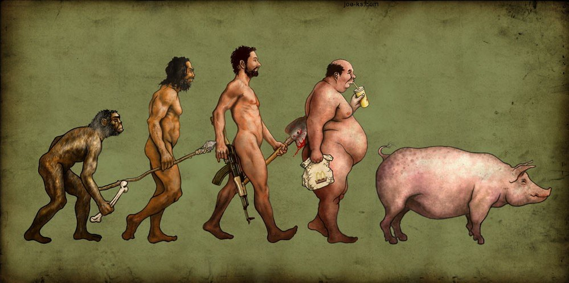
Evolution??

Slide 5
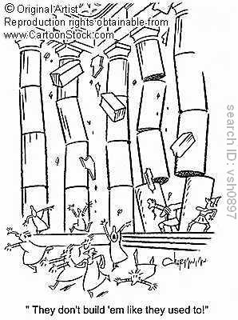
Why bother with theory in accounting?
Foundation, reason for practice
  As it is OR as it should be
Basis for evaluation of practice
Explanation of practice
  Regulatory theory
  Positive theory (political tool or tool to reduce agency costs)

Slide 6
Unit focus
Information for external users who do not have the power to demand specific information and have a legitimate right to receive information. Currently provided with:
  ‘general purpose’ reports – Balance Sheet and Profit and Loss and Cash Flow Statements: content determined by accounting standards and accepted accounting practice

Slide 7
Topic 1 Regulatory environment of accounting
Reference:
  Deegan, C, 2010, Australian Financial Reporting, 6th ed., McGraw Hill Irwin, Sydney, Ch. 1

Slide 8
1.1 Learning objectives
Understand the political nature of accounting (various interested parties competing for power over accounting regulation), specifically:
Identify the main bodies involved in the regulation of accounting and describe their main responsibilities
Explain the nature of and reasons for changes in the accounting setting arrangements in Australia
Articulate and apply different theories of regulation in an accounting context

Slide 9
1.2 Is accounting regulation necessary?
Before looking at the main influences on accounting regulatory environment we will discuss 2 opposing theories about whether regulation is necessary (pp. 38-41 text)
We will look at how these theories apply in an accounting context…

Slide 10
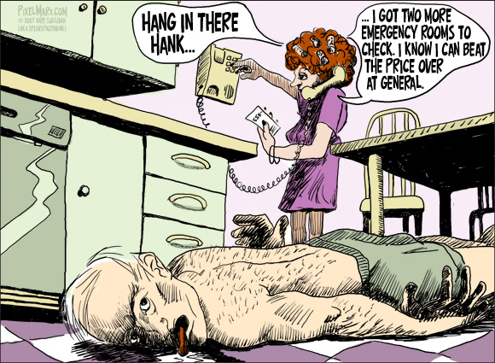
1.2.1 Free market theory
Market unregulated
Through free competition between sellers for the provision of products and services, prices tend to decrease, and quality tends to increase.
The following quote illustrates the theory:
“the freedom to contract and to conduct business without government meddling allowed for free choice, allocated resources efficiently, facilitated economic growth, and made us all a little richer“ (Frederich von HayekThe Road to Serfdom )

Slide 11
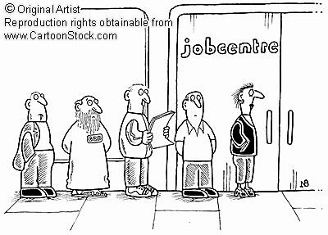
Free market theory applied to accounting
Organisations will produce optimal information – ie. relevant and reliable
Why?
  economic incentives
  labour market incentives
  Supply and demand
Let us discuss these arguments

Slide 12
What ‘economic’ incentives might encourage management to produce relevant and reliable information?
What ‘labour market’ incentives?
How might supply and demand apply to the production of accounting information?

Slide 13
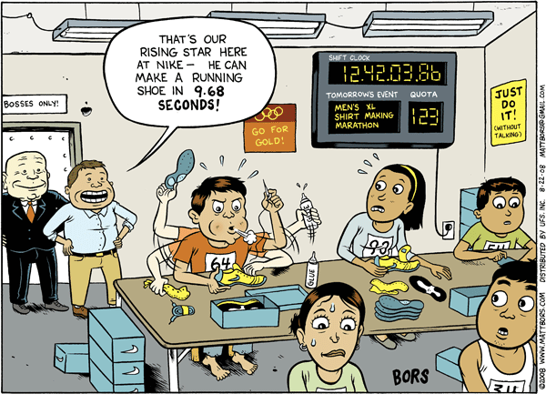
1.2.2. Pro-regulation theory:
Market may fail – eg. sweatshops;
Regulation needed to reduce impact of market failure eg. work safety and wage regulation
“Just do it”!

Slide 14
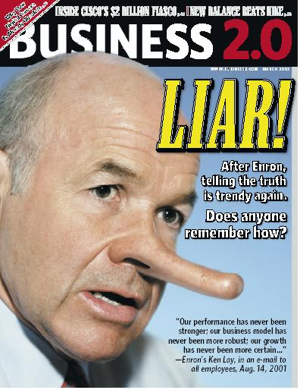
Pro-regulation theory: applied to accounting
Market may fail – relevant and reliable information not produced
Regulation needed to protect public
Examples of market failure ie. financial statements misleading: Waste Management, Enron, Sunbeam, HIH, OneTel see next slide

Slide 15
The financial statements of the companies mentioned (there are many others) were deliberately misleading. Why might company managers deliberately report financial information which is inaccurate and intentionally misleading?

Slide 16
Task: Read article: “Nortel Board finds accounting tricks behind ‘03 profits”
  What accounting irregularities are reported?
  What impact would this have on the financial statements?
  Which theory of regulation would be consistent with the events reported in the article? Why?
We will now look at the main influences on the regulation of ‘general purpose’ financial reports ….

Slide 17
1.3 Accounting regulatory environment: main influences
Australian Accounting Standards Board - AASB
Corporations Act
Australian Securities and Investments Commission - ASIC
International Accounting Standards Board - IASB
Financial Reporting Council - FRC
Ministerial Council
Australian Stock Exchange (ASX) – listed corporations only

Slide 18

International accounting Standards Board (IASB)
Ministerial council (final approval)
Financial Reporting Council
(overseeing role)
AASB accounting standards
Australian Accounting Standards Board (AASB)
International Accounting Standards
Generally accepted accounting practice
AASB framework
Corporations Law
Corporations
Stakeholders’ resources
General purpose financial reports
Audited financial reports
Influences on “general purpose reports” of corporations

Slide 19
1.3.1 Australian Accounting Standards Board (AASB)
Government agency under Australian Securities and Investments Commission Act 2001.
Mission: “to develop and maintain high-quality financial reporting standards for all sectors of the Australian economy”; and “contribute … to the development of global financial reporting standards …”
9 members from a variety of backgrounds appointed by Financial Reporting Council (FRC)
The history of standard setting illustrates its political nature …
Notes:
Economic impact:
Example: Company A
Goodwill $5m
Profit $200,000
New proposed accounting standard requires the write-off of goodwill over 20 years
Profit $200,000 - $250,000 = ($50,000)
New standard requires the recognition of foreign exchange gains and losses
Example: On ! July 2000 Co. B borrowed US$500,000 for 5 years.
Date Rate $A
July 2000 .75 666,667
June 2001 .80 625,000
June 2002 .75 666,667
June 2003 .70 714286
June 2004 .65 769,230
June 2005 .75 666,667
AASB required to consider the economic impact of standards

Slide 20
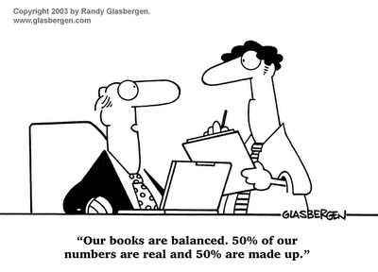
AASB history: pre 1984:
Standards developed and issued by accounting profession through Australian Accounting Research Foundation
not legally binding
high level of non-compliance eg. goodwill Why?
Non-compliance associated with “market failure”
Profession sought legal backing for standards

Slide 21

AASB history: 1984
Accounting Standards Review Board (ASRB) established by government to sponsor development of, and approve, standards
Approved standards legally binding on companies
Board to be independent of profession and representative of broad range of interests (Why might this have been considered important ???)

Slide 22

AASB history: post 1984 cont.
Pressure to replace ASRB due to conflict between profession and board
  Profession felt it had lost control of standard setting however …
  Other groups perceived procedures, priorities and output of ASRB to be controlled by profession

Slide 23
Questions
Why would control of the board by the accounting profession be regarded as a problem by some?
What group/s might object to this?
The accounting profession lobbied against development of accounting standards by the ASRB
Why might they have done this?

Slide 24
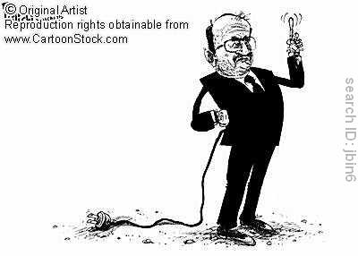
AASB history: 1991
ASRB restructured and renamed AASB
Powers included development of accounting standards BUT
no capability to do so!

Slide 25
AASB history: 2000
AASB restructured (again) as a consequence of the view that AASB dominated by accounting profession – professional bias
Broader representation on Board - reduced influence of accounting profession
Capability to develop standards

Slide 26
AASB history: 2005
AASB adopted International accounting standards (IAS or IFRS) & conceptual framework as their own
  Corporate Law Economic Reform Program (CLERP) recommendation; FRC decision
  Strong opposition from corporations – economic impact
  Applicable to private & public sectors
  Subject to Parliamentary approval
The adoption of IAS will be examined in the next lecture under “private interest theory”

Slide 27
1.3.2 Corporations Act 2001
Corporate compliance with AASB standards mandatory
Requires presentation of ‘true and fair’ financial statements
‘true and fair’ not defined
Technical (ie. compliance), not literal view, of true and fair adopted ie. if compliance with standard does not reflect true and fair view this should be disclosed in notes

Slide 28
Question
A company purchased a factory in July 2005 for $300,000 with plans to expand production. If the plans go ahead as anticipated the increase in production is expected to increase revenue by $700,000. The company is working on a ten year plan. The useful life of the factory may be 10 years, or more, or less. The current selling price of the factory is $400,000. Current replacement cost is $440,000.
What ‘values’ does the factory have?
What value/s do you think would represent a ‘true and fair’ view of the asset in a balance sheet? Why?
What value/measure do you think would be most relevant to a bank manager in making a decision as to whether to lend money to the company and in deciding what amount to lend?

Slide 29
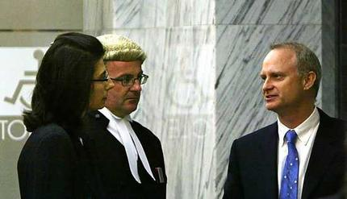
1.3.3 Australian Securities and Investments Commission (ASIC)
‘Former One.Tel chairman John Greaves has been ordered to pay $20 million in compensation and has been banned from managing a corporation for four years’. The Age September 7, 2004
Government body;
administers compliance with Corporations Act
Greaves was charged with breaching Corporations Law by failing to properly assess One.Tel’s financial position

Slide 30
1.3.4 Other influences
Financial Reporting council
  Government body established following proposal by government review in 1997
  Oversees AASB
International Accounting Standards Board
  Produces International Accounting Standards
Australian Stock Exchange
  Requires: compliance of listed companies with listing rules: continuous disclosure

