Slide 1
ALTERNATIVE SECURITIES
Topic 3: Introduction to leveraged buyouts

Slide 2
Student learning objectives
3.1 Define leveraged buyouts (LBOs) and management buyouts.
3.2 Identify important developments in the history of LBOs.
3.3 Describe an example of an LBO.
3.4 Describe the layers of LBO financing.
3.5 Compare value creation methods of the five general categories of LBOs.
3.6 Compare the structure of LBO funds to that of hedge funds and venture capital funds.
3.7 Describe fee structures for LBO firms.
3.8 Describe the characteristics of an LBO target firm
3.9 Compare the risk of LBOs to that of venture capital deals.

Slide 3
References
Anson, Mark J.P. (2006). Handbook of Alternative Assets. John Wiley & Sons Inc. New Jersey. Chapter 17.

Slide 4
Objective 3.1
Definition
“Leveraged buyouts (LBOs) are a way to take a company with publicly traded stock private, … LBOs use the assets or cash flows of the company to secure debt financing either in bonds issued by the corporation or bank loans, to purchase the outstanding equity of the company. In either case, control of the company is concentrated in the hands of the LBO firm … and there is no public stock outstanding.”
  [Anson]
Management buyouts are LBOs in which the control of the company is concentrated in the hands of both the LBO firm and the management of the company.

Slide 5
Objective 3.2
Milestones in the history of LBOs
In 1976, Kohlberg Kravis Roberts & Co (KKR) was created with $3m of their own funds to invest
In 1977, KKR raised sufficient capital from investors to finance the buyout of A.J. Industries, a small manufacturing conglomerate, for $94m, comprised $32m equity from KKR investors, $62m bank loans
In 1979, KKR bought out Houdaille Industries, financed with 86% of debt in the form of senior and subordinated notes
In the 1980s, junk bonds, subordinated debt with little collateral protection, became a popular source of LBO financing
KKR bought out RJR Nabisco Inc for $31bn

Slide 6
Michael Milken ( famous in developing junk bond issues) and KKR showed that a company’s cash flows and the strength of its management team were more creditworthy assets than traditional forms of collateral such as property, plant and equipment.

Slide 7
Objective 3.2
Milestones in the history of LBOs
In the early 1990s, LBOs suffered from:
  The US recession of 1990/91, which increased credit spreads and limited junk bond financing, by the end of 1991, 26 of 83 large LBOs completed between 1985 and 1989 had defaulted on their debt financing.
  In 1998 the default of the Russian government on their treasury bonds set credit spreads spiraling upwards
From 1992 onwards LBO funds committed rose to peak at over $100bn in 2000, fuelled largely by the growth in the number of LBO or private equity firms which had grown from 2 in the 1970s to over 1,000
In the early 2000s, LBOs again suffered from recession and the IT crash and as at 2004 the funds committed each year stood at $60bn

Slide 8
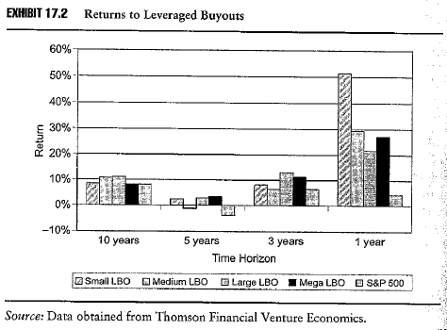
Objective 3.2
Returns from LBOs
Returns from LBO pools have been mixed, with LBO returns higher than the S&P 500 over 1, 3 and 5 years to 2005, but lower over 10 years
Returns have suffered from too many LBO firms chasing too few targets, increasing the cost of acquisition and reducing the potential return

Slide 9
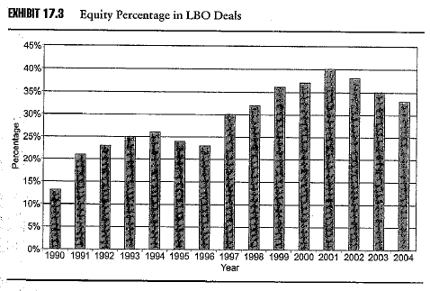
Objective 3.2
Returns from LBOs
The fewer LBO targets has had the effect of increasing the equity component of the financing from around 13% in 1990 to a peak of 40% in 2001
As the leverage declines so does the potential return
With lower interest rates the leverage has again increased since peaking in 2001

Slide 10
Objective 3.3
A theoretical example of an LBO
Company ABC has a market value of $500m and debt with a face value of $100m on its books
ABC generates EBITDA of $80m, representing a 13.3% ROA
An LBO firm offers $700m to purchase the equity of the company and to pay off the outstanding debt
  Debt is paid off at face value $100m
  Equity is acquired at $600m, a 20% premium to motivate the sale of shares by existing shareholders
The LBO is financed by $600m in 10% coupon debt and $100m in equity

Slide 11
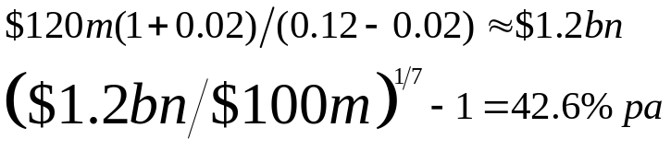
Objective 3.3
A theoretical example of an LBO
Post the LBO, management improves its operations, streamlines expenses and improves asset utilisation to increase EBITDA by 50% from $80m to $120m, with interest expense at $60m
By forgoing dividends and using EBITDA to pay down debt the LBO fund can own the company outright in about seven years
After seven years the LBO firm can claim the $120m EBITDA to itself
The return on the LBO investment, assuming a sustainable growth rate of 2% and a discount rate of 12% is

Slide 12
The debt is locked in at a 10% coupon, which means that any operating efficiencies and capital gains generated from the business accrue to the benefit of the equity holders.
 | 1 | 2 | 3 | 4 | 5 | 6 | 7
Balance | 540 | 474 | 401.4 | 321.4 | 233.4 | 136.4 | 30
Principle payment | 60 | 66 | 72.6 | 80 | 88 | 97 | 106.4
Interest payment | 60 | 54 | 47.4 | 40 | 32 | 23 | 13.6
Cash flow | 120 | 120 | 120 | 120 | 120 | 120 | 120

Slide 13
Objective 3.3
A theoretical example of an LBO
On the repayment of the debt, ie, at the end of seven years, the LBO fund can harvest the $1.2bn value either by:
  A trade sale
  An IPO
    e.g. Gibson Greetings was acquired from RCA for $81m with all but $1m financed in debt. When it went public via IPO the 50% equity interest owned by the LBO firm was worth $140m, an annual return of over 200%
  A second LBO
  A refinancing of the debt to fund a large dividend to equity holders
    United Defense Industries Inc was purchase by Carlyle Group in 1997 for $850m with $173m equity and the rest in debt. By July 2001 debt was paid down to $235m. At that point Carlyle borrowed an additional $850m, of which $400m was used to pay a huge dividend to its investors

Slide 14
Objective 3.3
Attractions of an LBO
Attractions to corporate management
  The use of leverage where interest payments are tax deductible
  Less scrutiny from public equity investors and regulators
  Freedom from a distracted corporate parent
  The ability of management to become significant equity holders and to enjoy the upside of building the business
Attractions to shareholders
  The usually benefit from a significant premium being offered to entice them to sell their shares to the LBO firm

Slide 15
Objective 3.4
Financing an LBO
Generally in every buyout there are three tranches of financing
  Senior debt: typically bank financing along with credit/finance companies and insurance companies
  Mezzanine debt: purchased by mezzanine private equity funds, insurance companies and other institutional investors
  Equity

Slide 16
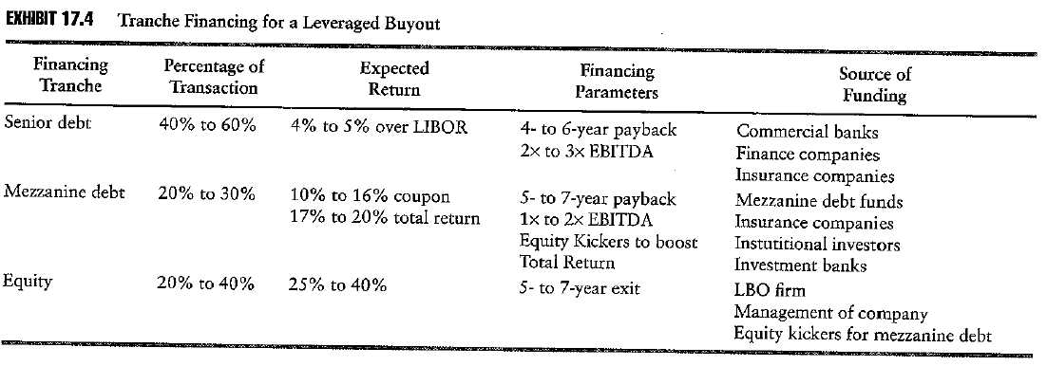
Objective 3.4
Financing an LBO
Notes:
INSERT EXHIBIT 17.4

Slide 17
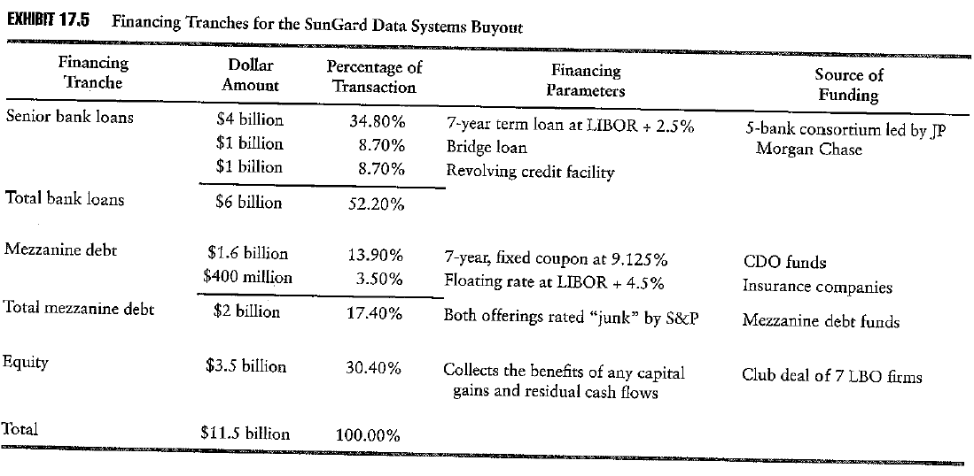
Objective 3.4
An example of financing for an LBO

Slide 18
SunGuard Data Sytems was acquired for $11.5bn in 2005.
SunGuard provides trade clearing and data processing for stock, option and future exchange.
The 30% equity contribution was a bit lower than usual, but the strong cash flows and dominant position in the trade clearing business allowed a higher level of leverage.

Slide 19
Objective 3.5
How LBOs create value
LBOs create value in various ways
  Improving operating efficiency
  Unlocking an entrepreneurial mindset
  Unlocking hidden value in conglomerates
  Consolidating and unlocking synergies
  Turning around companies

Slide 20
Objective 3.5
Improving operating efficiencies
Large publicly owned companies may have agency problems, whereby management may have little incentive to create value and may be compensated based on revenue or asset growth
Safeway Corporation
  In 1986 KKR took Safeway, a grocery/supermarket chain private at a cost of $4.8bn, with 86% debt funding
  Safeway had an expensive cost structure, including wages 33% above industry average, inefficient inventory controls and poor operating procedures
  All divisions lacking wages parity with competitors were divested, including over 1,000 stores and 40% of employees
  Regional managers we compensated based on return on capital employed rather than sales
  When Safeway went public again the LBO firm made a 43% pa return

Slide 21
Value came from greater operating efficiencies in a mature industry
Efficiency buyouts often result in a reduction in firm assets and revenue, but eventually an increase in firm profits
An LBO produces more concentrated ownership and better management incentives to overcome the agency problems
Management incentives schemes are tied to increasing operating margins and equity value
Management's ability to pursue inefficient projects is constrained by high leverage
The LBO firm provides a more active oversight than a diverse shareholding

Slide 22
Objective 3.5
Unlocking an entrepreneurial mindset
An unwanted or neglected operating division may be unable to pursue its business plan under its parent
Duracell Corporation
  Duracell was a division of Kraft Foods, but its batteries were different from the consumer foods primarily produced by Kraft. It was too small and too different from its parent to warrant much attention
  In 1988, the management of Duracell took it private in an MBO with KKR
  The management increased its budget for R&D, producing batteries that lived longer and were more environmentally friendly and expanding overseas, in turn increasing cash flows at 17% pa from 1989 to 1995
  When it was sold to Gillette Corporation in 1995, it compound return to investors as 40% pa

Slide 23
Duracell is a classic entrepreneurial LBO
The leverage ratio cannot be as high on an entrepreneurial LBO as there must be sufficient flexibility for the management to pursue their new initiatives. A moderate amount of leverage of between 50% and 70%. This contrasts with an efficiency LBO which requires a higher leverage ratio to focus management.

Slide 24
Objective 3.5
Unlocking hidden value in conglomerates
Conglomerates are often not followed by analysts as they do not fit into any single category and can be hard to understand, resulting in their being undervalued
Beatrice Foods
  KKR bought out Beatrice Foods, a food processing conglomerate, in 1986 for $6.2bn, at a 45% premium to the previous last sale price
  Over two years management sold off $7bn in assets reaping an $800m gain on the LBO price. Total debt after the sale was $376m compared to $300m.
  Sales declined from $11.4bn to $4.2bn after the asset sale but profits rose from $300m to $1bn
  LBO investors made an annual compound return of over 40%

Slide 25
Too many products across too many markets
Similar to the efficiency LBO in that operating efficiencies were gained by the sale of assets and a stronger focus on the profitability of core operations
Safeway sold of inefficient businesses, Beatrice sold off assets that lacked synergy and diluted the focus and identity of the company, they simplified the company’s focus and identity
Both Safeway and Beatrice benefited from strong monitoring by the LBO firm

Slide 26
Objective 3.5
Consolidating and unlocking synergies
Value can be generated by combining several operating companies through several LBOs of strategically aligned firms
Berg Electronics
  Two buyout firms acquired Berg Electronics, a computer connector manufacturer from DuPont Corporation in 1993 for $335m, at the time Berg earned $18m on $380m in sales
  Over 5 years Berg made 8 acquisitions including AT&T’s connector business and Ericsson AB’s connector division. By 1997 Berg had sales of $785m and profits of over $180m and employed 7,800 employees in 22 countries
  In early 1998, the buyout firms distributed shares in Berg to investment partners and retained 20%
  In August 1998 Framatome Connectors acquired Berg for $1.85bn, a 1,000% return on the original equity contributed by the buyout firms

Slide 27
Objective 3.5
Turning around companies
Distressed firms and underperforming companies in other LBO funds
Aegis Communications Group
  In 1996 Thayer Capital Partners purchased majority stakes in two teleservice companies
  In 1997, these companies were combined into a third company in the LBO fund to form IQI Inc., which was subsequently merged with ATC Communications Group to form Aegis
  The plan was to build a national call centre servicing company
  It was not successful and its stock price fell from $19 in 1996 to $1 in 1999
  Thayer brought in another LBO firm Questor to help revive the company by acquiring $46.75m in convertible prefs to repay about $43 in bank debt in return for 47% of voting stock

Slide 28
Objective 3.6
LBO fund structures
Almost all LBO funds are designed as limited partnerships
Every LBO fund is run by a general partner, typically the LBO firm
All investment discretion and day-to-day operations vest with the general partner
Limited partners are passive investors
Some LBO funds have advisory boards, comprising the general partner and a select group of limited partners, which advise the general partner on conflicts of issue that may arise on acquiring a company or on collecting fees
LBO funds must be aware of the restrictions on offering units in the fund, to avoid being deemed an investment company

Slide 29
Objective 3.7
LBO fees
Management fees: range from 1.25% to 3% on funds committed
Performance fees: range from 20% to 30% of the profits of the investment pool
Privatisation fees: LBO firms charge the LBO target firm up to 1% of the selling price for arranging and negotiating to buy the LBO target
Break fees: LBO firms may earn a break fee if an agreed deal to buy an LBO target is trumped
Divestment fees: LBO firm may charge a fee on arranging the sale of a division of portfolio firm
Director’s fees: fees for LBO firm nominated directors

Slide 30
Objective 3.7
Characteristics of an LBO target
Financial characteristics
  A history of profitability with steady profit margins
  Strong cash flows to service additional debt levels
  A balance sheet not already overburdened with a high debt level
  A strong balance sheet with a large cash/current asset balance
  A weak stock price
Operating characteristics
  Mature firm with a strong brand name and competitive market position
  Products that are not subject to technological obsolescence
  A diversified customer base that generates recurring revenues
  A management team in need of improvement to increase operating efficiency

Slide 31
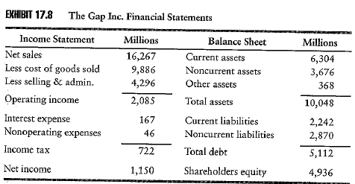
Objective 3.8
Characteristics of an LBO target: The Gap
Operating and net margins of 13% and 7%, respectively
Consistently profitable
Strong balance sheet with 63% of assets, current
Debt/equity ratio 51:49
Notes:
INSERT EXHIBIT 17.8

Slide 32
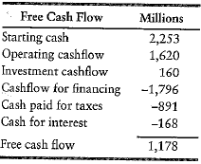
Objective 3.8
Characteristics of an LBO target: The Gap
Languishing share price, with the price having decline 17% in 2005

Slide 33
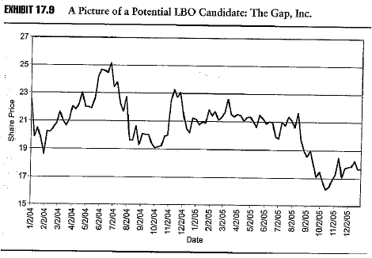
Objective 3.8
Characteristics of an LBO target: The Gap
Significant free cash flow after interest and taxes

Slide 34
The Gap is a mature retailer with a strong brand
Clothing is not subject to technological obsolescence, though fashion trends can change quickly
Diversified customer base with Kid’s Gap and Baby Gap along with regular stores
Recurring revenues
In 2005 the Gap experienced significant change in management

Slide 35
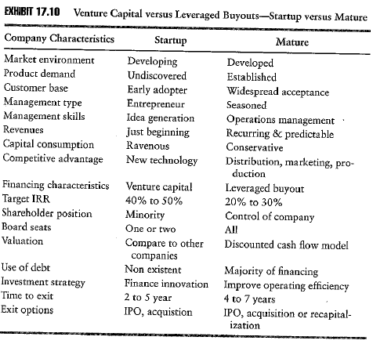
Objective 3.9
Venture capital vs LBO

Slide 36
Objective 3.9
Risks of LBOs
LBOs are less risky than venture capital deals as:
  The target firm is a seasoned company
  The target’s management has an established track record so they can be evaluated
  The target has an established product or service
  Exit strategies are more feasible since the target’s stock is already public
LBOs are nevertheless risky due to their extreme leverage
The high leverage is useful in three ways:
  It allows equity holders to realize large gains
  It allows management to owe a significant share of equity and hence aligns equity holder’s interest with management's interest
  It focus management on the bottom line

Slide 37
ALTERNATIVE SECURITIES
The Performance of Leveraged Buyout-Backed
Initial Public Offerings in the UK

Slide 38
Think about the following questions:
  What is (are) the research question(s)?
  What is the motivation of this research?
  What is the contribution of this article?
  What is the conclusion of this article?
  Summarize the relevant literature and theories (if any).
  What is the research design (sample, methodology, etc)?
  Any possible recommendations or suggestions?

