Slide 1
ALTERNATIVE SECURITIES
Topic 1: What is an alternative asset class?
Notes:
Alternative Securities
What is an alternative asset class?
These slides have been drafted by the La Trobe University, School of Business based on Anson (2006).

Slide 2
Student learning objectives
1.1 Define an alternative asset class.
1.2 List five major alternative asset classes.
1.3 Define three super asset classes.
1.4 Distinguish asset allocation based on alternative asset classes from that based on traditional asset classes.
1.5 Distinguish beta drivers from alpha drivers and explain how this distinction might assist in portfolio management.
These slides have been drafted by the La Trobe University, School of Business based on Anson (2006).
1.<number>
Notes:
Alternative Securities
What is an alternative asset class?
These slides have been drafted by the La Trobe University, School of Business based on Anson (2006).

Slide 3
References
Anson, Mark J.P. (2006). Handbook of Alternative Assets. John Wiley & Sons Inc. New Jersey. Chapters 1 & 2.
These slides have been drafted by the La Trobe University, School of Business based on Anson (2006).
1.<number>
Notes:
Alternative Securities
What is an alternative asset class?
These slides have been drafted by the La Trobe University, School of Business based on Anson (2006).

Slide 4
Objective 1.1
Definition
Alternative assets are NOT separate asset classes. This is because
They are just different investment strategies within an existing asset class such as debt ,equity or derivatives. Hence, alternative assets derive their value from equity, debt or derivatives.
They expand the investment opportunity set for investors who generally are institutional investors and high net worth investors. Alternative assets are generally purchased privately, outside of the public exchange.
These slides have been drafted by the La Trobe University, School of Business based on Anson (2006).
1.<number>
Notes:
Alternative Securities
What is an alternative asset class?
These slides have been drafted by the La Trobe University, School of Business based on Anson (2006).

Slide 5
Objective 1.2
Five major types of alternative assets
Hedge funds
  limited partner units in a private limited partnership.
  highly sophisticated investors. highly risky;
  only wealthy / high net worth investors and institutional investors can invest. Normally, the minimum investment is between 100,000 US$ and 250,000 US$.
  A hedge fund usually charges 1%-2% management fee and 20% incentive fee. A hedge fund cannot advertise to general audience
These slides have been drafted by the La Trobe University, School of Business based on Anson (2006).
1.<number>
Notes:
Alternative Securities
What is an alternative asset class?
These slides have been drafted by the La Trobe University, School of Business based on Anson (2006).

Slide 6
Private equity: the investment in companies prior to their IPO or taking a public company private
  Venture capital takes a firm to IPO or sell the firm to another company.
  LBO takes a public firm private
  Mezzanine debt is a hybird security that has features of both debt and equity. MD is an important source of funds to LBO.
  Distressed debt is investing the debt of troubled companies. It can used to generate superior returns either through an equity stake in the company or through the increased value of the debt.
These slides have been drafted by the La Trobe University, School of Business based on Anson (2006).
1.<number>

Slide 7
Corporate governance as an alternative investment strategy
  Corporate governance improves the internal controls of a company and adds value to the shareholders, therefore creates wealth for investors.
Commodity and managed futures
  Commodities generally are consumable (corn) or transformable assets (crude oil). They have economic value but don’t have an ongoing stream of revenue.
  Their prices are determined globally rather than regionally through the demand and supply.
  Investment strategies: purchase the commodity, investment in the shares of natural resource companies, commodity future contracts (traded on an exchange), commodity swaps and forward contracts (custom made, not traded on an exchange) and commodity-linked notes
These slides have been drafted by the La Trobe University, School of Business based on Anson (2006).
1.<number>

Slide 8
Credit derivatives
  Credit derivatives can be purchased through limited partner units, or directly through the purchase of credit default swaps or credit options. CDOs, collateralized debt obligations are asset-backed securities where a pool of fixed income instruments are repacked into different tranches which have different credit ratings.
These slides have been drafted by the La Trobe University, School of Business based on Anson (2006).
1.<number>

Slide 9
Objective 1.3
Three super asset classes
Capital assets
Assets that can be used as economic inputs
Assets that are a store of value
These slides have been drafted by the La Trobe University, School of Business based on Anson (2006).
1.<number>
Notes:
Alternative Securities
What is an alternative asset class?
These slides have been drafted by the La Trobe University, School of Business based on Anson (2006).

Slide 10
Objective 1.3
Three super asset classes
Capital assets
  Defined by their claim on the future cash flows of an enterprise
  Valued based on the NPV of their future cash flows
  Hedge funds, private equity funds, credit derivatives and corporate governance funds are valued based on the NPV of the expected future cash flows from the securities in which they invest
These slides have been drafted by the La Trobe University, School of Business based on Anson (2006).
1.<number>
Notes:
Alternative Securities
What is an alternative asset class?
These slides have been drafted by the La Trobe University, School of Business based on Anson (2006).

Slide 11
Objective 1.3
Three super asset classes
Assets that can be used as economic inputs
  Commodities (cooper, crude oil, etc.)
  Defined by the fact hat they are consumed or transformed in the production cycle
  Do not produce a future cash flow, hence cannot be valued based on NPV
  Commodities, however offer excellent diversification properties due to their lack of dependency on future cash flow to derive their value
These slides have been drafted by the La Trobe University, School of Business based on Anson (2006).
1.<number>
Notes:
Alternative Securities
What is an alternative asset class?
These slides have been drafted by the La Trobe University, School of Business based on Anson (2006).

Slide 12
Objective 1.3
Three super asset classes
Assets that are a store of value
  Art, gold and precious metals
    Gold is however an example of the lack of clarity in these definitions, eg it can generate a cash flow via the gold lease rate and it can be transformed via the process of production in the case of conductive products and jewelry
  Do not generate future cash flows, hence cannot be valued based on NPV
  Are a finished product, hence not consumed or transformed via production cycle
  Owner invests in the asset in the expectation that it can be sold in the future for a higher price than paid for in the past
  Value is realized via sale and transfer
  It provides neither economic benefits nor is used as an economic input, but retains the value paid for it
These slides have been drafted by the La Trobe University, School of Business based on Anson (2006).
1.<number>
Notes:
Alternative Securities
What is an alternative asset class?
These slides have been drafted by the La Trobe University, School of Business based on Anson (2006).

Slide 13
Objective 1.4
Asset allocation
What is asset allocation?
It is defined as the allocation of an investor’s portfolio across a number of asset classes. It is an investment profile that provides a framework for constructing a portfolio based on measures of risk and return.
These slides have been drafted by the La Trobe University, School of Business based on Anson (2006).
1.<number>
Notes:
Alternative Securities
What is an alternative asset class?
These slides have been drafted by the La Trobe University, School of Business based on Anson (2006).

Slide 14
Objective 1.4
Traditional asset allocation vs alternative asset allocation
Strategic vs Tactical
  Strategic asset allocation is aimed at meeting long term goals via target asset weights with defined bands. It is designed to accomplish a long-term goal such as funding pension benefits or matching long-term liabilities. Current market conditions are not very important in the determination of the weight of asset classes.
  Tactical asset allocation is aimed at taking advantage of current short term market conditions to maximize return.
These slides have been drafted by the La Trobe University, School of Business based on Anson (2006).
1.<number>
Notes:
Alternative Securities
What is an alternative asset class?
These slides have been drafted by the La Trobe University, School of Business based on Anson (2006).

Slide 15
Efficient vs Inefficient
Semi-strong efficient market: all publicly available information regarding a publicly traded company is fully and very quickly incorporated into that company’s traded securities such as shares and bonds. The U.S. equity and bond markets are generally considered the most efficient market in the world.
Information is inefficient for the market for alternative assets because most alternative assets are privately traded. The relevant information is not readily available to the public. Or most investors don’t have the time or talent to acquire and filter the information about a private company. The value of private assets cannot be observed on an public exchange, therefore it must be determined by book value, appraisal, or other valuation models.
These slides have been drafted by the La Trobe University, School of Business based on Anson (2006).
1.<number>

Slide 16
Constrained vs Unconstrained
Traditional asset allocation is constrained because the allocation must match the risk and return profile which are determined by the investment strategy.
Alternative asset vehicles are not bounded by traditional asset lines, they can invest outside the benchmark, and are free to exploit any profitable investment opportunities. Alternative assets economic exposure is defined more by how they trade, than in what asset class they trade, hence they tend to show greater turnover than traditional fund managers
These slides have been drafted by the La Trobe University, School of Business based on Anson (2006).
1.<number>

Slide 17
Asset class risk premiums vs Trading strategy risk premiums
  Traditional investment managers earn risk premiums based on what they trade-large-cap equity, small-cap equity, bond, resources equity, etc.
  Alternative asset managers earn risk premiums based on how they trade. They are actively taking the risk of their trading strategies.
These slides have been drafted by the La Trobe University, School of Business based on Anson (2006).
1.<number>

Slide 18

Objective 1.5
A review of CAPM
According to CAPM, E(R)=R(f)+beta*[E(M)- R(f)]
Where E(R) is the expected return of a security, R(f) is the risk-free rate, E(M) is the expected return of the market portfolio. E(M)-R(f) is the equity market risk premium. the equation implies the excess return can be derived solely from beta and the equity market risk premium.
If we run the regression E(R)-R(f)=alpha + beta*[E(M)- R(f)], if alpha is significant different from zero, then the excess return may come from other sources in addition to beta.
These slides have been drafted by the La Trobe University, School of Business based on Anson (2006).
1.<number>
Notes:
Alternative Securities
What is an alternative asset class?
These slides have been drafted by the La Trobe University, School of Business based on Anson (2006).

Slide 19
Objective 1.5
Equity risk premium during the 1980s and 1990s
The long term implied equity risk premium in the US has been estimated at 3.8%
Annual average total return to the S&P 500 during the 1980s and 1990s was over 17% as compared to the annual average total return for the 10-year US Treasury Bond at 9.83%
Hence in the 1980s and 1990s the realized equity risk premium significantly exceeded the expected risk premium
These slides have been drafted by the La Trobe University, School of Business based on Anson (2006).
1.<number>
Notes:
Alternative Securities
What is an alternative asset class?
These slides have been drafted by the La Trobe University, School of Business based on Anson (2006).

Slide 20
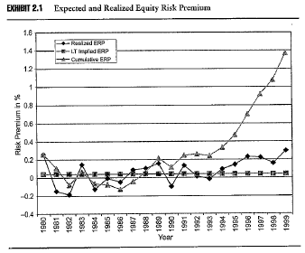
Objective 1.5
Equity risk premium during the 1980s and 1990s
These slides have been drafted by the La Trobe University, School of Business based on Anson (2006).
1.<number>
Notes:
Alternative Securities
What is an alternative asset class?
These slides have been drafted by the La Trobe University, School of Business based on Anson (2006).

Slide 21
Objective 1.5
Equity risk premium during the 1980s and 1990s
As a result of the realized equity risk premium exceeding the expected risk premium for such a long time, institutional investors began to rely on asset allocation models where asset classes were defined strictly according to benchmarks
Throughout the 1980s and 1990s investors needed only to worry about return
The bear market of the early 2000s highlighted the power of mean reversion
Hence the increased interest in alternative asset classes
These slides have been drafted by the La Trobe University, School of Business based on Anson (2006).
1.<number>
Notes:
Alternative Securities
What is an alternative asset class?
These slides have been drafted by the La Trobe University, School of Business based on Anson (2006).

Slide 22
Objective 1.5
Strategic vs tactical asset allocation
Strategic asset allocation defines a target, or targeted range, allocation of the available funds among the major asset classes, which meets the long term objectives of the institutional investor
Strategic asset allocation establishes the beta or market risk of the fund, which is the weighted average of each asset class’ beta.
Tactical asset allocation seeks active returns or alpha within each asset class
These slides have been drafted by the La Trobe University, School of Business based on Anson (2006).
1.<number>
Notes:
Alternative Securities
What is an alternative asset class?
These slides have been drafted by the La Trobe University, School of Business based on Anson (2006).

Slide 23
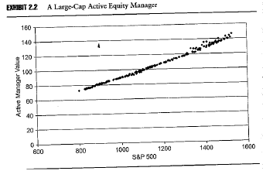
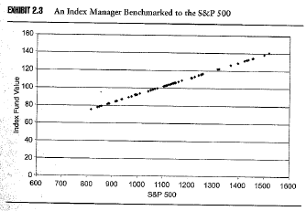
Objective 1.5
“Beta drivers”
Beta drivers are linear in their performance against the benchmark index, hence their returns are derived solely from the index not from the managers value add through active management
Upper graph is an active manager charging 65 bp
Lower graph is a passive manger charging 4 bp
These slides have been drafted by the La Trobe University, School of Business based on Anson (2006).
1.<number>
Notes:
Alternative Securities
What is an alternative asset class?
These slides have been drafted by the La Trobe University, School of Business based on Anson (2006).

Slide 24
Objective 1.5
Separating alpha from beta
Traditionally institutional portfolios find alpha only when it is attached to beta, they define their beta via strategic asset allocation and then within the ranges defined they attempt to generate alpha
Investment managers have to seek Alpha by investing on the most efficient markets, i.e. those of the major benchmarks. Often, it is a very hard task.
In the new investment model alpha is sought independently of beta
Beta remains important to implement the strategic asset allocation established by the investor, however, alpha is sought from investment products in less efficient markets outside the benchmarks.
These slides have been drafted by the La Trobe University, School of Business based on Anson (2006).
1.<number>
Notes:
Alternative Securities
What is an alternative asset class?
These slides have been drafted by the La Trobe University, School of Business based on Anson (2006).

Slide 25
Objective 1.5
Broad categories of alpha drivers
Absolute return strategies
  Hedge fund investment is not tied to the stock and bond index so she can pursue value added strategies regardless of size, market direction or benchmark restrictions
Market segmentation
  Alternative investors are able to invest in segments of the market which are often overlooked or not open to investment by traditional fund managers, such as commodities, and CDOs
These slides have been drafted by the La Trobe University, School of Business based on Anson (2006).
1.<number>
Notes:
Alternative Securities
What is an alternative asset class?
These slides have been drafted by the La Trobe University, School of Business based on Anson (2006).

Slide 26
Concentrated portfolios
  Diversification while reducing risk but also minimizes the probability of outperformance, whereas concentrated portfolios, such as corporate governance and private equity portfolios offers greater opportunity for excess returns
Non-linear return distributions
  Alternative investors often seek assets or strategies with non-linear return distributions, such as via option-like securities.
These slides have been drafted by the La Trobe University, School of Business based on Anson (2006).
1.<number>

Slide 27
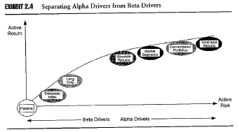
Objective 1.5
Separation of alpha from beta
These slides have been drafted by the La Trobe University, School of Business based on Anson (2006).
1.<number>
Notes:
Alternative Securities
What is an alternative asset class?
These slides have been drafted by the La Trobe University, School of Business based on Anson (2006).

Slide 28
Alpha is not static and can evolve to become beta
  The excess returns (Alpha) of some investment strategies that once been considered as management skills now can be explained by Beta using some sophisticated models.
Alpha strategies go through cycles
  Alpha strategies are sometimes in favor and some times out of favor.
These slides have been drafted by the La Trobe University, School of Business based on Anson (2006).
1.<number>

Slide 29
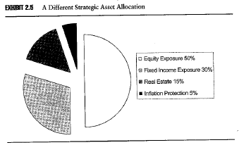
Objective 1.5
An alternative asset allocation model
Strategic asset allocation will meet the investor’s long term objectives by allocating the funds across the major asset classes
These slides have been drafted by the La Trobe University, School of Business based on Anson (2006).
1.<number>
Notes:
Alternative Securities
What is an alternative asset class?
These slides have been drafted by the La Trobe University, School of Business based on Anson (2006).

Slide 30
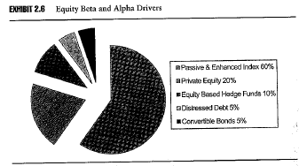
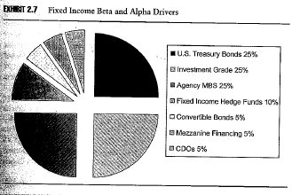
Objective 1.5
An alternative asset allocation model
Within each asset class a blend of beta drivers and alpha drivers is designed to extract greater value
Note the blurring of asset classes
These slides have been drafted by the La Trobe University, School of Business based on Anson (2006).
1.<number>
Notes:
Alternative Securities
What is an alternative asset class?
These slides have been drafted by the La Trobe University, School of Business based on Anson (2006).

Slide 31
Key Points
Think outside the benchmark
Recognize that alpha can be generated across asset class boundaries
Consider the risk of failing to outperform a peer group
Pursue alternative assets where you have the greatest informational advantage
These slides have been drafted by the La Trobe University, School of Business based on Anson (2006).
1.<number>
Notes:
Alternative Securities
What is an alternative asset class?
These slides have been drafted by the La Trobe University, School of Business based on Anson (2006).

Slide 32
ALTERNATIVE SECURITIES
Asset Allocation with Private Equity
Notes:
Alternative Securities
What is an alternative asset class?
These slides have been drafted by the La Trobe University, School of Business based on Anson (2006).

Slide 33
References
Ennis R.M. & M.D.Sebastian. Asset Allocation with Private Equity, Summer 2005, The Journal of Private Equity, 81-87.
These slides have been drafted by the La Trobe University, School of Business based on Anson (2006).
1.<number>
Notes:
Alternative Securities
What is an alternative asset class?
These slides have been drafted by the La Trobe University, School of Business based on Anson (2006).

Slide 34
What is (are) the research question(s) in this paper?
  Does adding private equity to the traditional investment portfolio improve portfolio efficiency?
  If adding private equity can increase the efficiency, does this benefit depend on the composition of existing portfolio?
  What other factors could affect the selection of private equity as an alternative investment in the portfolio?
These slides have been drafted by the La Trobe University, School of Business based on Anson (2006).
1.<number>

Slide 35
Total investable capital market in the world(Dec, 2003)
Equity : Emerging market+US market+other=34.7% .
Debt: 59.2%.
Real estate: 5.4%
Private equity: 0.7% (1/3 venture capital and 2/3 LBOs)
Insert Exhibit 1 here.
The weight of private equity is very small compared with other investments. The implication is that investors’ overall holdings is equal 0.7% of world-wide investment opportunities.
These slides have been drafted by the La Trobe University, School of Business based on Anson (2006).
1.<number>
Notes:
Alternative Securities
What is an alternative asset class?
These slides have been drafted by the La Trobe University, School of Business based on Anson (2006).

Slide 36
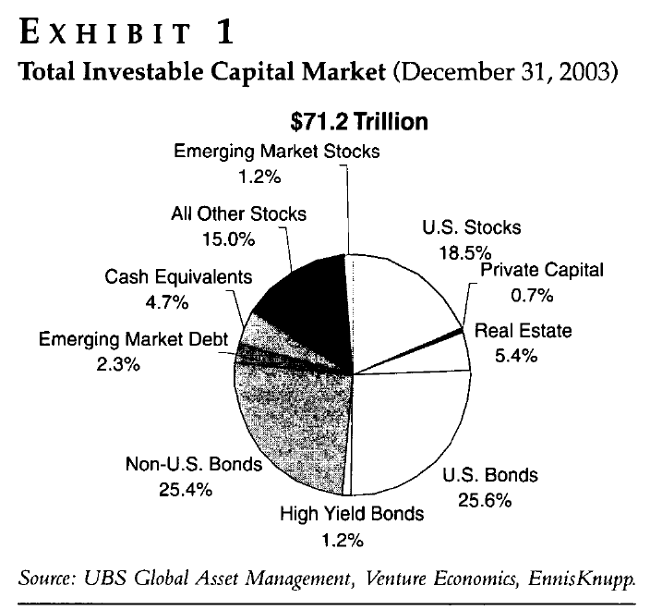
These slides have been drafted by the La Trobe University, School of Business based on Anson (2006).
1.<number>

Slide 37
What are the efficient portfolios?
  Efficient portfolios are those that offer the maximum expected return at a given level of risk, measured as the volatility of annual return. Efficient portfolios are also those that offer the minimum risk at a given level of expected return.
  For a portfolio that includes multiple assets, one need to calculate each asset’s expected return, volatility and the covariance of returns between all assets.
  One can generate efficient portfolios using mean-variance optimization technique, which is typically implemented by some computer software.
These slides have been drafted by the La Trobe University, School of Business based on Anson (2006).
1.<number>

Slide 38
What assets are included in the efficient portfolio in this paper?
  U.S. equity
  International equity
  Real estate
  Private equity
  Fixed income
How do we measure the returns of these assets?
  The Wilshire 5000 Stock Index
  The Morgan Stanley All-Country World (ex. U.S.) Index
  The Wilshire Real Estate Securities Index (with adjustment to the leverage effect)
  The CSFB Warbug Pincus/Venture Economics Post-Venture Capital Index (PVCI)
  The Lehman Aggregate Bond Index
These slides have been drafted by the La Trobe University, School of Business based on Anson (2006).
1.<number>

Slide 39
Risk-return
PVCI (Post-Venture Capital Index) is used as the proxy for the performance of private equity.
One problem is that PVCI only measures the 10-year’s performance after the IPO. But many venture capitals actually exit after IPO. Hence, this index may not be an appropriate proxy for the measurement of the performance of private equity.
Private equity has the highest risk but not the highest return over the period 1986-2003.
Insert Exhibit 2 here
These slides have been drafted by the La Trobe University, School of Business based on Anson (2006).
1.<number>
Notes:
Alternative Securities
What is an alternative asset class?
These slides have been drafted by the La Trobe University, School of Business based on Anson (2006).

Slide 40
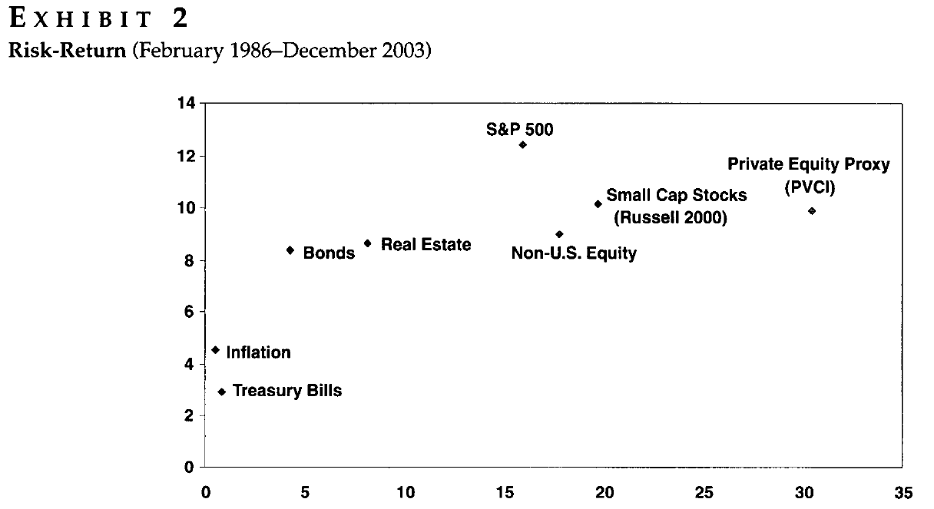
These slides have been drafted by the La Trobe University, School of Business based on Anson (2006).
1.<number>

Slide 41
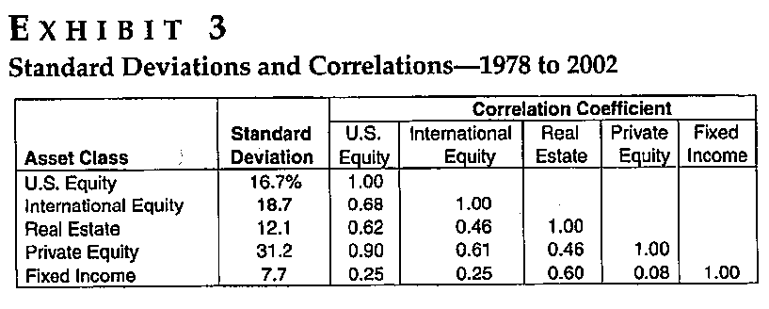
These slides have been drafted by the La Trobe University, School of Business based on Anson (2006).
1.<number>

Slide 42
The expected return-CAPM model
Investors demand compensation for risk
  If investors hold “diversified” portfolios, risk can be defined through the interaction of a single investment with the rest of the portfolios through a concept called “beta”
The CAPM gives the required relationship between “beta” and the return demanded on the investment.
The “diversified” portfolio is defined as the word-wide capital assets in this paper.
The expected return estimated for private equity is 11.3%, beta is 2.61. Note this return does not consider any premium that the investor demands for the additional idiosyncratic risk of private equity.
Insert Exhibit 4 here.
These slides have been drafted by the La Trobe University, School of Business based on Anson (2006).
1.<number>
Notes:
Alternative Securities
What is an alternative asset class?
These slides have been drafted by the La Trobe University, School of Business based on Anson (2006).

Slide 43
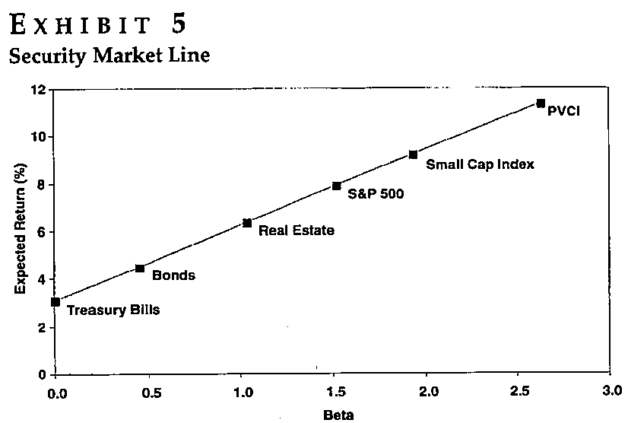
These slides have been drafted by the La Trobe University, School of Business based on Anson (2006).
1.<number>

Slide 44
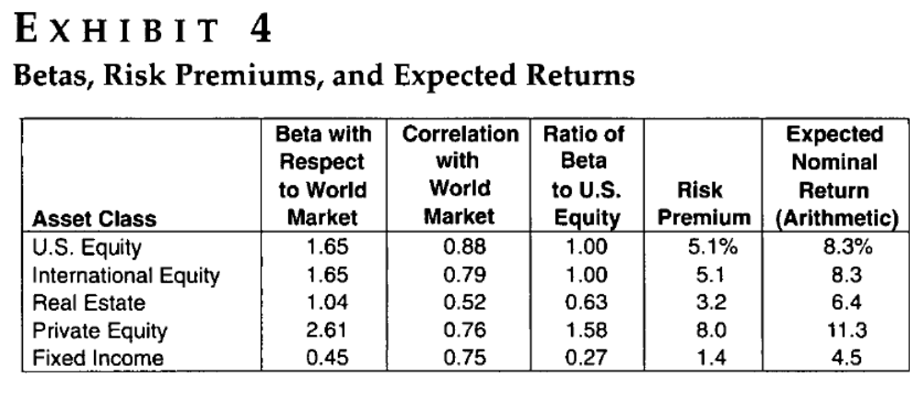
These slides have been drafted by the La Trobe University, School of Business based on Anson (2006).
1.<number>

Slide 45
Optimal portfolios
Given the expected returns, risks and the correlations between different investments, the optimal weight for each investment can be estimated.
The authors show that the weight for private equity in an efficient portfolio is relatively small (less than 6%).
Insert Exhibit 6.
These slides have been drafted by the La Trobe University, School of Business based on Anson (2006).
1.<number>
Notes:
Alternative Securities
What is an alternative asset class?
These slides have been drafted by the La Trobe University, School of Business based on Anson (2006).

Slide 46
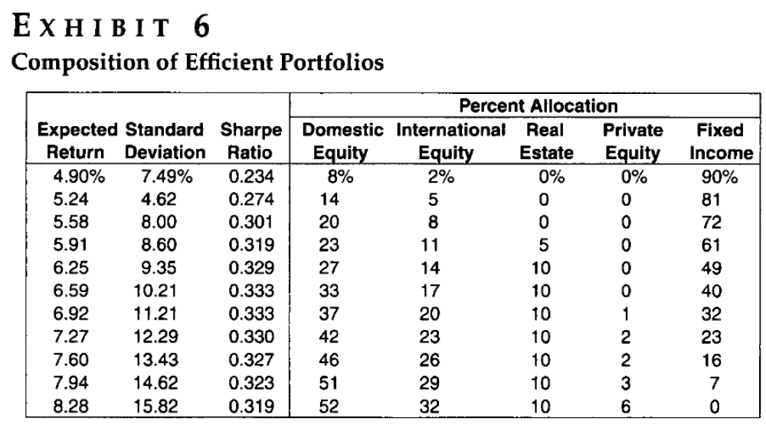
These slides have been drafted by the La Trobe University, School of Business based on Anson (2006).
1.<number>

Slide 47
Observations:
Private equity does not appear in efficiently diversified portfolios with about 60% or less in equity investment.
The range of private equity is about between 1% and 6%.
The results are consistent with the fact that private equity has high risk and should represent a small proportion of the investment opportunity set.
These slides have been drafted by the La Trobe University, School of Business based on Anson (2006).
1.<number>

Slide 48
An investor need to consider the following factors when making an investment decision in private equity
Managers’ investment skills
  The difference between the upper quartile return of venture capital and LBOs could be as high as 40%.
Risk tolerance
  If you prefer safer investments, say, bonds make up more than 30% of the portfolio, then you may not want to include the private equity in your portfolio.
Liquidity
  Less needs for liquidity means greater tolerance for private equity.
Portfolio size
  Market for private equity is small
Internal resources for supervision
Board experience
Confidential dealing
  Some public funds face legal issues about the release of information. Because of the nature of private equity, some funds may find themselves excluded from some private investment opportunities
These slides have been drafted by the La Trobe University, School of Business based on Anson (2006).
1.<number>
Notes:
Alternative Securities
What is an alternative asset class?
These slides have been drafted by the La Trobe University, School of Business based on Anson (2006).
.

Slide 49
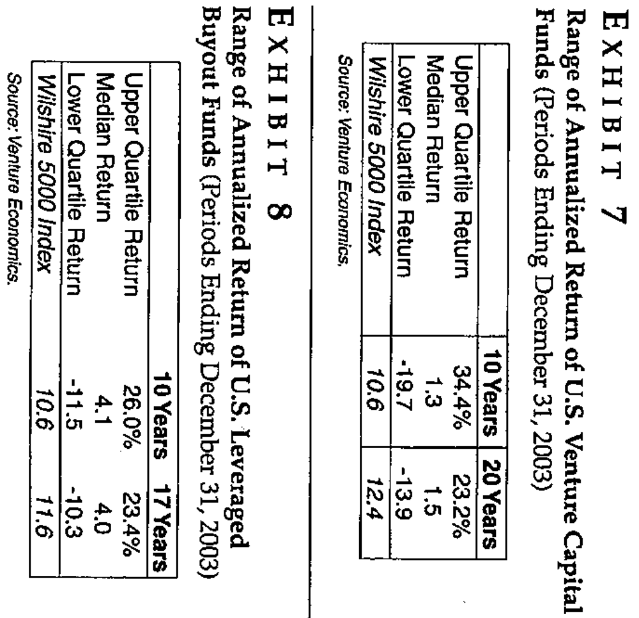
These slides have been drafted by the La Trobe University, School of Business based on Anson (2006).
1.<number>

Slide 50
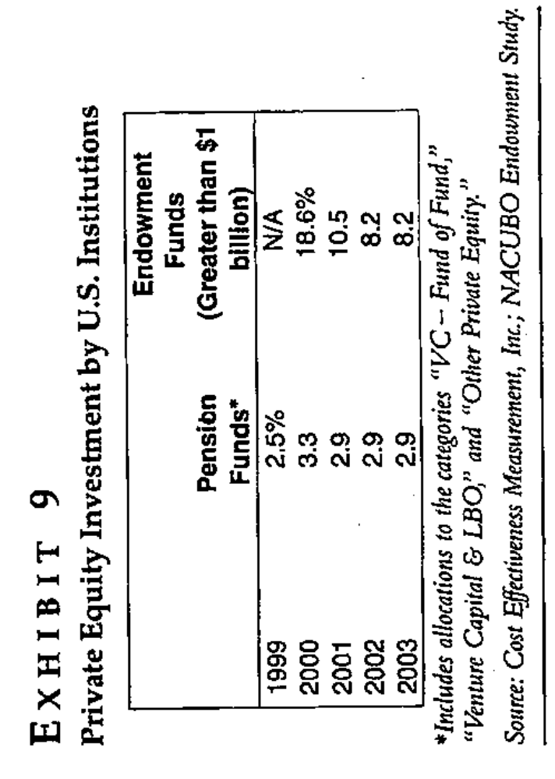
Investor practice
These slides have been drafted by the La Trobe University, School of Business based on Anson (2006).
1.<number>
Notes:
Alternative Securities
What is an alternative asset class?
These slides have been drafted by the La Trobe University, School of Business based on Anson (2006).

Slide 51
The figures in exhibit 9 include all the funds surveyed, including those with no private equity investments.
In the case of pension funds, more than half of the funds have no private equity allocation, this indicates that the average allocation of private equity for the funds that have private equity is as least twice as much as that shown in exhibit 9.
These slides have been drafted by the La Trobe University, School of Business based on Anson (2006).
1.<number>

