Slide 1
ALTERNATIVE SECURITIES
Topic 10: Convertible bond arbitrage
Presented by:
Dr Hui (Michael) Li
Lecturer
School of Economics and Finance

Slide 2
Reference: Stefanini (2006), Investment strategies of hedge funds, Chapter 6.
Reference: F.J. Fabozzi (2002), Fixed income securities, 2nd edition, John Wiley & Sons.

Slide 3
Student learning objectives
10.1 Define a convertible bond.
10.2 Explain why companies may want to issue convertible bonds.
10.3 Explain why investors may want to buy convertible bonds.
10.4 Describe current status of the convertible bond market.
10.5 Understand the prospectus of a convertible bond.
10.6 Identify the four stages in a convertible bond.
10.7 Understand implied volatility and historical volatility.
10.8 Identify cash-flow arbitrage and volatility trading .
10.9 Describe historical performance of convertible bond arbitrage
10.10 Describe the main risks associated with convertible bond arbitrage

Slide 4
Objective 10.1
What is a convertible bond?
Convertible bonds are bonds that give their holders the right to periodic coupon payments and, as of a fixed date, the right to covert the bonds into a fixed number of shares; or alternatively, at a pre-specified price, the conversion price, which is at a premium to the underlying equity spot price at issuance.
Convertibles bonds have characteristics of both bonds and equities. Convertibles bonds typically have a lower coupon and yield compared with a straight bond due to the embedded option value.

Slide 5
Objective 10.1
What is a convertible bond?
In most cases the shares that can be converted are common stock of the issuer, but sometimes it can be shares from another company, should the issuer decide to sell an equity investment it holds in another company by issuing a convertible.
The prospectus for convertible bonds can be very complicated and can have many options. The features embedded in a convertible bond can greatly affect its valuation. Prospectuses should be read carefully to fully understand all the bond’s features.

Slide 6
Objective 10.1
What is a convertible bond?
Some examples of the options embedded in a convertible bond:
  Calls give the issuer the opportunity to redeem the bond, over a pre-specified period and under pre-specified conditions.
  Puts permit the bondholder to redeem the bond on pre-specified dates, usually at issue price or accreted value.
  Dividend protection: compensates bondholders for foregone stock dividends in excess of set thresholds.
  Takeover protection: compensates bondholders for loss of optionality/credit deterioration in a change of control event.

Slide 7
Objective 10.1
What is a convertible bond?
The standard terms for a plain vanilla convertible bond are:
  5 year maturity
  Coupon of 2-3%
  Premium 25-30%
  Option for the issue to require conversion after 3 years.

Slide 8
Objective 10.2
Explain why companies may want to issue convertible bonds.
The issuer believes that its stock is undervalued by the market and therefore wants to sell it forward at a premium.
The issuer can enjoy a lower cost of capital compared to what the issuer has to pay with the issue of non-convertible bond.
The issuer wants to raise capital without dilution of its ownership at least until the conversion date of the convertible bond.
The issuer wants to sell an equity investment in another company at a premium.

Slide 9
Objective 10.2
Explain why companies may want to issue convertible bonds.
Companies may take advantage of a sharp rise in their equity to opportunistically issue a convertible on favorable terms to the issuer when their stock is attracting positive sentiment.
Convertible bonds attract additional investor groups, such as hedge funds, outright convertible funds and institutional trading desks.
Tax advantages: Depending upon the jurisdiction of the holder and issuer, Convertibles may have the effect of reducing or deferring tax liabilities
The market forces of supply and demand – both from investors and from banks that are competing for the deals – mean that convertible bonds may be priced on very favorable terms to the company.

Slide 10
Objective 10.3
Explain why investors may want to buy convertible bonds.
A wide range of investors buys convertible securities for various reasons, as they have become an increasingly popular and better-understood asset class.
Equity funds: downside protection and/or yield advantage.
Fixed income and high yield investors: upside participation, credit exposure.
Convertible funds: valuation and security-specific strategies.
Hedge funds: leveraged option trading and hedging-based strategies.
Risk-arbitrage/specialist funds: corporate activity and special situations.

Slide 11
Objective 10.4
Describe current status of the convertible bond market.
The convertible bond market in the world shows a booming growth in the last decade. In 1994, the total market capitalization was about 330billion. In 2003, the total market capitalization peaked at about 560billion. (Insert figure 6.1)
The US and Europe accounted for 75% of the world convertible bond market. (US 45%, Europe 30%, Japan 14%) (Insert figure 6.2)
US convertible bond market is an over-the-counter market. Most issues are not backed by a prospectus and are served to qualified investors and are not offered to the public.
Japanese convertible bond market is made up of a large number of very small domestic issues, listed and traded on the Tokyo stock exchange.

Slide 12
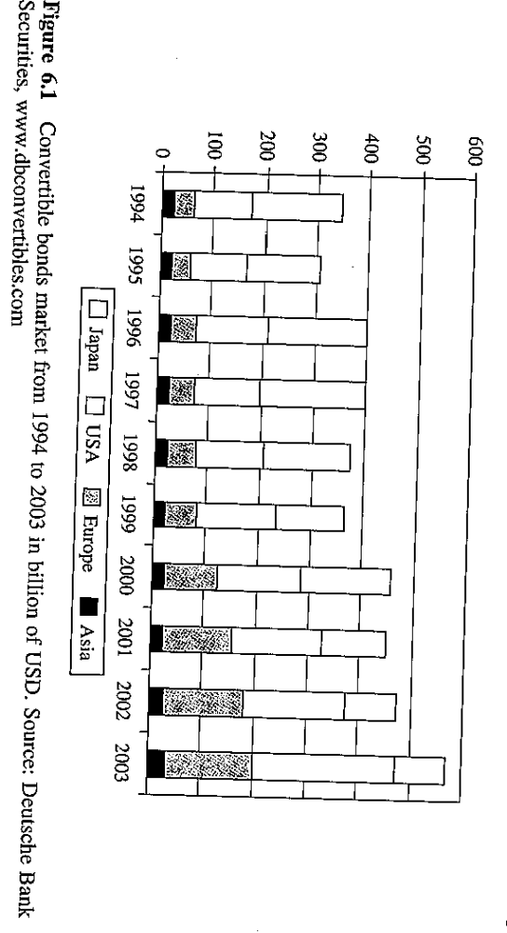

Slide 13
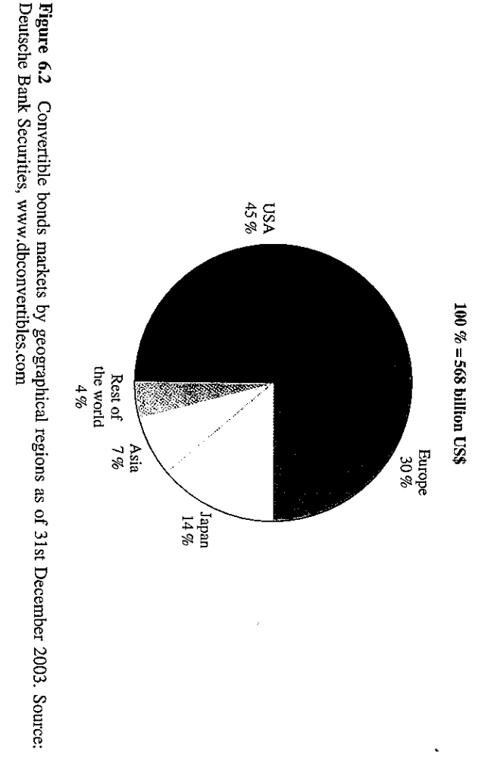

Slide 14
Objective 10.4
Describe current status of the convertible bond market.
Most European issues com from large companies, with a market cap above $10billion. In comparison, only 25% of the US issuers’ market cap exceeds $10billion.
65% of the market in Europe is comprised of investment grade convertible bonds (BBB or higher), against only 40% in the US.
24% of the European market has no rating against only 18% of the US market.
Hedge funds pursuing a convertible bond arbitrage strategy accounted for 8% of the hedge fund industry. The estimated value of convertible bonds held by hedge fund industry accounts for about 30% of total convertible bond market. Trades generated by hedge funds account for 65% of the market.

Slide 15
Objective 10.5
Understand the prospectus of a convertible bond
The maturity is the date on which the issuer must offer to redeem for cash the par value of the convertible bond.
The coupon is the payment of the bond interest.
The conversion ratio is the fixed number of shares of common stock into which a bond is exchangeable.
  ABC ‘s conversion ratio is 25, this means that for each 1000 of par value of the issue the bondholder exchanges for ABC’s commons stock, he will receive 25 shares.
  It also means at the time of issuance, the issuer effectively grants the bondholder the right to purchase the common stock at a price equal to 1000/25=$4, this price is also called sated conversion price. (sometimes the issue price of convertible bonds may not be equal to par, then the stated conversion price is determined by the issue price of the bond)

Slide 16
Objective 10.5
Understand the prospectus of a convertible bond
Conversion value or parity value
  It is the value of the security if it is converted immediately.
  Conversion value=market price x conversion ratio.
The minimum price of a convertible bond is the greater of
  1) its conversion value
  2) its value as a bond without the conversion option (straight value).
If the price is not the greater of the above two values, then an arbitrage opportunity exists.
  If conversion value>straight value, and the bond trades at straight value, buy the bond and convert it and realize the profit which is the difference between the conversion value and straight value
  If straight value>conversion value, and the bond trades at its conversion value, buy the bond and realize a higher yield than a straight bond.

Slide 17
Objective 10.5
Understand the prospectus of a convertible bond
The premium of a convertible bond is the difference between the convertible’s market value and its conversion value, and it is expressed as a percentage of the conversion value.
  Investors are willing to pay a premium on the conversion value of the convertible bond because a convertible bond offers a downside protection.
  A low premium means that the convertibles will be highly sensitive to changes in the underlying stock price.
  A high premium means that the convertibles will be more sensitive to changes in the interest rates .

Slide 18
Objective 10.5
Understand the prospectus of a convertible bond
Bond floor
  Bond floor is the present value of future cash flows of the convertible as a straight corporate bond. The value of the non-convertible bond component alone represents the lower limit value to the convertible.
  To value the bond floor of a convertible bond, it is necessary to know the interest rate and assess the credit risk of the issuer.
Credit spread
  The credit spread is the interest rate difference paid by the convertible bond compared to the risk-free interest rate.
  Credit Spread=Bond yield – Government bond with the same maturity

Slide 19
Objective 10.6
Identify the four stages in a convertible bond
Insert figure 6.6
Insert figure 6.7
Distressed stage:
  When the share price is very low and the issuer’s ability to pay the bonds is questionable.
Bond proxy:
  When the share price is low, the conversion right is unlikely to be exercised, and the conversion option is out-of-the-money.

Slide 20
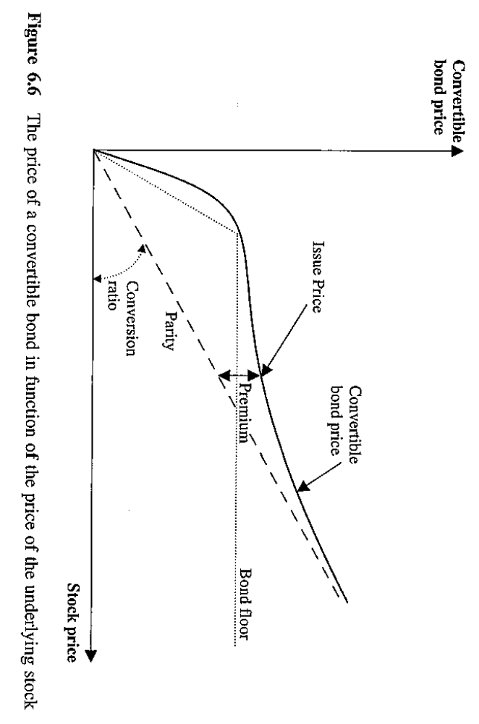

Slide 21
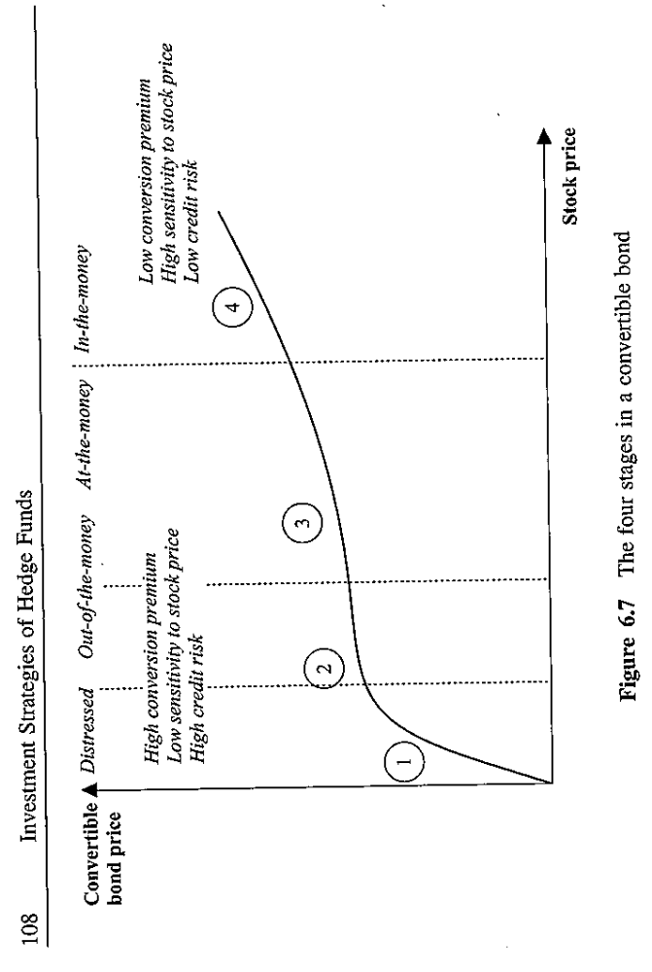

Slide 22
Objective 10.6
Identify the four stages in a convertible bond
True convertible
  When the share price is close to conversion price, and the option is at-the-money.
Equity proxy
  When the share price is very high, conversion is very probable and the conversion option is in-the-money.
If a convertible bond is trading close to its bond floor, the value of the convertible’s bond will be more sensitive to interest rate changes. If a convertible bond is trading at a premium, the value of the convertible bond will be more sensitive to changes in the underlying stock price.

Slide 23
Objective 10.6
Identify the four stages in a convertible bond
Traders use quantitative models to identify convertible bonds whose market value differs from its theoretical value.
There are two types of quantitative models:
  Analytical models
  Numerical models

Slide 24
Objective 10.6
Identify the four stages in a convertible bond
Analytical models – Ingersoll (1976)
  The model is based on the Black-Scholes option pricing model. The assumptions of this model are as follows:
  Market operated continuously
  No transaction costs
  Share prices have a log normal distribution
  The underlying stock volatility is constant
  No limits on short selling
The complexity of a convertible bond makes this model fairly difficult to implement in practice.

Slide 25
Objective 10.6
Identify the four stages in a convertible bond
Numerical models
  Binomial tree model (Cox, Ross and Rubinstein, 1979)
  Trinomial tree model (Boyle, 1986)
  Monte Carlo method
All the models are helpful when making a decision.
But there is no a single model that can fit in all kinds of convertible bonds, thus the fund manager’s skill and a rigorous risk management discipline become very important to evaluate the arbitrage opportunity in convertible bonds.

Slide 26
Objective 10.7
Understand implied volatility and historical volatility
Implied volatility is the volatility the marketplace is implying through the price of the convertible bond.
Implied volatility is the value that, when included in the convertible valuation formula chosen by the hedge fund manager (where all other variables have been fixed or estimated), makes it possible to obtain a theoretical value of the convertible bond identical to the market price.
Implied volatility can be used to verify the market opinion on the expected volatility of a given security.

Slide 27
Objective 10.7
Understand implied volatility and historical volatility
Historical volatility refers to the price fluctuations of a stock over a specific period of time in the past (typically 100 days, 180 days or 250 days). The standard deviations of the stock’s historical series of rates of return at fixed intervals (generally one day) is calculated.
Generally, the option embedded in the convertible bond is traded at lower implied volatility of the underlying stock.

Slide 28
Objective 10.7
Understand implied volatility and historical volatility
Both credit spreads and implied volatility are a measure of the potential return premium expected by investors, given the perceived risks.
The greater implied volatility and credit spreads are , the greater the risk level perceived by investors.
Both indicators have decreased significantly in 2003 and 2004.
The drop in credit spreads and implied volatility means that either investors believe there is much lower risk than in the past, or that compared to the past they are willing to receive a lower return for the same risk, or both.

Slide 29
Objective 10.8
Identify cash-flow arbitrage and volatility trading
The goal of a hedge fund manager is to identify convertible bonds that have a substantial market price difference compared to the theoretical value and to carry out trades that allow him to extract the value, while being protected against market risks.
Most convertible bond arbitrage deals are constructed with a long position on the convertible bond, hedged with a concurrent short sale of the underlying common stock.

Slide 30
Objective 10.8
Identify cash-flow arbitrage and volatility trading
Generally, the risk of interest rate fluctuations is hedged on the convertible long position by using interest rate swaps, and sometimes the convertible issuer’s credit risk is also hedged against (risk that spread widens and issuer default risk) by resorting credit default swaps.
The complexity of valuation models and the variety of deals clearly indicate that to carry out an arbitrage strategy on convertible bonds it is necessary to rely on a complex and expensive technological infrastructure, which represents a significant barrier to entry.

Slide 31
Objective 10.8
Identify cash-flow arbitrage and volatility trading
Technological infrastructure must be able to monitor the convertible bond markets constantly through the application of valuation models, looking for opportunities that the fund manager may take advantage of by using a specific arbitrage strategy.
Fund managers must assess the risk/return profile of each position individually and of the entire portfolio as a whole. The fund manager must diversify the portfolio and use leverage, and must also rely on strict selling rules for each position making up the portfolio.

Slide 32
Objective 10.8
Identify cash-flow arbitrage and volatility trading
Convertible bonds with the following characteristics are suitable for arbitrage:
  High volatility of the underlying stock.
  Good liquidity of the convertible issue and easily borrowable underlying stock.
  Low conversion premium (less sensitive to interest rate and credit risk)
  Stock paying no dividends or low dividends (to avoid having to pay out a dividend while shorting stocks)
  High convexity of convertibles
  Issues with a low implied volatility

Slide 33
Objective 10.8
Identify cash-flow arbitrage and volatility trading
Cash-flow arbitrage
  Buy a convertible bond and shot sell the underlying stock. The proceeds from the short sell are used to finance the purchase of the convertible bond.
An example (insert figure 6.8)
  Buy a convertible bond at $110, a 10% premium to the market price of the underlying stock. The stock is sold short at $100 simultaneously. Hence, the arbitrages only needs $10 to finance the transaction ignoring the margin requirement for the short sell)

Slide 34
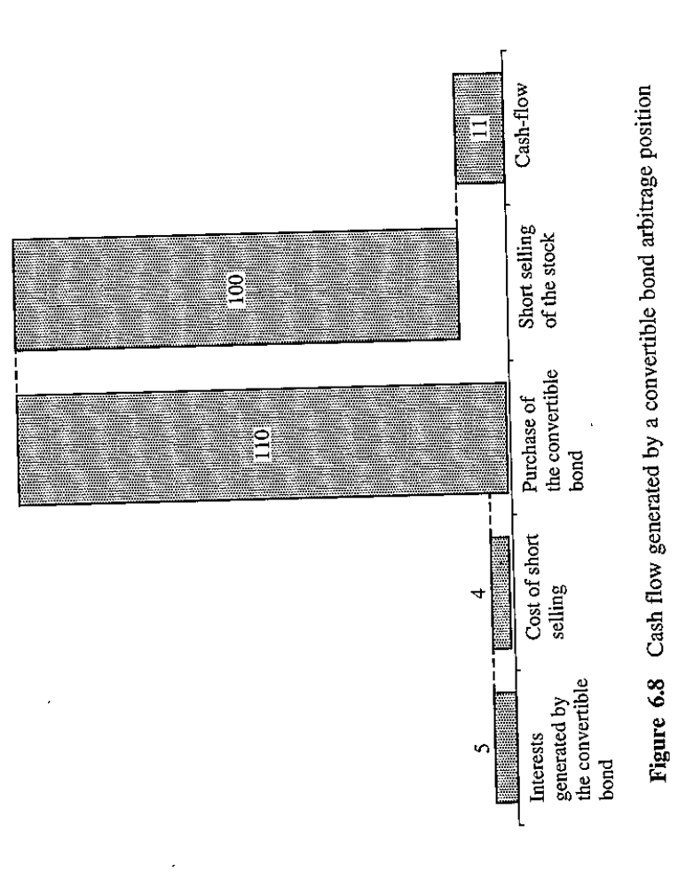

Slide 35
Objective 10.8
Identify cash-flow arbitrage and volatility trading
An example
  The convertible generates 5% ($5)per year. The short sale cost 2% ($2)per year and the dividend paid by is 2%($2). The arbitrage gives the arbitrager a $1 return on an invested capital $10, namely 10% return.
  In reality, other arbitragers will drive the convertible bond price up, raising the premium. Hence, the return of this arbitrage will be lower than 10%.
  Transaction costs, broker fees and interest rate on the leverage will also narrow down the arbitrage possibilities.

Slide 36
Objective 10.8
Identify cash-flow arbitrage and volatility trading
Cash-flow arbitrage is actively used in situations where there is no bond floor, for example in mandatory convertibles, because they have a higher coupon compared to a convertible bond and generally have a similar risk.

Slide 37
Objective 10.8
Identify cash-flow arbitrage and volatility trading
Convertible bonds are generally undervalued with respect to their theoretical value for as least three reasons:
  Most issuers have a speculative rating and only few investors are interested in these notes, which leads to a thin liquidity on the market.
  Many convertible issues come in small sizes and are neglected by analysts.
  Investors tend to prefer plain vanilla securities. (Bonds or shares).

Slide 38
Objective 10.8
Identify cash-flow arbitrage and volatility trading
Volatility trading
  For traders, volatility is the most important variable in the option pricing models.
  The delta of a convertible is the convertible price sensitivity to the underlying share price changes.
  Mathematically, delta is the first order derivative of the convertible price with respect to the underlying stock price.
  Graphically, delta is represented by the slope of the tangent to the curvature of the convertible price as a function of underlying share price, at a fixed share price. (Insert figure 6.9)

Slide 39
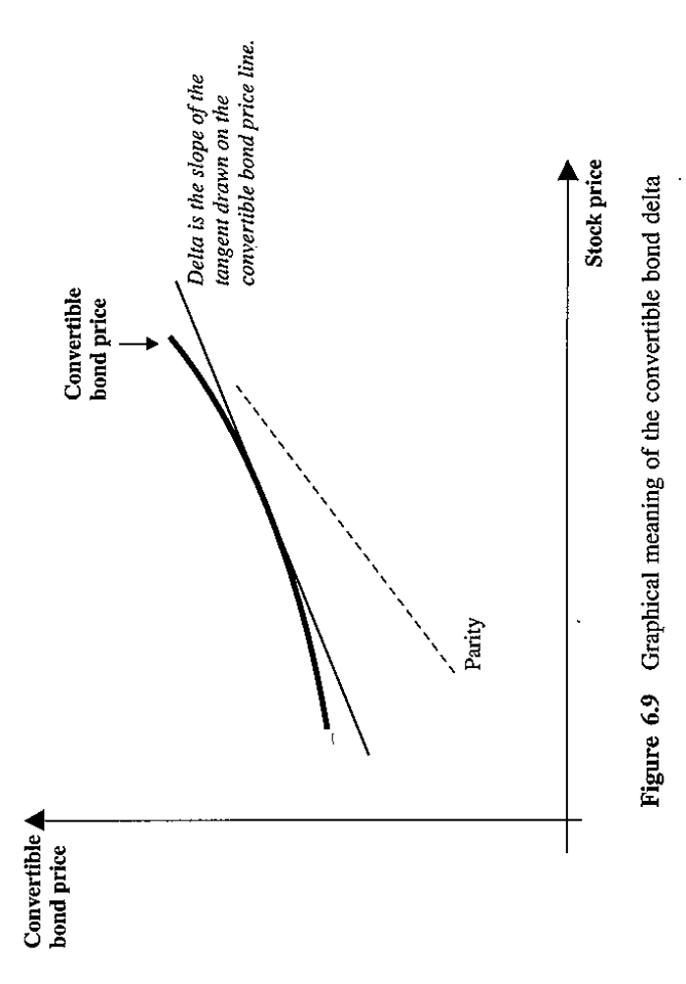

Slide 40
Objective 10.8
Identify cash-flow arbitrage and volatility trading
Volatility trading
  Suppose a manager has a long position of a convertible bond whose price is 1000 and the current share market price is 50. The conversion premium is 25%. So the conversion price is 50*(1+0.25)=75. This means that the bond can be converted to 1000/75=13.33 shares if it is converted immediately.
  Suppose that the bond has a delta of 0.65. To form a delta neutral portfolio, the fund manager needs to sell 0.65*13.33=8.67 shares.

Slide 41
Objective 10.8
Identify cash-flow arbitrage and volatility trading
Volatility trading
  Note that delta is constantly changing with respect to the changes in the underlying stock price (insert figure 6.9)
  The change in the delta of the convertible bond implies that the size of the short position of shares must be dynamically adjusted to remain delta neutral. This constant change of short positions to keep the portfolio delta neutral is called delta hedging.

Slide 42
Objective 10.8
Identify cash-flow arbitrage and volatility trading
Volatility trading
  Delta rises when the stock goes up and declines when the stock goes down. (Insert figure 6.9)
  To keep a position delta neutral, when the share price goes up, also driving up the delta, the fund manager must short sell more shares, whereas when the share price goes down, also pulling down the delta, the fund manager must buyback shares.
  In the case of delta hedging, fund managers can actually stabilize the movement in share prices!

Slide 43
Objective 10.8
Identify cash-flow arbitrage and volatility trading
Volatility trading
  The convexity of the curvature of the convertible bond price favors the arbitrager: if the share price rise sharply, the convertible price should increase more rapidly than the losses on the short position, and if the share price drops significantly, the convertible price should fall less rapidly than the gains that can be obtained on the short position.
  A delta hedging is as if long on the volatility of the underlying stock! This is referred to volatility trading.

Slide 44
Objective 10.8
Identify cash-flow arbitrage and volatility trading
Volatility trading
  With delta hedging, it is possible to make a profit if the volatility of the underlying stock grows.
  Being long on volatility is like buying a protection against capital market crisis during which the volatility will be very high.
  If the volatility of the underlying share in a given period is higher than the volatility implied in the convertible price at the time of purchase, the trade will yield a positive return.

Slide 45
Objective 10.8
Identify cash-flow arbitrage and volatility trading
Volatility trading
  VXO index (Chicago Board Options Exchange OEX Volatility Index) is an estimate of the short-term volatility on the stock market, calculated as the weighted average of the implied volatility of 8 OEX S&P 500 calls and puts. (Insert figure 6.10)
  VXO captures the US large cap equity market, whereas the issuers of convertibles usually have a lower cap and lower credit ratings, so that their stocks tend to be more volatile that VXO.

Slide 46
Objective 10.8
Identify cash-flow arbitrage and volatility trading
Volatility trading
  Return profile of a long position on a convertible bond for a given amount plus a short position on the underlying stock for the same amount. (Insert figure 6.11)
    If the share price goes up, the fund manager converts the bond and returns the borrowed shares. He will lost the conversion premium he paid when he bought the convertible. But if the position is generating a positive cash flow (coupon payments), the longer the position can be kept open, the sooner the premium is paid back.
    When the share price goes down, the manager can buy back the shorted shares and sell the convertible with a higher premium than at the time of purchase.
    So the return profile is asymmetric.

Slide 47
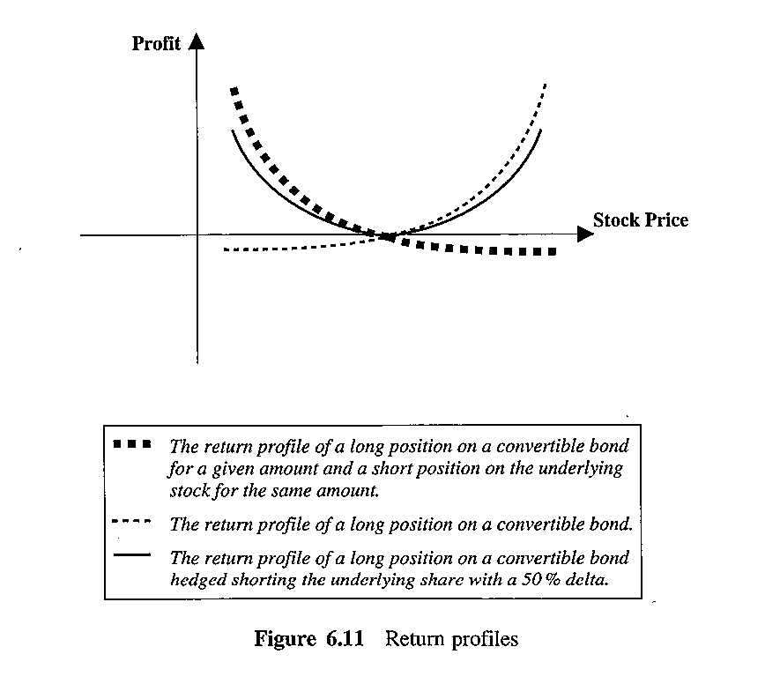

Slide 48
Objective 10.8
Identify cash-flow arbitrage and volatility trading
Volatility trading
  Return profile of a long position on two convertible bonds and short position only one underlying share. (Insert figure 6.11)
  The return profile now is symmetric!
  Convertible bonds with a delta close to 50% are called balanced convertibles.
  Often, new convertibles issues tend to have a delta close to 50%, which explains why hedge funds are often willing to pay a high price for newly issued convertibles.

Slide 49
Objective 10.8
Gamma trading
The gamma of a convertible bond is the convertible’s delta sensitivity to changes in the underlying stock. Analytically, gamma is the first order derivative of the delta of the convertible price with respect to the share price.
Gamma hedging or gamma trading is the delta hedge adjustment process in response to market movements. If gamma is small in absolute terms, the delta changes very slowly and it is not necessary to carry out frequent adjustments to keep the portfolio delta neutral.
If gamma is big in absolute terms, the delta is highly sensitive to the changes in the underlying stock price and it is now necessary to carry out frequent adjustments to keep the portfolio delta neutral.

Slide 50
Objective 10.8
Gamma trading
Graphically, the gamma is represented by the convexity of the curvature of the convertible price as a function of the underlying stock price, at a fixed price of the underlying share.
The greater the convexity, the greater the hedge ratio error following the share price movement. The greater the gamma, the greater the potential profit for the hedge fund manager.
As long as markets are volatile, delta hedging and gamma trading can generate profits. A hedge fund manager adopting these two strategies will suffer losses when market volatility falls below a certain level.

Slide 51
Objective 10.8
The greatest risk for delta trading and gamma trading is the credit risk of the convertible issuer. A hedge fund manager can buy a credit default swap to hedge against the credit risk.
A credit default swap is a contract that offers a protection against the default risk. The buyer of the swap receives the right to sell the bond at par. The buyer makes periodic payments to the seller up to the expiration of the contract or until the company defaults.
A interest rate swap is an agreement whereby one party promises to pay a fixed rate interest payment in exchange for an floating rate interest payment based on a notational principal.
A hedge fund manager can eliminate the interest rate risk by entering a interest rate swap whereby the managers pays the fixed rate in exchange for the floating rate.

Slide 52
Objective 10.9
Mandatory convertibles
Mandatory convertibles automatically convert to stock upon maturity, compared to bond convertibles where the exchange is optional. On expiration, mandatory convertibles are converted into a number of shares that depends on the price of the underlying share.
Company may decide to issue a mandatory convertible for the following reasons:
  Coupons are tax-deductible
  Avoid cash redemptions on expiration
  De-leverage the balance sheet, as generally mandatory convertibles are treated like shares.
  Make a deferred sale of shares at a premium to the current price.
  Raise capital at a lower commission costs.

Slide 53
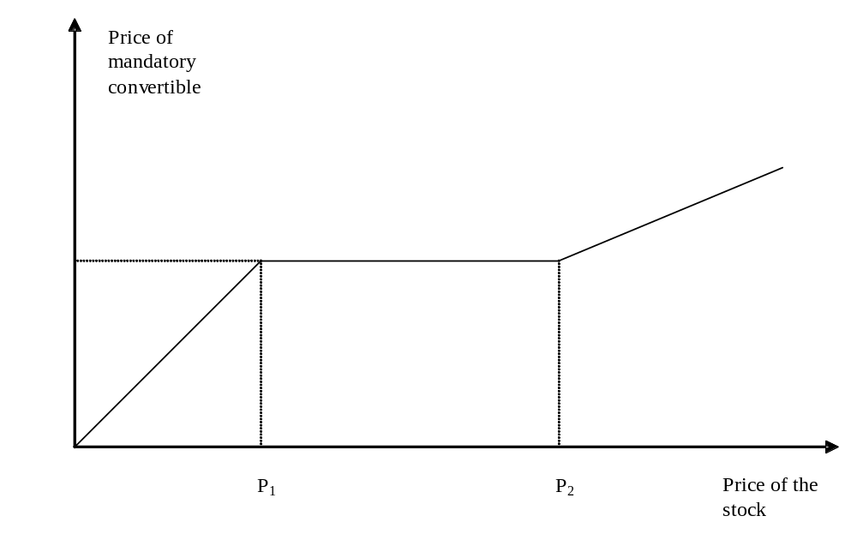

Slide 54
Objective 10.9
Describe historical performance of convertible bond arbitrage
Insert table 6.3
  CS/Tremont Convertible Bond Arbitrage Index between 1994 and 2004 shows that the performance has been strong, with an annualized return of 9.8% and a low volatility (4.7%).
Insert table 6.20
  Note there are four underwater periods during which the market conditions are adverse to convertible bond arbitragers.

Slide 55
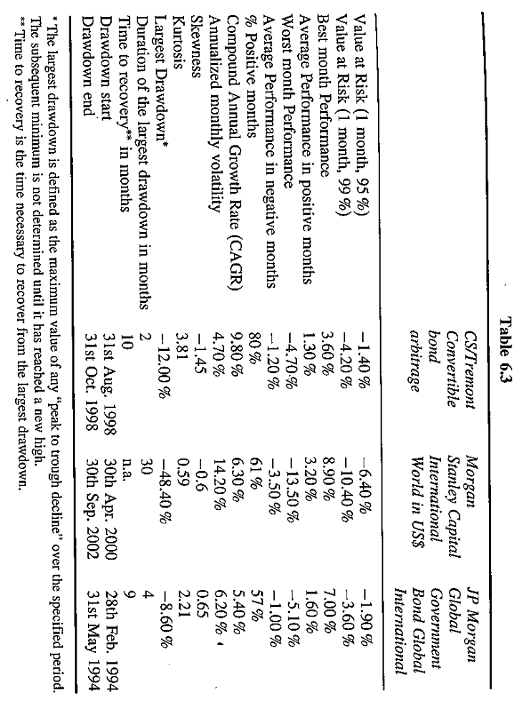

Slide 56
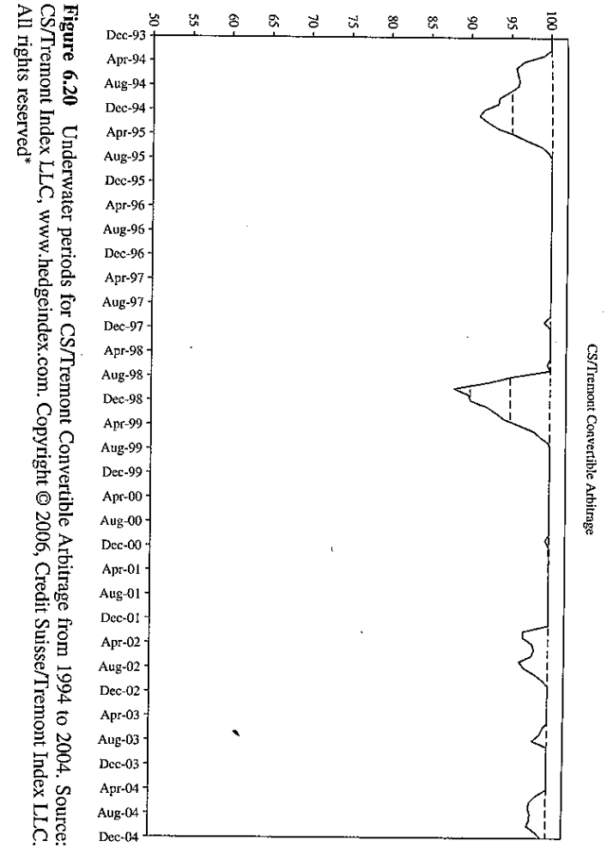

Slide 57
1994, bond prices go down while share prices remain unchanged.
2002, both share and bonds go down. Companies go bankruptcy or do not pay back the bond upon maturity.
1998, liquidity crisis, credit spreads widen and share prices go down, there is no liquidity on the market.
2005, share prices go up but bond prices go down.

Slide 58
Objective 10.10
Describe the main risks associated with convertible bond arbitrage
Equity market risks
  If the hedging is not equity market-neutral, the arbitrage is exposed to the risk of market fluctuations.
Interest rate risk
  Interest rate movement is negatively associated with the movement in convertible bond prices.
  A short position on the underlying stock acts as a protection against interest rate risk.
  The value of the option embedded grows as interest rate rises, so it also provide a hedge against interest rate risk.
  Arbitragers can hedge their interest rate risk using interest rate swap.

Slide 59
Objective 10.10
Describe the main risks associated with convertible bond arbitrage
Credit risk-risk of widening credit spreads
  The short position on the underlying stock partly reduces this risk because when credit spreads widen, share prices go down.,
  Arbitragers can hedge credit risk using credit default swap.
Leverage
  The use of leverage increases risk.
The risk of special events
  In the event of a dividend payout, the fund manager who shorts the underlying stock has to pay dividends.

Slide 60
Objective 10.10
Describe the main risks associated with convertible bond arbitrage
Liquidity risk
  The risk that the bid/ask spread on the convertibles and shares widen. The liquidity risk is higher for small convertible issues and for companies with a low creditworthiness. Arbitragers cannot hedge this risk.
Shot squeeze
  A sudden call for the shares to be returned.
A shortage of borrowable shares
Unfavorable provisions in the prospectus to the bondholder
Currency risk

