Slide 1
ALTERNATIVE SECURITIES
Topic 11: Merger arbitrage

Slide 2
Reference: Stefanini (2006), Investment strategies of hedge funds, Chapter 5.

Slide 3
Student learning objectives
11.1 Define the merger arbitrage.
11.2 Identify the key questions that a hedge fund attempts to answer in a merger arbitrage.
11.3 Identify the waves in mergers & acquisitions and understand the current development in mergers & acquisitions.
11.4 Describe the steps involved in merger or acquisition.
11.5 Identify the risks associated with merger & acquisition.
11.6 Identify different types of mergers and acquisitions.
11.7 Describe the strategy’s historical performance.

Slide 4
11.1 Define the merger arbitrage.
“The merger arbitrage strategy seeks to seize the opportunities arising form mergers and acquisitions (M&A), by trading the stocks of the companies involved in the deal.”
It is called risk arbitrage whose outcome purely depends on the risk associated with the deal outcome.

Slide 5
11.1 Define the merger arbitrage.
The hedge fund manager takes a directional position on the spread.
  In the case of acquisition, between the value offered for the acquisition and the current market value of the company to be acquired;
  In the case of merger, between the theoretical exchange ratio of the stock of the two merging entities and the exchange ratio currently expressed by the market.

Slide 6
11.1 Define the merger arbitrage.
The greater the risk of a deal failure, the greater is the spread.
The manager opens arbitrage position and expects the current market spread to converge towards the offered one. The manager will make a profit if the spread narrows, and will lose money if spread widens.
The manager may choose between two approaches:
  Take a position after the transaction has been announced;
  Try to anticipate the merger or acquisition event, taking a position before the announcement.

Slide 7
11.1 Define the merger arbitrage.
Generally, hedge fund managers trade after the deal has been announced. To invest seeking to anticipate an event may take risks that can be linked to the illegal practice of insider trading.
The hedge fund manager’s information resources are:
  Companies’ public documents, Internet, analyst reports and SEC filings.
  Network with investment analysts, the management of companies concerned, advisors specialized in the sector, the management of companies belonging to the same sector and legal offices.

Slide 8
Objective 11.2
Identify the key questions that a hedge fund attempts to answer in a merger arbitrage.
Does the deal make sense both in strategic and financial terms?
Are there other potential bidders who may make a higher bid for the target company?
If the deal fails, what is the possible loss?
What is the probability of the deal being completed and what is its expected time-to-completion
The size of the position that the manager will build depends on the risk associated with the highest losses and the expected time-to-completion.

Slide 9
Objective 11.3
Identify the waves in mergers & acquisitions.
There are five major merger waves in the history of US.
  The “trustification” of industrial America between 1898 and 1903
    Many small and medium enterprise consolidated set up monopolies in the oil, steel and manufacturing industries.
    The wave ended as a result of President Roosevelt’s intervention aimed at limiting “trustification”, and of the economic recession that has started in 1902.

Slide 10
Objective 11.3
Identify the waves in mergers & acquisitions.
  The introduction of the assembly line between 1923 and 1929
    Many sectors had consolidated and oligopolies in the power, gas and manufacturing industries were created.
    This wave was ended with the crash of the stock market in 1929 and the onset of the Great Depression.

Slide 11
Objective 11.3
Identify the waves in mergers & acquisitions.
The third wave of mergers took place in the 1960s
  Big economic conglomerates were formed through the merger of companies belonging to different industries.
  Many investment banks started to create their own merger and acquisition arbitrage groups, making substantial profits.
  This wave ended at the beginning of the recession of the 1970s, which caused conglomerate profits to sink, followed by their shares.

Slide 12
Objective 11.3
Identify the waves in mergers & acquisitions.
The fourth wave of mergers took place in the 1980s
  The number of hostile bids exploded, favored by low interest rates and by a favorable regulatory framework. The oil, natural gas, financial services, regional banks and food industries were swept up in a consolidation process.
  Following financial scandals involving some of the prominent figures of the merger arbitrage community, the golden age of mergers and acquisitions ended abruptly in Oct 1989, when the LBO of American Airlines failed. Many leveraged companies filed for bankruptcy.

Slide 13
Objective 11.3
Identify the waves in mergers & acquisitions.
The fifth wave of mergers took place in the second half of the 1990s.
  The reasons of this wave can be traced back to technological changes, globalization and market liberalization.
  Deregulation swept across the financial, telecommunication and utilities industries.
  This wave ended with the burst of the new economy bubble and the onset of recession in 2001.
Insert figure 5.1.

Slide 14
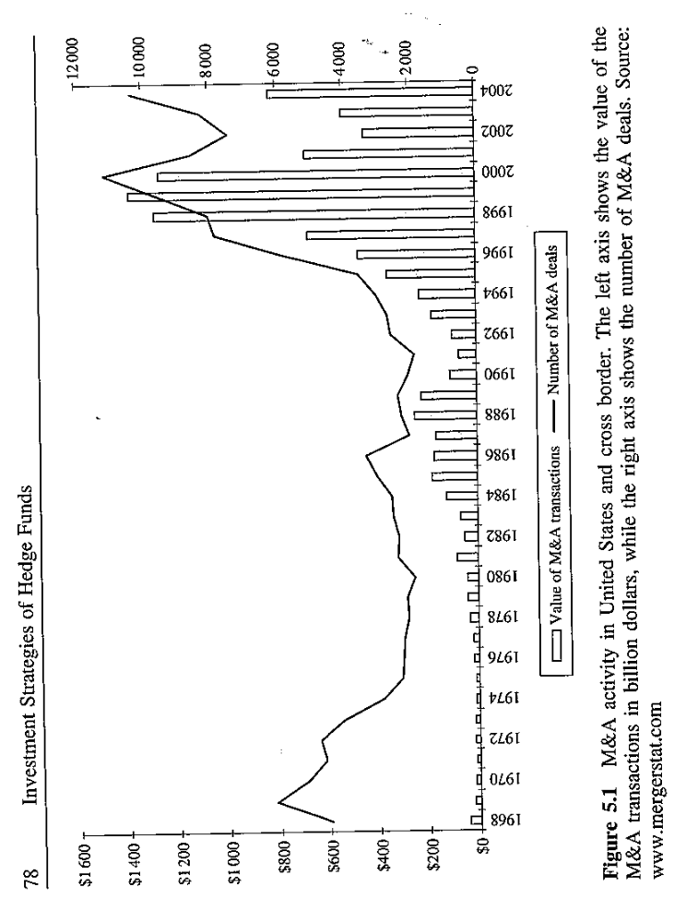

Slide 15
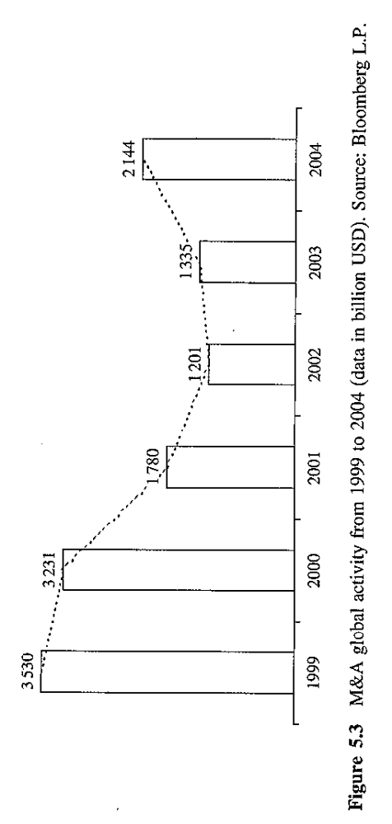

Slide 16
Objective 11.3
Understand the current development in M&A
Insert figure 5.3.
After the peak in 1999 the M&A market reached its lowest point in 2002 and then began to grow, sustained by the high level of cash in corporate balance sheets and by the pressure for consolidation in many sectors.
Insert figure 5.4
From 1997 to 2005, telecom and banks have been the most active sectors in the period. The search for a critical size is a success factor to survive the high level competition in the telecom and banking sectors.

Slide 17
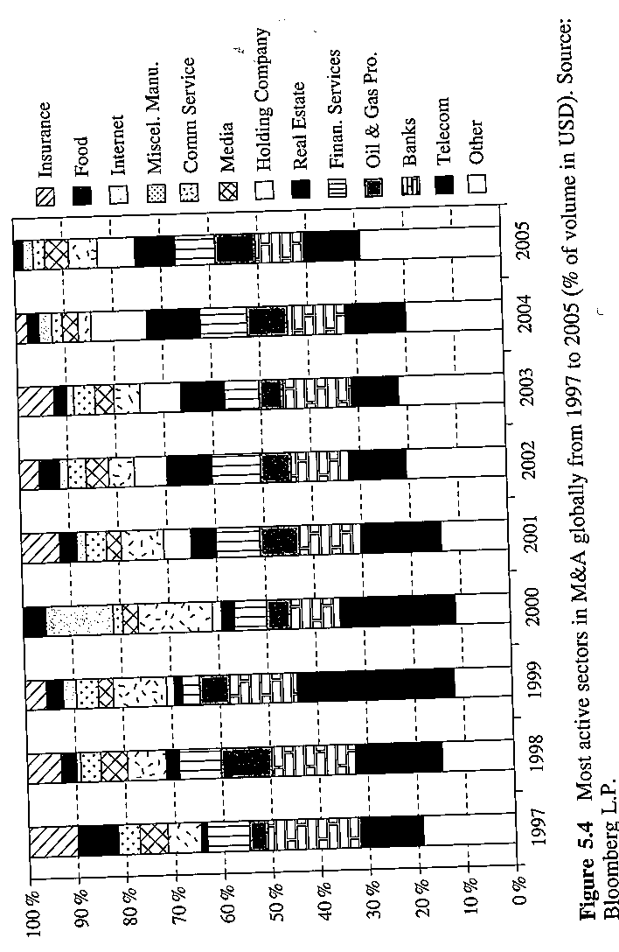

Slide 18
Objective 11.3
Understand the current development in M&A
Between 1998 and 2000 all share exchange deals accounted for about 30% of transactions worth more than one billion dollars.
Only 15% of the greatest deals in 2003 was on a share exchange basis, mainly as a direct effect of the low interest rates throughout 2003.
61% of deals over one billion dollars in 2003 was on a purely cash basis.

Slide 19
Objective 11.3
Understand the current development in M&A
Even though deal volumes grew in 2003 and 2004, arbitragers did not benefit from it, and obtained only mediocre results. The internal rate of return is only about 5%. The narrow spread is probably due to the high number of arbitragers trading on the same transactions and the low interest rates.
Citigroup maintains that most probably M&A activity is on the verge of a new significant wave.
In this sixth wave, the shock is represented by the integration of the Internet and of the new IT causing corporate processes to be reconfigured.
The sectors that will most probably consolidate are finance, media and healthcare.

Slide 20
Objective 11.4
Describe the steps involved in merger or acquisition.
The merger or acquisition is made up of the following steps:
Preliminary agreement;
Final agreement specifying the terms and conditions along which the transaction is performed and the withdrawal terms for each party,
Audit of the financial reports of the company being acquired, or in the case of merger, of both companies by an auditing company,
Shareholder’s approval for both companies in the case of merger or for the company being acquired in the case of acquisition,
Approval by market regulatory authorities and anti-trust authorities,
Legal outcome of the deal.

Slide 21
Objective 11.5
Identify the risks associated with merger & acquisition
Shareholders do not approve the deal;
  This may happen when shareholders are not satisfied with the exchange ratio offered in the case of merger or with the bid in the case of acquisition.
Deal terms may be renegotiated due to pressures by the shareholders or the target company management;
The anti-trust authorities and the market regulatory authorities do not give the green light;
Fiscal or regulatory issues;
A new buyer steps in, who is on more friendly terms with the current management of the target company;
Defensive actions by the management of the target company, for fear of layoffs or deep changes in the management structure;
Other unforeseen factors.

Slide 22
Objective 11.5
Identify the risks associated with merger & acquisition
A company may challenge a hostile takeover thorough the following actions:
  Poison Pill - to make the target less attractive to the acquirer or to make the acquirer impossible to buy the sufficient amount of shares in order to takeover the target.
  One example is to offer shares at a significant discount exclusively to the company’s current shareholders. Hence, the acquirer’s proportion of shareholding will be greatly diluted after the current shareholders’ purchase of the new issued shares.

Slide 23
Objective 11.5
Identify the risks associated with merger & acquisition
A company may challenge a hostile takeover through the following actions:
  Staggered board:
    A board of directors in which only a portion of the directors are elected each year, to thwart unfriendly takeover attempts, since potential acquires would have to wait at least one year to take full control of the company’s board.
    The acquirer will have to win two ballots in two different shareholder’s meetings, instead of winning a single ballot in the meeting at the time of the offer.

Slide 24
Objective 11.5
Identify the risks associated with merger & acquisition
A company may challenge a hostile takeover thorough the following actions:
  Special share classes
    For example, Class A and Class B have different voting rights. This method is used when a majority shareholders wishes to retain control over a company, by holding the shares with more favorable voting rights and floating the other class of shares.

Slide 25
Objective 11.5
Identify the risks associated with merger & acquisition
The spread between the announced exchange ratio and the market exchange ratio is greater in the case of hostile bids, in that there is a higher risk that the deal will fail.
The greater the uncertainty as to the deal outcome, the larger the merger arbitrage spread becomes.
Generally, managers tend to increase their position in a single deal little by little as it approaches a positive ending. The probability of the success increases along the way until the deal smoothly reaches its positive conclusion.
The risk/return profile of a M&A is highly asymmetric: there is a high probability of gaining a narrow spread and a very little probability of losing a lot of money.

Slide 26
Objective 11.5
Identify the risks associated with merger & acquisition
An example of deal failure
On 22nd Oct 2000, General Electric announced its intension to acquire Honeywell International with an offer of 1.055 GE shares for each Honeywell share. It was estimated that the acquisition would produce a cost saving of $1.5billion.
GE’s market cap was about $573billion, while Honeywell’s market cap was $28billion. In view of the size of the two companies, many analysts gave a positive opinion to this merger. Many hedge fund manager went into merger arbitrage.
On 2nd May 2001, the US Department of Justice approved the merger. This strengthen the merger’s probability of success.

Slide 27
Objective 11.5
Identify the risks associated with merger & acquisition
An example of deal failure
However, on 14th June 2001, EU competition commissioner announced the commission’s intention to reject the merger. The decision was based on the fact that the European Union was worried that the resulting company would have a dominant position in the market of airplane engines and electronics.
This was the first time the EU reached a different conclusion from the US antitrust authorities.
This decision made the merger failed, inflicting a hard blow on arbitragers (Insert figure 5.6)

Slide 28
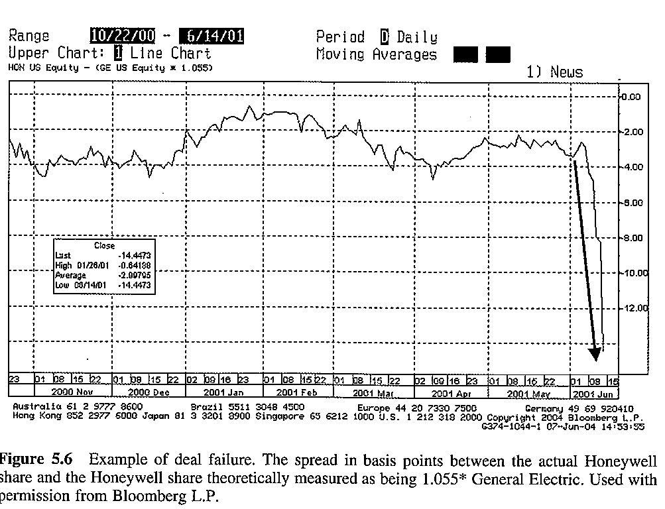

Slide 29
Objective 11.6
Identify different types of mergers and acquisitions.
Cash mergers or tend offers
Stock swap mergers or stock-for-stock mergers
Stock swap mergers with a collar
Multiple bidder situations
Leveraged buyouts and hostile takeovers
Spin-offs

Slide 30
Objective 11.6
Identify different types of mergers and acquisitions.
Cash mergers or tend offers
  The acquirer offers a fixed cash amount for each share of the target company.
  The price offered for the shares includes a premium on the market price of the share before the offer.
  Following the announcement, the price of the shares of the target company should rise but it does not immediately reach the price offered by the acquirer.

Slide 31
Objective 11.6
Identify different types of mergers and acquisitions.
Cash mergers or tend offers
  The percentage difference between the initial price of the offer and the closing share price of the target company the day after the announcement of the acquisition is called merger arbitrage spread.
  This spread varies as a function of the risk that the deal may fail.
  In the case of cash merger, the hedge fund manager purchases the shares of the target company without short selling the shares of the acquirer.

Slide 32
Objective 11.6
Identify different types of mergers and acquisitions.
Cash mergers or tend offers-A case of merger arbitrage
  On 10th Sep 2001, LVMH (Moet Hennessy-Louis Vuitton),PPR( Pinault Printemps Redoute) and Gucci reached the following agreement:
    The purchase in Oct 2001 by PPR of a package of Gucci shares held by LVMH at a price of $94 for a total amount of $806million;
    The payment by Gucci of a $7 dividend per share in Dec 2001;
    The obligation for PPR to launch a takeover bid for all Gucci shares it did not hold yet in Mar 2004 at a unit price $101.5

Slide 33
Objective 11.6
Identify different types of mergers and acquisitions.
Cash mergers or tend offers-A case of merger arbitrage
  The September 11 terrorist attack caused the prices of luxury stocks to drop considerably.
  Dutch securities commission approved the agreement without introducing additional terms.
  A hedge fund manager realized that this deal resembles a convertible bond-i.e., a convertible bond issued by PPR, with a coupon rate equal to the dividend payment distributed by Gucci in Dec 2001 and a conversion price $101.5.
  The hedge fund manager found that Gucci was undervalued compared to a basket of luxury shares.

Slide 34
Objective 11.6
Identify different types of mergers and acquisitions.
Cash mergers or tend offers-A case of merger arbitrage
  The hedge fund manager bought the Gucci shares.
  To hedge against PPR’s credit risk, the manager bought credit default swaps on PPR with a notional value of 1.7 times the Gucci share price.
  The interest rate risk was hedged by purchasing Eurodollar futures.
  To be delta neutral with respect to the convertible bond, the hedge fund sold short a basket of luxury shares.

Slide 35
Objective 11.6
Identify different types of mergers and acquisitions.
Cash mergers or tend offers-A case of merger arbitrage
  In Jun-July 2002, corporate bonds started to widen their spread with respect to Treasures with a similar maturity, due to the worrisome corporate accounting scandals and the bankruptcy of issuers that used to have an investment grade creditworthiness.
  PPR shares tumbled from 125 to 80, but also the luxury share basket that the manager had sold short dropped sharply, generating a profit of 10% of the market value of Gucci shares for the manager.

Slide 36
Objective 11.6
Identify different types of mergers and acquisitions.
Stock swap mergers or stock-for-stock mergers
  The acquirer offers its shares in exchange for the shares of the target company, based on the relation indicated by the exchange ratio.
  To purchase the target's shares and then convert the shares into the shares of acquire does not guarantee a profit because the acquirer's share price could decrease substantially upon the completion of the merger.
  The manager constructs a portfolio that brings the real exchange ratio as expressed in market values towards the theoretical exchange ratio.

Slide 37
Objective 11.6
Identify different types of mergers and acquisitions.
Stock swap mergers or stock-for-stock mergers
  The manager takes a directional position on the spread between the theoretical exchange ratio and the actual exchange ratio.
  Generally, the position does not depend on the global market performance.
  Recently, merger spreads have narrowed down. The managers have to use leverage to achieve a desired level of return in a short time period.

Slide 38
Objective 11.6
Identify different types of mergers and acquisitions.
Stock swap mergers or stock-for-stock mergers: A case of merger arbitrage (Insert figure 5.7)
  On 1st Sep 2003, France Telecom announced the acquisition of Orange with 11 France Telecom shares in exchange 25 Orange shares.
  The hedge fund manager believes the actual exchange ratio should converge to the announced one.
  One orange share should worth 11/25 Telecom share.
  If the spread is positive (1 orange – 11/25 Telecom>0), the manager will short 25 orange shares and long 11 Telecom shares, and vice versa.

Slide 39
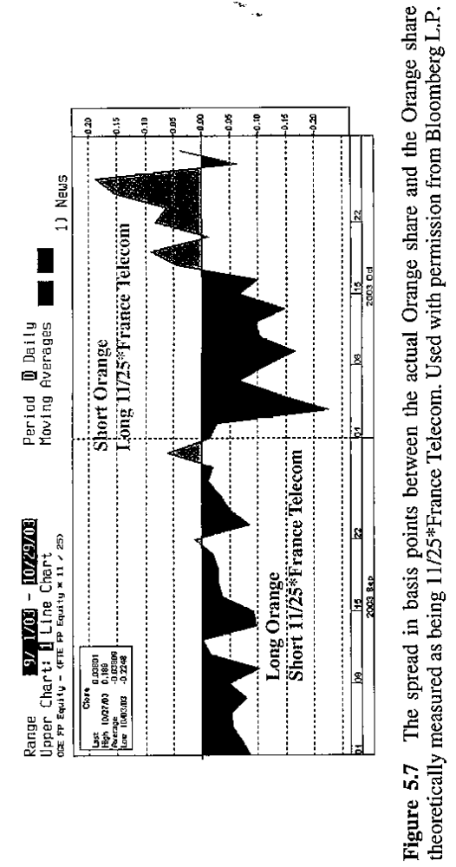

Slide 40
Objective 11.6
Identify different types of mergers and acquisitions.
Stock swap mergers with a collar
A stock swap merger with a collar is a complex merger situation where the exchange ratio is based on the price of the acquiring company at the date of completion. In extreme cases, the target has the right to cancel the merger of the value of the share of the bidding company goes below a given value, called a collar.
The greater uncertainty is associated with a wider spread.

Slide 41
Objective 11.6
Identify different types of mergers and acquisitions.
Stock swap mergers with a collar
  Insert figure 5.8.
  Company A offers to buy Company B. If A’s price is less than 46, the exchange ratio is 0.478. If A’s price between 46 and 58, the price is fixed at 22. If A’ s price is greater than 58, the exchange ratio is 0.379.
  The hedge technique involves delta hedging with options.

Slide 42
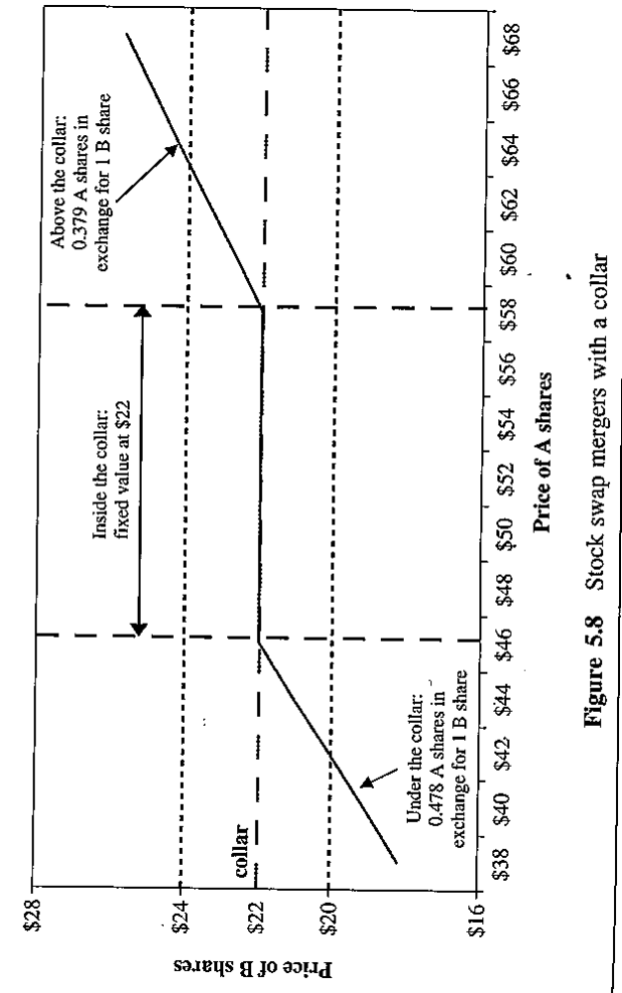

Slide 43
Objective 11.6
Identify different types of mergers and acquisitions.
Multiple bidder
  Multiple companies involve in a web of mergers and acquisitions.
  Spreads are wider because of a greater uncertainty.
LBO
Spin-offs
  Spin-off is a form of divestiture resulting in a new independent company which is a subsidiary or a division of the parent company.

Slide 44
Objective 11.6
Identify different types of mergers and acquisitions.
Spin-offs
  The shares of new company are distributed on a pro rata basis to the parent company or sold to the new shareholders through IPO.
  In general, spin-off shares tend to be decline immediately after the spin-off.
    For institutional investors, the size of the distribution may be too small to monitor the firm’s performance. So many institutions may want to liquidate them.
    Very little is known with regard to the allocation of overhead and admin. Costs between the new entity and the parent, thus it is hard to correctly value the new company.

Slide 45
Objective 11.7
Describe the strategy’s historical performance.
CS/Tremont risk arbitrage index between 1994 and 2004.
  Compound annual growth rate is 8.2%.
  The percentage of positive month is 80%. The average return in positive months is 1.1%.
  There were two underwater periods.
    August 1998 market crisis.
    Summer 2002, a very weak stock market.
  M&A arbitrage is generally not correlated to the direction of financial markets except for extreme events.
  (Insert Table 5.2)

Slide 46
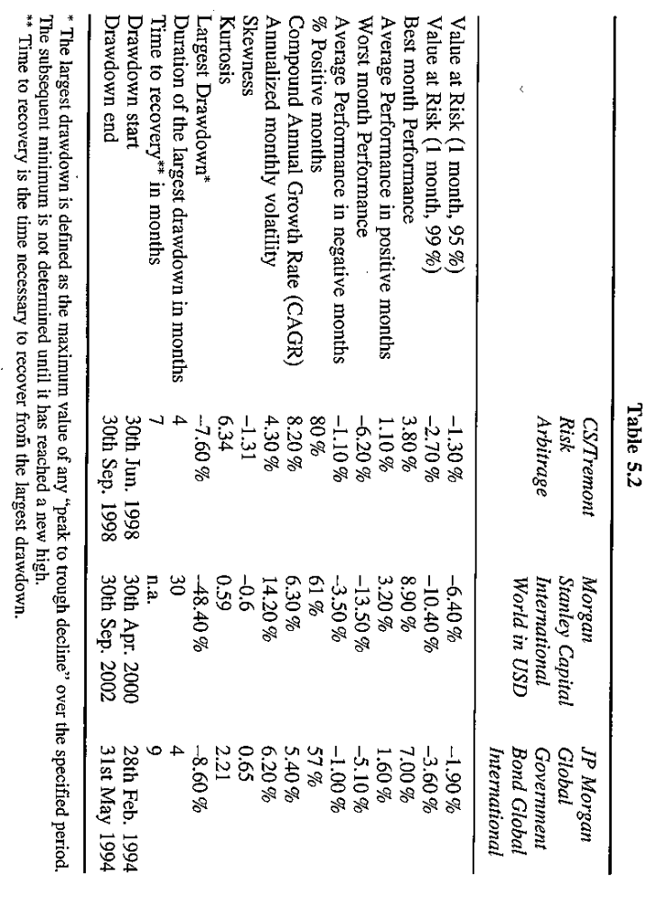

Slide 47
Objective 11.7
Describe the strategy’s historical performance.
The performance mainly depends on the number of mergers and acquisitions and the premium offered (the spread).
  The number of deals is cyclical and seems to be associated with share prices. Bullish market favors stock swap deal.
  A sufficient number of deals allows the manager to construct a diversified portfolio.

Slide 48
ALTERNATIVE SECURITIES
Merger deal structures and investment strategies

Slide 49
Reference: Branch and Yang, 2006, Merger Deal Structures and Investment Strategies, The Journal of Alternative Investments

Slide 50
Question
What are the research questions in this article?
What is merger/risk arbitrage?
What is a fixed payment collar?
What is a fixed exchange collar?
What is a fixed payment or exchange collar with multiple layers?
What are the hypotheses in this article?
How do the authors test these hypotheses and what are the results?
How do the authors calculate the return for merger/risk arbitrage?

Slide 51
What are the research questions in this article?
How wealth protection provided to target firm shareholders by collar offers influences the performance of merger/risk arbitrage positions?
How wealth protection provided to target firm shareholders by collar offers influences the probability of merger completion?
What are the factors that help determine the choice of a fixed payment collar?

Slide 52
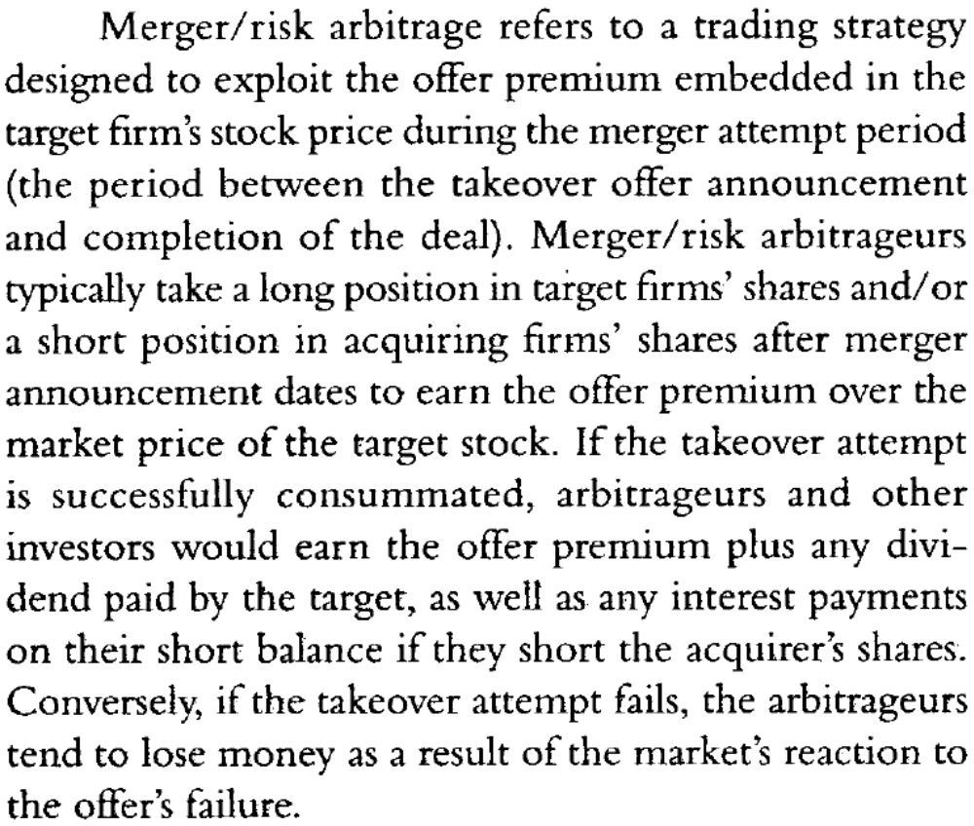
What is merger/risk arbitrage?

Slide 53
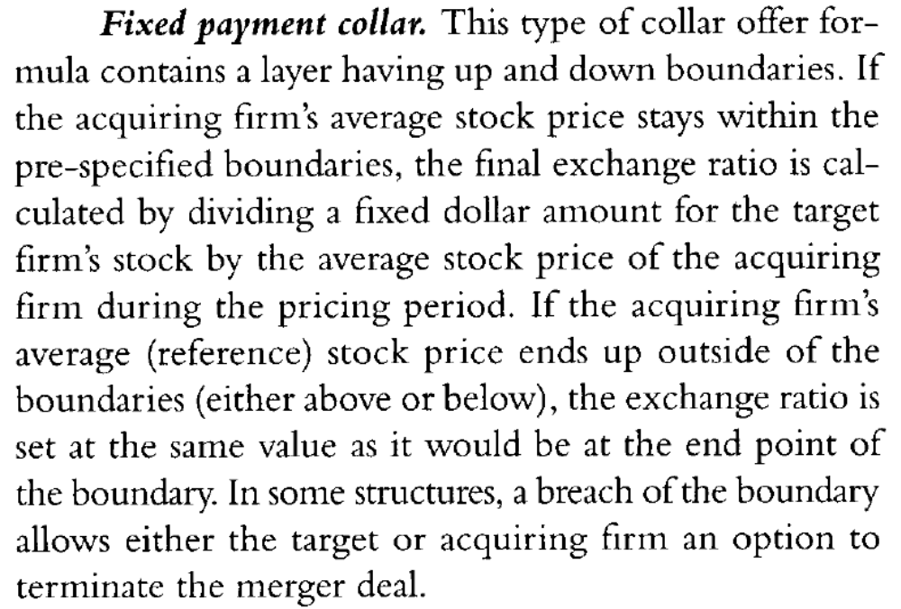
What is a fixed payment collar?

Slide 54
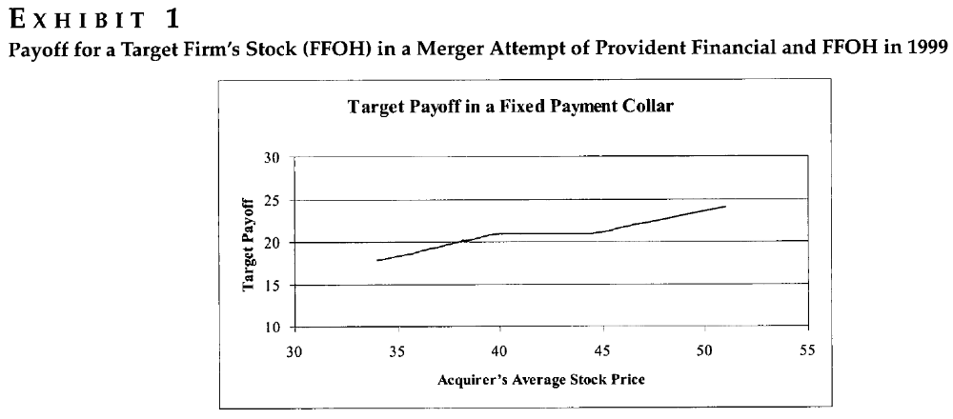

Slide 55
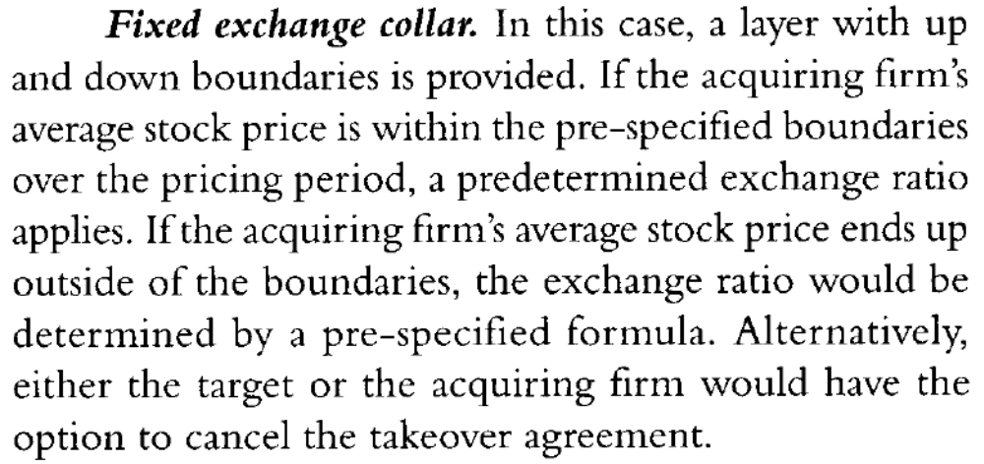
What is a fixed exchange collar?

Slide 56
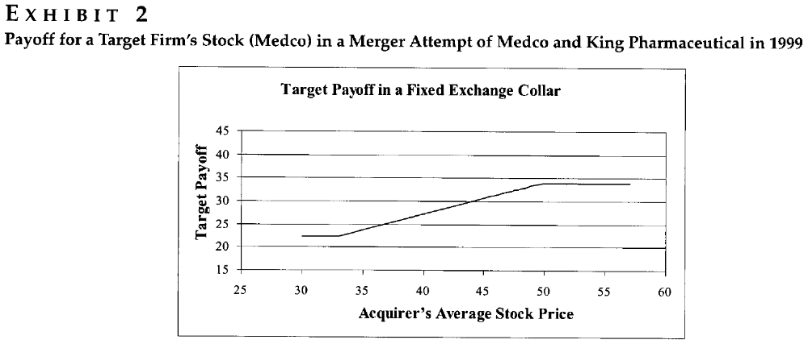

Slide 57
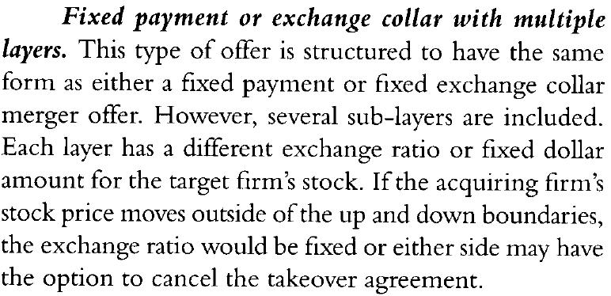
What is a fixed payment or exchange collar with multiple layers?

Slide 58
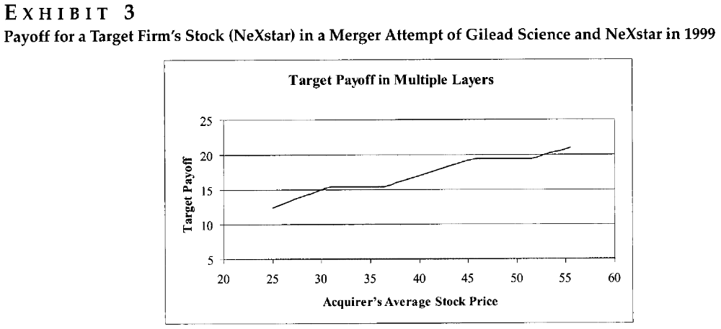

Slide 59
What are the hypotheses in this article?
Compared to a fixed exchange (collar offer), a fixed payment (collar offer) would tend to improve the performance of merger/risk arbitrage trading positions and/or the chance of merger completion.
the existence of a termination fee tend to improve the performance of merger/risk arbitrage strategies or the chance of merger completion.
In terms of wealth protection rather than benefits from the increasing acquirer's stock price, a relatively wide down-range in a fixed payment collar offer would improve wealth protection for the target firm's shareholder and thus tend to improve the performance of merger/risk arbitrage or the chance of merger completion.

Slide 60
The protection index (the level of wealth protection) should be positively related to the performance of merger/risk arbitrage and/or the chance of merger completion.
A high volatility or systematic risk (beta) for the acquirer would
negatively relate to the chance of choosing a fixed (dollar amount)
payment collar offer, whereas the return correlation and the growth
potential of the target would positively relate to the chance of choosing a fixed payment collar.

Slide 61
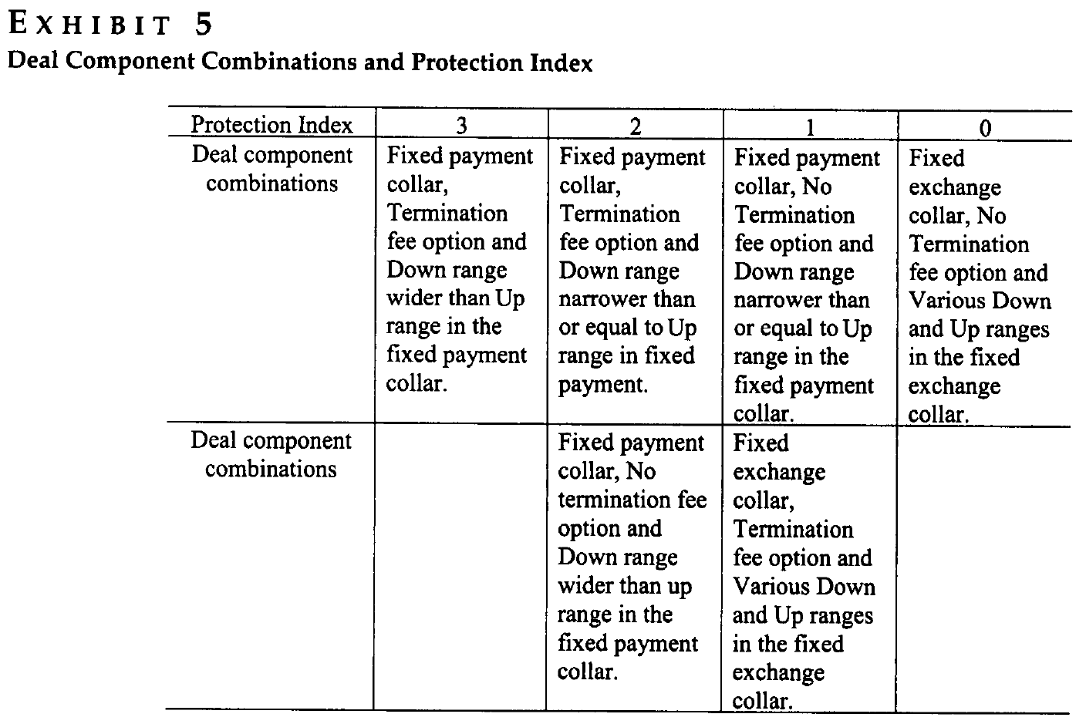
How do the authors test these hypotheses and what are the results?

Slide 62
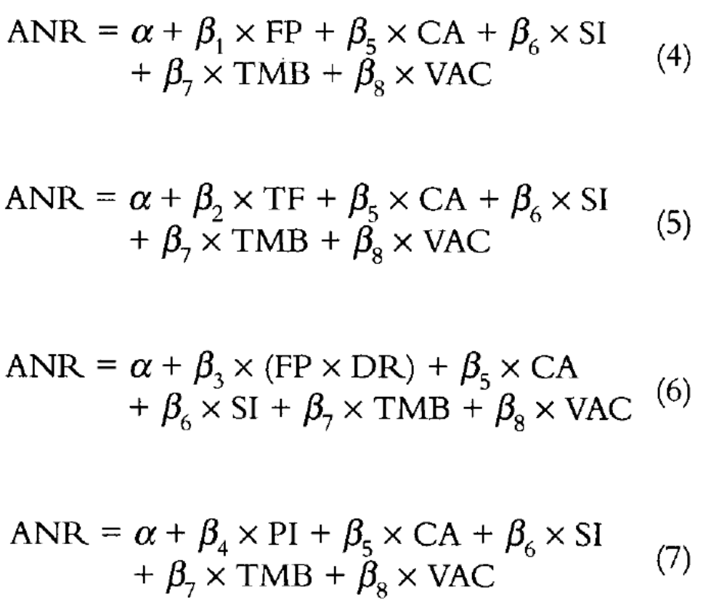

Slide 63
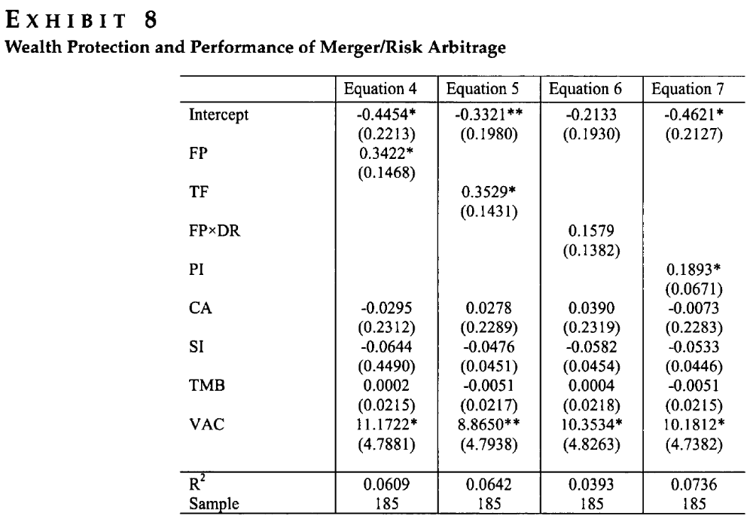

Slide 64
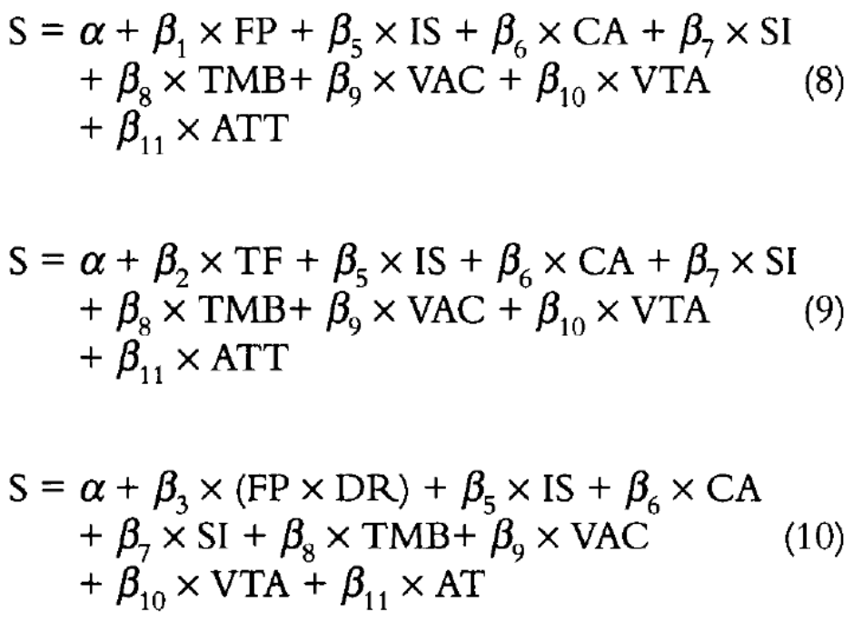
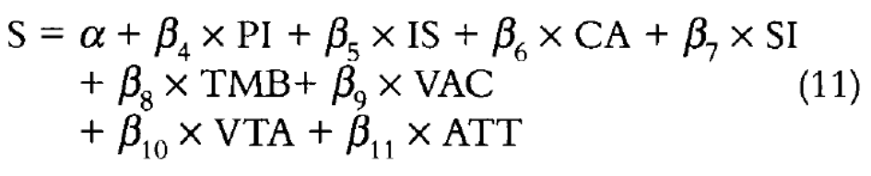

Slide 65
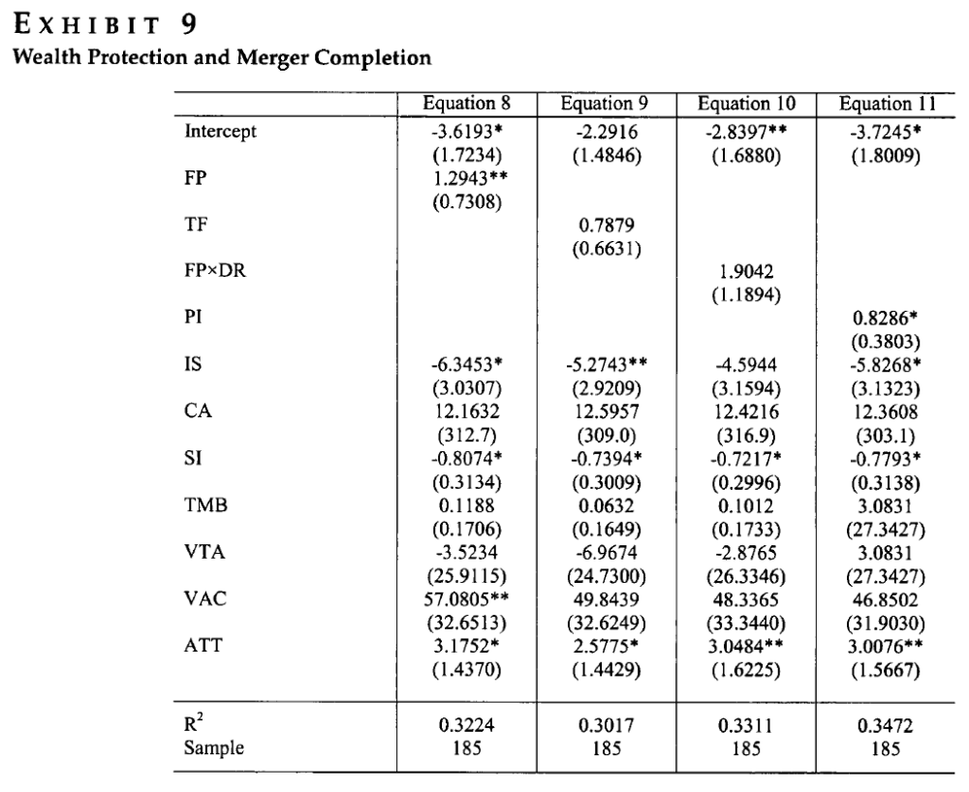

Slide 66
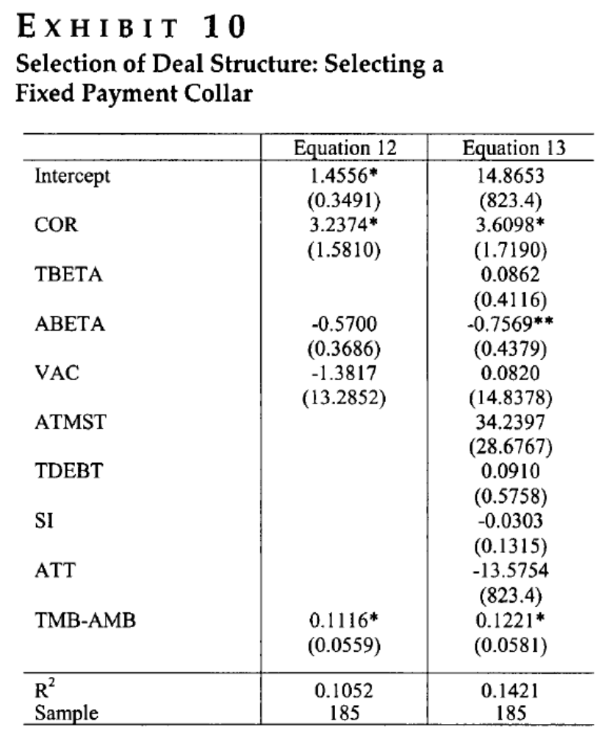
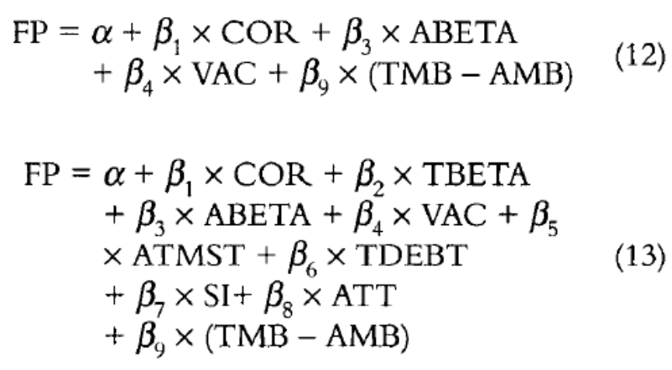

Slide 67
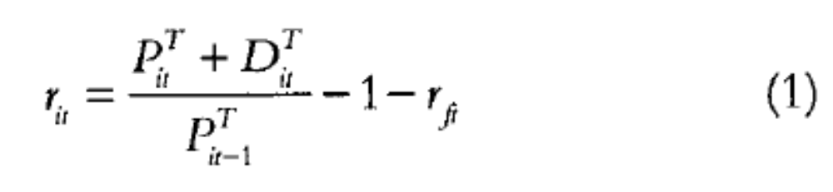
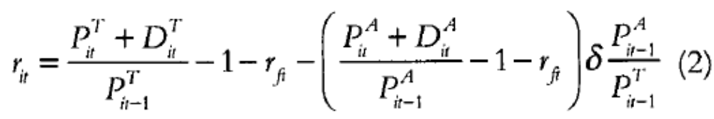
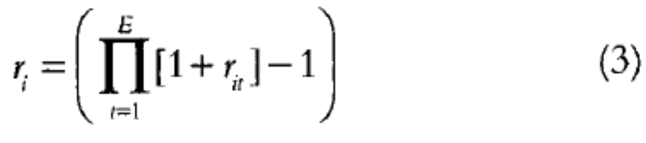
How do the authors calculate the return for merger/risk arbitrage?

