Slide 1
ALTERNATIVE SECURITIES
Topic 12: Global macro, event driven and other strategies

Slide 2
Reference: Stefanini (2006), Investment strategies of hedge funds, Chapter 14, 11,13,15.

Slide 3
Learning objectives
12.1 Define Global Macro strategy.
12.2 Identify milestones of Global Macro funds.
12.3 Describe some examples of Global Macro strategy.
12.4 Describe the historical performance of Global Macro strategy.
12.5 Understand event driven strategy the activism of event driven investing.
12.6 Describe the historical performance of event driven strategy.
12.7 Understand managed futures strategy and its historical performance.
12.8 Understand other various forms of other hedge fund investment strategies.

Slide 4
Define Global Macro strategy.
“…macro funds are comparable to the queen on the chessboard, the most powerful chess piece who can move in any direction.”
The Global Macro strategy is a top-down strategy based on the fundamental analysis of macro economic variables associated with the different countries. The key variables are GDP, balance of trade, public deficit, population and demographics, treasuries yield, equity market returns, price of raw materials, exchange rates, etc.
Market forecasts are made from sophisticated econometric models. The fund managers establish un-hedged directional positions on capital markets based on the forecasts, trade all asset classes, use all financial instruments and use short selling and leverage.

Slide 5
Define Global Macro strategy.
Due to the directional bias of Global Macro strategy, the managers generally offer little transparency to their investors. Profits will be reaped if the managers correctly anticipate the price movements of global financial markets.
Compared to other strategies, the size of the assets under management for Global Macro is larger. The assets are traded on highly liquid markets. The performance depends on the quality and timing of the forecasts. The returns are highly volatile compare with other strategies.

Slide 6
The first years of the 1990s were the golden age of macro funds. Robertson, Soros and Steinhardt shifted from the long/short equity to the global macro strategy.
The global macro strategy gave them access to the currency, commodity and treasury markets, which are highly liquid and have no capacity problems. For example, the currency market has a daily estimated volume of $1200 billion.

Slide 7
Identify milestones of Global Macro funds.
George Soros
In 1992, Quantum fund sold a enormous amount of Italian Lira and British Pounds with an extensive of leverage. Soros caused a significant devaluation of the two currencies and made a huge profit of 2 billion.
In Apr 2000, George Soros announced that he would stop making leveraged macro investments. To reduce the risk he would downsize his return objectives.

Slide 8
Identify milestones of Global Macro funds.
Michael Steinhardt
On 4th Feb 1994, the Fed unexpectedly raised the interest rate by 25 basis points, causing market liquidity to temporarily drain out. Steinhardt Partners suffered a 31% loss. Steinhardt decided to retire at the end of 1995.
Julian Robertson
In Oct 1998, the appreciation of the Japanese Yen caused Robertson’s Tiger to suffer a loss of about 2 billion. From 1998 to 2000, the assets under management had plunged from 25billion to 8billion. Robertson liquidated the Tiger fund in 2000.

Slide 9
Identify milestones of Global Macro funds.
In 1990, global macro funds accounted for 71% of the hedge fund industry, whereas at the end of 2004 they were down to 10%.
Currently, the number of global macro funds is small, but they tend to have a greater size than other hedge funds. At the end of 2004, one of the largest hedge fund was Caxton, with about 10 billion assets under management along a global macro strategy.

Slide 10
Examples of global macro strategy
The devaluation of British Pound
  In 1990 UK joined the European Monetary System. The EMS required its member states to maintain their currencies within a 2.25% fluctuation band above or below the fixed parity rate, and the maximum fluctuation of the individual currencies against the dollar at 4.5%.
  However, the divergence of economic conditions in European countries affects the interest rate differential needed to maintain the fixed exchange rate system.

Slide 11
Examples of global macro strategy
The devaluation of British Pound (Figure 14.1)
  German had a heavy inflationary pressure and thus German had a high interest rate. The UK had a slow growth and a decreasing interest rate. To keep the British Pound within the EMS, the British Central Bank could not cut interest rates as an incentive to the UK economy.
  In Sep 1992, Soros believed that the British Pound could not maintain is value against other currencies belonging to the EMS and that the central bank could not defend the British Pound from the market forces. Soros sold 10billion Pounds with leverage. As a result, the GBP/USD exchange rate declined from about 2.0 to about 1.5 within a month. The Quantum Fund made a profit of 1billion.

Slide 12
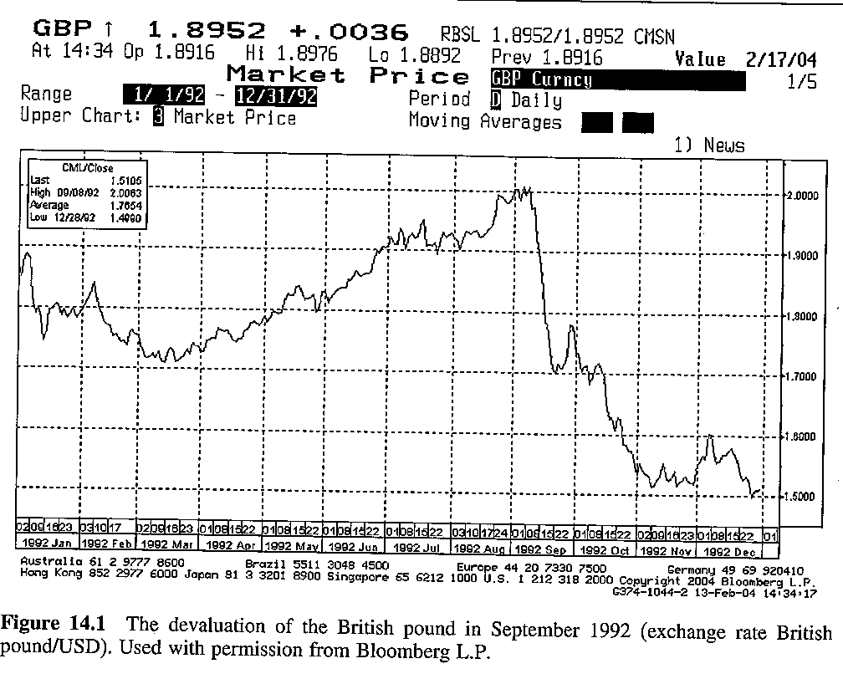

Slide 13
Examples of global macro strategy
The devaluation of Italian Lira (Figure 14.2)
  In 1992, Italy’s public deficit was skyrocketing; the balance of trade deficit was unsustainable; interest rates were high; inflation was high; and the unemployment rate was high.
  The high interest rate generated a vicious circle between growing debt service, balance deficit and growing debt. But, under the EMS, Italy could not devalue its currency despite high inflation and interest rate.
  Soros short sold Italian Lira. In one week, Italian Lira depreciated against USD by 14.2%. Soros made another 1 billion.

Slide 14
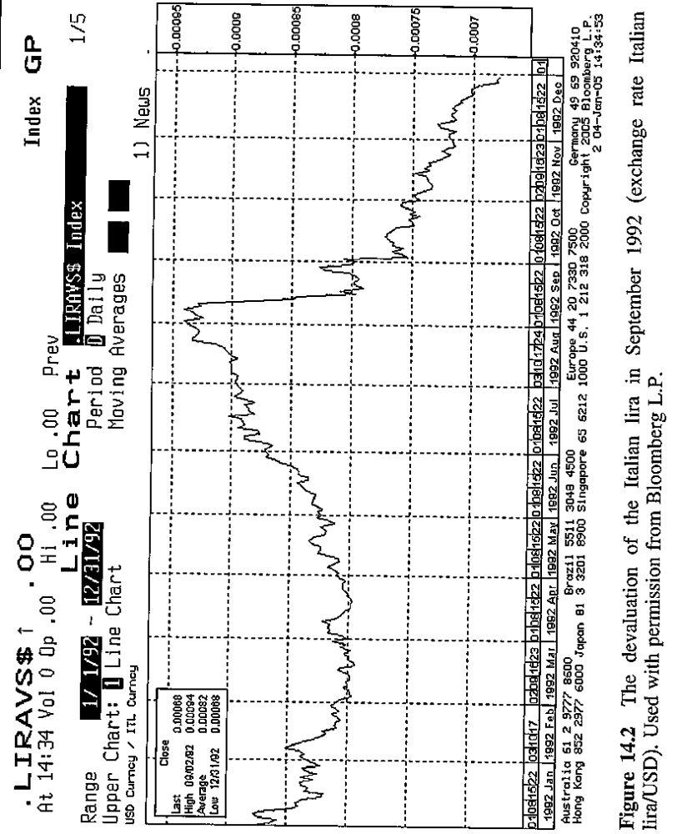

Slide 15
Examples of global macro strategy
Swiss France as safe haven (Figure 14.3)
In 2003, the Swiss franc had been appreciated as a result of being considered as a safe haven. The Swiss economy was weak. The Swiss National Bank has reiterated its concern over the strength of the Swiss franc by cutting overnight interest rates.
The volatility of out-of-the-money put options on the eur/chf (or call options on chf/eur) is higher than the volatility of the corresponding out-of-the-money put options on the chf/eur (or call options on eur/chf). This imbalance was casued by the Swiss franc’s characteristics of being considered a safe heaven.
A fund manager sold out-of-the-money put options on the eur/chf while buying an equal amount of put options on the chf/eur (less out-of-money than the former).

Slide 17
Examples of global macro strategy
Swiss France as safe haven
  The sale of eur/chf put options financed the purchase of the chf/eur put options, therefore, the hedge fund paid no price to open positions.
  Two possible outcome:
    If euro goes down, the holder of the put on eur/chf exercises his position and forced the manager to buy euro. The result is that the manager holds a long position in euro but at a lower level. The manager’s long put on chf/eur lapses.
    If euro goes up, the manager exercises his call on euro and made a profit.

Slide 18
Examples of global macro strategy
Convergence toward the European Union (Figure 14.4)
The currencies of East European countries have displayed a long-term growth trend triggered by the expected convergence towards the EU.
The currency convergence took place at different rates in the different East Europe countries.
The rate convergence in the Czech republic is lower than Slovakian crown.
A fund manager expects the ongoing convergence to cause an appreciation of Slovakian crown over the Czech crown because direct foreigh investments found more appealing opportunities in Slovakia.
The manager bought one month forward on the Slovakian crown and sold one month forward on the Czech crown.

Slide 19
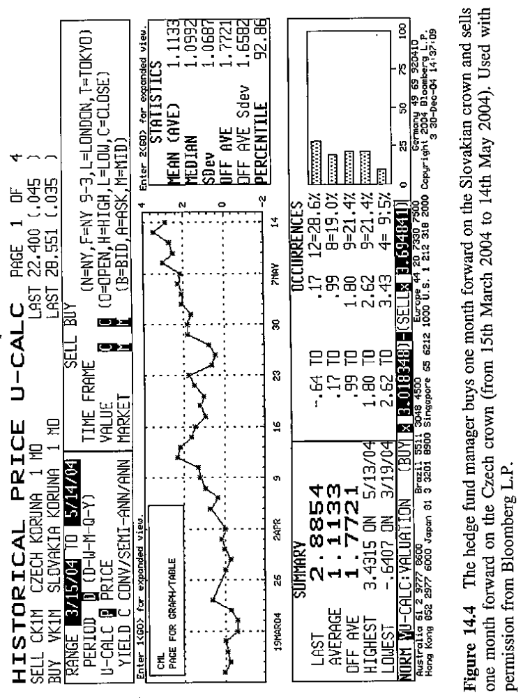

Slide 20
Examples of global macro strategy
Debt emerging markets
Bullish position on Brazil
  Traditional trade: buy the treasures of Brazil with a fixed rate of 8.875% and maturity date on 15th Apr 2024.
  In the case where Brazil defaults, the long position causes a much greater loss than the profit that can be made in the case where Brazil is solvent. (Figure 14.7)
  Relative value trade: buy the treasures of Brazil with a fixed rate of 8.875% and maturity date on 15th Apr 2024, with a short position on Brazil bond, with maturity date 15th Apr, 2014 and fixed rate 8%. (Figure 14.8)
  The relative value trade between the two treasuries is profitable irrespective of Brazil’s creditworthiness.
  The position is still subject to interest rate risk because the position does not have a zero duration.

Slide 21
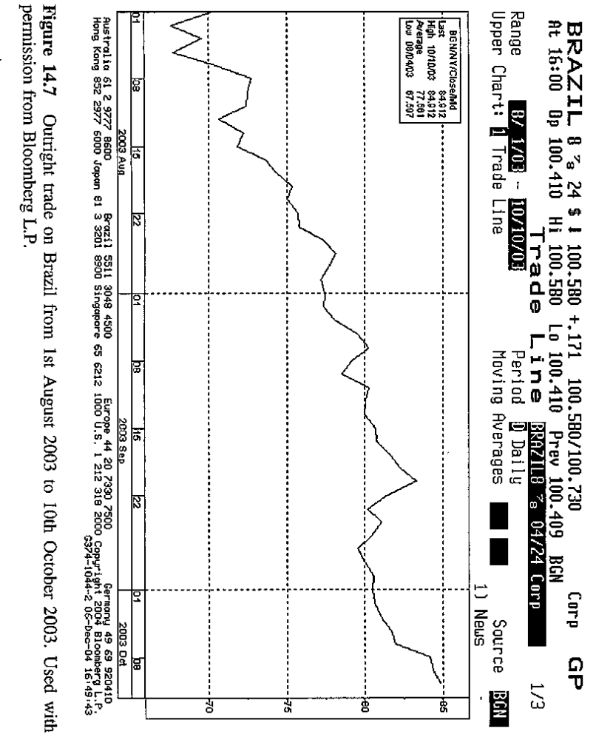

Slide 22
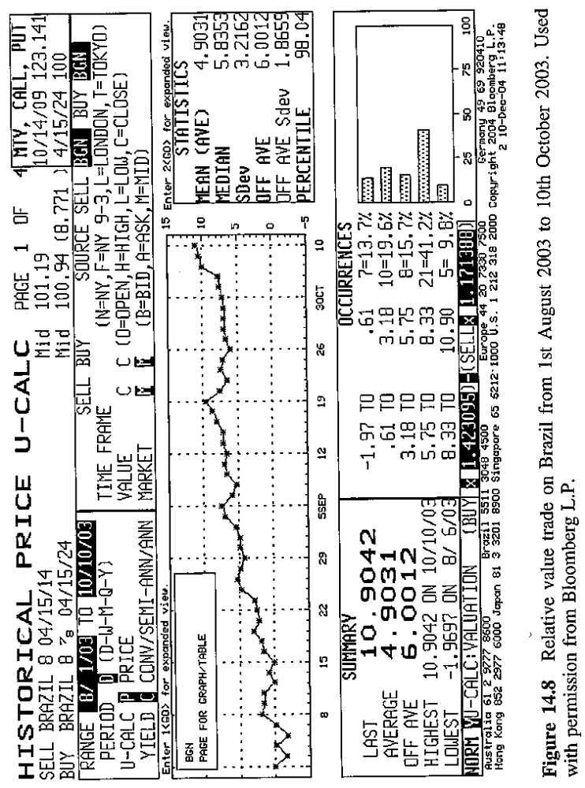

Slide 23
Strategy's historical performance
Measurements: CE/Tremont Global Macro Index between 1994 and 2004. (Table 14.1 and Figure 14.11)
Annualized return 14% with a high volatility 11.6%.
Two “underwater” periods: one due to the unexpected interest rate rise in Feb 1994 by the US Federal Reserve. The other is triggered by the Russian default in 1998.

Slide 24
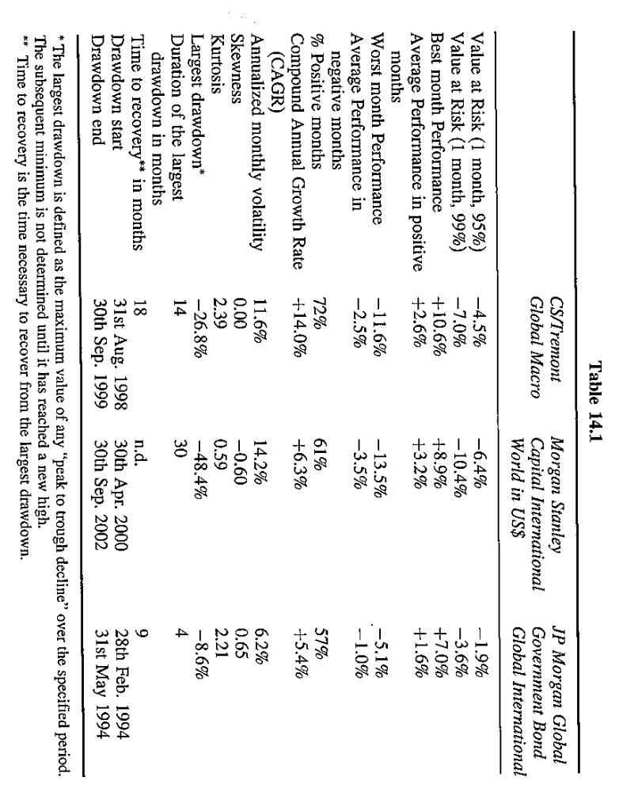

Slide 25
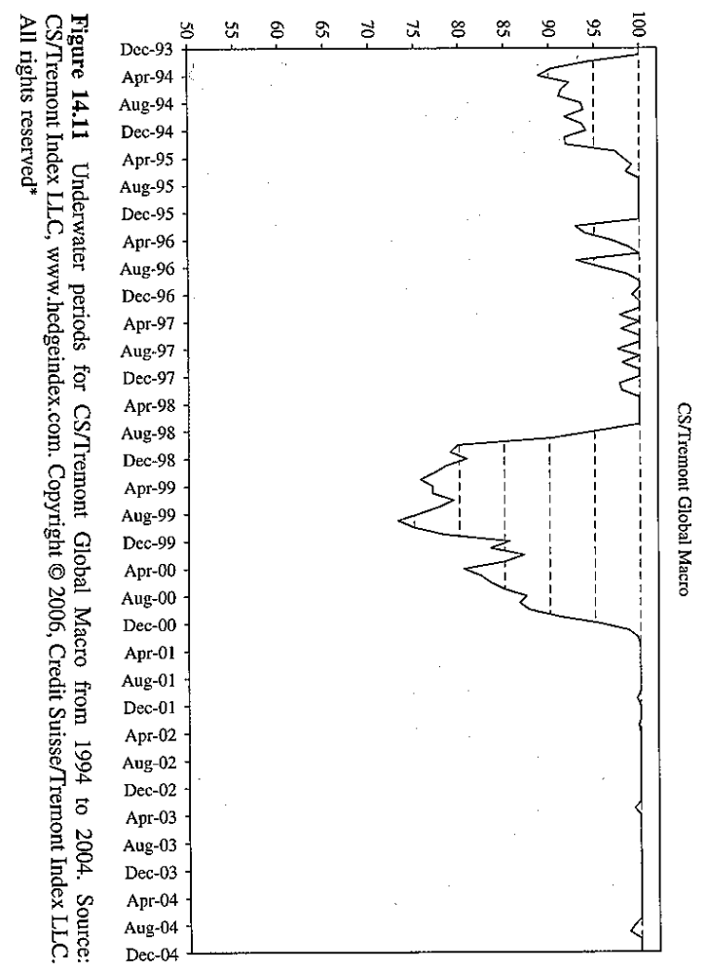

Slide 26
Event driven strategy
The event driven investment strategy, also called special situations, refers to opportunities that arise throughout a company’s life and that are created by extraordinary, or special corporate, events.
Corporate events include spin-offs, mergers and acquisitions, business consolidations, liquidations, reorganizations, bankrupcies, recapitalizations, share buy-backs, hostile takeovers, changes in benchmark or index composition, sale or purchase of assets, discrepancies in the value of share classes, agreements, legal disputes and even investments in real estates.
All investment decisions rely on bottom-up analysis (fundamental analysis and industrial analysis)

Slide 27
Event driven strategy
The event driven strategy consists in trying to predict the outcome of a given deal, as well as the best time to allocate capital in the investment. The performance of event driven strategy in general has a less correlation with the market.
The ability to assess the probability and forecast the timing of potential catalysts is a key success factor.
Activism is a particular style of event driven investing where hedge fund managers have an active role in generating catalysts events that unlock shareholders value.
Activists can act directly alone or be followers of other activists. As a key part of the strategy, the manager takes active participation in the management.

Slide 28
Event driven strategy
The actions taken to create value are:
  Reorganization of companies and battle for strategic change;
  Disposal of non-core assets;
  Spin-off business units;
  Distribution of cash flow to shareholders through a share buy-back or the payment of a special dividend.
The main risks of activism are:
  Portfolio concentration risk;
  Liquidity risk because activists are insiders and they might be restricted in buying or selling.
  Reputational risk.

Slide 29
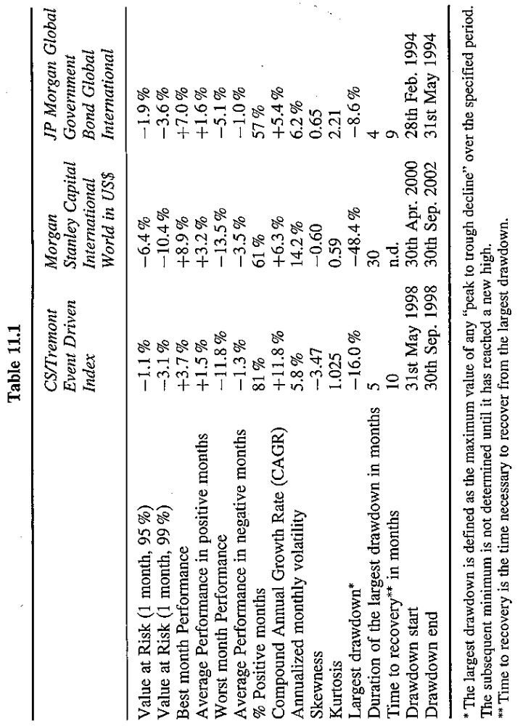
Historical performance of event driven strategy

Slide 30
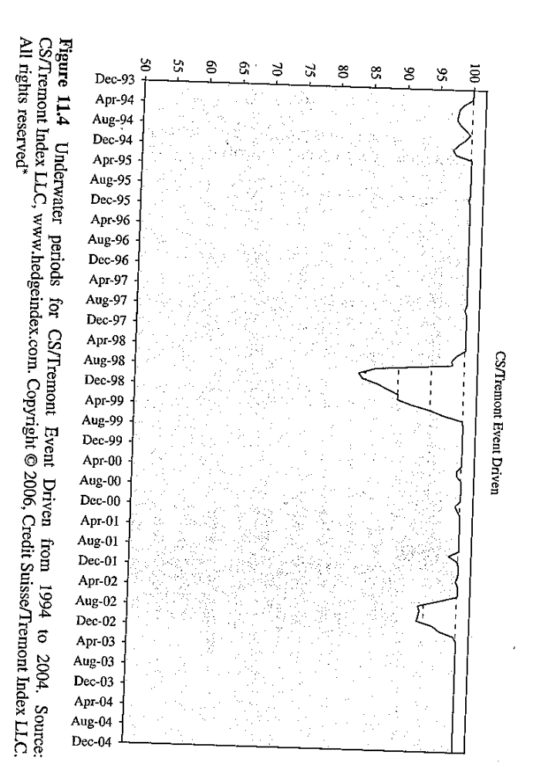

Slide 31
Managed futures
This strategy is also called CTA –Commodity Trading Advisor, who is any individual or firm that for compensation or profit, directly or indirectly, advises others on the opportunity to buy or sell commodity futures or options contracts.
Managed futures are not literally hedge funds, in that they do not hedge, but are in fact highly directional funds. But most of them have the same legal structure as a hedge fund and the same way as calculating performance fees with the high watermark and many funds of hedge fund managers invest in managed futures.
According to the LIPPER TASS database, as of 31 Dec 2004, managed futures funds accounted for 5% of the hedge fund industry.
Along with the Chicago Board of Trade, the London Metal Exchange is one of the main exchanges where commodities are traded.

Slide 32
A futures contract
A futures contract is a standardized agreement between two parties to buy or sell a specific amount of a commodity (raw materials, agricultural products, etc) or a financial instrument (shares, interest rates, indices or currencies, etc) at a particular price on a future date.
The margin of a futures contract is the amount of money a hedge fund deposits with a broker to start the trade and keep open positions on futures contract. The margin varies over time with the performance of the underlying assets.
Margin requirements are very low (5-10%) which allows for a very high leverage, so a relative small future prices movements may lead to sizeable losses or gains.

Slide 33
Managed futures strategy
Managed futures can be concentrated in a limited number of positions or offer a diversification on a wide variety of futures markets.
Most futures fund managers do not consider fundamental analysis, and instead conduct only technical analysis. They operate with highly technical trading systems that they apply through sophisticated risk management systems.
Managed futures focus only on derivatives and use a high leverage and offer greater transparency to their customers and incur no capacity problems and retain good liquidity.

Slide 34
Managed futures strategy
There are two types of CTA based on the trading approach:
  Discretionary: A qualitative approach is used and the entry/exit decisions are based on the manager’s subjective opinion.
  Systematic: the trade decisions are based on mathematical models. Purchase and sale signals are generated by the computer and risk management is automated.
Based on the trading methodology, there are two types of CTA:
  Trend following: the transactions are opened in the same direction as the trend and closed when the trend reveres;
  Counter trend: where positions are counter to the trend to try and anticipate reversals.

Slide 35
Figure 13.2

Slide 37
Managed futures strategy
CTAs also differ from other strategies in terms of length of time horizon.
  Long-term trends are those lasting from one to six months;
  Medium trends are those lasting eight to 30 days;
  Short-term trends are those lasting from one to seven days.
Systematic CTAs can operate on over 100 different markets worldwide, 24 hours a day in real time. The exposure to single markets may vary over time depending on the opportunities arising on the different models.
One of the benefit of this strategy is the low correlation with other hedge fund investment strategies, thus providing some diversification benefit to other investment strategies.

Slide 39
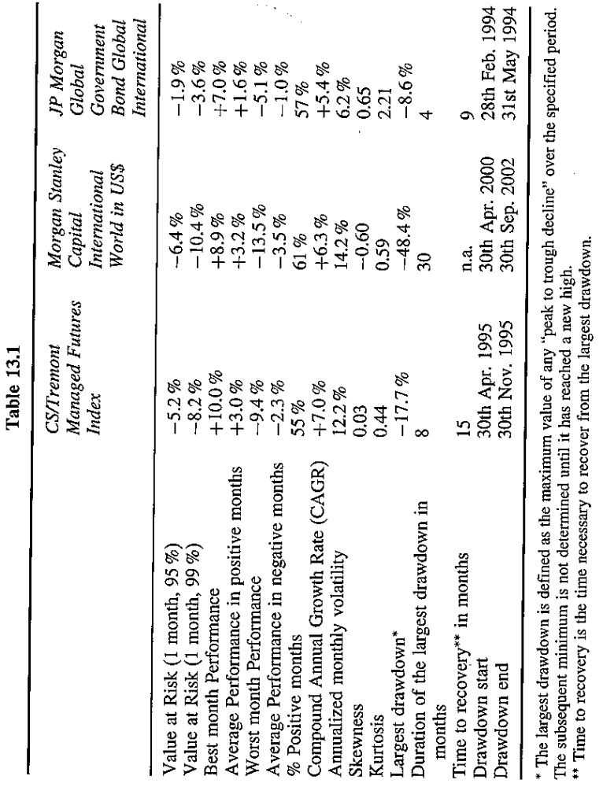
Historical performance of manager futures

Slide 40
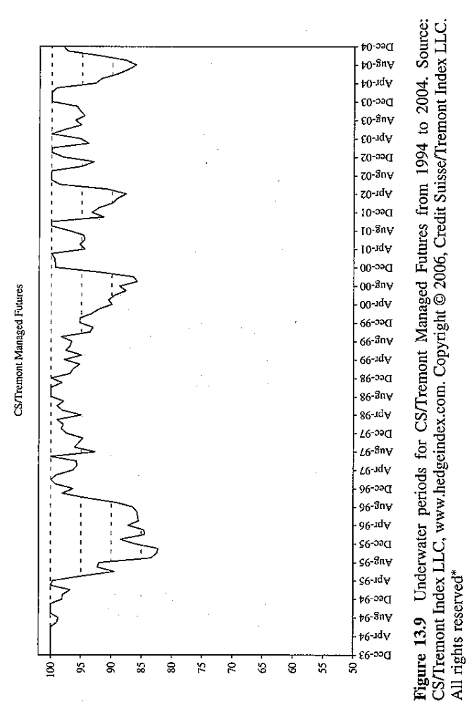

Slide 41
Other strategies- Holding company arbitrage
Holding company arbitrage
  The market capitalization of a holding company trades at a premium or, more frequently, at a discount to the Net Asset Value of shareholdings. The discount may reflect the risk that the majority of shareholders may impair the interest of minority shareholders.
  Generally, a fund manager will take a long position on the holding company and short sell the listed companies held by the holding company. The fund manager will make a profit if the discount narrows down.
  The fund manager can also construct an opposite position if he believes that the discount to NAV is too small.

Slide 42
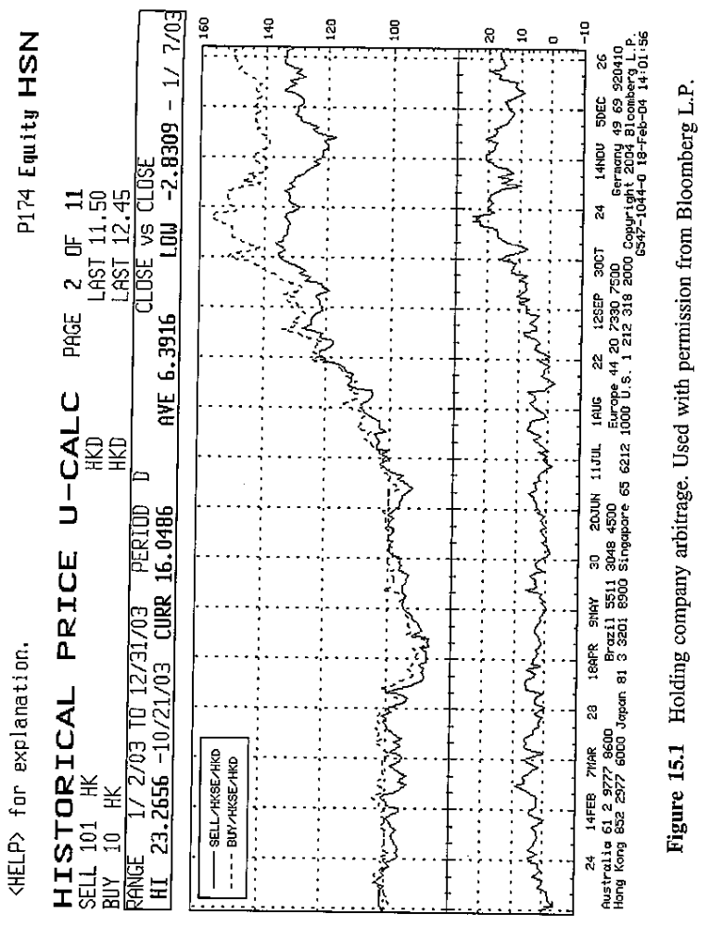

Slide 43
Other strategies: Closed-end fund arbitrage
Closed-end fund arbitrage
  Arbitrages on listed close-end funds seek to capture the premium or discount changes between the net asset value of the listed closed-end funds and the market capitalization of their shares.
An example:
  In Feb 2002, the equity index Athens Stock Exchange had dropped by about 60% from its 1999 peak and the share prices of closed-end funds were at a discount to the fund’s NAV ranging between 25% and 35%.
  The hedge fund decided that there was a potential to take an active role in the management of the close-end funds to reduce the share price discount. In May 2003, the hedge fund launched a tender offer on all the residual shares outstanding of the close-end fund New Millennium at 16% discount.
  This called the investors’ attention to the undervalued market of Greek closed-end funds and drove prices up by about 5-10% for all closed-end funds and by 12% for the New Millennium fund.

Slide 44
Other strategies: Statistical Arbitrage
This strategy starts with the quantitative analysis of the difference between the theoretical value and the market current value. Fund managers use proprietary mathematical processes to analyze thousands and thousands of financial instruments in a wide range of asset classes and countries in search of potential abnormalities in market valuations.
In-house research analysts construct databases that they keep updated with historical financial data. Pricing abnormalities are typically identified through an assumption formulation, testing and a rigorous validation process. The abnormalities that prove statistically significant are then used in trading strategies, which typically operate in real time based on an almost continuous flow of financial data.
Experimental results are then used to refine the adopted models. Optimization software products help to construct and dynamically change the portfolio makeup.

Slide 45
Other strategies: Index arbitrage
This strategy seeks to profit from the spread convergence between a futures contract and the basket of securities it is made up of.
Fund managers specializing in this type of arbitrage actively trade on the days that index changes have been announced, when there are securities entering and exiting indices.
A classical strategy is the purchase of a security that has been added to the index and the concurrent sale of an equal amount of futures on the index so as to hedge the position against market risk.

Slide 46
Other strategies: Volatility trading
Volatility traders are typically looking for options that “misprice” volatility. Given an option’s market price, it is possible to derive the implied volatility inherent in the option price by using some models.
Option trading:
  If we believe that a share price will not change much and the implied volatility is high, we may decide to speculate by selling an option with this share as an underlying.
Delta hedging:
  If we believe that the future volatility of a stock will be lower than the current implied volatility, we will sell the option and delta hedge it (or, vice versa)
  The strategy requires sophisticated trading system and software products to measure one’s exposure daily.

Slide 47
Other strategies: Volatility trading
Variance swap is designed to help investors express their views on volatility.
In the swap, a “strike” volatility level is defined, linked to the market’s current implied volatility levels. On the day when the position is opened, no money is exchanged between the counterparties. One the day the variance swap expires, a money payment is exchanged between the party having a long position and the party with a short position.
If the realized volatility is greater than the implied volatility, the seller will settle the difference in cash to the buyer (and vice versa).

Slide 48
Other strategies: Split-strike conversion
A long position on a basket of 30-35 of the largest cap shares in the S&P 100, proportional to their weight in the index. The basket displays a high index correlation.
The sale of S&P 100 out-of-the-money call options with an underlying value equal to the value of the shares belonging to the above basket.
The purchase of an equal amount of S&P 100 out-of-the-money put options. The purchase is financed with the proceeds from the sale of the options and from any dividends.
The sale of the call options increases the return of the baskets while allowing the equity portfolio to move upside towards the call option’s exercise value. The put options protect the equity position from downside risk.

Slide 49
Other strategies: Direct lending
Hedge funds offer competitive rates compare with banks and a more rapid lending process. Typically, the hedge funds diversify their loans and limit the sizes of their loans trying to guarantee a wide sector distribution among borrowing companies.
In general, a hedge fund grants convertible loans collateralized by assets of the borrowing company. The convertible loan can provide a positive carry due to the interest payments, a limited downside in the case of default and the share in the upside of the share price.
The main risk is an increase in the corporate bankruptcy rate in specific times of economic recession.

Slide 50
Other strategies: PIPEs or Regulation D
Regulation D governs the limited offer and sale of securities without registration under the Securities Act of 1933. PIPEs allow the public companies issue shares under Regulation D directly to the private investors.
Generally, securities issued under Regulation D take two forms:
  Share issue: investors purchase the company shares at a discount.
  Convertible issue: Also these convertibles are selling at a discount.
Generally, the issuer files the registration with SEC within 180 days of issue, thus allowing the issued securities to be publicly traded. The investors are subject to the price downside risk, credit risk and the liquidity risk.

Slide 51
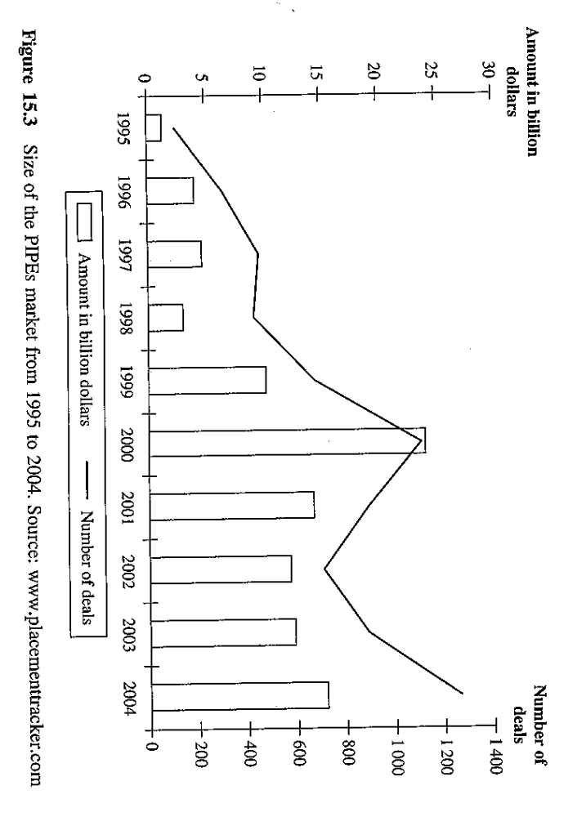

Slide 52
Other strategies: PIPEs or Regulation D
If the issuer cannot register these securities with the SEC within the defined deadline, the hedge fund manager may be given the right to purchase an additional number of securities at a discount. The securities held by the hedge fund can be sold only in a private transaction, generally at a discount to the original buying price.
By the time of the hedge fund manager can dispose of the securities by selling them on the public market, the market price might have dropped below the price paid by the fund manager. The concurrent sale of the shares by other investors might drive the market price of the issuer’s share deeply down.

Slide 53
Other strategies: Natural resources
A strategy investing in natural resources generates positive returns in a scenario of economics expansion and negative returns in a scenario of global recession. Hedge fund manager uses macroeconomic analysis to assign a probability to these scenarios and act accordingly.
Commodity markets comprise base metals, precious metals, energy and agriculture produce. Raw material each have their own particular attributes. For example, precious metals behave like a currency. Historically, precious metals are a hedge in times of weak dollar.
Factors that have historically affected the valuation of the different raw materials.

Slide 54
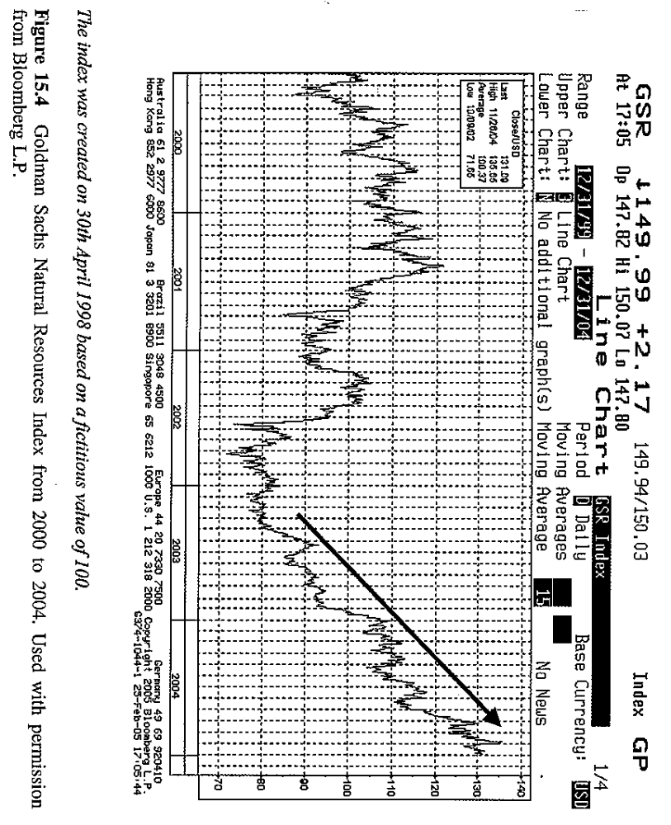

Slide 55
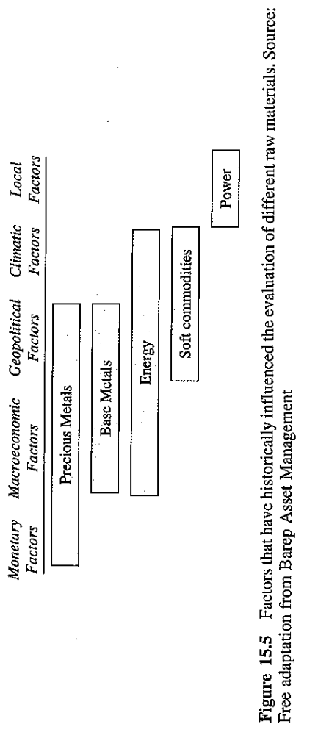

Slide 56
Other strategies: Natural resources
Hedge funds can invest in natural resources by directional bet or relative value deals.
Relative value deals include:
  Calendar spread: abnormality in the prices of a raw material between different delivery month.
  Geographical spread: price abnormality between two similar products with different delivery locations.
  Inter-commodity spread: price abnormality between two raw materials within the same class of natural resources and traded at prices that do not reflect their relative value.
  Commodity-related equity spread: price abnormality between two shares whose price depends on the performance of raw materials.

Slide 57
Other strategies: Natural events
Cat-bonds, short for catastrophe bond, are bonds associated with natural catastrophes like earthquakes, hurricanes, volcano eruptions, landslides, storms, tornados, typhoons and cyclones. At the end of 2003, the market of these innovative financial instruments reached $4.34 billion.
The issuers of this type of bonds are re-insurers. The issuer transfers the risk to institutional investors who are willing to take on the environmental risk in exchange for the bonds cash flows.
Cat-bonds pay a rather high interest rate that depends on the likelihood a given natural disaster may occur. If the catastrophic event does occur, the investor will receive no interest and may also lose the principle.

Slide 58
Other strategies: Natural events
A Special Purpose Vehicle (SPV) issues the cat-bonds. The proceeds are then re-invested in money market as a provision for bond redemption. There are two types of cat-bonds: indemnity bond and parametric bond.
Indemnity bond:
  The redemption of the face value depends on the losses suffered by the issuer as a result of a catastrophic event. The investors do not know exactly the extent of the issuer’s exposure at the time a catastrophe occurs.
Parametric bond:
  The percentage redemption of the face value depends on a calculation based on physical parameters measured during the catastrophe.

Slide 59
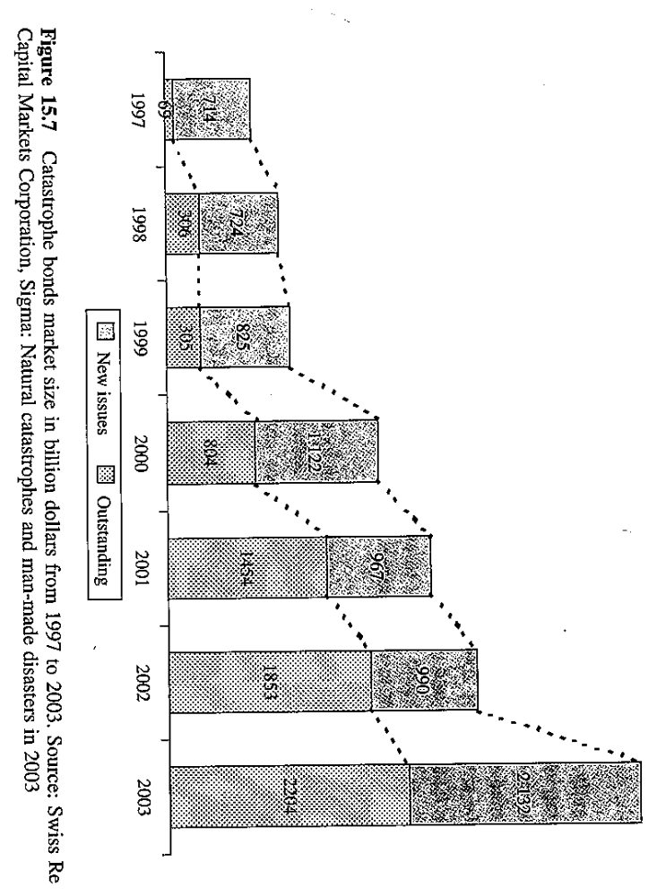

Slide 60
Other strategies: Natural events
An example:
  In December 1999, Electricite de France launched two cat-bonds to insure against damages to transmission lines caused by windstorms.
  The cat-bonds issued by the special purpose vehicle Pylon Ltd. Were issued on a private placement in two tranches, €120 million and €70 million respectively, both with a maturity date on 29th December 2008. The two tranches pay floating rate coupons the first tranche pays EURIBOR + 3.9% and the second EURIBOR + 1.5%. Subscribers do not receive the coupon payment or even the principle if an index calculated on the wind speed in France exceeds a given threshold.

