Slide 1
ALTERNATIVE SECURITIES
Topic 2: Introduction to venture capital

Slide 2
Student learning objectives
2.1 Define venture capital.
2.2 Identify important developments in the history of venture capital.
2.3 Describe expected returns in the venture capital market relative to those in the public stock market.
2.4 Identify the venture capitalist’s role in the industry.
2.5 List and briefly describe the aspects of the entrepreneur’s business opportunity upon which venture capitalists focus.
2.6 List sources of venture capital and describe how the structure of the venture capital marketplace changed from previous years.

Slide 3
Student learning objectives
2.7 List and briefly describe various venture capital investment vehicles.
2.8 List specializations within the venture capital industry.

Slide 4
References
Anson, Mark J.P. (2006). Handbook of Alternative Assets. John Wiley & Sons Inc. New Jersey. Chapter 16.

Slide 5
Objective 2.1
Definition
“Venture capital is the supply of equity financing to startup companies that do not have a sufficient track record to attract investment capital from traditional sources.”
  [Anson]
Why do startup firms require specific sources of funding?
  No tangible assets as collateral for a loan
  No positive cash flows out of which to make the repayments on a loan or to pay dividends

Slide 6
Venture capitalists finance these high-risk, illiquid, and unproven ideas by purchasing equity stakes while the firms are still privately held.
Venture capitalists are willing to underwrite new ventures with untested products and bear the risk of no liquidity only if they expect a reasonable return for their efforts. The unusual expected return for a venture capital investment is 33% or more.
Successful start-up companies funded by venture capital include Cisco Systems, Cray Research, Microsoft, and Genentech.

Slide 7
Objective 2.2
Milestones in the history of venture capital
Early 1800s in the UK, land barons began to finance entrepreneurial companies by purchasing an equity ownership in the companies
In 1946 the first modern venture capital firm, American Research and Development, was formed as a publicly traded closed-end fund
  ARD had the investment objective to finance companies in growth industries. Broad casting, aerospace, and pharmaceuticals.
  Between 1946 and 1958 a small number of similar venture capital firms were established

Slide 8
In 1958, the US Congress created Small Business Investment Companies (SBICs)
  licensed and regulated by the Small Business Administration
  Government-backed but privately owned investment companies that provide both management assistance and venture financing for startup companies
  Include Citicorp Venture Capital and Clinton Capital
  Have provided capital to the likes of Apple Computer, Federal Express and Intel Corporation
  There are about 300 SBICs today
In 1958, the first venture capital limited partnership, Draper, Gaither and Anderson, was formed for investing in venture capital
  Limited partnerships accounted for a small number of venture capital vehicles in the 1960s and 70s and never exceeded more than a few hundred million dollars in total

Slide 9
Objective 2.2
Milestones in the history of venture capital
In 1979, the US Department of Labor, which oversees the Employee Retirement Income Security Act 1974, clarified the prudent person rule to indicate that venture capital and other high-risk investments
  Should not be considered on a stand-alone basis but on a portfolio basis, and
  The prudent person test should be based on the investment review process, rather than the ultimate outcome of investment results
  The change in the interpretation/application of the prudent person rule allowed pension funds for the first time to wholly endorse venture capital investing

Slide 10
In the 1980s, venture capital funds increasingly had to access pension funds via investment advisors or gatekeepers, who provided the funds with the resources to evaluate and monitor venture capital funds
By 1991, up to one-third of all pension fund commitments to venture capital and one-fifth of all venture capital funds raised came via gatekeepers. Investors are usually lack of the experience and expertise in venture capital. Gatekeepers are the sspecialist advisers who assist institutional investors in their private equity allocation decisions

Slide 11
Objective 2.2
Growth of venture capital
In 1980, US venture capital commitments stood at $1.5bn
By 1987, this had risen to over $5.0bn
By 1991, this had been reduced to $2.5bn as a result of the stock market crashes of 1987 and 1989 and the recession of 1990 – 91
By 1995, it had gradually recovered to about $7.0bn
Between 1995 and 2000, it experienced exponential growth averaging 82% per annum to peak at over $100bn in 2000
The busting of the IT bubble in 2000 saw venture capital commitments rapidly decline to less than $20bn in 2005

Slide 12
Objective 2.2
Growth of venture capital
The growth of venture capital funds has been fueled by three factors:
  Robust returns in the US stock market
  A strong initial public offering market in the US
  Low US inflation and a low interest rate environment
These factors allowed investors
  To increase their risk tolerance and bear high risks for start-up companies
  To extend their investment horizon and accept the risk associated with the long lock-up periods associated with venture capital investing.

Slide 13
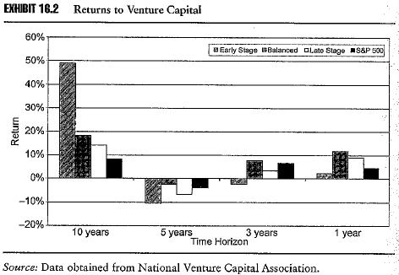
Objective 2.2
Growth of venture capital
Returns are shown in Exhibit 16.2 from 1996 up until end of 2005
Venture capital returns exceed the S&P500 returns over the long term, compensating investors for incremental risk
Returns over 1, 3 and 5 years are mixed due to:
  Effect of IT bubble
  Effect of 2000 – 01 recession
  Effect of 2000 – 2003 bearish market

Slide 14
Objective 2.3
Expected returns of venture capital
Over the full economic cycle the returns expected of venture capital should show a 5% to 7% premium over the returns available on the stock market, to compensate for the higher risk and the lower liquidity associated with these investments
Over the 10-year cycle to the end of 2005 balance and late stage venture capital funds showed a premium of 10% and 6% respectively over the S&P 500

Slide 15
Objective 2.4
Role of venture capitalist
Venture capitalists have two primary roles
  Raising the funds from investors
  Investing the funds with startup companies
Venture capitalists are active investors taking a role either as
  A consultant to the board of the startup
  A director of the startup
Venture capitalists usually ensure they have defined rights
  To hire and fire key managers
  To exit the investment

Slide 16
Objective 2.4
Relationship of venture capitalist with investors
Most venture capital funds are structured as limited partnerships, where the venture capitalist is the general partner and the investors are limited partners
As general partner the venture capitalist has the authority to manage the fund as she sees fit, subject to restrictions placed in the covenants of the fund’s documents
Protective covenants fall into three categories
  Restrictions on the management on the venture capital fund
  Restrictions on the activities of the general partner
  Restrictions on the type of investments

Slide 17
Restrictions on the management on the venture capital fund
  Percentage of the fund invested in any single venture, to ensure that venture capitalist does not bet the fund on any single investment.
  Restrictions on the use of debt or leverage by the venture capitalist. The risk is already too high!
  Restrictions on coinvestments with current or future funds controlled by the venture capitalist. Don’t want throw good money after bad!
  Covenant regarding the distribution of profits as they accrue. Investors prefer to receive the cash. Distributed profits reduce the amount of committed capital which in turn reduces the fees paid to the venture capitalist.

Slide 18
Restrictions on the activities of the general partner
  Restrictions on the ability of the general partner to make private investments in ventures funded by the fund. Private investments can lessen the attention to other investments.
  Restrictions of the ability of the general partner to sell their general partnership interest in the fund.
  Restriction on the amount of future fund raising. Time consuming and distracting.
  Restrictions on outside interests of the general partner
Restrictions on the type of investments
  Restrictions on investing in ventures outside the expertise of the general partner

Slide 19
Objective 2.4
Fees
Two levels of fees
Management fees: range 1.0% to 3.5% of committed capital, with most between 2.0% and 2.5%
  As the management fee is paid on the committed rather than invested capital, The venture capitalist collects a management fee when an investor signs a subscription agreement to invest capital- even through no capital has actually been contributed by the investor.
  Example: The venture capital raises $100m in committed capital. The fee is 2.5%. 50 million has been invested. The annual fee is 100*2.5%=25m not 50*2.5%=12.5m.
  the venture capitalist is essentially paid to have a call option on the limited partner’s capital according to the subscription agreement.

Slide 20
Performance fees, being a percentage of the profits earned by the fund: 20% is usual but better known funds may get up to 35% of the profits generated
  Performance fees have the payoff characteristics of a call option, being the maximum of 20% x the profit or zero, depending on whether the fund is profitable. This has the effect of creating an incentive for the general partner to invest in riskier ventures so as to increase the volatility of the returns of the fund, which increases the value of the option. Notably this call option is free.
  The increased risk may not be in the best interest of the limited partners. This creates the agency problem.

Slide 21
Covenants aimed at reducing the agency costs of the fee structure
  Clawback provision allows limited partners to clawback previously paid performance fees if at the liquidation of the fund they are still out of pocket some costs or lost capital investment.
  Escrow agreement, which holds a portion of the incentive fees in escrow until liquidation of the fund. If a profit is earned by every limited partner, the escrow proceeds are released to the venture capitalist.
  Prohibition on the distribution of performance fees until all committed capital has be repaid to limited partners. The limited partners must first be paid back their invested capital before profits may be shared by the general partner.

Slide 22
Objective 2.5
The business plan
The venture capitalist chooses ventures in which to invest based largely on information contained in the business plan
The business plan must:
  Be comprehensive, coherent and internally consistent
  Clearly state the business strategy
  Identify the niche that the new company will fill
  Describe the resources required to fill that niche
  Clearly reflect management’s ability to develop and present and intelligent strategic plan of action
  Be realistic and set out achievable financial milestones

Slide 23
Objective 2.5
The business plan
The business plan should cover the following matters:
  The market
  The product/service
  Intellectual property rights
  The management team
  Operations and prior operating history
  Financial projections
  Amount of financing required
  Exit strategy

Slide 24
Objective 2.5
The market
Is there an existing market?
What is the competition?
How does the product/service improve on the existing market solution?
What is the marketing plan?
  Pricing
  Distribution
  Promotion

Slide 25
Objective 2.5
The product or service
What is the product or service?
  Is the product new to the market, selling at a lower price, of a higher quality, available in a shorter timeframe, providing better customer service …
What is the unique selling point of the product or service?
How will the product be developed or its range extended?

Slide 26
Objective 2.5
Intellectual property rights
Venture capital is often required in technology industries.
Most startups in technology industries base their business opportunity on the claim to proprietary technology
Does the company being financed hold clear and unequivocal rights to the technology?
  Venture capitalists do not like the intellectual property rights being held by the entrepreneur and licensed to the company
  Venture capitalists may require the key men to sign non-compete agreements and confidentiality agreements to protect the intellectual property rights

Slide 27
Objective 2.5
Management team
What is the range and quality of the skills of the management team?
What are the gaps in the management team’s skills and experience?
Have the management team brought a startup through to IPO previously?
What skills and relationships can the venture capitalist bring to the management team and board of directors?

Slide 28
Objective 2.5
Prior operating history
How will the product or service be built or delivered?
What is the nature and size of capital, fixed and variable costs?
Has a prototype been developed, if not what is the timeline and cost of its development?
What are the barriers to entry to the industry?
Has the firm been involved in any prior bankruptcy or failure?
What is the nature of prior debt and equity claims?
Is the company in good legal standing as to its current state of incorporation and conduct of shareholder and board meetings?

Slide 29
Objective 2.5
Financial projections
A complete set of financial statements including both historical and forecast figures is required.
Are forecasts realistic yet enticing to a venture capitalist?
When will breakeven be achieved in the income statement?
  Most business plans will show a breakeven achieved within three years
When will debt financing be required and when will it begin to be paid down?
Will any additional equity financing be required, if so when?
What is the timing and collection of receivables?
What is the burn rate and when will firm begin to be self financing?
What are alternate scenarios and related sensitivities?

Slide 30
Objective 2.5
Amount of financing
How much money is the startup requesting?
  This should equal the burn rate over the time horizon expected by the startup. The burn rate is simply the rate at which the startup venture uses cash on a monthly basis.

Slide 31
Objective 2.5
Exit strategy
When, how and with what probability will the venture capitalist be able to exit from the venture?
  By arranging an industry sale
  By arranging an IPO
  By exercising a put option
  By exercising redemption rights
Convertible preferred stock is the preferred form of venture capital investment as it carries a priority over common stock for dividends, voting rights and on liquidation as well as the upside of conversion on an IPO

Slide 32
Convertible notes, debentures and warrants are alternatives
  Convertible notes and debentures may also be converted upon the occurrence of an event such as a merger, acquisition or IPO. Venture capitalists may also be granted warrants to purchase the common equity of the start-up company in the event of IPO.
  Redemption rights and put options are generally not favored.

Slide 33
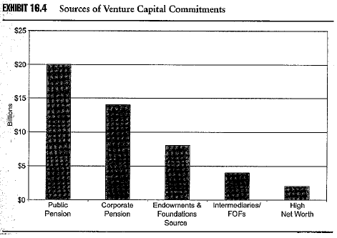
Objective 2.6
Sources of venture capital financing
In 1990, pension funds accounted for 70% of venture capital funds and government 11%
In 2005, pension funds accounted for 50%, with the remainder from endowments, individuals and intermediaries

Slide 34
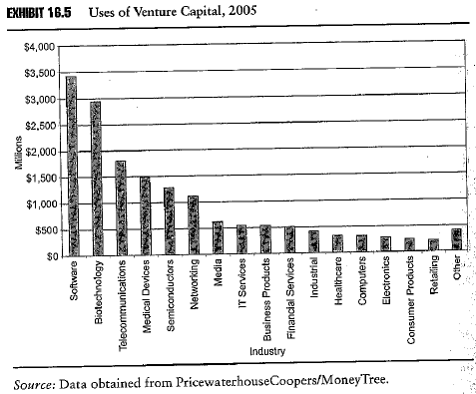
Objective 2.6
Uses of venture capital financing
Technology, biotech, media, medical services, and telecom industries
The four categories that are technology related (computers, semiconductors, computer software, and internet) accounted for 60% of the use of venture capital financing in 1999.
Notes:
.

Slide 35
Objective 2.7
Venture capital investment vehicles
Limited partnerships
  Main form of venture capital investing in the US
  The partnership itself is not taxed as all income and capital gains flow through to limited partners. It avoids double taxation.
  Since 1996 check the box identification as a limited partnership for tax purposes was introduced they have become even more popular. US internal revenue services decide to let entities to decide their own tax status by checking a box on their annual tax form.
  Expected life of 10 years with an option to extend for another 5 years
  General partner manages the venture capital fund’s investments, but is required to invest a defined amount to align his/her interests with those of limited partners. General partner can be a legal entity
  Limited partners commit to a specific investment amount, which is called down when an investment is identified. They are passive or relatively uninformed investors

Slide 36
Objective 2.7
Venture capital investment vehicles
Limited liability companies (LLC)
  The LLC is not taxed as all income and capital gains flow through to shareholders
  Expected life of 10 years with an option to extend for another 5 years
  Managing Director acts like a general partner. MD can be a legal entity.
  Used when there is a smaller group of investors
    Shareholders rights and privileges are specific and best utilized with a smaller group of investors
    Shareholders have the right to decide whether and to whom additional share should be issued, which provides the shareholders with greater powers than limited partners

Slide 37
Objective 2.7
Venture capital investment vehicles
Corporate venture capital funds
  Formed with capital of a single corporate parent, e.g. Intel Corporation
    Large cash balance requiring a return on capital
    Large cash flows
    Ability to provide technical expertise
    Allows the parent to think outside the box and gain a window on a new technology
    Supplements the parent’s R & D budget
  Intel Capital ha invested more than $4bn in approximately 1,000 companies in more than 30 countries, with 160 companies having been acquired and 150 companies sold as an IPO, a 31% success rate

Slide 38
  Over 100 CVCFs in the US
  Pitfalls include:
    Conflicting goals between venture capital subsidiary and the corporate parent.
    Corporate parent may not want a 10-15 year investment horizon
    A funded startup may not wish to be acquired by parent
    May expose the parent to significant loss, e.g. Dell took a chare of $200m in 2001 as a result of losses associated with Dell Ventures and its portfolio value declined by more than $1bn in 2001 and Intel’s portfolio declined by more than $1bn in 2001

Slide 39
Objective 2.7
Venture capital investment vehicles
Venture capital fund of funds
  A fund which invests in venture capital funds rather than directly in the ventures
  Advantages of a fund of fund investment to investor
    Diversification of venture capitalists
    Diversification of ventures
    Access to private equity or institutional funds
  Advantages of a fund of fund investment to venture capitalist
    Access to fewer larger investments which is more efficient
    Interface with an informed investor/fund of fund manager

Slide 40
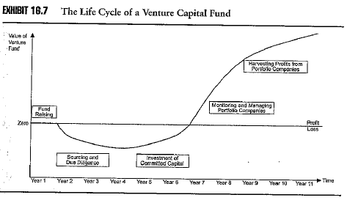
Life cycle of a venture capital fund
A venture capital investment is typically for 10 years
Five stages in the venture capital fund life cycle
  Fund raising via obtaining commitments (6 – 12 months)
  Sourcing investments (5 years)
  Investment and call on capital
  Managing and monitoring investments
  Sale or liquidation of investments

Slide 41
Objective 2.8
Specialisation within the venture capital industry
Industry
  Domain Associates is a fund specialising on molecular engineering
  Communication Ventures specialises in startups in telecommunications
  American Health capital ventures specialises in new health care companies
Geography
  Silicon Valley
  easier monitoring. Less diversification. Startups from remote locations may have greater difficulty in attracting VC.
Special situations
  Reprise Capital Corporation specialises in turnaround situations

Slide 42
  Turnaround example:
    A startup is owned 50% by venture capitalists and 50% by its founder.
    Product delays and poor management have resulted in $10m in corporate assets and $15m in liabilities
    The turnaround venture capitalist offers the founder $1m and a job for his 50%, creditors are offered 50c in the dollar, costing $8.5m all up.
    The $8.5m might come from $1m from the turnaround venture capitalist and $7.5m in bank loans secured by the $10m in assets
    Hence the turnaround venture capitalist gets 50% of the company for $1m and restores it to financial health

Slide 43
Objective 2.8
Specialisation within the venture capital industry
Stage of financing
  Angels
    Family/friends put up $50,000 - $500,000 to fund prototype and business plan
  Seed capital
    Initial venture capital investment of $1m to $5m
    Business plan and prototype is complete and product is being beta tested
  Early stage capital
    In excess of $2m to commence initial sales with the aim of market penetration
  Late stage/expansion
    $5m - $15m to expand distribution or production facilities or fund working capital
  Mezzanine stage
    $5m - $15m as bridging finance to fund working capital through to sale or IPO

Slide 44
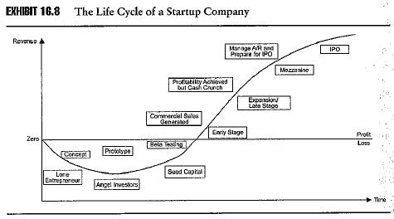
Objective 2.8
Specialisation within the venture capital industry

Slide 45
Example 2.0
A Case Study:Cacheflow Inc/Blue Coat Systems
Cacheflow (CFI) was founded in 1996 by a renowned computer scientist to make network-caching equipment to speed up applications on the internet
Mar 1996: CFI raised $1m in seed capital from a dozen angel investors to prepare a business plan
Oct 1996: CFI sold 3.2m shares of Series A convertible preferred stock at 87.5c per share to a venture capital firm to raise $2.8m for a 25% interest
Dec 1997: raised $6m of Series B convertible preferred stock for a 17% interest from a second venture capital fund
Mar 1999: raised $8.7m of Series C convertible preferred stock for a 7% interest from a third venture capital fund
Nov 1999: raised $3.1m for 280,953 shares of Series D convertible preferred stock from Marc Andreessen, who became a director

Slide 46
Example 2.0
Cacheflow Inc/Blue Coat Systems
Cacheflow recorded its first revenue in January 1998
Cacheflow went public on November 18, 1999 at a price of $24 per share
Its closing price on listing was over $126 per share and one day increase of 427%, giving Series A investors a return of over 14,000%
Cacheflow’s stock price reached a high of $165 at the end of November 1999
In November 2000 its stock price decline 51% on disappointing sales
By end 2001 its stock price was less than $1

Slide 47
Example 2.0
Cacheflow Inc/Blue Coat Systems
Cacheflow reinvented itself to focus on internet security and changed its name in the process to Blue Coat Systems
In September 2002 the board announced a reverse 1:5 stock split, which increased the price of the shares over $1
By 2005 the company and net sales revenue in excess of $96m and net income in excess of $5m with a strong balance sheet including cash and cash equivalents of $47.2m

Slide 48
ALTERNATIVE SECURITIES
Formal business plan and Performance

Slide 49
Think about the following questions:
  What is (are) the research question(s)?
  What is the motivation of this research?
  What is the contribution of this article?
  What is the conclusion of this article?
  Summarize the relevant literature and theories (if any).
  What is the research design (sample, methodology, etc)?
  Any possible recommendations or suggestions?

