Slide 1
ALTERNATIVE SECURITIES
Topic 5: Introduction to distressed debt

Slide 2
Student learning objectives
5.1 Identify factors that have influenced growth in the market during the 1990s.
5.2 Describe the nature of the market’s investors.
5.3 Understand the basics of the Chapter 11 bankruptcy process.
5.4 Illustrate how an investor can gain control of a company through Chapter 11 bankruptcy proceedings.
5.5 Describe an arbitrage strategy based on distressed debt ivestment.
5.6 Identify two of the main risks of distressed debt investing.

Slide 3
References
Anson, Mark J.P. (2006). Handbook of Alternative Assets. John Wiley & Sons Inc. New Jersey. Chapter 19.

Slide 4
Objective 5.1
Definition
“Distressed debt investing is the practice of purchasing the debt of troubled companies.”
“Distressed” can have two meanings in this context:
  The issuer of the debt is suffering financial troubles, its liabilities may exceed its assets or it may not have the cash flow to meet its financial obligations
  The price of the company’s bonds may be trading at a fraction of their par value
  Either way a distressed debt investment requires some workout, turnaround or bankruptcy solution to be implemented for the bonds to appreciate in value and offer a return to the investor
This form of investing requires a long-term horizon and is lack of liquidity.
Distressed debt investing is less dependent on the overall stock market.

Slide 5
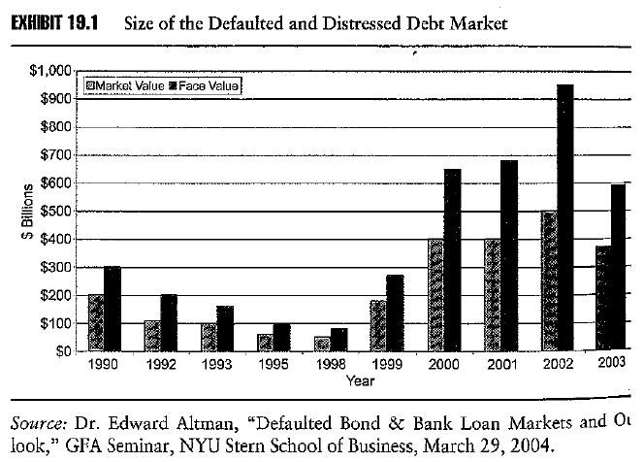
Objective 5.1
Growth of distressed debt market
Distressed debt portfolios doubled in value: 1990 - 2003
Growth has been influenced by
  Increase in the types of commercial loans that are routinely bought and sold
  Banks are adjusting their loan portfolios to achieve a certain risk return balance by selling nonperforming and subperforming loans in the market at attractive discounts
  The debt markets continue to grow.

Slide 6
In addition to the traditional industrial loans there are now credit card receivables, medical and healthcare receivables, insurance premium deficiencies, auto deficiencies and recreational loans.

Slide 7
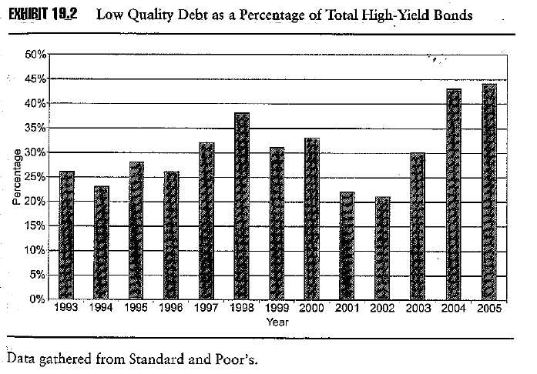
Objective 5.1
Growth of distressed debt market
Low quality debt as a percentage of total debt issues historically has fallen in recession and risen in periods of expansion
A rise in the low quality debt as a percentage of total debt issues historically is followed by an increase in the default rates on bonds a few years later

Slide 8
During the recession of 1990 and 1991, default rates on corporate bonds were 10% pa. This lead to a tightening of credit standards by banks, rating agencies and investors.
Consequently post the 1990-91 recession bond defaults declined significantly due in part to the up turn in the economy and the tighter credit standards.
However, bond issues increased in the late 1990s resulting in an overabundance of low quality debt that quickly became distressed debt in 2001 and 2002

Slide 9
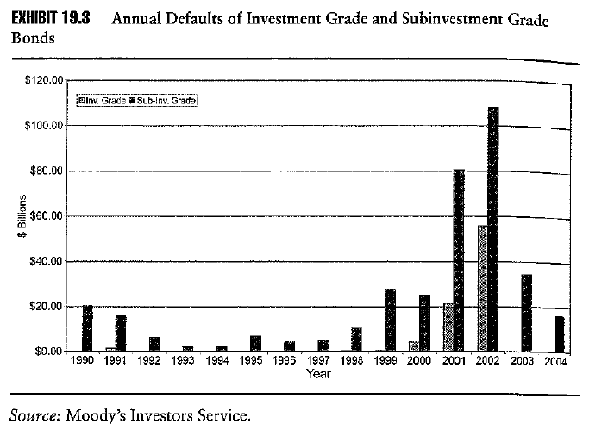
Objective 5.1
Growth of distressed debt market
US economic expansion through most of the 1990s spawned many new companies, not all of which were successful
Distressed debts tend to rise in periods of recession
  1990 – 1991
  2001 – 2002
The market for distressed debt is most active in periods of recession

Slide 10
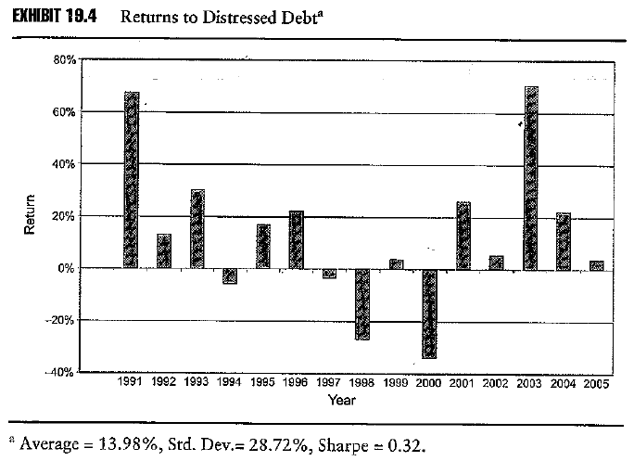
Objective 5.1
Returns from distressed debt
Returns to distressed debt can be rewarding and have averaged 14% pa over the period 1991 – 2005
However, they are volatile and can be negative

Slide 11
Objective 5.2
Distressed debt investors
Distressed debt investors are often referred to as “vulture investors” as they pick over the bones of failing companies
The intention of the investors is to buy the debt of failing companies at a fraction of its face value then seek improvement in the operations of the company
There is no standard model to distressed debt investing, as a result distressed debt investing is mostly about company selection and the returns generally have a low covariance with the stock market

Slide 12
Sometimes the debt is swapped for equity
Other times the vultures help the company to get back on its feet
At other times the vultures acquire the debt from impatient creditors and just wait till improvements occur

Slide 13
Objective 5.2
Distressed debt is an inefficient market
The market for distressed debt is inefficient
  It is not publicly traded
  Much distressed debt was originally issued in a private offering under Rule 144A of the Securities Act (1933) which allows companies to sell their bonds directly to institutional investors not retail investors, hence these bonds lack liquidity
  When the company becomes distressed, the degree of illiquidity becomes more severe, which leads a steep discount to their true value.
Notes:
Investment grade (BBB- S&P)

Slide 14
    The distressed debt market is segmented
    Pension funds are often not allowed to invest in below investment grade debt, hence when a bonds rating falls below investment grade such funds are forced sellers at a discount
    Banks offer credit but often sell non performing loans at a discount as they do not have the skills or patience to engineer a workout
    Trade creditors are in the business of producing goods not managing a distressed debt portfolio, hence they may be sellers of their claims at a discount

Slide 15
Objective 5.3
Chapter 11 Bankruptcy
Chapter 11 of the U.S. Bankruptcy Code recognises the corporation as a going concern, affording a troubled company protection from its creditors while it works through its problems
Only a debtor company can file for protection under Chapter 11
Under Chapter 11 the debtor company proposes a plan of reorganisation that describes how creditors and shareholders are to be treated
The claimants of each class of creditor are entitled to vote on plan
If all impaired classes of creditors approve the plan the bankruptcy court will conduct a confirmation hearing
If all requirements of bankruptcy code are met the plan is confirmed

Slide 16
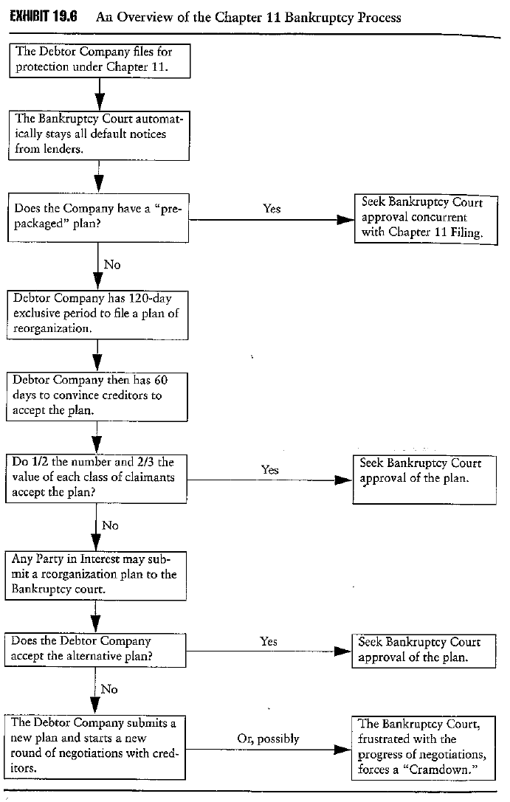
Notes:
INSERT EXHIBIT 19.6

Slide 17
Pre-packaged plan: a debtor company and its creditors have agreed on a negotiated plan before the company formally files for protection under Chapter 11. Normally creditors agree to make concessions up front in return for equity in the reorganized company.
Cramdowns are the last resort if the debtor and creditor cannot come to an agreement. Bankruptcy court can firm a plan over the objection of any impaired class. Cramdowns are rare in practice.

Slide 18
Objective 5.3
Chapter 11 Bankruptcy
Classification of claims
  A reorganisation plan may place a claim in a particular class only if such claim is substantially similar to the other claims. For example, all subordinated debt can constitute one class of creditors.
Plan of reorganisation
  Debtor company has 120 days to file a reorganisation plan and a further 60 days to convince creditors of the merits of the plan
  No competing plan can be filed within this period of 180 days
  After the exclusive 180 day period any claimant may file a plan with the bankruptcy court
  Any single class of creditors can block a reorganisation plan

Slide 19
Objective 5.3
Chapter 11 Bankruptcy
Voting within a class
  To constitute acceptance of the plan by a class, the class must either
    Be unimpaired by the plan, i.e. paid out in full
    One half in number and two-thirds in dollar value in favour of the plan
  If any dissenting creditors receive at least what they would receive under a Chapter 7 bankruptcy they will be bound to receive the treatment under the plan as they will be no worse off than under a liquidation of the company

Slide 20
  A single creditor can block the plan if it holds one-third in value of a particular class of creditors, this will force the debtor to negotiate with the blocking creditor
  The bankruptcy court can, though rarely does, “cramdown” an objection of any impaired class that votes against the plan if the plan does not unfairly discriminate against the members of that class and if it is fair and equitable

Slide 21
Objective 5.3
Chapter 11 Bankruptcy
Absolute priority
  A plan of reorganisation must follow the rule of priority with respect to its security holders
    Senior debt holders: bank loans
    Bond holders
      Senior
      Subordinate
    Shareholders
Chapter 7 Bankruptcy
  If a reorganisation cannot be accepted by creditors the company must liquidate its assets under a Chapter 7 bankruptcy

Slide 22
Typically a plan pays out the senior debt holders in full and the subordinated debt holders are paid out in part with the remainder converted into new equity in the reorganised company. The existing equity holders are wiped out and replaced by the new issue of equity to compensate the subordinated debt holders.
The debt of existing creditors may be sold during the Chapter 11 process and this is how distressed debt investors are able to gain control of the company by acquiring subordinated debt and having it converted into equity under the reorganisation plan

Slide 23
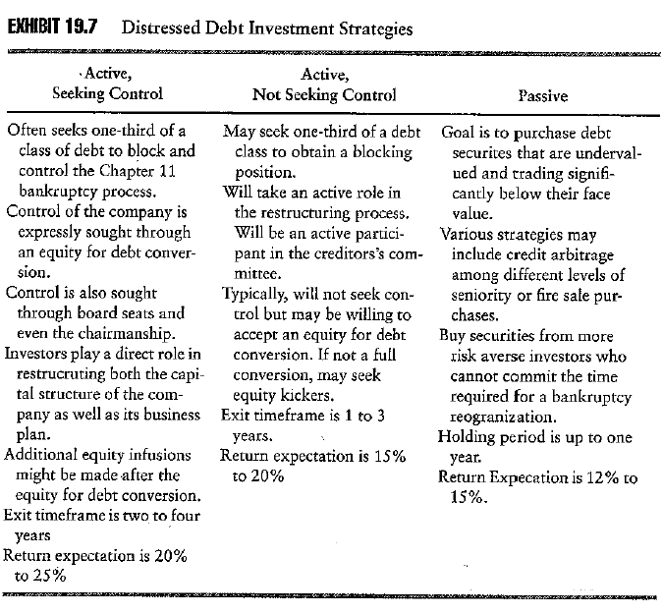
Notes:
INSERT EXHIBIT 19.7

Slide 24
Objective 5.4
Distressed debt investment strategies: examples
Using distressed debt to recycle private equity
  Example: Regal Cinemas Inc the largest U.S. cinema chain which was acquired by two buyout firms who put up $500min equity to acquire the firm for $1.5bn in 1998
    Regal added $1.2bn to its balance sheet in bank debt and subordinate notes
    Over capacity in cinemas, a slowing economy and fewer blockbuster films meant Regal make a loss of $167m in the first 9 months of 2000
    In Dec 2000 bank lenders refused to allow Regal to pay interest to subordinate bondholders as it would violate loan covenants
    A distressed debt investor stepped in to buy 82% of Regals outstanding bank debt and 95% of its subordinate debt paying 70 to 75 cents in the dollar
    In Sept 2001 Regal announced a prepackaged Chapter 11 converting debt holders to equity and wiping out existing equity
    In May 2002 Regal was refloated at a total market value of $2.5bn

Slide 25
Active seeking control strategy.
Distressed debt situations also are a great opportunity for initiating an LBO
Advantages to the LBO company of acquiring distressed debt: an example
  Hicks acquired $458m in assets of Vlasic for $370m
  Hicks acquired several well known brands
  Hicks acquired the company free of debt, which allowed the company to be refinanced with new debt
  All shareholder equity was wiped out
  Hicks streamlined operations
  Sold unrelated businesses to generate cash
  Provided stronger management
  Promoted the well known brands

Slide 26
Objective 5.4
Distressed debt investment strategies
Distressed buyouts
  Example: Vlasic Foods International Inc the makers of a number of well known food brands filed for Chapter 11 in early 2001 listing $458m in assets and $649m in debts.
  In June 2001 the bankruptcy court agreed to a cash bid by an LBO firm of $370m for the assets of Vlasic
  Using the strict rules of priority all senior debt was repaid in full and $70m was used to pay unsecured creditors 35 to 40 cents in the dollar
  Vlasic changed its name to Pinacle Foods and was sold two years later for $485m a gain of 31% over two years

Slide 27
Objective 5.4
Distressed debt investment strategies
Converting distressed debt to private equity
  Example: In 2001, Loews Cineplex Entertainment the largest publicly traded US movie theatre chain filed for Chapter 11 and at the same time signed a letter of intent with two distressed debt investors. This was a prepackaged bankruptcy.
  The letter of agreement proposed that the distressed debt investors convert $250m of senior secured bank debt and $180m of unsecured company bonds into 88% of the equity of the reorganised company. Other unsecured creditors would receive the remaining 12% equity. Remaining bank debt holders would receive new term loans as part of the bankruptcy process equal to about 98% of the face value of the existing debt
  Loews was sold to another private equity firm in 2004 at an internal rate of return of 41%

Slide 28
The distressed debt investors who had acquired most of the bank and subordinated debt became the majority owners of the company as all the original equity was wiped out.
In effect the bankruptcy transformed the company from a public company to a private company.

Slide 29
Objective 5.4
Distressed debt investment strategies
Using distressed debt for a takeover
  Example: Federated Department Stores was able to gain control of RH Macy and Co with an initial investment in distressed debt of only $109m
  7 days after Federated came out of Ch 11 Macy’s went into Ch 11 and Federated sought to acquire it but was rebuffed
  In 1994 Federated acquired half of Macy’s most senior debt of $1bn including accrued interest, secured by 70 of Macy’s best stores, for $109m. It also acquired an option to acquire the remaining half within three years. In doing so it became Macy’s largest and most senior creditor
  Federated gained approval of the bankruptcy court to challenge Macy’s plan, present a new plan and obtain nonpublic information
  Federated proposed swapping its bank debt for equity, which was eventually agreed to by the court and Federated acquired Macy by converting its debt to equity and acquiring the $4.1bn in liabilities of Macy’s

Slide 30
Objective 5.4
Distressed debt investment strategies
Distressed debt as an undervalued equity
  Investors are less concerned in taking control of the company. They expect to benefit it the company can implement a successful strategy.
  Montgomery Ward, the first mail-order merchant in the U.S., filed Ch 11 bankruptcy in 1997. Merrill Lynch bought its senior debt of $40m.
  Ward emerged from bankruptcy in 1999 with the capital injection by GE Capital.
  Secured creditors were paid in full. Those distressed debt investors who bought senior claims at a discount gained profit.

Slide 31
Objective 5.4
Distressed debt investment strategies
Distressed debt in a fire sale
  A “fire sale” is a liquidation of inventory at prices far below their normal value.
  Refco filed bankruptcy in 2005 due to company fraud. It was liquidated under Chapter 7 to payoff its creditors. Refco had one bond outstanding (senior debt), 9% notes due 2012.
  The bond price declined from 110 to 40 (40cents on a dollar) after the fraud was discovered.
  The bond price went up from 40 to 80 in two months. The distressed debt investors who purchased the debt of Refco enjoyed a huge profit.

Slide 32
Objective 5.5
Distressed debt arbitrage
Arbitrage positions:
  Take a long position in the undervalued distressed debt of the company
  Offset this with a short position in the equity securities of the company
Outcomes:
  If the company’s prospects deteriorate the arbitrage will loose money on the long position and but make more money on the short position as the equity position will fall further as equity holders will be wiped out in a liquidation
  If the company’s prospects improve the arbitrage will make money on the long position and loose a similar amount of money on the short position, however the company is unlikely to pay dividends but the interest paid as a return on the investment in the discounted debt will yield a significant profit

Slide 33
Objective 5.6
Risks of distressed debt investing
Credit risk is almost irrelevant as the company is usually already in default
The primary risk of distressed debt is actually the business risk of the company as distressed debt investors are not concerned with the short-term payment of principal and interest but the ability of the company to execute a viable business plan which will revalue the distressed securities and/or the new equity of the company issued to distressed debt holders as part of the reorganisation
The second major risk is that of liquidity, which reduces the ability of the distressed debt investor to trade out of a distressed debt position without suffering a further discount

Slide 34
Objective 5.6
Risks of distressed debt investing
Business risk example: Iridium LLC a satellite-telephone system with $1.5bn in high yield debt.
  Motorola started it in 1997 and owned 18%.
  It launched 66 satellites to build a global telephone network
  It went public in 1997 and its market capitalisation reached almost $11bn
  But its handpieces were too large and the service unreliable in cars and buildings, hence it attracted only 20,000 subscribers not 600,000
  As a result it could not meet its interest payments on $800m of senior bank debt
  In May 1999 distressed debt investors acquired Iridiums 14% subordinated debt for 26 cents in the dollar when it looked as if it could reschedule its senior debt. However it failed to do so and filed for Chapter 11 in August 1999, when its subords were trading at 14.5 cents in the dollar
  Iridiums woes continued and its subords sank to 2 to 3 cents in the dollar prior to the bankruptcy court liquidation the company for $25m with its bonds worthless

Slide 35
ALTERNATIVE SECURITIES
Supplementary material: A Case Study of Bankruptcy Sale

Slide 36
References
Goldberg L.B. (2005). The Hole Story: Case study of Bess Eaton’s Bankruptcy Sale. The Journal of Private Equity, special turnaround issue, 35-38.

Slide 37
What is the background of Bess Eaton? What are the reasons that caused the trouble of Bess Eaton?
What are the results of NHB’s (turnaround specialist) analysis about the company’s status?
What are the rescue strategies made by NHB?
What is the final deal?
What is the most impressive thing that you have learned from this case study?

