Slide 1
ALTERNATIVE SECURITIES
Topic 6: The economics of private equity

Slide 2
Student learning objectives
6.1 Compare the investment results of investing in the four private equity categories to that of investing in the S&P 500.
6.2 Describe the return distributions of the four private equity categories, given by the average, standard deviation, skewness, and kurtosis.
6.3 Rank the risk-adjusted average returns (Sharpe ratio) for the four private equity categories and understand reasons for the differences in performance.
6.4 Discuss the diversification benefits of including private equity in a portfolio of traditional investments.

Slide 3
References
Anson, Mark J.P. (2006). Handbook of Alternative Assets. John Wiley & Sons Inc. New Jersey. Chapter 20.

Slide 4
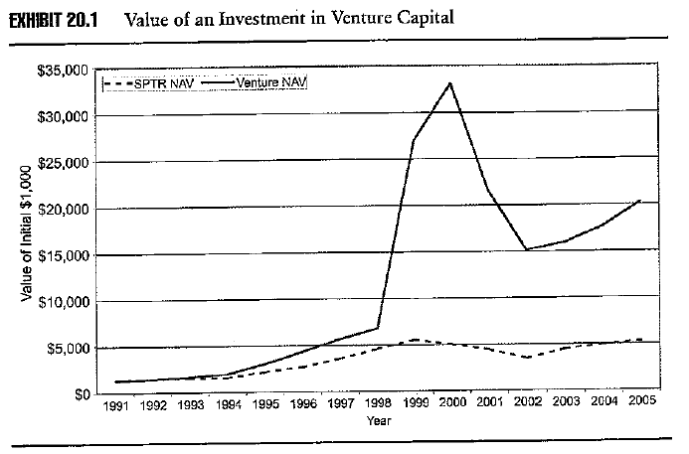
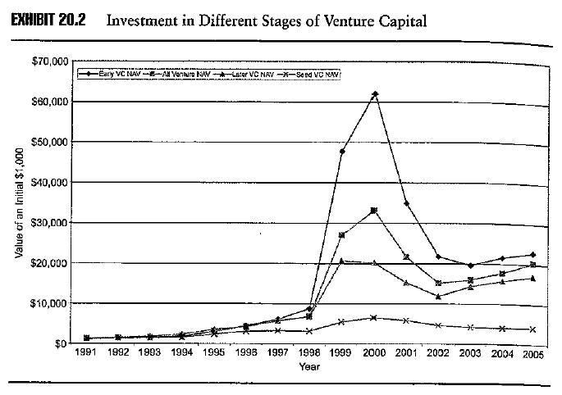
Objective 6.1
Relative performance of venture capital (VC)
Venture capitalists seek to earn in excess of 5% above the stock market index
This risk premium compensates:
  Business risk
  Liquidity risk
  Concentration risk
VC earned a steady premium on the market for most of the 1990s
Returns for different stage VC investments are similar until the technology bull and bear market

Slide 5
Business risk: VC is unique in that the venture capitalist takes on the business risk prior to the company implementing its business plan
Liquidity risk:
  No public market
  Some trading amongst venture capitalists, but this is inefficient due to the custom nature of the VC arrangements and the lack of symmetry in information between the buyer and seller, which leads to a large discount being applied by the buyer
Concentration risk: CAPM is premised on the securities being freely transferable which is not the case with VC, hence company specific risk must be compensated. VC also requires specialisation to overcome the information differences. Specialisation leads to concentration but also leads to higher returns。

Slide 6
For most of the 1990s, venture capital earned a steady excess return over S&P 500. During the tech boom period between 1998 and 2000, the average return of VC is 298%.
When the stock market declined in 2001 and 2003, the returns to VC funds also decline but still earn a healthy risk premium over the S&P 500.
Seed VC funds show lower returns than later stage funds.

Slide 7
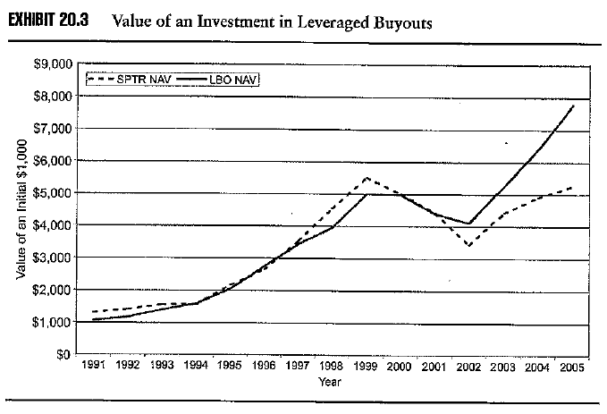
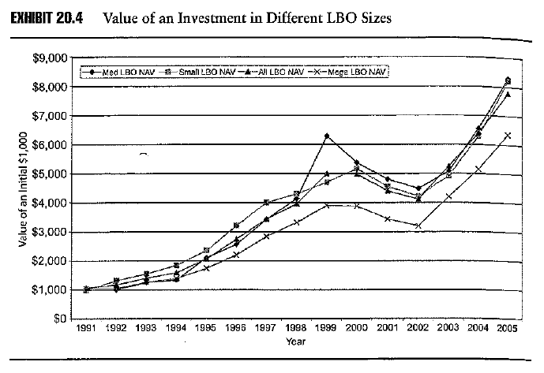
Objective 6.1
Relative performance of leveraged buyouts (LBO)
LBO funds, also focus on stock selection rather than market timing but have less risk than VC funds
  They invest in well established companies
  They tend to be less specialised
LBO returns are lower than VC returns and have been higher than for S&P 500, though between 1990 – 2000 they were on a par
Notes:
INSERT EXHIBIT 20.3 and 20.4

Slide 8
The LBO targets can range from movie theatres to grocery stores. LBO funds have greater diversification than VC.
LBO funds are differentiated by size of the deals they seek. (small: 100m-500m;middle:500m-2b;large:over 2b)They have shown similar returns except for the Mega deal funds, which have shown below average returns due to the fact that these deals are the result of an auction process which creates a more efficient market and hence offers lower returns
Note that there is much less variation between the return by type of LBO fund than type of VC fund, hence the choice of VC fund is more critical than it is for LBO fund

Slide 9
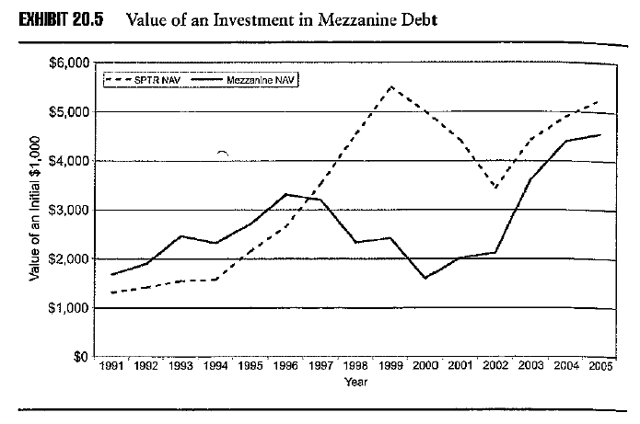
Objective 6.1
Relative performance of mezzanine debt (MD)
As it is a hybrid security combining the characteristics of both debt and equity, MD returns are less than VC, LBO and the stock market generally
However, MD returns are less volatile

Slide 10
The high coupons in the first half of the 1990s plus the some equity appreciation meant that MD returns were only slightly higher than the market’s returns
The booming stock market of the late 1990s meant that MD underperformed the stock market, however, due to the influence of its debt characteristics it was less volatile
The downside protection offered by the debt characteristics during the downturn in the stock market in 2000 – 2002 is also evident

Slide 11
Objective 6.1
Relative performance of distressed debt (DD)
DD funds are similar to VC and LBO funds holding business risk, but less risky than either
  debt ranks higher than equity
Less concentration risk than VC and LBO as DD tend to invest across industries
DD funds earned a higher return than MD but less than VC and LBO funds, however, while it outperformed the stock market prior to mid-1990s it has underperformed since then
The underperformance against the stock market is disappointing as investors in DD should earn a higher return given the risk of company distress.

Slide 12
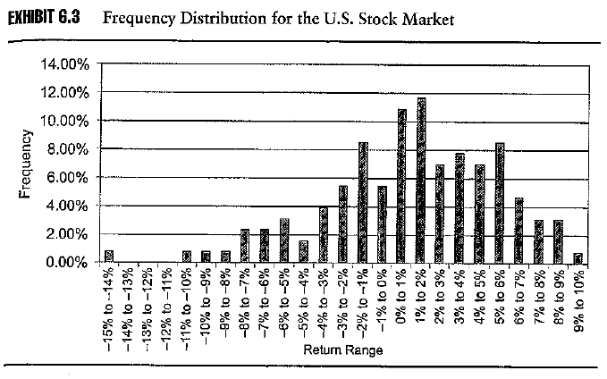
Objective 6.2
Return distribution of S&P 500
Expected return 1.01%
Standard deviation 4.40%
Skewness -0.63
Kurtosis 0.58
Sharpe ratio 0.14

Slide 13
Monthly data for period 1990 – 2005
Sharp ratio can be captured by the mean and variance of the distribution. For a normal distribution, Sharp ratio is an appropriate measure for risk and return
Skewness and Kurtosis capture the third and fourth moment. A positive value for kurtosis indicates a distribution with “fatter” than normal tails. A negative skew indicates that the mean of the distribution is to the left (less) then median of the distribution.
A negative skew and a large value kurtosis means that there are more frequent large negative outlying returns than large positive outlying returns and a considerable downside risk.

Slide 14
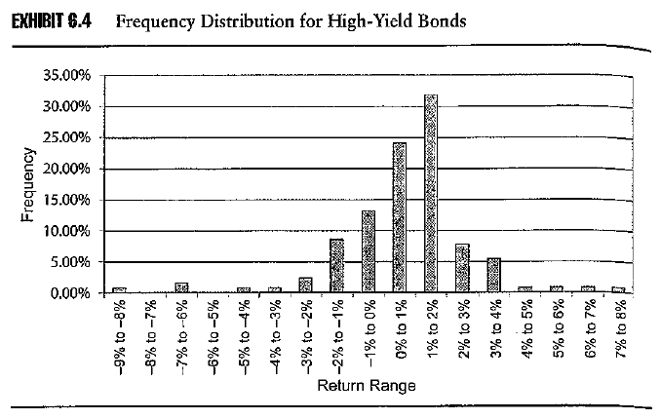
Objective 6.2
Return distribution of SB high yield bond index
Expected return 0.75%
Standard deviation 2.05%
Skewness -0.81
Kurtosis 4.16
Sharpe ratio 0.17
A “fat” tail reflects the event risk of defaults, downgrades, and bankruptcies.

Slide 15
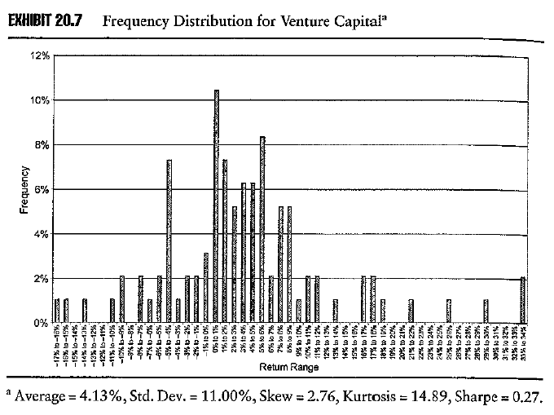
Objective 6.2
Return distribution for venture capital (VC)
Large positive returns, though high risk
A relatively flat distribution with an expected return of 4.13%
High standard deviation of 11%, hence returns are volatile
Large positive kurtosis (14.89), indicates more large outliers
Large positive skewness (2.76)
High Sharpe ratio at 0.27
Large positive skewness combined with large value of kurtosis translated into large positive returns for VC investors

Slide 16
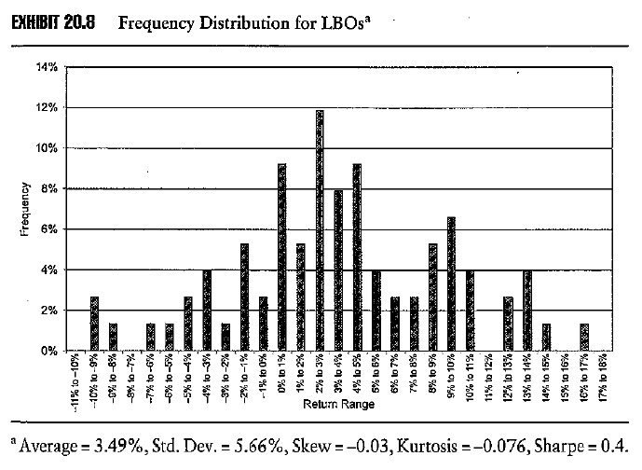
Objective 6.2
Return distribution for leveraged buyouts (LBO)
High returns and better risk – reward proposition than VC and the market
A relatively symmetrical distribution with an expected return of 3.49%
Standard deviation of 5.66%
Kurtosis close to zero (-0.076),
Skewness close to zero (-0.03)
High Sharpe ratio at 0.4

Slide 17
More symmetrical distribution of returns than for VCs
LBOs have less business risk than do VC funds, hence the return distribution more closely resembles that of the stock market.
LBO funds generate an expected return of 3.5% per quarter with much lower volatility than VC funds, hence their Sharpe ratio is higher, representing a better risk reward tradeoff.
The negative kurtosis states that the tails are thinner than those of the market, hence LBOs have less exposure to outlier events than the market
Investors looking for less risk would be attracted to LBO funds

Slide 18
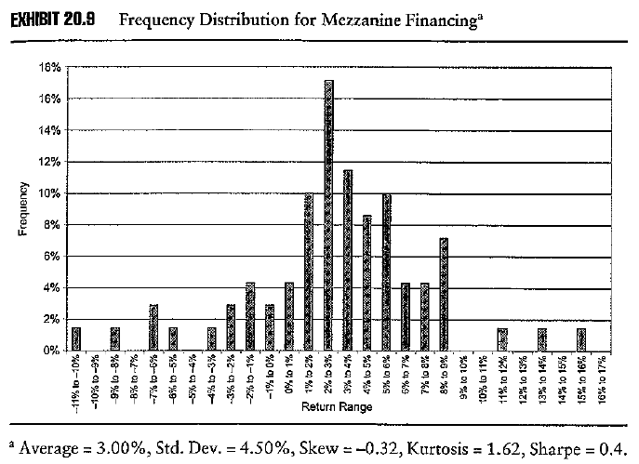
Objective 6.2
Return distribution for mezzanine debt (MD)
Lower returns than VC or LBO but higher Sharpe ratio due to the lower volatility associated with the debt characteristics BUT also better than high yield debt
Expected return of 3.00%
Standard deviation of 4.50%
Kurtosis 1.62
Skewness -0.32
Sharpe ratio at 0.4

Slide 19
The negative skewness and positive value of kurtosis is similar to that of high yield debt, however junk bonds have larger values indicating a larger downside fat tail than for MD due to the lower credit risk of MD and the benefit of the equity kicker to MD

Slide 20
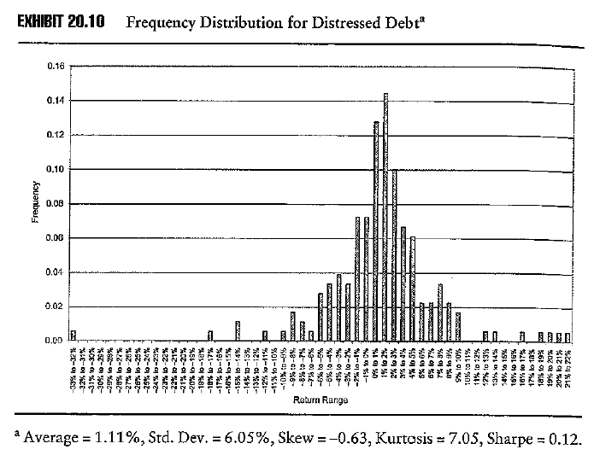
Objective 6.2
Return distribution for distressed debt (DD)
Larger values of skewness and kurtosis than for high yield bonds reflecting the higher event risk associated with bankruptcy
Expected return of 1.11%
Standard deviation of 6.05%
Kurtosis 7.05
Skewness -0.63
Sharpe ratio at 0.12

Slide 21
Credit risk is a feature of distressed debt investing, hence there is a higher event risk.
Negative skewness and a large value of kurtosis, which is indeed larger than for high yield bonds, reflecting the greater probability of bankruptcy.

Slide 22
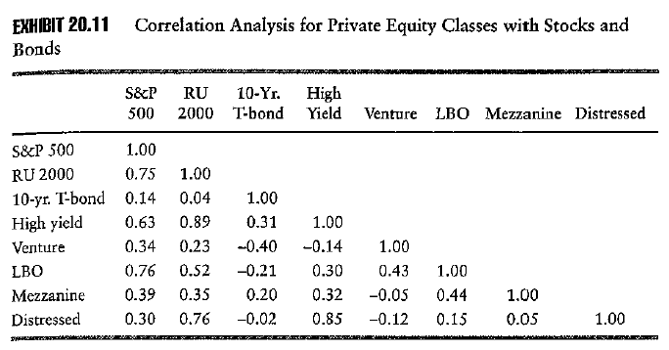
Objective 6.2
Correlation of private equity returns
Different classes of private equity investing have low correlations with each other
Returns to private equity have low correlations with traditional asset classes
Three of four classes of private equity are negatively correlated with US Treasury bonds
LBO funds are more highly correlated with equity

Slide 23
Private equity as an asset class can be a useful addition to a diversified portfolio
The different classes of private equity offer the opportunity of adding something unique feature into the portfolio.

Slide 24
Objective 6.3
Ranking of Sharpe ratio for private equity classes
Leveraged buyouts 0.40
Mezzanine debt 0.40
Venture capital 0.27
SB high yield bonds 0.17
S&P 500 0.14
Distressed debt 0.12

Slide 25
Objective 6.4
Introducing private equity into a diversified portfolio
First build the efficient frontier of stocks and bonds.
Then adding 10% allocation of each class of private equity.

Slide 26
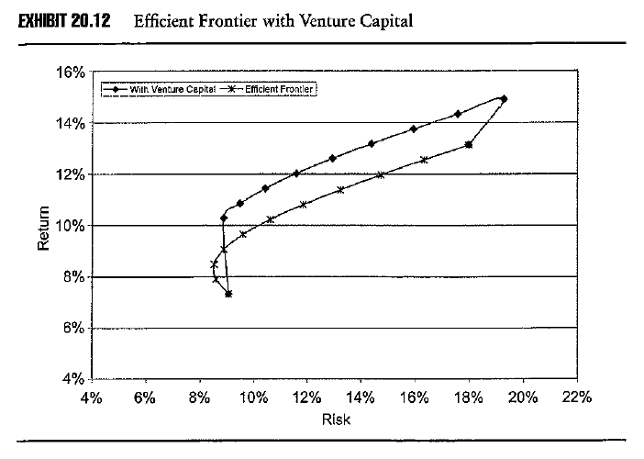
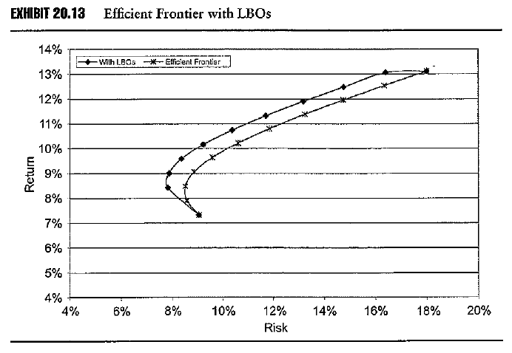
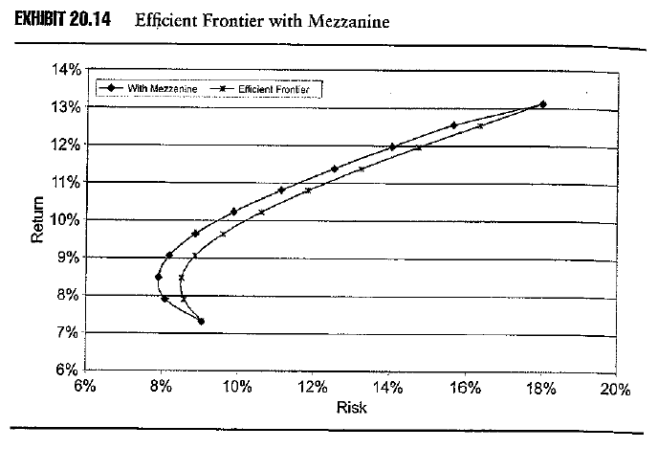
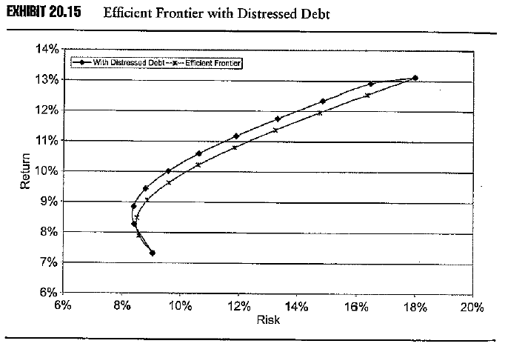
Objective 6.4
Introducing private equity into a diversified portfolio

Slide 27
Objective 6.4
Introducing private equity into a diversified portfolio
The addition of a 10% weighting to any of the four classes of private equity leads to a significant upwards shift in the efficient frontier, which represents an increase in return for any constant unit of risk
Distressed debt due to the existence of high event risk shows the smaller improvement

Slide 28
ALTERNATIVE SECURITIES
How good are private equity returns?

Slide 29
References
Robert M. Conroy and Robert S. Harris. How Good are Private Equity Returns? Journal of Applied Corporate Finance • Volume 19 Number 3, Summer 2007.

Slide 30
What are (is) the research question (s) of this paper?
What are (is) the result (s) of this paper?
Briefly describe the limited partnership for private equity.
What are the measurement challenges for measuring the returns of private equity?
What are the three types of return used by the authors in this paper?
What is LPE? What is stale pricing?
Why the authors need to make the adjustments for stale pricing in Table 3?
Why the authors need to make the adjustments in Table 4?
Explain Figure 1 and Figure 2.

